Slide 1
Service Wars
Or: How we got to how we are!

Slide 2
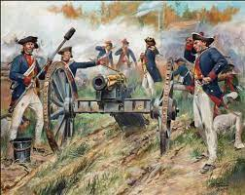
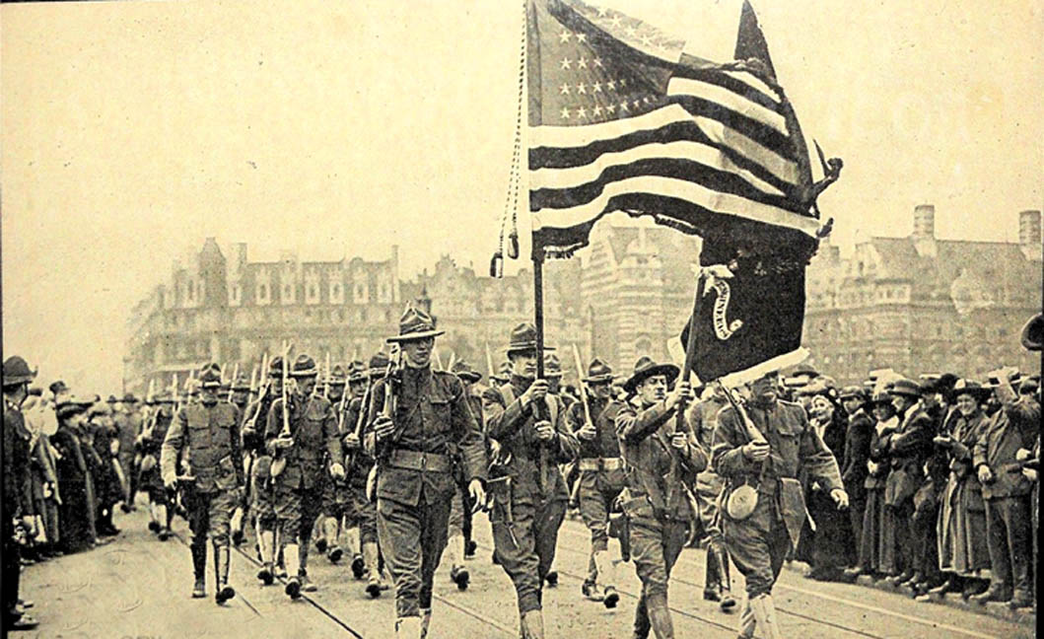
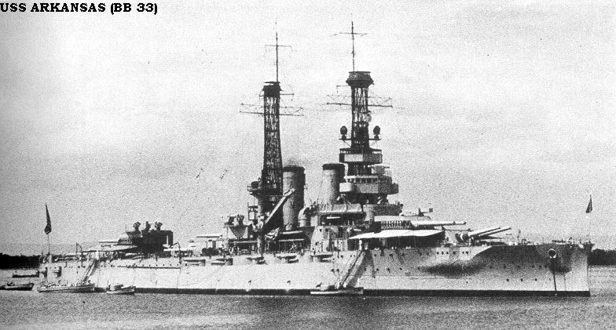
Who are we?
Very small professional military
Constitutional limitations
Washington’s admonition
But….1917….and….Victory?

Slide 3
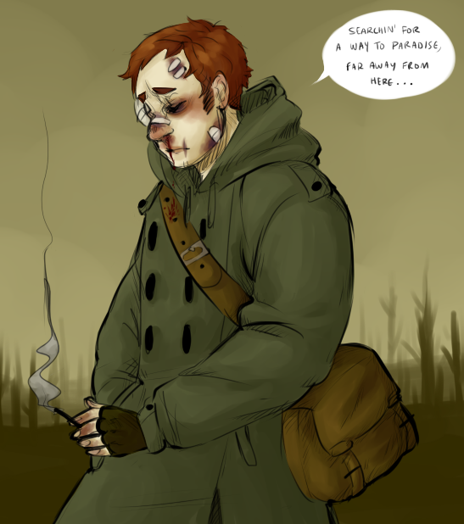
The Setting: 1939
Army: Frontier force, very small. Limited budget. Infantry/Cavalry focus (189K)
Navy: Battleship focus, favored by administration, but expensive. 4 Carriers (125K)
Marines: Overseas/contingency (19K)
Air power: Under control of the army; mission unclear
Coordination?

Slide 4
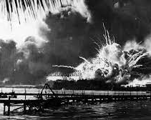

Slide 5
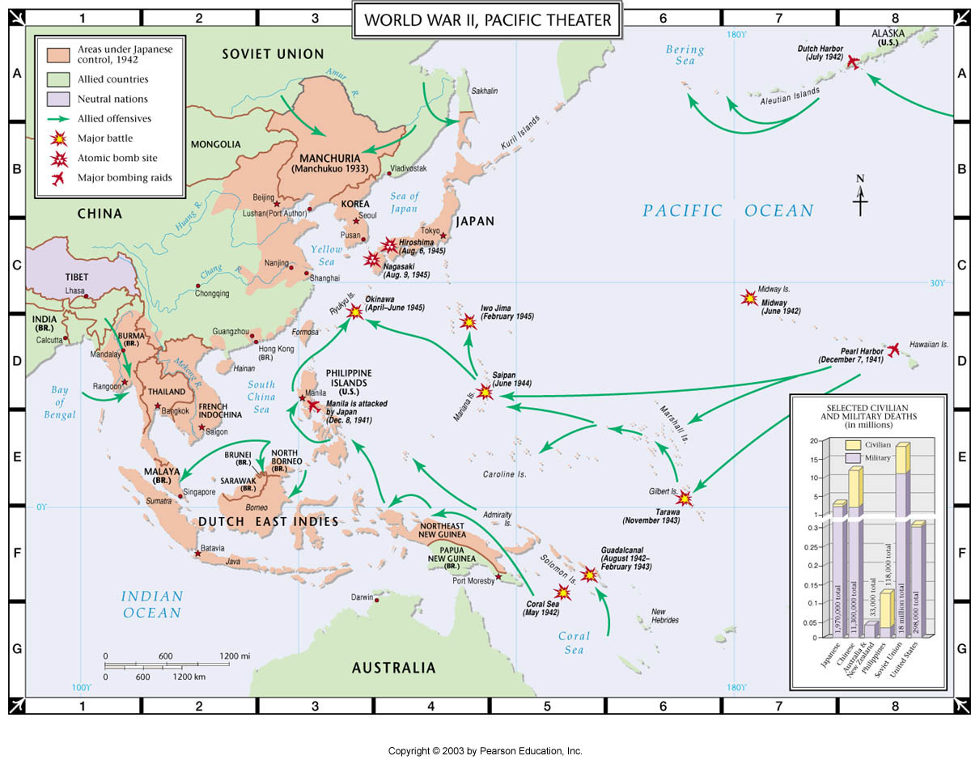
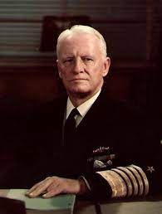
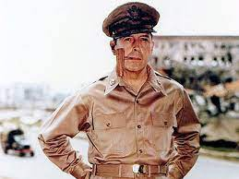

Slide 6
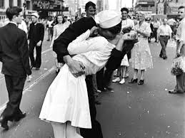
The Size of the Effort—And After
Post WW2: 1945/1947
Army: 8 million/990K
Navy: 3 million/484K
Air Corps: (soon to be AF)/306K
Marines: 474K/92K
We’re a “Superpower” but….Who gets the funding?

Slide 7
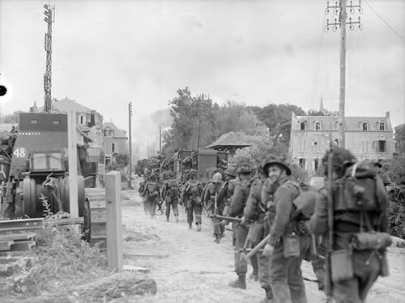
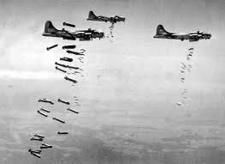
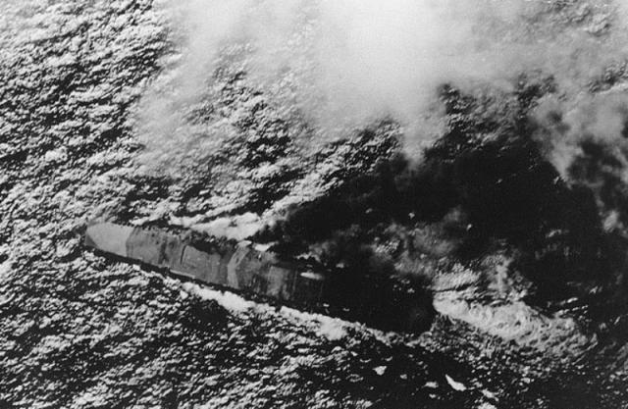
How did we do?
We won!
We won!
We won!

Slide 8
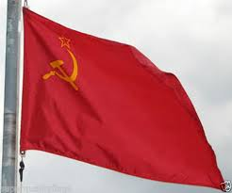
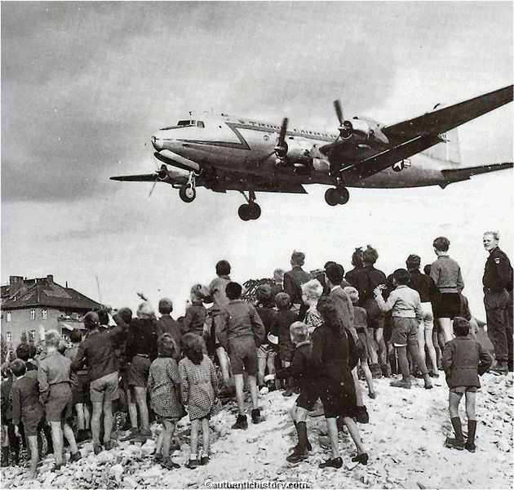
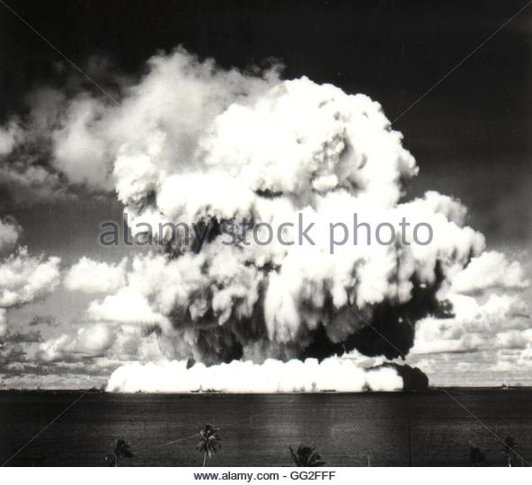
Game Changers
Demobilize??

Slide 9
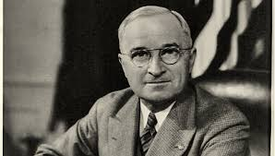
National Security Act 1947
--Forms JCS
--Forms DOD
--Increase Civ Control
But:
Cuts14 billion in one year
Instead of massive manpower: technology

Slide 10
The Superpower Dilemma:
Big Mission, limited funds. Where to be strong? Where to put our emphasis?
The Arguments:
Air Force: New, Strike capability, atomic weapons
Army: Traditional force, combat proven
Navy: New(ish), strike capability, flexible, atomic weapons (?).

Slide 11
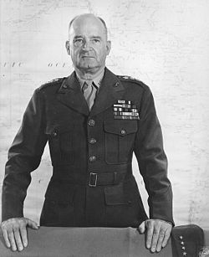
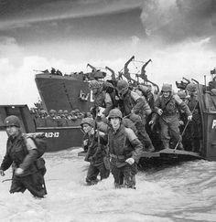
Round 1: Why do we have Marines?

Slide 12
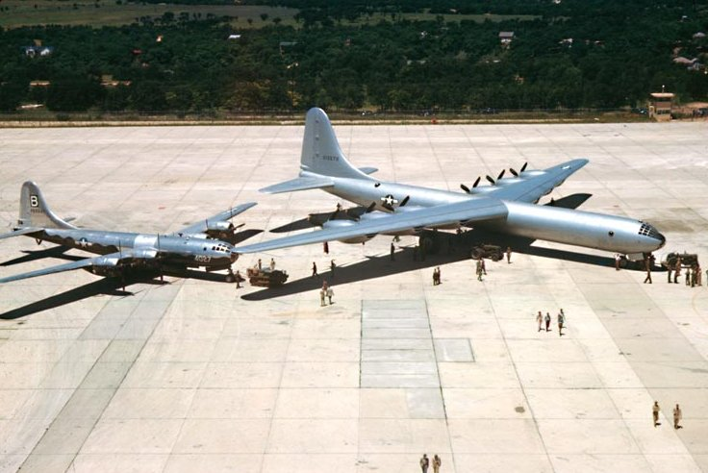
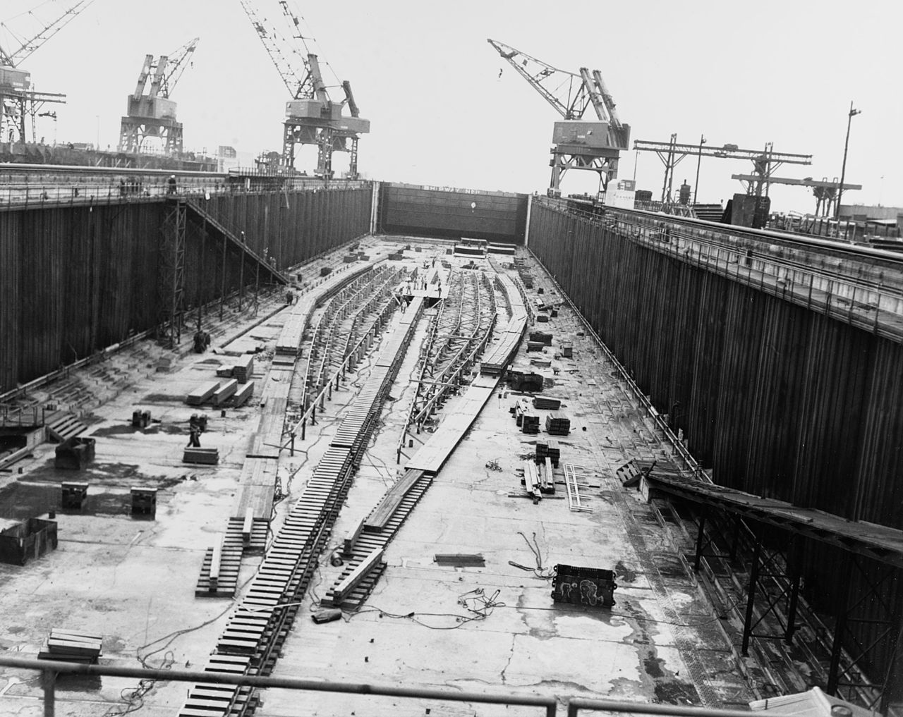
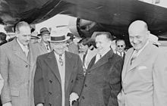
Round 2: 1949, “Revolt of the Admirals”

Slide 13
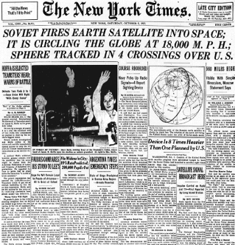
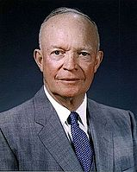
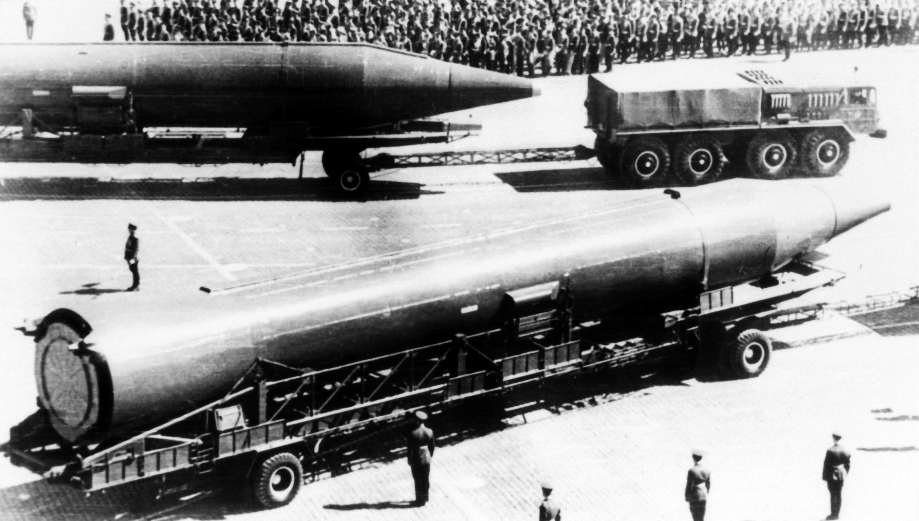
Round 3: The RIF (1953-1961)
Army: Police
Navy: Transport
Air Force: Warfighting

Slide 14
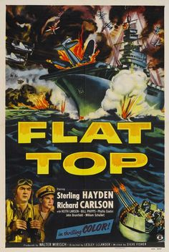
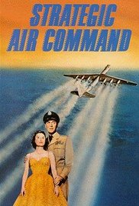
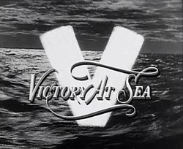
Enter Hollywood

Slide 15
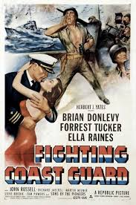

Slide 16
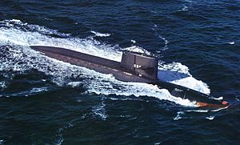
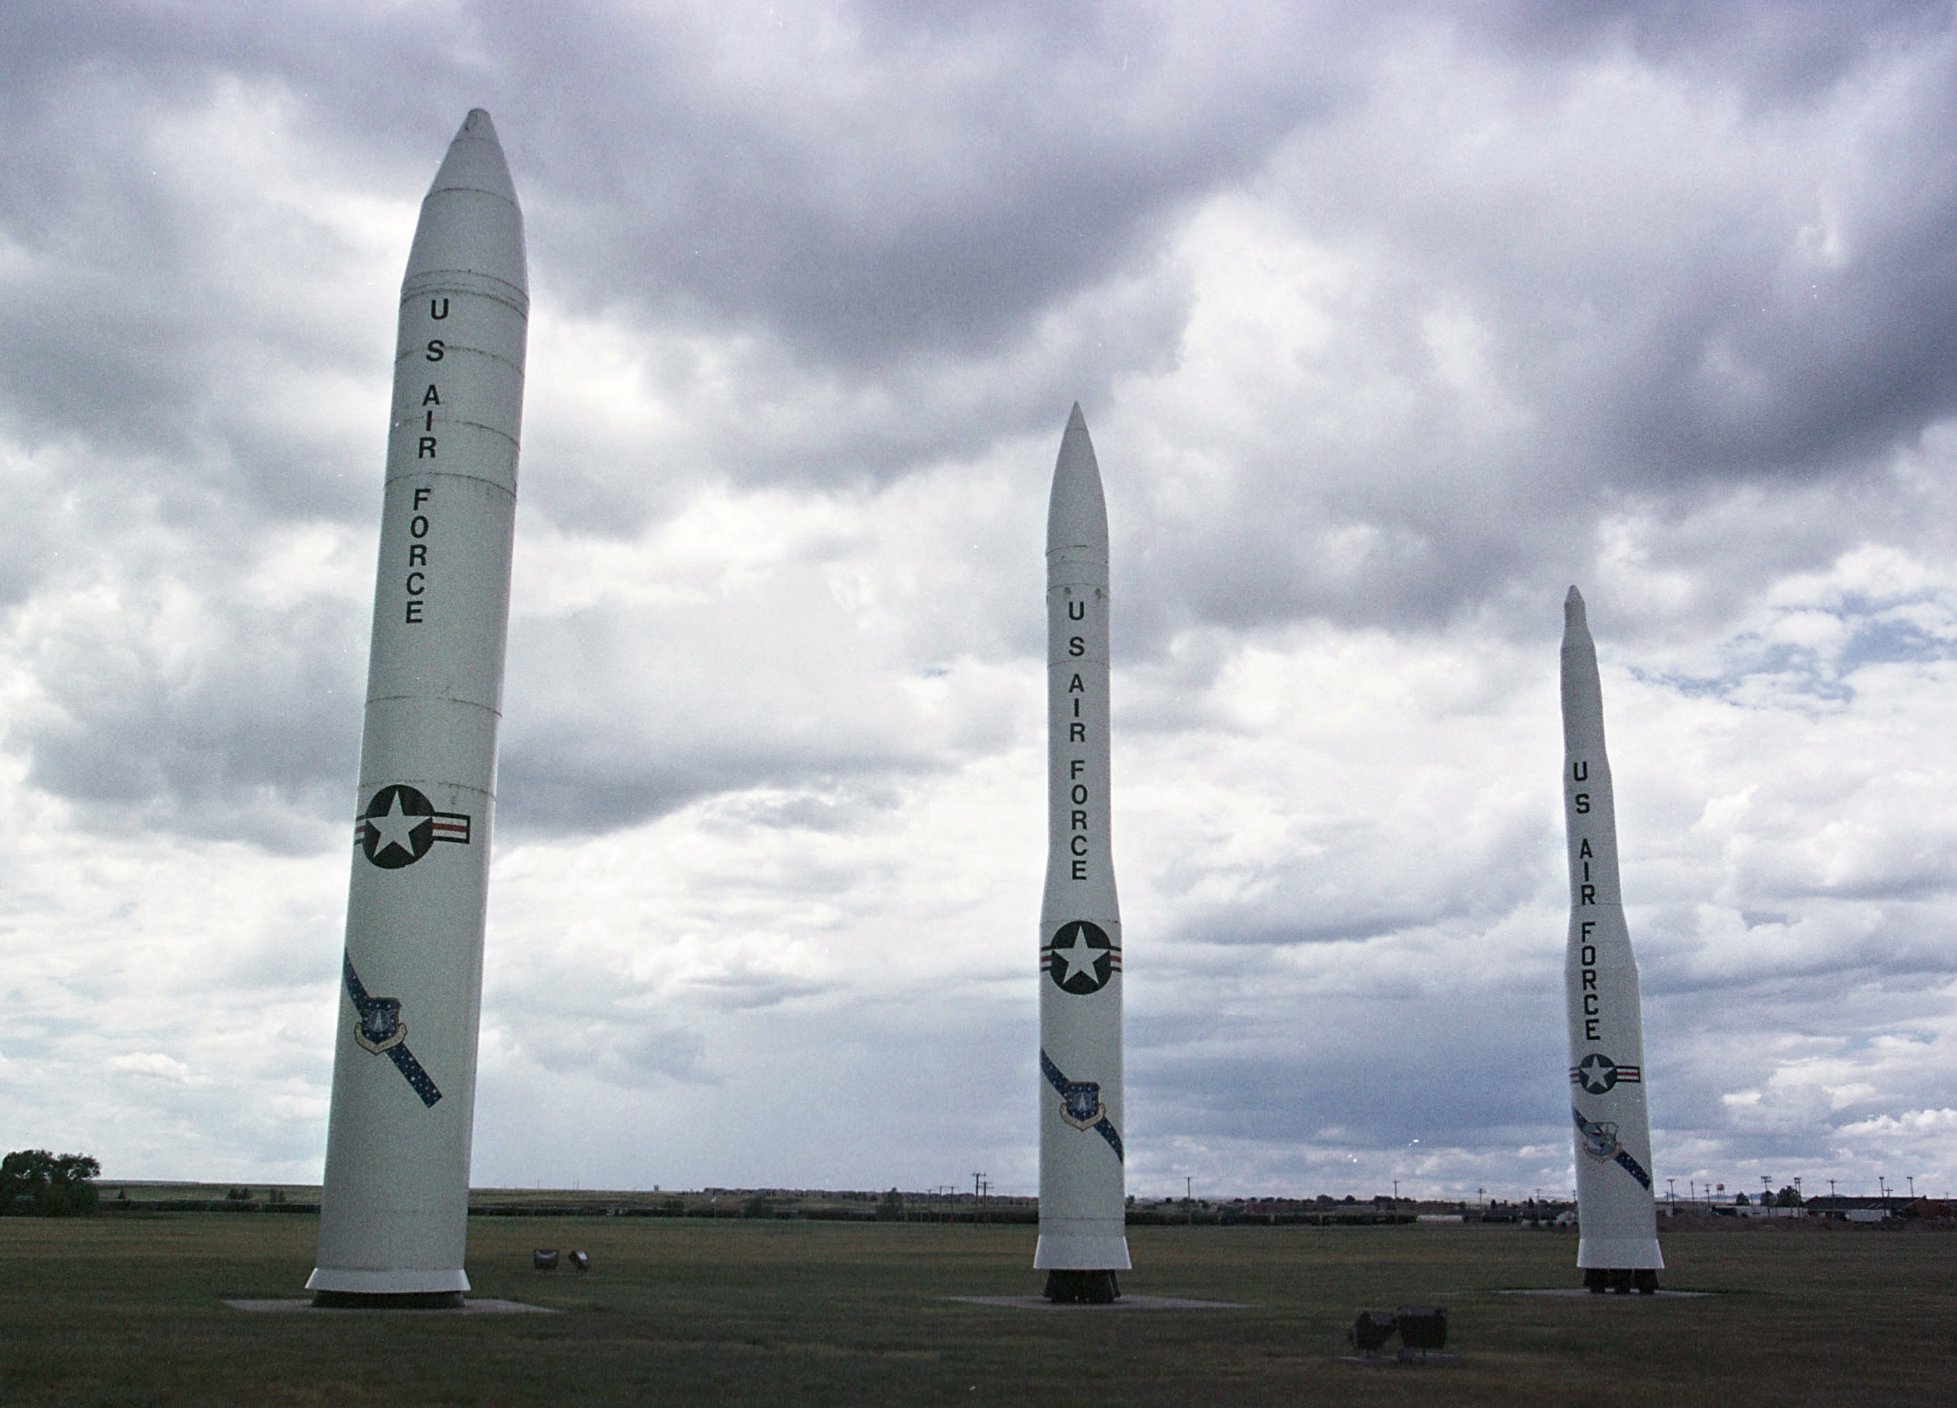
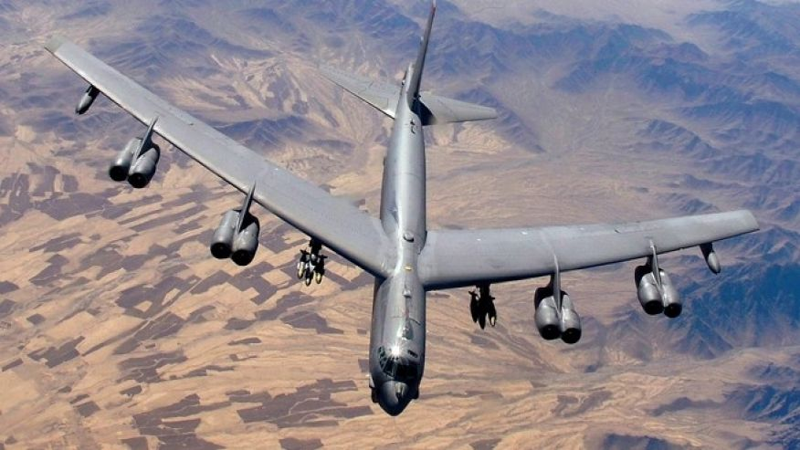
Response: The Services go Atomic.

Slide 17
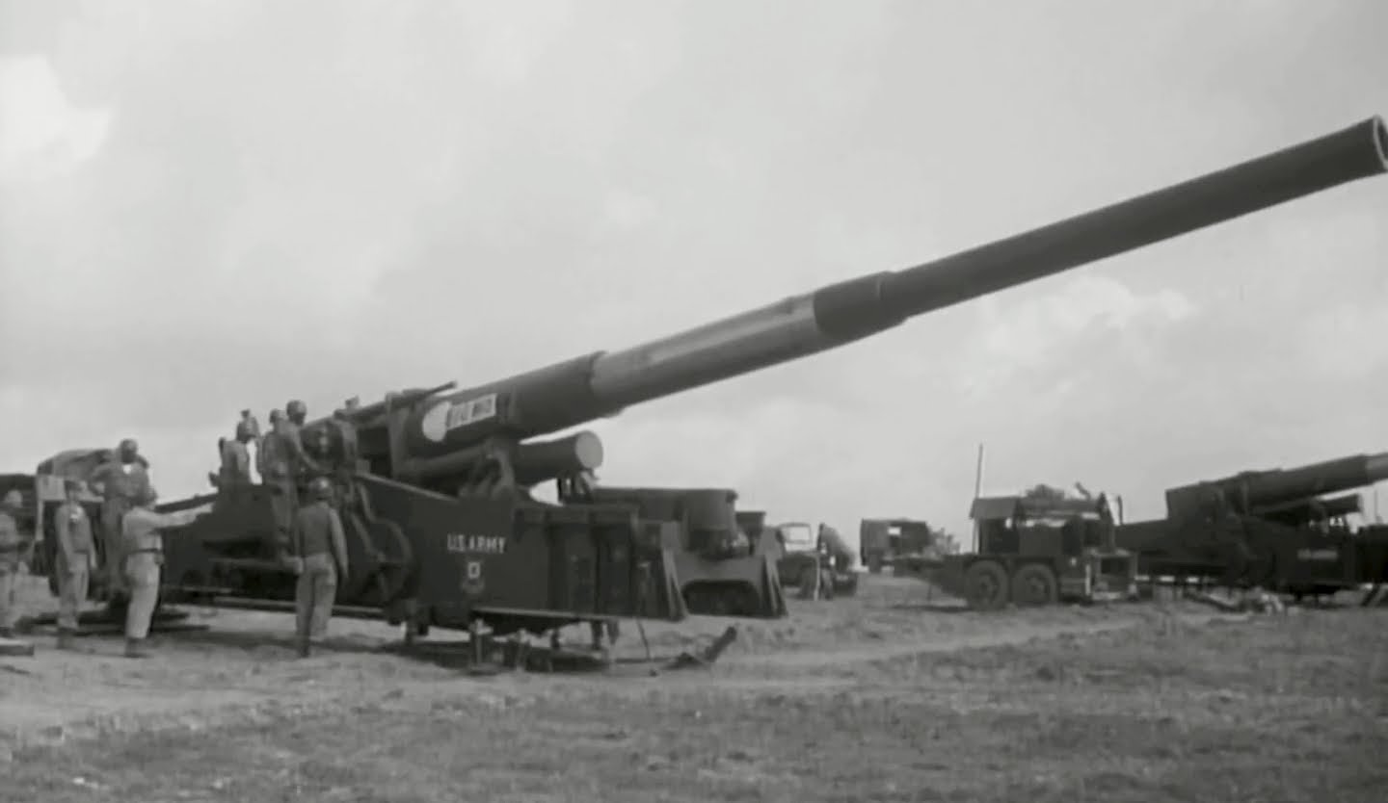
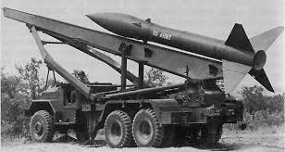
Army?
(Good luck)

Slide 18
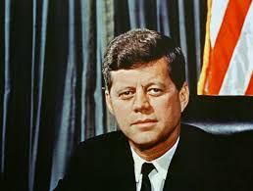
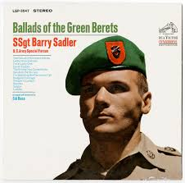
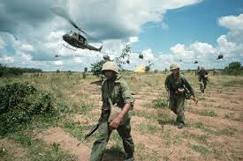
Game Changers: 1960s

Slide 19
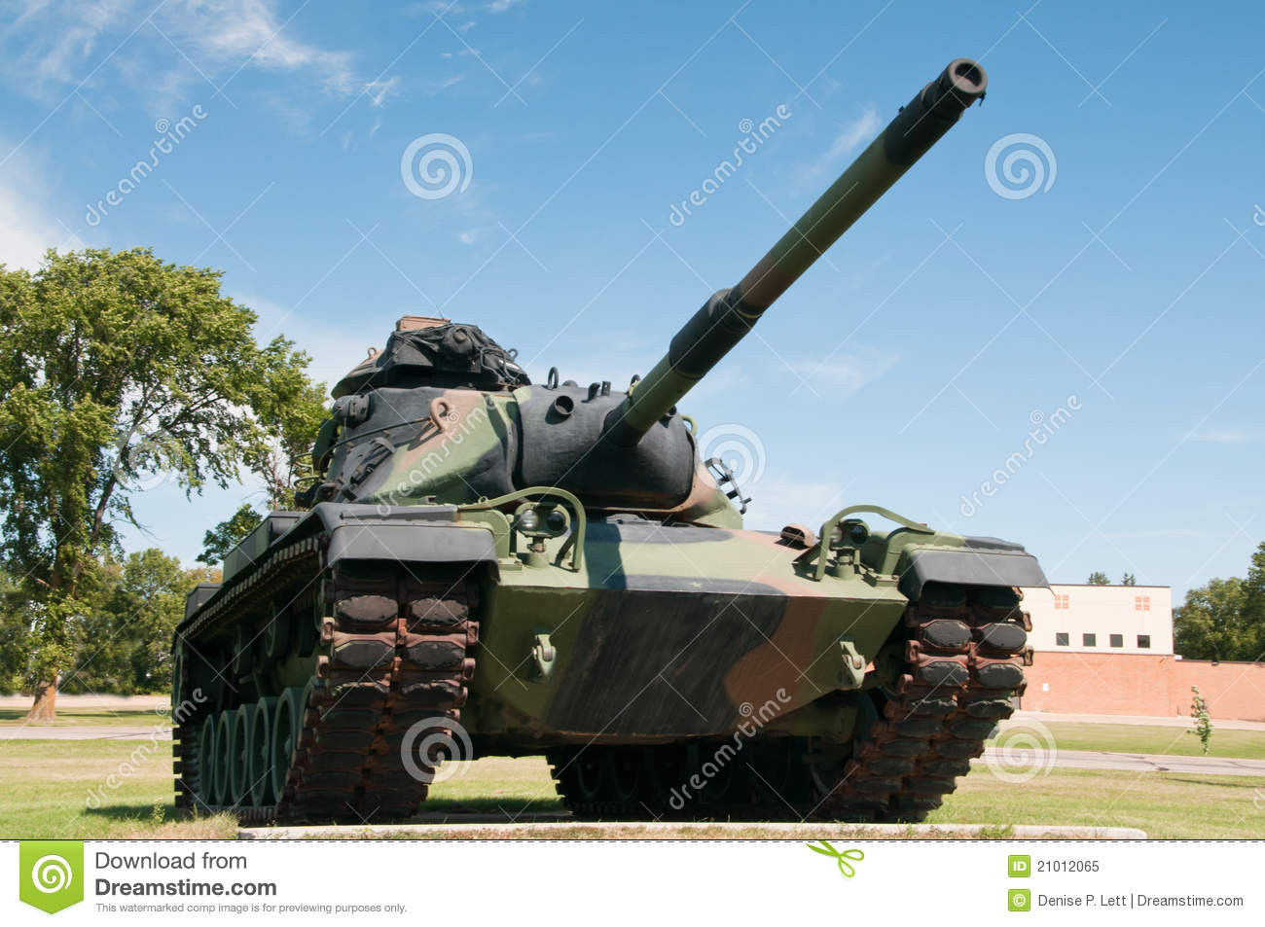
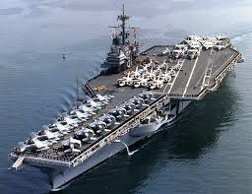
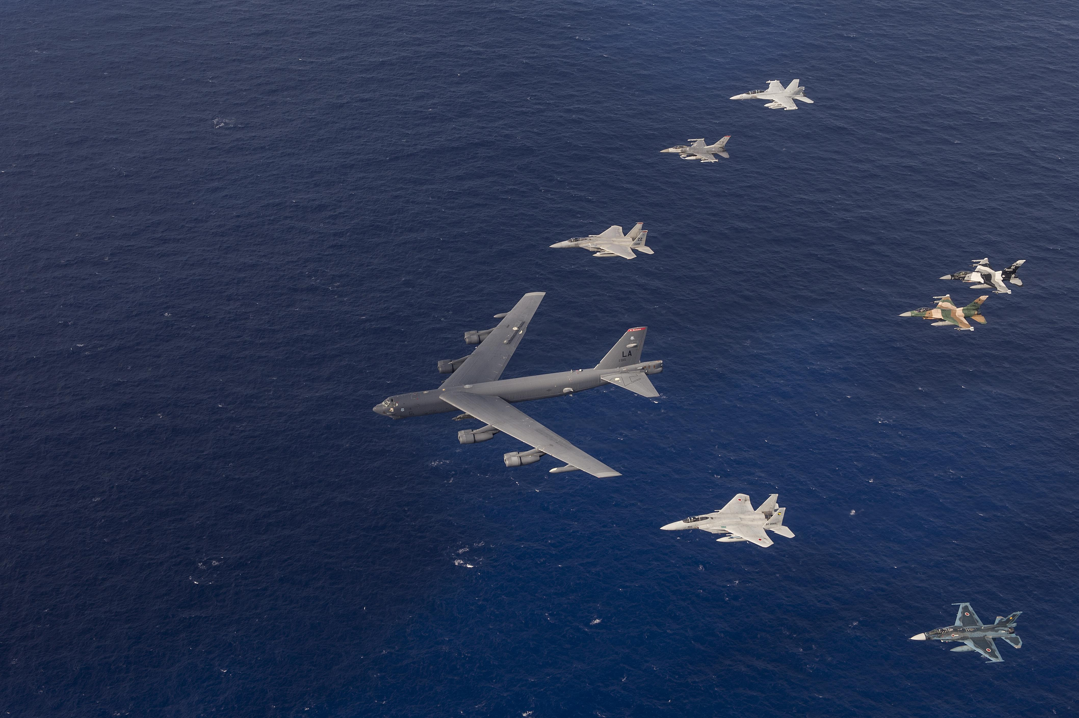
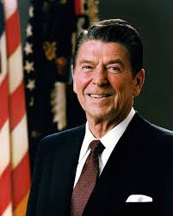
1970s-1980(s)

Slide 20
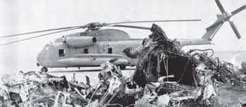
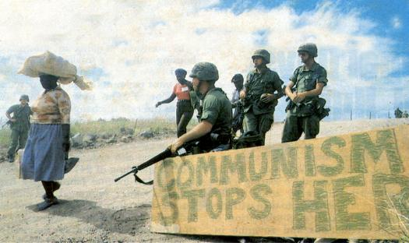
How Well Does it Work?

Slide 21
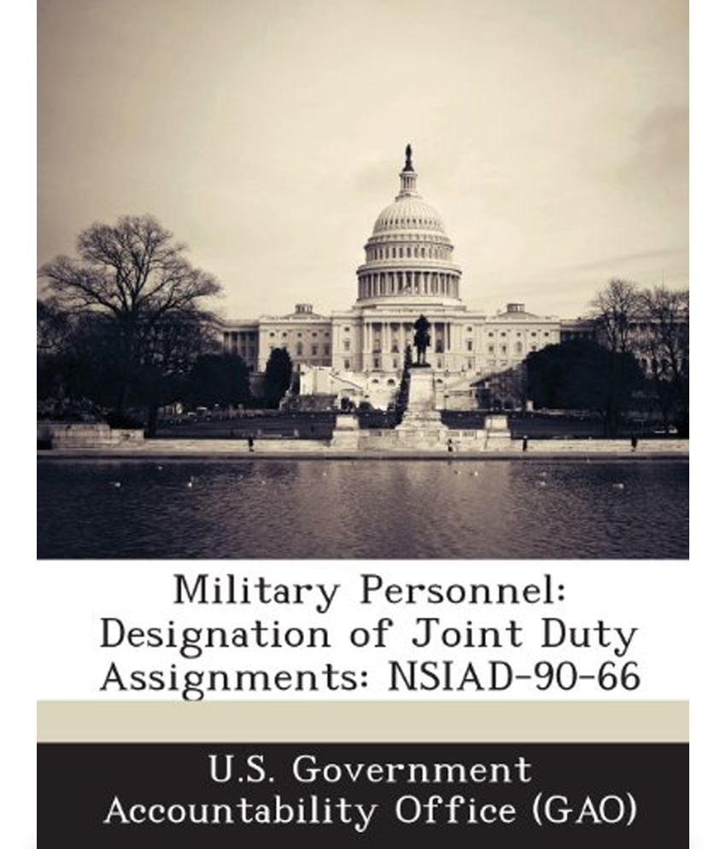
The Answer: Goldwater-Nichols

Slide 22
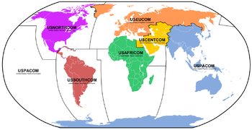

Slide 23
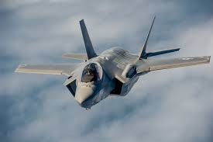

Slide 24
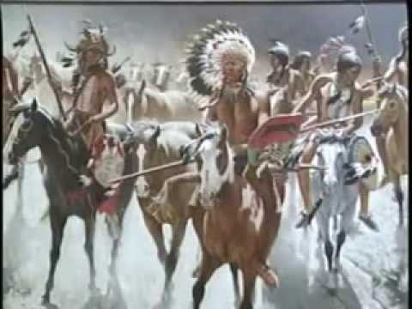

Slide 25
Questions?

