Slide 1
Your TRICARE Program
UNCLASSIFIED
Jody W. Donehoo, Ph.D.
Zelly Zim, MHA
February 24, 2024
Notes:
general update on changes to TRICARE, friction points you are experiencing, the plan to address those friction points, as well as any best practices/resources you have for helping people to navigate TRICARE

Slide 2
Key Takeaways
Purpose – To foster better understanding of your TRICARE program and its health plans
Take Home Points
The Military Health System (MHS) provides a healthcare benefit to our 9.5 million beneficiaries both through the Direct Care System (DCS) at the military medical treatment facilities (MTFs) when capability/capacity exists, and in private sector care (PSC) under the TRICARE program
TRICARE wraps-around local MTFs to increase capacity and capability through TRICARE-authorized providers, suppliers, and pharmacies, network and non-network, in PSC including international host nation providers
In addition to Active-Duty Service Members (ADSMs), TRICARE covers Active-Duty Family Members (ADFMs), retirees and their families, and qualified survivors
The family of TRICARE health plans is administered by huge federal service contracts
The unique MHS promotes recruitment, retention, and readiness in the eight covered Uniformed Services
Grounded in statutory law, the TRICARE is a federal health benefit program. It is not health insurance.
TRICARE is implemented in federal regulation (32 CFR 199)
TRICARE contractors administer the program according to requirements specified in the four TRICARE Manuals (Policy (TPM), Operations (TOM), Reimbursement (TRS), and Systems (TSM))
www.tricare.mil contains the most up-to-date information for MHS beneficiaries; includes one website for each MTF
www.health.mil contains information for MHS and other government staff

Slide 3
TRICARE – A Wrap-Around Local MTFs
TRICARE Private Sector Care
MTF
Uniformed Services (8)
}
10 USC §101
United States Army | United States Navy | United States Space Force
United States Marine Corps | United States Air Force | United States Coast Guard
United States Public Health Service (PHS) Commissioned Corps
National Oceanic and Atmospheric Administration Commissioned Officer Corps (NOAA)
Armed Forces (6)
3

Slide 4
TRICARE BENEFIT Evolution
DoD Health Benefits Have Been Expanding Steadily Since 1995
Northwest Region 11
1st TRICARE contract
Enhanced Benefit –“Watershed” Legislative Year
Added TRICARE for Life (TFL)
Added TRICARE Senior Pharmacy
Eliminated copayments for AD Families in TRICARE Prime
Reduced retiree catastrophic cap from $7,500 to $3,000
…and much more
CHAMPUS Legislated Benefit
Civilian Health Care where MTFs do not exist
Families & Retirees <65
TRICARE Managed Care Legislation
3 options (Prime, Standard, Extra)
Automatic enrollment for Active Duty
Priority for TRICARE Prime enrollees
Space Available for Non-enrollees
2001
TRICARE Reserve Select Plan Added
TRICARE Benefit Expansion
Dependents Medical Care Act
Authorizes SecDef to contract with civilian providers for medical care for Active Duty dependents
TRICARE Young Adult Plan Added
CHAMPUS Reform Initiative (CRI)
Pilots in CA and HI introduce health plan choice (pre-cursor to TRICARE)
1995
TRICARE Select (PPO) replaced TRICARE Standard & Extra
Added FEDVIP vision & dental
Title 10 Legislated Benefit
Space Required for Active Duty
Space Available for Families and Retirees
Family Member Dental Program Established
1966
DHA in the Now
MTF ADC (authority, direction & control)
Defense Health Networks (9) worldwide
MTF stabilization
Digitalization
1956
1966
1986
1988
1994
2001
2005
2011
2018
1940
1950
1960
1970
1980
1990
2000
2010
2020
1948 - 2016
1998
2013
2017
2017
2019
Defense Health Agency (DHA) established
Expanded role from TMA
NDAA 2019
New DHA organizations for:
Research & Development
Training & Education
Public Health
MHS Oversight & Management
TRICARE Management Activity (TMA) established
Field activity of OASD/Health Affairs
MHS Governance Studies
20 Commissions and/or studies conducted to evaluate best approach for managing and delivery the military health benefit
NDAA 2017
DHA gains MTF authority, direction, & control (ADC) over MTFs
Notes:
29 Jan 2015 – “Military Compensation and Retirement Modernization Commission” (MCRMC)
https://apps.dtic.mil/sti/citations/ADA625626
08 Feb 2016 – “MHS Modernization Study”
https://health.mil/Reference-Center/Reports/2016/02/08/Review-of-MHS-Modernization-Study
Detailed evolution – see Appendix of “Annual Evaluation of the TRICARE Program” (Report to Congress)
www.health.mil/Military-Health-Topics/Access-Cost-Quality-and-Safety/Health-Care-Program-Evaluation/Annual-Evaluation-of-the-TRICARE-Program
MHS Home > Military Health Topics > Health Care Administration & Operations > Health Care Program Evaluation > Annual Evaluation of the TRICARE Program

Slide 5
TRICARE Benefits and Coverage

Slide 6
Who and What TRICARE Covers AKA the TRICARE Basic Benefit
Active-duty service members 10 U.S.C. 1074 | Private sector care is covered under rules of the Supplemental Health Care Program (SHCP) In addition to covered services, non-covered services can be provided with an approved SHCP waiver from DHA Director (or designee)
Active-duty family members 10 U.S.C. 1079 | Only covered services that are medically necessary or psychologically necessary can be provided New or emerging services or technology must be confirmed “proven” using a hierarchy of reliable evidence (32 CFR 199.2)
Retirees and family members 10 U.S.C. 1086

Slide 7
What TRICARE Pays
Cost-shares are required by law and cannot be waived
TRICARE must reimburse like Medicare where practicable, by law (10 USC 1079). Not practicable includes:
Most areas overseas
Areas where reimbursement does not align with needs of younger/healthier population (e.g., maternity)
Network discounts are permitted by law
Locality-based waivers (LBW) – rates may be increased in certain localities, or for specific providers, to prevent severely limited access to care
Notes:
Locality-based reimbursement rate waivers allow a higher individual provider payment rate when it has been determined that the availability of an adequate number and mix of qualified health care providers in a network in a specific locality is not found, where the higher rates may be necessary to maintain an adequate network. Network waivers have a cap of 15% above the current CMAC, and are approved by the Private Sector Care Integration Office.
Additionally, if it is determined that access to specific health care services is severely impaired, higher payment rates can be applied to all similar services performed in a locality, or a new locality could be defined for application of the higher payment rates. There is no cap for locality-based waivers (LBW); however, a detailed analysis is obtained to determine what rates would be reasonable based on the population, locality, and provider, and the final determined rate is established by TRICARE contractor negotiation with the requesting provider. LBW waiver requests are reviewed by the THP Private Sector Care division and approved by the Director.

Slide 8
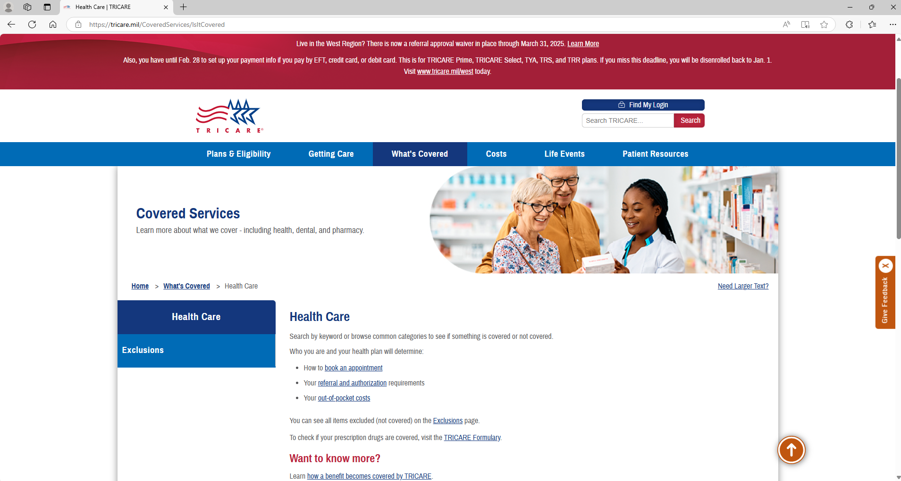
www.tricare.mil
as of February 14, 2025

Slide 9
TRICARE Health Plans

Slide 10
TRICARE Network of Providers
TRICARE contractors certify providers as TRICARE authorized providers
TRICARE can only pay claims for services TRICARE authorized providers deliver
TRICARE Network providers are the subset of TRICARE authorized providers who signed an active agreement with a TRICARE contractor
The TRICARE Network wraps around the Direct Care System to meet the primary, specialty, inpatient, outpatient, and pharmacy needs of the TRICARE enrolled population
Network adequacy – TRICARE contractors establish & maintain the TRICARE network of individual and institutional providers sufficient in number, mix, and geographic distribution to provide the full scope of benefits for TRICARE health plan enrollees within TRICARE access to care standards
Quality standards – performance of contract requirements is monitored by DHA’s TRICARE Health Plan (THP) directorate for all Prime Service Areas (PSA), non-PSAs (i.e., U.S. areas remote from MTFs), and worldwide
TRICARE network is accredited by a nationally recognized accrediting body
Address provider licensure, education, training, hospital privileges, and liability insurance
Both TRICARE regional contractors s hold URAC accreditation
The U.S. Family Health Plans (6) are accredited by URAC or National Committee for Quality Assurance (NCQA)

Slide 11
TRICARE Plans
TRICARE Select (PPO model) – a non-“gatekeeper” plan for enrollment worldwide
No referrals required for coverage
TRICARE authorized providers, network and non-network
TRICARE Prime (HMO model) – a “gatekeeper” plan in Prime Service Areas (PSAs).
Requires referrals. Enrollees are assigned to a primary care manager (PCM).
Mandatory enrollment for active-duty service members (ADSMs).
Variations:
TRICARE Prime Remote (TPR) – available for certain ADSMs in areas geographically remote from MTFs, i.e. outside PSAs
TRICARE Prime Remote for Active-Duty Family Members (TPRADFM) – offered to certain ADFMs of a TPR-enrolled Service member, i.e. outside PSAs
TRICARE Overseas Program (TOP) Prime and TOP Prime Remote
US Family Health Plan (USFHP) – closed network TRICARE Prime plan offered in six designated service areas in the U.S.

Slide 12
TRICARE Plans (Continued)
TRICARE Overseas Program (TOP) – coverage for all eligible overseas beneficiaries, including eligible Reserve Component (RC) Service members
Also includes dental coverage for TOP Prime Remote ADSMs
Other eligible beneficiaries may purchase TRICARE Dental Program (TDP) coverage
Premium-based TRICARE health plans
TRICARE Reserve Select (TRS) – member/family TRICARE Select coverage available for purchase by qualified Selected Reserve members and qualified survivors
TRICARE Retired Reserve (TRR) – member/family TRICARE Select coverage available for purchase by qualified Retired Reserve members and qualified survivors
TRICARE Young Adult (TYA) – individual Prime or Select coverage available for purchase by sponsor to cover qualified family members under the age of 26 who have lost or will lose TRICARE eligibility due to age (compare to Affordable Care Act)
Notes:
TRS – ADFM level of cost sharing payable by both RC sponsor and covered family members/qualified survivors
TRR – retiree level of cost sharing payable by both RC sponsor and covered family members/qualified survivors
TYA – level of cost sharing depends status of sponsor, ADSM or retired

Slide 13
TRICARE Plans (Continued)
TRICARE For Life (TFL) - wraparound coverage for TRICARE beneficiaries who have both Medicare Part A and Medicare Part B, regardless of age or place of residence
TFL pays Medicare deductibles and copayments, for TRICARE covered services
TFL coverage will begin automatically the first day an individual has both Medicare Parts A and B.
Medicare is awarded in the 25th month of receiving SSDI (for those under 65).
or
*** Sign up for Medicare Parts A and B two months before your 65th birthday !! ***
Medicare card and Uniformed Services ID card are proof of TFL coverage and must be presented at time of service
TFL beneficiaries may get care from:
Medicare participating and Medicare nonparticipating providers
Military hospitals and clinics if space is available
Avoid getting TFL-covered services from either (a) the VA for non-service connected conditions, or (b) a Medicare opt-out provider.
Medicare cannot pay anything for services from either of these providers
Patient will be responsible for billed charges minus 20% of TRICARE allowable charge paid by TRICARE

Slide 14
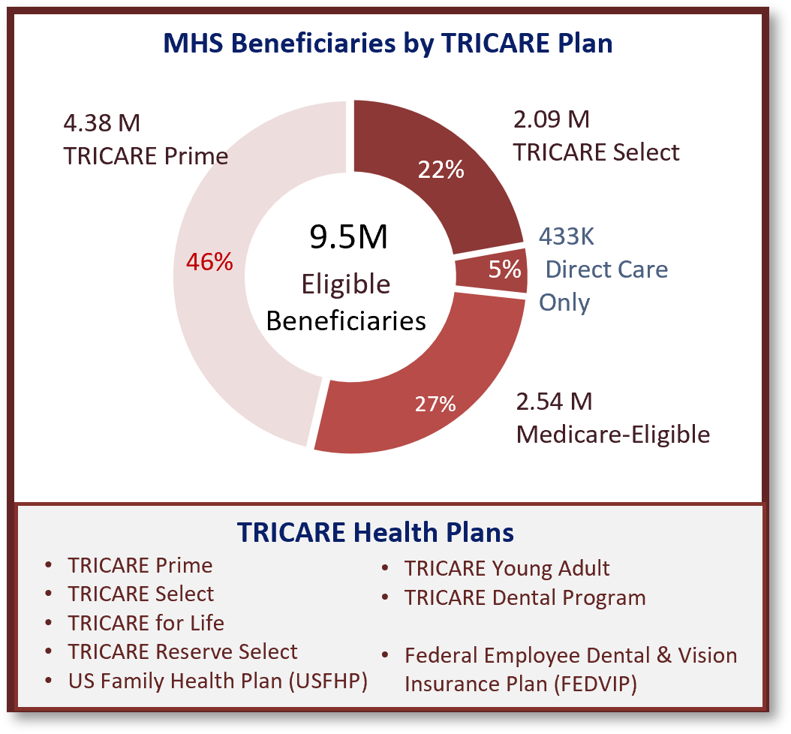
The Military Health System (MHS)
Source: FY 2024 Evaluation of the TRICARE Program (p. 11–12)
¼
½
¼

Slide 15
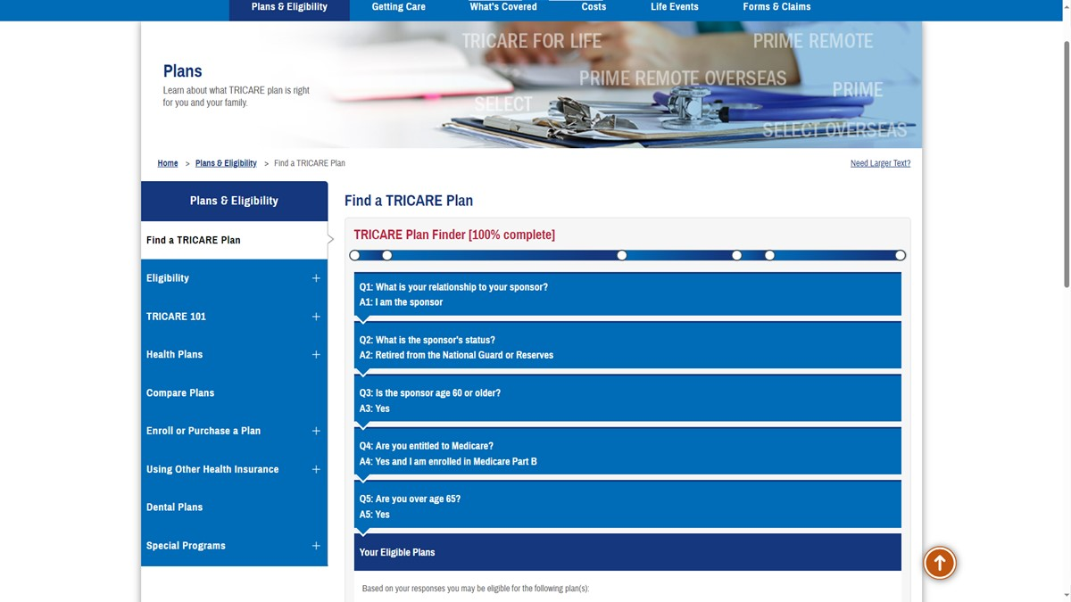
What are the eligible plans?
TRICARE Select
TRICARE for Life
TRICARE Prime Remote
TRICARE Retired Reserve
TRICARE for Young Adults

Slide 16
TRICARE Plans (Continued)
Temporary Continuation of Coverage
Transitional Assistance Management Program (TAMP) – offers 180 days of premium-free TRICARE Select or TRICARE Prime (in PSA) coverage upon separation from active duty for certain sponsors
ADFM cost-sharing applies to both sponsor and family members
Continued Health Care Benefit Program (CHCBP) – offers full-cost premium-based medical coverage to certain beneficiaries for 18–36 months after TRICARE eligibility or premium-based plan coverage ends
No MTF access
Dental Plans (by DoD)
Active-Duty Dental Program (ADDP)
ADSMs – remote from Dental Treatment facilities (DTFs) or care referred by DTFs
Reserve Service members – while activated 30 or more days/covered by TAMP (family members not included)
TRICARE Dental Program (TDP) – premium-based coverage
ADFMs
Members of the Ready Reserve and their eligible family members
Selected Reserve (drilling Guard/Reserve)
Individual Ready Reserve (IRR), Inactive National Guard (ING)

Slide 17
TRICARE Pharmacy Program
All TRICARE health plans, except USFHP, include pharmacy coverage through the TRICARE Pharmacy Program.
You may fill prescriptions through:
Military pharmacies
TRICARE Pharmacy Home Delivery (some limitations overseas)
TRICARE retail network pharmacies
Non-network pharmacies or overseas pharmacies
Most retirees and their family members are required to fill certain maintenance medications through home delivery.
Learn more about your pharmacy options and copayments at https://www.tricare.mil/pharmacy.

Slide 18
Other Benefit Programs
Federal Employee Dental and Vision Insurance Program (FEDVIP) – administered by U.S. Office of Personnel Management (OPM), not by DoD
FEDVIP exclusions:
ADSMs. Enrollees in TYA, CHCBP, and TAMP
DoD eligible persons not enrolled in a TRICARE health plan, i.e. direct care only
Foreign Force members and their families
Dental plan – retirees, including members of the Retired Reserve, their families, and survivors.
Additional exclusion – anyone eligible for the TRICARE Dental Program (TDP)
Vision plan – TFL & TRICARE health plan enrollees, including TRS & TRR enrollees (i.e. must be enrolled)
Extended Care Health Option (ECHO) – a supplemental program to the TRICARE Basic Program.
Provides eligible Active-Duty Family Members (ADFMs) with an additional financial resource to assist in the reduction of the disabling effects of the beneficiary’s qualifying condition
TRICARE Plus –program offering primary care priority access at some military hospitals and clinics
Each military hospital or clinic commander/director decides if TRICARE Plus is offered
Women, Infants, and Children (WIC) Overseas Program – supplemental food and nutrition program for qualified families as certified by a WIC Overseas counselor

Slide 19
Constants During T-5 Transition
Dual-eligible Medicare/TRICARE beneficiaries (2.2 M)
TRICARE Overseas beneficiaries (400 K)
Uniformed Services Family Health Plan enrollees (100 K)
TRICARE Dental Program
Prescription Drug Networks

Slide 20
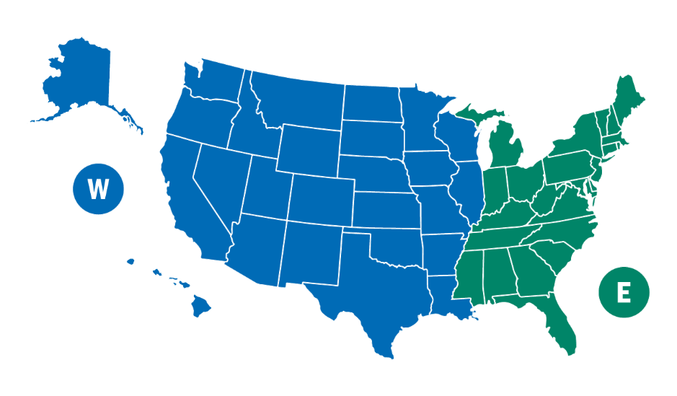
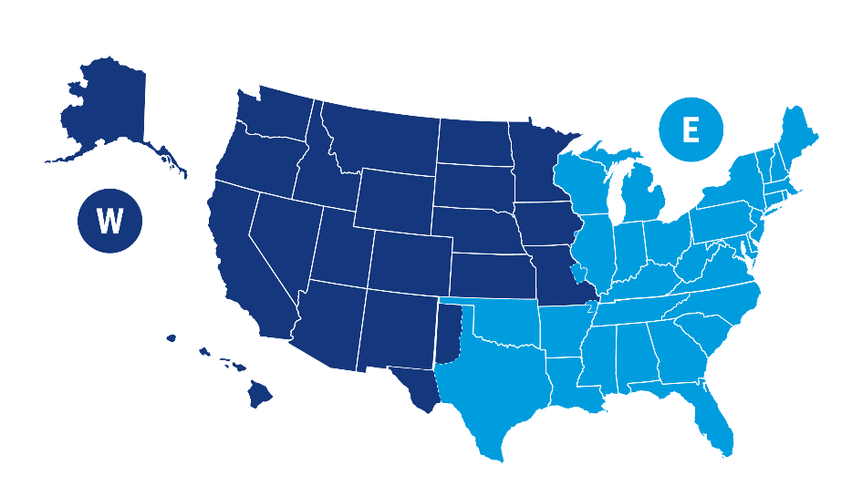
Six States Migrated to West Region from East Region
Arkansas* | Texas | St. Louis area (Missouri
Louisiana | Illinois | Rock Island (Iowa)
Oklahoma | Wisconsin
TRICARE Regions January 1, 2025
TRICARE Regions Previous
Notes:
TRICARE East Region and West Region
6 states moved from East Region to West Region (with exceptions for some ZIP codes)
West Region’s new contractor: TriWest Healthcare Alliance replaced Health Net Federal Services, LLC.
Humana Military will remain the contractor for the East Region.
More efficient transfers between the two regions
Greater provider network flexibility
Improved beneficiary choice
Enhanced access to telehealth

Slide 21
TRICARE T-5 Regional Contracts
T-5 Contracts are designed to provide significant improvements in customer service, access to care, referral management and medical management of complex cases
The 8-year contracts also provide greater stability to TRICARE networks
DHA will assess network adequacy across all specialties, including OB/Gyn and Pediatrics in all Prime Service Areas
TRICARE regional contractors maintain network directories
Start of Health Care Delivery began on schedule, January 1, 2025

Slide 22
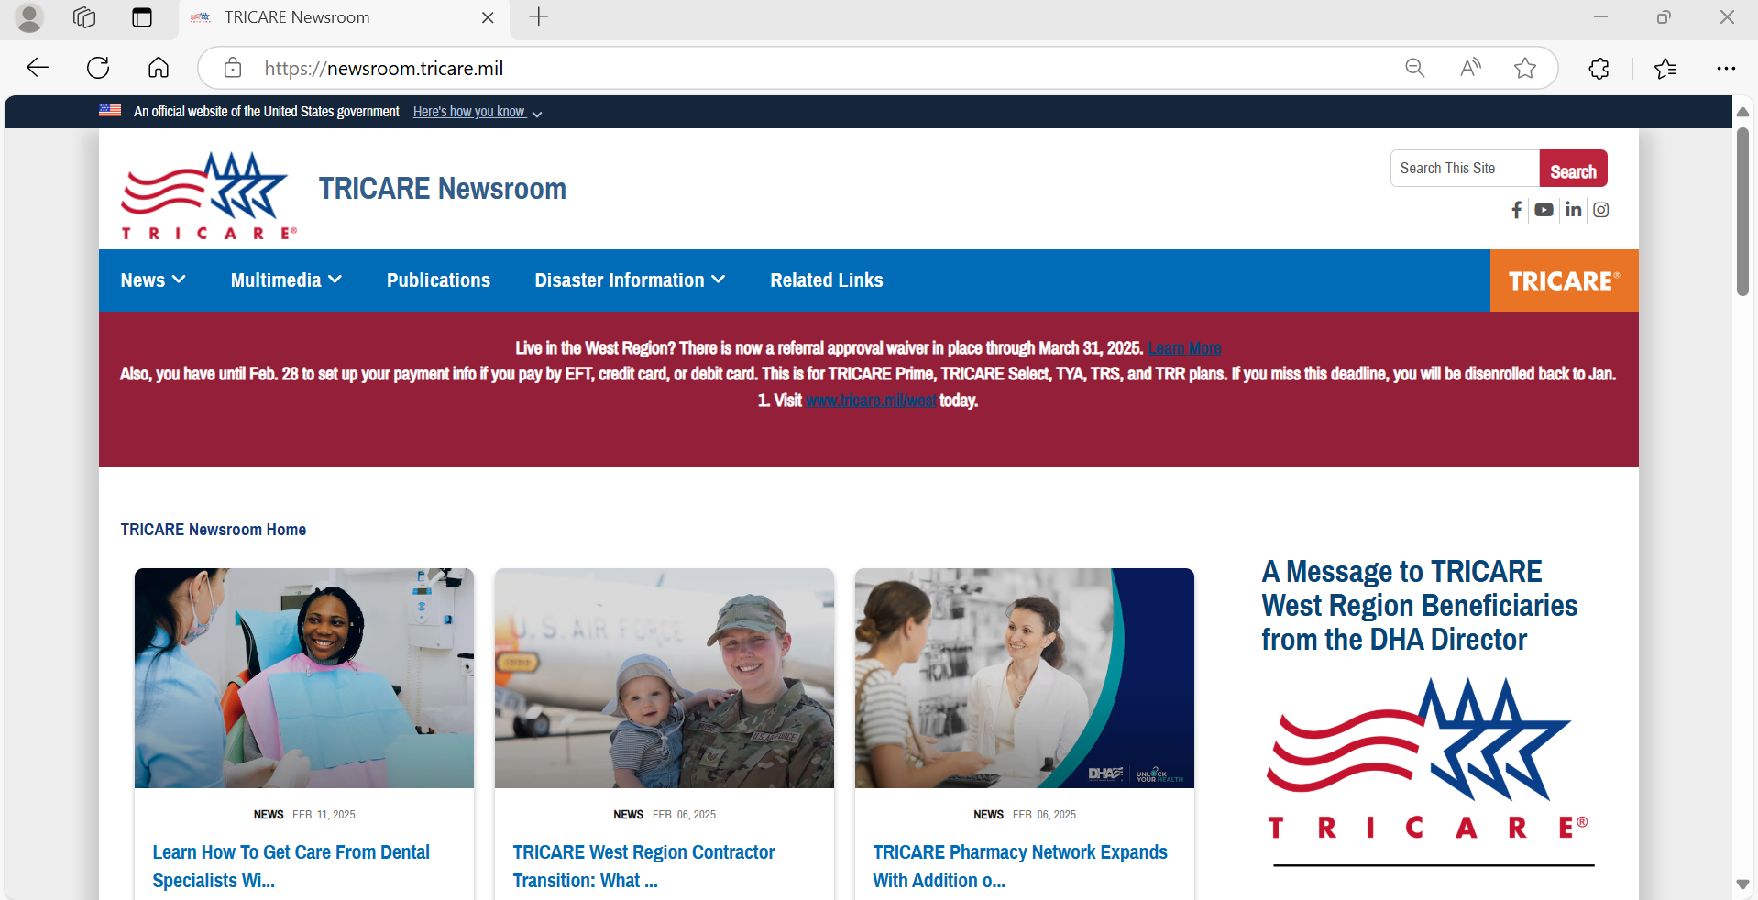
https://newsroom.tricare.mil
as of February 14, 2025

Slide 23
Key Takeaways
Purpose – To foster better understanding of your TRICARE program and its health plans
Take Home Points
The Military Health System (MHS) provides a healthcare benefit to our 9.5 million beneficiaries both through the Direct Care System (DCS) at the military medical treatment facilities (MTFs) when capability/capacity exists, and in private sector care (PSC) under the TRICARE program
TRICARE wraps-around local MTFs to increase capacity and capability through TRICARE-authorized providers, suppliers, and pharmacies, network and non-network, in PSC including international host nation providers
In addition to Active-Duty Service Members (ADSMs), TRICARE covers Active-Duty Family Members (ADFMs), retirees and their families, and qualified survivors
The family of TRICARE health plans is administered by large federal service contracts
The unique MHS promotes recruitment, retention, and readiness in the eight covered Uniformed Services
Grounded in statutory law, the TRICARE is a federal health benefit program. It is not health insurance.
TRICARE is implemented in federal regulation (32 CFR 199)
TRICARE contractors administer the program according to requirements specified in the four TRICARE Manuals (Policy (TPM), Operations (TOM), Reimbursement (TRS), and Systems (TSM))
www.tricare.mil contains the most up-to-date information for MHS beneficiaries; includes one website for each MTF
www.health.mil contains information for MHS and other government staff

Slide 24
References – TRICARE website
www.tricare.mil | Up-to-date TRICARE information
www.tricare.mil/mtf | MTF websites
www.newsroom.tricare.mil | Latest TRICARE news releases
www.tricare.mil/bcacdcao | Beneficiary Counseling and Assistance Coordinators (BCACs) and Debt Collection Assistance Officers (DCAOs)
www.tricare.mil/east | TRICARE East Region information
www.tricare.mil/west | TRICARE West Region information
www.tricare.mil/overseas | TRICARE Overseas information
www.tricare.mil/customerservice | TRICARE Customer Service

Slide 25
Questions?

Slide 26
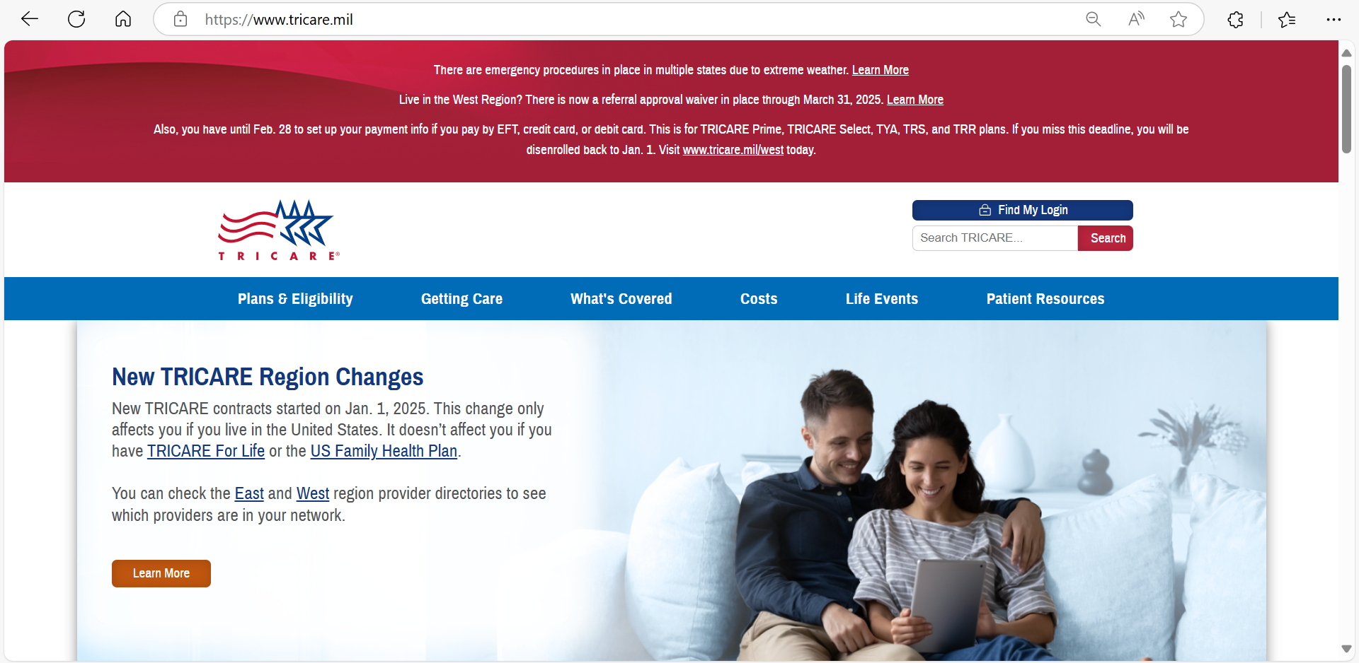
www.tricare.mil
as of February 14, 2025

Slide 27
Back-up Slides

Slide 28
Reserve Component Coverage “Life Cycle”
Not activated
TRICARE Reserve Select (TRS)
TRICARE Retired Reserve (TRR)
Line of Duty (LOD)
Pre-Activation (Early Eligibility) ¹
Active-duty benefits
RC Service member and family
Deactivation:
Transitional Assistance Management Program (TAMP) and Continued Health Care Benefit Program (CHCBP)
www.tricare.mil/reserve
Deactivation
Transitional Assistance Management Program (TAMP) ¹
Continued Health Care Benefit Program (CHCBP)
Activated
Active-duty benefits
RC Service member and family
¹ Activation for a federal preplanned mission (10 USC §12304b) or in support of a contingency operation (§101(a)(13)(B))

Slide 29
OCONUS TRICARE Region
Contact Information
The TRICARE Overseas Program is managed through three geographic areas.
Latin America &Canada
+1-215-942-8393 (overseas)
1-877-451-8659 (stateside)
Eurasia-Africa
+44-20-8762-8384 (overseas)
1-877-678-1207 (stateside)
Pacific Singapore:
+65-6339-2676 (overseas)
1-877-678-1208 (stateside)
Sydney:
+61-2-9273-2710 (overseas)
1-877-678-1209 (stateside)
Latin America & Canada Central and South America, the
Caribbean Basin, Canada, Puerto Rico, and the U.S. Virgin Islands
Eurasia-Africa Europe, Africa,the Middle
East, Pakistan, Russia, and several former Soviet Republics
Pacific
Asia, Guam, Australia, New Zealand, India, Japan, South Koreaand Western Pacific remote countries
Country Specific Contact Information: www.tricare-overseas.com

