Slide 1
East Asian Strategic Context in 2025: some thoughts
Cynthia Watson, PhD
Provost Emerita, NDU
26 February 2025
Capstone Spouses

Slide 2
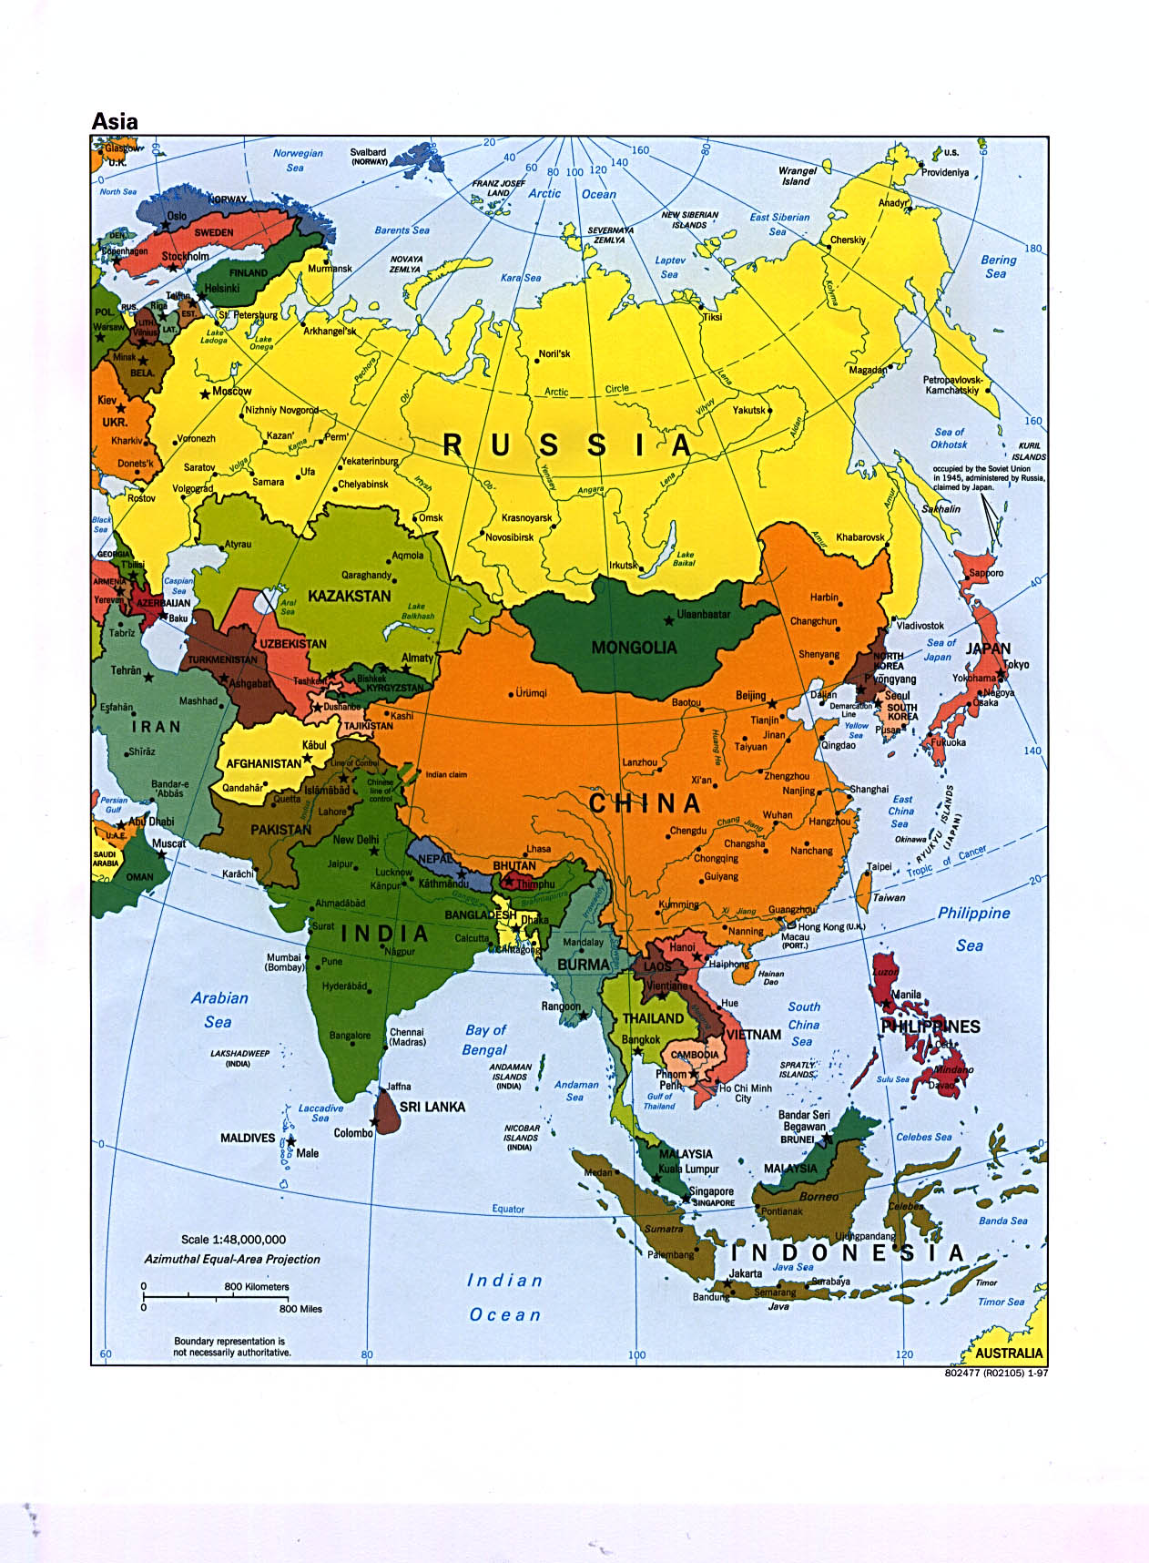

Slide 3
discussion
Strategic context—the players
Challenges for strategy in Asia
Tools of statecraft
Indo-Asia-Pacific within U.S. strategic priorities
Questions for consideration?

Slide 4
Strategic context--the players
Arisen China: demand for ‘respect’ while internal limits
Where does Taiwan fit into this?
Reassertive Japan? Upheaval of late but the bilateral ties?
The Korean peninsula still uncertain path ahead whether North or South
How does Vlad the Impaler play here, too?
Southeast Asia—diverging paths
India under ultra-nationalist Modi
Australia unquestionably U.S. strongest partner
Canada and United Kingdom receding into background

Slide 5
Challenges for strategy in Asia
An expanding centrality of China
  Regional bully but
  Trade dominance which is indisputable so tariffs will ??
  Maritime disputes deepening
  Increasingly active globally—more recent twist
  Selective about keeping any commitments: Hong Kong, UNCLOS
  But Xi has worries at home
Will anyone else care about Taiwan?
The DRPK remains a substantial, growing threat w/ opaque rule & nukes. Special relationship with POTUS?
Democracy waivering RoK coup, Thailand, Myanmar,
Press freedoms, travel, human rights imperiled
U.S. alliances revitalized but do they pay enough? China says ‘encirclement’
Expanding Asia to include India good or futile aspiration?

Slide 6
Tools of statecraft
China using any and all instruments of national statecraft
  Trade dominance: RCEP and BRI for starters
  'Filling the jar': vaccines, aid, infrastructure, diplomacy, tourism and more
  Military modernization only one of many instruments deployed
U.S. abandoned free trade for tariffs
Multilateralism or various Chinese-modeled organizations?
Multilateral aspirations between far flung players
US instruments beyond military and US Pacific Command?
AUKUS has great potential but unlikely it will not survive because of political vaguerities and costs
Allies: Japan and South Korea are stepping up but will they really want to defend Taiwan? Will they satisfy new POTUS? Historic animosity
Modi’s aims so muddled as to confuse which tools he brings

Slide 7
Indo-Asia-Pacific within US national priorities
China China China: obvious priority for budget and approach to region but unanticipated 8% DoD cuts mean?
Could POTUS make a deal with Xi? What kind?
North Korea? What chance denuclearization?
Will India be important for us within Indo-Pacom or as adjunct to Pakistan issues? An end or a mean?
Global center of economic gravity moving to Asia but what about Europe? Does Belt & Road matter?
Should we increase military spending or worry about our huge budget deficit?
BOTTOM LINE: do we see this region as our top priority or are we merely accustomed to seeing any competitor’s action as threatening? Are we willing to abandon everything else for China?

Slide 8
Questions for consideration
The Chinese model no longer as appealing so…?
How will tariffs/trade affect our role in region?
Are we really willing to abandon everything to oppose China?
Does diplomacy matter in Asia?
Are the alliances sustainable under new leadership?
Is Asia evolving into something quite different from the past or is that merely because of China's current confidence?
What happens if China stumbles?
Is this Xi or is this China?

