Slide 1
East Asian Strategic Context in 2024: some thoughts
Cynthia Watson, PhD
Provost Emerita, NDU
20 November 2024
Capstone Spouses

Slide 2
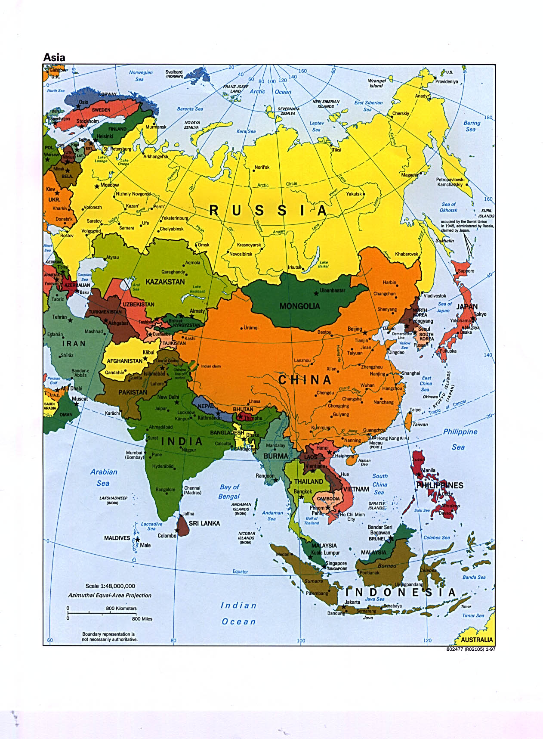

Slide 3
discussion
Strategic context—the players
Challenges for strategy in Asia
Tools of statecraft
Indo-Asia-Pacific within U.S. strategic priorities
Questions for consideration?

Slide 4
Strategic context--the players
Arisen China: the demand for ‘respect’ w/ internal limits
Declining Japan? Upheaval of late but the bilateral ties?
The Korean peninsula still uncertain path ahead
How does Vlad the Impaler play here, too?
Where does Taiwan fit into this?
Southeast Asia
India under ultra-nationalist Modi
Australia unquestionably U.S. strongest partner
Canada and United Kingdom

Slide 5
Challenges for strategy in Asia
An expanding centrality of China
  Trade dominance which is indisputable
  Maritime disputes
  Hegemon rather than merely a member state?
  What instruments do we have versus them?
  Increasingly active globally—a really new twist
The DRPK remains a substantial, growing threat w/ opaque rule & nukes
Will anyone else care about Taiwan?
Press freedoms, travel, human rights imperiled
U.S. alliances revitalized but do they pay enough? China says ‘encirclement’
Expanding Asia to include India good or futile aspiration?

Slide 6
Tools of statecraft
China using any and all instruments of national statecraft
  Trade dominance: RCEP and BRI for starters
  'Filling the jar': vaccines, aid, infrastructure, diplomacy, tourism and more
  Military modernization a message across the region
U.S. backing off free trade has implications
Multilateralism or various Chinese-modeled organizations?
Multilateral aspirations between far flung players
US instruments beyond military and US Pacific Command?
AUKUS has great potential but also dangers it will not survive because of political vaguerities and costs
Allies: Japan and South Korea are stepping up but will they really want to defend Taiwan? Will they satisfy new POTUS?
South Korea still fears its unpredictable northern neighbor

Slide 7
Indo-Asia-Pacific within US national priorities
China China China: obvious priority for budget and approach to region
North Korea?
Will India be important for us within Indo-Pacom or as adjunct to Pakistan issues? An end or a mean?
Global center of economic gravity moving to Asia but what about Europe? Axis of authoritarians?
Should we increase military spending or worry about our huge budget deficit?
BOTTOM LINE: do we see this region as our top priority or are we merely accustomed to seeing any competitor’s action as threatening? Are we willing to abandon everything else for China?

Slide 8
Questions for consideration
The Chinese model no longer as appealing so…?
How will tariffs/trade affect our role in region?
Are we really willing to abandon everything to oppose China?
Does diplomacy matter in Asia?
Are the alliances sustainable under new leadership?
Is Asia evolving into something quite different from the past or is that merely because of China's current confidence?
What happens if China stumbles?
Is this Xi or is this China?

