Slide 1
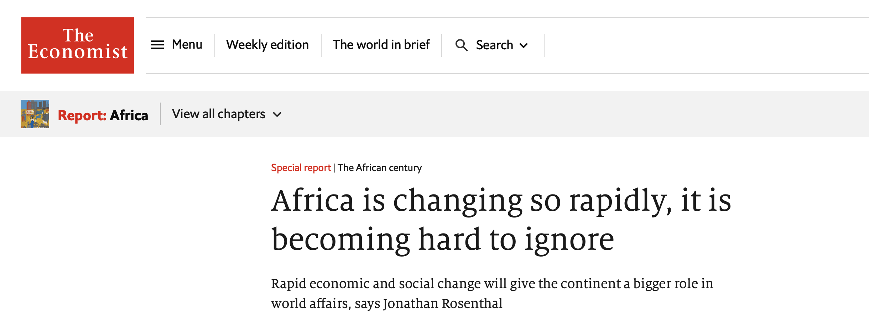
WHY AFRICA MATTERS FOR THE UNITED STATES AND THE REST OF THE WORLD
Joel Amegboh, Ph.D

Slide 2
The Global Megatrends Impacting African Governments and Citizens Focus on Challenges and Opportunities
Demographic shifts/Population growth
Accelerating Urbanization/Growing inequality
Climate change/Resources Stress
Rise of Technology
Public debt
---------------------------------------------------------------------------
Democratization Trends in Africa
Great Power Competition
U.S.-Africa Partnerships

Slide 3
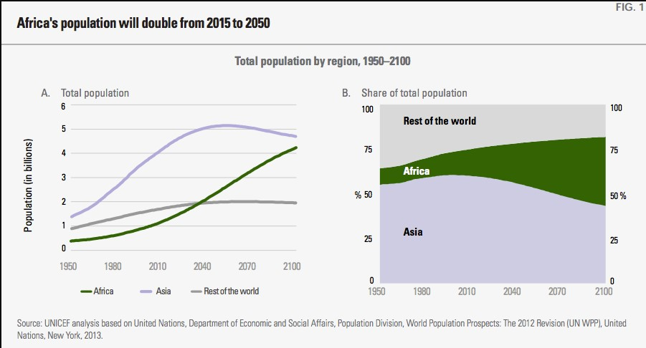
Africa’s Youth Bulge Demographic Dividend or Disaster?

Slide 4
Demographic Shifts
Citizen questions to government: Will I have a pension when I am old and will it be sufficient for me to live on? How will we ever find enough jobs for our youth?

Slide 5
UNDP 2023

Slide 6
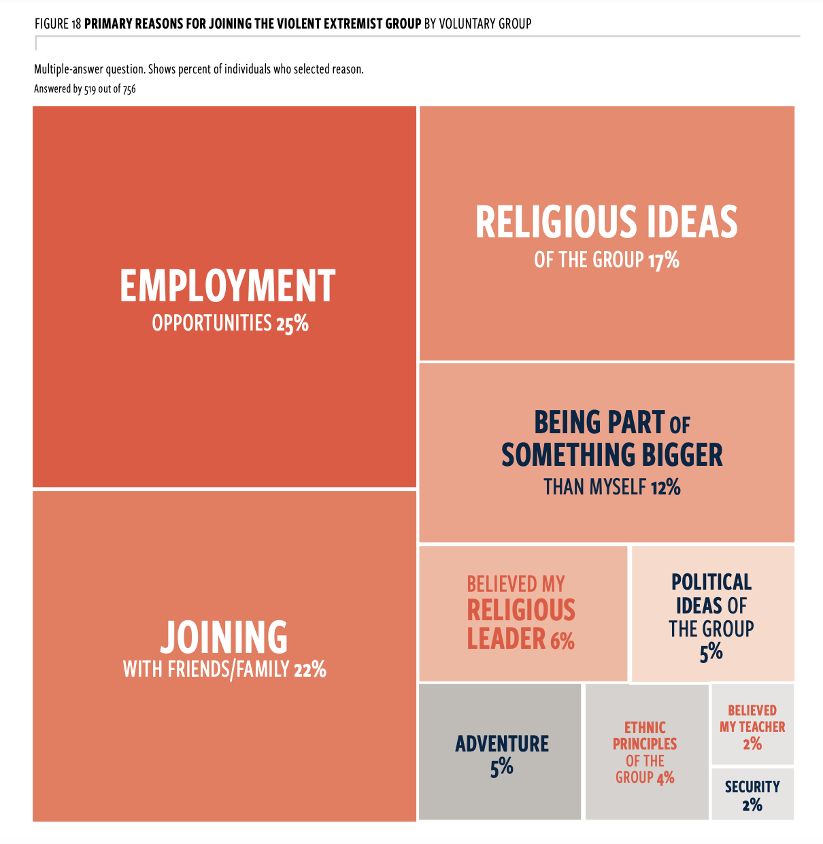
Key findings – Pathways to Recruitment
Although 25% of surveyed voluntary recruits identified employment opportunities as their primary reason for joining, the research did not find a significant correlation between unemployment and susceptibility to violent extremism.
This study does not find a statistical relationship between levels of trusts and susceptibility to violent extremism. Levels of trust in state actors and institutions are low among all respondents. 58% of voluntary recruit exhibited little/no trust in national government, compared to 50% of reference groups counterparts.
Among the 48% voluntary recruits who had experienced a trigger event, i.e. a 'tipping point' factor, as many as 71 % experienced short, punctuated and sharp escalations of human rights abuses such as government action, killing of a family member or and arrest of family member (10%), similar to the first study.
Low levels of access to information and communication increases vulnerability to recruitment. Recruits that never use or lack access to internet at the time of joining, joined more quickly than others.
Male recruits were more likely to join with friends, female recruits with family. While 61 percent of male recruits joined with a friend, 50 percent of female recruits joined with family (husbands).

Slide 7
Accelerating urbanization
Citizen questions to government: How can government plan for infrastructure better so that it is timely, effective and sustainable? What is government doing to get rid of poverty in my city?

Slide 8
Accelerating Urbanization Cont.

Slide 9
Climate Change and Resource Scarcity
Citizen questions to government: How will government ensure that we have sufficient
resources for our future needs as demand exceeds supply?

Slide 11
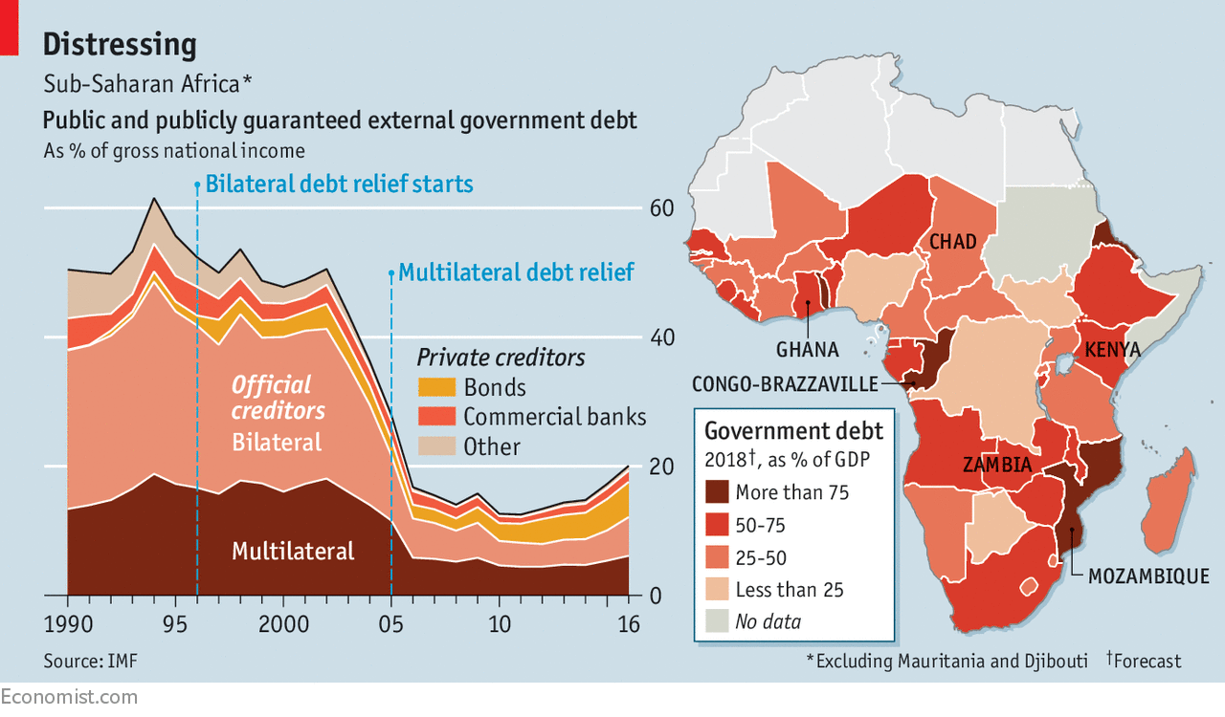
Increasing debt in many African countries is a cause for worry

Slide 12
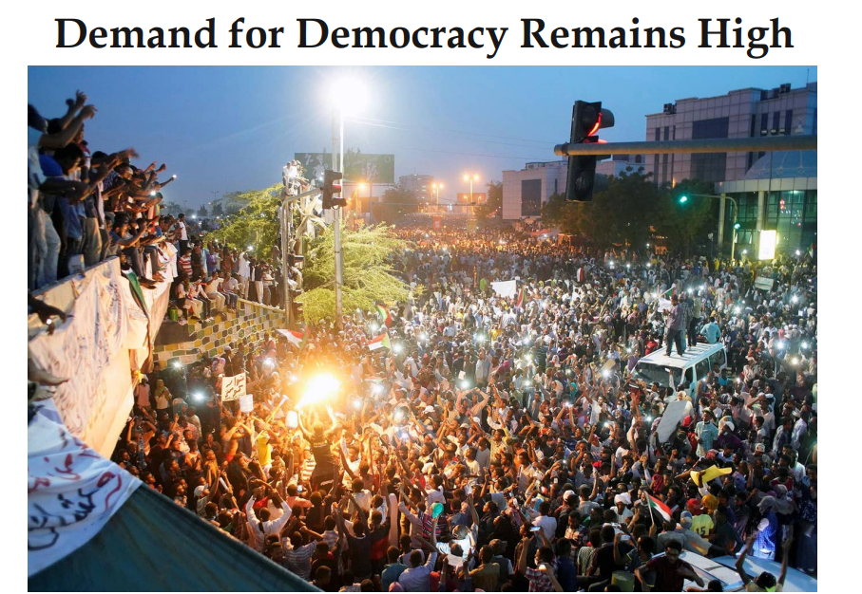
Democratization Trends in Africa:
Protests, Crackdowns, and Breakthroughs

Slide 13
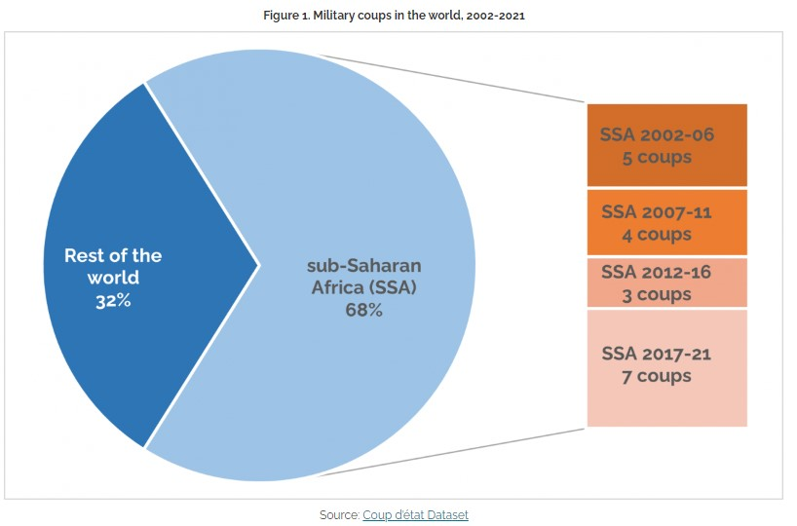
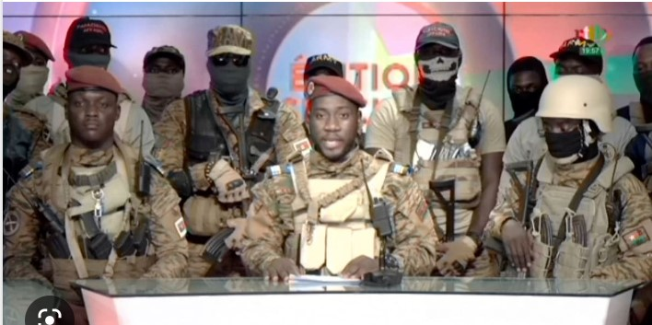
Democratic Backsliding in Africa
Lieutenant-Colonel Paul-Henri Sandaogo Damiba
Captain Ibrahim Traoré

Slide 14
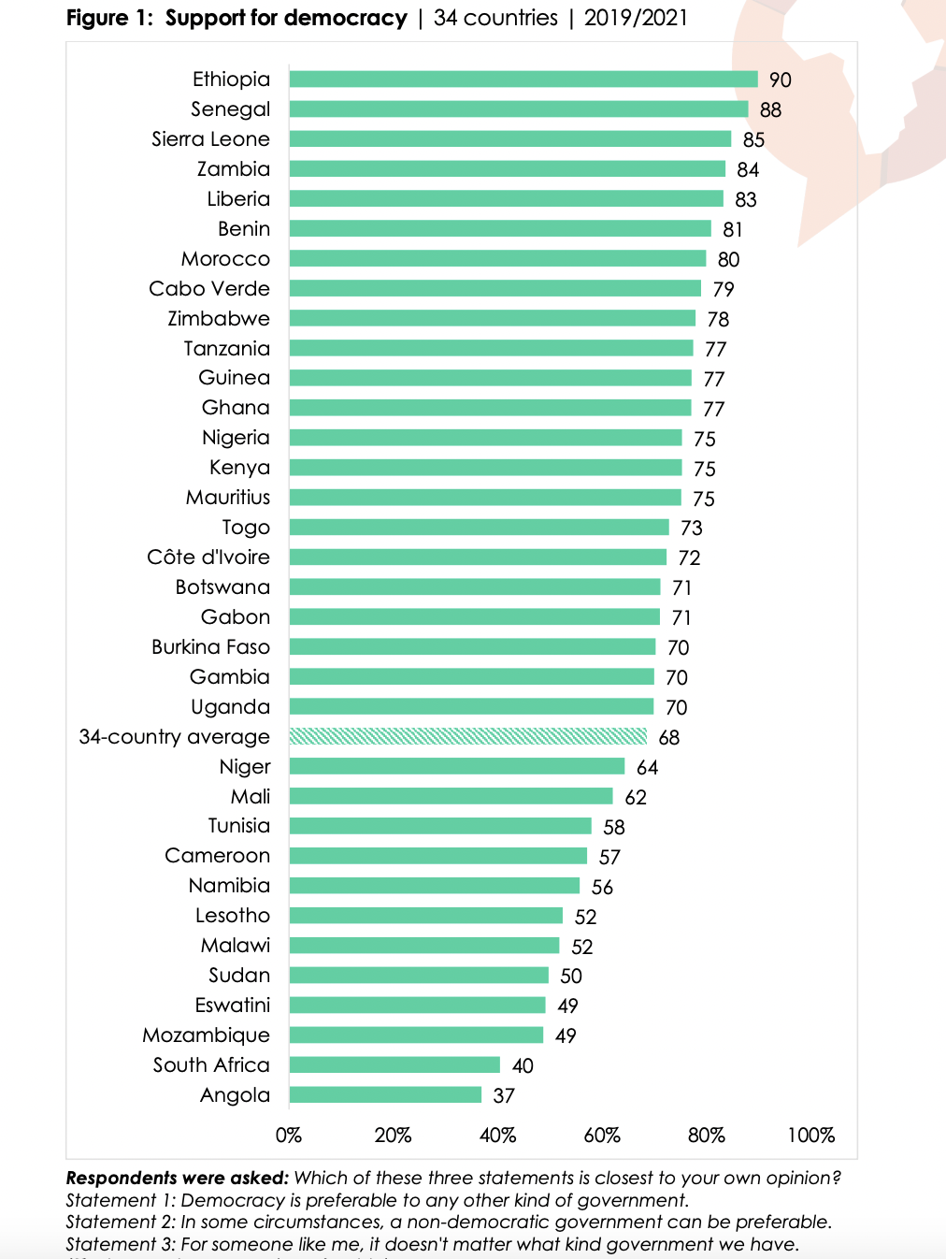
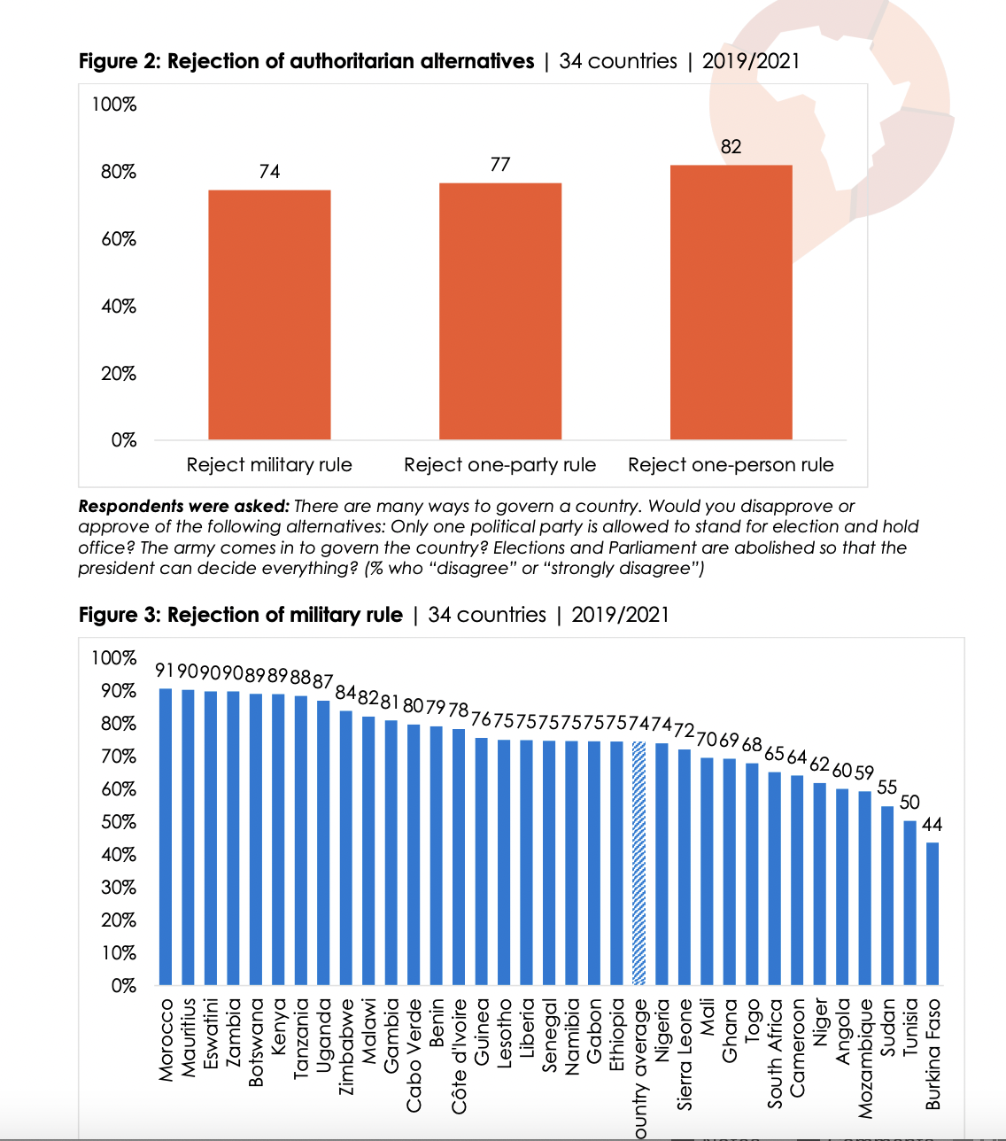

Slide 15
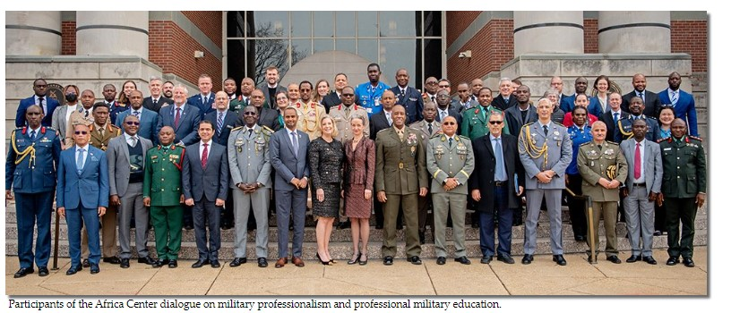
Civil-Military Relations in Africa
“We need African militaries to serve the public,” “We need African militaries to be autonomous, accountable, and respectful of democratic values. If they are not, we will constantly be starting over and will not have stability.”
General Cissé

Slide 16
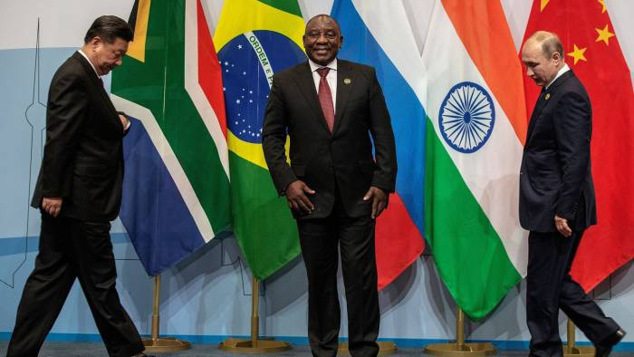
Great Power Competition: Russian and Chinese Influence In Africa

Slide 17
Does Africa Matter to the U.S
National Defense Strategy
White House Africa Strategy
DoD Africa Strategy
USAFRICOM Campaign Plan

Slide 18
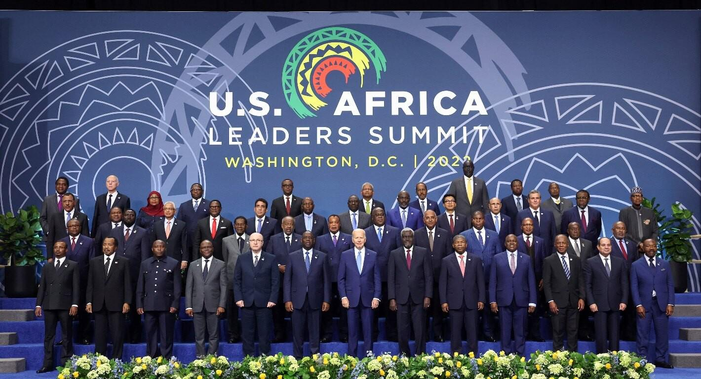
U.S.-Africa Leaders Summit Marks a Shift in Relations with the Continent

Slide 19
U.S. STRATEGY TOWARD SUB-SAHARAN AFRICA
“We believe in the nations of Africa, in the continent-wide spirit of entrepreneurship and innovation. And
through the challenges ahead, although they are great, there is no doubt that our nations, our people, the
African Union — we’re up to this task.”
President Joe Biden African Union Summit February 5, 2021
Strategic Objectives
Foster Openness and Open Societies
Deliver Democratic and Security Dividends
Advance Pandemic Recovery and Economic Opportunity
Support Conservation, Climate Adaptation, and Just Energy Transition

Slide 20
U.S.-Africa Partnerships
Mobilizing a “Whole-of-Government” Approach
Supporting Africa’s Representation in Global Governance
Pledging Billions to Advance Shared Priorities
“$55 billion pledge is broadly aimed at supporting the AU’s Agenda 2063”
Moving From Aid to Trade and Investments
Supporting Key Pan-African Initiatives

Slide 21
U.S.-Africa Partnerships
Economic Cooperation and Development
AGOA: Promoting Trade and Respect for Human Rights in Africa
Prosper Africa: U.S. and African Businesses Growing Together
Youth Engagement
Young African Leaders Initiative (YALI)
Health Cooperation
Speed Global COVID-19 Vaccination Campaign
Environmental Issues
“Transformative” Action To Stop Deforestation by 2030
Security, Peace, and Stability
U.S. Helping African Partners Fight Terrorism
U.S. Africa Command Helps Partners Address Security, COVID-19

