Slide 1


The Changing Character of Warfare
Adapt or Perish

Slide 2
The Key Rule of
Military History
Leave Mountain
People Alone
2

Slide 3
Purpose
What emergent capabilities are driving changes in character of warfare?
What impact will these changes have on the various domains of warfare?
Operational and strategic implications
Some questions to consider
3

Slide 4
Underlying
NATURE OF WAR does not change,
CHARACTER OF WARFARE changes continually
4

Slide 5
Emergent Capabilities
Pervasive surveillance
Precise mass
  Extended range
  Emerging autonomy
C4ISR that can exploit both
Multidomain is norm
Both sides are able to practically hit
‘everything, everywhere all at once’
The Hague Center Feb 2026

Slide 6
Pervasive Surveillance
All weather, all the time
Space based
  Visual/IR (10 cm) , SAR, ESM, Radar – many times per day – 10 cm
  100,000 small sats by 2030
Ground based – all spectrum
Drones – minutes to weeks
If you produce a signature,
You will be seen.

Slide 7
Precision Mass
Artillery, rockets, missiles, drones
If you are seen, you can be hit

Slide 8
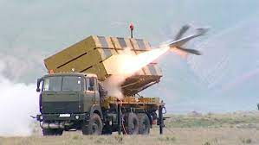

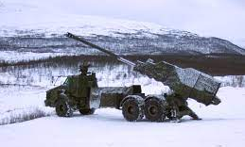
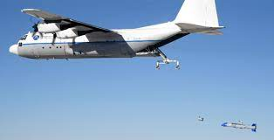
Harop – loitering munition
  600 Miles – 50 lbs
VTOL
Autonomous – Visual, IR, EMS
Operational in over 10 nations
Swedish Archer 155 mm
Range: 50 km
Emplace, 3 rounds, displace
  72 seconds
  C-130 w/ Rapid Dragon
    JASSM-ER – 600 miles
    Longer range missiles available
  Allied use too

Slide 9
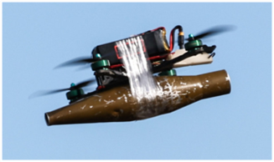
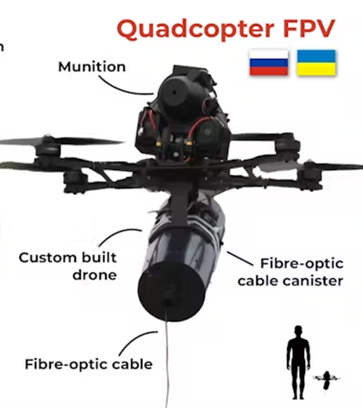
First Person View
Homemade
RPG Warhead
10 km
$500-1000
Fiber-Optic Guidance
Loitering Munitions
15 – 50 kms
Semi-autonomous
$900 -??
11,000 Homemade FPVs = 1 M1

Slide 10
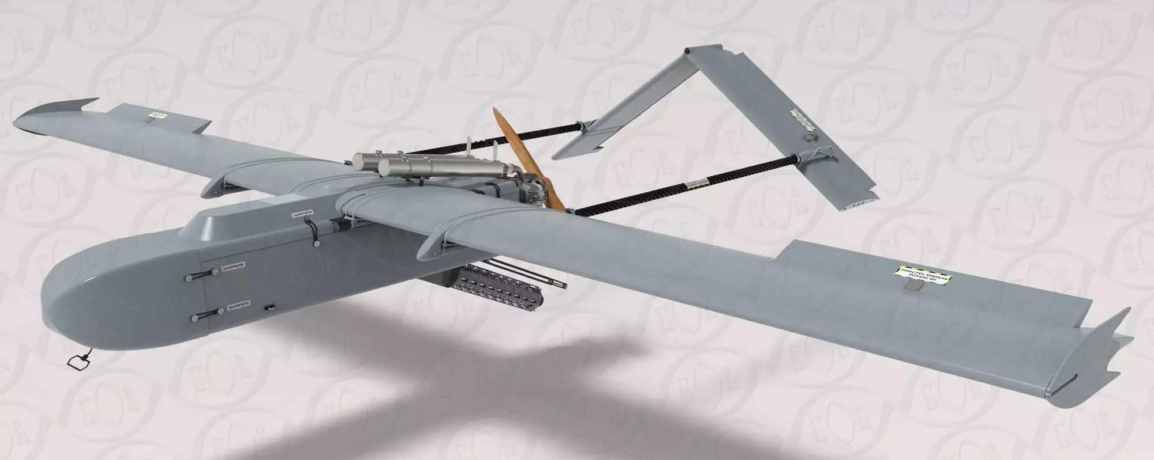
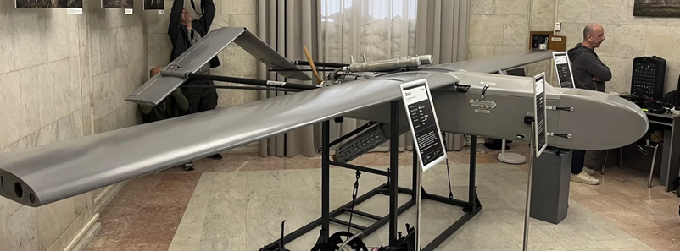
Ukraine
Medium-Range Strike
FP-1 – 1600 km
60-120 KG
$55,000
100/day - plywood frame
FP-2 – 200 km
58 KG
$55,000
Autonomous – fixed tgts
Remote control – moving

Slide 11
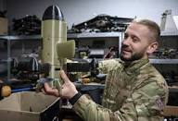
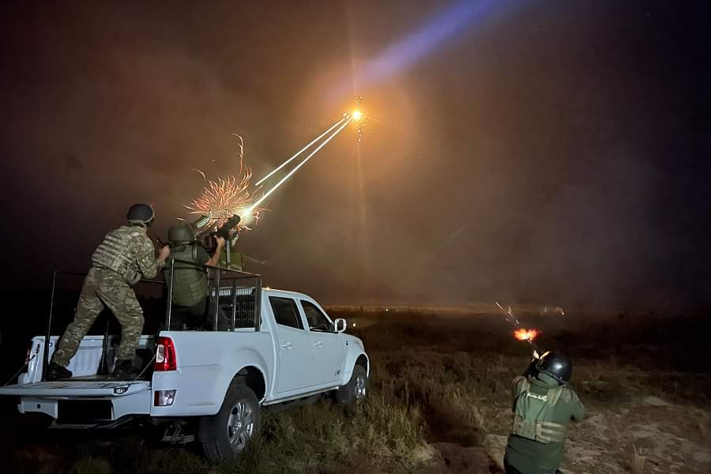
Countering UAVs
Sting VTOL
$2500
VTOL
Autonomous
March 2026 – 33,000 kills
Mobile fire units
Reservists/part time
Radar assisted
AI positioning

Slide 12
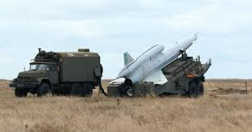
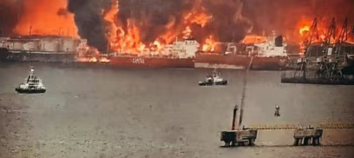
Ukraine
Long-Range Strike
3000 KM
1150 KG Warhead
GPS/GNSS w/INS
$500,000
Manufacture 2/day
Scale to 2500 year
Ust-Luga Russia

Slide 13
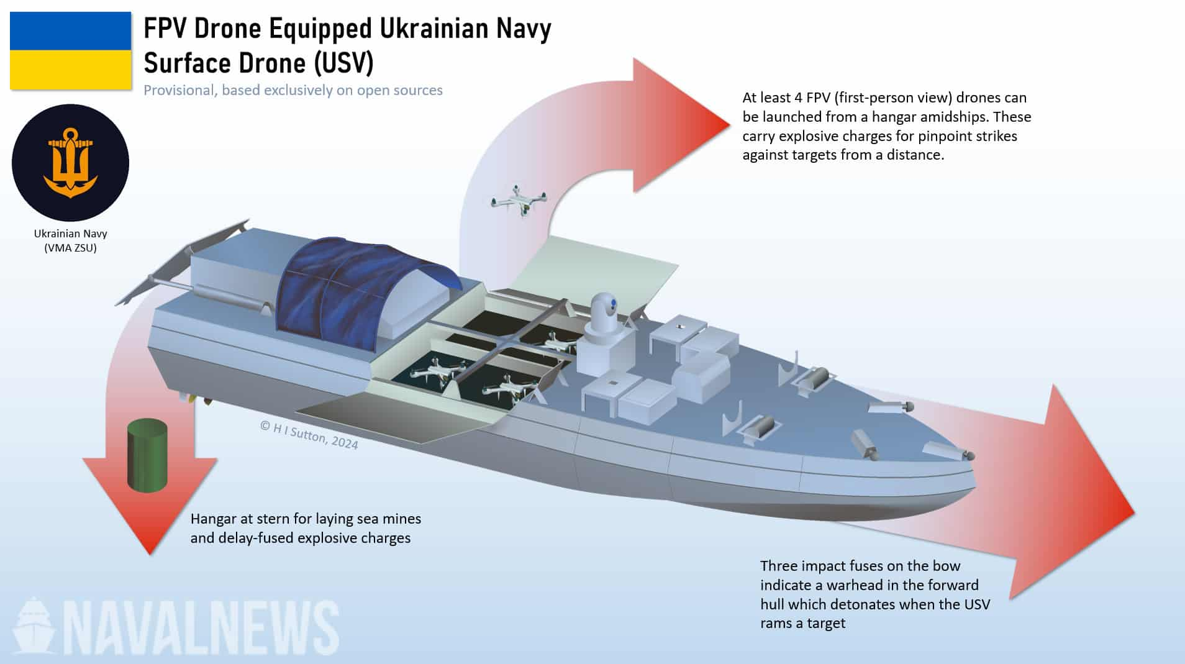
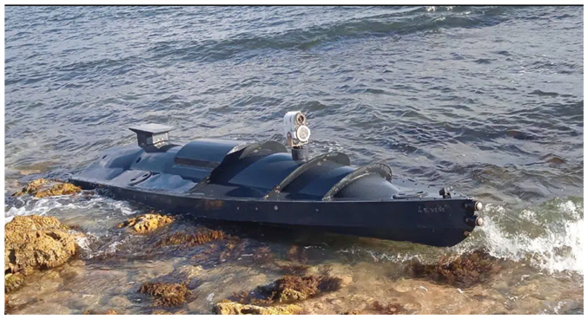

Sea Baby to Magura 7
2022
400 NM
240 KG
800 NM
650 KG
SAMs, guns,
drones, mines,
$700,000
42 knots

Slide 14
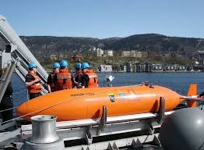

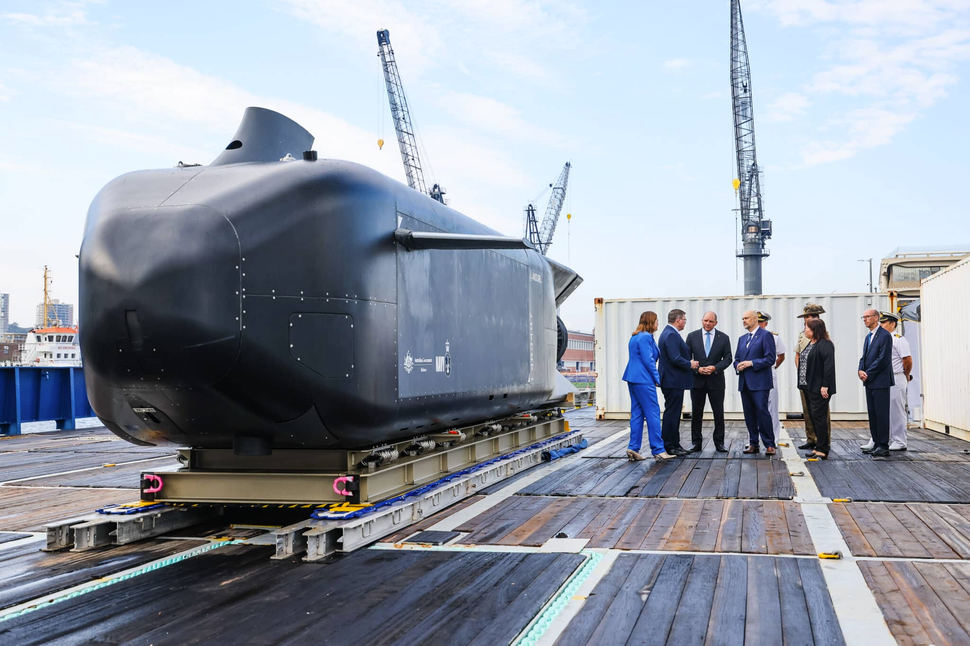
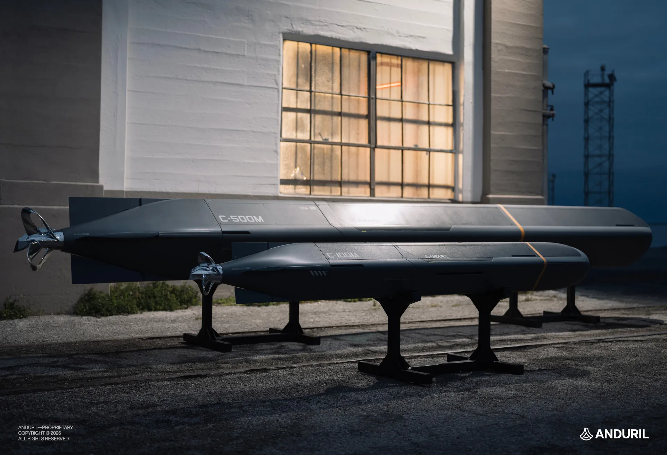
Autonomous Underwater Vehicles
Norwegian HUGIN
  Autonomous
  Surveillance
  1,000 NM
  0.04% Nav accuracy
Anduril Copperhead
  MK 48 ADCAPs
  MK 54
200 sharks/year; 1,000s of Copperheads

Slide 15
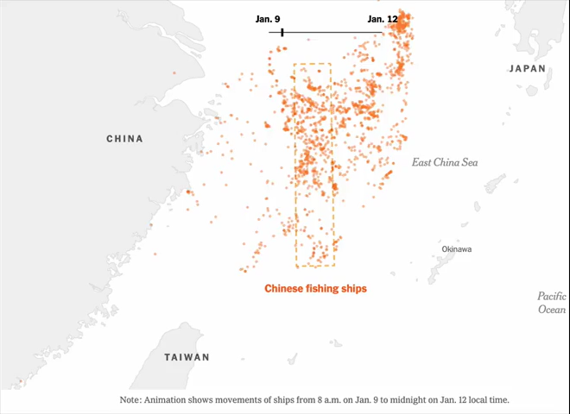
Chinese Fishing Fleet
Barrier Formation

Slide 16
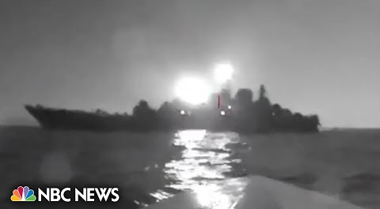
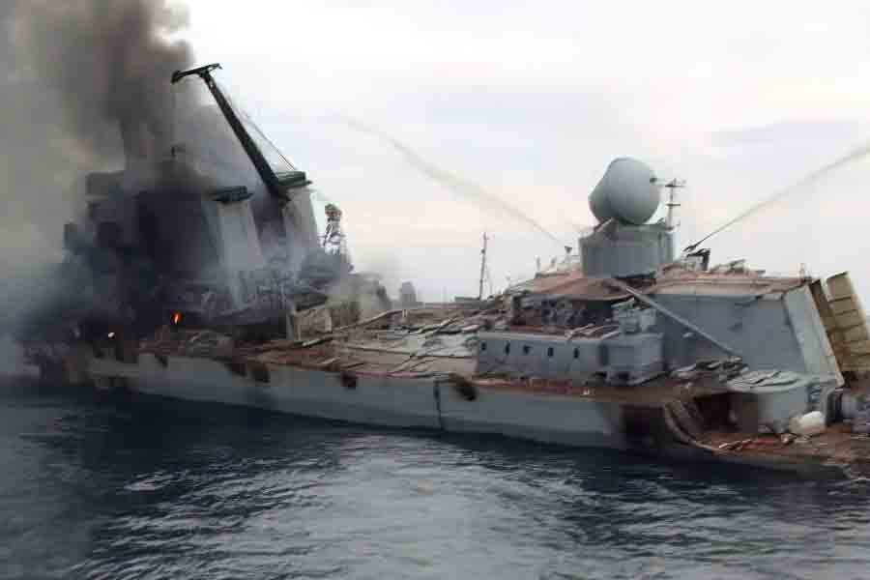
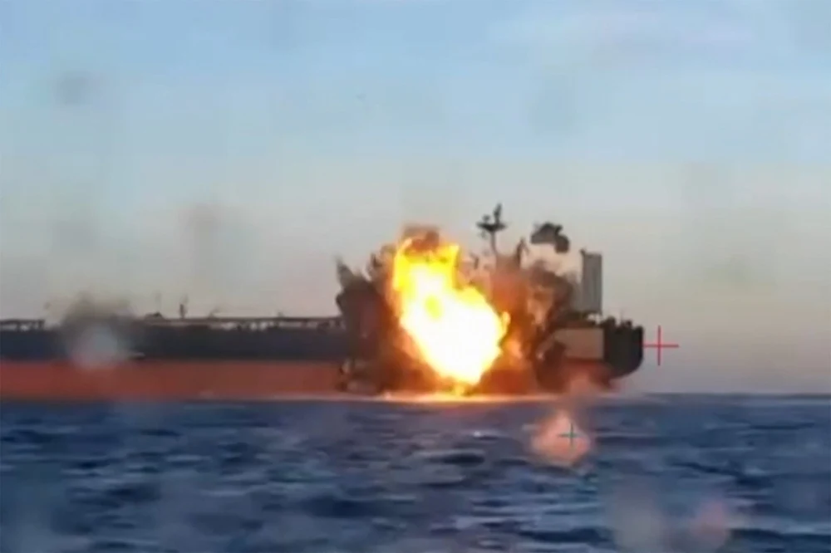
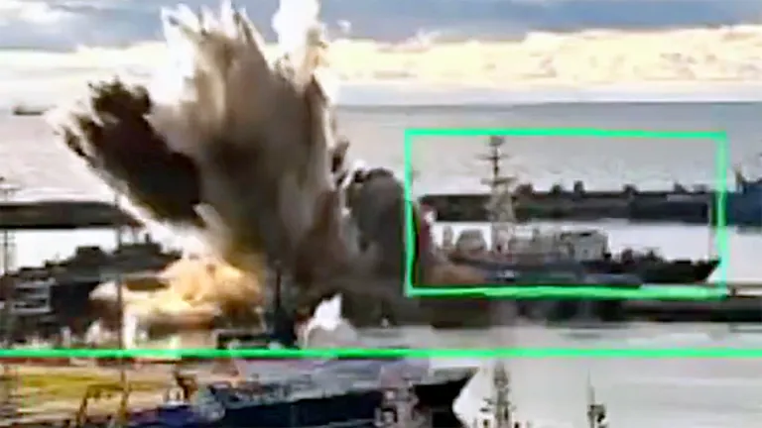
UxVs vs Black Fleet
  1 Cruiser
  5 Frigates and missile ships
  9 Large landing ships
  2 Improved Kilo-class submarines
  14 Minesweepers and support ships
  Numerous small landing ships
  Damaged three oil tankers
    Mediterranean and Atlantic

Slide 17
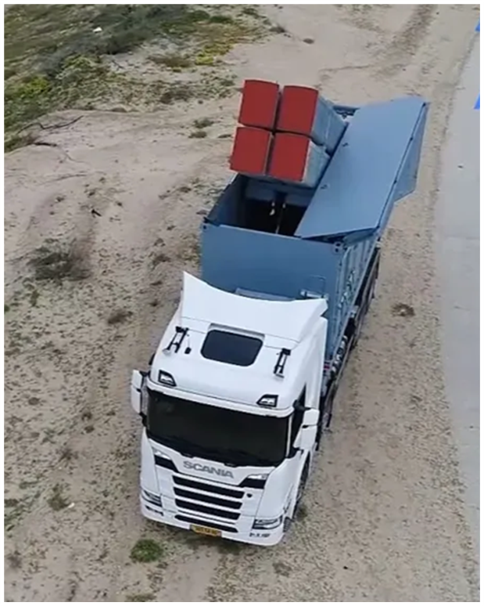
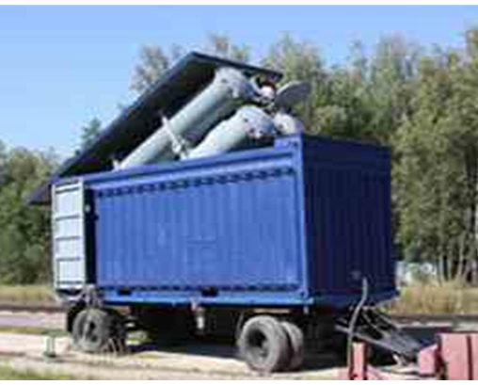
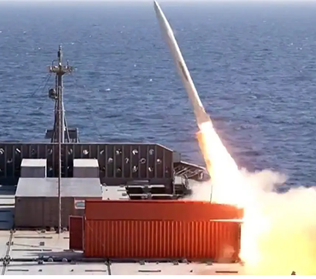
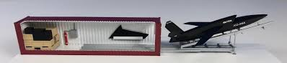
Containerized Systems
Hide in plain site
Russian Club-K
Iranian test
Estonian ASCM
Valkyrie
17

Slide 18
C4I:
Exploit advances

Slide 19
C4I - Ukraine
Demonstrated capability
Delta – decision support/sit awareness
  Runs on any platform
  Routed through Starlink
  AI assisted – Palantir
  Inputs from sats, radars, sensors, phones
Unit to national communications package

Slide 20
Tactical Impacts

Slide 21
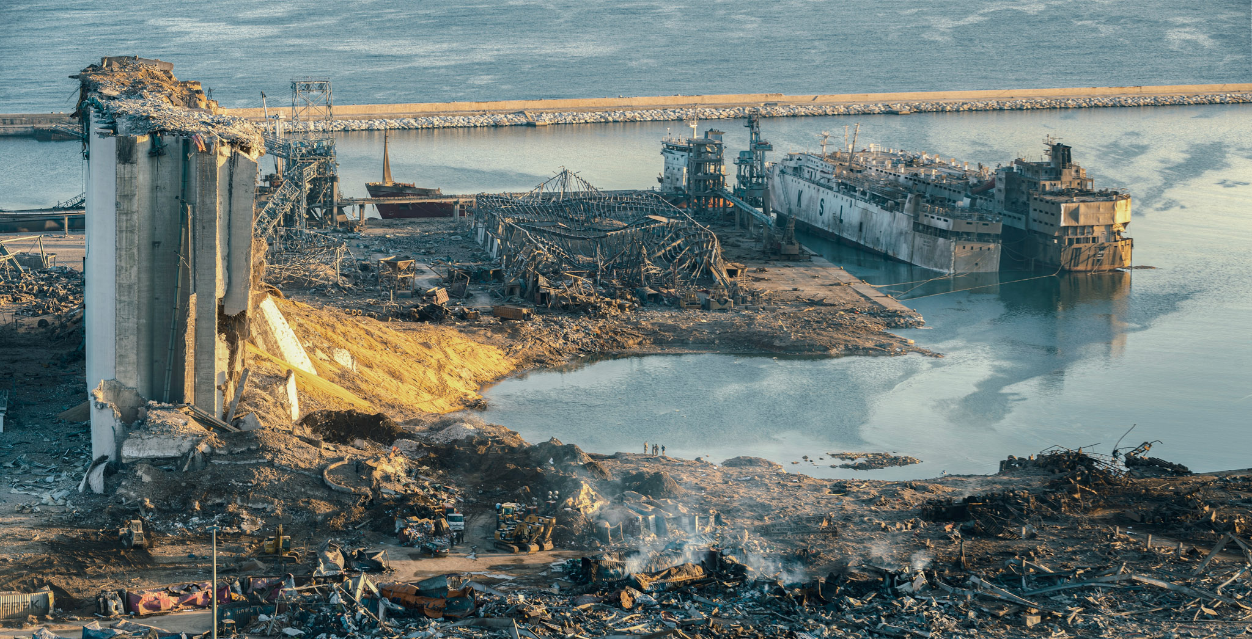
Irregular War
Convergence favors non-state actors
  Little infrastructure to protect
  State infrastructure vulnerable
  Civil and military logistics vulnerable
Powerful role for outside sponsors
  Long-range precision strike
  Swarms
Old tech still works

Slide 22
Conventional Warfare
Connected C2 critical
  Must prepare to fight disconnected
Defense dominates air, land domains
Sea domain is mixed
Space and electromagnetic contested
Cyber uncertain
Power projection much more costly

Slide 23
Legacy vs Emerging
Systems
Outranged
Outnumbered
Fragile
Unsupportable
Unaffordable
Unreplaceable

Slide 24
Air Domain
Numbers and Range
Operational Range in Nautical Miles
Drones
Ballistic
Missiles
Cruise
Missiles
F-35A
Are manned aircraft range obsolete?

Slide 25
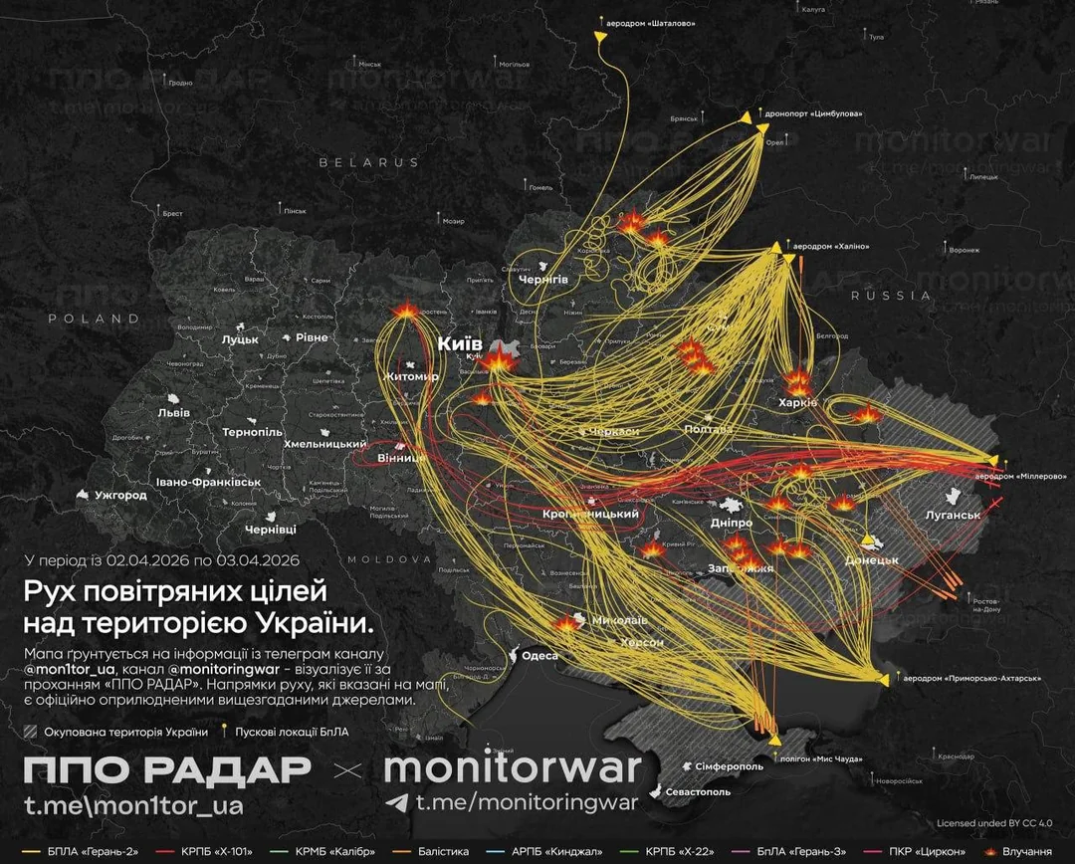
Russian Drone/Missiles
April 3, 2026

Slide 26
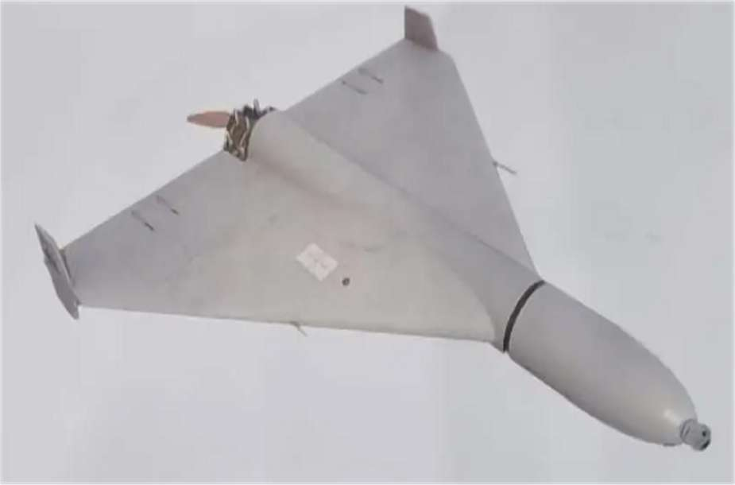
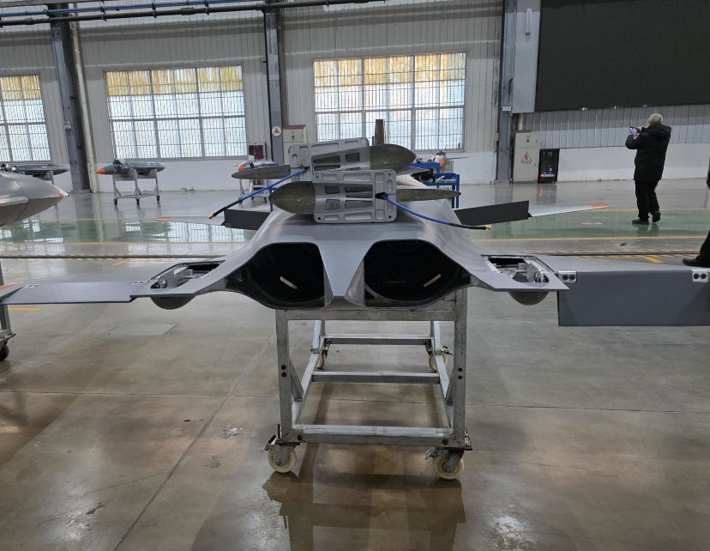
China
Sunflower 200
2,000 km
50 kg
Mass produced
TM-300
Stealth
Mach 1.8
1,200 km, 100 kg
Mass produced

Slide 27
Bases Vulnerabilities
Stimson paper 7-30 days
  Partial PLARF
  No PLAA, PLAN, PLAAF participation
CONUS bombers/tankers vulnerable
Ports can be mined or struck
Massive signatures of C2 and logistics
  Most fixed and unprotected

Slide 28
Land Domain
Defense Dominant
  Attacker must move and converge
Cheap drones range – 30 – 100 km
  Over 10 million in Ukraine in 2026
  Increasing autonomy
Russian ground force losses
  Tanks – 11,000; APCs – 23,000; Arty – 33,000
  Personnel – 1.3 million
Armor/tube artillery outranged

Slide 29
Impact of Drones &
Cheap Missiles
Drones
  Early 2024 – 90% of vehicle kills
  2025 – UKR 819,737 confirmed hits
  March 2026 – 35,000 KIA/WIA, 96% drones
  Cumulative Russian losses –
    65,000 tanks, IFVs, Arty
    1.2 Million casualties
Missiles
  50% reduction in oil exports
  400,000 bpd less production
  Air Force withdrawn deeper into Russia

Slide 30
USN is Fragile
Any ship can kill any other ship
Think weapons not platforms
  Missiles, drones, mines, torpedoes
  Tens of thousands not dozens
Land based defense dominates sea to increasing ranges
  Comms, cover, & magazine advantages
  Choke points closed – land-based blockade
Small states/insurgents challenge navies
,

Slide 31
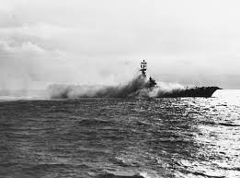
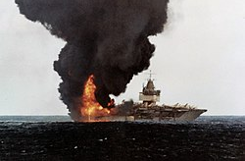
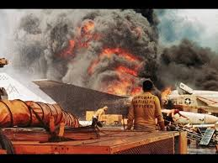
Fragility - Carriers
USS Oriskany – 1966
5 months
USS Enterprise -1966
51 days
USS Forrestal – 1967
9 months

Slide 32
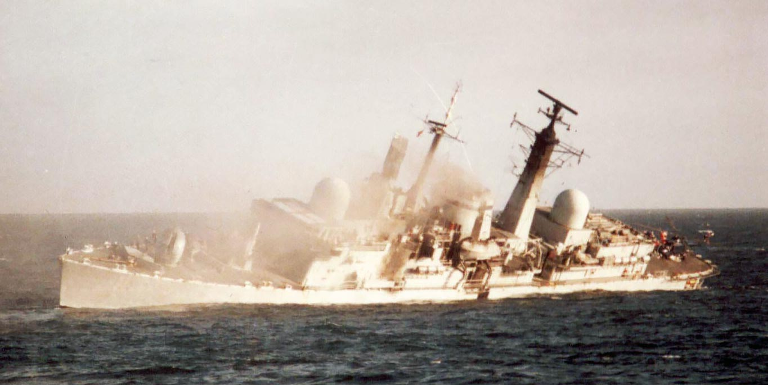
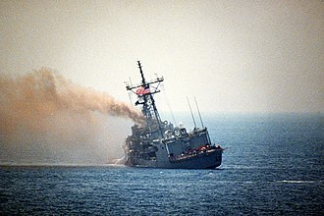
Fragility – Surface Line
Average 1.2 Cruise missiles to sink or disable
HMS Coventry
USS Stark
32

Slide 33
Unsupportable
Very low readiness rates < 50% for many
Complexity of weapons
Limited suppliers
Massive logistics backlog
Forward logistics facilities in range
Peacetime with large bases

Slide 34
Unaffordable
F-35A = $855M each lifetime
  $2.1B to insure one works
    Lockheed was delivering w/out TR-3 or Block 4
    Next gen will cost 3 times as much
CV = Purchase > $20 B with airwing
= Lifetime – approaching $100B
Missiles = LRASM/JASSM-ER - $3.3M; PAC-3 Interceptor - $3.4M

Slide 35

Unreplaceable
F-35: 13 per month (20 users)
B-21: 7 per year
CV: 9 years each (JFK delayed)
DDGs: 2/year; FFG: ??
SSNs: 1.5/year
Munitions: Iran war has consumed years of production

Slide 36
The Good News
New weapons
  Range
  Mass producible in wartime
  Affordable
  Supportable

Slide 37
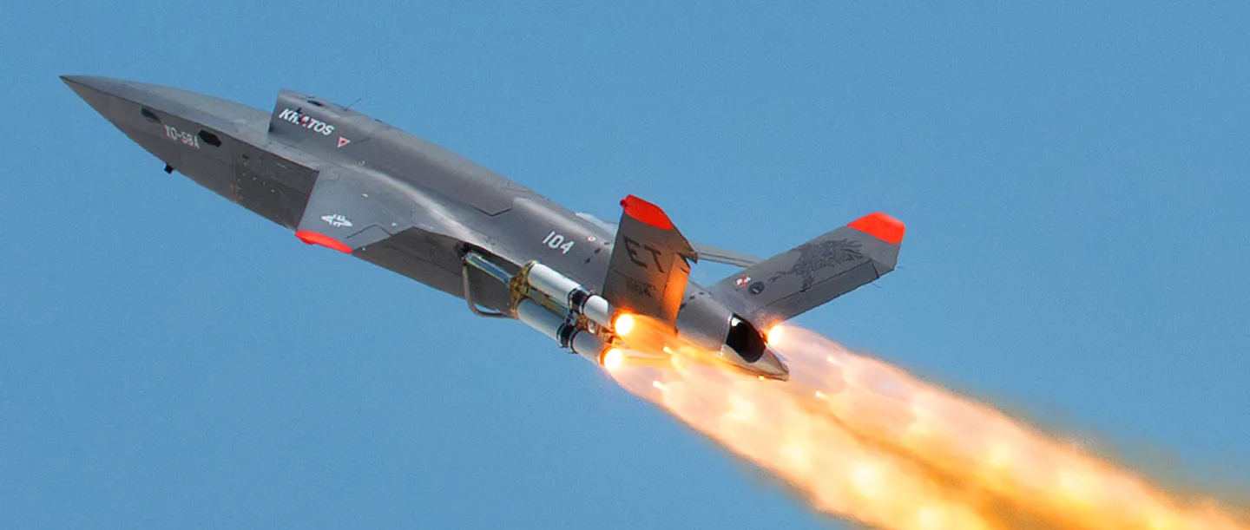
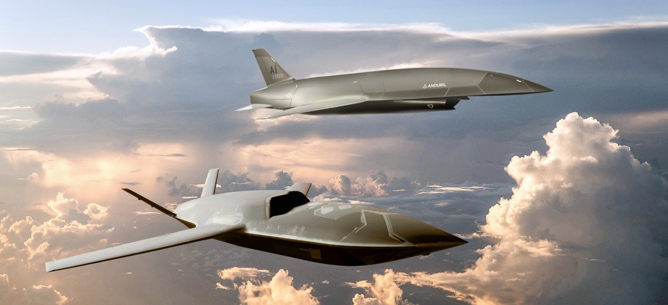
Collaborative
Combat Aircraft
XQ-58A Valkyrie
5,000 KM – 270 KG
4.000 KM – 540 KG
Autonomous/VTOL
$3M
Mass produced
YQF-42A and 44A
1,200 KM
Semi-autonomous
$25-30M
700 Valkyrie = 1 F-35A Lifetime cost
Notes:
Key is AI – no GPS, no external links
DX -3 900 miles $100K
Less than 1.5 hours F-35 mission
Aerovel Flexrotor – 2K miles, $200K
Tern – 500 lbs, 900 miles
Kratos QX222 – 1500 miles, 500 lbs, $2M
ALL VTOL and OUTRANGE THE F-35
w/tanking F35C get out to 700 miles

Slide 38
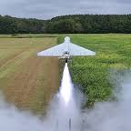
FML-136 LUCAS
Low-cost Unmanned System
Linked, swarming
Autonomous
NLOS control if needed
700 km, 18 kg warhead
$35,000
3 months to reverse engineer Shahed
TF Scorpion Strike in CENTCOM

Slide 39
Autonomous Attack Drones
Over 100,000 delivered in 2025
Bumblebee – 15-30 km range
  Lock on from 1.6 km
  70% hit rate – 1,000 live missions
Hornet – 120 km range
  5 kg payload
  6,000 per month initial plan
Vermeer – 90 km
  Guidance – .5 kg

Slide 40
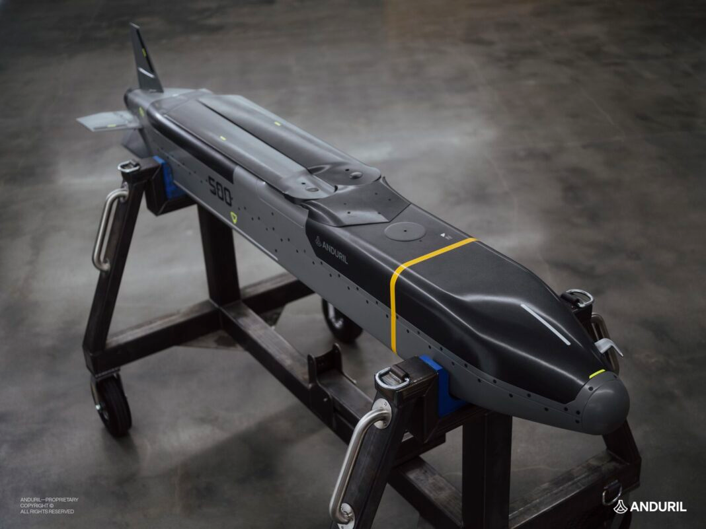
Cheap Long-range Precision
Platform Agnostic - autonomous
VTOL
Swarming
Commercial parts
2026 – 100/month
Anduril Barracuda
100 – 220 km, Helicopter, fighter, container
250 – 370 km, Fighter, cargo, container - $160K
500 – 900 km, Fighter, cargo, container -$220K
15 Barracuda 500s for 1 LRASM
40

Slide 41
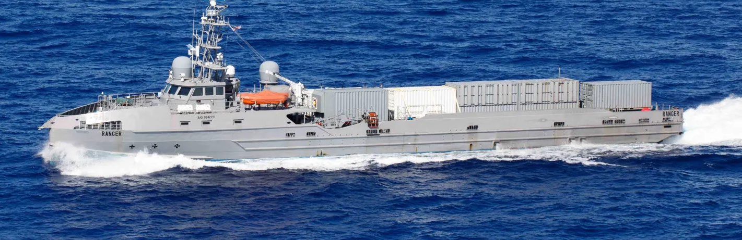
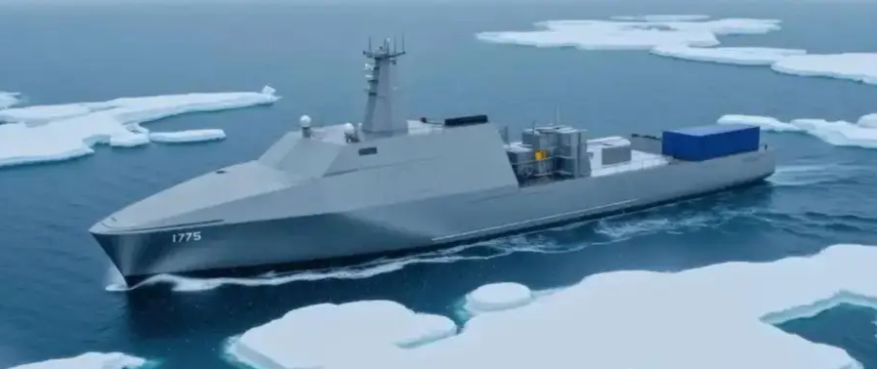
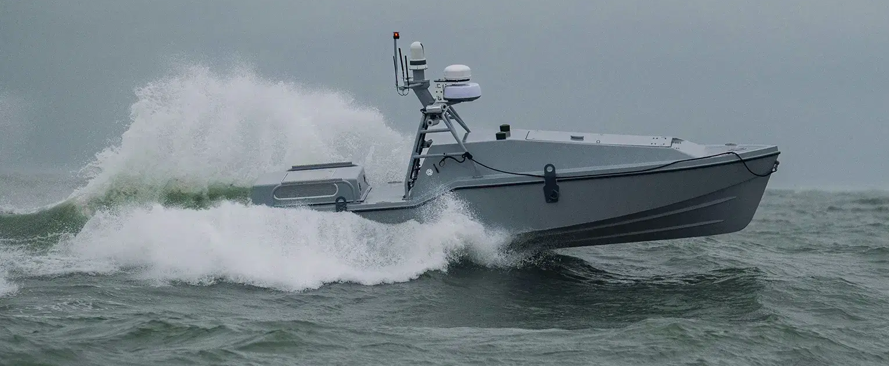
Autonomous Surface Vessels
USN MUSV
8 containers
20-66 Barracuda each
Autonomous/swarming
Blue Water Autonomy
5 shipyards
Container capable
Saronic Corsair
1000 km
450 kg
35 knots

Slide 42
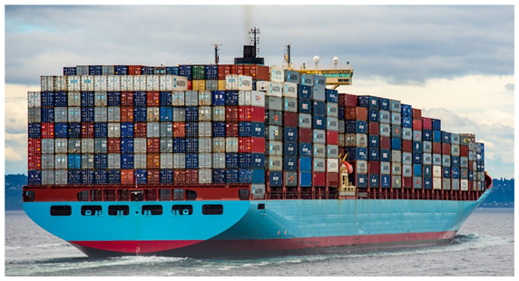
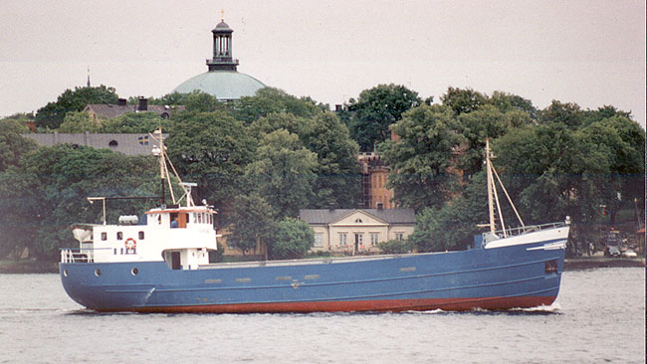
Missile Merchants
$25 million for ship
Total - $125M
  40-250 missiles
  VTOL Drones
Small crew
Well-armored
$2-5 million for ship
4 – 20 LR missiles per TEU
66 SR missiles per TEU
VTOL Drones
8 Large MM w/320 to 2000 missiles = 1 Constellation class

Slide 43
Initial analysis
Weapons NOT platforms - High-low mix
Current platforms
  Reduce/slow/stop buys
  Invest in readiness for current systems
Current weapons
  Continue buys but examine replacements
Accelerate weapons/systems for emerging missile age

Slide 44
Some Questions
Should operating concepts focus on defense?
Payloads not platforms?
Containerize everything?
Production for long wars?
Battlespace management?

Slide 45


Slide 46
Contact Information
txhammes1@gmail.com

