Slide 1
TRICARE Update
CAPSTONE Spouse Course
Curt B. Prichard, MHA, FACHE
Deputy Director, TRICARE Health Plan
August 11, 2025
Notes:
general update on changes to TRICARE, friction points you are experiencing, the plan to address those friction points, as well as any best practices/resources you have for helping people to navigate TRICARE

Slide 2
Agenda
Purpose and Highlights
TRICARE and the Military Health System (MHS)
Benefits and Coverage
  Eligibility, Coverage, and Exclusions
  Who and What TRICARE Pays
TRICARE Plans
T-5 Contracts
TRICARE Overseas Program

Slide 3
Key Takeaways
Purpose – To foster better understanding of your TRICARE program and its health plans
Take Home Points
  The Military Health System (MHS) provides a healthcare benefit to our 9.5 million beneficiaries both through
  the Direct Care System (DCS) at the military medical treatment facilities (MTFs) when capability/capacity exists,
  and in private sector care (PSC) under the TRICARE program
  TRICARE wraps-around local MTFs to increase capacity and capability through TRICARE-authorized providers, suppliers, and pharmacies, network and non-network, in PSC including international host nation providers
  In addition to Active-Duty Service Members (ADSMs), TRICARE covers Active-Duty Family Members (ADFMs),
  retirees and their families, and qualified survivors
  The family of TRICARE health plans is administered by huge federal service contracts
  The unique MHS promotes recruitment, retention, and readiness in the eight covered Uniformed Services
  Grounded in statutory law, the TRICARE is a federal health benefit program. It is not health insurance.
  TRICARE is implemented in federal regulation (32 CFR 199)
  TRICARE contractors administer the program according to requirements specified in the
  four TRICARE Manuals (Policy (TPM), Operations (TOM), Reimbursement (TRS), and Systems (TSM))
  www.tricare.mil contains the most up-to-date information for MHS beneficiaries; includes one website for each MTF
  www.health.mil contains information for MHS and other government staff

Slide 4

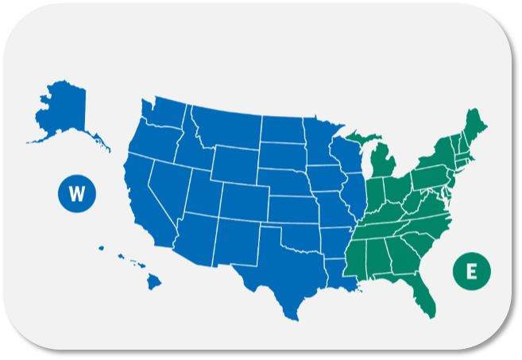
The Military Health System
Direct Care System (DCS) of
military hospitals and clinics
“Training Platform for Ready Medical Force”
Patients by TRICARE Plan
Private Sector Care (PSC)
“TRICARE authorized civilian providers,
network and non-network”
4.38 M
TRICARE Prime
2.09 M
TRICARE Select
Administered by:
TRICARE Regions
January 1, 2025
Two USA regions/contractors
  TriWest
  Humana
One International contractor
  International SOS
T-5
9.5M
433K
Direct Care Only
Eligible
Beneficiaries
T-5
 | FY2024
Inpatient Hospitals | US 32 | Intl 13
Outpatient Clinics | US 481 | Intl 91
Dental Clinics | US 88 | Intl 27
 | FY2024
Network Providers | 931,689
Network Hospitals | 4,158
Behavioral Health facilities | 2,148
Network Pharmacies | 41,500
Network Dentists | 105,000
2.54 M
Medicare-Eligible
TRICARE Health Plans
TRICARE Prime
TRICARE Select
TRICARE for Life
TRICARE Reserve Select
TRICARE Retired Reserve
US Family Health Plan (USFHP)
TRICARE Young Adult
TRICARE Dental Program
Federal Employee Dental & Vision Insurance Plan (FEDVIP)
Combat Support
Joint Medical Logistics | Research & Development | Global Public Health | Education & Training | Joint Trauma System
Identify and deliver medical materiel solutions to meet operational requirements | Provide novel medical tools, techniques, and clinical practice guidelines to modernize MHS capabilities for near-peer conflict | Provide combatant commands with near real-time disease and bio-surveillance threat information | Help build a ready medical force to execute operational medicine and readiness-related requirements | Maximize battlefield injury survival functional recovery rates
Source: FY 2024 Evaluation of the TRICARE Program, pgs. 11-12

Slide 5













TRICARE – A Wrap-Around Local Military Treatment Facilities (MTFs)
TRICARE
Private Sector Care
MTF
Uniformed Services (8)
}
10 USC §101
United States Army | United States Navy | United States Space Force
United States Marine Corps | United States Air Force | United States Coast Guard
United States Public Health Service (PHS) Commissioned Corps
National Oceanic and Atmospheric Administration Commissioned Officer Corps (NOAA)
Armed Forces (6)
5

Slide 6


TRICARE BENEFIT Evolution
DoD Health Benefits Have Been
Expanding Steadily Since 1995
Northwest Region 11
1st TRICARE contract
Enhanced Benefit –“Watershed” Legislative Year
Added TRICARE for Life (TFL)
Added TRICARE Senior Pharmacy
Eliminated copayments for AD Families in TRICARE Prime
Reduced retiree catastrophic cap from $7,500 to $3,000
…and much more
CHAMPUS Legislated Benefit
Civilian Health Care where MTFs do not exist
Families & Retirees <65
TRICARE Managed Care Legislation
3 options (Prime, Standard, Extra)
Automatic enrollment for Active Duty
Priority for TRICARE Prime enrollees
Space Available for Non-enrollees
2001
TRICARE Reserve Select Plan Added
TRICARE Benefit Expansion
Dependents Medical Care Act
Authorizes SecDef to contract with civilian providers for medical care for Active Duty dependents
TRICARE Young Adult Plan Added
CHAMPUS Reform Initiative (CRI)
Pilots in CA and HI introduce health plan choice (pre-cursor to TRICARE)
1995
TRICARE Select (PPO) replaced TRICARE Standard & Extra
Added FEDVIP vision & dental
Title 10 Legislated Benefit
Space Required for Active Duty
Space Available for Families and Retirees
Family Member Dental Program Established
1966
DHA in the Now
MTF ADC (authority, direction & control)
Defense Health Networks (9) worldwide
MTF stabilization
Digitalization
1956
1966
1986
1988
1994
2001
2005
2011
2018
1940
1950
1960
1970
1980
1990
2000
2010
2020
1948 - 2016
1998
2013
2017
2017
2019
Defense Health Agency (DHA) established
Expanded role from TMA
NDAA 2019
New DHA organizations for:
Research & Development
Training & Education
Public Health
MHS Oversight & Management
TRICARE Management Activity (TMA) established
Field activity of
OASD/Health Affairs
MHS Governance Studies
20 Commissions and/or studies conducted to evaluate best approach for managing and delivering the military health benefit
NDAA 2017
DHA gains MTF authority, direction, & control (ADC) over MTFs
Notes:
29 Jan 2015 – “Military Compensation and Retirement Modernization Commission” (MCRMC)
https://apps.dtic.mil/sti/citations/ADA625626
08 Feb 2016 – “MHS Modernization Study”
https://health.mil/Reference-Center/Reports/2016/02/08/Review-of-MHS-Modernization-Study
Detailed evolution – see Appendix of “Annual Evaluation of the TRICARE Program” (Report to Congress)
www.health.mil/Military-Health-Topics/Access-Cost-Quality-and-Safety/Health-Care-Program-Evaluation/Annual-Evaluation-of-the-TRICARE-Program
MHS Home > Military Health Topics > Health Care Administration & Operations > Health Care Program Evaluation > Annual Evaluation of the TRICARE Program

Slide 7
FY2025 Unified Medical Budget
FY2025 Unified Medical Budget: $61.3 B
Federal Spending
$7.3 Trillion
DoD Budget
Healthcare Delivery Costs
$850 B
Unified Medical Budget
$61 B
Combat Support and other centralized support costs for 130 MTFs: $7.4 B
7

Slide 8
TRICARE Benefits and Coverage

Slide 9
Who and What TRICARE Covers
AKA the TRICARE Basic Benefit
Active-duty service members 10 U.S.C. 1074 | Private sector care is covered under rules of the Supplemental Health Care Program (SHCP) In addition to covered services, some non-covered services can be provided with an approved SHCP waiver from DHA Director (or designee)
Active-duty family members 10 U.S.C. 1079 | Only covered services that are medically necessary or psychologically necessary can be provided New or emerging services or technology must be confirmed “proven” using a hierarchy of reliable evidence (32 CFR 199.2)
Retirees and family members 10 U.S.C. 1086

Slide 10
What TRICARE Pays
Cost-shares are required by law and cannot be waived
TRICARE must reimburse like Medicare where practicable, by law
(10 USC 1079). Not practicable includes:
  Most areas overseas
  Areas where reimbursement does not align with
  needs of younger/healthier population (e.g., maternity)
Network discounts are permitted by law
Locality-based waivers (LBW) – rates may be increased in certain localities, or for specific providers, to prevent severely limited access to care
Notes:
Locality-based reimbursement rate waivers allow a higher individual provider payment rate when it has been determined that the availability of an adequate number and mix of qualified health care providers in a network in a specific locality is not found, where the higher rates may be necessary to maintain an adequate network. Network waivers have a cap of 15% above the current CMAC, and are approved by the Private Sector Care Integration Office.
Additionally, if it is determined that access to specific health care services is severely impaired, higher payment rates can be applied to all similar services performed in a locality, or a new locality could be defined for application of the higher payment rates. There is no cap for locality-based waivers (LBW); however, a detailed analysis is obtained to determine what rates would be reasonable based on the population, locality, and provider, and the final determined rate is established by TRICARE contractor negotiation with the requesting provider. LBW waiver requests are reviewed by the THP Private Sector Care division and approved by the Director.

Slide 11
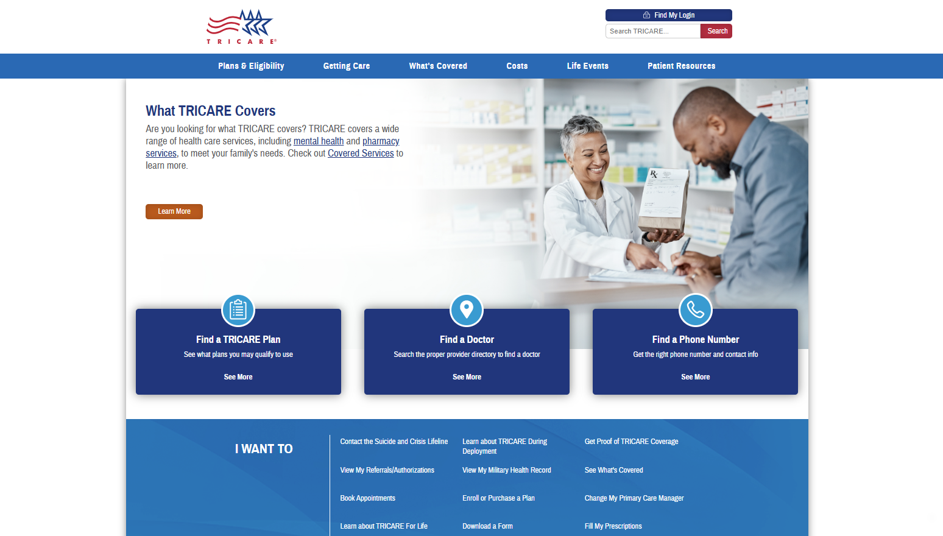
www.tricare.mil
as of August 6, 2025

Slide 12
TRICARE Health Plans

Slide 13
TRICARE Network of Providers
TRICARE contractors certify providers as TRICARE authorized providers
  TRICARE can only pay claims for services TRICARE authorized providers deliver
  TRICARE Network providers are the subset of TRICARE authorized providers
  who signed an active agreement with a TRICARE contractor
The TRICARE Network wraps around the Direct Care System to meet the primary, specialty, inpatient, outpatient, and pharmacy needs of the TRICARE enrolled population
  Network adequacy – TRICARE contractors establish & maintain the TRICARE network of individual and institutional providers sufficient in number, mix, and geographic distribution to provide the
  full scope of benefits for TRICARE health plan enrollees within TRICARE access to care standards
  Quality standards – performance of contract requirements is monitored by DHA’s TRICARE Health Plan (THP) directorate for all Prime Service Areas (PSA), non-PSAs (i.e., U.S. areas remote from MTFs), and worldwide
TRICARE network is accredited by a nationally recognized accrediting body
Address provider licensure, education, training, hospital privileges, and liability insurance
  Both TRICARE regional contractors s hold URAC accreditation
  The U.S. Family Health Plans (6) are accredited by URAC or National Committee for Quality Assurance (NCQA)

Slide 14






TRICARE Plans
TRICARE Select (PPO model) – a non-“gatekeeper” plan for enrollment worldwide
  No referrals required for coverage
  TRICARE authorized providers, network and non-network
TRICARE Prime (HMO model) – a “gatekeeper” plan in Prime Service Areas (PSAs).
Requires referrals. Enrollees are assigned to a primary care manager (PCM).
Mandatory enrollment for active-duty service members (ADSMs).
Variations:
  TRICARE Prime Remote (TPR) – available for certain ADSMs
  in areas geographically remote from MTFs, i.e. outside PSAs
  TRICARE Prime Remote for Active-Duty Family Members (TPRADFM) – offered to certain ADFMs of a TPR-enrolled Service member, i.e. outside PSAs
  TRICARE Overseas Program (TOP) Prime and TOP Prime Remote
  US Family Health Plan (USFHP) – closed network TRICARE Prime plan
  offered in six designated service areas in the U.S.

Slide 15
TRICARE Plans
(Continued)
TRICARE Overseas Program (TOP) – coverage for all eligible overseas beneficiaries,
including eligible Reserve Component (RC) Service members
  Also includes dental coverage for TOP Prime Remote ADSMs
  Other eligible beneficiaries may purchase TRICARE Dental Program (TDP) coverage
Premium-based TRICARE health plans
TRICARE Reserve Select (TRS) – member/family TRICARE Select coverage
available for purchase by qualified Selected Reserve members and qualified survivors
TRICARE Retired Reserve (TRR) – member/family TRICARE Select coverage
available for purchase by qualified Retired Reserve members and qualified survivors
TRICARE Young Adult (TYA) – individual Prime or Select coverage
available for purchase by sponsor to cover qualified family members under the age of 26
who have lost or will lose TRICARE eligibility due to age (compare to Affordable Care Act)
Notes:
TRS – ADFM level of cost sharing payable by both RC sponsor and covered family members/qualified survivors
TRR – retiree level of cost sharing payable by both RC sponsor and covered family members/qualified survivors
TYA – level of cost sharing depends status of sponsor, ADSM or retired

Slide 16
TRICARE Plans
(Continued)
TRICARE For Life (TFL) - wraparound coverage for TRICARE beneficiaries who have
both Medicare Part A and Medicare Part B, regardless of age or place of residence
TFL pays Medicare deductibles and copayments, for TRICARE covered services
TFL coverage will begin automatically the first day an individual has both Medicare Parts A and B.
  Medicare is awarded in the 25th month of receiving SSDI (for those under 65).
  or
  *** Sign up for Medicare Parts A and B two months before your 65th birthday !! ***
Medicare card and Uniformed Services ID card are
proof of TFL coverage and must be presented at time of service
TFL beneficiaries may get care from:
  Medicare participating and Medicare nonparticipating providers
  Military hospitals and clinics if space is available
Avoid getting TFL-covered services from either (a) the VA for non-service connected conditions,
or (b) a Medicare opt-out provider.
  Medicare cannot pay anything for services from either of these providers
  Patient will be responsible for billed charges minus 20% of TRICARE allowable charge paid by TRICARE

Slide 17

TRICARE Plans
(Continued)
Temporary Continuation of Coverage
Transitional Assistance Management Program (TAMP) – offers 180 days of premium-free TRICARE Select or TRICARE Prime (in PSA) coverage upon separation from active duty for certain sponsors
  ADFM cost-sharing applies to both sponsor and family members
Continued Health Care Benefit Program (CHCBP) – offers full-cost premium-based medical coverage
to certain beneficiaries for 18–36 months after TRICARE eligibility or premium-based plan coverage ends
  No MTF access
Dental Plans (by DoD)
Active-Duty Dental Program (ADDP)
  ADSMs – remote from Dental Treatment facilities (DTFs) or care referred by DTFs
  Reserve Service members – while activated 30 or more days/covered by TAMP (family members not included)
TRICARE Dental Program (TDP) – premium-based coverage
  ADFMs
  Members of the Ready Reserve and their eligible family members
    Selected Reserve (drilling Guard/Reserve)
    Individual Ready Reserve (IRR), Inactive National Guard (ING)

Slide 18

TRICARE Pharmacy Program
All TRICARE health plans, except USFHP, include pharmacy coverage through the TRICARE Pharmacy Program.
You may fill prescriptions through:
  Military pharmacies
  TRICARE Pharmacy Home Delivery (some limitations overseas)
  TRICARE retail network pharmacies
  Non-network pharmacies or overseas pharmacies
  Most retirees and their family members are required to fill certain maintenance medications through home delivery.
  Learn more about your pharmacy options and copayments at https://www.tricare.mil/pharmacy.

Slide 19
Other Benefit Programs
Federal Employee Dental and Vision Insurance Program (FEDVIP)
– administered by U.S. Office of Personnel Management (OPM), not by DoD
  FEDVIP exclusions:
    ADSMs. Enrollees in TYA, CHCBP, and TAMP
    DoD eligible persons not enrolled in a TRICARE health plan, i.e. direct care only
    Foreign Force members and their families
  Dental plan – retirees, including members of the Retired Reserve, their families, and survivors.
    Additional exclusion – anyone eligible for the TRICARE Dental Program (TDP)
  Vision plan – TFL & TRICARE health plan enrollees, including TRS & TRR enrollees (i.e. must be enrolled)
Extended Care Health Option (ECHO) – a supplemental program to the TRICARE Basic Program.
  Provides eligible Active-Duty Family Members (ADFMs) with an additional financial resource
  to assist in the reduction of the disabling effects of the beneficiary’s qualifying condition
TRICARE Plus –program offering primary care priority access at some military hospitals and clinics
  Each military hospital or clinic commander/director decides if TRICARE Plus is offered
Women, Infants, and Children (WIC) Overseas Program – supplemental food and nutrition program for qualified families as certified by a WIC Overseas counselor

Slide 20

Next Generation of TRICARE Contracts (T-5)

Slide 21
T-5 Overview
Supports the National Defense Strategy and Military Health System Transformation
Optimizes Readiness of Medical Forces
By creating incentives to refer care back to into DoD Military Medical Treatment Facilities (MTFs)
Improves Access to Care
With greater opportunities to leverage virtual health technology
Aligns Quality Outcomes
To ensure the same high standards for care in MTFs and in civilian networks
Provides Stability & Smooth Contract Transition
8 contract years of health care delivery with an estimated value of $136B

Slide 22
T-5 Contract Objectives
Readiness - Support the MHS readiness mission by partnering with the Military Medical Treatment Facilities (MTFs) to optimize the delivery of health care services to enhance the clinical expertise of providers in the direct care system (see definition of MTF optimization in the TRICARE Manual, Definitions1 ) for all TRICARE- eligible beneficiaries (see definition at Title 32 Code of Federal Regulations (CFR) Part 199.17(a)(6)(i))
Experience of Care - Provide a care experience that is patient and family centered, compassionate, convenient, equitable, safe, and always of the highest quality
Manage Per Capita Cost - Create value by focusing on quality, eliminating waste, and reducing unwarranted variation; considering the total cost of care over time, not just the cost of an individual health care activity
Population Health - Within the constraints, boundaries, and benefits of the current program, encourage beneficiaries and providers to seek ways to improve health

Slide 23
Managed Care Support Contractors (MCSCs) T-5
T-5 East: Humana Government Business (HGB) of Louisville, KY
  $70.9 billion Contract Value
  Claims Processor/Fiscal Intermediary (FI): Palmetto Government Business Administrators (PGBA), Surfside Beach, SC / Florence, SC
  January 1, 2025 - Started Health Care Delivery
T-5 West: TriWest Healthcare Alliance of Phoenix, AZ
  $65.1 billion Contract Value
  Claims Processor/FI: Palmetto Government Business Administrators (PGBA), Surfside Beach, SC / Florence, SC
  January 1, 2025 - Started Health Care Delivery

Slide 24
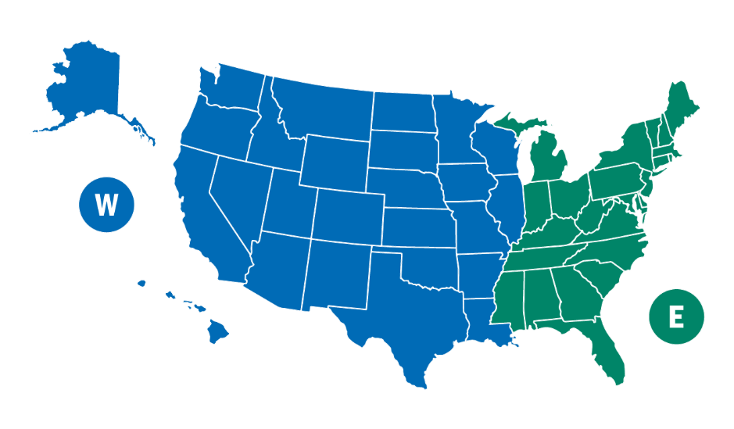
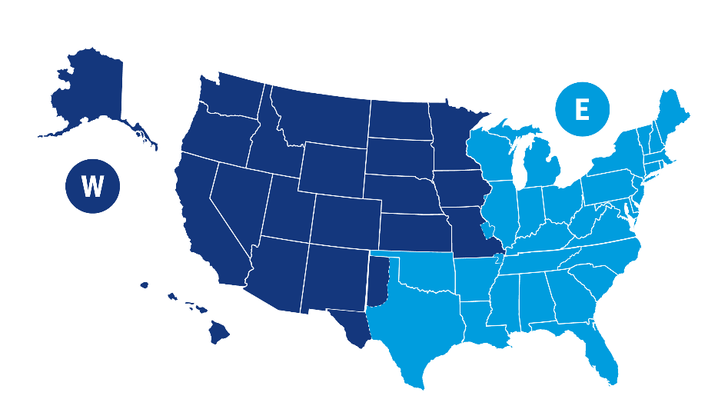
Six States Migrated to West Region from East Region
Arkansas* | Texas | St. Louis area (Missouri
Louisiana | Illinois | Rock Island (Iowa)
Oklahoma | Wisconsin
T-5 TRICARE Regions
January 1, 2025
T2017 TRICARE Regions
Previous
Notes:
TRICARE East Region and West Region
6 states moved from East Region to West Region (with exceptions for some ZIP codes)
West Region’s new contractor: TriWest Healthcare Alliance replaced Health Net Federal Services, LLC.
Humana Military will remain the contractor for the East Region.
More efficient transfers between the two regions
Greater provider network flexibility
Improved beneficiary choice
Enhanced access to telehealth

Slide 25

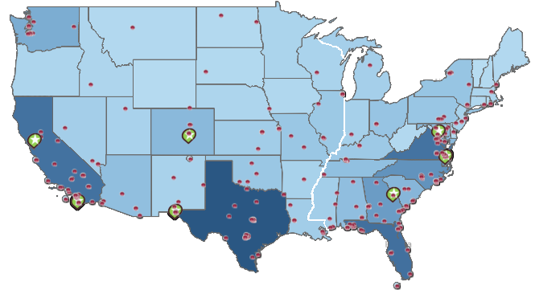

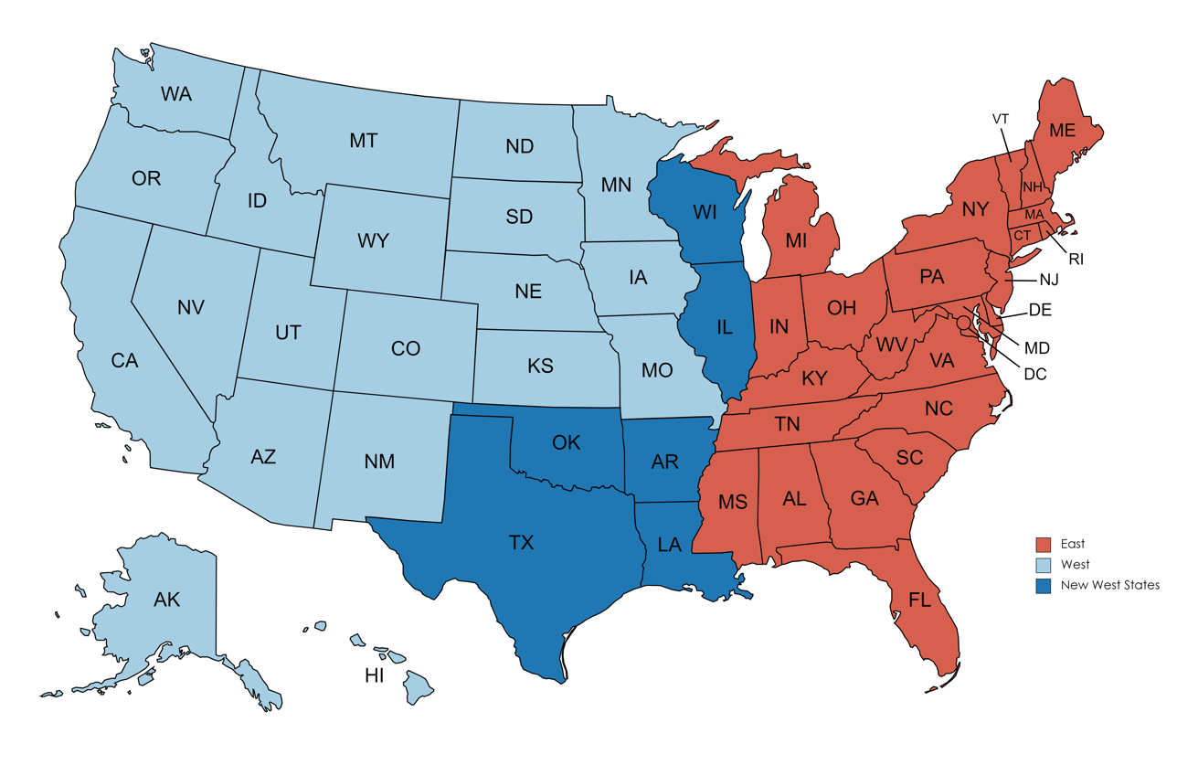
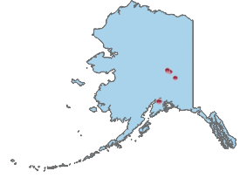

Defense Health Network HQs and T-5 Regions
West
DHN Main Site
Washington
Montana
North Dakota
East
Defense Health Networks (DHNs)
DHN MTFs
Minnesota
South Dakota
Wisconsin
Vermont
Maine
INDO-PACIFIC
PACIFIC RIM
WEST
CENTRAL
ATLANTIC
EAST
NATIONAL CAPITAL REGION
EUROPE*
CONTINENTAL
Oregon
Idaho
New Hampshire
Wyoming
Michigan
New York
Massachusetts
Iowa
Connecticut
Nebraska
Pennsylvania
Rhode Island
Colorado
Illinois
Ohio
New Jersey
Nevada
Utah
Indiana
Maryland
Kansas
Missouri
West Virginia
Delaware
California
Kentucky
Virginia
Oklahoma
Arkansas
Tennessee
North Carolina
Arizona
New Mexico
South Carolina
*TAO covers Europe DHN
Mississippi
Alabama
Georgia
Texas
Louisiana
Florida
Alaska
Hawaii
Source: M2 Demographics, Tableau (frances.l.bautista.civ@health.mil)

Slide 26
References – TRICARE website
www.tricare.mil | Up-to-date TRICARE information
www.tricare.mil/mtf | MTF websites
www.newsroom.tricare.mil | Latest TRICARE news releases
www.tricare.mil/bcacdcao | Beneficiary Counseling and Assistance Coordinators (BCACs) and Debt Collection Assistance Officers (DCAOs)
www.tricare.mil/east | TRICARE East Region information
www.tricare.mil/west | TRICARE West Region information
www.tricare.mil/overseas | TRICARE Overseas information
www.tricare.mil/customerservice | TRICARE Customer Service

Slide 27
TRICARE Overseas Program

Slide 28
TOP21 Contract vs Managed Care Support Contracts
TOP Contract (Overseas) | Managed Care Support Contract (United States)
Frequent fluctuation in # of eligible beneficiaries | # of eligible beneficiaries more stable
3 Geographical Areas | 2 Geographical Areas (East/West)
106 Countries | 1 Country
99 Languages | 1 Language
Clinical Quality/Standard of Care are variable | Clinical Quality/Standard of Care requirements are uniform
Accommodates a wide range of cultural differences | Health care delivery largely standardized
Does not cover home health care, or facility charges for hospice, skilled nursing facility, partial hospitalization programs, inpatient rehab | Covers all aspects of Medicare certified home health care, hospice care, skilled nursing facility care, partial hospitalization programs
Notes:
Explain remote dental no longer part of TOP contract.
Most significant changes: under TOP 21 are improved clinical quality, beneficiary experience of care, and medical document collection
59 TOP Prime Locations; 275 TOP Prime Remote Locations (3 new sites in progress)

Slide 29
TOP21 Contract vs Managed Care Support Contracts
TOP Contract (Overseas) | Managed Care Support Contracts (United States)
Payment at time of service often expected (network providers agree to cashless, claimless) | Payment not usually expected at time of service
Billing based on host nation laws/practice | Bills are all inclusive
134 Foreign Currencies | 1 Currency
3 years to file a claim (except PR/US territories) | 1 year to file a claim
Contractor codes claims | Private Sector provider codes claims
Notes:
Explain remote dental no longer part of TOP contract.
Most significant changes: under TOP 21 are improved clinical quality, beneficiary experience of care, and medical document collection
59 TOP Prime Locations; 275 TOP Prime Remote Locations (3 new sites in progress)

Slide 30
TRICARE Overseas Program Contract (TOP21)
Third Generation Overseas Contract
  Contractor: International SOS (TOP contractor since 2010)
  Started Health Care Delivery under the TOP 21 contract on 1 September 2021; Contract ends 31 August 2028
Health care support services include the development of private sector provider networks, referral management activities, medical evacuation, medical documentation collection, translation services, medical management, customer service/call center activities, beneficiary/provider education, marketing, and claims processing
Requirements place emphasis on Clinical Quality, Beneficiary Experience, and Combatant Command Support
Primary Objectives of the TOP21 Contract:
Optimal Beneficiary Experience of Care
Flexible, Versatile, and Adaptable Overseas Health Care Delivery System
Highest Level of Clinical Quality
Efficient and Integrated Overseas Health Care Delivery
Notes:
Explain remote dental no longer part of TOP contract.
Most significant changes: under TOP 21 are improved clinical quality, beneficiary experience of care, and medical document collection
59 TOP Prime Locations; 275 TOP Prime Remote Locations (3 new sites in progress)

Slide 31
Questions?

Slide 32
Back-up Slides

Slide 33

Reserve Component Coverage “Life Cycle”
Not activated
TRICARE Reserve Select (TRS)
TRICARE Retired Reserve (TRR)
Line of Duty (LOD)
Pre-Activation
(Early Eligibility) ¹
Active-duty benefits
RC Service member and family
Deactivation:
Transitional Assistance Management Program (TAMP) and Continued Health Care Benefit Program (CHCBP)
www.tricare.mil/reserve
Deactivation
Transitional Assistance Management Program (TAMP) ¹
Continued Health Care
Benefit Program (CHCBP)
Activated
Active-duty benefits
RC Service member and family
¹ Activation for a federal preplanned mission (10 USC §12304b) or in support of a contingency operation (§101(a)(13)(B))

Slide 34
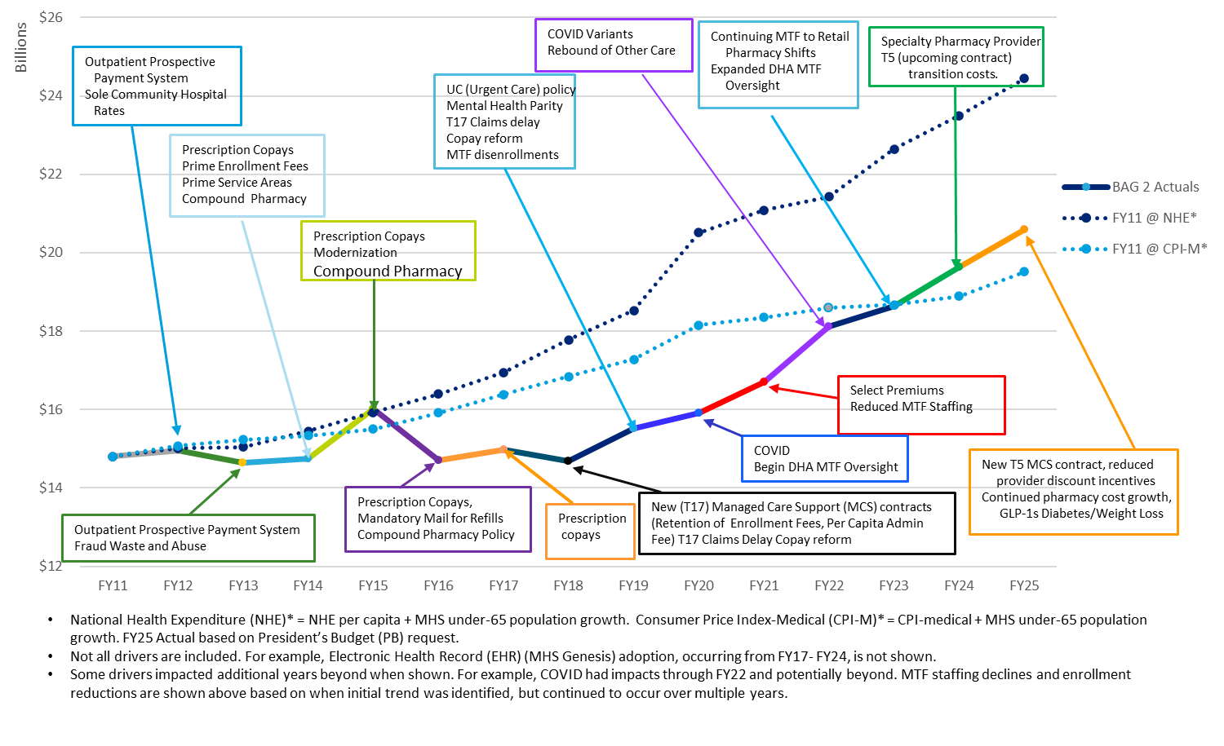
Policy Change and Other Selected Drivers of Budget Activity Group (BAG) 2 Costs/Savings
34

Slide 35
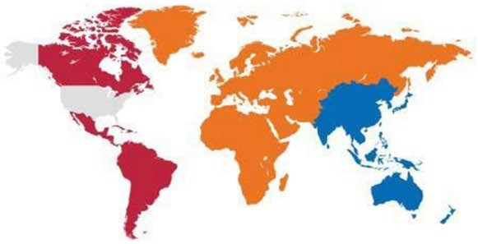

OCONUS TRICARE Region
Contact Information
The TRICARE Overseas Program is managed through three geographic areas.
Latin America &Canada
+1-215-942-8393 (overseas)
1-877-451-8659 (stateside)
Eurasia-Africa
+44-20-8762-8384 (overseas)
1-877-678-1207 (stateside)
Pacific Singapore:
+65-6339-2676 (overseas)
1-877-678-1208 (stateside)
Sydney:
+61-2-9273-2710 (overseas)
1-877-678-1209 (stateside)
Latin America & Canada Central and South America, the
Caribbean Basin, Canada, Puerto Rico, and the U.S. Virgin Islands
Eurasia-Africa Europe, Africa,the Middle
East, Pakistan, Russia, and several former Soviet Republics
Pacific
Asia, Guam, Australia, New Zealand, India, Japan, South Koreaand Western Pacific remote countries
Country Specific Contact Information: www.tricare-overseas.com

