Slide 1
TAPS
CAPSTONE
FEBRUARY 2025
Caring for the Families of America’s Fallen Heroes
3033 Wilson Blvd, Third Floor
Arlington, VA 22201
202.588.TAPS (8277)
TAPS.org

Slide 2
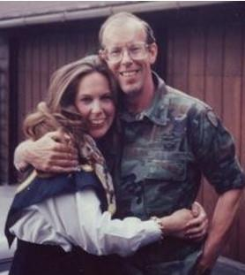
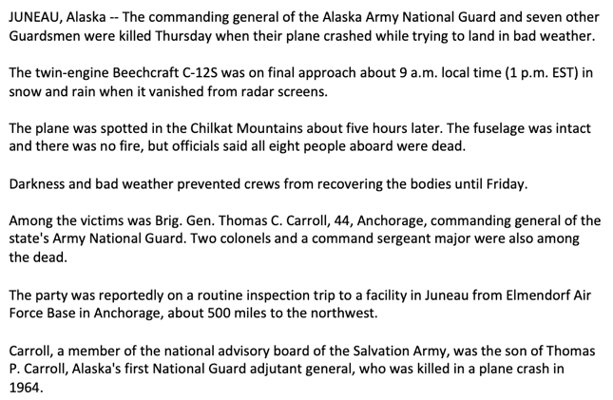
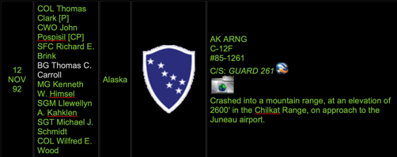
C12 CRASH 1992

Slide 3
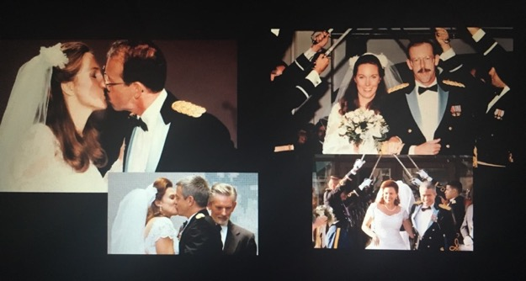
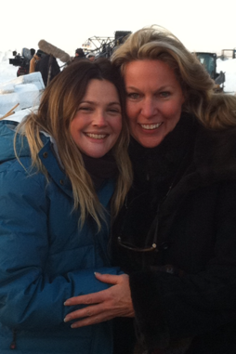

Slide 4
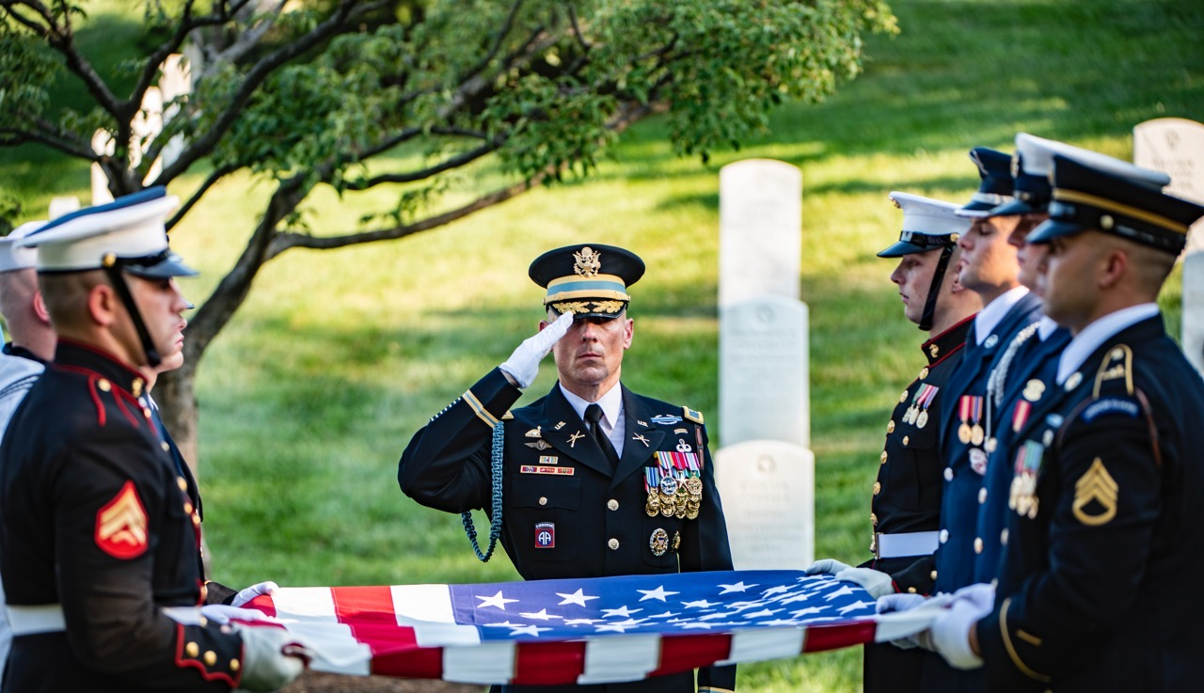
TAPS Mission
TAPS is the national nonprofit organization providing compassionate care and comprehensive resources to all those grieving a death in the military or veteran community.

Slide 5
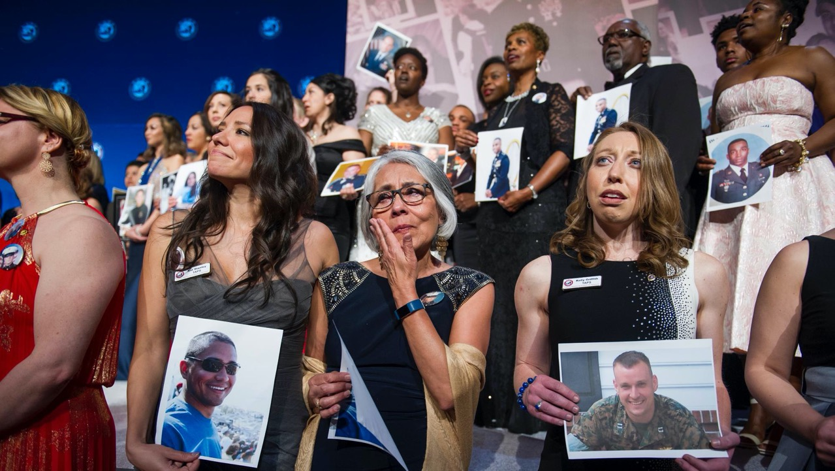
TAPS Vision
TAPS honors our military men and women by caring for all those they loved and left behind.

Slide 6
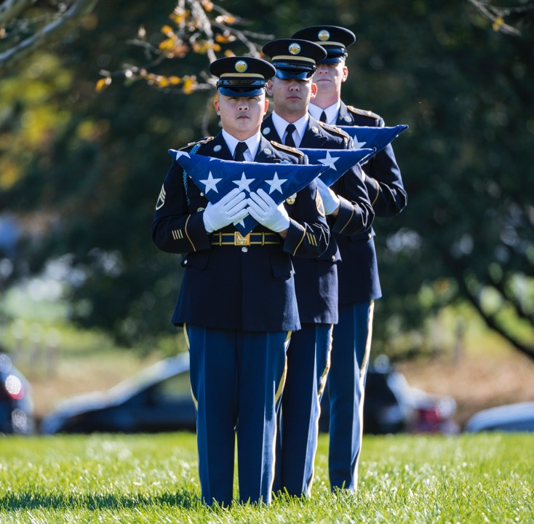
TAPS VALUES
HONOR AND REMEMBRANCE: We cherish the life of our fallen heroes and celebrate military survivors as the living legacies of their loved ones’ service and sacrifice.
EMPOWERMENT: We empower survivors with healthy coping tools, resources, and opportunities to connect in the comfort of their home, their community, their region, and the nation to grow with their grief.
CONNECTION: We connect all those grieving a military death 24/7 to a nationwide network of peer based emotional survivor support and critical casework assistance.
EDUCATION: We inform and educate using research-informed best practices in bereavement and trauma care for survivors and advocate on behalf of survivors with policy and legislative priorities.
CREATING COMMUNITY: We build community with survivors to provide comprehensive comfort, care, and resources where they live, when they need it, and in a manner comfortable for them.

Slide 8
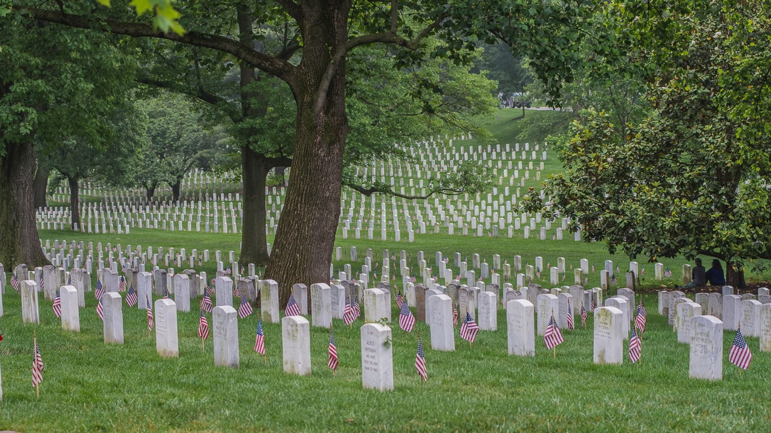
TAPS CORE SERVICES
Grief doesn’t follow a timeline. TAPS provides 24/7 care, forever.
24/7 National Military Survivor Helpline
TAPS is the only national nonprofit organization ready with a 24/7 live-answer helpline staffed by trained professionals specializing in grief and trauma support.
Peer Based Emotional Support
As the national nonprofit organization providing comfort, care, compassion, and connections with resources, TAPS connects survivors living with grief and trauma with trained peers who share a similar experience of grief and loss, fostering connectedness and belonging.
Community
Based Care
TAPS Community-Based Care creates a supportive network of local grief support groups and mental health professionals who offer compassionate assistance and services to grieving military survivors and families in their community.
Casework
TAPS Casework provides practical support to military survivors and families living with grief, helping them navigate administrative processes and access emergency and critical financial resources.

Slide 9
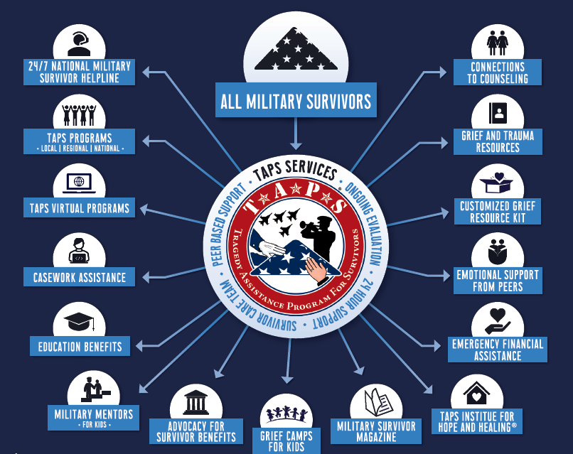

Slide 10
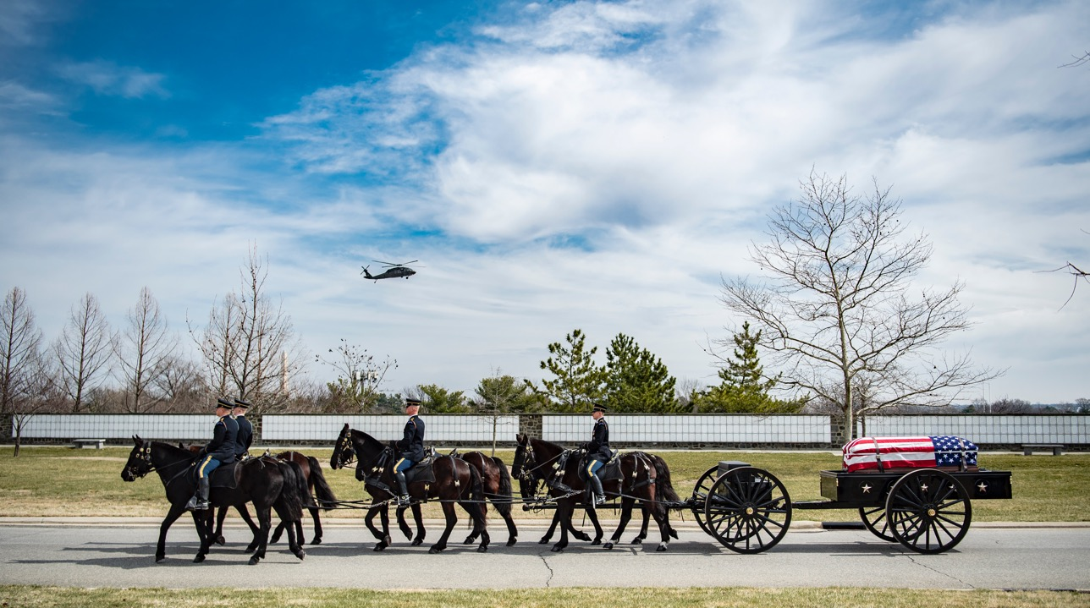

Slide 11
2024 TAPS NEW SURVIVORS BY BRANCH OF SERVICE
TAPS.org/Mission
43% Army
20% Navy
13%
Air Force
15% Marine Corps
1%
Coast Guard
0% Space Force
4% ** National Guard
8% Others: Contractor, Foreign Military, Military Dependent, Public Health Service, US Air Force Academy, US Military Academy, US Naval Academy, Government Civilians
*Does not include non-military; military dependent; contractors; and unknown at time of intake
**Dependent on official military records or survivor connection
***Air National Guard and Army National Guard

Slide 12
2023 NEW SURVIVORS
+9% more new survivors welcomed in 2023 than in 2022
9,611
New Survivors Connected with TAPS in 2023
8,849
New Survivors Connected with TAPS in 2022
78% (7,490) of all new 2023 survivors Adults
21% (2,012) of all new 2023 survivors Children
*1% of all new 2023 new survivors are Unknown if Adult or Children as of 31 Dec 2023

Slide 13
TAPS Supports all Military and Veteran Loved Ones
On average for every 1 deceased service member, there are 10.5 significantly impacted by the loss.^{3,4}
Military or Veteran
Service Member
TAPS is the only national organization supporting all military and veteran survivors across all duty status, all relationships to the deceased, all manners of death, and all branches of service
³Berman, A. L. (2011). Estimating the population of survivors of suicide: Seeking an evidence base. Suicide and Life‐Threatening Behavior, 41(1), 110-116. doi:10.1111/j.1943-278x.2010.00009.x
⁴Cerel, J., McIntosh, J. L., Neimeyer, R. A., Maple, M., & Marshall, D. (2014). The continuum of “survivorship”: Definitional issues in the aftermath of suicide. Suicide and Life‐Threatening Behavior, 44(6), 591-600. doi:10.1111/sltb.12093

Slide 14
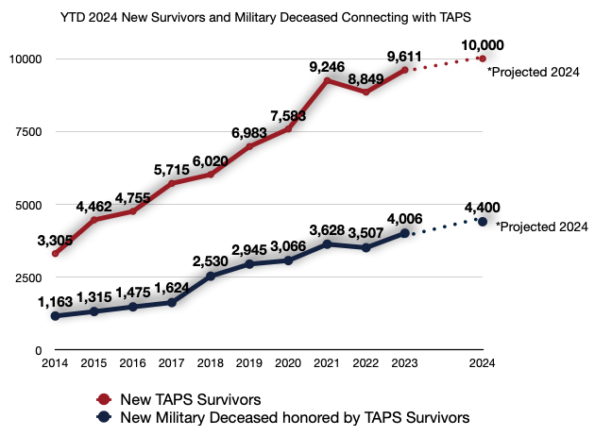
TAPS is projecting to welcome 10,000+ new survivors in 2024
Survivors engaging with TAPS and attending TAPS events demonstrate greater gains in hope, overall well-being, post-traumatic growth, and the ability to make meaning from their loss in comparison to survivors who are not engaged with TAPS

Slide 15
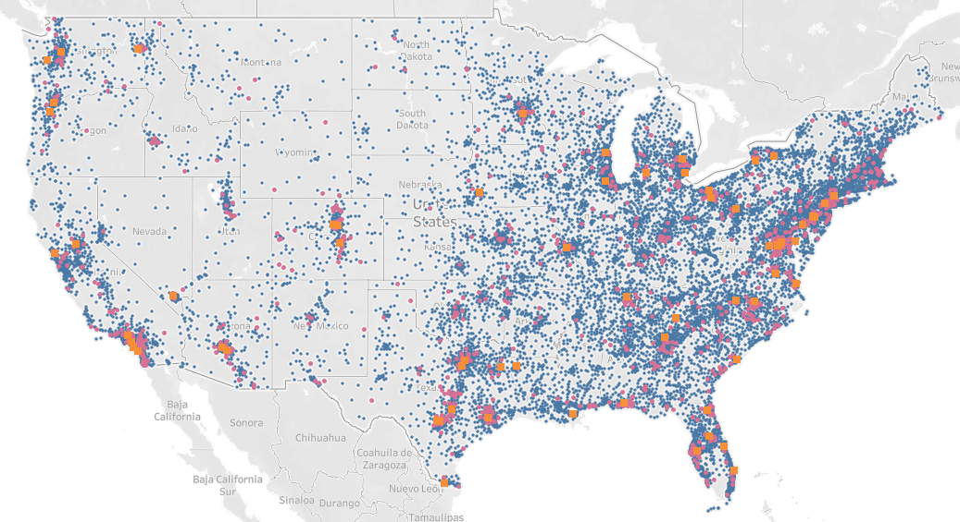
In just one year, TAPS facilitated over 130,000 connections, offering comfort, care, and essential resources to survivors and welcomed over 13,900 survivors to our in-person events.
Blue Dots = 97,251 Military and Veteran Survivors
Pink Dots = 1,242 TAPS Peer Mentors
Orange Squares = 67 TAPS Care Groups
Gold Stars = 4 Regional Seminars in 2024
TAPS Round Logo = 1 National Seminar in 2024
*As of 8 Nov 2024 and representing USA (not including Alaska and Hawaii) and for those survivors with a known location.

Slide 16
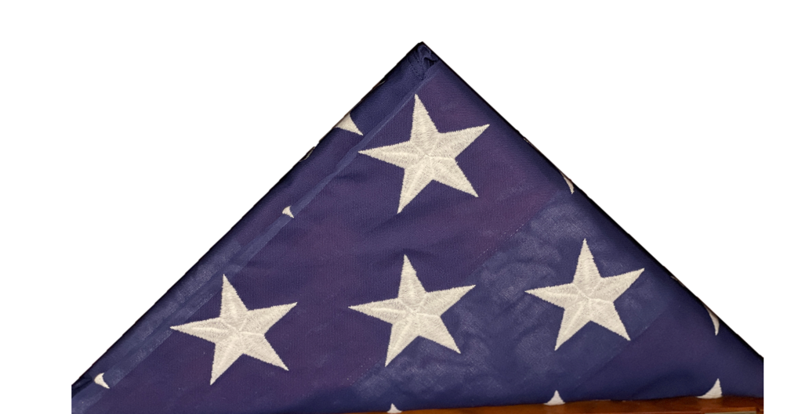
ALWAYS BY THEIR SIDE
If our survivors do nothing proactive, they still receive 432 Messages of Hope and Healing from TAPS Every Year
EVERY DAY:
365 TAPS Daily Reflection Email Messages
ONGOING PEER CONNECTION:
24 Invitations to Connect With Other Survivors with a Similar: Manner of Death | Gender | Relationship to Loved One | Other Special Circumstances
EVERY YEAR:
1 Angelversary Card Honoring the Anniversary of their Loved One’s Death
WHEN NEW TO GRIEF:
1 Customized Grief Resource Kit
2X A MONTH:
24 Email Invitations to Join a TAPS Care Group
EVERY YEAR:
1 Birthday Message Honoring the Birthday of Their Deceased Loved One
EVERY MONTH:
12 Monthly TAPS Family Newsletters
EVERY YEAR:
4 TAPS Quarterly Magazines

Slide 17
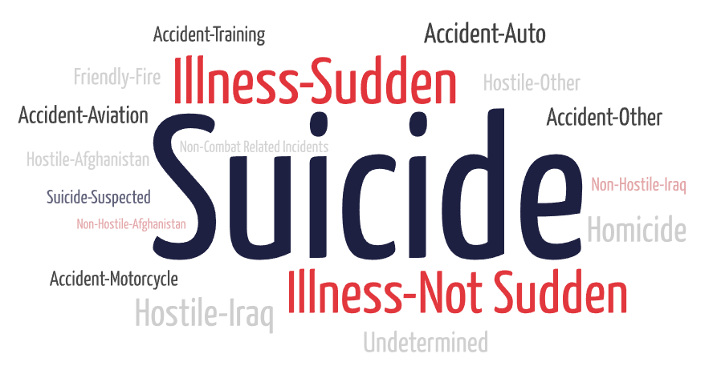
TRENDS IN MANNER OF DEATH

Slide 18
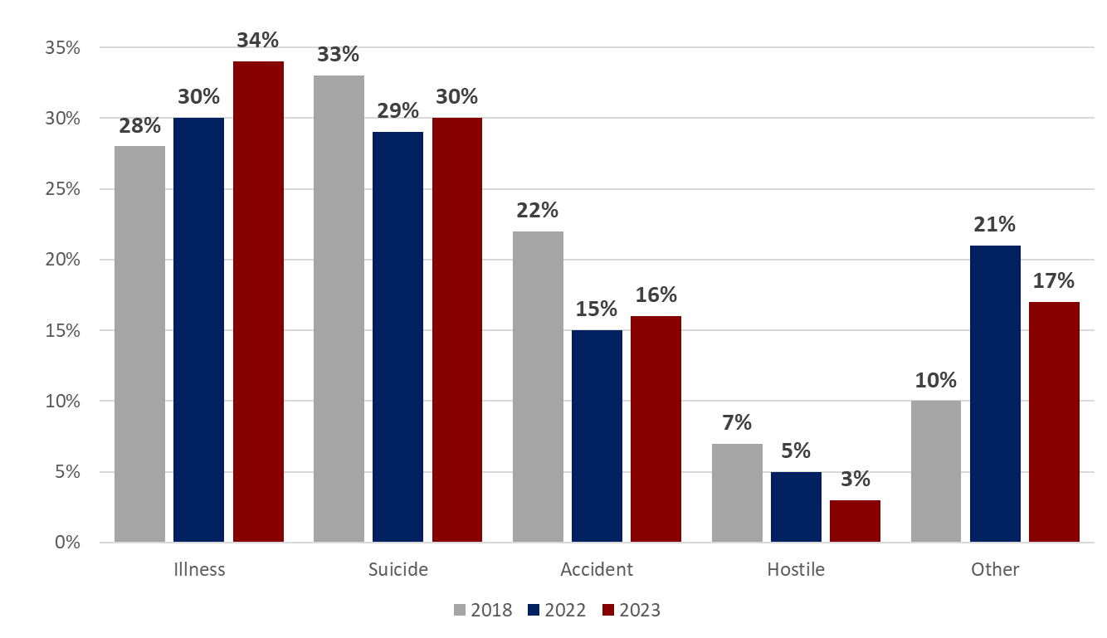
TRENDS IN MANNER OF DEATH
Increase of +6% in the number of illness survivors connecting with TAPS in 2023 in comparison to 2018
Other includes Friendly Fire, Homicide, Non-Combat Related Incidents, Non-Hostile, Undetermined, or Unknown at time of intake with TAPS. Numbers will vary upon connection with military survivors to identify cause of death

Slide 19
TRENDS IN MANNER OF DEATH
Trends in deaths involving fentanyl
Pain
Opioids
Addiction
Street drugs
Fentanyl
Loss of benefits to surviving family
“My son died on February 23, 2022, at his home in Fort Benning GA. He was in the process of transitioning out of the Army at the time of his death, but he was still Active Duty at the time of his death. Because he died at home and a drug overdose was suspected, I requested an autopsy thru the military, which was done. The results of his autopsy indicated multiple drugs in his system at time of death - including fentanyl. My son was a Staff Sergeant and a sniper instructor when he was assigned to Fort Benning, GA in late fall of 2019, with 10 years of very dedicated service to our country and two tours to Afghanistan. But he was diagnosed with PTSD, depression, insomnia, and the range of issues related to these unfortunate souls that were our so loved children…..”

Slide 20
MEETING THE MISSION

Slide 21
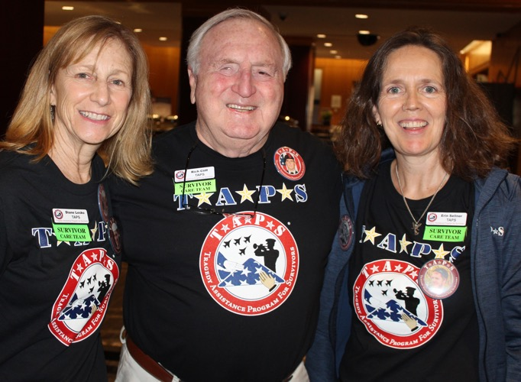
SURVIVOR CARE TEAM
Frontline of survivor comfort, care, and support
Connecting survivors with professional peer support based on:
Relationship to deceased
Circumstances of death
Manner of death
Generation level
“When we lose someone we love, time ceases to exist. There’s only a before their death and an after their death. TAPS helps me to come to a place of peace between these times.”
– Survivor on Survivor Care Team

Slide 22
"TAPS Casework was the answer to my prayers when my husband died. He loved being in the Air Force and was so proud of America. As a military wife, I grew very grateful for all the wonderful experiences we had while he was in the service. I just want to thank you for your wonderful support for all you do for surviving spouses. May God bless you and your workers."
CASEWORK ASSISTANCE
+56% from Q4 of 2024
Survivor Support
Supporting survivors of a military death through the complexities after the loss of their military member
Financial Assistance
Providing emergency financial support in their greatest time of need
Retroactive Benefits
Retroactive benefits awarded to survivors with the support of TAPS Casework Assistance
Legal Medals Personal Effects
YTD 2024 – 4,899 Resolved
2023 - 5,763 Cases Resolved
2022 - 6,397 Cases Resolved
2021 - 6,459 Cases Resolved
Official Papers | Employment Headstone | Healthcare Investigations | Line of Duty
Legal Cases | Medals
Personal Effects | Survivor Flags
Groceries | Mortgage/Rent
Lost Income | Funeral Expenses
Post-Mortem Cleaning
Travel Costs | Moving Expenses
Clothing | School Supplies
Holiday Support | Tutoring
YTD 2024 – $5.7M
2023 - $5.7M
2022 - $3.9M
2021 - $2.5M
DFAS (SBP, SSIA, AOP)
VA (DIC and Survivor Pension)
OSGLI (SGLI and SGLI-DE)
Notes:
2023 – 4,160 resolved | 2022 - 4,311 RESOLVED | 2021 - 5,113 Resolved
2023 - $3.6M | 2022 - $2.7M | 2021 – $1.6M

Slide 23
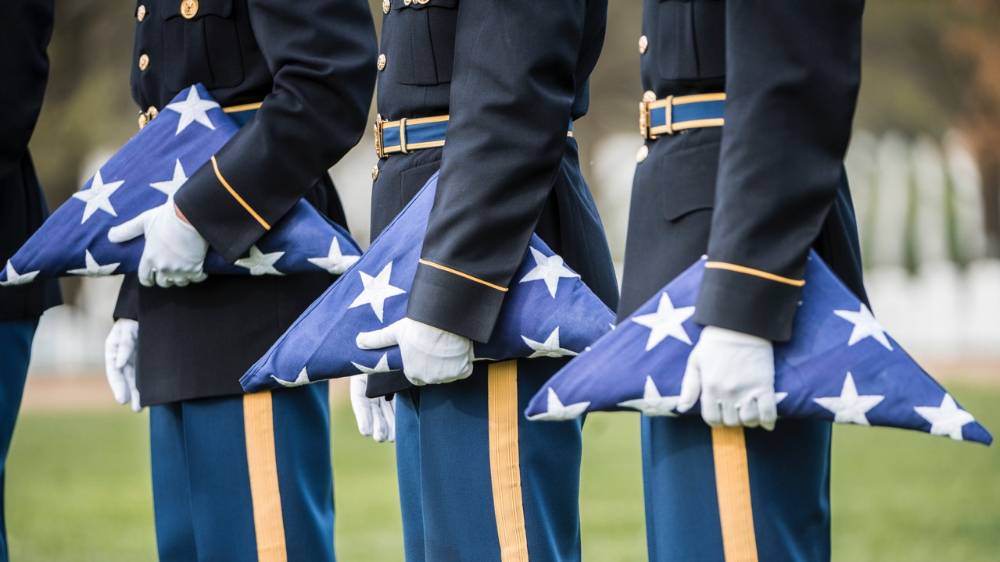
24/7 NATIONAL MILITARY SURVIVOR HELPLINE
In 2023, TAPS answered the most calls in our history
20,656
+16% from total calls answered in 2022
2020 - 2023 Averages
2020 # of incoming calls per day | 37
2021 # of incoming calls per day | 43
2022 # of incoming calls per day | 50
2023 # of incoming calls per day | 57
Casework, Emotional Support, and TAPS Programming are the main reasons military and veteran survivors call the 24/7 TAPS Helpline
Notes:
15,766 calls in 2021
17,867 calls in 2022

Slide 24
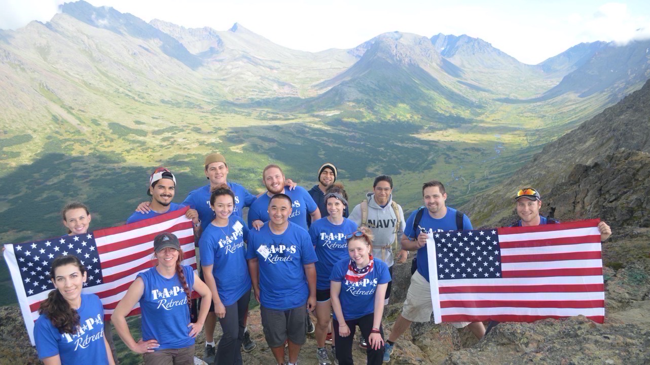
TAPS PROGRAMS
Survivor Seminars | Suicide Pre/Postvention | Caregiver to Survivor Women’s Empowerment | Sports & Entertainment | Outdoor Expeditions Retreats | Care Groups | Young Adults | TAPS Togethers
Online Community | Virtual Programming

Slide 25
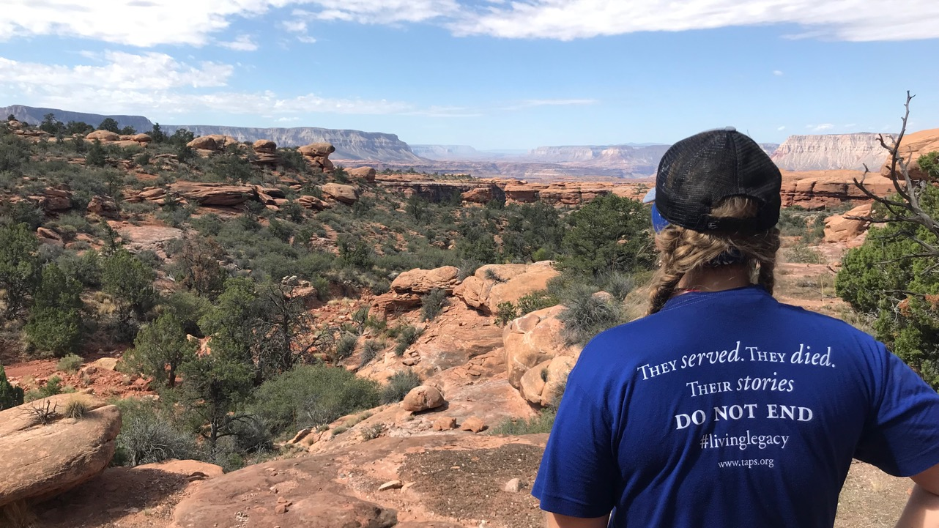
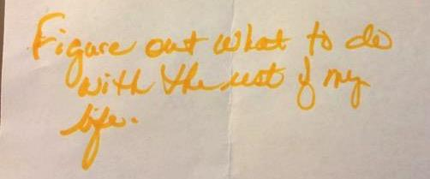
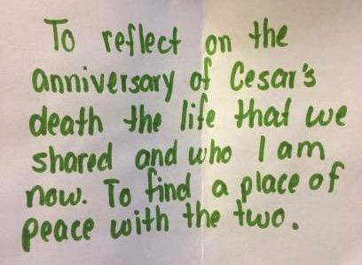
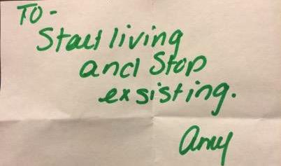
WHAT SURVIVORS GAIN

Slide 26
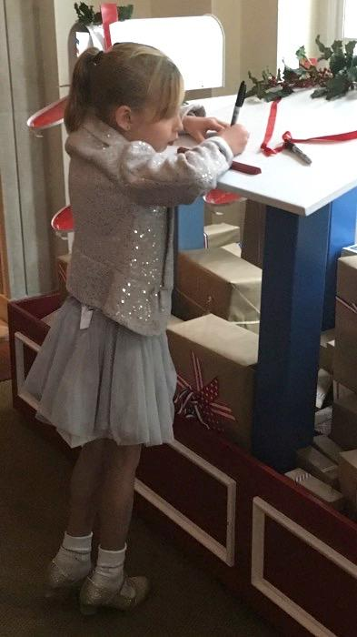
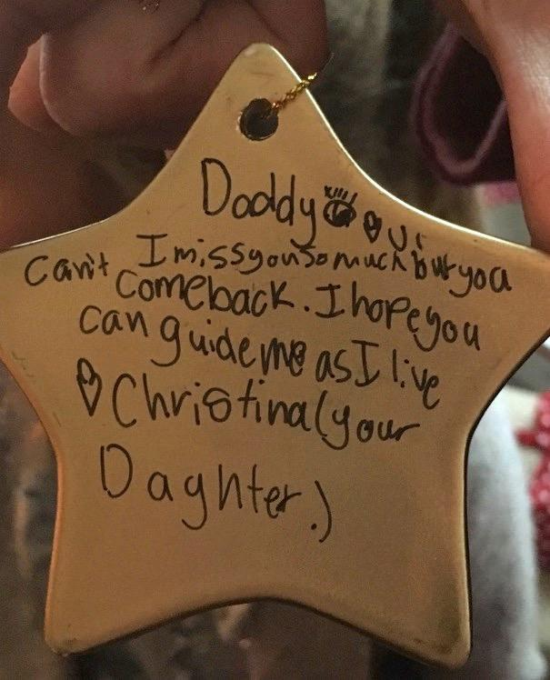
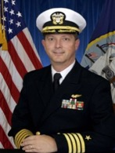
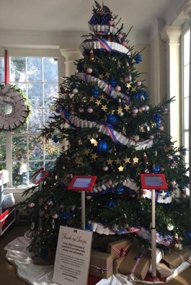
EMBRACING LIFE AS LIVING LEGACIES

Slide 27
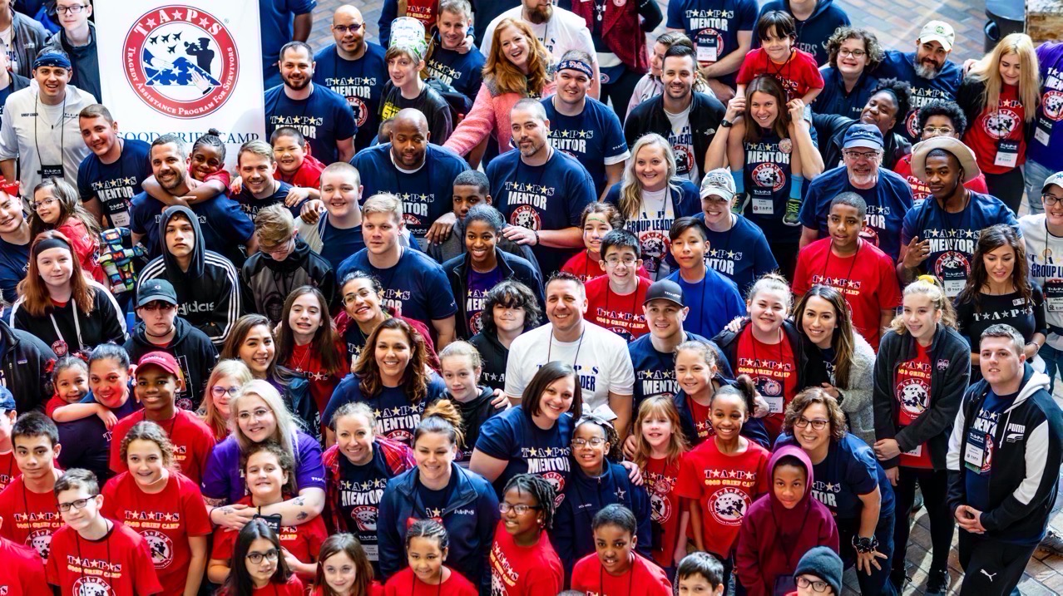
TAPS SUPPORT TO YOUTH
Good Grief Camps | Family Campouts
Early Childhood | Young Adults | Online Support

Slide 28
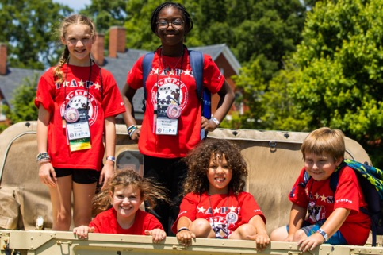
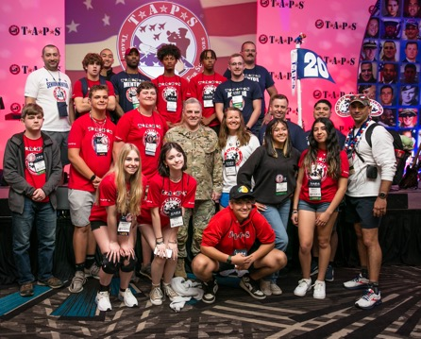
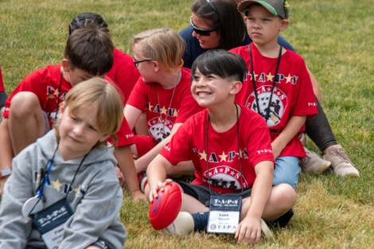
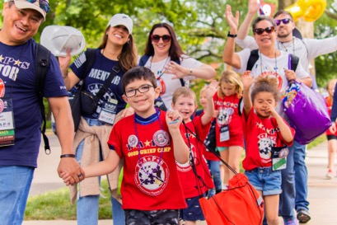
GOOD GRIEF CAMP
"TAPS has really been amazing for my daughter, by helping her establish friendships with other kids and adults that understand her loss. She doesn’t feel quite as alone, even if every story is different, they all share a commonality in their grief, and I feel like the peer support is so important."- Surviving spouse
“My boy has been coming for almost 10 years and the all-day events at Ft Myer were fantastic. He told me he felt this was the best Good Grief Camp he has attended. Also, the Group Leaders and Military Mentors were great as usually. Thank you!” – Surviving spouse

Slide 29
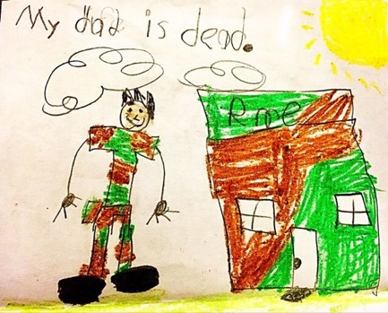
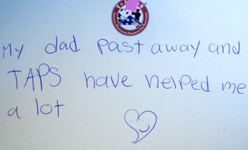
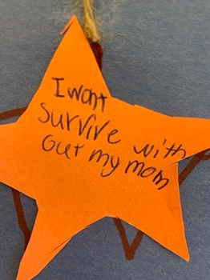
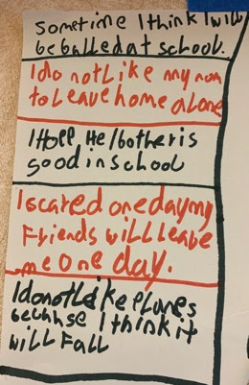
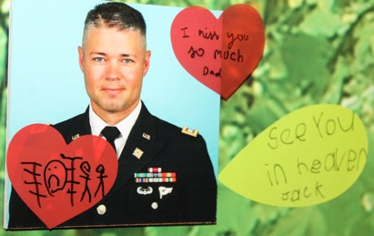
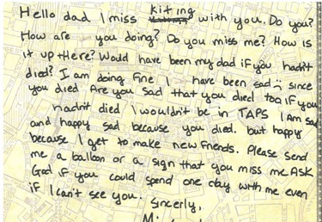
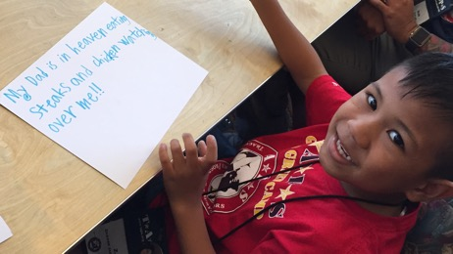

Slide 30
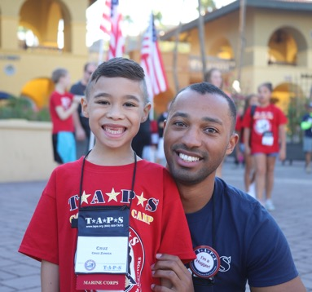
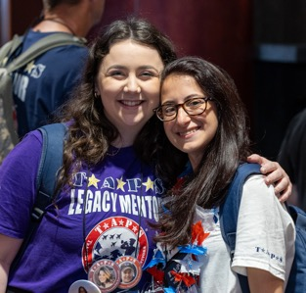
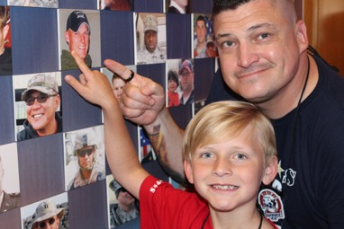
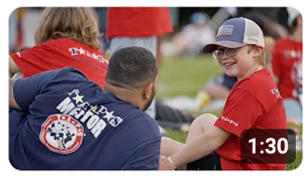
IMPACT STORY
"As a Military Mentor, supporting a bereaved child through their grief is not just about being there; it's about being a source of strength and understanding in their darkest moments.”
– Military Mentor
93%
of Mentors would recommend the TAPS Military Mentor program to fellow service members and surviving families
71%
of Mentors volunteer in honor of a Battle Buddy
@TAPSorg on YouTube

Slide 31
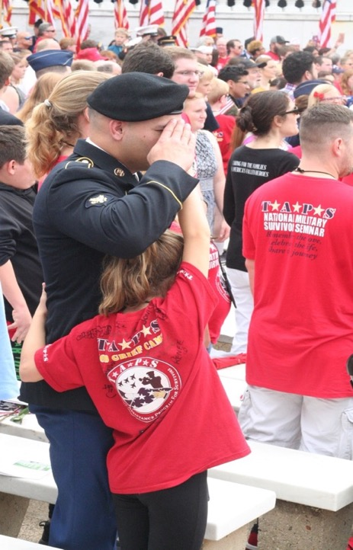

Slide 32
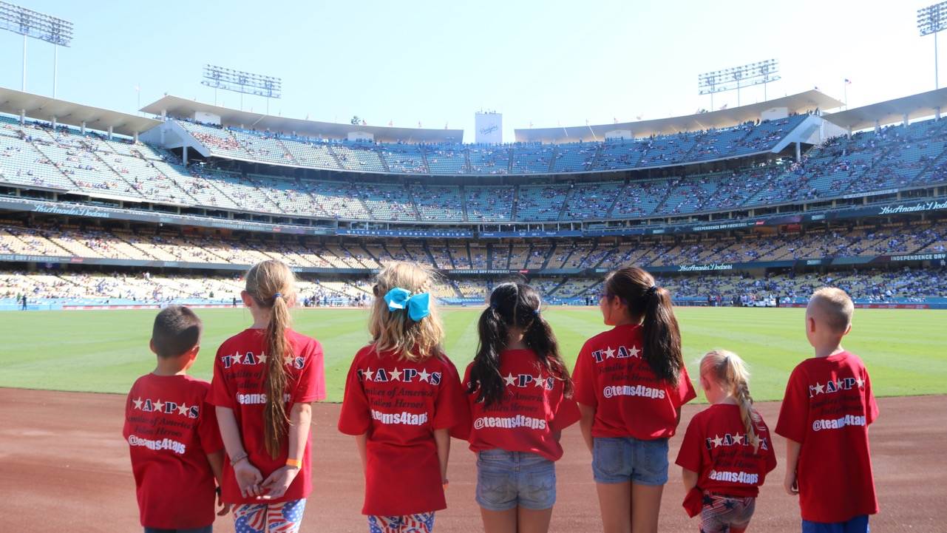
BRINGING JOY TO MILITARY SURVIVORS
teams4taps | Stars4TAPS

Slide 33
ADVOCACY

Slide 34
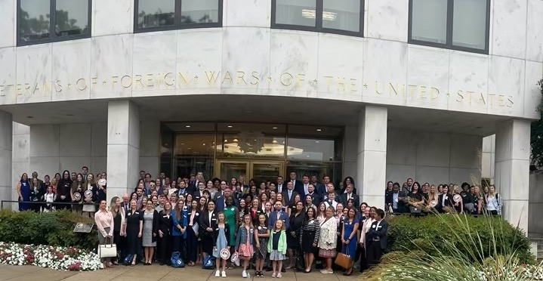
CAPITOL HILL ADVOCACY
NEARLY 150 SURVIVORS (ages 5 – 76) VISITED 300+ CONGRESSIONAL OFFICES
EDUCATING ON THE NEEDS AND EXPERIENCES OF AMERICA’S MILITARY SURVIVORS
Key Accomplishments:
Partnered with 35 Fellow VSO’s | Advocated for 4 Key Survivor Issues
Met With 50 States (all currently seated senate offices) | Added 20 New Co-Sponsors Per Bill
350 Attendees to the TAPS Joint Congressional Reception with Elizabeth Dole Foundation (EDF)

Slide 35
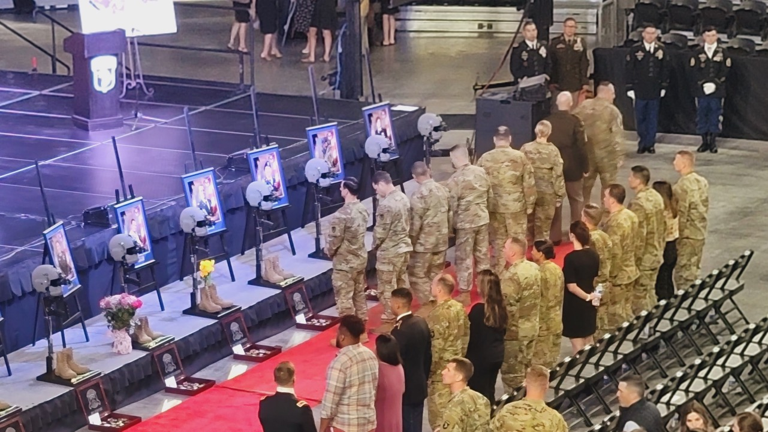
HOW WE GRIEVE

Slide 36
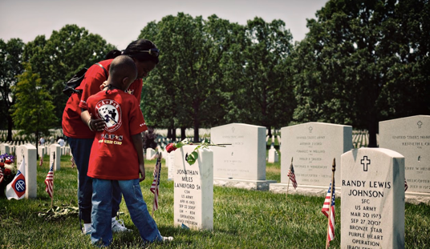
WHAT IS GRIEF?
A universal emotional response
A natural response to death and loss of a person we love
Separate from depression and anxiety and trauma
Risk Factors for Complicated Grief in the Military Community. OMEGA - Journal of Death and Dying, First Published 20 May 2021. Grace E. Seamon-Lahiff, Chantel M. Dooley, Paul T. Bartone, Bonnie Carroll
Disenfranchised Grief in Gold Star Military Families. Combat Stress. Fall 2022. Paul T. Bartone, Ken Doka. Retrieved January 19, 2023, from https://www.stress.org/disenfranchised-grief-in-gold-star-military-families.

Slide 37
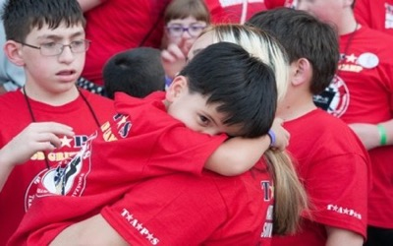
THE “TASKS” OF GRIEF
The Four Tasks of Grief
Acknowledge the reality of the death
Experience the pain of grief
Adjust to the environment in which the deceased is missing
Form a new identity and reinvest energy without forgetting the past
Carroll, B. & Wolfelt, A. D. (2015). Healing your grieving heart after a military death: 100 practical ideas for family and friends. Companion Press.
Worden, J. W. (2018). Grief counseling and grief therapy: A handbook for the mental health practitioner. Springer Publishing Company.
Dooley, C., Carroll, B., Fry, L., Seamon-Lahiff, G. (2019). A model for supporting grief following traumatic loss: The tragedy assistance program for survivors (TAPS). Journal of Military Medicine (In press).

Slide 38
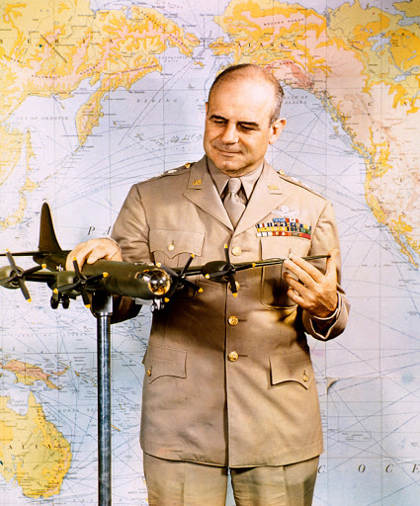
As General Jimmy Doolittle wrote after the death of his son serving in the Air Force,
“Only when someone very near and dear to one leaves does one appreciate the stark tragedy of death.
Even then, nature tends to cushion the initial shock, and the thought ‘he is gone’ does not carry the later realization of finality and permanence that comes only with the final indisputable understanding that
‘we will never see him again’.”

Slide 39
LIFE…AND DEATH.

Slide 40
LIFE…AND DEATH.

Slide 41
REALITY. IT’S WHERE WE LIVE

Slide 42
REALITY. IT’S WHERE WE LIVE

Slide 44
TAPS PUBLICATIONS

Slide 45
IS MILITARY GRIEF DIFFERENT?
Sudden and traumatic death differs dramatically from anticipated death
Leading causes of death among the military: suicide, training accident, other accidents, rare and aggressive illnesses
Trauma shatters the way we look at the world
Risk of survivors feeling accountable for death, or the death was preventable
Loss of community and identity
Risk Factors for Complicated Grief in the Military Community. OMEGA - Journal of Death and Dying, First Published 20 May 2021. Grace E. Seamon-Lahiff, Chantel M. Dooley, Paul T. Bartone, Bonnie Carrol
A Model for Supporting Grief Recovery Following Traumatic Loss: The Tragedy Assistance Program for Survivors (TAPS). Military Medicine, 184(7-8), 166–170 (April 2019). Grace E. Seamon-Lahiff, Chantel M. Dooley, Laura E. Fry, Paul T. Bartone, Bonnie Carroll.

Slide 46
TOOLS FOR YOUR TOOLKIT
Note the use of the word “phases” instead of “stages”. Grief does not have stages.
Give accurate information, not awkward platitudes and sympathy.
Know survivors are aware that you can't fix what is truly broken, nor are you expected to.
No matter what you do, the family won't be "happy" or "satisfied” – but they can be reassured their loved one will be treated with dignity and honor.
Follow up is so important - if you don't know something, say that. Offer to get the information and get back in touch with them. Then get back in touch with them.
Say their person's name - it's the most wonderful sound we hear.

Slide 47
WHAT CAN YOU SAY?
“I’m very sorry.”
“You have our support. Call on us.”
“This is a great loss to the organization/nation.”
“____ will be greatly missed.” (use their loved one’s name)
Offer choices and listen to requests
Begin conversations with those emotionally related to the deceased with an acknowledgement of their sacrifice
not just a “statement of facts” or need for information
Focus on the life and the service rather than how and where they died

Slide 48
WORDS TO AVOID
The bereaved are often traumatized, they are not mentally ill
Acceptance - this feels “unacceptable”
Goodbye - they live forever in our hearts
Closure - you never “close” them out of your life or forget the life and the love
Loss - they are not “lost”, they have died
Move past this - you can’t force healing
Get on with life - life is forever altered
Get over it - “it” is not something you “get over”, you must find comfort and peace within and then, somehow, create a new future

Slide 49
Companioning is about:
Being present to another person’s pain; it is not about taking away or relieving the pain.
Going to the wilderness of the soul with another human being; it is not about thinking you are responsible for finding the way out.
Honoring the spirit; it is not about focusing on the intellect.
Listening with the heart; not analyzing with the head.
Bearing witness to the struggles of others; it is not about judging or directing those struggles.
Companioning Model by Dr. Alan Wolfelt, Center for Loss and Life Transition

Slide 50
Companioning is about:
Walking alongside; it is not about leading.
Discovering the gifts of sacred silence; it is not about filling every painful moment with talk.
Being still; not about frantic movement forward.
Respecting disorder and confusion; it is not about imposing order and logic.
Learning from others; it is not about teaching them.
Compassionate curiosity; it is not about expertise.
Companioning Model by Dr. Alan Wolfelt, Center for Loss and Life Transition

Slide 51
PARTNERSHIPS

Slide 52
TAPS TRAININGS
TAPS.org/MilitaryCasualty militarycasualty@TAPS.org
TAPS provides virtual and in-person trainings for Military Casualty and Military Community Partnerships to Casualty and Mortuary representatives and ships Casualty Care Packages
“We just had an amazing brief about the wonderful program, TAPS, to our group here in Europe. What you and this organization do for not just grieving families of loved ones, but also the country is extraordinary. These people are members of our American community, no matter how their loved one was lost. What this organization can provide is bigger than assisting the grieving families within the DoD entity.
These family members become a more powerful version of themselves as a result of this organization's resources and efforts and interject their genuine character and meaningful contributions into society, much like this organization does for each grieving person.”
– Army Casualty Notification Officer | Casualty Assistance Officer Training
Air National Guard Casualty Mortuary Affairs (CAMO) Course at Dover Air Force Base with Mrs. Kelly Hokanson, spouse of GEN Dan Hokanson, 29th Chief, National Guard Bureau

Slide 53
RENEWING PARTNERSHIPS
“What is unique about TAPS is the level of commitment to all survivors,” Hokanson said. “Your loved one may not have died on the battlefield. They might not have died in a duty status. You may not be officially recognized as ‘next of kin.’ But TAPS has built a sanctuary that transcends these distinctions, honoring all service members who’ve lost their lives, and supporting the loved ones they left behind.”
National Guard Chief begins Memorial Day weekend by renewing ties with survivor group

Slide 54
TAPS IS YOUR FORCE MULTIPLIER
Without coping strategies or a long-term support system in place, survivors could experience grief severity, prolonged trauma symptoms, and complicated grief.
TAPS provides 24/7 support for you and your survivors.

Slide 55
TAPS IS YOUR FORCE MULTIPLIER
Connecting survivors immediately guarantees:
The likelihood survivors will seek and accept current and future assistance
Survivors will process their loss in a healthy manner and find meaning along grief journey
Individually tailored coping strategies
Positive and safe social engagement
Fisher, J.E., Zhou, J., Zuleta, R.F., Fullerton, C.S., Ursano, R.J., & Cozza, S.J. (2020). Coping strategies and considering the possibility of death in those bereaved by sudden and violent deaths: Grief severity, depression, and posttraumatic growth. Front. Psychiatry 11. 749. doi:10.3389/fpsyt.2020.00749

Slide 56
HOW CAN YOU HELP?
Connect Survivors Immediately
Share the Mission
TAPS Engagement Opportunities

Slide 57
TAPS.ORG/MILITARYCASUALTY
Developed specifically for our partners in military casualty
Steps To Connect Military and Veteran Survivors with TAPS
Links to DoD, VA, and Military OneSource Resources for Survivors
Death by Suicide Toolkit for Military Leadership
Document Library for All Manners of Death
Document Library for Suicide Loss

Slide 58
TAPS 31ST ANNUAL MILITARY SURIVVOR SEMINAR AND GOOD GRIEF CAMP
May 23 – 26, 2025
Arlington, VA
1,500 military and veteran survivors
500 children
500 Military Mentors
300 Volunteers

Slide 59
SAVE AND SHARE TAPS CONTACT
24/7 800.959.TAPS
TAPS.org/JoinTAPS

Slide 60
CONNECT A SURVIVOR TAPS.ORG/SURVIVOR

Slide 61
“The lives of those we love, remember, and honor are carved into our soul, imprinted on our hearts, and woven into the fabric of our nation. They make us stronger, they inspire us, and in that way, they are eternal.”
- Bonnie Carroll, TAPS Founder and President

Slide 62
The Global Gathering of Organizations Caring for
Families of Military and Conflict Deceased
Burkina Faso
Georgia
Italy
Kenya
Kurdistan
Libya
Nepal
New Zealand
Poland
Romania
Somalia
Uganda
United Arab Emirates
Ukraine
United States
Abu Dhabi, United Arab Emirates
29 November to 3 December 2023
Funded by
The Royal Family of UAE
The Good Feet Store
BHE Land Systems

Slide 63
TAPS ADVANCEMENT OF WOMEN, PEACE, AND SECURITY
TAPS has a vital role in implementing WPS and by providing support to survivors affected by military loss and conflict around the world.
TAPS supports global conflict survivors with grief and trauma and empowers women (often mothers and spouses) to foster peace and stability within their communities.

Slide 64
HOW DO WE HEAL? Grief is a universal response to loss impacting individuals and communities. Untreated grief can contribute to adverse mental health outcomes and, if unaddressed, can drive further violence and instability.
Notes:
The essential ingredients for healing are respect, information, connection, empowerment, and hope.
These five elements are interwoven, each relating closely to the others.
Together, we will find the way.

Slide 65
NAVIGATING GRIEF AND
ANXIETY IN UNCERTAIN TIMES
In moments of upheaval and change, the weight of uncertainty can feel overwhelming. The shifts in our government, the sudden changes in military leadership, and the fear of future instability create an emotional toll that is deeply felt—especially by those who stand in quiet strength behind our service members.

Slide 66
NAVIGATING GRIEF AND
ANXIETY IN UNCERTAIN TIMES
Senior military spouses carry an immense burden: 💙 The weight of leadership in uncertain times 💙 The responsibility of holding families and communities together 💙 The silent grief of sacrifice, change, and the unknown

Slide 67
NAVIGATING GRIEF AND
ANXIETY IN UNCERTAIN TIMES
Grief is not just about loss—it is about navigating the unknown, carrying the unspoken fears, and standing steady when the ground beneath us shifts.
We honor those who shoulder this unseen burden. You are the backbone of resilience, the voice of wisdom, and the heart of our military families.
You are not alone.
We see you. We stand with you. We are here to support you.

Slide 68
TAPS
CAPSTONE
JANUARY 2025
Caring for the Families of America’s Fallen Heroes
3033 Wilson Blvd, Third Floor
Arlington, VA 22201
202.588.TAPS (8277)
TAPS.org

