Slide 1
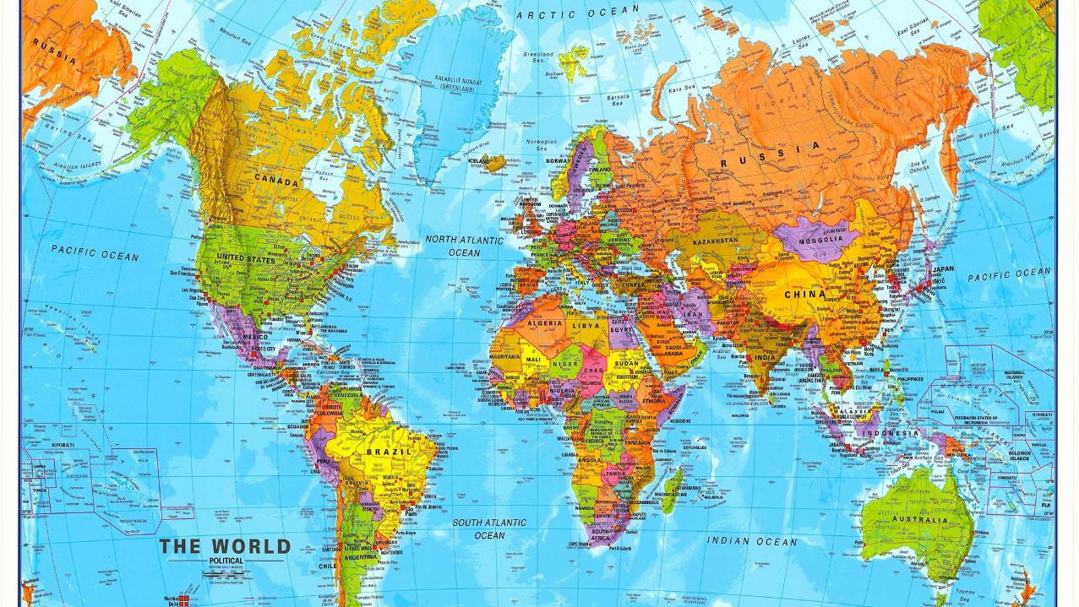
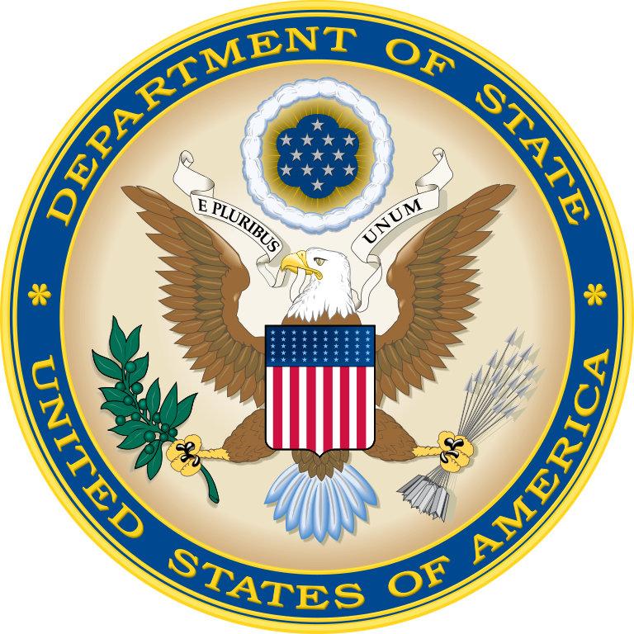
Ambassador Roxanne Cabral
Senior Vice President
Ambassador Gautam Rana
Deputy Commandant National War College
National defense university
The State Department and the partnership between defense and diplomacy

Slide 2
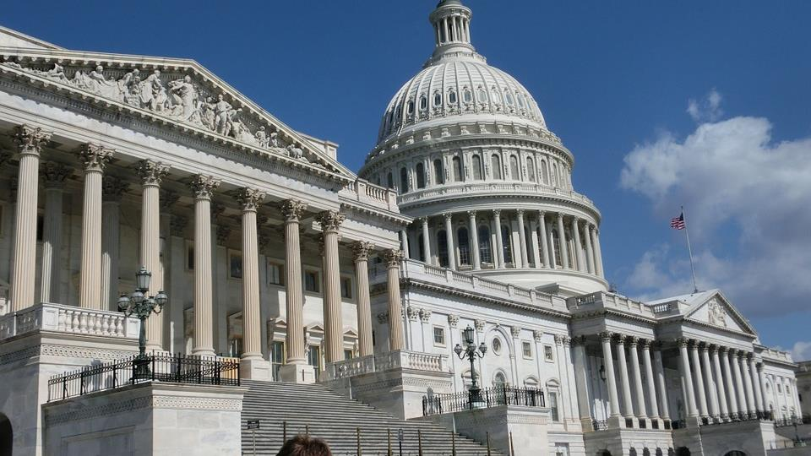
What We Do in the field:
Advance America’s Interests
Assist U.S. citizens
Report and analyze
Negotiate and influence
Tell America’s story
Promote trade and prosperity
Partner on international security
Promote democracy
Assist with development
Manage disaster relief
Maintain USG presence overseas
Notes:
DAY TO DAY Diplomacy and Foreign Policy Implementation – in the Field
Assist U.S. citizens and process visas for non-Americans
Shape sound policy through reporting and analysis
Negotiate with and influence governments and their leaders
Tell America’s story: Engage with key foreign audiences through Public Diplomacy and exchange programs
Promote trade and prosperity, including supporting American companies
Partnership and assistance on international security, law enforcement, arms control, and counterterrorism
Promote democracy, human rights, good governance, and rule of law
Provide and manage development assistance programs through USAID; manage disaster relief programs
Manage and support the USG presence overseas
How do we actually go about “advancing the interests of the American people, their safety and economic prosperity”? This is by no means a comprehensive list, but a broad overview of the categories of activities that the State Dept (and a bit USAID) lead.
State by no means does this alone. In carrying out its responsibilities, the State Department works closely with the NSC, the Department of Defense, the intelligence community, and the myriad of other U.S. government agencies that are involved in the formulation and implementation of the foreign policy of the United States, including but not limited to Treasury, Justice, Agriculture, Commerce, and DHS.
If you take a look at this list you’ll see that virtually all of the activities listed here are activities carried out by U.S. embassies and consulates overseas. That’s where the bulk of the day-to-day work of advancing U.S. interests takes place – not in Washington. In Washington, more effort is focused on policy formulation and coordination, and less on implementation.

Slide 3
Secretary of State
S
C
Counselor
2x Deputy Secretaries D
U/S
P
Political
Affairs
E
Economic and
Business Affairs
T
Arms Control &
International
Security Affairs
R
Public Affairs &
Public
Diplomacy
M
Management
F
Foreign Assistance,
Humanitarian Affairs,
& Religious Freedom
Geographic
(Regional)
Bureaus
and Int’l
Organiz’ns
Bureaus for
Arms Control,
Nonproliferation,
Political-Military
Affairs
A/S
Embassies
and
Consulates
Notes:
Political Affairs (P)
- 6 regional bureaus, international organizations (UN, WTO, WHO, ICAO)
- works most closely with our embassies and multilat missions
- manages bilat and multilat relations
(working closely with functional bureaus and interagency)
- works with partners/allies and to contain/counter adversaries
Arms Control and International Security (T)
leads the interagency policy process on nonproliferation
manages global U.S. security policy,
principally in the areas of arms control,
regional security and defense relations, and
arms transfers and security assistance.
- oversees the negotiation, implementation, and verification
of international agreements in arms control and international security.
- defense trade controls (w/ interagency esp USDOC and DOD)
to prevent missile, nuclear, chem, bio, and convtnl weapons proliferation.
- polmil affairs: dozens of POLADs, peacekeeping forces, IMET, FMF
USAID is an independent agency of the USG that works closely with the State Department and receives overall foreign policy guidance from the Secretary of State

Slide 4
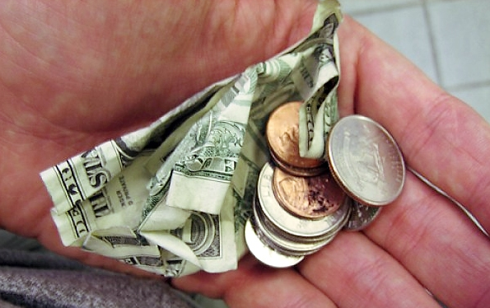
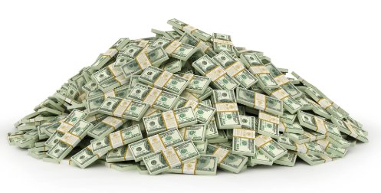
Notes:
DoD v. DOS resources.

Slide 5
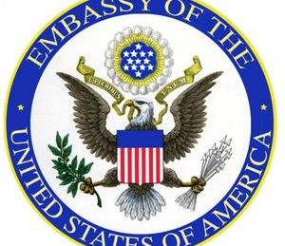
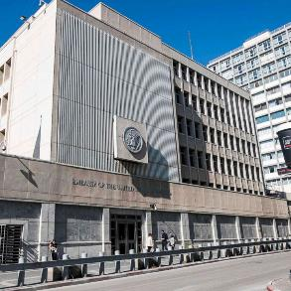
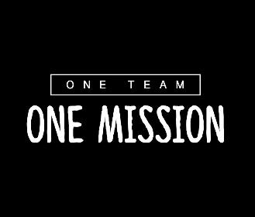
Chief of mission authority
The COM is in charge of all Executive Branch activities and operations and fully responsible for the direction, coordination, and supervision of all U.S. Executive Branch employees, regardless of their employment categories or location, except those under command of a U.S. area military commander, on the staff of an international organization, or VOA reporters on assignment.

Slide 6
U.S. Embassy Structure: The Country Team
Ambassador
(Chief of Mission)
Deputy Chief of Mission (DCM)
Political
Affairs
Economic
Affairs
Consular
Affairs
Manage-
ment
Public
Affairs
Regional
Security
Office
Defense
(SDO)
Consulates/
Constituent Posts
Marine Security Guard
Detachment
DAO
Security
Assistance
Office
Other USG Agencies
IC
FBI DEA
DHS (ICE/CBP/HSI) FAS
Commerce FAA
Peace Corps USSS
Treasury Energy
NASA IRS
CDC SSA
The Ambassador is the President’s “personal representative” and reports to the Secretary of State (usually through the regional Assistant Secretary)
Notes:
Let's now look at the structure of embassies overseas.
Composition varies a lot in size and make-up by country.
Small embassies have only State + DOD with no USAID. Other agencies like DEA and FBI cover Gabon from regional offices at other embassies in the region.
Large embassies like London have 30+ agencies, including IRS, Social Security Agency, Secret Service, even Library of Congress.
The State Department manages the platform upon which all agencies work – security, local HR, warehousing, facilities and housing maintenance, security, etc.
In a well-run country team, this is where the real interagency cooperation takes place. It is streamlined and issue-focused
Here you can see where the DATT office fits in.
The Ambassador is the leader of the WHOLE Embassy – all agencies and everyone who works for them. This is called Chief of Mission Authority.

Slide 7
How Embassies Help DoD
Context and Analysis
Relationships
Formal Agreements

Slide 8
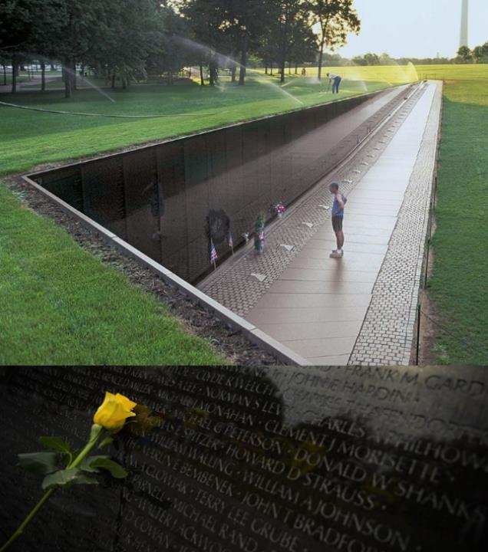
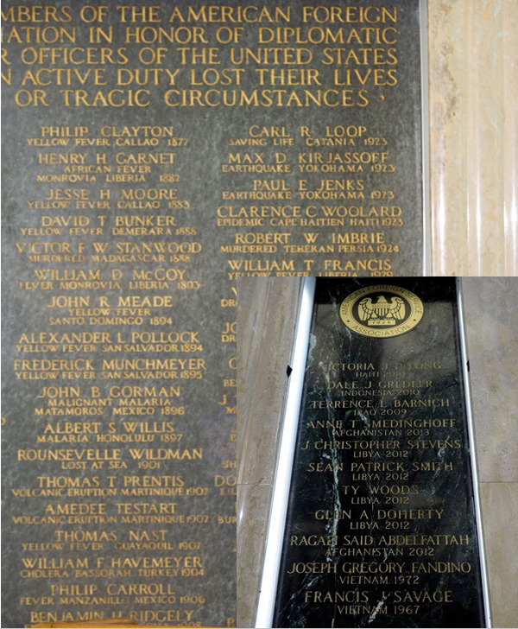
Notes:
DoD holds no monopoly on bravery.

Slide 9


Notes:
DoD: black and white; DOS: endless shades of grey.

Slide 10
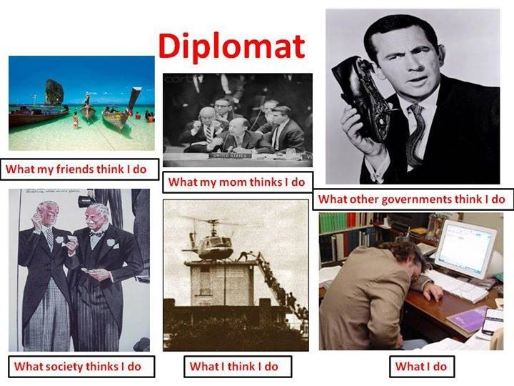

Notes:
-Manage foreign relations between the U.S. and other countries.
-Maintain and promote peace; avoid conflict and risk.
-Focus on relationships: alliances and partnerships to promote U.S. national security and prosperity and advance U.S. policy goals.
-Coordination and leadership of all instruments of national power in foreign policy domain during peacetime.
The policy making process occurs in DC – while foreign policy is led by State it’s coordinated by the NSC with the interagency (IPCs, Sub IPCs, DC, PCs) for Big policy decisions.

