Slide 1
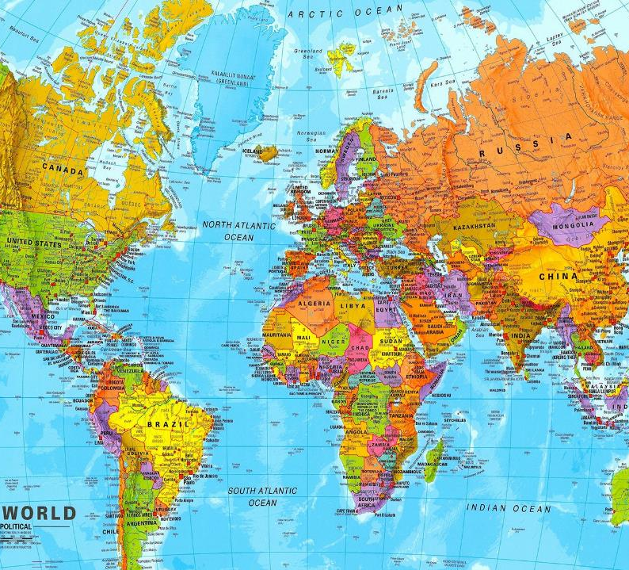
Capstone may 14, 24th, 2024
Ambassador Andrew Young
International Student Management Office
National Defense University
Notes:
What we will discuss:
Who the State Department is
How it is organized
What we bring to the table
Limitations and challenges

Slide 2
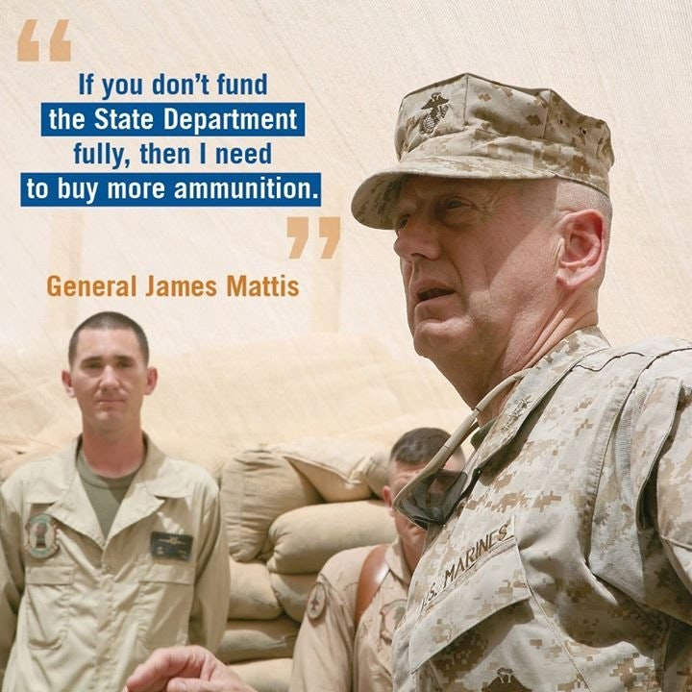
Notes:
This slide is required by law.

Slide 3
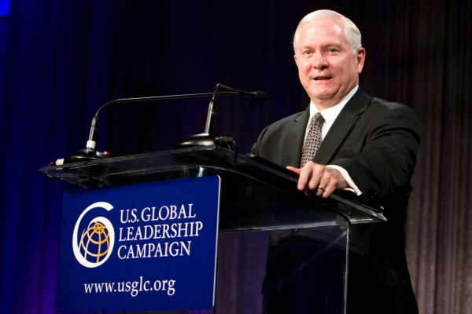
“Development is a lot cheaper than sending soldiers”
- Secretary of Defense Robert Gates

Slide 4
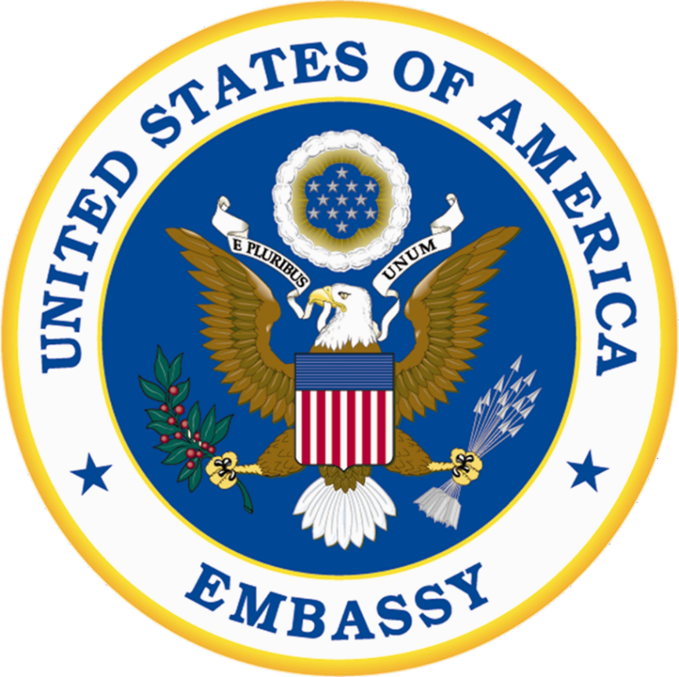
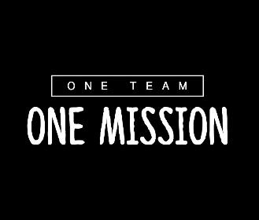
Chief of Mission
Ambassador or Chargé d’Affaires
Personal representative of the President to host nation
POTUS Letter of Instruction
Command Authority over all U.S. Government personnel in-county, except those assigned to a Combatant Commander or international organization
Notes:
Note the change from regional COCOM to all COCOMs

Slide 5
Diplomacy in a Nutshell
Manage foreign relations between the U.S. and other countries that promotes peace, avoids conflict, and reduces risk.
Focus on relationships: alliances and partnerships to promote U.S. national security and prosperity and advance U.S. policy goals.
“Diplomacy is the art of letting other people have your way.”

Slide 6
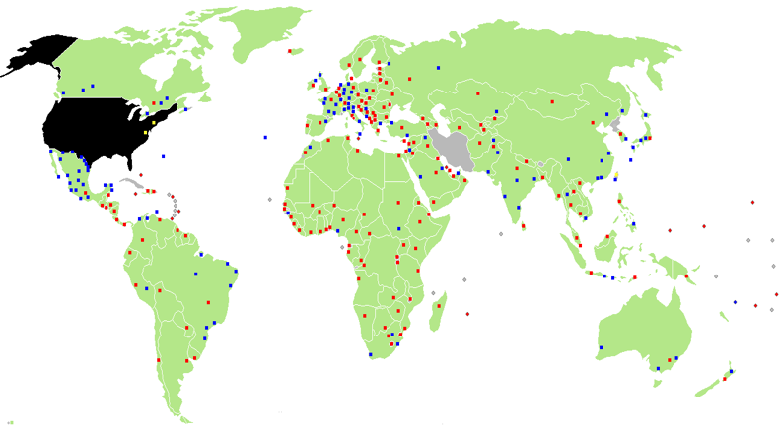
A Global Presence: U.S. Diplomatic and Consular Missions
273 overseas posts in 175 countries
* 168 Embassies
* 88 Consulates General +
Consulates
* Nine Permanent Missions
* 30 U.S. Government Agencies abroad
Notes:
--Now let's turn to the work of diplomacy via overseas embassies.
--An embassy is its own interagency entity; it represents back to Washington the views of the agencies that make up the mission.

Slide 7
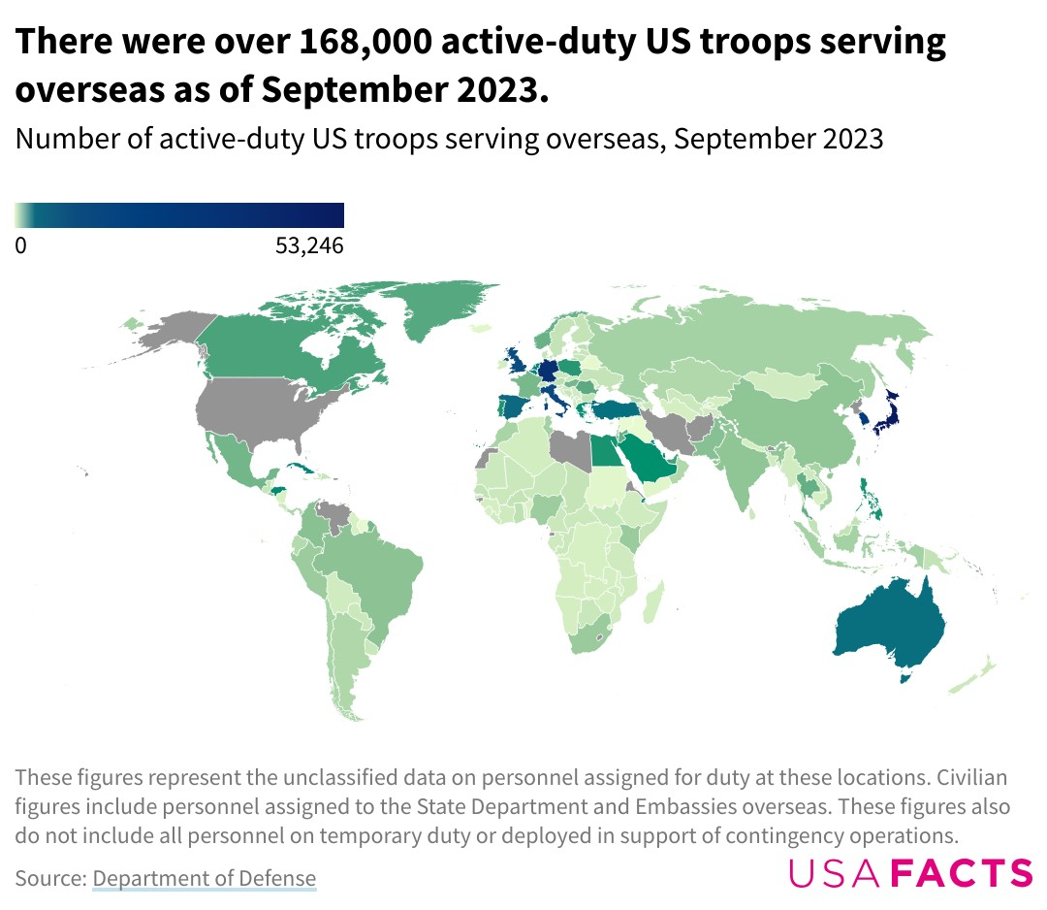
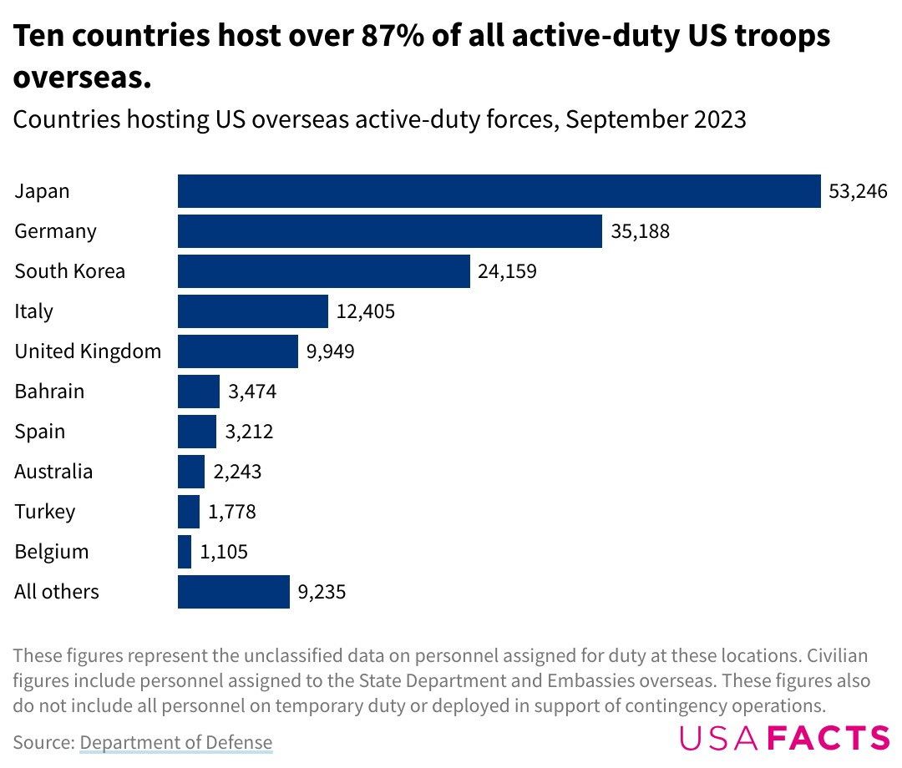
U.S. Military Presence Abroad
Illustrative, Not USG Information
https://usafacts.org/articles/where-are-us-military-members-stationed-and-why/

Slide 8
State’s Internal Chain of Command
Secretary of State
USAID
C
Counselor
Deputy Secretaries x2 D
U/S
P
Political
Affairs
E
Economic and
Business Affairs
T
Arms Control &
International
Security Affairs
R
Public Affairs &
Public
Diplomacy
M
Management
J
Civilian Security,
Democracy and
Human Rights
Geographic
(Regional)
Bureaus
and Int’l
Organiz’ns
Bureaus for
Economics,
Energy,
Environment
Bureaus for
Arms Control,
Nonproliferation,
Political-Military
Affairs
Bureaus for
Educational,
Cultural and
Info Programs;
Public Affairs
Bureaus for
Administration,
Budget, HR,
IT, Medical,
Dip. Security,
Buildings Ops,
Consular Affairs
Bureaus for
C/T, Law
Enforcement,
Human Rights,
Refugees, TIP,
and Conflict
Stabilization
Bureaus for
Legal Affairs,
Policy Planning,
Legislative Affairs,
Protocol, OIG,
Women’s Issues,
HIV/AIDS,
Civil Rights;
plus
Special Envoys
A/S
Embassies
and
Consulates
Notes:
Here’s a more readable and simpler version of the org chart to give you an idea of how the Department of State divides up work.
Political Affairs (P)
- 6 regional bureaus, international organizations (UN, WTO, WHO, ICAO)
- works most closely with our embassies and multilat missions
- manages bilat and multilat relations
(working closely with functional bureaus and interagency)
- works with partners/allies and to contain/counter adversaries
Arms Control and International Security (T)
leads the interagency policy process on nonproliferation
manages global U.S. security policy,
principally in the areas of arms control,
regional security and defense relations, and
arms transfers and security assistance.
- oversees the negotiation, implementation, and verification
of international agreements in arms control and international security.
- defense trade controls (w/ interagency esp USDOC and DOD)
to prevent missile, nuclear, chem, bio, and convtnl weapons proliferation.
- polmil affairs: dozens of POLADs, peacekeeping forces, IMET, FMF
Civilian Security, Democracy, HR (J)
Prevents and counters threats to civilian security, such as violent extremism, mass atrocities, and weak governance and the rule of law.
Advances the security of the American people by assisting countries around the world to build more democratic, secure, stable, and just societies.
- Conflict and stabilization - CT & CVE
Global Criminal Justice - DRL
Narcotics and Law Enforcement, including anti-corruption and rule of law
Refugees and Migration - Trafficking in Persons
This all falls under the umbrella of the “political cone” and what would be handled by an Embassy’s political section, but there are four other cones in the FS which are equally important.
Public Diplomacy & Public Affairs
informs and influences foreign publics, govt leaders, civil society, youth
leads America's public diplomacy outreach,
which includes messaging to counter terrorism and violent extremism.
oversees Educational and Cultural Affairs,
- Scholarships and exchanges (students & profs Fulbright)
Economics, Energy, & Environment (E)
Advance the Department’s economic development agenda;
incl coml advocacy, trade promotion, Invest in USA
efforts related to energy security, clean energy, and enviro sustainability;
ESTH – include Arctic, Antarctic, & Oceans/Fisheries, cross border pollution, invasive and endangered species trffkg, Ebola crisis response
Foster innovation thru robust science, entrepreneurship, and tech policies.
Management (M) – supporting domestic offices and 200+ embassies & consulates, which serve as platforms for the entire interagency overseas
Bureau of Administration
Bureau of Budget and Planning
Bureau of the Comptroller and Global Financial Services
Bureau of Diplomatic Security (grown significantly during my career – DS Agents now out number political cone officers)
Bureau of Human Resources
Bureau of Information Resource Management
Bureau of Overseas Buildings Operations
Foreign Service Institute
Office of Medical Services
Consular Affairs (C) – travel info, ACS, ppts, over 10m visas issued per yr (Dave)
Consular Affairs (CA) is the public face of DOS for millions of people around the world. responsible for the welfare and protection of U.S. citizens abroad,
for the issuance of passports and other documentation to citizens and nationals, and
for the protection of U.S. border security and the facilitation of legitimate travel to the United States. 10 million visas issued last year
CA also has a significant domestic presence, most notably the 29 U.S. Passport agencies and centers, 26 of which deal directly with the U.S. public.
almost entirely funded through revenue generated by consular fees. This revenue totaled $4.16 billion in 2015, making CA the equivalent of a Fortune 600 company.
USAID is an independent agency of the USG that works closely with the State Department and receives overall foreign policy guidance from the Secretary of State

Slide 9
U.S. Embassy Structure: The Country Team
Ambassador
(Chief of Mission)
Deputy Chief of Mission (DCM)
Political
Affairs
Economic
Affairs
Consular
Affairs
Manage-
ment
Public
Affairs
Regional
Security
Office
Defense
(SDO)
USAID
Consulates/
Constituent Posts
Marine Security Guard
Detachment
DAO
Security
Assistance
Office
Other USG Agencies
IC VOA
FBI DEA
DHS (ICE/CBP/HSI) FAS
FCS FAA
Peace Corps USSS
Treasury Energy
NASA IRS
CDC SSA
The Ambassador is the President’s “personal representative” and reports to the Secretary of State (usually through the regional Assistant Secretary)
Notes:
Let's now look at the structure of embassies overseas.
Composition varies a lot in size and make-up by country.
Small embassies have only State + DOD with no USAID. Other agencies like DEA and FBI cover Gabon from regional offices at other embassies in the region.
Large embassies like London have 30+ agencies, including IRS, Social Security Agency, Secret Service, even Library of Congress.
The State Department manages the platform upon which all agencies work – security, local HR, warehousing, facilities and housing maintenance, security, etc.
In a well-run country team, this is where the real interagency cooperation takes place. It is streamlined and issue-focused
Here you can see where the DATT office fits in.
The Ambassador is the leader of the WHOLE Embassy – all agencies and everyone who works for them. This is called Chief of Mission Authority.

Slide 10
We’re Better Together : One Instrument Reinforces the Effectiveness of the Others

Slide 11
Asymmetric Resources State - Defense
Personnel
DoS Roughly: 75,000 (8K FSO, 5.5K FSS, 11K CS, 50K Locally Employed Staff)
DOD Roughly: 3,000,000 (1.4M AD, 750K Civ, 850K G/R)
[AD = Active Duty, Civ = Civilian]
[G/R = Guard and Reserve]
Budget
DoS + USAID FY22 $ 38 B
DoD FY 22 $ 754 B
DoD to DoS
Personnel: 40 to 1 Dollars: ~20 to 1

Slide 12
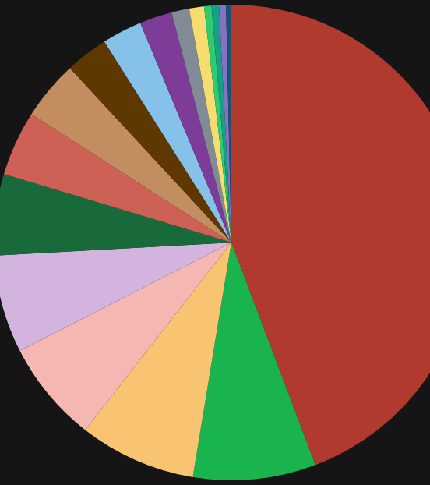
FY 2022 Discretionary Spending (Where Congress sort of/kind of gets to choose:) 2022 = $1.69 trillion total (21% of total spending)
National Defense $754 billion (44% of discretionary/9.3% of total budget)
Veterans Benefits and Services $117 billion (6.9% of discretionary/1.5% of total budget)
International Affairs $75 billion (4.4% of discretionary/0.9% of total budget)
(For context -- $113 billion to Ukraine in 2022)
Source: University of New Hampshire fedgovspendexplorer.org

Slide 13
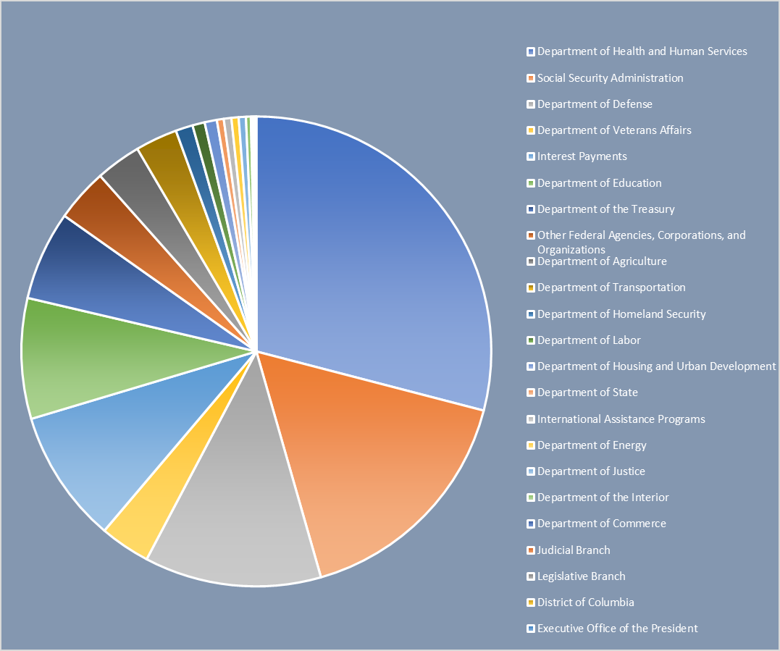
Federal Spending 2022 by U.S. Department $8.07 Trillion
State & International Assistance
Dept of Defense: $980b (12%)
Veterans Affairs: $279b (3%)
State Dept: $38b ( < 1%)
International Assistance: $42b (1%)
Healthcare & Social Security
Debt
Veterans
DOD
Source: University of New Hampshire fedgovspendexplorer.org
Notes:
As you know, the federal Budget process is long and arduous.
I’ve included the last, good pie chart I could find (FY 2017, mysteriously) with International Affairs as a percentage of overall federal spending. The percentage is historically under 1%.
Recent budget requests have proposed steep declines; I believe for FY 2018, the initial request to Congress included cuts of about 42% across International Affairs. As General James Mattis said (before his days as Secretary of Defense), “If you don’t fund the State Department fully, then I need to buy more ammunition." Congress has largely filled the gap by setting appropriations at near “normal” levels in recent years, well above the White House requests.
Questions/Comments?

Slide 14
A Quick Guide to U.S. State Department Rank and Insignia
Rank | FS-05 | FS-04 | FS-03 | FS-02 | FS-01 | FS-OC | FS-MC | FS-CM | FS-CA
GS Equivalent | GS- 8/9 | GS- 10/11 | GS-12/13 | GS-14 | GS-15 | SES | SES | SES | SES
DoD Equivalent | O-2 | 0-3 | O-4 | O-5 | 0-6 | O-7 | 0-8 | O-9 | 0-10
Insignia (Male)
Insignia (Female)
Typical Title (Male) | Bob | Bob | Bob | Bob | Bob | Bob | Bob | Bob | Sir
Insignia (Female) | Carol | Carol | Carol | Carol | Carol | Carol | Carol | Carol | Ma'am

Slide 15
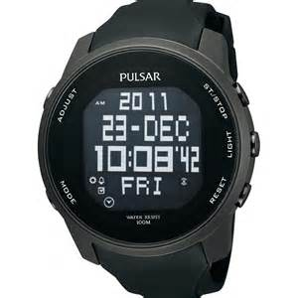
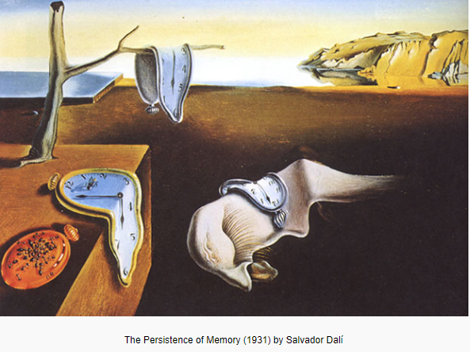
Distinct DoD & DoS Cultures
Distinclanning Cultures
Plan for Objectives : Seek Resources to achieve mission
Achieve Mission within Existing Resources
Linear Mindset
Mission is Never Final
Bias
Action or Analysis
Sense of Time
Notes:
--State plans/engages/thinks bilaterally, whereas DoD thinks regionally/more about problem sets/threats that don't respect borders. Foggy Bottom can be thinking regionally, but Ambassadors in country have zero incentive to think about anything other than their bilateral relationship in-country. Therefore, with only 1 half of the equation thinking regionally, systems default to bilateral. DoD is much more effective in their much more elaborate planning structures to be working topically/regionally.
--DoD invests in leadership training. State and USAID do not, and this becomes apparent when you get to senior levels and State/USAID leaders are superior SMEs but may have disfunction in their teams. There is no incentive to become a strong leader or manager for State and USAID (cable writing is how you get ahead, right?). No other department or agency invests as much in leader development than DoD.
--The consensus-based decision-making style at State is the opposite of DoD's hierarchical decision making. This means that a talented GS13 or FS3 can make big things happen at State, whereas in DoD you have to be at least a GS15 or O6 (or really GOFO) to make anything move. At USAID, their process is very consultative, but it will take longer to reach decision because feelings/grievances/and conversations must be aired. But, when USAID finally makes that decision, everyone is 100% behind it because everyone feels heard ...and there are no split memos to the Administrator in the way there to S at State. (We always used to joke that USAID would bring their feelings to each NSC meeting.)
--DoD is motivated by, plans around, and thinks in terms of end states. As DAS Peter Lord so often reminded me when I was at the NSC, there is no end state in diplomacy. After DoD finishes whatever they're going to do, diplomats much maintain relations and continue a bilateral conversation with whomever/whatever country. This fundamentally changes the way State v DoD approach problems, resourcing, etc.
--USAID's flexibility to respond to changing priorities is much more limited than State's or DoD's because so much of their money is earmarked.

Slide 16
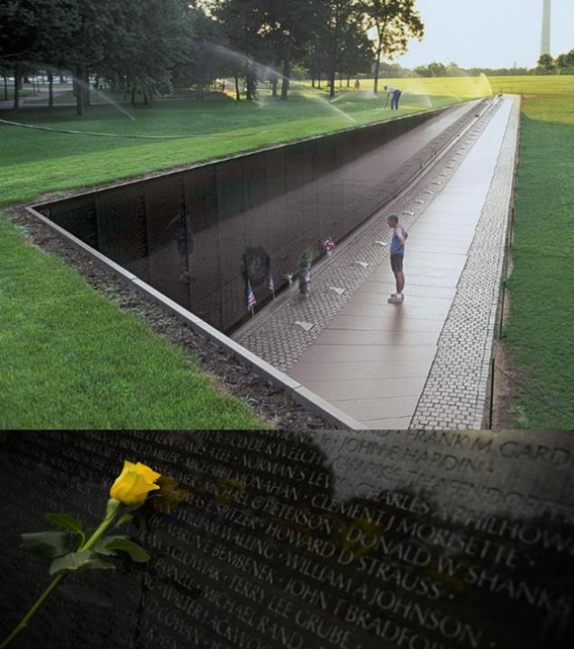
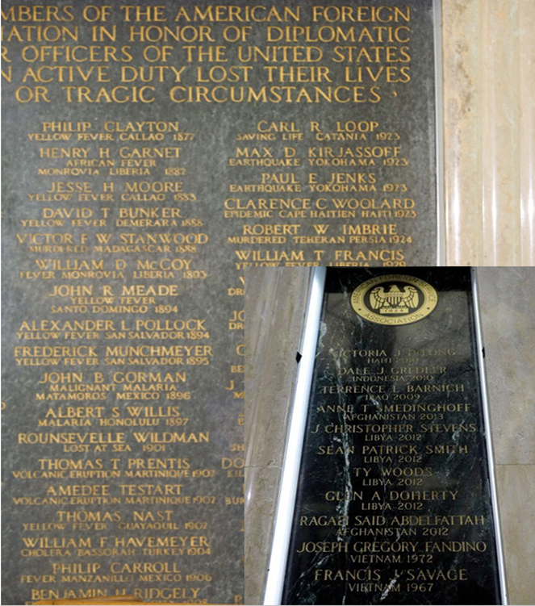
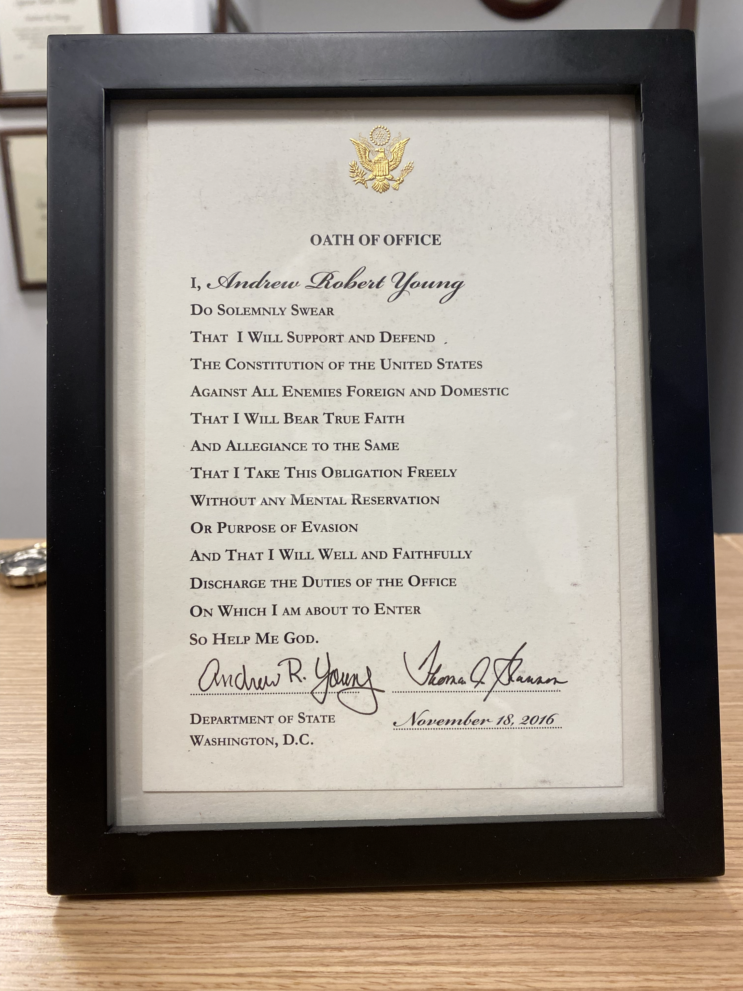
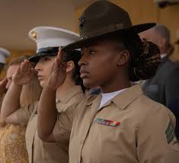
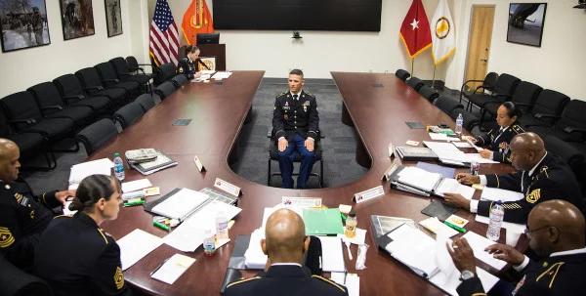
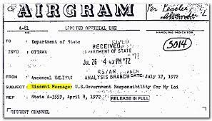
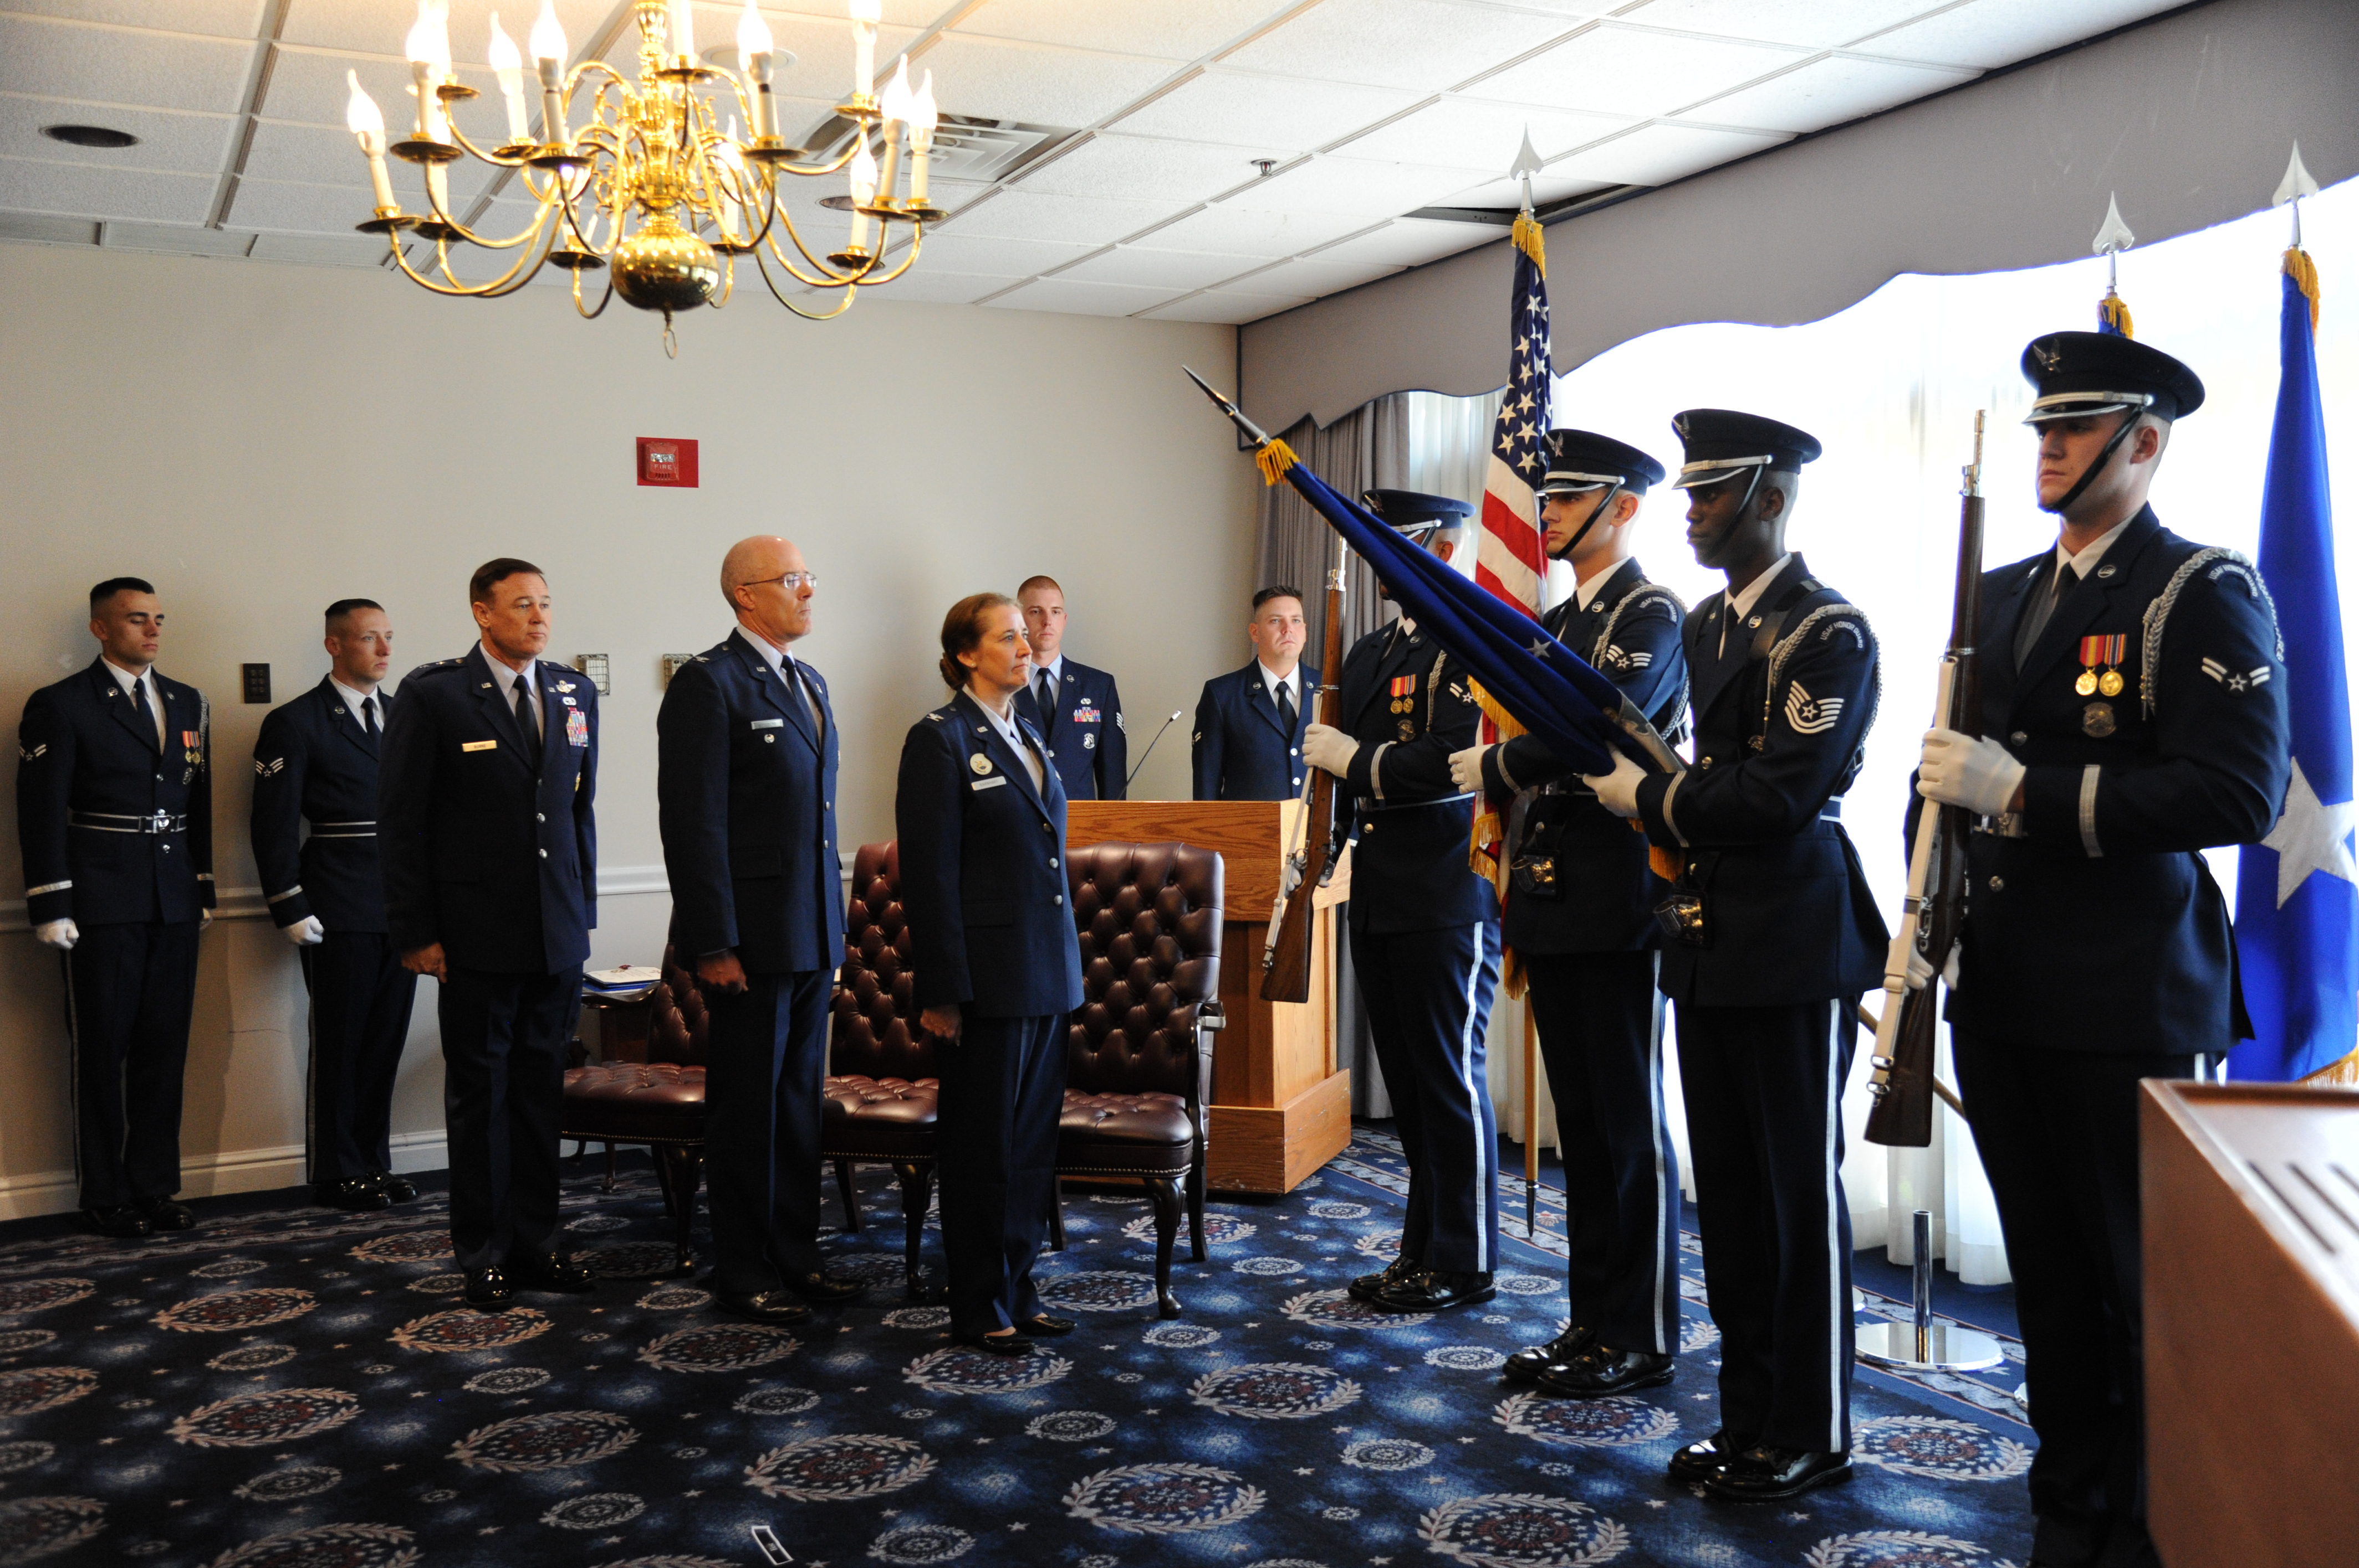
What We Share – How We Differ
Hierarchy
Duty & Sacrifice
Oath of Office
Follow Legal Orders
Up or Out Promotion System
Reward Dissent

Slide 17
UNCLASSIFIED
AFRICOM Campaign Plan
AFRICOM Mission Statement: U.S. Africa Command, with partners, counters malign actors and transnational threats, responds to crises, and strengthens security forces in order to advance U.S. national interests and promote regional security, stability, and prosperity.
1
2
3
4
AFRICOM Priority
Country List (APCL)
AFRICOM Priority Country List
(APCL)
Campaign Objective
Ensure Access and Influence
Campaign Objective
Counter Threats
Campaign Objective
Respond to Crisis
Campaign Objective
Team with Allies and Partners
Gain and Maintain
Strategic Access and Influence
Disrupt Violent Extremist
Organizations and Other Emerging Threats to
U.S. Interests
Prepare for and Respond to Crises to Protect U.S. Interests
Coordinate Action with Allies and Partners to Achieve Shared Security Objectives
Geostrategic Chokepoint
Sea Lines of Communication
End State: Adversary and competitor activities in Africa are effectively identified, countered, disrupted, or deterred. VEOs no longer pose a threat to the U.S. homeland; AFRICOM retains the strategic and operational access, influence, and partnerships necessary to conduct crisis and contingency operations. AFRICOM actions contribute to DoD and whole of government efforts to enhance regional security, stability, and prosperity.
UNCLASSIFIED
Notes:
What Does Right Look Like

Slide 18
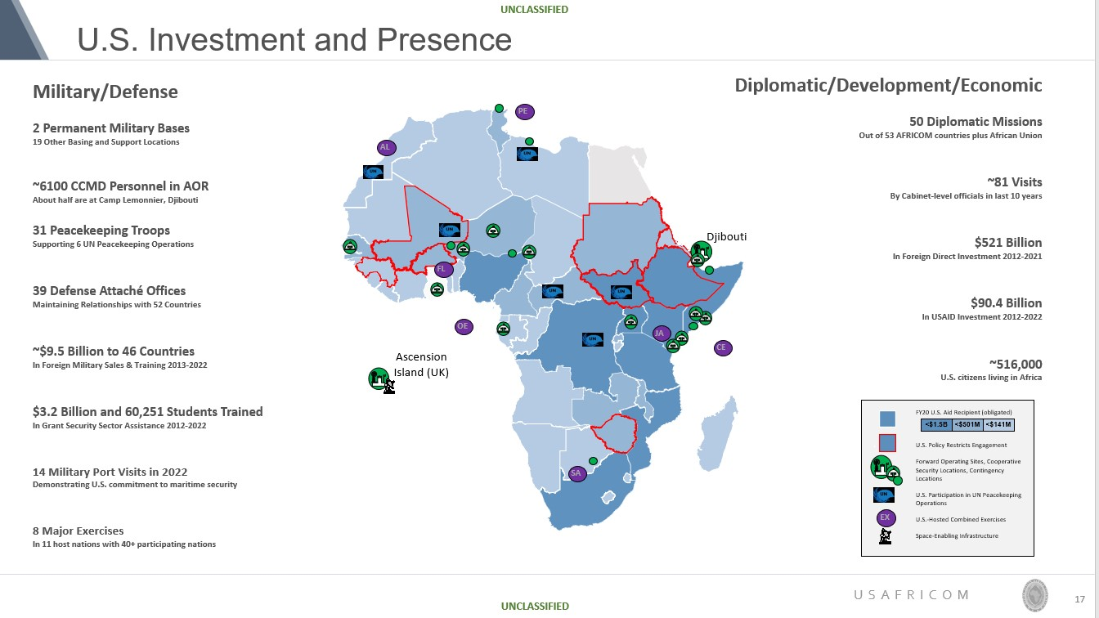
A Model of 3Ds Planning: Diplomacy, Development & Defense

Slide 19
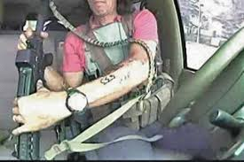
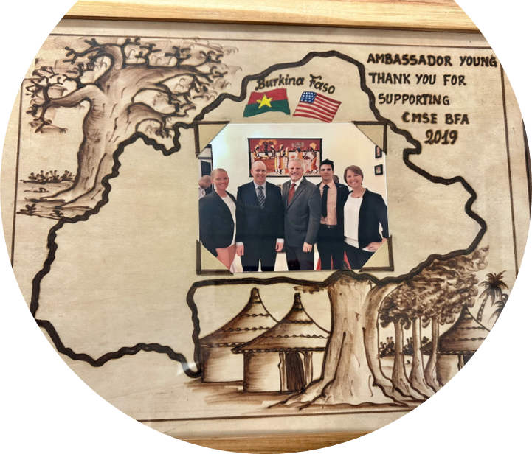
More Effective Together
Radisson Blu Bamako:
SOF & DoS go kinetic
DoD, DoS, USAID enable Burkinabè
to stay in the fight
Operation United Assistance.
DOD surge enabled by DoS footprint and USAID technical skills to defeat Ebola in Liberia.

Slide 20
Key Takeaways
We are Better, Together
Cannot Surge Trust & Cannot Surge Context - Invest Early in Both
All of us Build Trust & Shared Effectiveness through
Communication,
Advocacy,
Transparency,
Notes:
The best strategies employ all instruments of national power to advance U.S. national interests
Diplomacy, Development, Defense are different and complementary

Slide 21
Comments & Questions

Slide 22
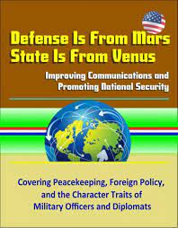
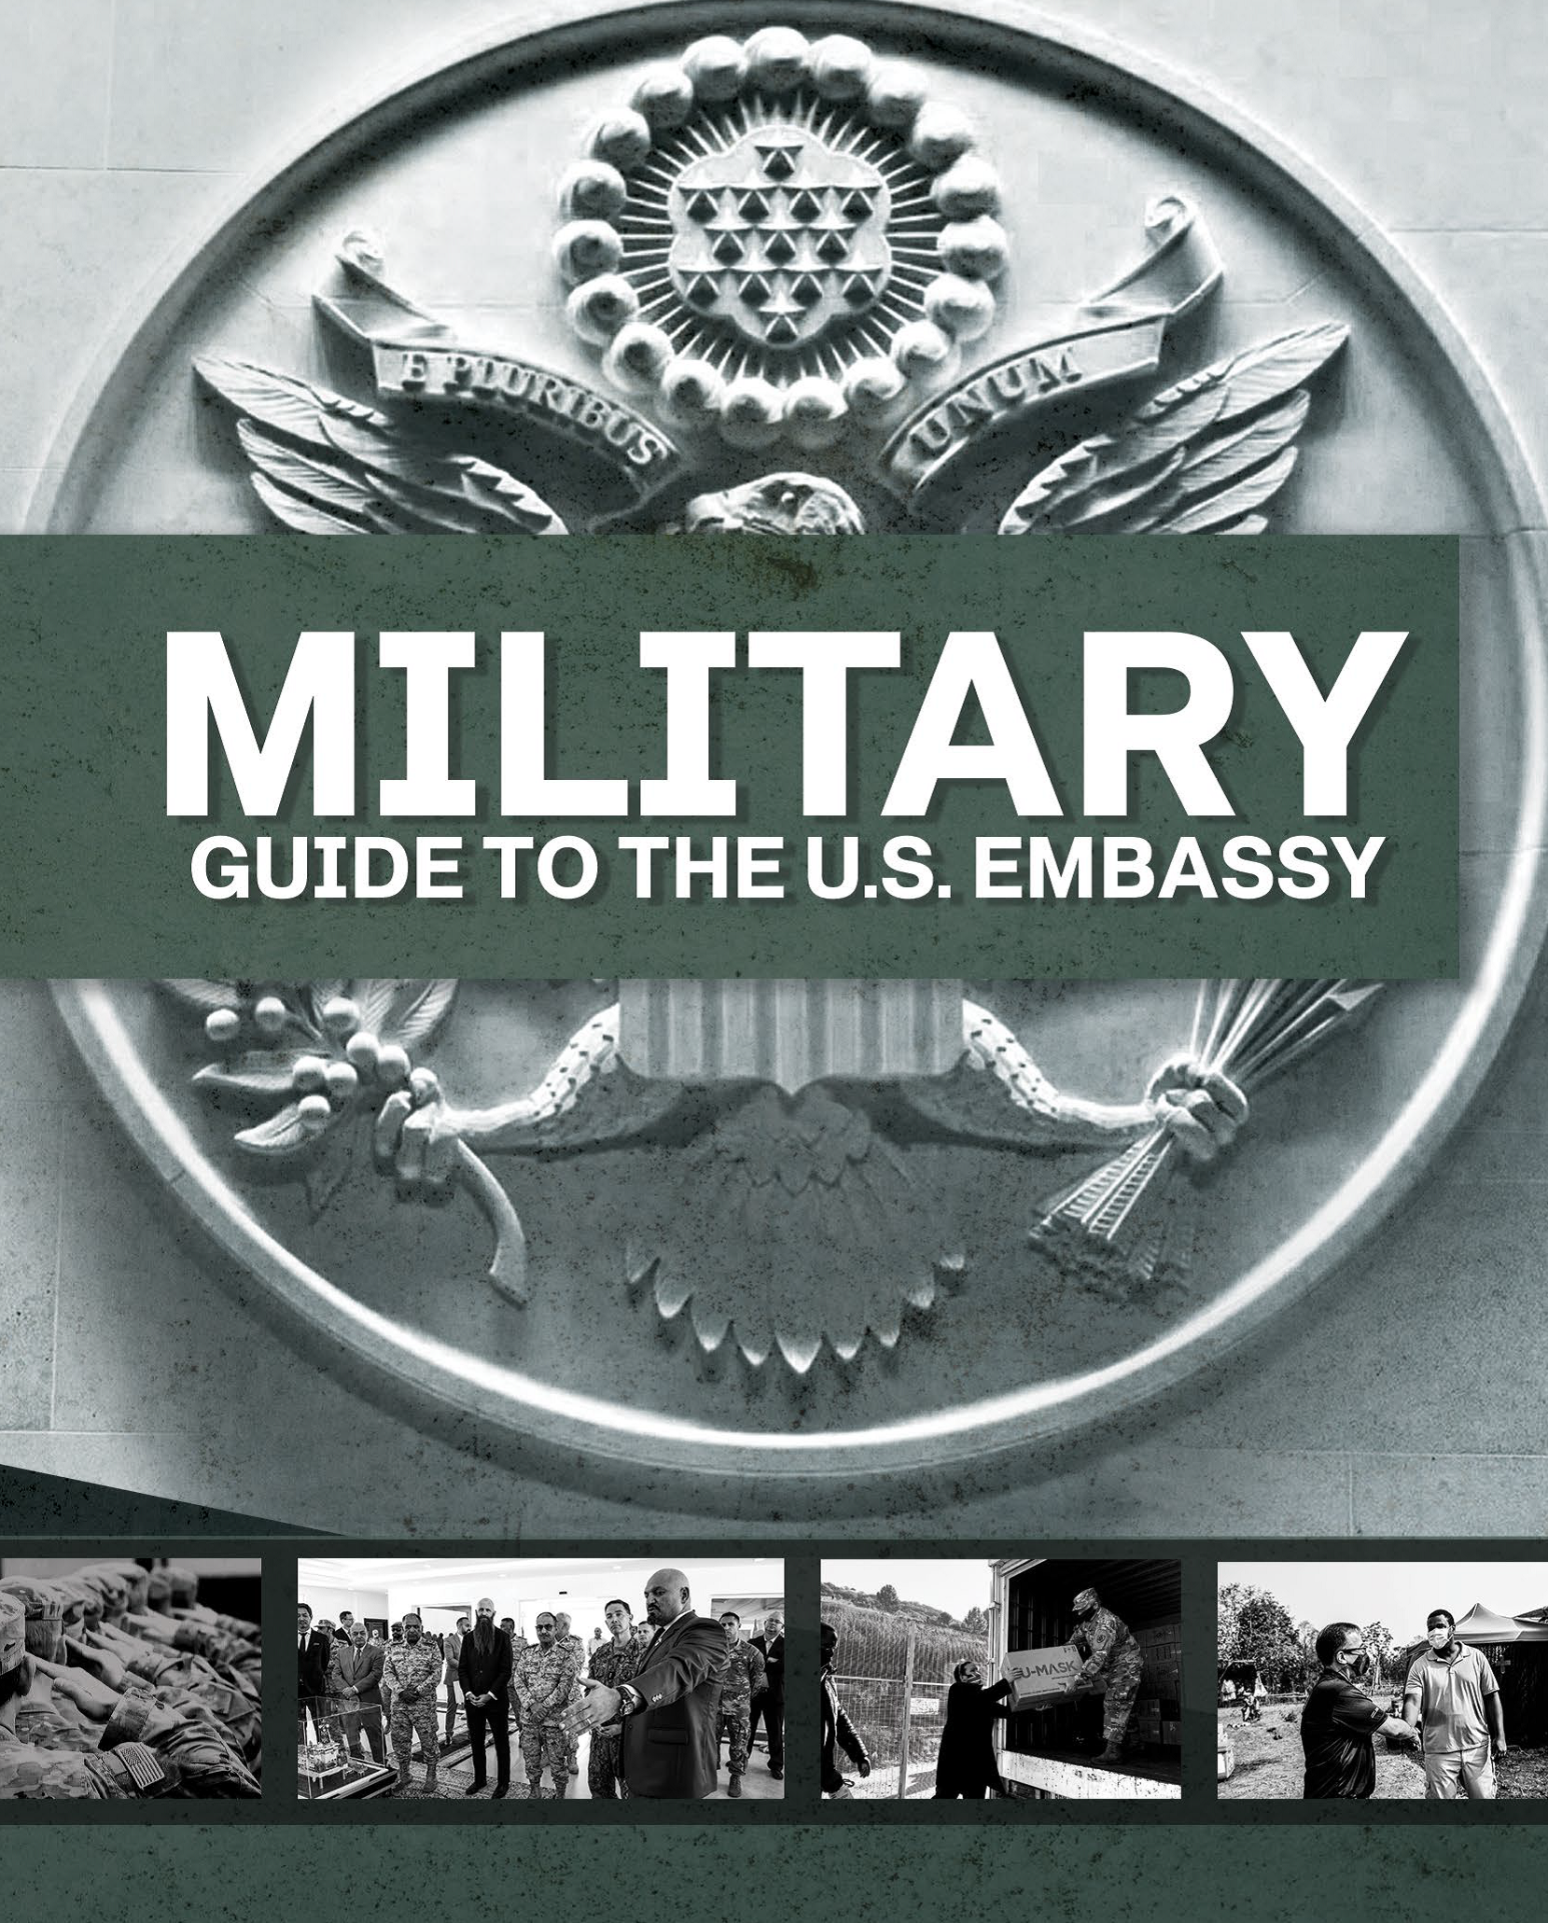
Additional Resources
Andrew Young
Andrew.R.Young.civ@NDU.edu

Slide 23
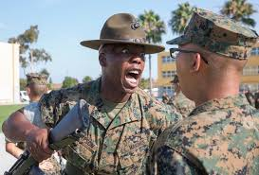
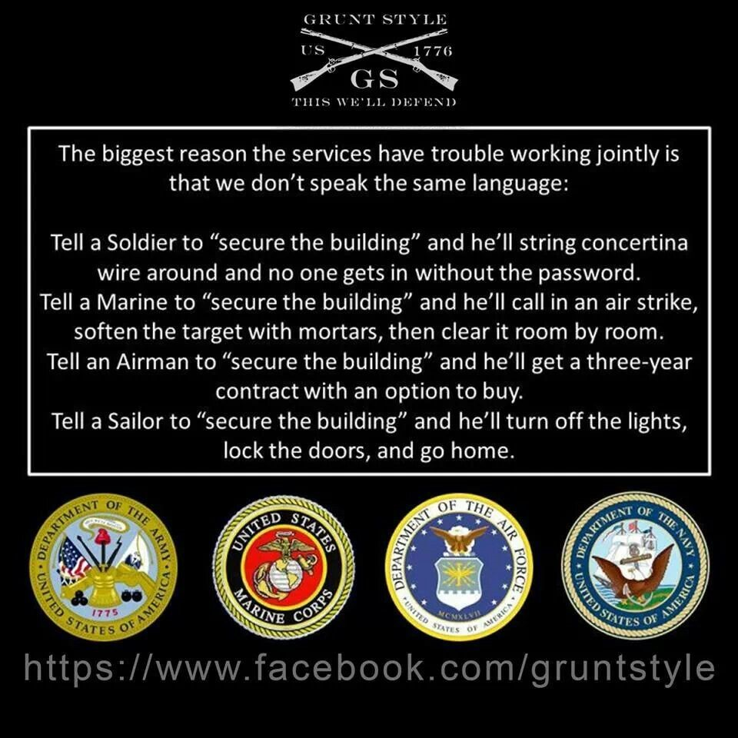
Stereotypes

Slide 24
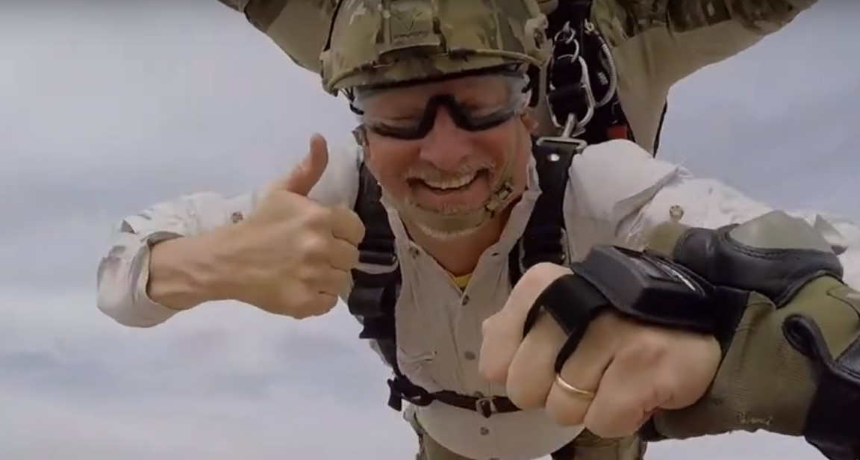
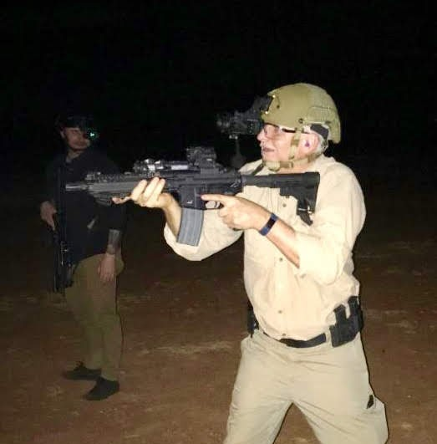
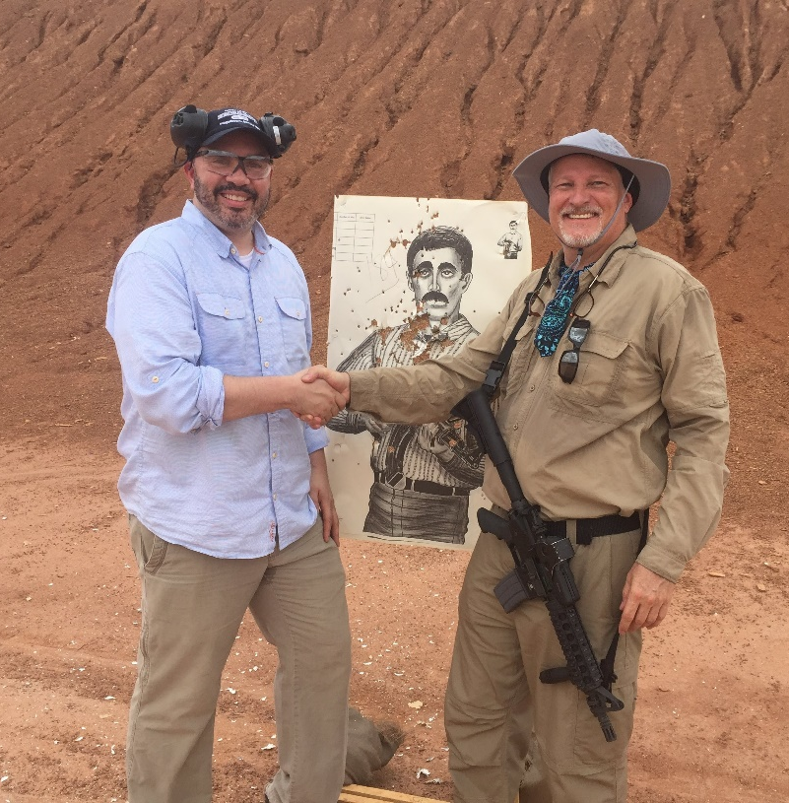
Typical Diplomat?

Slide 25
Back Up Slides

Slide 26
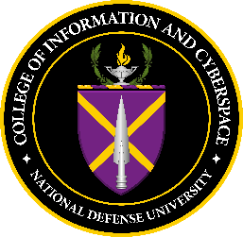
Colleges:
= JPME II programs
MS in National
Security
Strategy
MS in National Resource Strategy
MS in Joint Campaign Planning and Strategy
MS in Strategic Information & Cyberspace Studies
MA in Strategic Security Studies
Senior Acquisition Course
Joint Advanced Warfighting School
Certificates: Cyber Leadership, CIO, CISO, CFO, IT Program Mgt, Chief Data Officer
Joint Special Operations MA
Programs:
Joint and Combined
Warfighting School
Concentrations:
Cyber Studies, Data
& Disruptive Tech, Financial Mgt, Influence Warfare
Reserve Comp. Nat. Sec. Course
JC2IOS
Resident/Satellite/Hybrid
NDU Board of Visitors
OSD Policy Centers at NDU
CSWMD
CSR
Africa Center
CAPSTONE
PINNACLE
KEYSTONE
CSCMA
NDU Foundation
Near East South Asia Center
NDU Press
ISMO and American Studies Program
AY22: 145 International Fellows from 75 countries
Total: 4,712 international alumni from 152 countries
Perry Center Western Hemisphere
CASL
2 Accreditations: Middle States Commission on Higher Education & Process for Accreditation of Joint Education

Slide 27
National Defense University : International Students : Allies and Partners
NDU International Fellows Alumni:
A Powerful Network of Partners
146 students from 80 countries currently enrolled in 10-month programs across 3 campuses
International Alumni:
- 5000+ graduates
- 152 countries represented
84 International Fellows Hall of Fame Inductees
NDU alumni now serving
in positions of prominence:
Cabinet Minister - 3
Chief of Defense - 5
Chief of Service - 22
Ambassador - 2

Slide 28
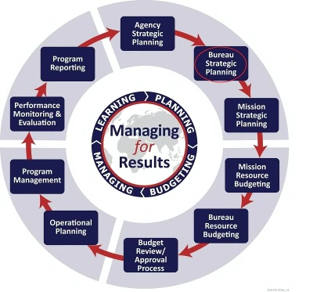
State Department Planning Documents
U.S. National Security Strategy
Department of State and USAID Joint Strategic Plan FY 2022-2026 sets forth the vision and direction for both organizations and presents how the Department and USAID will implement U.S. foreign policy and development assistance.
Regional Bureau Strategic Plans
Mission Strategic Plan/Integrated Country Strategy

Slide 29
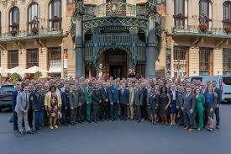
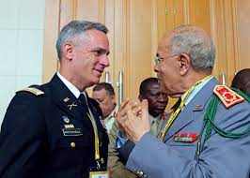
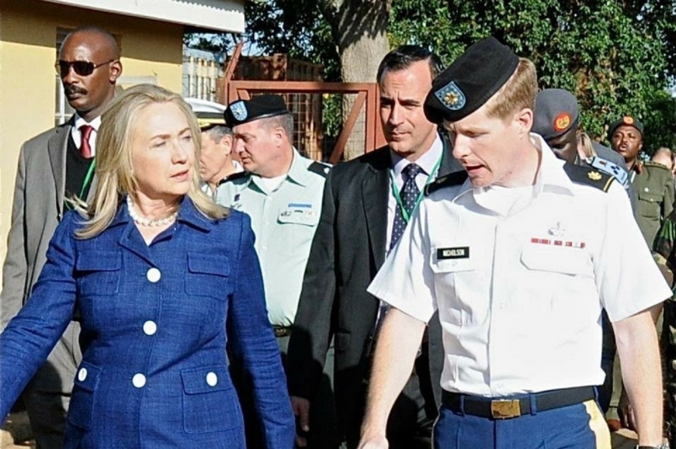
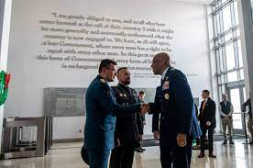
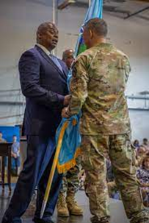
Warrior Diplomats: Foreign Area Officers
Building Partnerships

Slide 30
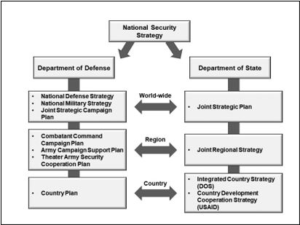
National Security Planning
Notes:
The White House publishes the National Security Strategy (NSS). Congress uses the NSS to set broad strategic goals and describe security concerns that guide employing elements of national power for the security of the United States. This forms the guiding document for planning done by the Department of Defense (DoD), Department of State (DoS), and the U.S. Agency for International Development (USAID), which turns the strategic guidance into specific objectives and actions down to the country level. The planning documents developed within the interagency construct have counterparts at each echelon.

Slide 31
UNCLASSIFIED
Strategic Guidance Toplines
NSS
2022 National Security Strategy
Out-compete China and Constrain Russia
Partner-led, US-Enabled strategy
In Africa:
Build 21st Century African Partnerships
Work closely with African regional bodies
Invest in Africa’s leading states, while deepening ties to emerging states
Engage as equal partners
Counter democratic backsliding by imposing costs on non-democratic transfers of power and endorsing civilian transitions
Enhance Africa’s peace and prosperity, and ability to solve regional challenges
U.S
SSA
2022 U.S. Strategy for Sub-Saharan Africa
Develop and enhance African Partner capacity to
Promote Regional Peace and Security
Counter terrorism and VEOs
Deliver security for democracies to thrive
Deliver security dividends –focus defense tools on enabling partners to respond to the drivers of conflict
Focus on increasing partner capacity, investing in security cooperation, and develop institutions to respond regionally
NDS
2022 National Defense Strategy
Integrated Deterrence
Campaigning to build enduring advantages
Monitor and Respond for Africa
Anchoring our strategy in allies and partners to advance regional goals
In Africa:
Prioritize disrupting VEOs threats against the homeland
Build state’s capability to degrade terrorist organizations
Orient towards security cooperation, increased coordination with Allies, and support U.S. interagency to disrupt PRC and Russian activities
NMS
2023 National Military Strategy
Strategic Discipline-ruthless prioritization and JF OAIs
Global Integration
Deter today, develop future warfighting advantage tomorrow
Defend the Homeland
Deter Strategic Attacks
Prevail in conflict
Focus on modernization
UNCLASSIFIED

Slide 32
UNCLASSIFIED
AFRICOM Campaign Plan
AFRICOM Mission Statement: U.S. Africa Command, with partners, counters malign actors and transnational threats, responds to crises, and strengthens security forces in order to advance U.S. national interests and promote regional security, stability, and prosperity.
1
2
3
4
AFRICOM Priority
Country List (APCL)
AFRICOM Priority Country List
(APCL)
Campaign Objective
Ensure Access and Influence
Campaign Objective
Counter Threats
Campaign Objective
Respond to Crisis
Campaign Objective
Team with Allies and Partners
Gain and Maintain
Strategic Access and Influence
Disrupt Violent Extremist
Organizations and Other Emerging Threats to
U.S. Interests
Prepare for and Respond to Crises to Protect U.S. Interests
Coordinate Action with Allies and Partners to Achieve Shared Security Objectives
Geostrategic Chokepoint
Sea Lines of Communication
End State: Adversary and competitor activities in Africa are effectively identified, countered, disrupted, or deterred. VEOs no longer pose a threat to the U.S. homeland; AFRICOM retains the strategic and operational access, influence, and partnerships necessary to conduct crisis and contingency operations. AFRICOM actions contribute to DoD and whole of government efforts to enhance regional security, stability, and prosperity.
UNCLASSIFIED

Slide 33
A Model of Integrated 3D Planning at the Combatant Command Level
Mutually Reinforcing Diplomacy, Development and Defense

Slide 34
UNCLASSIFIED
U.S. Investment and Presence
Military/Defense
2 Permanent Military Bases
19 Other Basing and Support Locations
~6100 CCMD Personnel in AOR
About half are at Camp Lemonnier, Djibouti
31 Peacekeeping Troops
Supporting 6 UN Peacekeeping Operations
39 Defense Attaché Offices
Maintaining Relationships with 52 Countries
~$9.5 Billion to 46 Countries
In Foreign Military Sales & Training 2013-2022
$3.2 Billion and 60,251 Students Trained
In Grant Security Sector Assistance 2012-2022
14 Military Port Visits in 2022
Demonstrating U.S. commitment to maritime security
8 Major Exercises
In 11 host nations with 40+ participating nations
Diplomatic/Development/Economic
50 Diplomatic Missions
Out of 53 AFRICOM countries plus African Union
~81 Visits
By Cabinet-level officials in last 10 years
$521 Billion
In Foreign Direct Investment 2012-2021
$90.4 Billion
In USAID Investment 2012-2022
~516,000
U.S. citizens living in Africa
PE
AL
Djibouti
FL
OE
JA
Ascension Island (UK)
CE
FY20 U.S. Aid Recipient (obligated)
U.S. Policy Restricts Engagement
Forward Operating Sites, Cooperative Security Locations, Contingency Locations
U.S. Participation in UN Peacekeeping Operations
U.S.-Hosted Combined Exercises
Space-Enabling Infrastructure
<$1.5B
<$501M
<$141M
SA
EX
UNCLASSIFIED

Slide 35
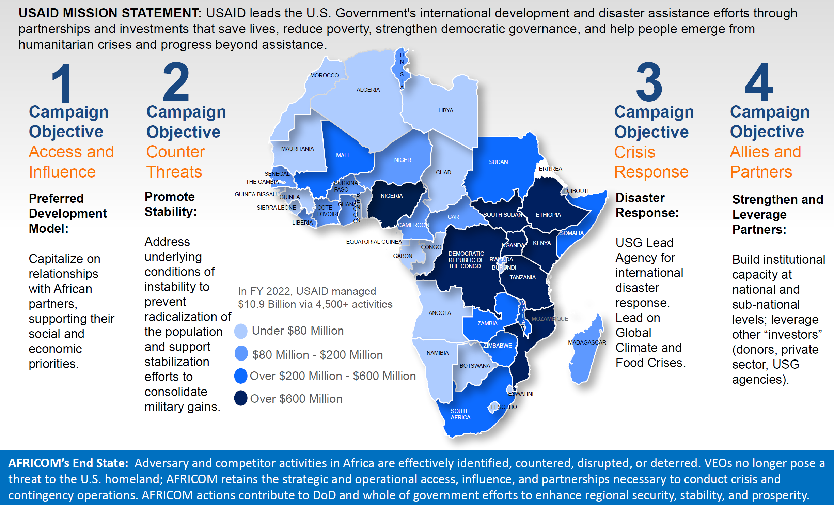
UNCLASSIFIED
USAID: Advancing the AFRICOM Campaign Plan
UNCLASSIFIED

Slide 36
A Quick Guide to U.S. State Department Rank and Insignia
Rank | FS-05 | FS-04 | FS-03 | FS-02 | FS-01 | FS-OC | FS-MC | FS-CM | FS-CA
GS Equivalent | GS-8/9 | GS-10/11 | GS-12/13 | GS-14 | GS-15 | SES | SES | SES | SES
DoD Equivalent | O-2 | O-3 | O-4 | O-5 | O-6 | O-7 | O-8 | O-9 | O-10
Insignia (Male)
Insignia (Female)
Typical Title (Male) | Bob | Bob | Bob | Bob | Bob | Bob | Bob | Bob | Sir
Typical Title (Female) | Carol | Carol | Carol | Carol | Carol | Carol | Carol | Carol | Ma’am
UNCLASSIFIED

