Slide 1
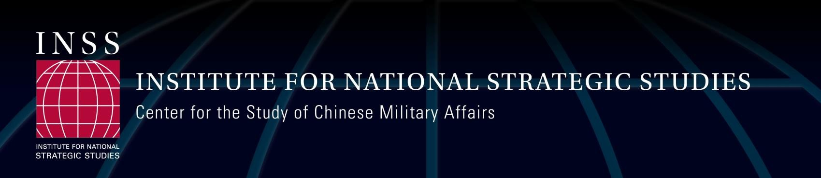
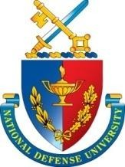
System Destruction Warfare and the PLA
Briefing for Capstone
February 2026
Phillip C. Saunders, Ph.D.
Director, INSS Center for the Study of Chinese Military Affairs

Slide 2

A Party-Army
PLA established in 1927
Officers are CCP members who take an oath to the party, not the nation
Typically led by the party general-secretary, currently Xi Jinping
Central Military Commission - the high command - is a party organ; culture of micromanagement from the center
System of political commissars and party committees to ensure compliance; units must make decisions based on consensus
In practice, the PLA monitors itself, which breeds corruption
20-25% of a soldier’s time is on political indoctrination - increased after troops failed to follow orders in 1989
A Very Different Oath
I am a member of the People’s Liberation Army. I promise that I will follow the leadership of the Communist Party of China, serve the people wholeheartedly, obey orders, observe strict discipline, fight heroically, fear no sacrifice, work hard to improve my fighting ability, prepare for battle at all times, and under no circumstances will I ever betray the Military or the Motherland.

Slide 3
China’s Military Strategic Guidelines
Year | Name | Primary Opponent | Primary Direction | Basis of Preparations for Military Struggle | Main Form of Operations
1956 | Defending the motherland | US | northeast | US amphibious assault | Positional defense, mobile offense
1960 | Resist in the north, open in the south | US | northeast | US amphibious assault | Positional defense, mobile offense
1964 | Luring the enemy in deep | US |  | US amphibious assault | Mobile, guerilla warfare
1977 | Active defense, luring the enemy in deep | USSR | North-central | Soviet armored/airborne assault | Mobile, guerilla warfare
1980 | Active Defense | USSR | North-central | Soviet armored/airborne assault | Positional warfare or fixed defense
1988 | Dealing with local wars and military conflicts
1993 | local wars under high tech conditions | Taiwan | southeast | Warfare under high-tech conditions | Joint operations
2004 | local wars under informationized conditions | Taiwan/US | southeast | Warfare under informationized conditions | Integrated joint operations
2014 | informationized local wars | Taiwan/US | southeast and maritime | Informationized warfare | Integrated joint operations
2019 | Informationized local wars | Taiwan/US | southeast and maritime | Informationized warfare | Integrated joint operations
Sources: Fravel (2019), Fravel and Wuthnow (2022)
2

Slide 4
PLA Strategy and Operational Thought
Overall Military Strategy remains “Active Defense”
Retains political advantage of “defensive” strategy, but in practice PLA seeks to seize the initiative and take the offense
“Informationized local wars” (2004, 2014, and 2019 updates)
Information plays a key role in modern battle (lessons from the Gulf War and
other U.S./NATO campaigns)
Development of the Integrated Command Platform and IT modernization in the logistics system
From basic coordination between the services to “integrated joint operations” featuring seamless communication between units from the different services
Greater focus on the space, cyber, and electromagnetic domains reflected desire to attain information dominance
Systems Destruction Warfare as key operational concept
Multi-domain precision warfare (MDPW) as new operational concept
4

Slide 5
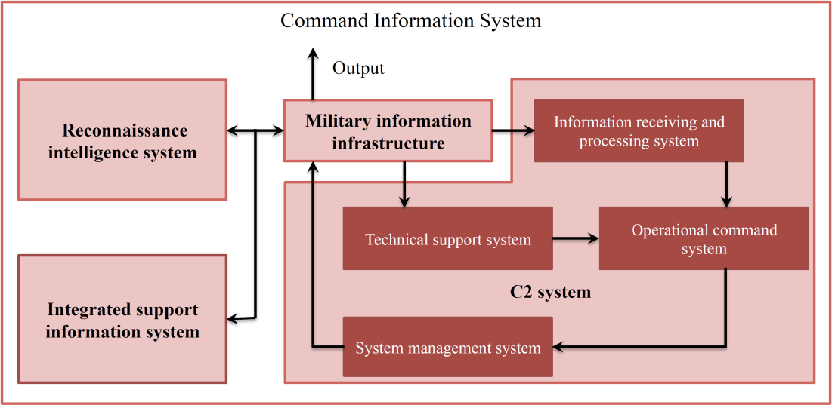
Core Operational Concepts
System Destruction Warfare and “Multi-Domain Precision Warfare”
According to this theory of victory, the enemy “loses the will and ability to resist” once its operational system cannot function (assuming that one’s own system can continue to function)
Key systems
-Command system
-Firepower strike system
-Information confrontation system
-Reconnaissance intelligence system
-Support system
Source: Engstrom, 2018
PLA is developing a related idea of “multi-domain precision warfare” that blends conventional strike with operations in other domains to assess and target adversary operational systems
Emphasis on shaping the political battlefield in peacetime and on seizing and maintaining the initiative in combat
3

Slide 6
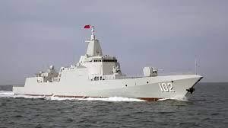
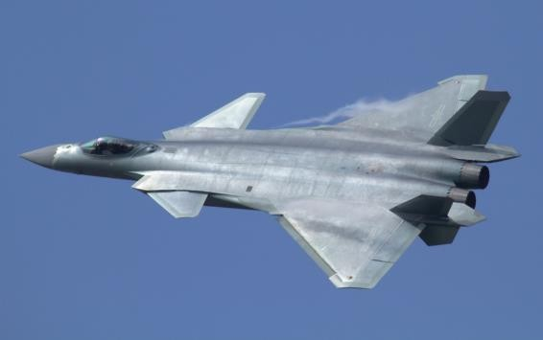
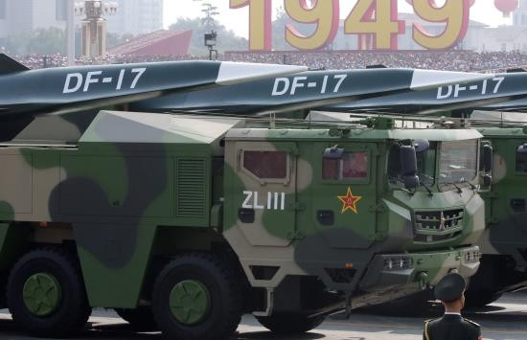
“World Class” Hardware
Conventional strike enables “system destruction warfare”/“multi-domain precision warfare”
PLA upgrading its inventory as part of its 2027-2035-2049 modernization goals
Fifth-generation fighters – 140+ J-20s allocated to all five theaters; new “sixth-gen” fighters
Progress towards H-20 (stealth) bomber – will have extended range
Rolling out Type-055 cruiser (13,000-ton ship with Aegis-like defenses)
Quiet, high-performance diesel electric submarine fleet plus smaller SSN force
Long-range precision munitions fitted with hypersonic glide vehicles (DF-17, DF-27)
Expanding means of “strategic deterrence”
Expanding nuclear inventory – tripling warheads by 2027, nuclear triad
Emphasis on “information age” weapons – space, cyberspace, EW
Type-055 cruiser
J-20 fighter
DF-17 MRBM
4

Slide 7
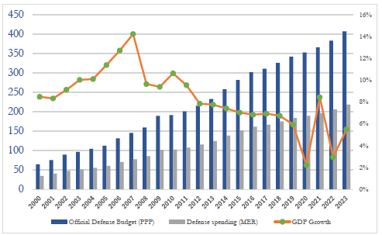
Resourcing
Official budget: $231 billion (2024)
More than $300 billion when accounting for off-budget expenses, e.g. R&D
China also derives perhaps ~$150B in value due to PPP differential
Largest defense budget in Asia (but well behind U.S. $895 billion FY25 budget)
Budgets growing at high single-digit rates
Still small as percentage of GDP and central government expenditures
Shift towards technological innovation
1990s, 2000s: mostly relying on foreign absorption. Allows PLA to catch up quickly but remains dependent on foreign technology
Today: PLA imports very little from abroad. Mostly self-sufficient. Unclear what impact U.S. restrictions in AI, semiconductors, quantum will have.
CMPR, 2024

Slide 8
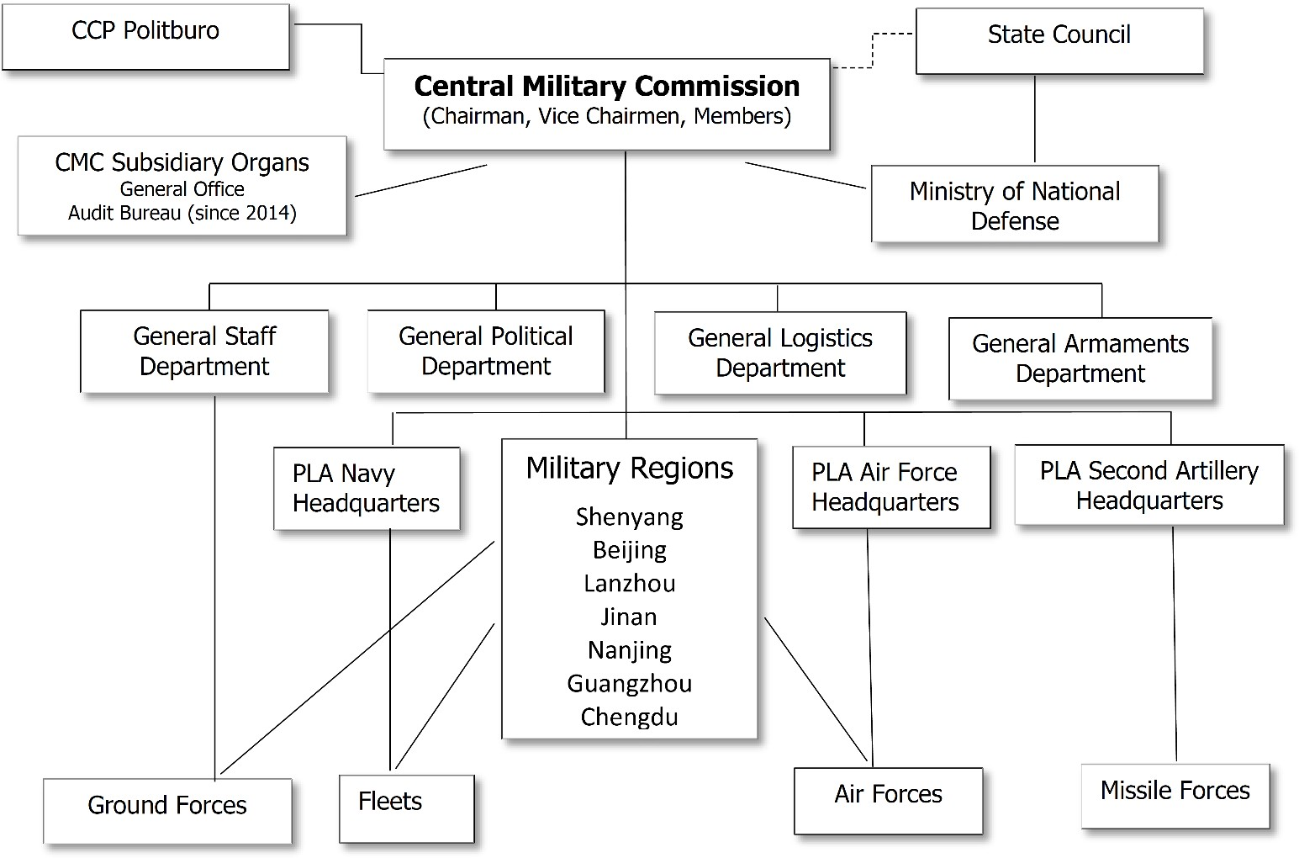

Pre-Reform PLA
PLA Org Before the Reform
1
3
4

Slide 9
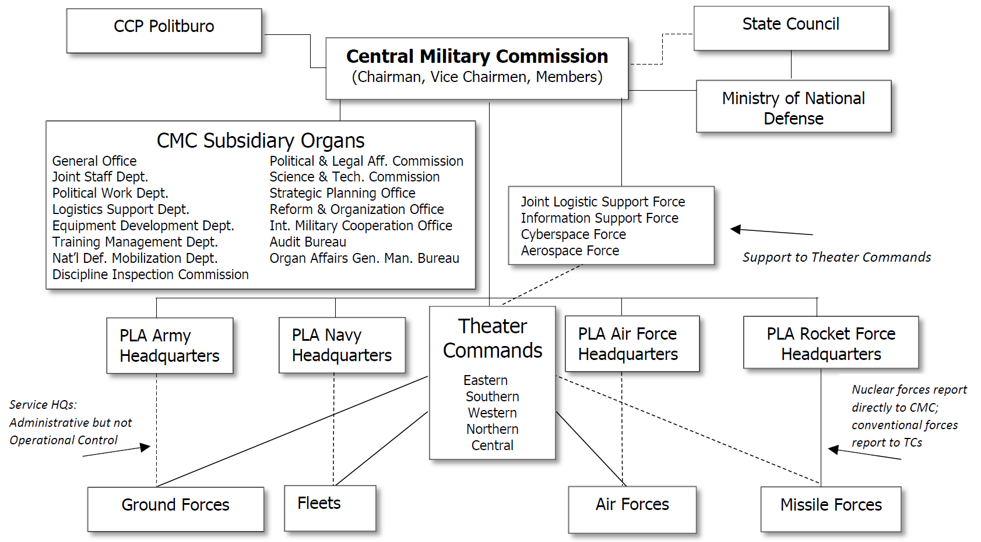
Structural Reforms
1
4
2
3
Organizational reforms promote multi-domain joint operations and allow for a more rapid transition from peace to crisis to war
5

Slide 10
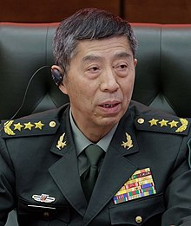
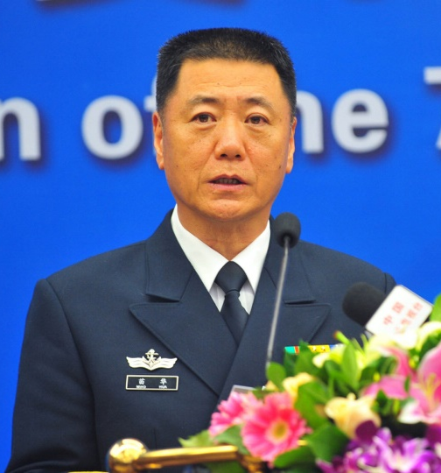
Corruption and Control
A Legacy of Distrust
Xi inherited a PLA with excessive secrecy, corruption, and questionable commitment to the Party’s ideals and values.
Early anti-corruption campaigns rooted out political rivals but could not remake a culture of non-compliance. System where PLA monitors itself breeds corruption.
Procurement scandals may impact military equipment and military readiness.
Serious questions whether any top civilian party leader can count on his most senior commanders to provide unvarnished advice on capabilities
Distrust exacerbates concerns that commanders lack real combat experience.
How much will emphasis on political control affect PLA combat capability?

Slide 11
Current PLA Purges
Round One (2023): PLARF Commander and Political Commissar replaced with navy and air force officers; deputies under investigation; former PLARF Commander/MINDEF Wei Fenghe expelled from CCP
Round Two (2024-2025): CMC Vice-Chair He Weidong, MINDEF Li Shangfu, and PWD director Miao Hua purged
Round Three (2026): CMC Vice-Chair Zhang Youxia and Joint Staff Department Chief Liu Zhenli purged
Most senior PLA officers on CMC staff, Theater Commands, and Services currently under investigation
Not clear whether Xi’s decision to purge most senior PLA leaders was due to concerns about corruption, political control, usurping his authority, or slow progress in military modernization
Near-term disruption will delay modernization goals, but younger, better trained generals may increase PLA effectiveness in medium-term

Slide 12
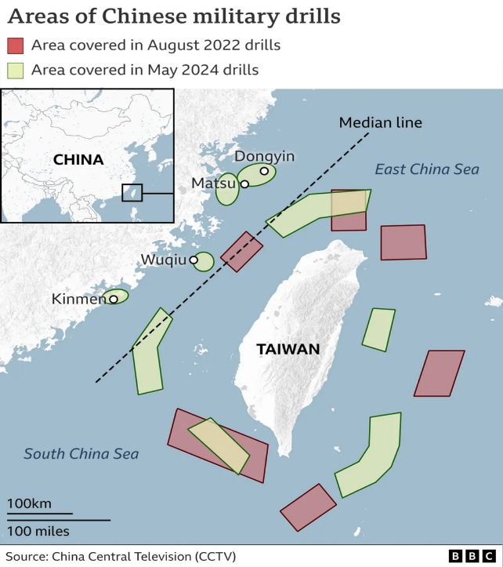
Implications for Taiwan
A Dangerous Decade – But Hope Remains
A new normal of “gray zone” coercion – focus on pressure tactics while limiting escalation and offering experience to troops. PLA has capacity to stage a quarantine/blockade, conduct missile bombardments, or seize offshore islands. Could inflict major economic disruption at a moment of internal uncertainty.
2027 is a readiness milestone for the PLA. Xi expects them to be able to conduct major operations against Taiwan by this date.
PLA is resolving key logistics challenges by scaling up production of transport assets and experimenting with new options.
PLA is strengthening tools to conduct key-point strikes against U.S. targets in the Western Pacific and to deter U.S. intervention through a “strategic deterrence” campaign.
However, PLA facing uncertainty given U.S. technological advances. An invasion would risk massive economic sanctions.
Taiwan in the process of learning lessons from Ukraine and undertaking badly needed defense reforms.
9

Slide 13
What’s Next for the PLA?
Near Term Assessment
Intensification of psychological warfare against Taiwan
Low appetite for actual conflict with other regional rivals and continued hesitance to ramp up global posture
Xi is in a continuing struggle to put capable/reliable officers in charge
Purges will disrupt near-term ability to conduct major campaign against Taiwan
Long Term Assessment
Military buildup emphasizing PRC advantages in industrial production and military financing will continue towards 2049
China’s willingness to expand global competition hinges on cross-Strait relations, intensity of Sino-U.S. rivalry, and internal PRC conditions
Difficult to resolve problems in human capital, organizational dynamics, party-army trust; Xi’s successor will struggle to rein in the PLA
Will younger generation of PLA leaders be more effective?
Will CCP Leadership maintain decades-long strategic patience that allowed sustained focus on PLA modernization?
10

Slide 14
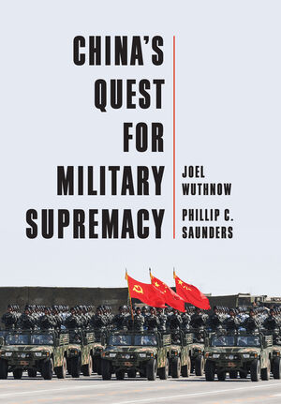
Further Reading/Contacts
NDU:
Center for the Study of Chinese Military Affairs
https://inss.ndu.edu/About/Center-for-the-Study-of-Chinese-Military-Affairs/
Army War College:
China Landpower Studies Center
https://ssi.armywarcollege.edu/CLSC/
Air University:
China Aerospace Studies Institute
https://www.airuniversity.af.edu/CASI/
Naval War College:
China Maritime Studies Institute
https://usnwc.edu/Research-and-Wargaming/Research-Centers/China-Maritime-Studies-Institute
https://ndupress.ndu.edu/

Slide 15
Backup Slides

Slide 16
PLA Operational Thought
1993: A Key Shift
From luring deep to fighting forward
From a war of annihilation to a campaign against key points
From a war of attrition to a decisive campaign with a decisive first battle
From waiting for the first blow to deterring the first blow by force
From a defensive campaign to an “offensive defense” campaign
From “advance and retreat boldly” to checking the initial enemy advance
From a “front army campaign” to a “war zone” campaign
From the principle of mass to the principle of concentration of firepower
From four single service campaigns to joint campaigns.
Source: Finkelstein (2000)
16

Slide 17
A New Joint C2 Structure
CMC Members
Strategic Decision-
Making
CMC General Office
CMC Joint Staff Dept.
Communications and War Readiness Office
Operations Dept./PLA Joint Operations Command Center
Supervises OOA operations
SSF/JLSF
enablers
Service HQs
Operational Decision-Making
Theater Command HQs
“Title X” oversight
TC Joint Operations Command Centers
TC Service Component HQs
Operations Departments
Operational Forces

Slide 18
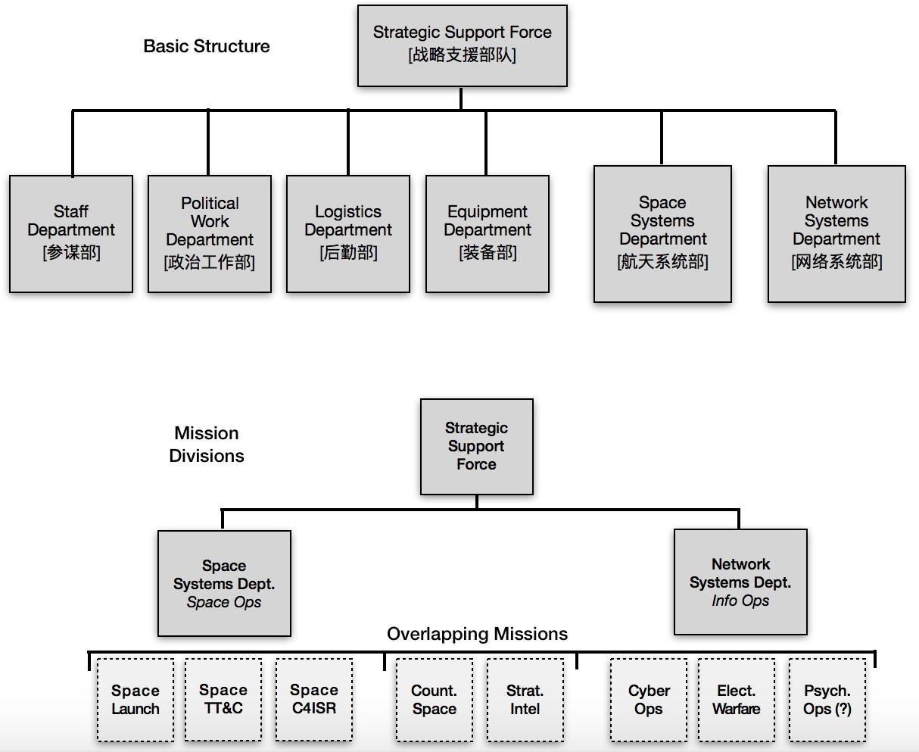
Strategic Support Force

Slide 19
Systems Destruction Warfare Concepts
Conflict is won by the belligerent that can disrupt, paralyze, or destroy the operational capability of enemy’s operational system through kinetic and nonkinetic strikes against key points and nodes
1. Flow of Information | 2. Essential Elements | 3. Operational Architecture | 4. Time Sequence
Disrupt or destroy: | Disrupt and paralyze: | Destroy: | Disrupt and paralyze:
Key data links Information network sites | C2, recon- intelligence, firepower, maneuver, protection, support, etc., capabilities | Physical nodes of essential elements | Reconnaissance -control-attack evaluation process
16
Jeffrey Engstrom, Systems Confrontation and Systems Destruction Warfare (RAND, 2018).

Slide 20
System Destruction Warfare Capabilities
The PLA has invested heavily in ISR, long-range and precision- strike, electronic warfare, counter-space systems, and offensive cyber capabilities that can attack key nodes in adversary systems and the C4ISR network that supports them
DF-21D and DF-26 Anti-Ship Ballistic Missiles
Land-attack cruise missiles and accurate terminally-guided ballistic missiles
Anti-satellite systems and jamming capabilities
These complement more capable conventional ships, submarines, and aircraft; longer-range offensive and defensive missiles; and longer-range bombers and aircraft carriers that are giving the PLA a significant power projection capability
In a conventional war, many of these power projection capabilities would fall off significantly as the conflict gets further away from the Chinese mainland
17

Slide 21











Career Patterns
PLA officers are siloed within specific career tracks
Not much interchange between different parts of the PLA: on 18% of senior officers served in both a Theater
Command and a CMC department in the last decade.
Little functional crossover: PLA officers usually stay within the same general career field.
PLA senior leaders change assignments every 2-3 years on average but wide variation. There is a “Beijing caste” that rarely rotates. Less than average U.S. 4-star tour of about 18 months.
Frequent geographic rotations at a senior level: 77% of 2021 cohort served in two or more theaters in the past decade. This is a long-term pattern intended to reduce patronage networks.
Rotations Between Position Types in the Previous 10 Years (percentage)
PLA Career Fields
Military Affairs (军事军官)
Political (政治军官)
Logistics (后勤军官)
Armaments (装备军官)
Technical Specialists (专业技术军官)
100
80
60
40
20
0
32
25
18
Service HQ to Service HQ to CMC CMC Department to Theater Command Department Theater Command
Yes No
Unclassified

Slide 22







Career Patterns
The PLA Does Not Prioritize “Joint” Experience for Rising Leaders
Only 56% of 2021 cohort held a “joint” position in the last decade (e.g., service in a General Department/CMC Department, MR/TC HQ, or NUDT/NDU/AMS)
Joint experience drops off significantly at the Corps Leader grade and below
There do not appear to be formal guidelines that officers need joint experience akin to the U.S. Joint Duty
Qualifications, though some in the PLA have discussed such a system
Joint Assignments Previous 10 Years, by Grade (%) – 2021 Cohort
120
100
80
60
40
20
0
 | 87
 |  |  | 76
 |  |  |  |  | 51
CMC Vice Chairmen/Members
TC Leader
TC Deputy Leader
Yes No
Unclassified

Slide 23
Bibliography
Jeffrey Engstrom, Systems Confrontation and System Destruction Warfare: How the Chinese People's Liberation Army Seeks to Wage Modern Warfare (Arlington, VA: RAND, 2018)
Joel Wuthnow and Phillip C. Saunders, China’s Quest for Military Supremacy (Hoboken, NJ: Polity Press, 2025)
John Costello and Joe McReynolds, China's Strategic Support Force: A Force for a New Era, China Strategic Perspectives 13 (October 2018).
Phillip C. Saunders Arthur S. Ding, Andrew Scobell, Andrew N.D. Yang, and Joel Wuthnow, eds., Chairman Xi Remakes the PLA: Assessing Chinese Military Reforms (Washington, DC: National Defense University Press, 2019)
Joel Wuthnow, Derek Grossman, Phillip C. Saunders, Andrew Scobell, and Andrew N.D. Yang, eds., Crossing the Strait: China’s Military Prepares for War with Taiwan (Washington, DC: NDU Press, 2022).
20

