Slide 1
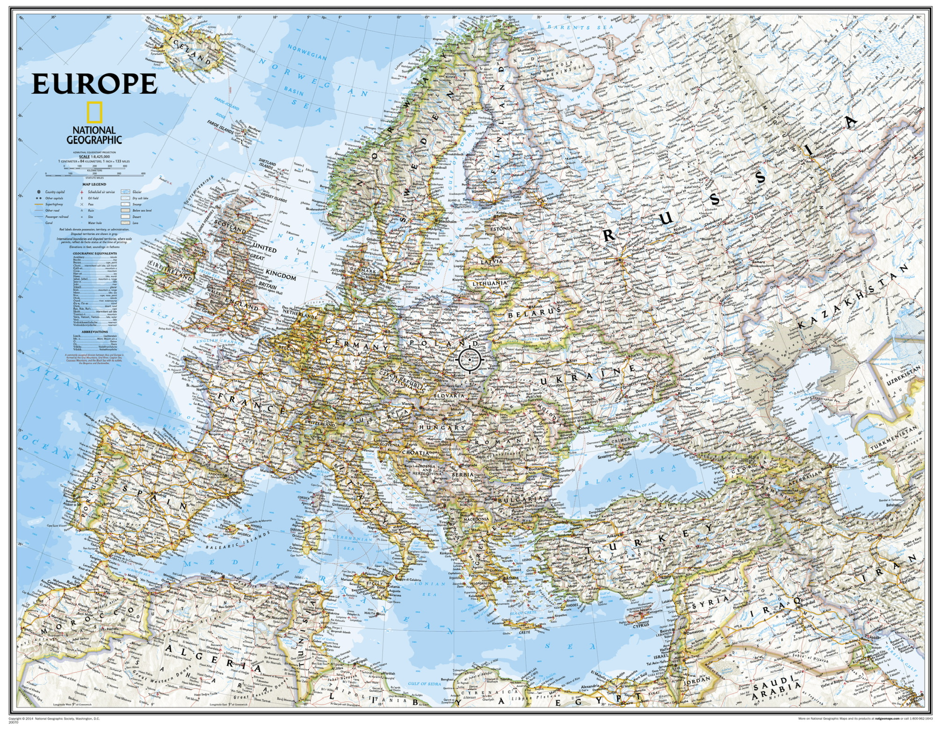
National Defense University
Washington DC
12 August 2025
1. NATO
2. EU
Concluding Thoughts
John N. Christenson, Vice Admiral U.S. Navy, (Retired)
Notes:
Thank you Larry Chalmers, Bonnie and Teresa.

Slide 2
Part 1:
NATO
North Atlantic Treaty Organization
August 2025

Slide 3
Why NATO?
”Killed or allowed to die by human decision”
~ 231 million for the 20th Century
“Deaths in Wars and Conflicts in the 20th Century” Milton Leitenberg CORNELL UNIVERSITY PAPER ©2006
When is it ok to kill your fellow man?
August 2025
Notes:
When is it ok to kill your fellow man?

Slide 4
Why NATO?
“The crimes which we seek to condemn and punish have been so calculated, so malignant and so devastating, that a civilization cannot tolerate their being ignored, because it cannot survive their being repeated.”
-U.S. Chief Prosecutor Robert Jackson, Opening Address for the United States, November 21, 1945 International Military Tribunal, Nuremberg
Never Again
August 2025
Notes:
Never again!

Slide 5
Why NATO?
“If you want peace, prepare for war”
-4th Century Roman
“Win without fighting”
-544 BC Sun Tzu China
Western Thought Eastern Thought
August 2025
Notes:
4th century Roman. 544BC.

Slide 6
Why NATO?
“Keep the Soviet Union out, the Americans in, and the Germans down.”
Lord Hastings Lionel Ismay, NATO’s first Secretary General
August 2025
Notes:
2.5 out of 3

Slide 7
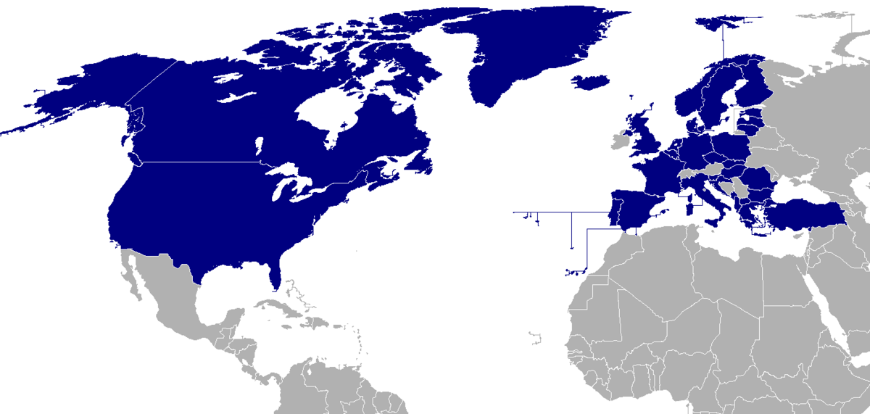
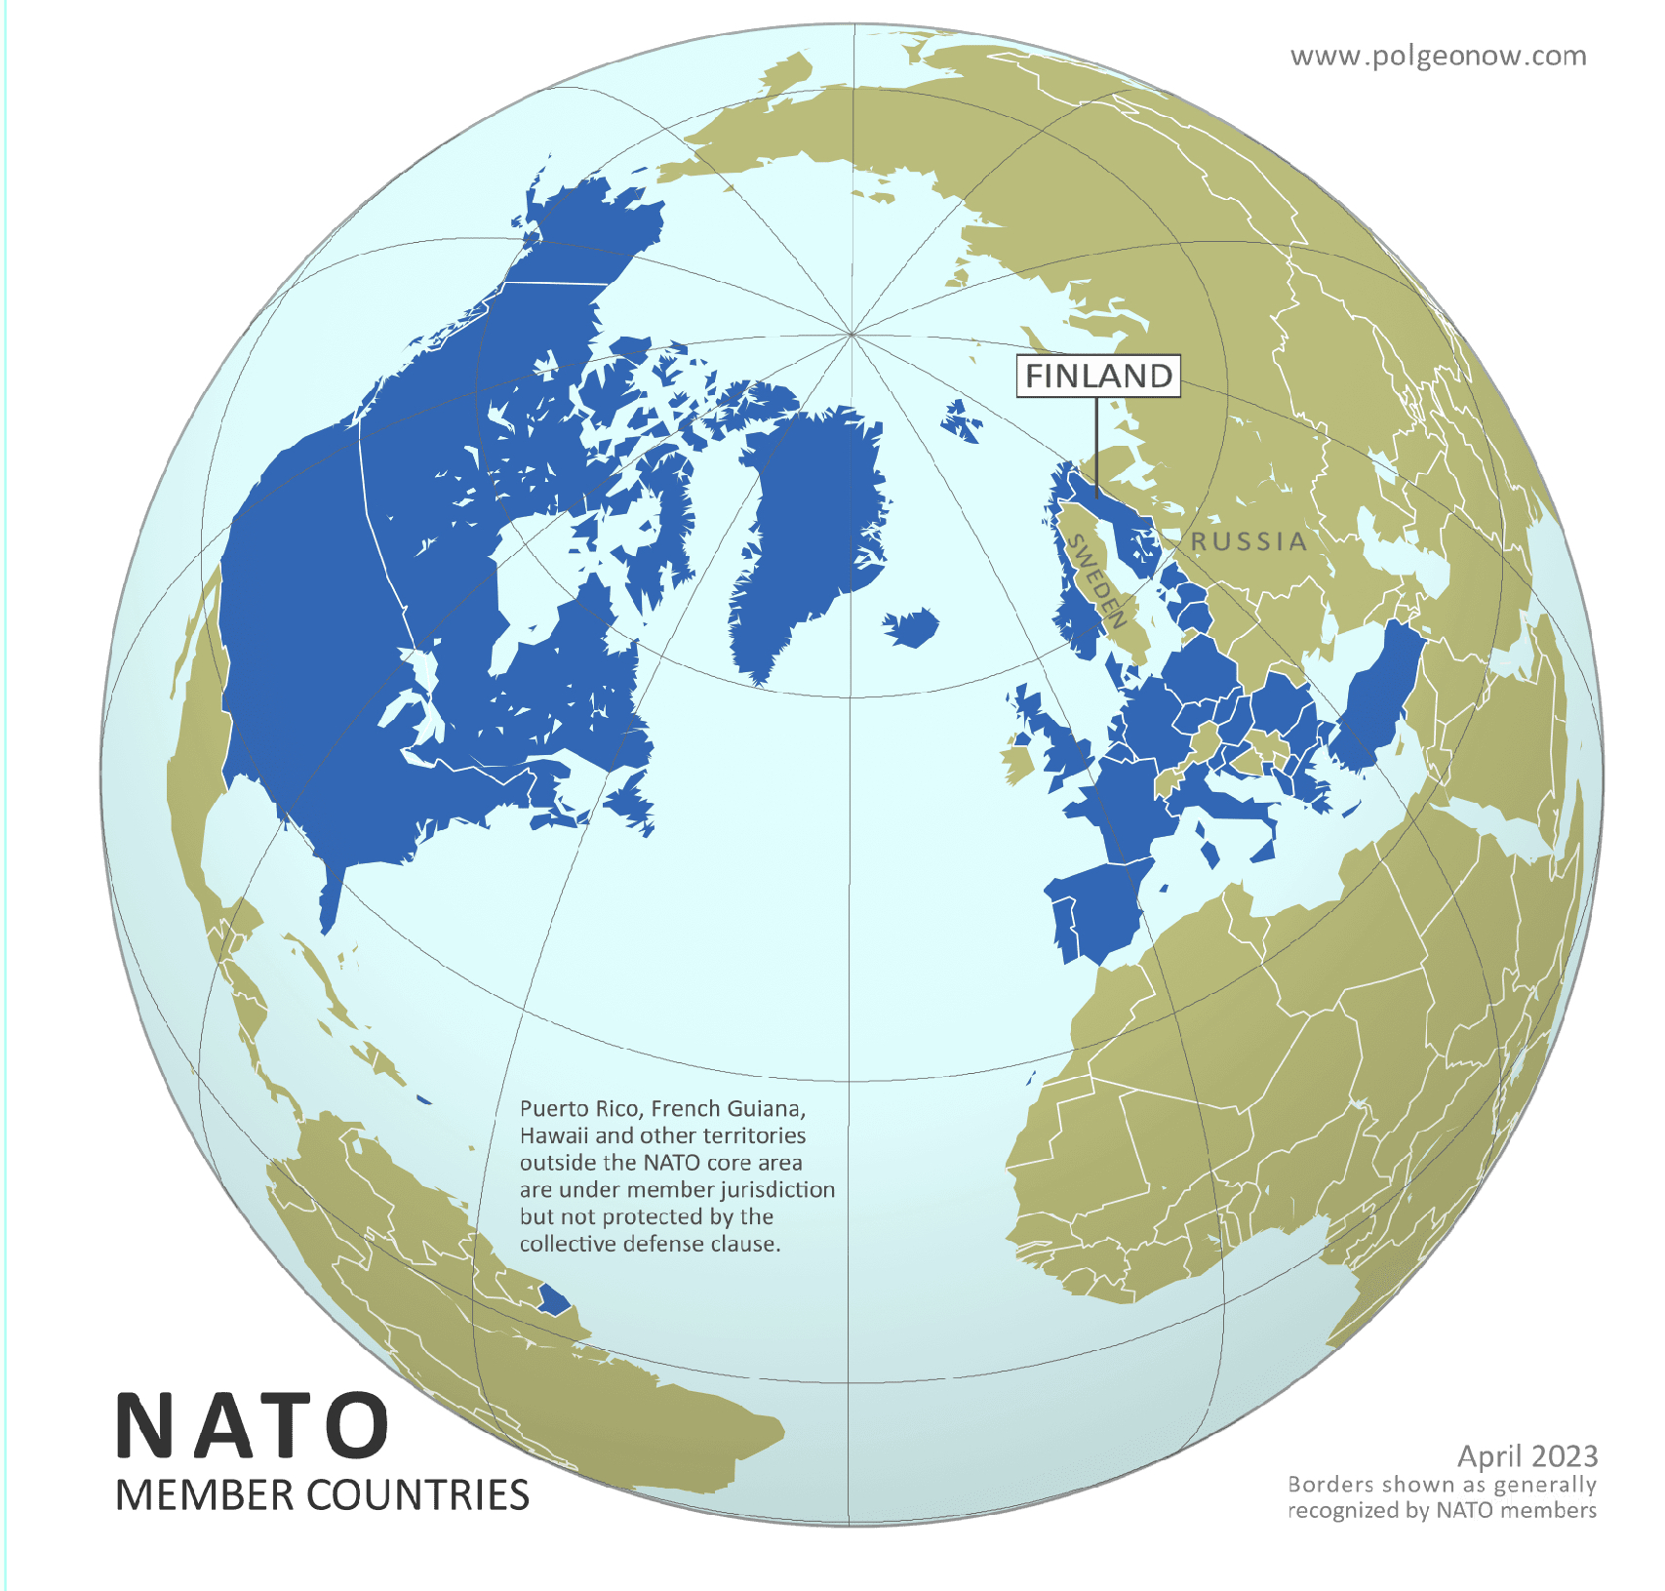
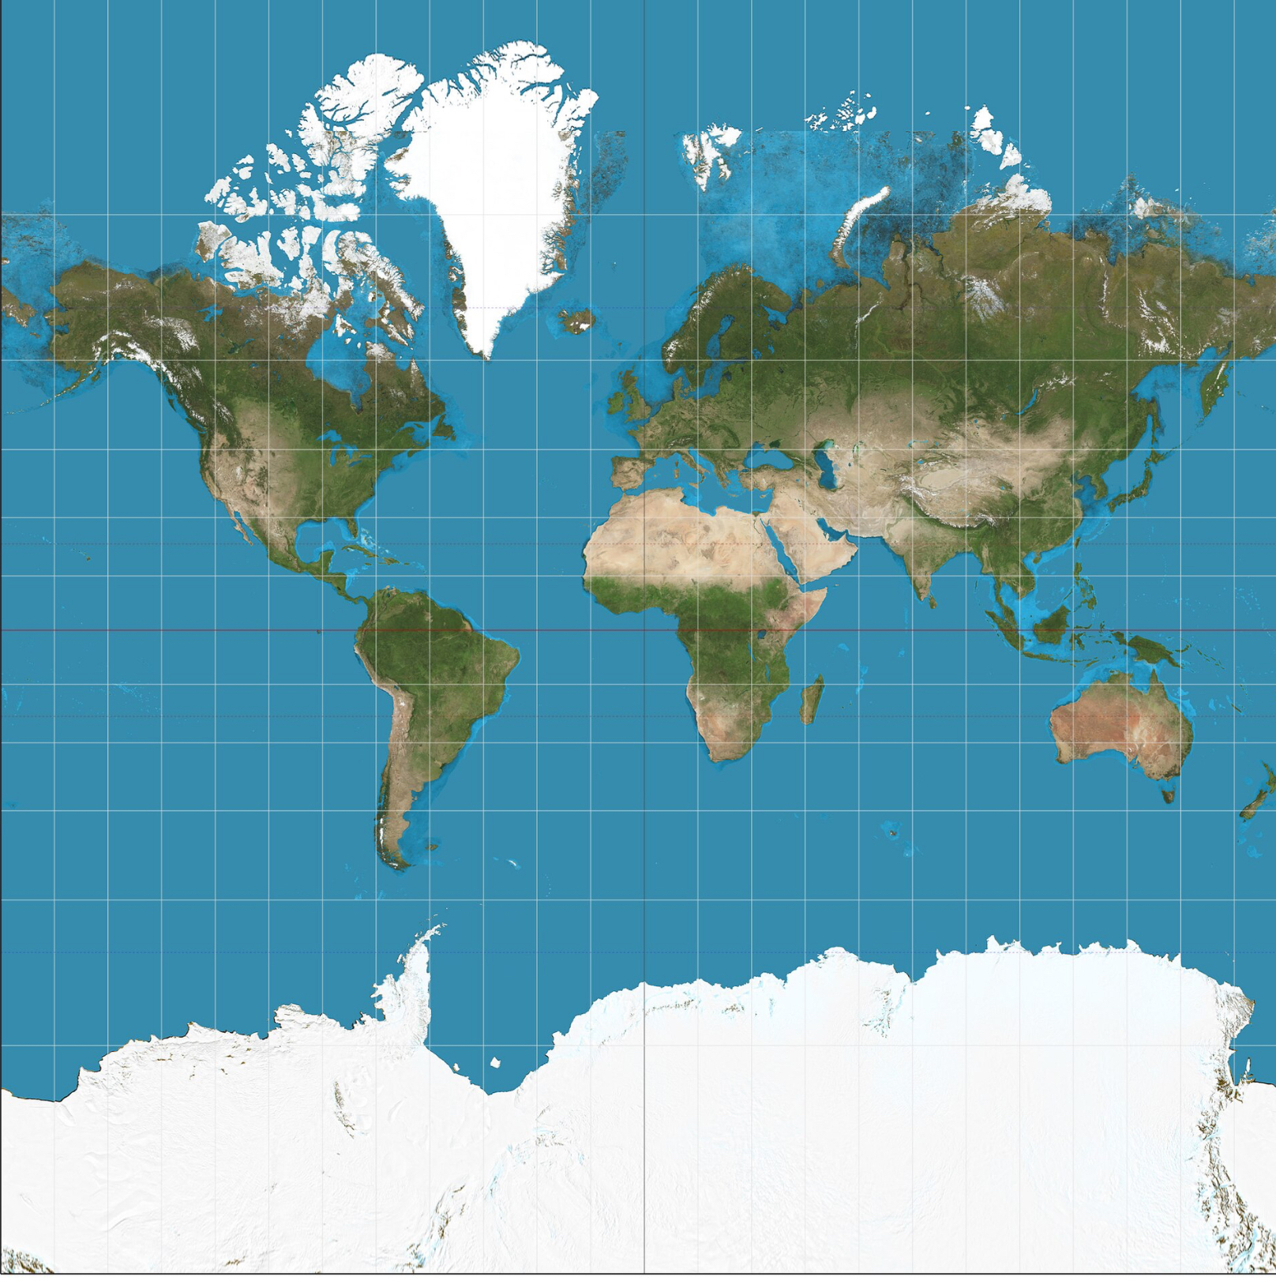
NATO Countries are 17% of World’s habitable area, only 12% of it’s population… ~50% Global GDP.
VALUES: Democracy-Individual Liberty-Human Rights-Rule of Law
August 2025
What’s bigger, Greenland or South America? Mercator
Notes:
I love maps

Slide 8
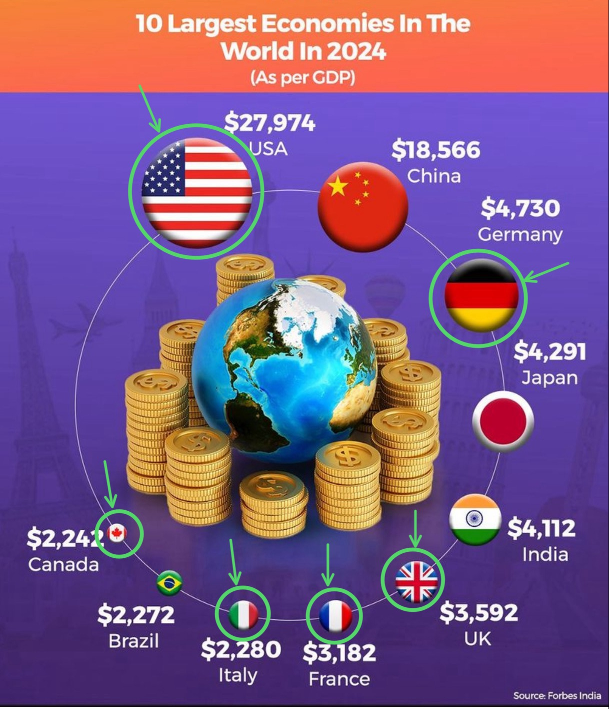
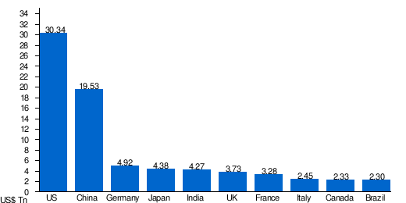
Value + Values
Democracy
Individual Liberty
Human Rights
Rule of Law
This is our glue
Largest economies in the world by GDP in 2025 according to International Monetary Fund

Slide 9
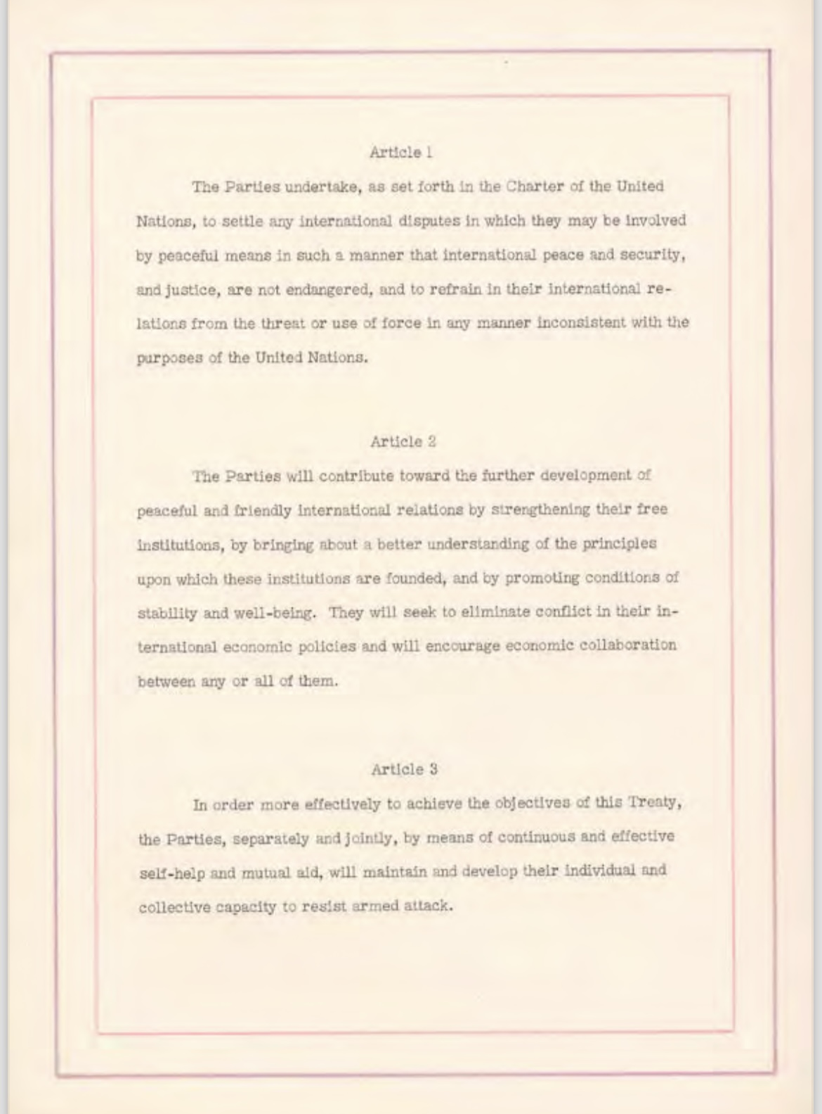
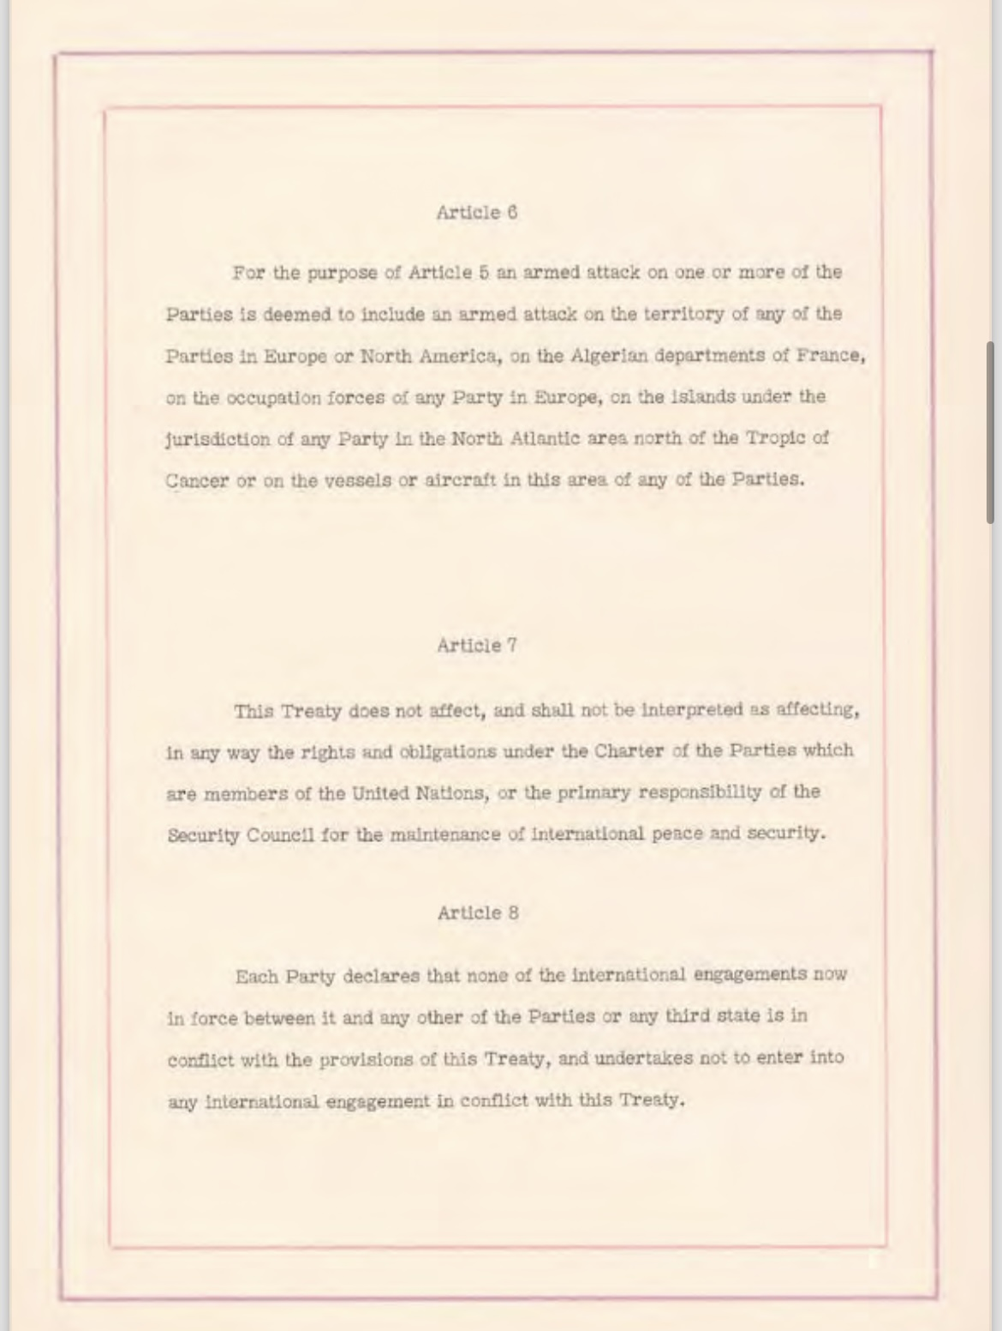
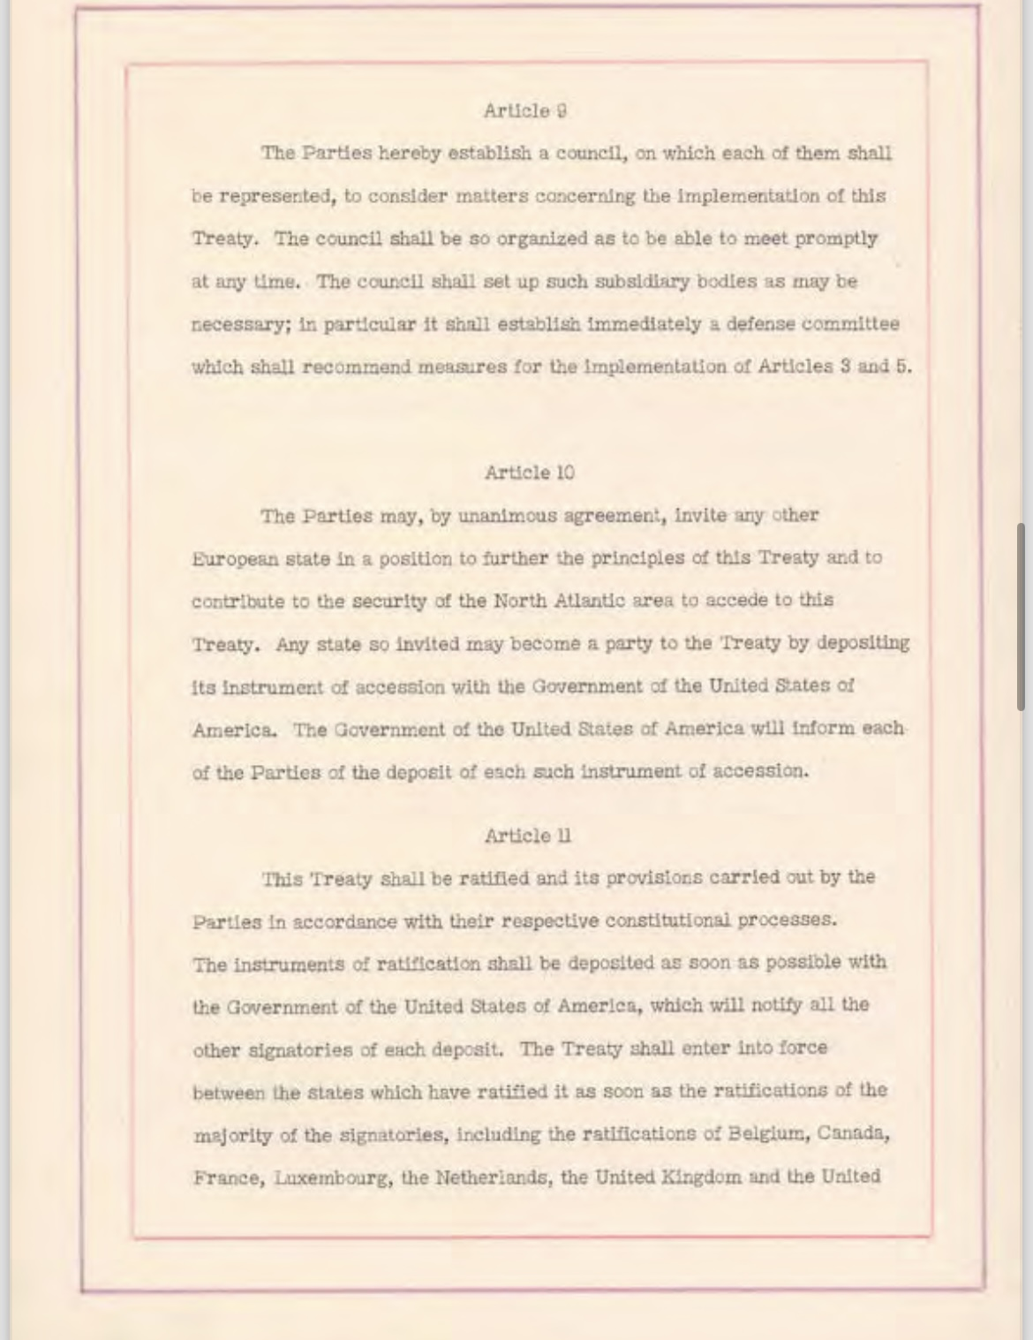
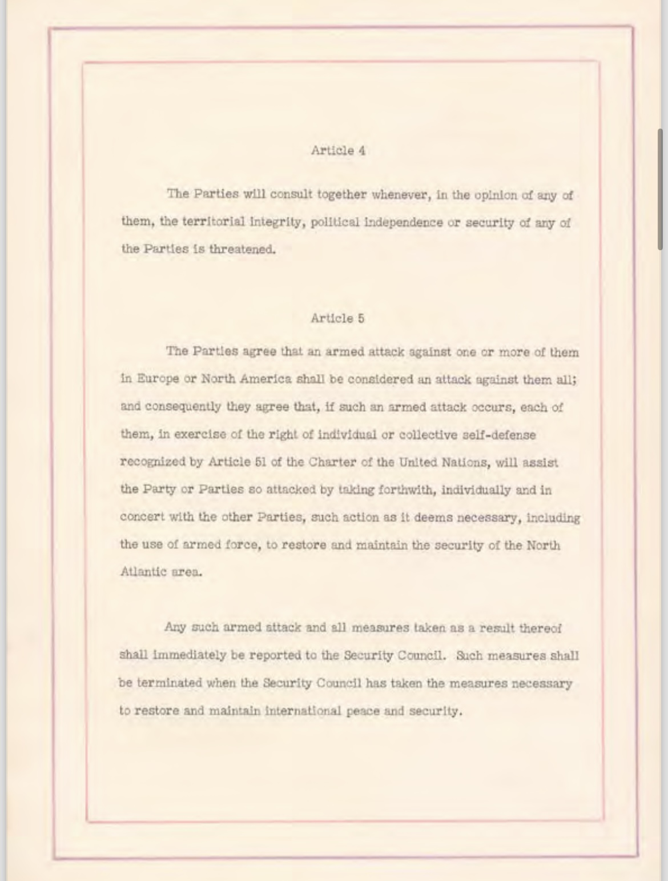
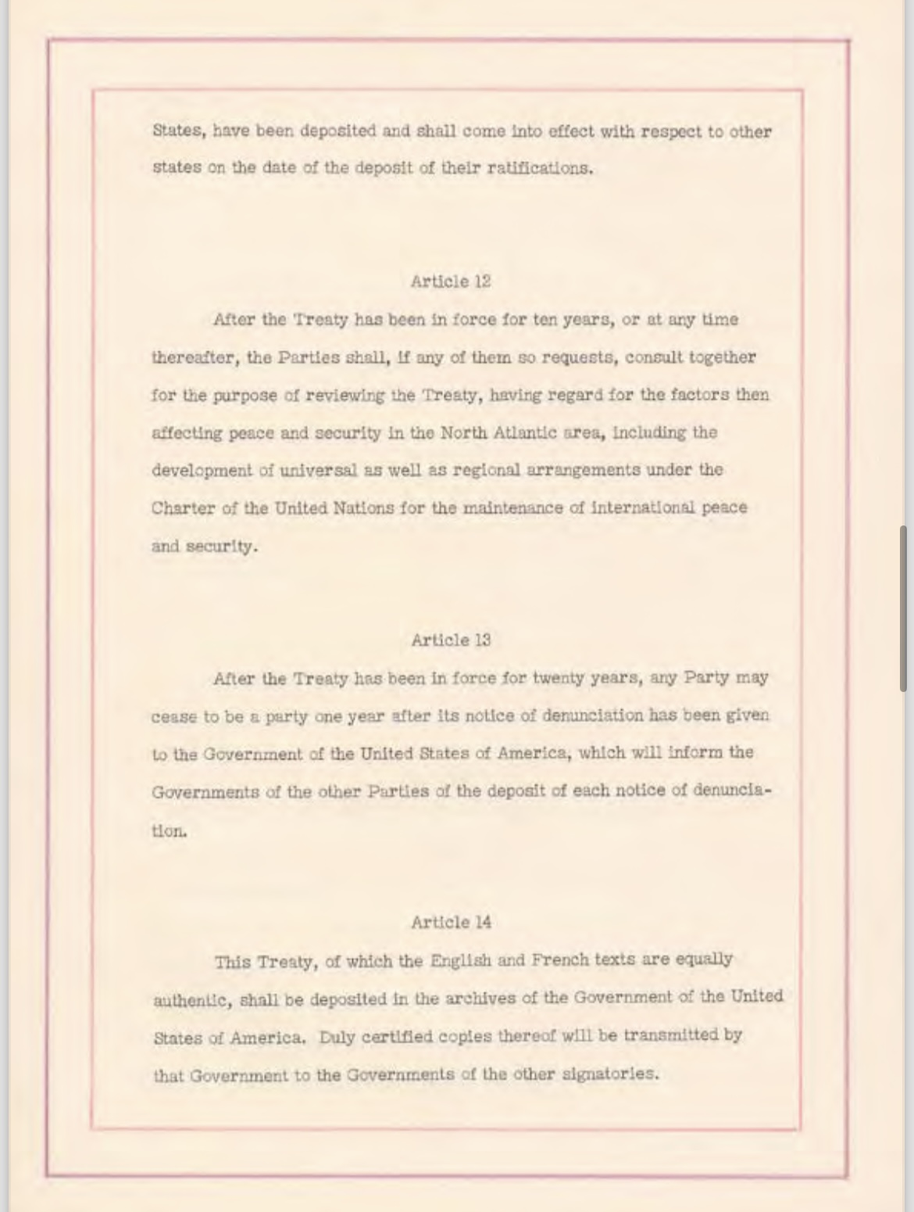
The
North
Atlantic
Treaty
Aka
“The
Washington
Treaty”
NATO’s purpose: to guarantee the freedom and security of its members through political and military means
4 April 1949
76 Years Old

Slide 10
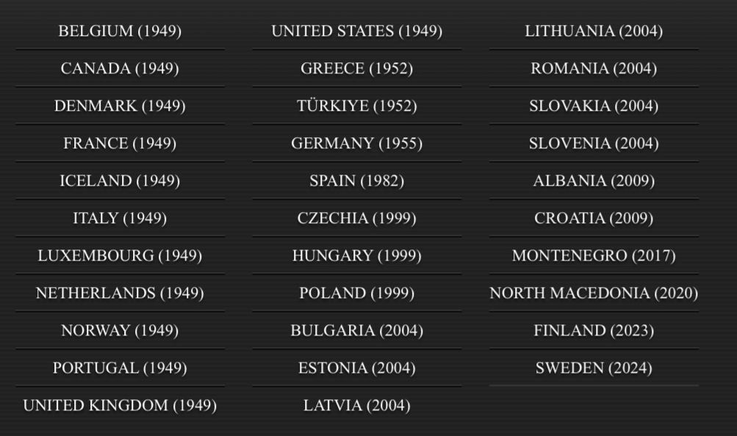
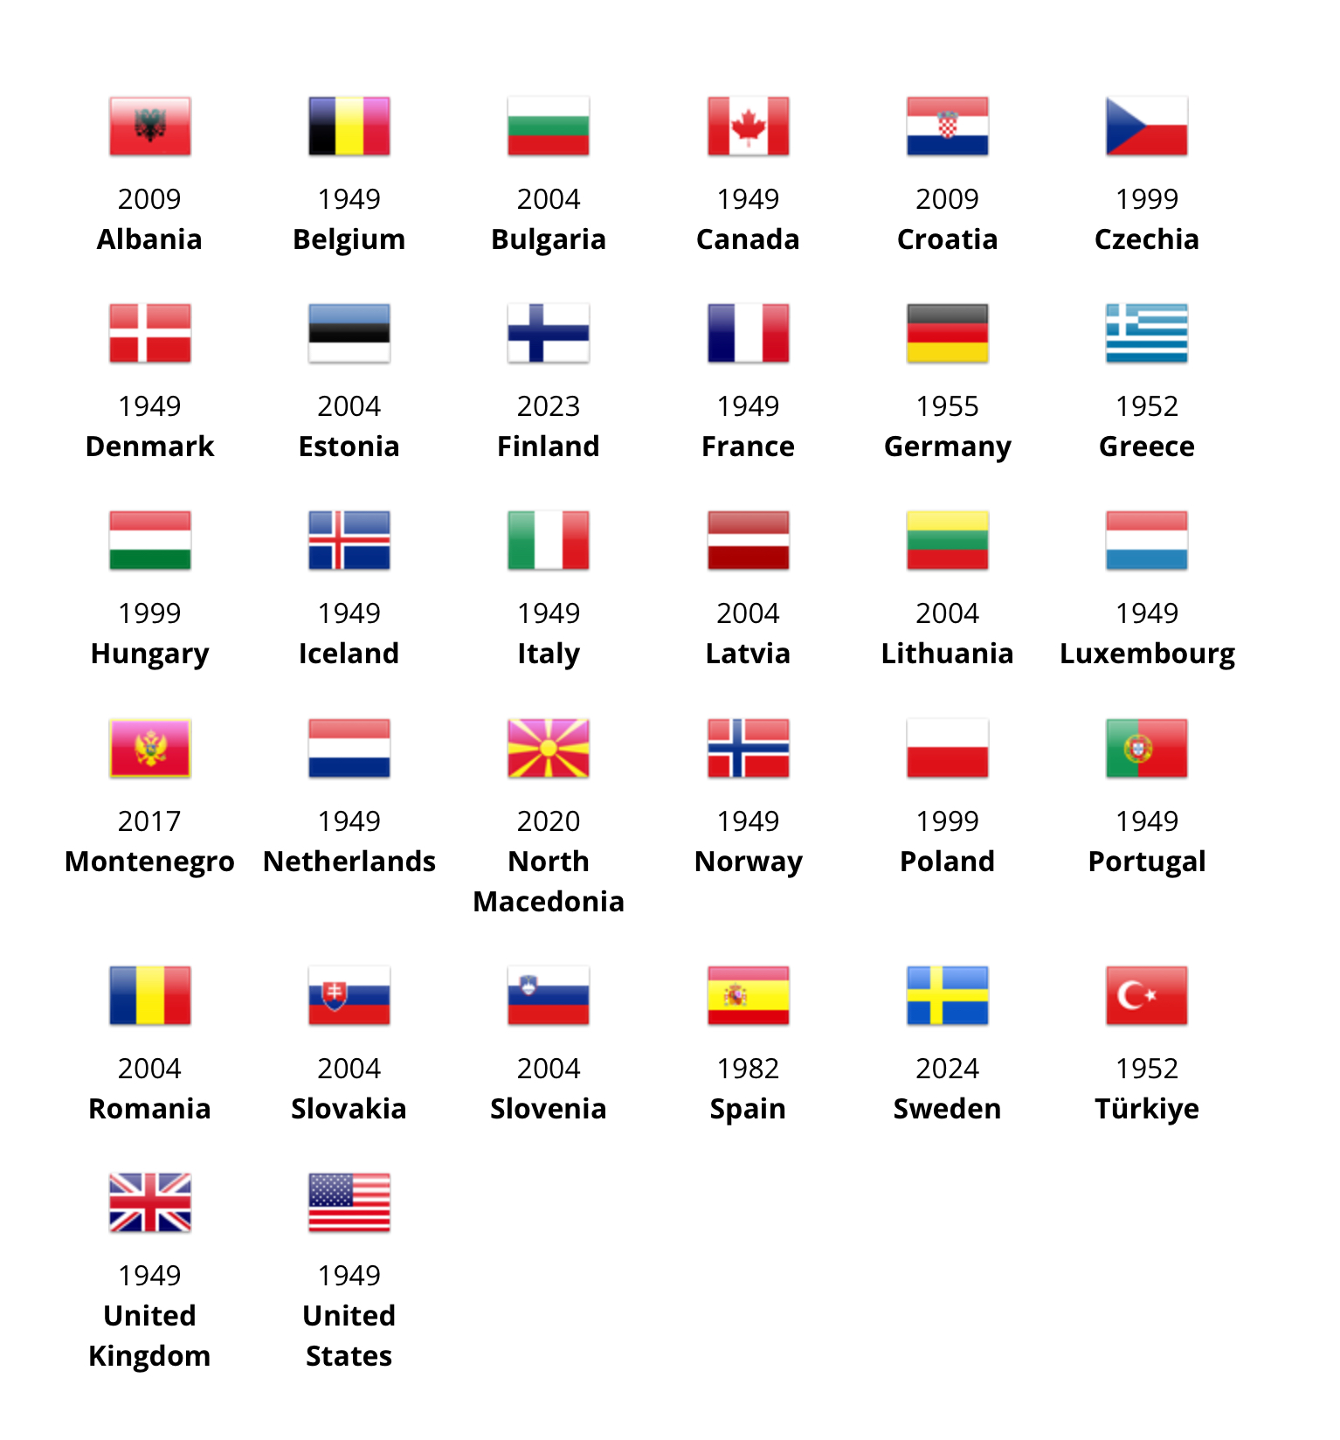

Slide 11
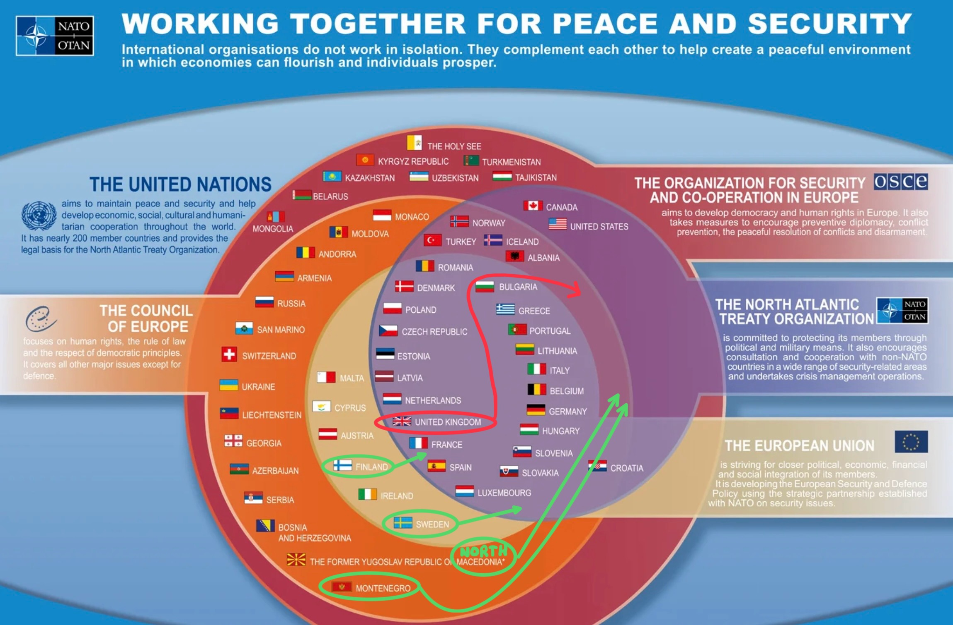
Notes:
Note changes. Best ever slide but getting old so I updated! Is enlargement a mistake?

Slide 12
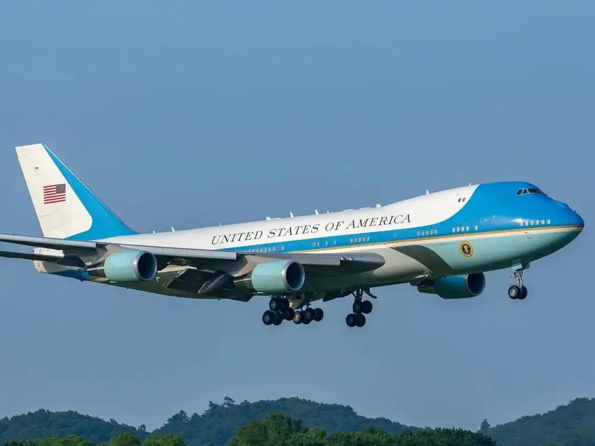
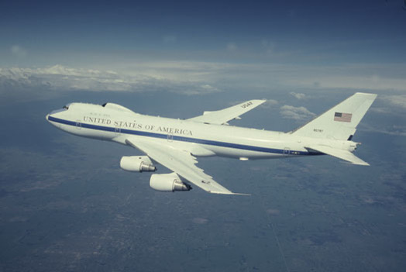
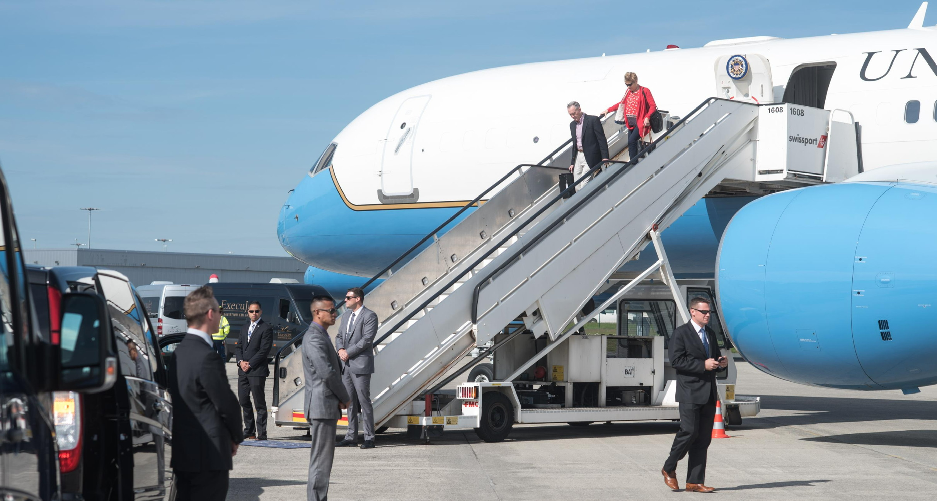
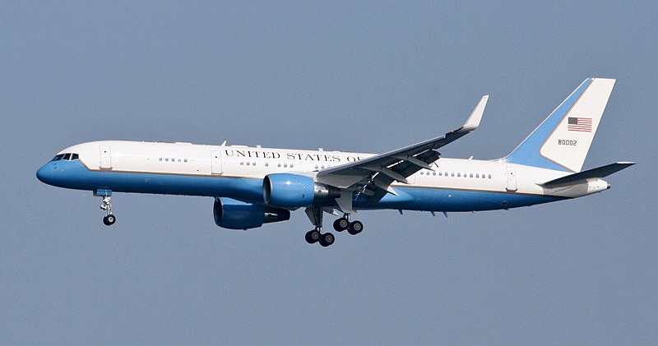
The President
Secretary of Defense
Chairman Joint Chiefs of Staff
Secretary of State
Notes:
To me, this is the best answer to why STILL NATO. Go AIR FORCE!

Slide 13
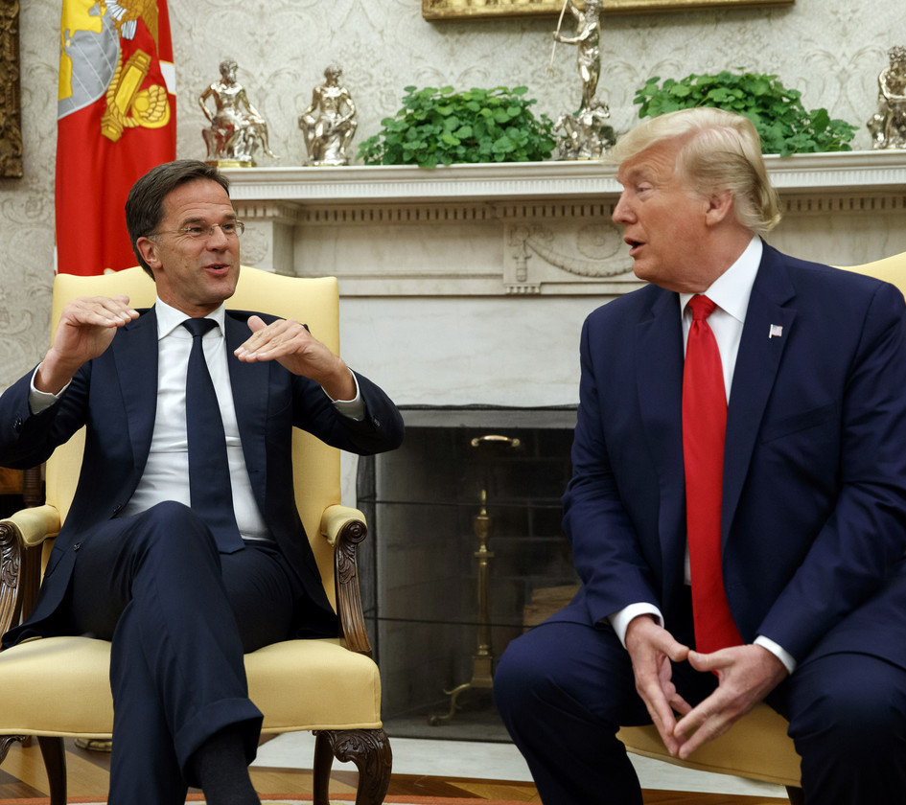
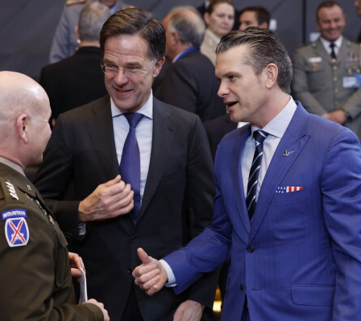
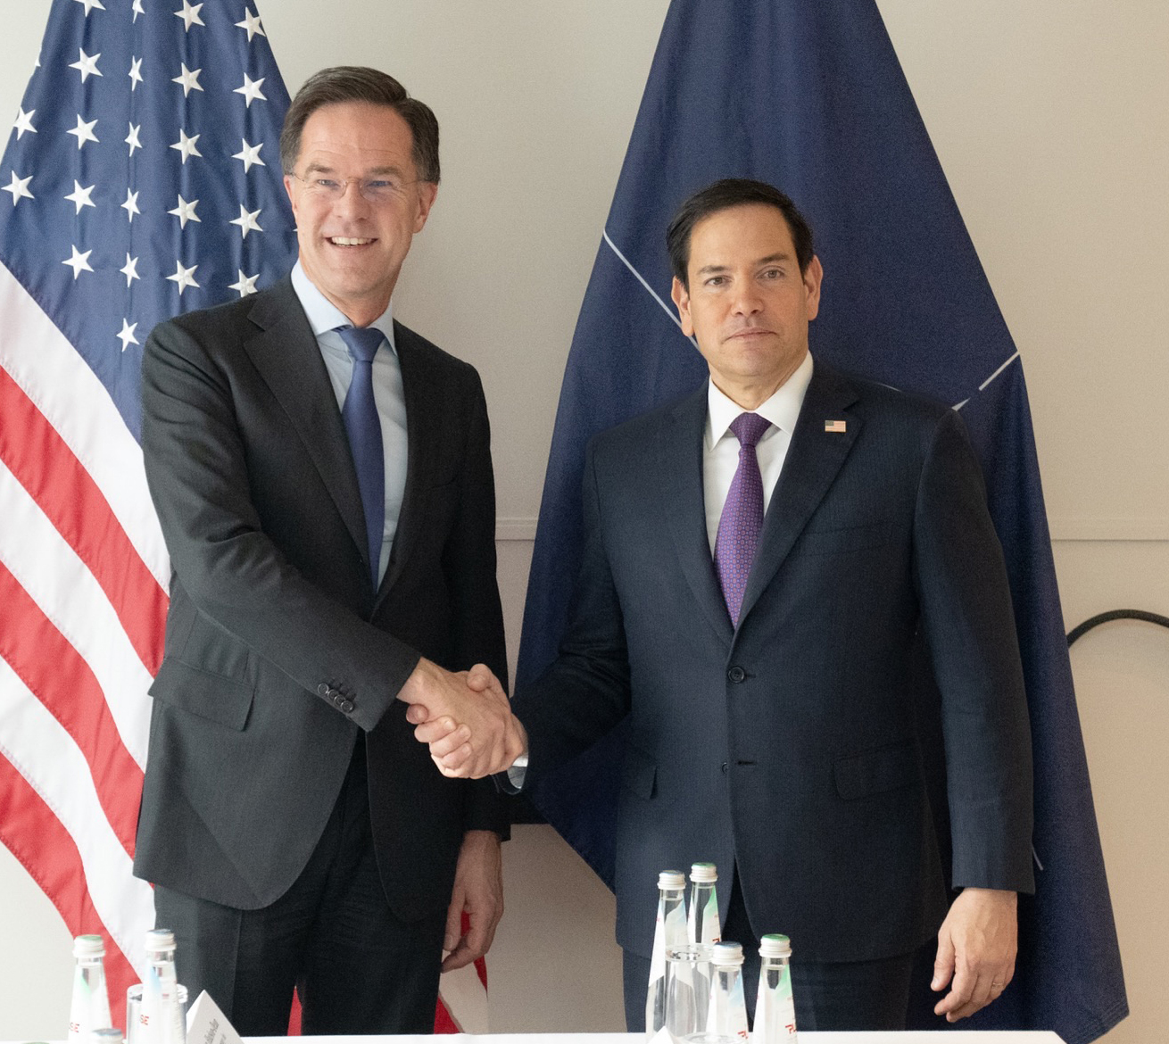
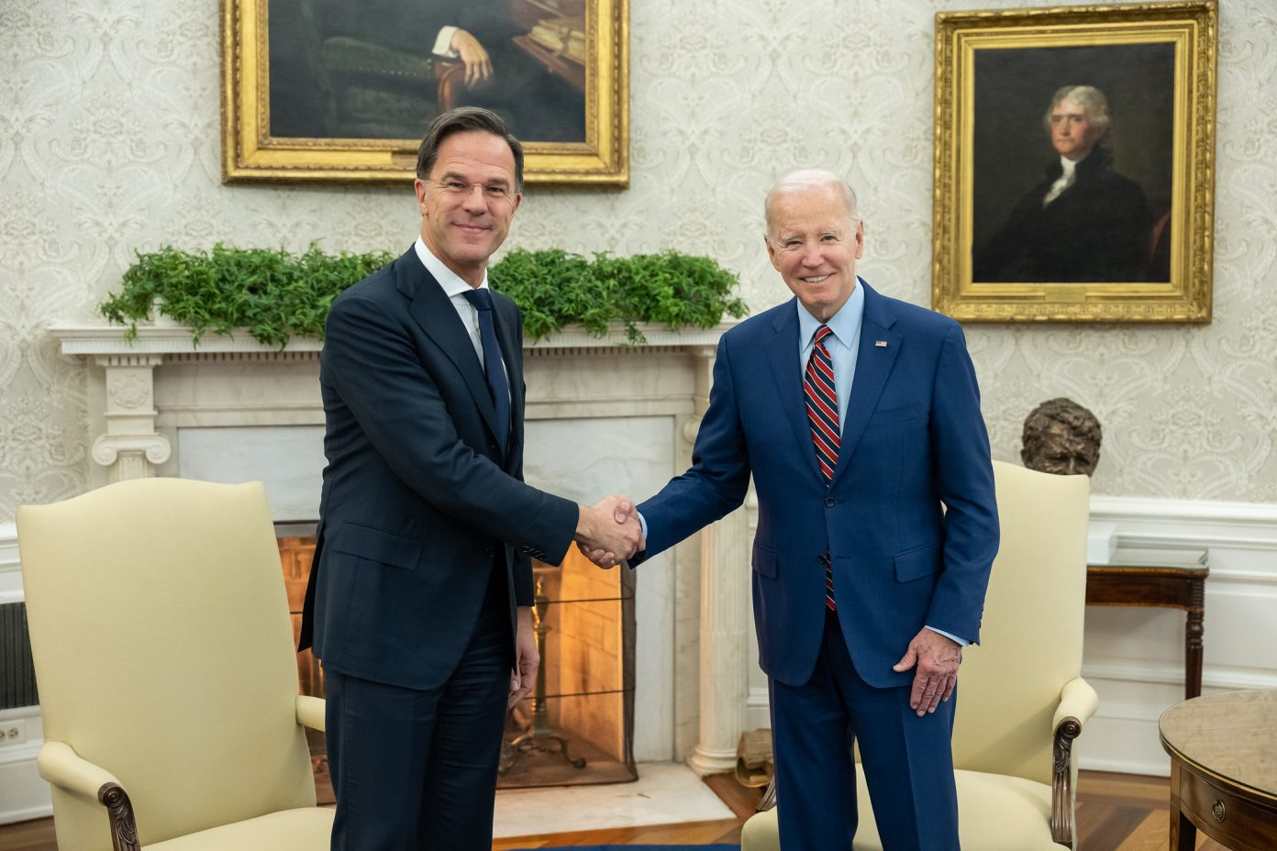
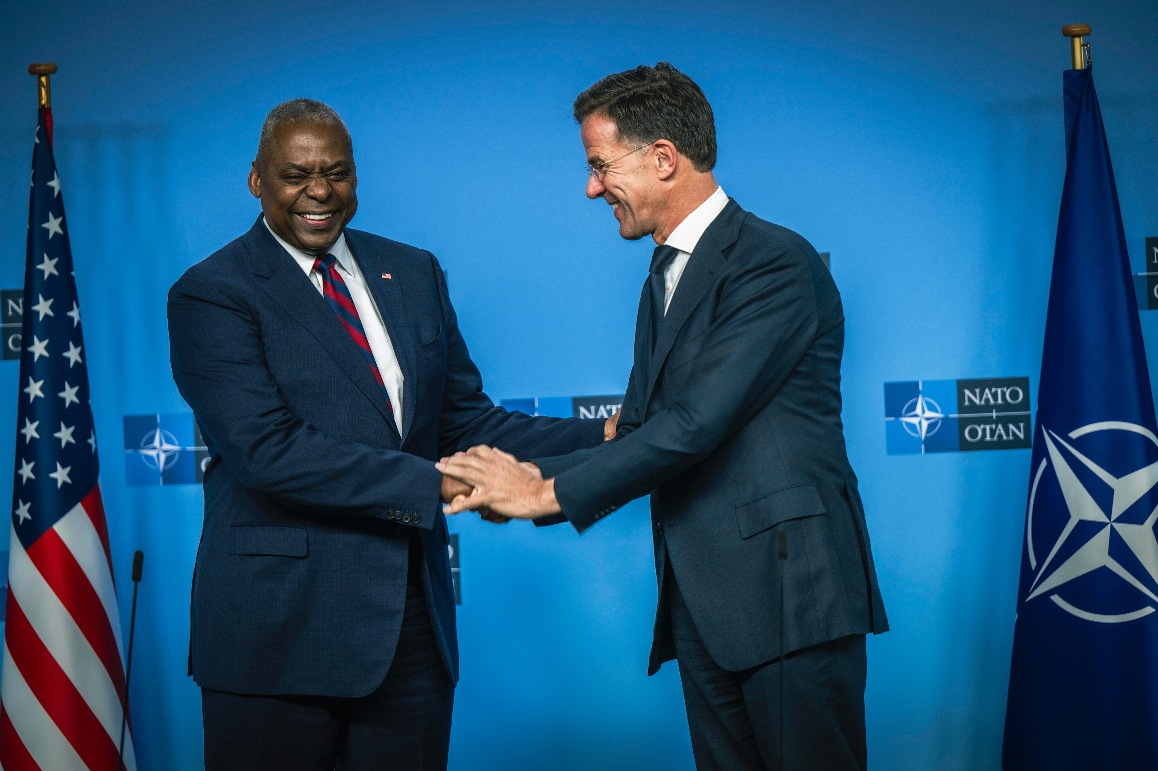
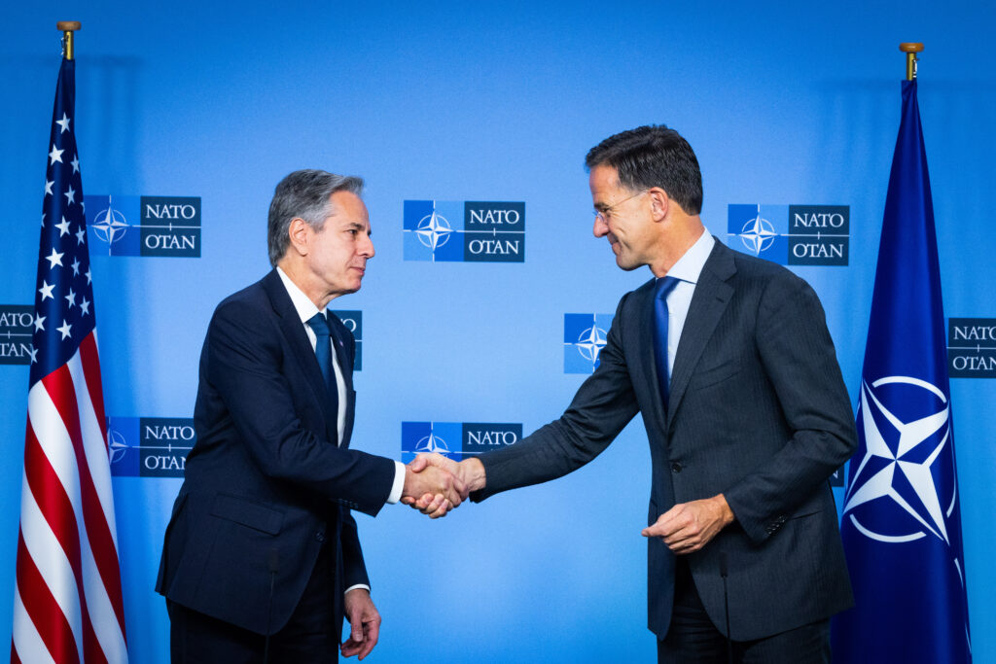
You Can’t Surge Relationships
Notes:
You can’t surge relationships. These were some of the American leaders CJCS Dunford and I worked for. Different parties, didn’t matter. Different styles, didn’t matter.

Slide 14
NATO Treaty, Article 4
“The Parties will consult together whenever, in the opinion of any of them, the territorial integrity, political independence or security of any of the Parties is threatened.”
10 February 2003, Turkey formally invoked Article 4, asking for consultations in the NAC on defensive assistance from NATO in the event of a threat to its population or territory resulting from armed conflict in neighboring Iraq. NATO agreed a package of defensive measures and conducted Operation Display Deterrence from the end of February to early May 2003.
22 June 2012, Turkey requested a NAC meeting under Article 4 after one of its fighter jets was shot down by Syrian air defense forces.
3 October 2012, Turkey requested Article 4 NAC consultations when five Turkish civilians were killed by Syrian shells. Following these incidents, on 21 November 2012, Turkey requested the deployment of Patriot missiles. NATO agreed to this defensive measure to help Turkey defend its population and territory, and to help de-escalate the crisis along the border.
3 March 2014, Poland invoked Article 4 following increasing tensions in neighboring Ukraine, as a result of Russia’s aggressive actions.
26 July 2015, Turkey requested that the NAC convene in view of the seriousness of the situation following terrorist attacks, and to inform Allies of the measures it was taking.
28 February 2020, Turkey requested consultations following the death of Turkish soldiers in air strikes by the Syrian regime and its backer Russia in Idlib province.
24 February 2022, Bulgaria, Czechia, Estonia, Latvia, Lithuania, Poland, Romania and Slovakia requested to hold consultations under Article 4 following Russia’s full-scale invasion of Ukraine.
Let’s Talk
Notes:
Let’s talk

Slide 15
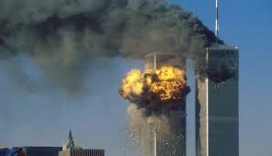
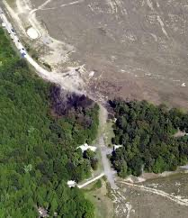
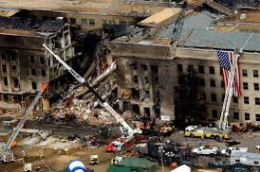
NATO Treaty, Article 5
The Big One
“The Parties agree that an armed attack against one or more of them in Europe or North America shall be considered an attack against them all and consequently they agree that, if such an armed attack occurs, each of them, in exercise of the right of individual or collective self-defense recognized by Article 51 of the Charter of the United Nations, will assist the Party or Parties so attacked by taking forthwith, individually and in concert with the other Parties,
such action as it deems necessary, including the use of armed force, to restore and maintain the security of the North Atlantic area.
Any such armed attack and all measures taken as a result thereof shall immediately be reported to the Security Council. Such measures shall be terminated when the Security Council has taken the measures necessary to restore and maintain international peace and security.”
“Let’s Roll”
Only ONCE
Notes:
The BIG one

Slide 16
NATO Treaty, Article 3
“In order more effectively to achieve the objectives of this Treaty, the Parties, separately and jointly, by means of continuous and effective self-help and mutual aid, will maintain and develop their individual and collective capacity to resist armed attack.”
My favorite
Notes:
My favorite

Slide 17
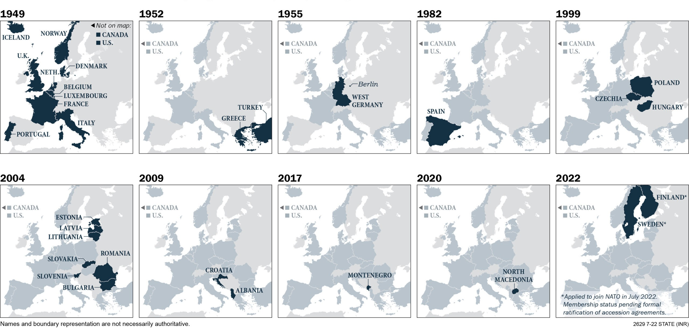

Slide 18
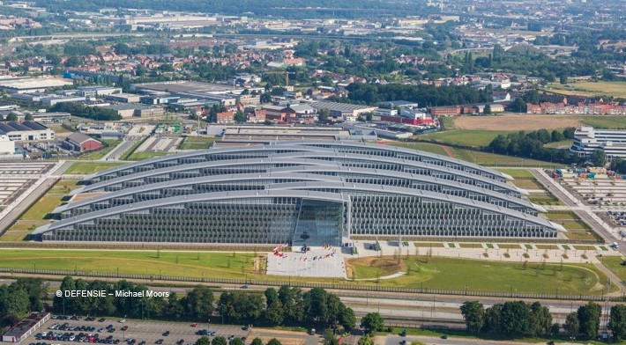
Notes:
Security.

Slide 19
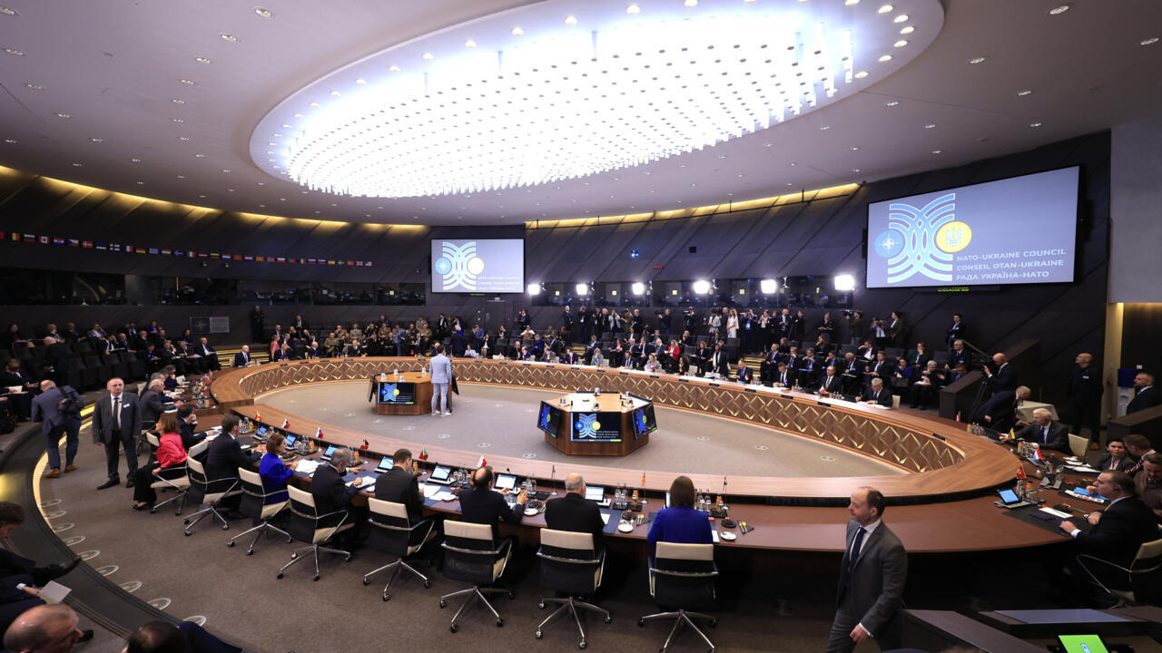
NATO Decision Making
Consensus
Silence
Footnoting

Slide 20
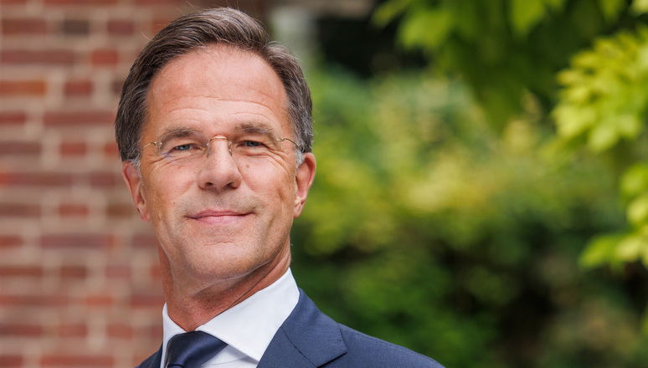
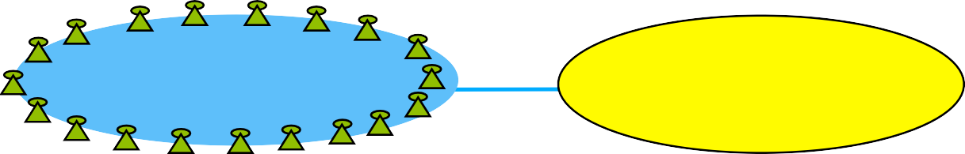
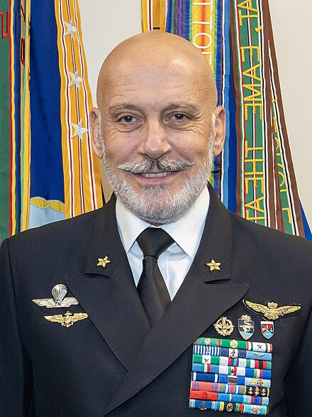
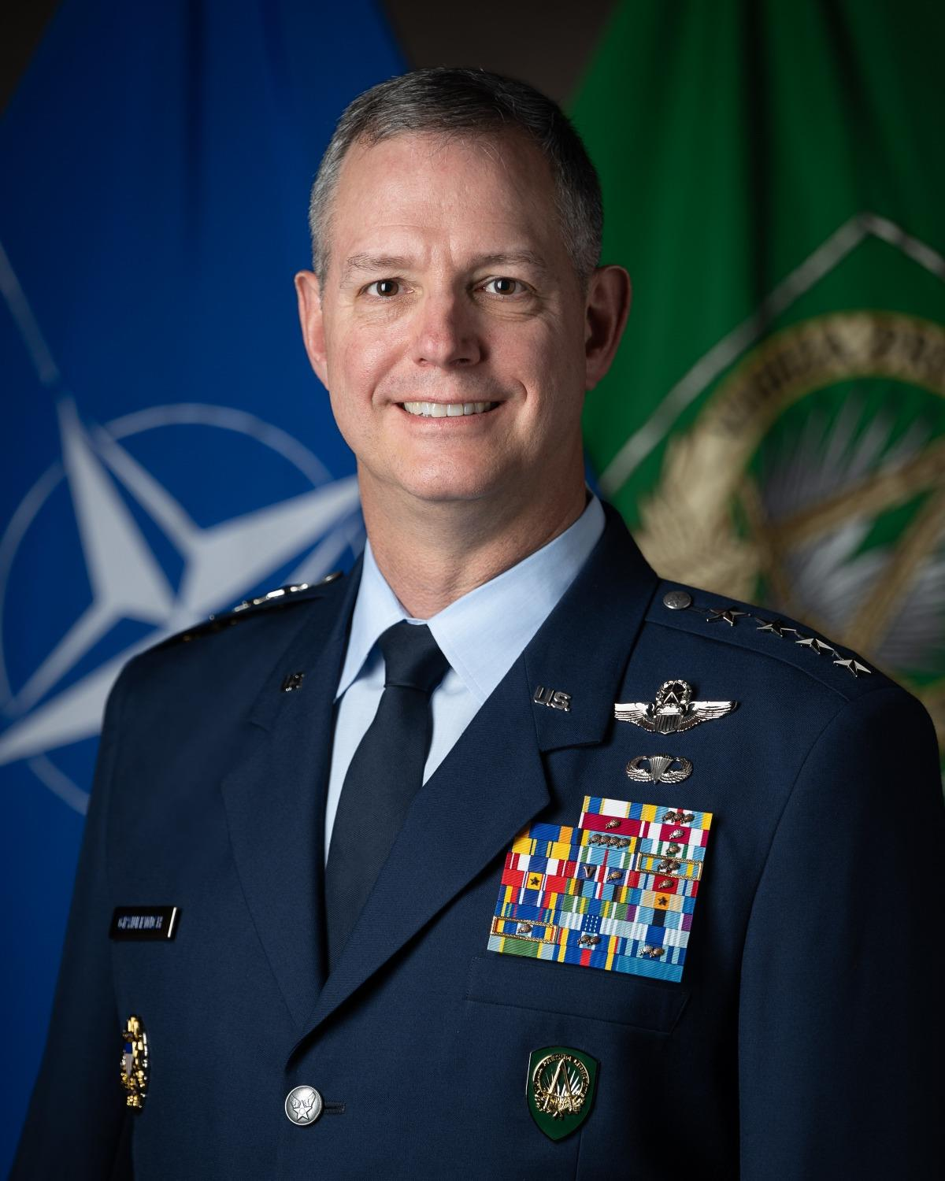
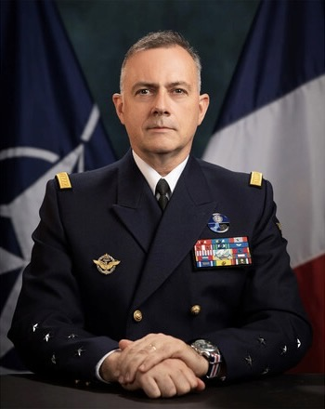
NATO Basic Structure
Civil Organization
Secretary General
Mark Rutte
“SECGEN” 2024
North Atlantic Council “NAC”
International Staff and Committees
Military Organization
Chair Military Committee
Admiral Giuseppe Cavo Dragone
Italian Navy
“CMC” 2025
Military Committee “MC”
International Military Staff
Strategic Commands
Supreme Allied Commander Transformation
Admiral Pierre Vandier, French Navy “SACT” 2024
Supreme Allied Commander
Europe
General Alexus G. Grynkewich
"SACEUR” 2025 (COMUSEUCOM)
August 2025

Slide 21
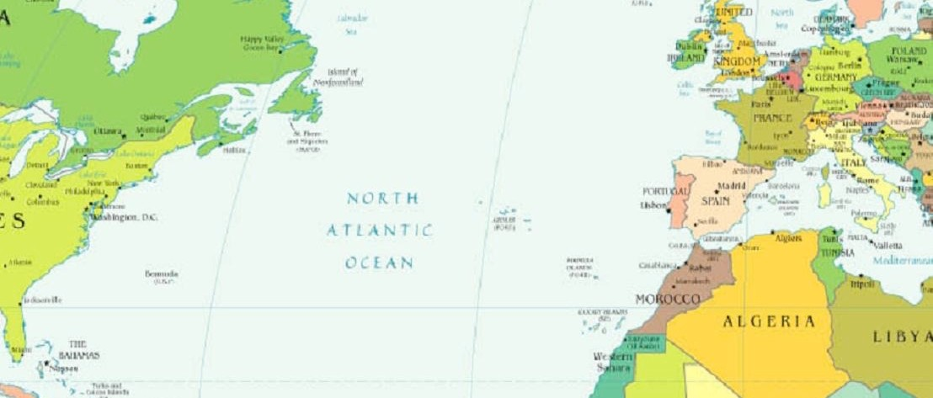


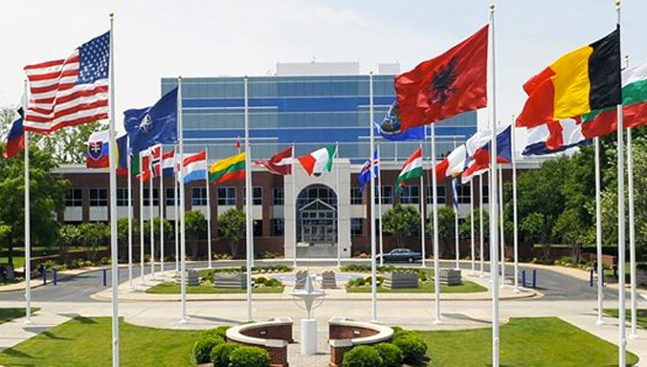
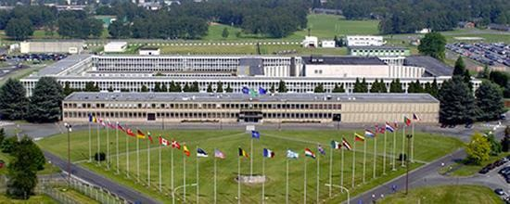
SACT and SACO
ADM P. VANDIER FN
GEN. A. GRYNKEWICH USAF
ALLIED COMMAND TRANSFORMATION (ACT) NORFOLK, VA USA
SUPREME HEADQUARTERS ALLIED POWERS EUROPE (SHAPE) ALLIED COMMAND OPERATIONS MONS, BELGIUM
Notes:
Norfolk, non US. Mons, US.

Slide 22
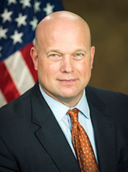

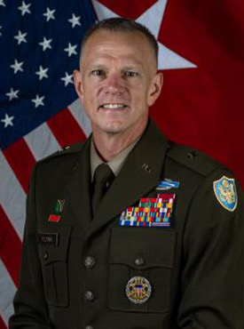
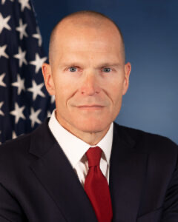
United States Representation at NATO HQ
Inter-Agency Process
SecState Rubio
SecDef Hegseth
CJCS
US MISSION
US DELEGATION
Ambassador
Matthew G. Whitaker
April 2025
Ambassador
MILREP
MilRep (acting)
Brigadier General
SEAN M. FLYNN
Defense Advisor/ SECDEFREPEUR
Scott Delius May 2025
IS
IMS
NAC
MC
SACEUR/SACT
August 2025
Notes:
Unique that ambassador works for President and SecDef and State

Slide 23
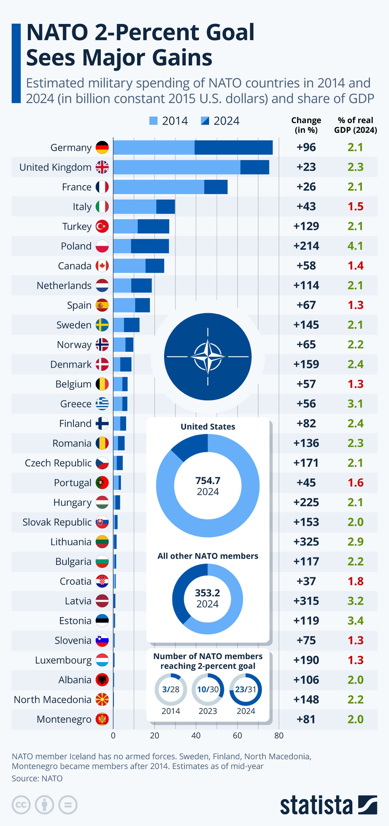
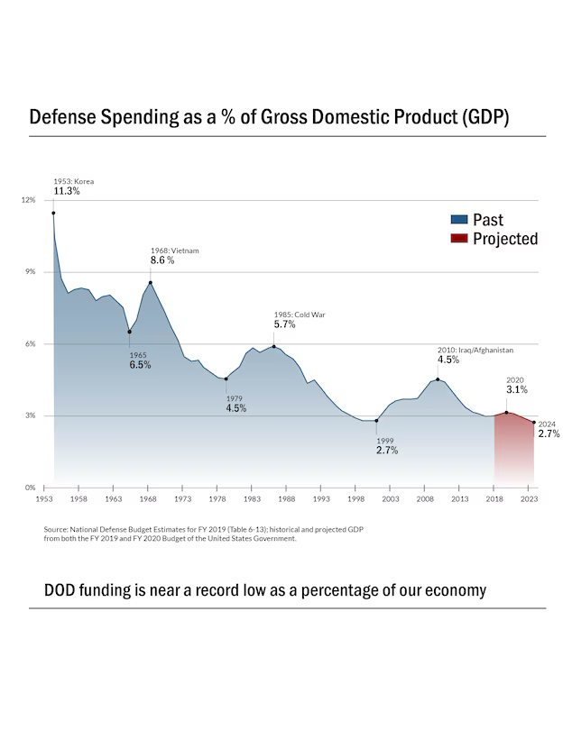

Slide 24
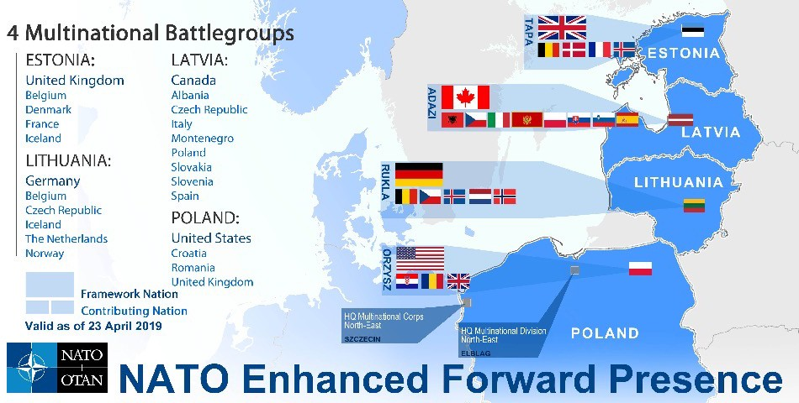
August 2025

Slide 25
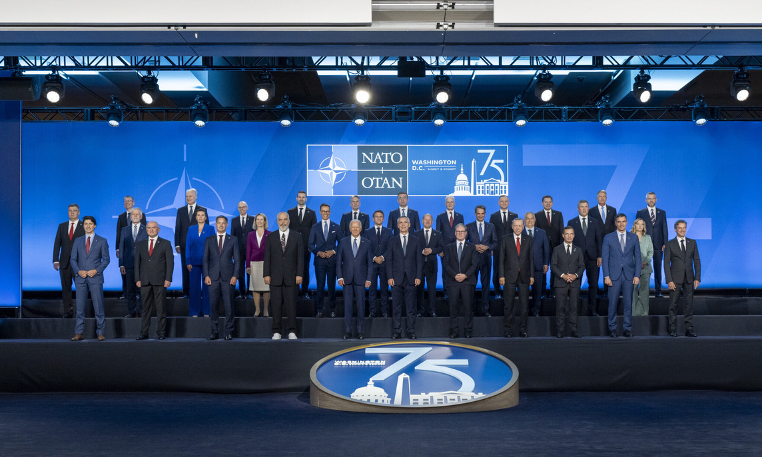
75 Years Old Last Year…Here in Washington DC

Slide 26
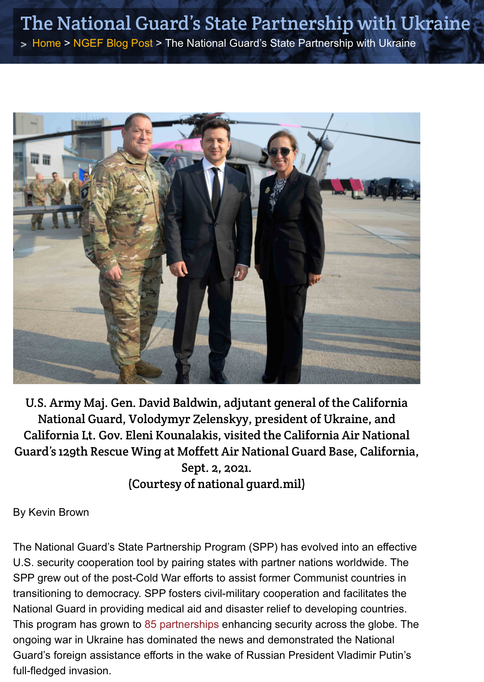

Slide 27
Part 2:
EU
European Union
August 2025

Slide 28
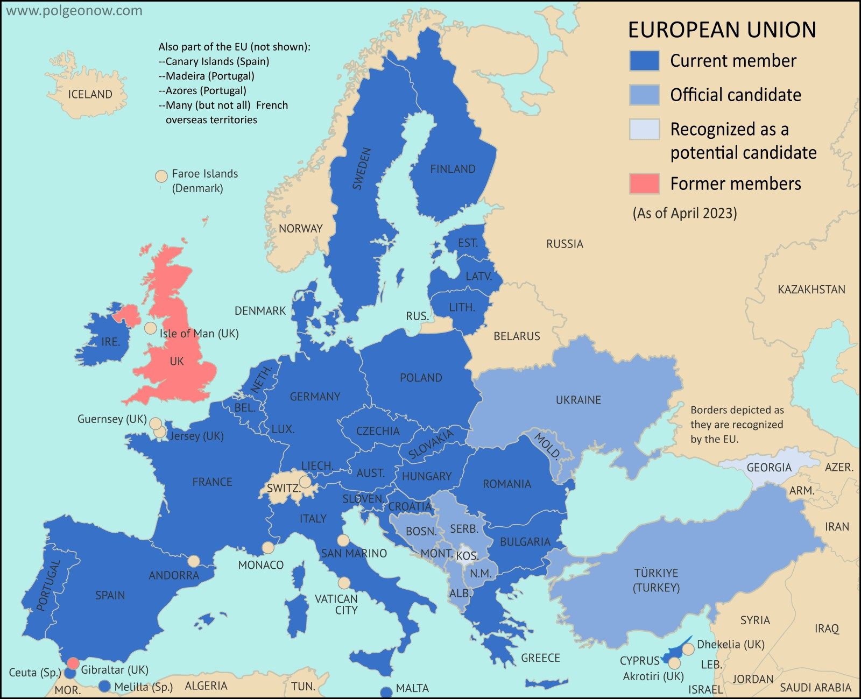
The European Union
27 countries
24 oﬃcial languages
Population 448 million
Notes:
Big, similar countries but some big differences.

Slide 29
1 Euro = US $ 1.16
The Euro – a single European currency
11 August, 2025
No fluctuation risk and foreign exchange cost
More choice and stable prices for consumers
Closer economic cooperation between EU countries
Coins: one side with national symbols, one side common
Notes: No national side

Slide 30
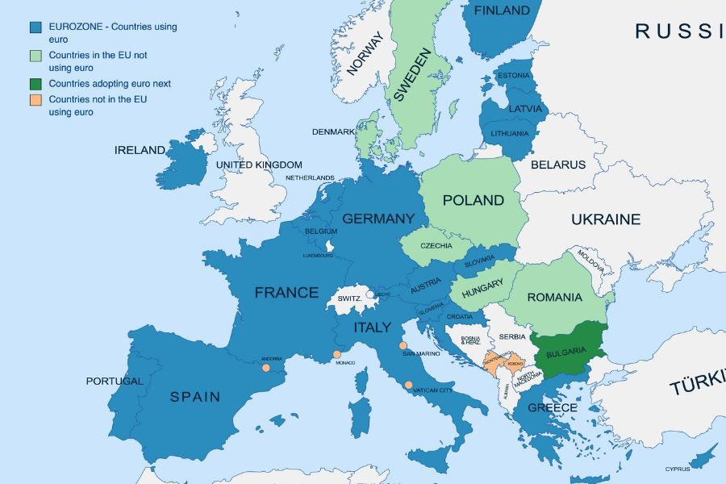
Russia
Note: Kaliningrad
(larger than Connecticut)

Slide 31





EU NAME HISTORY
BE, FR, GE, IT, LU, NL EURO COAL AND STEEL COMMU- NITY
NAME BECOMES EUROPEAN ECONOMIC COMMUNITY
EUROPEAN ANTHEM ADOPTED
NAME CHANGE
EURO- PEAN UNION
LAUNCH OF THE EURO
UK LEAVES THE EU: BREXIT
1951
1958
1972
1993
2002
2020

Slide 32
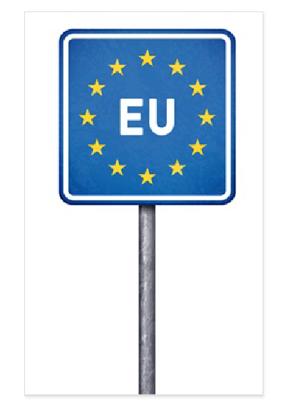
Freedom of Movement
No police or customs checks at borders between most EU countries
Schengen 6/14/1985
Controls strengthened at the EU’s external borders
More cooperation between police from diﬀerent EU countries

Slide 33

1. The member states rule.
Five Points to Remember About the EU
The EU does NOT want to be NATO.
EU bodies, procedures, and law are complex.
4. The EU does not always speak with
one voice
5. The EU does not do democracy well

Slide 34
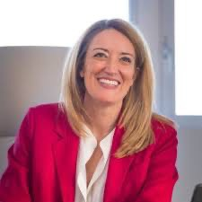


Three Key Actors and Voices
Malta
The European Parliament
Voice of the People
ROBERTA METSOLA, President of the
European Parliament
The European Council
Voice of the Member States Antonio Costa, President of the European Council
The European Commission
Promoting the common interest
URSULA VAN DER LEYEN, President of the
European Commission
Germany
Portugal

Slide 35






European Parliament
705 Members of European Parliament (MEPs)
Sit by party, not nationality
Only directly elected part of EU
Elected to 5 year terms
Seats appointed by MS’ population
Political powers
Approves appointment of Commission
Censure/fire Commission
Legislative powers
Shares power with Council on some issues
Brussels
Budgetary powers
Must approve EU budget
Modify certain EU expenditures
2 BN Euro budget (ca. 2.18 BN US$)
Voting age: 18 (AUSTRIA, MALTA 16)
Strasbourg

Slide 36

THE EUROPEAN COUNCIL
The European Council defines the EU's overall political direction and priorities and sets the EU's policy agenda. It usually adopts conclusions during European Council meetings which identify issues of concern and actions to take. It does not negotiate or
adopt EU laws.

Slide 37
The European Commission
Commission is the EU’s executive arm and runs the Union day-to-day
27 Members (one per MS) – 5 year term
Has power of the purse
“Guardian of the treaties”
Significant power player internationally
  Actions binding abroad (esp. in US)
Will enforce any new Euro regulations
Commissioners are appointed by EU members, do not represent member states’ views
Can negotiate and act on its own

Slide 38
Part 3:
Concluding Thoughts
August 2025

Slide 39

I Love CAPSTONE!
Notes:
CAPSTONE together 2008. 7 years later, two American three stars serving together in Europe when building bridges turned into rebuilding war plans.
Brussels, Polish border with Kaliningrad. Ukrainian border with “Russia” *

Slide 40

Opportunity
Luck is what happens when
preparation meets opportunity…
-Roman philosopher Seneca
Together you can really make a difference,
and it can be really meaningful and wonderful…
Notes:
14,246 Americans. Augusta National. OUR Memorial. The French give it their all.
None of know how long, or where we will get to serve…

Slide 41
Ambassador
a person who acts as a representative or promoter
of a specified activity
Diplomat
a person who can deal with people
in a sensitive and effective way

Slide 42

And YOU,
can make a difference,
and it can be,
… really exciting!
Read (history?)
Exercise (move, outside?)
Pray (meditate/think)
Notes:
Shortly after this, Teresa was asked to serve on DACOWITS for four years…first ever specifically selected to represent the spouse viewpoint.

Slide 43
Takeaways
There is a really good reason NATO was created
NATO is both Political and Military
NATO requires shared basic Values
The EU is Political
The EU is complex
Europe wants to do better than their history
I love NATO, Maps, and CAPSTONE!
Thank YOU for being here this week

