Slide 1
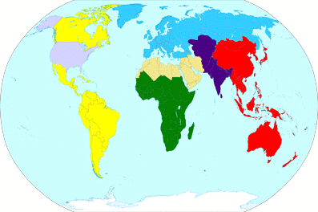

CAPSTONE Spouses
The State Department, U.S. Missions & Diplomatic Statecraft
August 12, 2025
Ambassador W. Patrick Murphy
Deputy Commandant, National War College

Slide 2

“Diplomacy: The art of letting someone else have your way”
--Sir David Frost

Slide 3
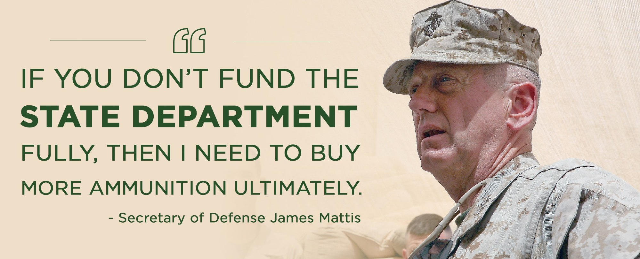

Slide 4
U.S. Missions & Diplomacy
Diplomacy: Roots & Rules & Tradecraft
Global Presence & the U.S. Embassy
Embassy Communities
State (DOS) vs Defense (DoD) Culture
Better Together

Slide 5
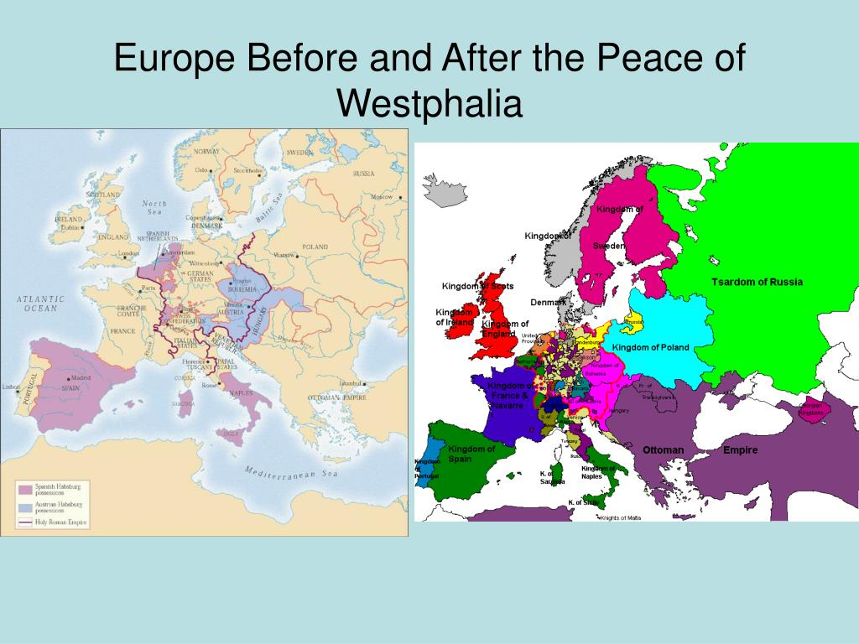
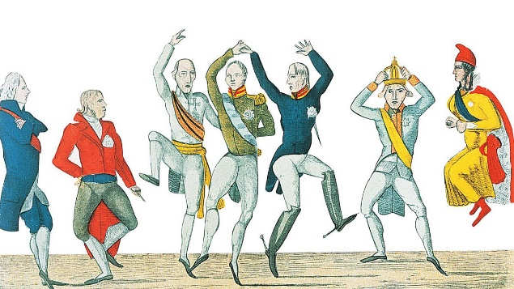
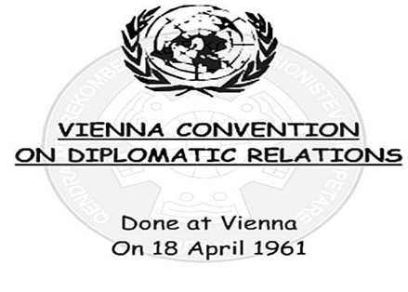
Framework for Modern Diplomatic Relations & Rules
1648 Congress of Westphalia
Post-30 Years’ War
Principle of sovereignty
1815 Congress of Vienna
Post-Napoleonic Wars
Codified diplomatic law
1961 Vienna Convention on Diplomatic Relations
Post-WWII
Appointments, protections, privileges

Slide 6

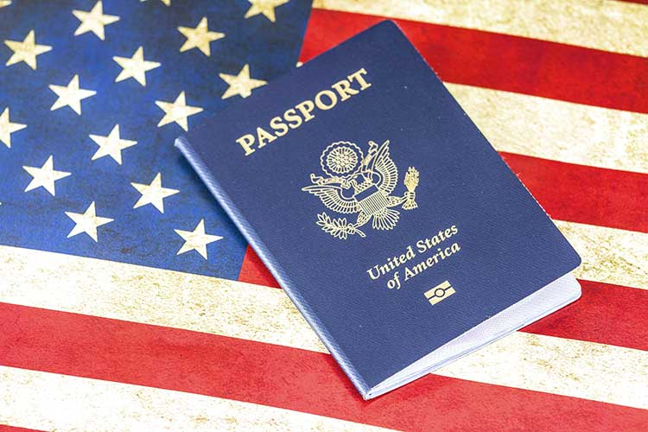
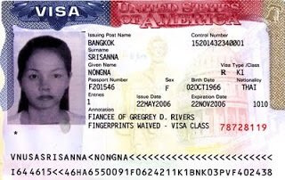


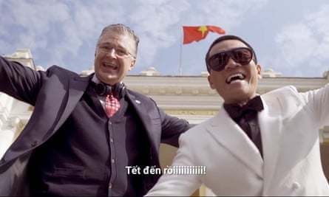
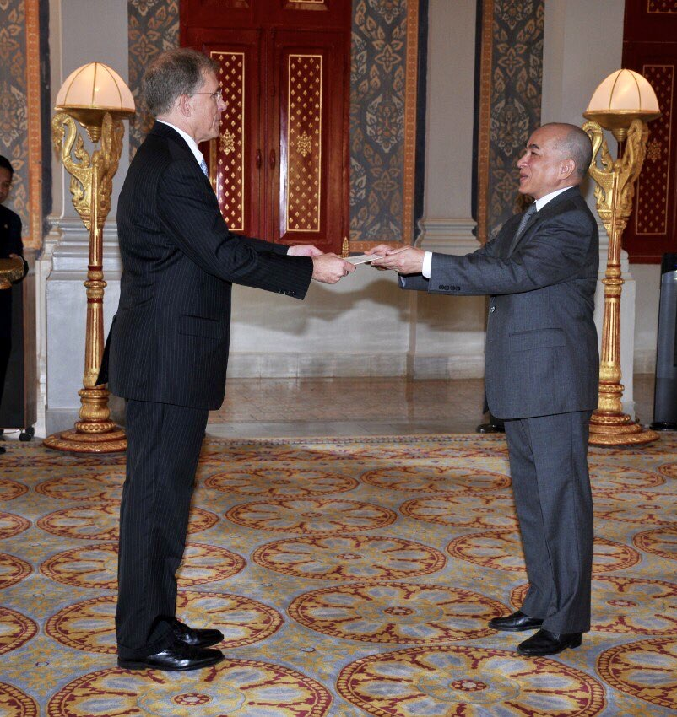
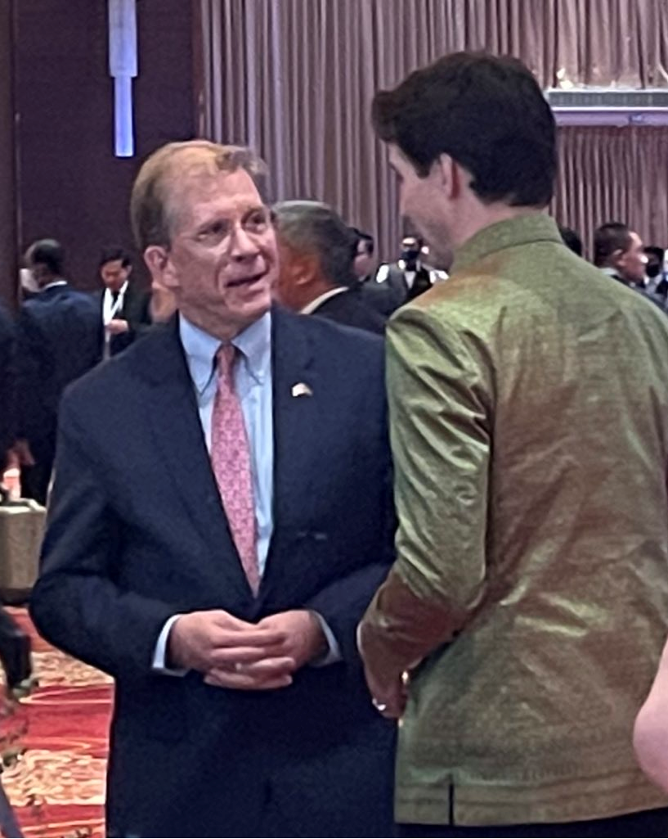

Elements of Diplomacy
  Alliances, partnerships, architecture
  Engagement
  International law, justice, norms
  Programs and assistance
  Citizens & travel
  Public Diplomacy

Slide 7
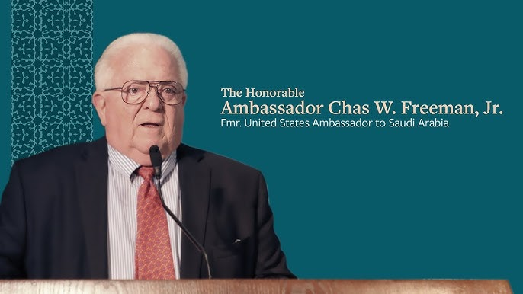
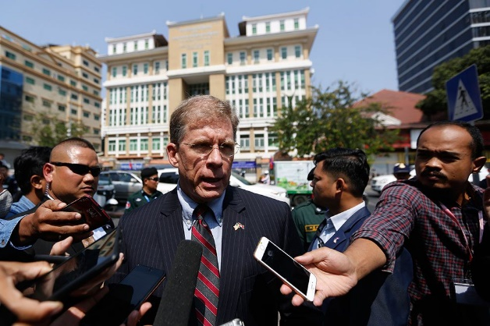
Skills of Diplomacy
Agency
Advocacy
Counseling
Dialogue
Expertise
Maneuvering
Negotiation
Reporting
Stewardship
  Communications
    Cross-cultural understanding
    Foreign Language
    Listening
  Compromise
  Confidentiality
  Honesty
  Patience & Persistence

Slide 8
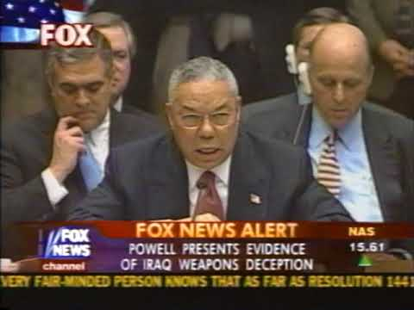
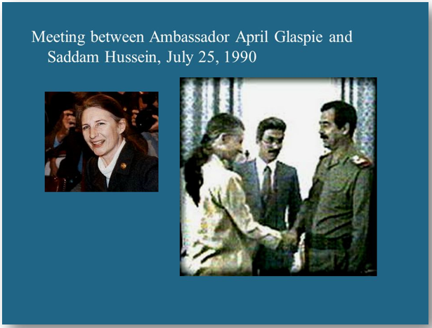
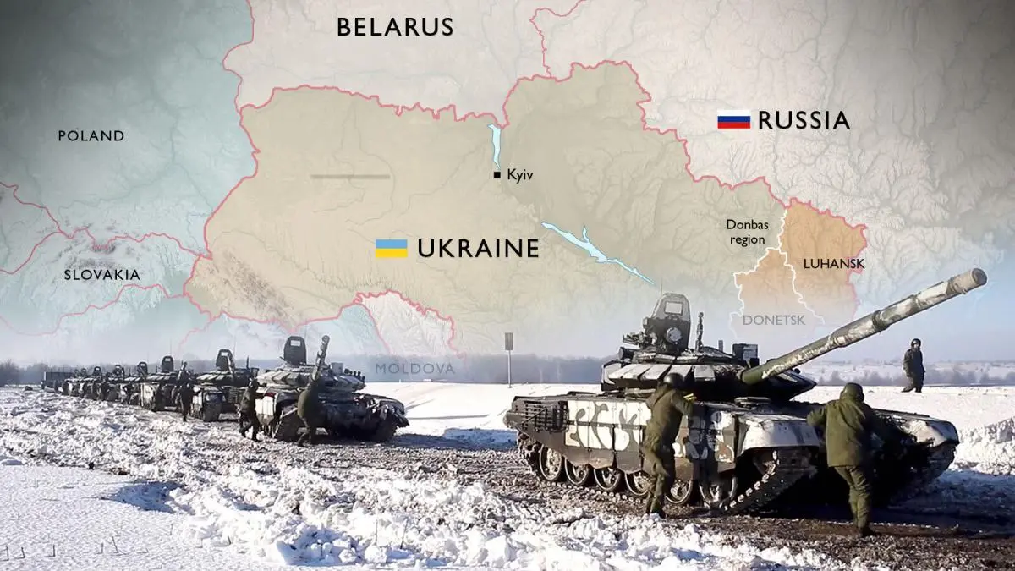
When diplomacy fails…
February 2003:
UN Security Council, New York
(March 2003: Invasion of Iraq)
(2005: Final weapons inspection = no WMD)
1990 Baghdad
(Iraq invades Kuwait six days later)
February 24, 2022
9 Feb 2022 Al Jazeera Headline:
No, Russia will not invade Ukraine
“A large-scale military operation does not fit into Moscow’s cost-benefit calculus.”

Slide 9
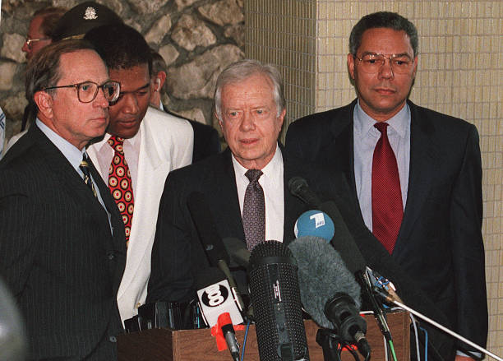
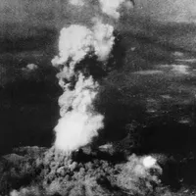
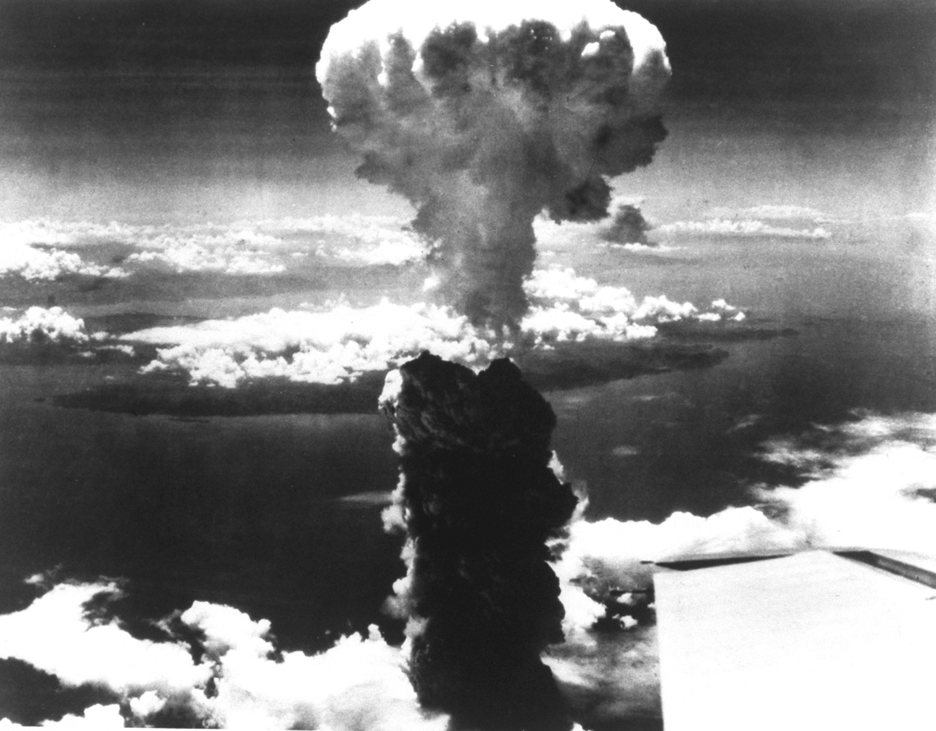
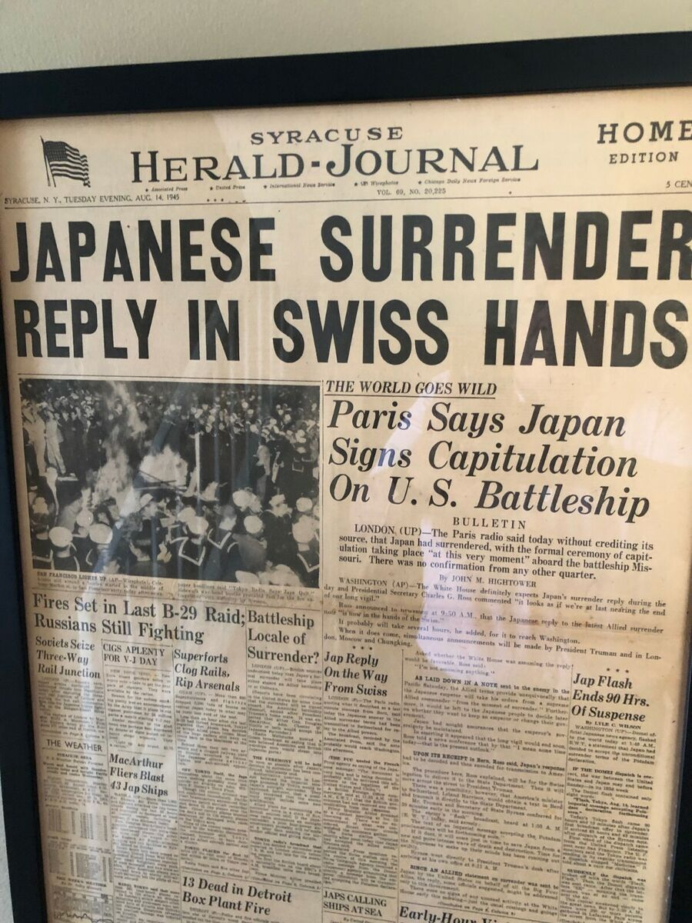
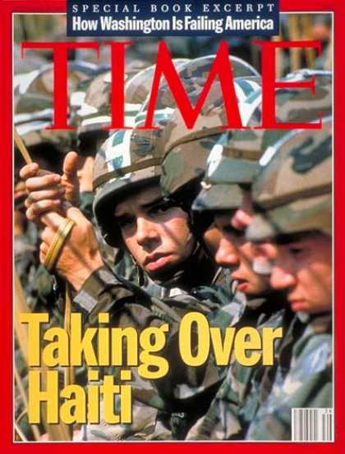
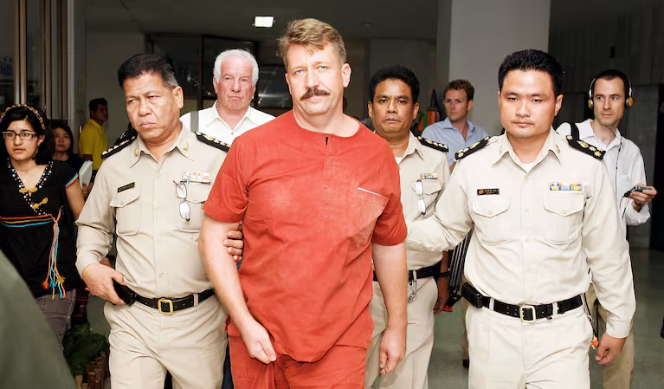

…when diplomacy succeeds
September 1994
August 6, 1945
August 9, 1945
August 14, 1945
November 10, 2010
December 10, 2022

Slide 10
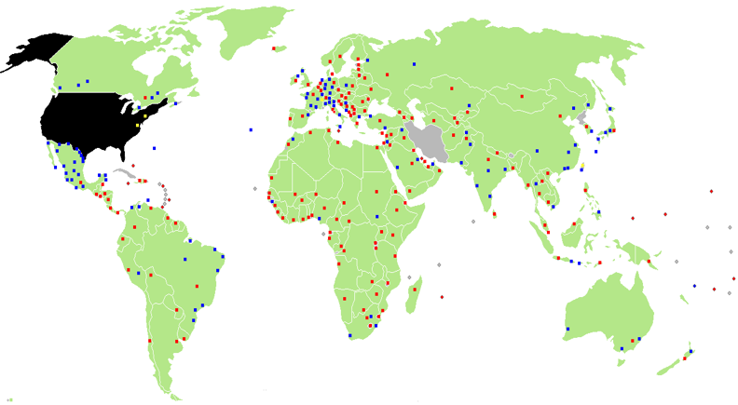
Global Presence: U.S. Diplomatic and Consular Missions
273 embassies, consulates, special missions, liaison offices, consular agencies in 175 countries
No relations: Afghanistan, Bhutan, DPRK, Iran, Syria)
Protecting powers/interest sections: Afghanistan (Qatar), DPRK (Sweden), Iran (Switzerland), and Syria (Czechia)
Relations but no presence: Andorra, Comoros, Cook Islands, Dominica, Libya, Liechtenstein, Monaco, Nauru,
Niue, San Marino, Saint Kitts/Nevis, Saint Vincent/Grenadines, Sao Tome/Principe, Sudan, Tuvalu, Venezuela)

Slide 11
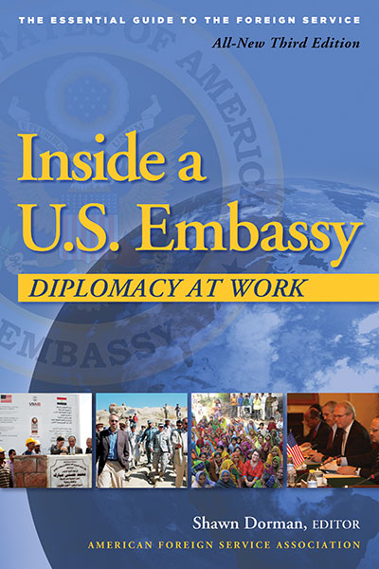
Department of State Staffing
75,000 employees worldwide
(3% of DOD total workforce)
14,500 Foreign Service:
About 15,000 work in the United States
10,000 Civil Service
-55% “Generalists”
-45% “Specialists”
2,368 Family Members
People:
Our Greatest Asset
50,000 foreign nationals (FSNs, LES)
2025:
15% employee reduction

Slide 12


“Chief of Mission”
Ambassador (or Chargé d’affaires, a.i.)
Extraordinary and Plenipotentiary
Personal Representative of the President
POTUS Letter of Instruction
Chief of Mission (Command) Authority
  (all Executive Branch personnel, except those under Combatant Command or assigned to international organizations)

Slide 13
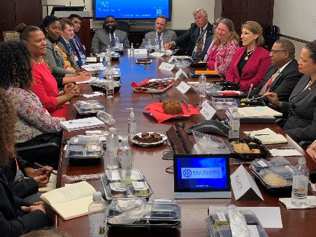
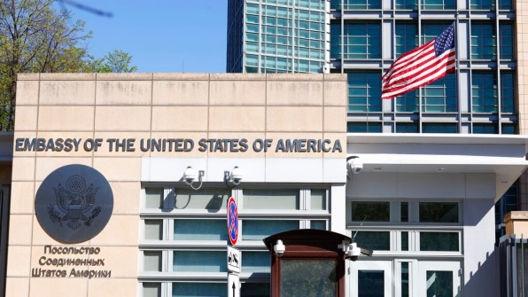
U.S. Embassy Structure: The Country Team
Ambassador
(Chief of Mission)
Deputy Chief of Mission (DCM)
Political
Affairs
Economic
Affairs
Consular
Affairs
Management
Section
Public
Affairs
Regional Security
Office
Senior Defense
Official
Other USG
Agencies
Consulates/
Constituent Posts
Community Liaison
Office
Marine Security Guard
Detachment
Defense
Attache
Defense
Cooperation

Slide 14

Interagency at U.S. Embassies
Foreign Affairs Agencies
State
Foreign Commercial Service
Foreign Agricultural Service
U.S. Agency for Global Media
Animal and Plant Health Inspection Service
(Former: USAID)
Others (common):
Department of Defense
U.S. Marine Corps (MSG)
Centers for Disease Control
Drug Enforcement Agency
Homeland Security
Justice
Peace Corps
Treasury
Others (less common):
American Battle Monuments Commission
Energy
Fish and Wildlife Service
Internal Revenue Service
Library of Congress
NASA
National Institutes of Health
Social Security Administration
Veterans Affairs

Slide 15
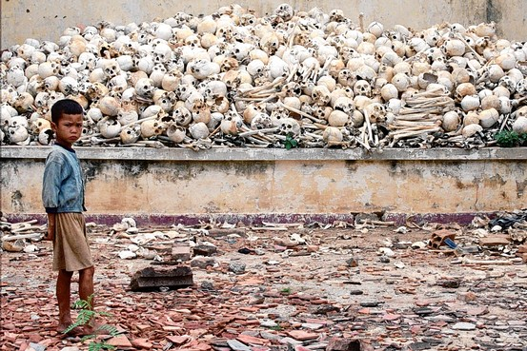

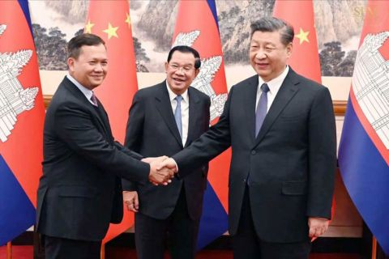
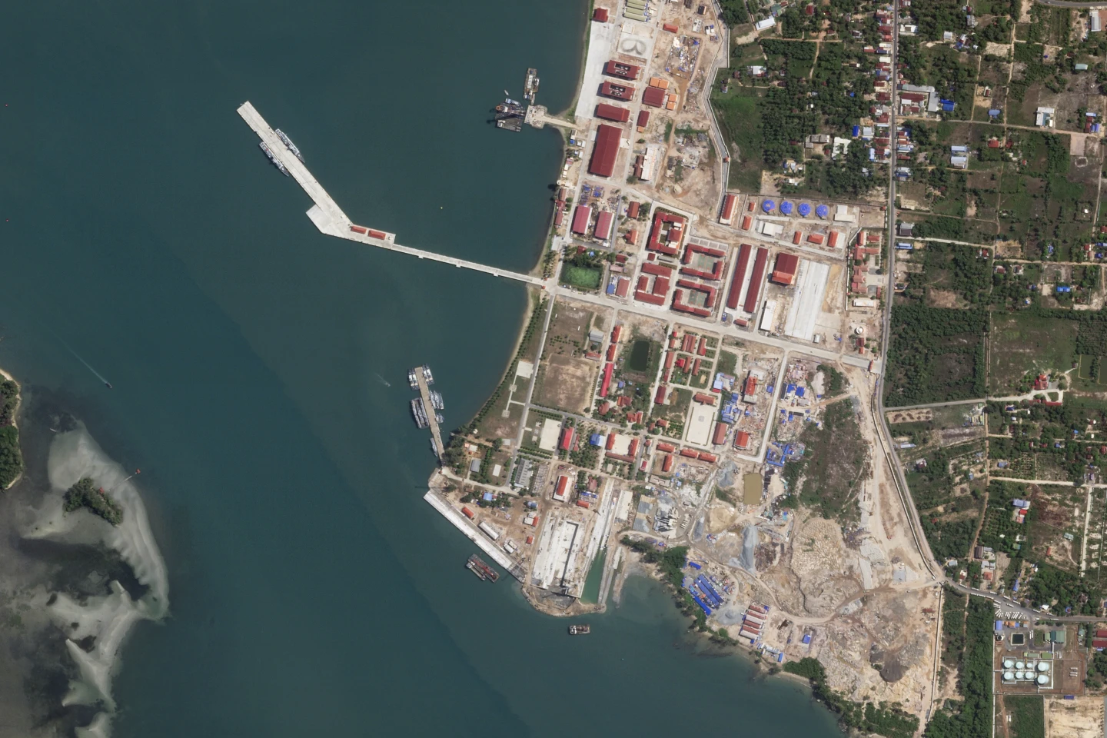
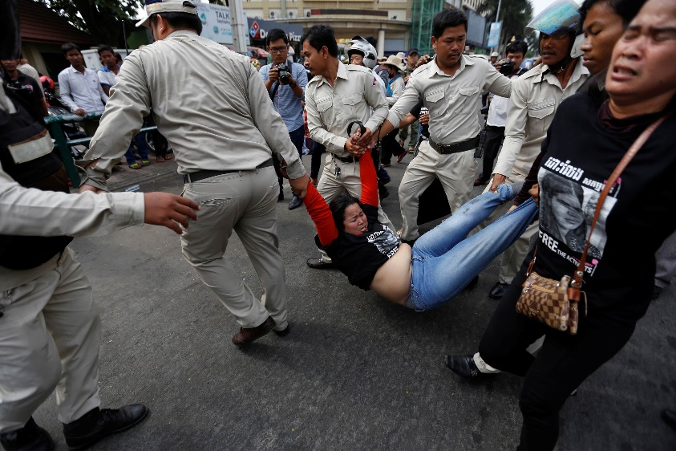
Cambodia – Diplomacy with an Enigma

Slide 16
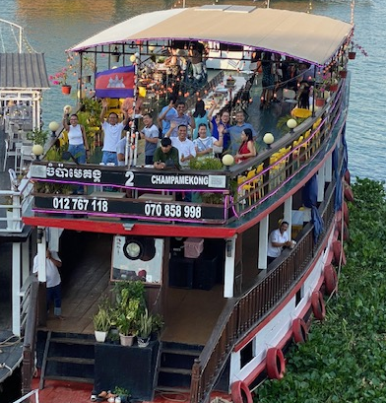
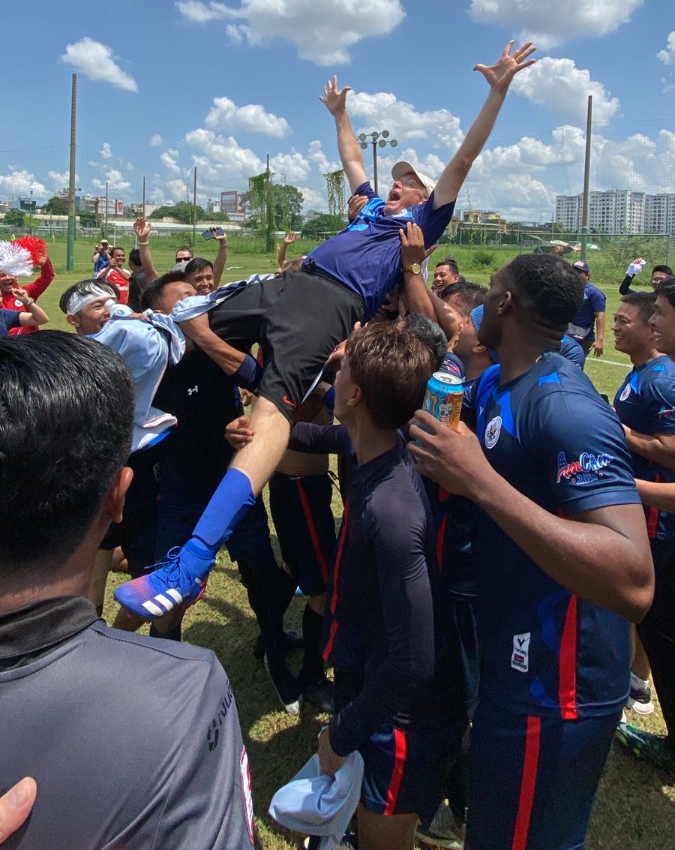

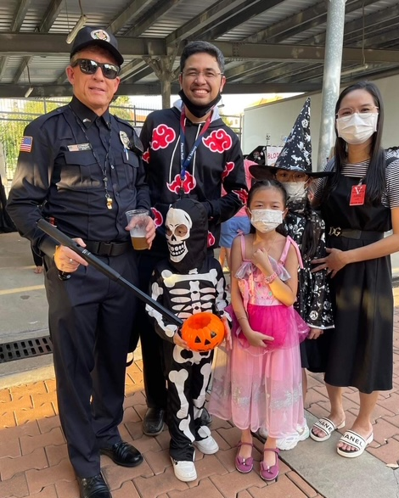

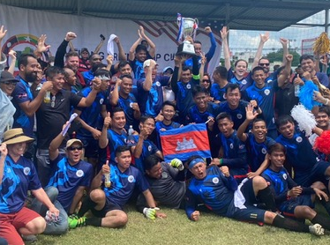
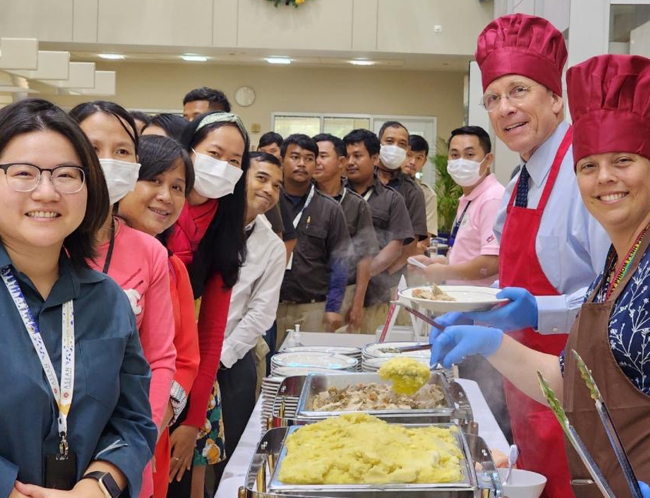
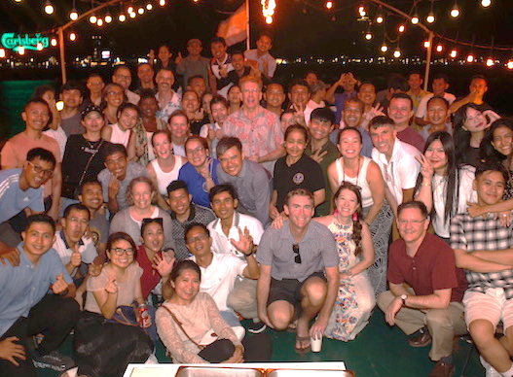
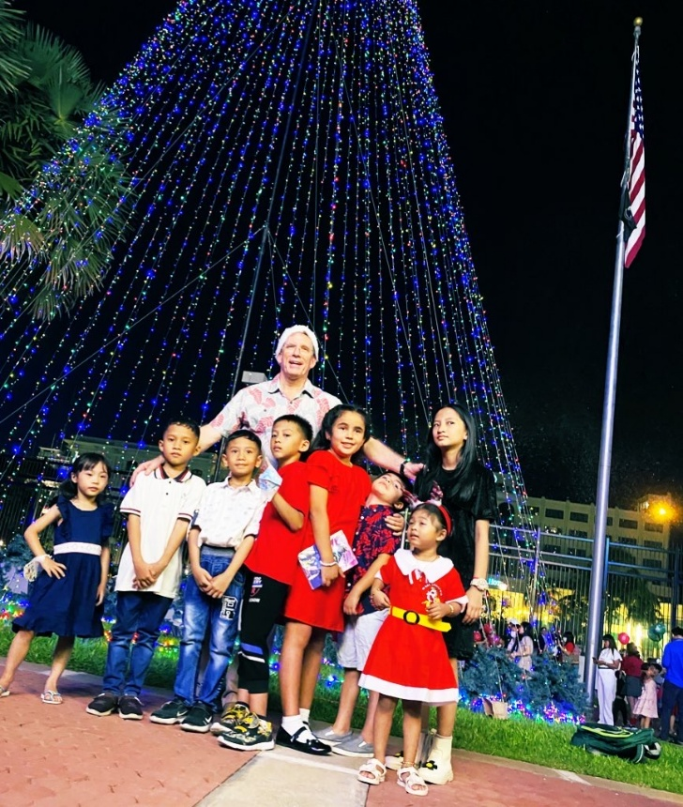
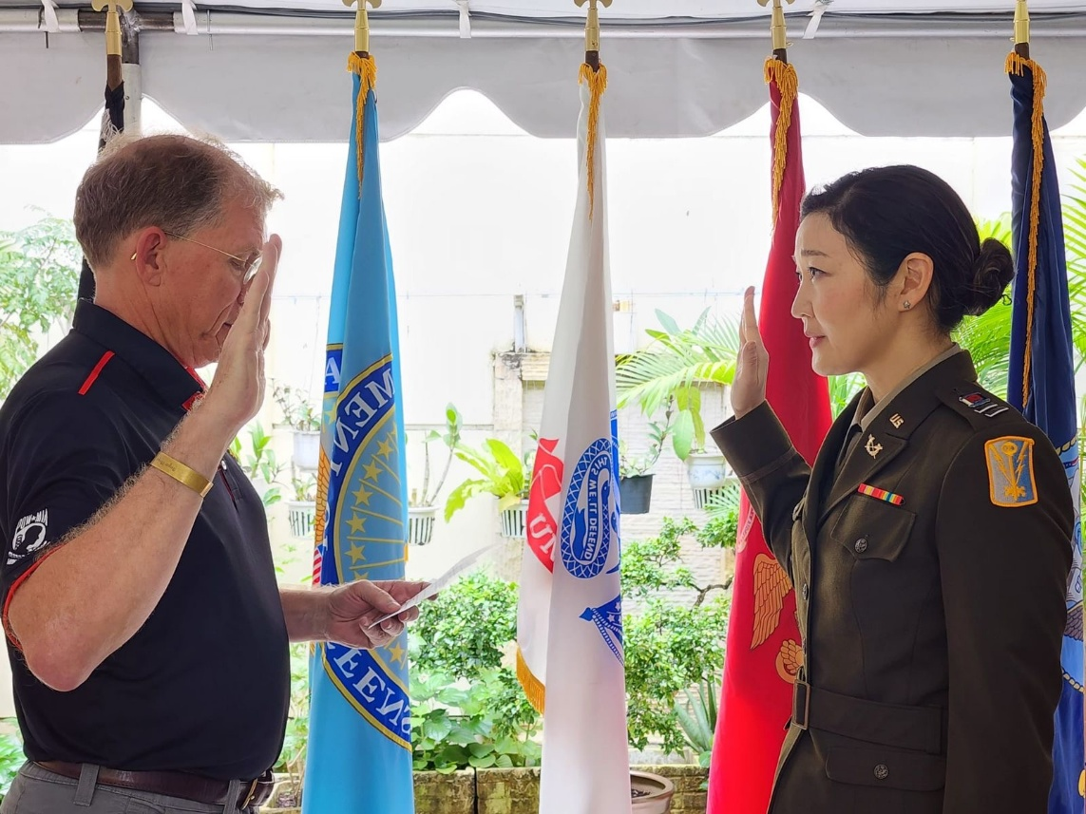
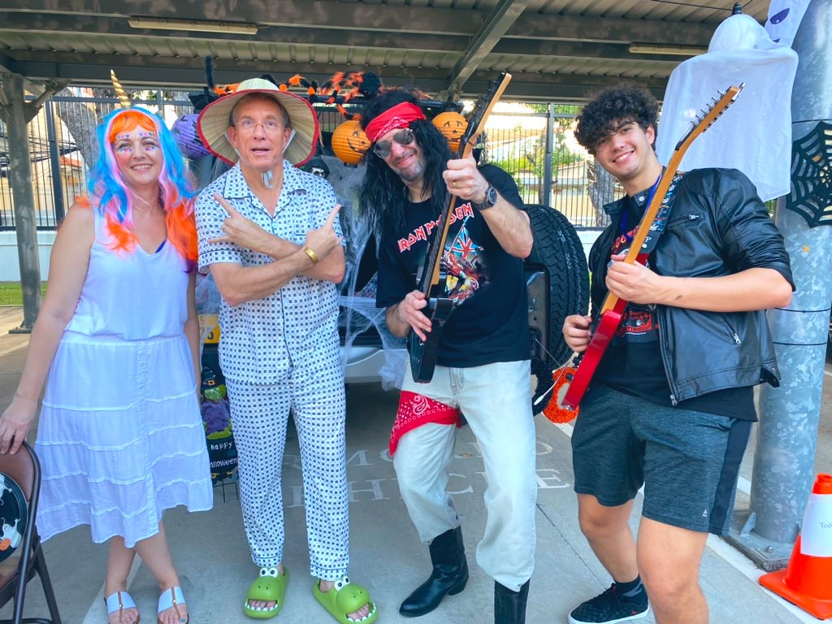

Embassy Communities

Slide 17

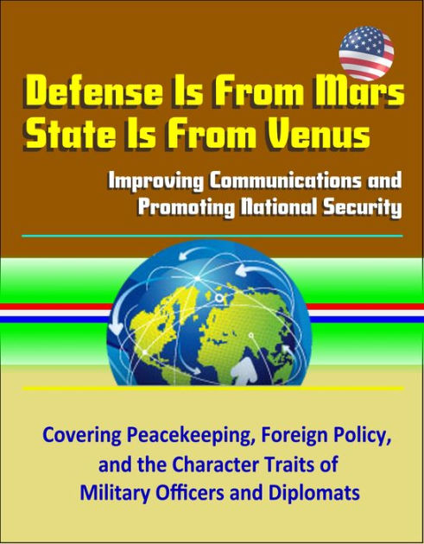
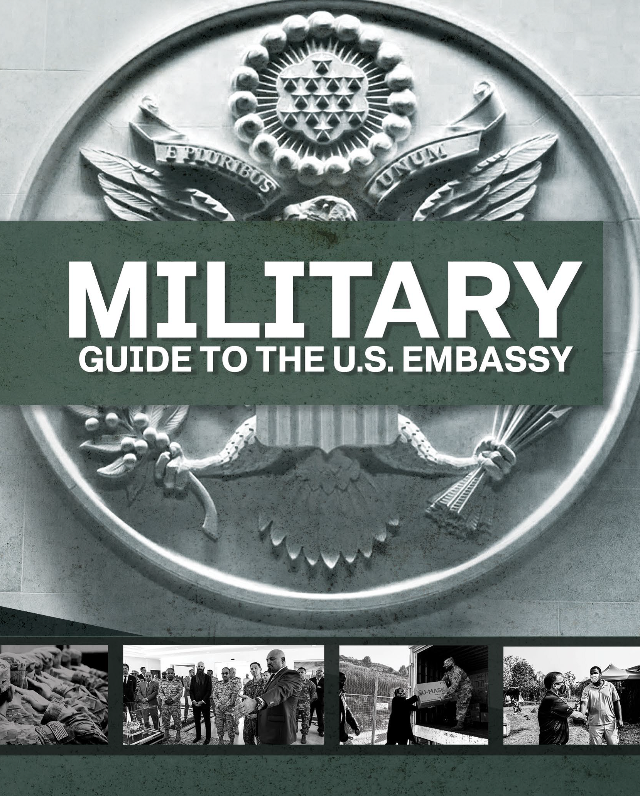
Cultural Differences: State & Defense

Slide 18
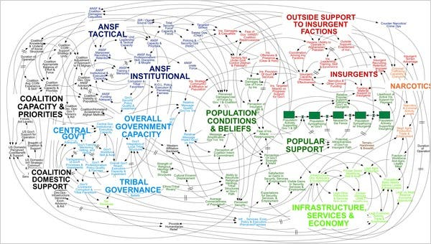
“We Have Met the Enemy and He Is PowerPoint”
Department of Defense PowerPoint
https://www.nytimes.com/2010/04/27/world/27powerpoint.html

Slide 19
Department of State PowerPoint

Slide 20









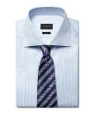
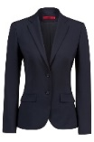



A Quick Guide to U.S. State Department Rank and Insignia
FS Rank | FS-05 | FS-04 | FS-03 | FS-02 | FS-01 | OC | MC | CM | CA
GS Equivalent | GS 8/9 | GS 10/11 | GS 12/13 | GS 14 | GS 15 | SES V | SES IV | SES III | SES II, I
DoD Equivalent Insignia | O-2 | O-3 | O-4 | O-5 | O-6 | O-7 | O-8 | O-9 | O-10
Insignia (Male)
Insignia (Female)
Typical Title (Male) | Greg | Greg | Greg | Greg | Greg | Greg | Greg | Greg | Sir
Typical Title (Female) | Alicia | Alicia | Alicia | Alicia | Alicia | Alicia | Alicia | Alicia | Ma'am

Slide 21
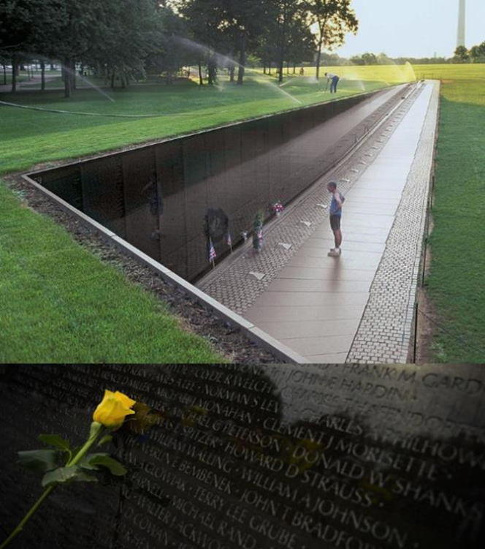
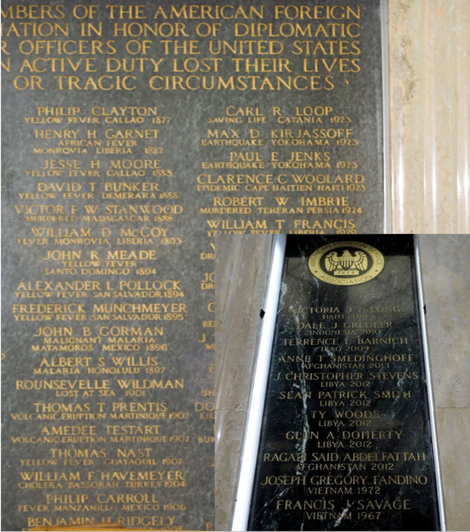
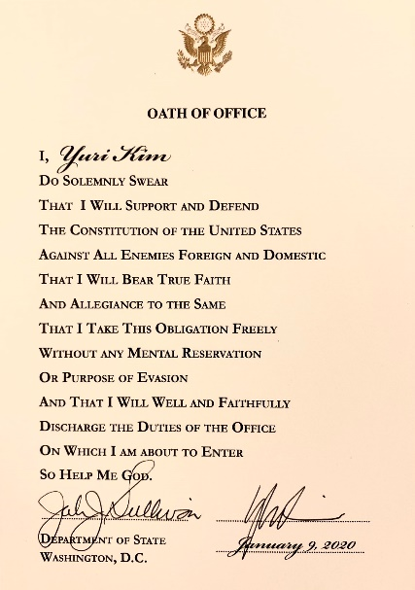
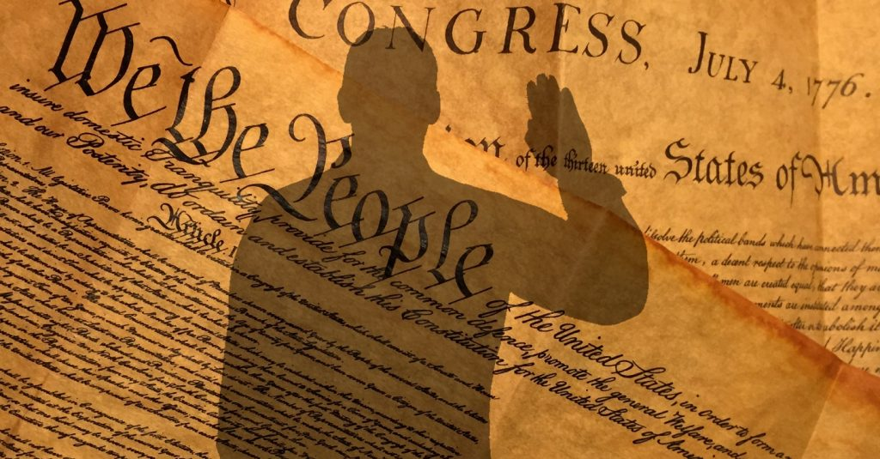
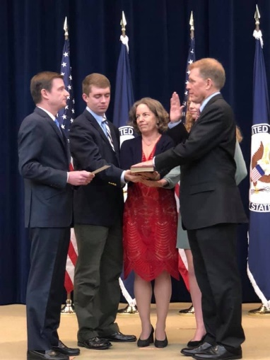
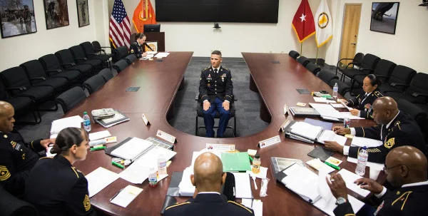
DoD & DOS: What We Share
Duty, Sacrifice, and Service
Oath of Office
Hierarchy: Up or Out

Slide 22
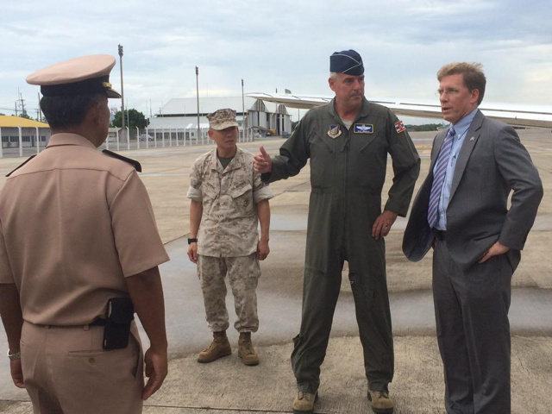





Better Together
Humanitarian Relief
(Nepal Earthquake JTF-505 2015
Thailand Hub)
Non-Combatant Evacuations
(“Operation Noble Obelisk” 1996
Sierra Leone/Guinea)
Combat Operations
(“Operation Iraqi Freedom” 2009
Ninewa/Kurdistan)
Partnerships
(West Point-Vietnam 2017)
POW/MIA WWII Recovery
(Papua New Guinea 2019)

Slide 23





POW/MIA Vietnam Era Recovery
(China, Cambodia, Thailand, Laos, Vietnam)
Humanitarian Demining
(Global)
Air Force MILAIR Support
(Global)
State-MSG Partnership
(since 1948)

Slide 24

Comments & Questions

