Slide 1
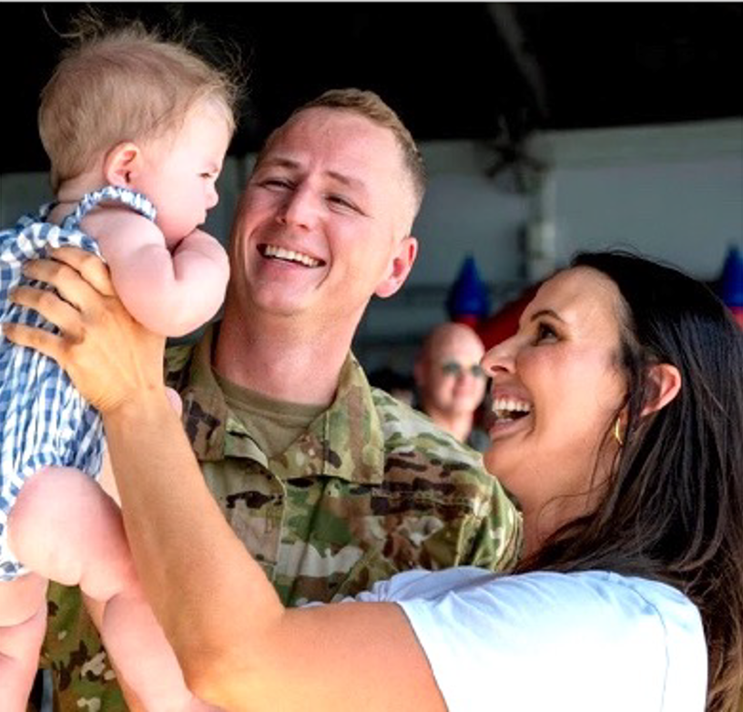
Slide Title
Military Community
and Family Policy
Overview
Mr. Dave Julian
Senior Advisor
Military Community and Family Policy
Ms. Josie Beets
Acting Director
Office of Spouse Employment
August 10, 2026

Slide 2
Military Community and Family Policy
MC&FP Mission
The Office of Military Community and Family Policy contributes to force readiness and quality of life by providing policies and programs that advance the well‐being of service members, their families, survivors and other eligible members of the military community.
We will build the foundation for a continuum of support across military and civilian communities that enables service members, military families and survivors to thrive.
Secretary of War Priorities
Restore the warrior ethos
Rebuild our military
Reestablish deterrence

Slide 3
Military Community and Family Policy
Policy Oversight
Casualty, Mortuary Affairs, Military Funeral Honors, and Personnel Accountability
Childcare Centers/
Child and Youth Programs
Military and Family Support Centers/Family Readiness
Exceptional Family Member Program
Defense-State Liaison Office
Military Community Advocacy Directorate
Morale, Welfare and Recreation
Resale (Commissary and Exchange)
Execution
Military OneSource
Military and Family Life Counseling Program
Military Family Readiness Council
SpouseWorks (formerly Spouse Education and Career Opportunities)
U.S. Department of Agriculture’s OneOp (formerly Military Families Learning Network)
Military Community and Family Policy Overview

Slide 4

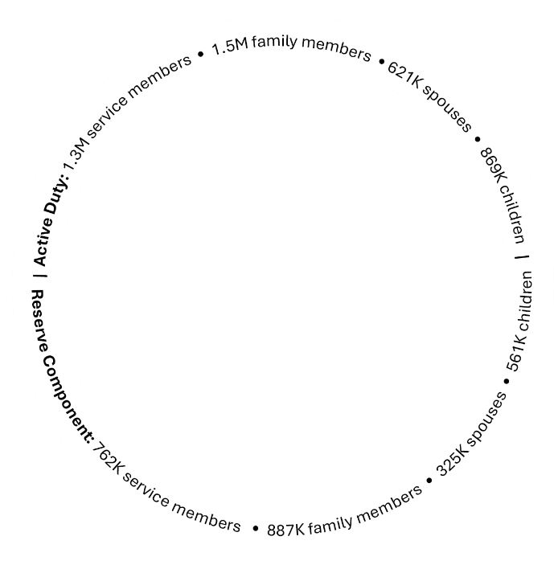

Office of the Deputy Assistant Secretary of War
Military Community and Family Policy
Quality of life policies and programs that help our service members,
their families and survivors be well and mission ready.
Deputy Assistant Secretary of War
and Principal Director
Research Oversight, Data and Analytics
Military OneSource
Sesame Street for Military Families
Military and Family Life Counseling
Outreach Operations
IT and Cybersecurity
Child Development Centers
Family Child Care Programs
School-Age Care Programs
Youth Services
School Liaison Programs
Thrive Online Parenting Program
Virtual Lab School
Militarychildcare.com
Early Learning Matters Curriculum
Military
Community
Support Programs
Child and Youth
Programs
Military
Community
Advocacy
Family Advocacy Program
Child and Youth Advocacy Program
Coordinated Community Response
Defense-State Liaison Office
Advance DOW State Policy Priorities
Educate State Policymakers
Military State Policy Source Website
State (and Territorial) Government Relations
Policy Development — Quality of Life and
Economic Well-Being
Regional Liaisons
Federal Congressional and Legislative Affairs
Federal and
State Legislative Resource Office
Office of Spouse Employment
SpouseWorks
(formerly Spouse Education and Career Opportunities)
Military Spouse Employer Partnership
(formerly Military Spouse Employment Partnership)
SpouseWorks Scholarship (
formerly My Career Advancement Account)
MWR and
Resale Policy
Human Resources and Personnel Security
Strategy, Policy,
Government Relations
MWR Policy
Business Policy (Exchanges,
Commissary and Lodging)
Nonappropriated Fund Policy
Office of Special Needs
Military Family Readiness Policy
Nutrition Readiness
Online Learning
Relocation and Deployment
OneOp
Casualty Assistance
Mortuary Affairs
Military Funeral Honors
DOW Cemeteries
Personnel Accountability
Military In Lasting Tribute
Casualty, Mortuary Affairs, and Military Funeral Honors
Office of Military Family Readiness Policy

Slide 5


Military OneSource (http://www.militaryonesource.mil/)
Military OneSource:
  Provides 24/7/365 connection to information, answers and support
  Helps service members, military spouses and families take full
  advantage of all the benefits and resources they have available
  Supports the greater military community
The My Military OneSource app is available
on both Google Play and the Apple App Store.

Slide 6


Military OneSource: A Comprehensive Range of Support
Confidential
Counseling
Financial and
Tax Consultation
SpouseWorks (formerly Spouse Education and Career Opportunities)
Transitioning
Veterans
Health and
Wellness Coaching
Building Healthy Relationships
Wounded Warrior and Caregivers
Eldercare
Education
Special Needs
New MilParent
Spouse Relocation
and Transition
Adoption and Foster Care
Peer-to-Peer Support
Document Translation and Language Interpretation
www.MilitaryOneSource.mil | 800-342-9647

Slide 7
Key Initiatives and Focus Areas
Family Readiness in Today’s Environment
  Operation Epic Fury/Overseas Operations
  Military Spouse Commission
Child Care:
  Military Child Care in Your Neighborhood (MCCYN)-PLUS
  Child Care In Your Home (CCYH)
  Armed Services YMCA CDC Partnership (Grand Opening #3 – Sept 2026)
Military Youth:
  Joint Service Teen Council
  Boys & Girls Clubs of America – National Military Youth of the Year
  Homeschooling (Professional Books and PCS)
Wellness:
  Relationships Campaign (Ready, Set, Connect Virtual Summit - recorded)
  Presidential Fitness Test\
  Nutrition Readiness
Military Spouse Employment:
  SpouseWorks Rebrand + Initiatives
Military Community and Family Policy Overview

Slide 8

The Office of Spouse Employment and SpouseWorks
The New Home for Trusted Career Support for Military Spouses

Slide 9
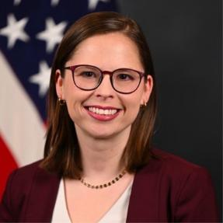
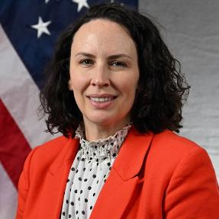
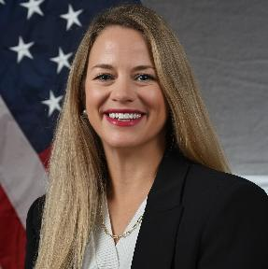
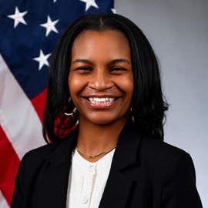
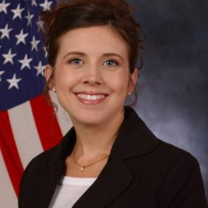
Office of Spouse Employment
The Office of Spouse Employment is leading the way for military spouse employment through policies, programs, and partnerships by helping spouses grow skills, get career advice, and find jobs.
Eryn Wagnon
Director
Josie Beets
Associate Director
SpouseWorks
Megan Paone
Program Manager
Employer Partnerships
Kathia Kilburn
Program Manager
SpouseWorks
Krista Thomas
Program Analyst
Policy

Slide 10




Introducing SpouseWorks
Previous brand experience
Military spouses often experience our support as a collection of separate programs and websites rather than one connected system.
A new look and easier access for career and education support.
One destination and one marquee brand providing a clear pathway to the key War Department spouse employment initiatives and resources.
The rebrand creates a simpler experience that helps spouses find, understand and access support more easily.

Slide 11
What’s Changing
We are aligning programs under one identity while bringing clarity to the names of the trusted services and support.
New Names | Old Names
SpouseWorks | Spouse Education and Career Opportunities
Military Spouse Employer Partnership | Military Spouse Employment Partnership
SpouseWorks Scholarship | My Career Advancement Account, or MyCAA
SpouseWorks Fellowship | Career Accelerator
SpouseWorks job board | MSEP Job Search

Slide 12
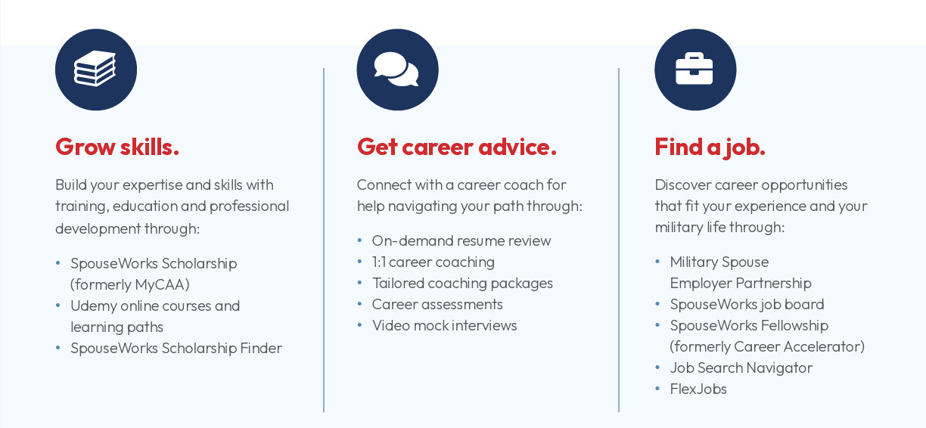
How SpouseWorks Supports You

Slide 13

SpouseWorks Scholarship
Start a new career, build new skills, or continue your education.
Build in-demand skills and move your career forward, without breaking the budget.
Up to $4,000 in financial assistance to eligible military spouses.​
Funding can be used for:
  license,
  certification, or
  associate degree.
Can also be used for continuing education credits.
spouseworks.militaryonesource.mil/portal/article/spouseworks-scholarship

Slide 14

SpouseWorks Career Coaching
Expert coaches provide personalized advice to help you move your career forward
Set career goals: Clarify career goals through expert advice and career assessments.
Develop and improve your resume: Unlimited resume and cover letter reviews.
Grow your skills: Explore education and skill building opportunities.
Be a job search superstar: Maximize your job search with concierge connections to employers.
Prep for the interview: Get personalized feedback on your interview style.
Build your business: Explore the skills and training needed to be a business owner.
spouseworks.militaryonesource.mil/portal/article/spouseworks-career-coaching-services

Slide 15

On-Demand Resume Review
Get expert resume advice on-demand
Email a resume and cover letter, along with a career goal or job description, to CareerCoach@SpouseWorks.mil
Within three business days, a career coach will send feedback to strengthen the resume and cover letter.
If there are questions, just email the career coach.
Expert Tip:
Include the job you’re applying for with your resume.

Slide 16

SpouseWorks Fellowship
Jumpstart your career with hands-on experience
12-week fellowship paid by DoW, providing hands on experience, professional mentorship, and tailored career support.
Candidates meet with a career coach to review their eligibility for the program and assess resume.
Fellows placed with employers across industries and locations, to include remote work.
Designed to lead to long-term employment.
Free to employers.
spouseworks.militaryonesource.mil/portal/career-accelerator

Slide 17

Military Spouse Employer Partnership
Connecting military spouse talent with employers committed to recruit, hire, promote and retain military spouses in their organizations.
Partnership between DoW and employers.
More than 1,000 vetted employers committed to spouse employment.
Provides a valuable pipeline of career opportunities to spouses.
Connects employers to valuable spouse talent.
spouseworks.militaryonesource.mil/portal/msep/partners

Slide 18

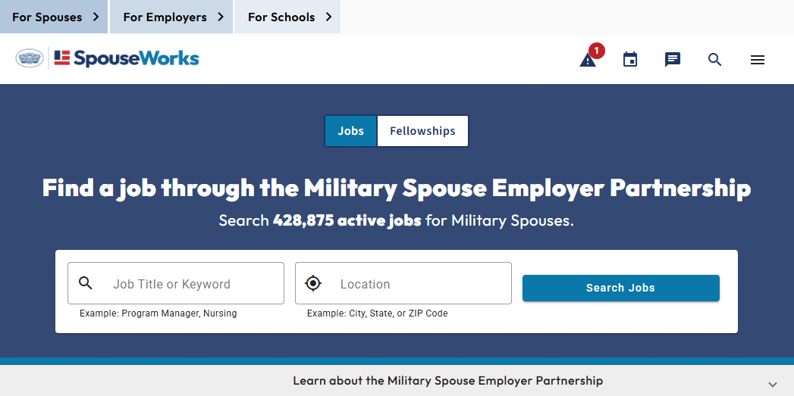
SpouseWorks Job Search
Start a Job Search by entering a Keyword and/or Location and clicking Search Jobs.
Find opportunities that match your career goals
More than 400,000 active jobs from employers.
Search by keywords, job types, location, industry, and more.
Remote and telework role filters.
Jobs from more than 1,000 employers looking for military spouse talent.
spouseworks.militaryonesource.mil/portal/msep/jobs

Slide 19


Free Udemy Membership
13,000+ on-demand, flexible, online, self-paced courses taught by leading experts
  Learn new skills
  Enhance current skills
  Stay up-to-date on the latest industry trends
Pathways to certification in areas including:
  Amazon Web Services
  Microsoft Azure
  CompTIA, Cisco, CISM, Salesforce
  Project Management Professional
  National Association of State Boards of Accountancy
spouseworks.militaryonesource.mil/portal/article/udemy-free-online-courses
MySECO.MilitaryOneSource.mil • 800-342-9647

Slide 20


Free FlexJobs Membership
Find opportunities that match your career goals
Gain access to 100,000+ flexible and remote job openings for all experience levels from thousands of employers.
Full-time, part-time, freelance, and flex schedule opportunities.
Every job listing is vetted to ensure legitimacy.
spouseworks.militaryonesource.mil/portal/article/remote-flexible-jobs-for-millife-get-a-free-flexjobs-membership

Slide 21
Slide Title
Questions?
Dave Julian
Senior Advisor
David.a.julian.civ@mail.mil
Military Community and Family Policy Overview

