Slide 1
Military Community and Family Policy Overview
Dave Julian
Senior Advisor
Office of the Deputy Assistant Secretary of Defense
Military Community and Family Policy
Notes:
Good afternoon, everyone! (intro?) good to be back at NDU – C team?
Pleasure to be here – thank you Mrs. Wilson and Mrs. Christensen (Nancy and Teresa) – and Bonnie
First of all, congratulations on Capstone
Already found an amazing week with some pretty notable speakers lined up
TAPS/Bonnie Carolll, Mrs. Grady, Mrs. Black, area briefs
Tools for you – continue discussion/networking/mutual supp
Advantage – bios: no secrets from one another
Two reasons:
1) who you are, who you represent, and the fact that you’ll be back out there to help your networks, SMs and families. Lawyers, Nurses/heath care professionals, teachers, fed employees, private sector, non-profit, volunteers, key spouses/ombdusman, FRGs, parents, grandparents. It’s the talent and passion in this room that we always tout when talking to leadership, employers, etc.
2) we like to offer myself up as a resource to you – phone a friend of sorts – actual contact information, actually write you back – still in touch with past spouses – let me know! “safe ask” How?
Purpose – let you know a little about our office – MC&FP and to provide you with some tools for your/resources you can share as you help your folks. Questions as we go along – really want to hear from you!

Slide 2

Military Community and Family Policy
MC&FP Mission
Contribute to force readiness and quality of life by providing policies and programs that advance the well-being of service members, their families, survivors and other eligible members of the military community.
Policy Oversight
Child Care Centers/Child and Youth Programs
Exceptional Family Member Program
Morale, Welfare and Recreation
Resale (Commissary and Exchange)
Family Support Centers/Family Readiness
Defense-State Liaison Office
Casualty and Mortuary Affairs/Military Funeral Honors
Execution
Military OneSource
Military and Family Life Counseling Program
Spouse Education and Career Opportunities
U.S. Department of Agriculture’s OneOp
MC&FP Vision
A continuum of support across military and civilian communities that enable service members, military families and survivors to thrive.
Secretary of Defense Priorities
Revive Warrior Ethos
Reestablish Deterrence
Rebuild our Military
Notes:
McFamily
Office in Office of SECDEF responsible for Quality of Life
Preaching to choir- family readiness supports mission readiness
Support, empower care for resilient and ready not just to survive but to thrive
Cradle to grave – 3 exceptions – pay, financial readiness, and housing – but work closely.
Total Force
Armed Forces Retirement Home (MC&FP history)
Demographcs: almost half < 25, 70% < 30, ½ married,
Policy office but with execution – standardization, agile, economies of scale, height of eye.
Sign of strength; not a sign of weakness

Slide 3
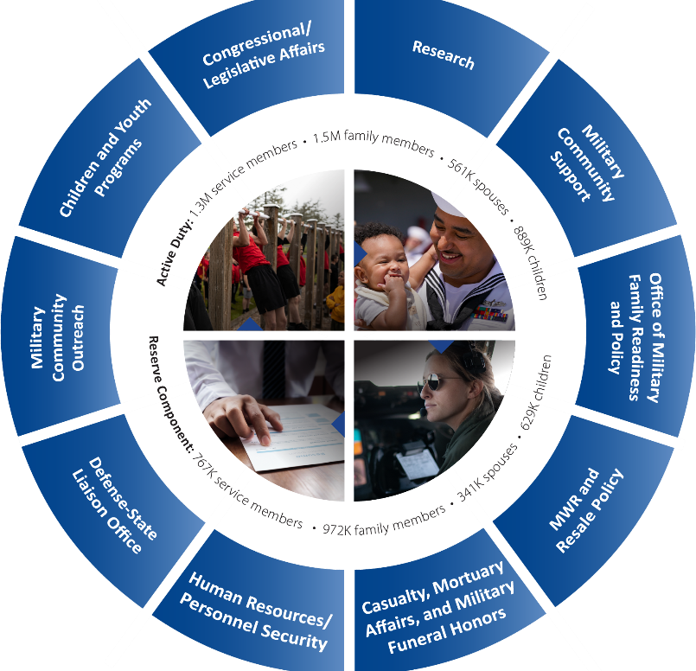
Military Community and Family Policy
Child Development Centers
Family Child Care Programs
School-Age Care Programs
Youth Services
School Liaison Programs
Thrive Online Parenting Program
Virtual Lab School
Early Learning Matters Curriculum
Data Analysis, Research and Surveillance
Military OneSource
Sesame Street for Military Families
Military and Family Life Counseling
Office of Special Needs
Military Family Readiness Policy
Nutritional Readiness
Online Learning
Spouse Education and Career Opportunities
Relocation and Deployment
OneOp
Strategic Communications and Analysis
Community and Public Engagement
Digital Portfolio Sustainment and Enhancement
IT, Cyber and Data Operations
Strategy, Policy, Government Relations
MWR Policy
Business Policy (Exchanges, Commissary and Lodging)
Nonappropriated Funds Policy
Advance DOD State Policy Priorities
Educate State Policymakers
Military State Policy Source Website
State (and Territorial) Government Relations
Policy Development — Quality of Life and
Economic Well-Being
Regional liaisons
Casualty Assistance
Mortuary Affairs
Military Funeral Honors
DOD Cemeteries
Personnel Accountability
Military In Lasting Tribute
Notes:
Give you “the numbers”

Slide 4
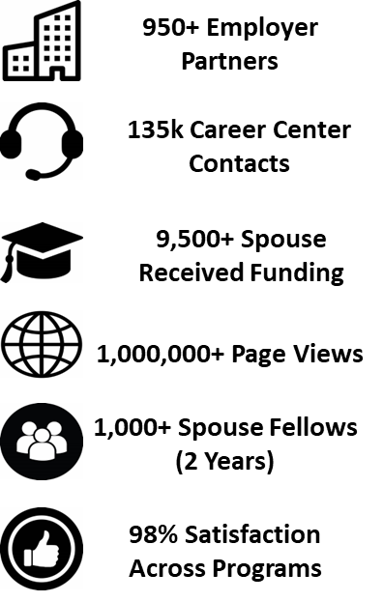



Military Spouse Employment and Childcare
Key Initiatives
Military Spouse Employment:
  Military Spouse Employment Partnership (MSEP)
  SECO Career Center
  My Career Advancement Account (MyCAA) scholarship
  MySECO Website
  Military Spouse Career Accelerator Pilot (MSCAP)
  Military Spouse Transition Programs (MySTeP)
Child Care:
  Military Child Care in Your Neighborhood (MCCYN)/PLUS
  Child Care In Your Home (CCYH)
  Armed Services YMCA CDC Partnership
42,000 Children in Community-Based Care
Pilot available in 12 States
3 CDCs – Norfolk, VA Grand Opening - 15 May 25
Notes:
Military spouses face barriers to meaningful employment related to their mobile military lifestyle, including frequent relocations and extended periods of family separation due to training and deployments.
The Military Spouse Employment Partnership (MSEP), which connects military spouses to employers who have committed to recruiting, hiring, promoting, and retaining military spouses. MSEP includes more than 950 employer partners representing corporations, small businesses, non-profits and Federal and State Governments.
The SECO Career Center provides virtual career and educational services through Career Advisors (4-year degree and relevant certifications) and Career Coaches (master's degree and relevant certifications) at no cost to military spouses.
The My Career Advancement Account (MyCAA) scholarship is a workforce development initiative that provides eligible spouses with up to $4,000 in financial assistance for the pursuit of education, training, and licensure.
The MySECO Website provides 24-7 virtual access to career resources such as events, training, the MSEP job search, MyCAA, resume builders and more.
The Military Spouse Career Accelerator Pilot (MSCAP) is a competitive, three-year pilot, providing military spouses with 12-week paid fellowships with industry.
The Military Spouse Transition Programs (MySTeP), accessed through MySECO, provides military spouses with more than 125 micro learning videos to prepare for and navigate the eventual transition away from military life.

Slide 5

+
Easy access to a vast network of digital tools and trusted information.
Personal, confidential support, when you want someone
to talk to.
Notes:
Military OneSource puts a huge ecosystem of support at your fingertips. You can call or click anytime to connect.
Call and get personalized support, recommendations, and referrals from a masters-level consultant
Click around our website and apps to discover tools, information, services and other support
Easy access to a vast network of digital tools and trusted information.
Whichever path you take, you'll find resources at the ready.

Slide 6

Confidential
Counseling
Financial and
Tax Consultation
Spouse Education and
Career Opportunities
Transitioning
Veterans
Health and
Wellness Coaching
Building Healthy Relationships
Wounded Warrior and Caregivers
Elder Care
Education
Special Needs
New MilParent
Spouse Relocation
and Transition
Adoption and Foster Care
Peer-to-Peer Support
Document Translation & Language Interpretation
All these consultations and services are just a phone call or chat away. Need other support? We can connect you!
MilitaryOneSource.mil | 800-342-9647
Notes:
Military OneSource connects service members and their families to a range of support for military life
This list is a sampling of the different areas we can help with; reach out or visit the website to explore more.
The most requested Military OneSource services:
Counseling, Spouse Employment and Tax Support
The top three user groups of Military OneSource are (in order):
Spouses
Service Members
Dependent Children

Slide 7

Support for the Military Community
Find free and confidential in-person counseling at Military and Family Support Centers on installations worldwide.
Military and family life counselors specialize in helping families navigate the challenges of military life.
Counseling is available for service members and their families.
Child and youth behavioral MFLCs support children’s well-being.
MFLCs can also deliver briefings, presentations and grief counseling if a unit experiences a death or other traumatic event.
To request support, visit:
Over 2,500 Military and Family Life Counselors
Assigned World-Wide
  https://supportrequest.militaryonesource.mil is the online resource for service providers to request virtual or in-person support for service members and their families.
Notes:
Key points:
You are able to request state consultants for in-person support at command events.
State consultants support hundreds of events per month across the country.
The Military and Family Life Counseling Program supports service members, their families and survivors worldwide with
confidential counseling.
Counselors are trained to work with the military community.
They offer face-to-face counseling services, briefings and presentations to the military community, both on and off installations.
Child and youth behavioral military and family life counselors:
Provide support to military children on a variety of issues
Have a positive effect on general behavior, performance in school and relationships
Work with kids to address:
Self-esteem issues
Communication and relationships at home and at school
Life skills, such as problem-solving and adjusting to changes
Behavioral issues, including bullying and anger management
Changes at home, such as dealing with deployment, reunions, divorce and grief
MFLCs can also deliver briefings, presentations and grief counseling if a unit experiences a death or other traumatic event. To request support, visit: supportrequest.militaryonesource.mil.

Slide 8
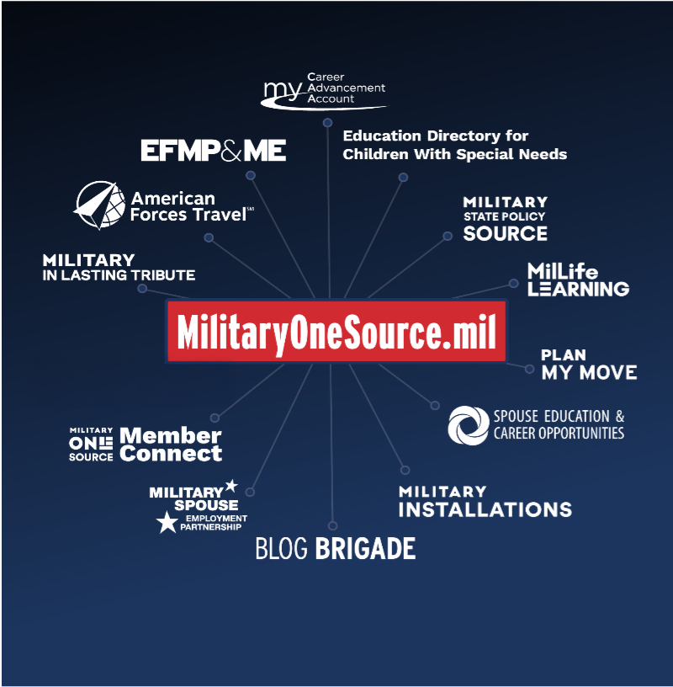
MilitaryOneSource.mil
  Your digital hub linking you to a network of websites and digital tools
Programs and services for travel, eLearning, moving, scholarships, job hunting, installation directories and member services
Sign up for e-Newsletters
for your areas of interest
Mobile apps for easy access
A universe of support for your
quality of life
Notes:
Military OneSource connects service members and their families to a range of support for military life, including online tools and apps
This list is a sampling of the different resources we can connect you with; reach out or visit the website to explore more
MilitaryINSTALLATIONS: Get to know your new home
You can search by installation or program
Spouse Education and Career Opportunities
EFMP & ME
Millife Learning – Key Spouse training
American Forces Travel *** Highlight

Slide 9








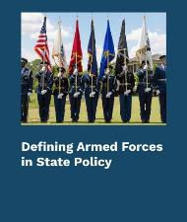
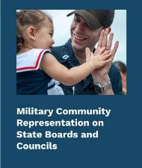



2025 DoD State Policy Priorities
Discrimination Protection for Military Families
Child Abuse and Neglect Reporting
Remote Driver’s License and Vehicle Registration Renewal
Access to Quality
Child Care
State Support of Military Families
With Special
Education Needs
Occupational Licensure Interstate Compacts
Occupational Licensure Interstate Compacts
https://statepolicy.militaryonesource.mil
9

Slide 10
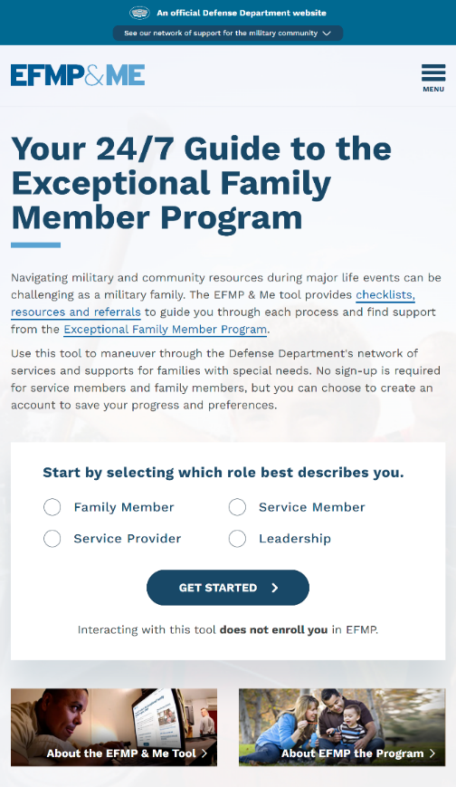
EFMP & Me
The EFMP & Me tool provides checklists, resources and referrals to guide service members and their families through each step of the EFMP.
A self-service tool for service members and families which can be accessed on any device with online capability, 24/7.
Users can contact EFMP Family Support providers through EFMP & Me.
A dashboard for service providers providing the latest (and greatest) in EFMP support, information and resources.
A platform to empower military leaders with information on EFMP so they can provide informed assistance to their service members and families.

Slide 11

Support for Living OCONUS
Once you’re in your new home, Military OneSource can help you settle in and enjoy life OCONUS:
Adapt to a new culture and explore
your new home
Get translation and interpretation services
in real time
Find your way around your installation
Find resources for military spouses,
children and child care
Touring and adventure with discounts
Stay in touch stateside with voting assistance
Military OneSource experts are on hand 24/7 to talk through the ins and outs of living overseas.
Notes:
Adapting to a new culture
The Living Overseas Military Life Guide has great information about making yourself at home OCONUS. From language lessons to getting your POV (Privately Owned Vehicle) overseas. Find essential information curated for you in these Overseas Living MilLife Guides, including benefits, tools and resources, links to additional relevant content and access to the support you need.
Language Services
Military OneSource offers real-time language translation services in more than 150 languages.
MilitaryINSTALLATIONS
Get information about your new installation such as major units, housing, child care, school liaisons, relocation assistance, health care, connecting with chaplain services, your military and family support center, and spouse education training and careers.
Save money with Armed Forces Travel and MWR Recreational Lodging
Take advantage of overseas travel opportunities and explore the area with military vacation discounts.
Voting assistance
Make sure your voice is heard in local, state and national elections stateside. Find out about absentee ballots and the Federal Voting Assistance Program.

Slide 12

What Can We Do Together As Champions?
  Supporting the warfighter and family with resources that foster well-being, readiness, and build community requires a joint effort to bolster resource awareness and engagement.
Amplify Resources
Promote social media content
Leverage formal and informal networks to create more awareness
Actively share THIS mission critical resource
Notes:
Supporting the warfighter and family with resources that foster well-being, readiness, and build community requires a joint effort to bolster resource awareness and engagement.
Military OneSource is an essential piece of gear. It’s vital support.
I encourage you to actively share this mission-critical resource.
Talk about it. Make it part of your Installation Spouse Programs. Every single mention can help to empower our service members.

Slide 13



Access our support when, where and how it's convenient for you.
Call 800-342-9647
Live Chat
My Military OneSource App
Notes:
Connect to Military OneSource and personalized support 24/7. You can call CONUS or OCONUS, arrange a live chat or download the app for easy access on your phone.
And stay up to date by signing up for our newsletters and joining us on social media.
Social Networks
Find Military OneSource on:
Facebook
Twitter
Instagram
LinkedIn (SECO / MSEP)
Pinterest
YouTube

Slide 14
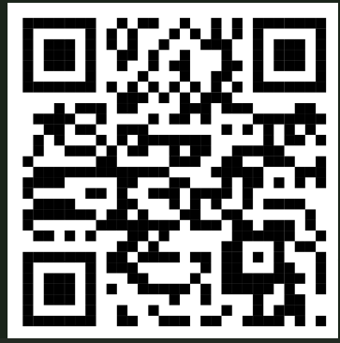
Senior Spouse Roundtable
Sign up for the MC&FP Quarterly Senior Spouse Roundtable
Fall 2025
Email: Bruce.a.moody.civ@mail.mil
Or click on the QR code:
Notes:
This QR code provides Ty Jones-Vincent’s email address for an invite to the upcoming senior spouse roundtable March 2025

Slide 15
Dave Julian
Senior Advisor, MC&FP
david.a.julian.civ@mail.mil
571-438-2048
Notes:
This QR code provides Ty Jones-Vincent’s email address for an invite to the upcoming senior spouse roundtable March 2025

Slide 16
Backup
Notes:
This QR code provides Ty Jones-Vincent’s email address for an invite to the upcoming senior spouse roundtable March 2025

Slide 17






Military Spouse Employment
Key Initiatives:
  The Military Spouse Employment Partnership (MSEP): Connects military spouses to employers who have committed to recruiting, hiring, promoting, and retaining military spouses.
  The SECO Career Center: Virtual career and educational services through Career Advisors (4-year degree) and Career Coaches (master's degree) at no cost to military spouses.
  The My Career Advancement Account (MyCAA) scholarship: Workforce development initiative that provides eligible spouses with up to $4,000 in financial assistance for the pursuit of education, training, and licensure.
  The MySECO Website: 24-7 virtual access to career resources.
  The Military Spouse Career Accelerator Pilot (MSCAP): A competitive, three-year pilot, providing military spouses with 12-week paid fellowships with industry.
  The Military Spouse Transition Programs (MySTeP): ~125 micro learning videos to prepare for and navigate the eventual transition away from military life.
950+ Employer Partners
135k Career Center Contacts
9,500+ Spouse Received Funding
1,000,000+ Page Views
1,000+ Spouse Fellows
(2 Years)
98% Satisfaction Across Programs
Notes:
Military spouses face barriers to meaningful employment related to their mobile military lifestyle, including frequent relocations and extended periods of family separation due to training and deployments.
The Military Spouse Employment Partnership (MSEP), which connects military spouses to employers who have committed to recruiting, hiring, promoting, and retaining military spouses. MSEP includes more than 950 employer partners representing corporations, small businesses, non-profits and Federal and State Governments.
The SECO Career Center provides virtual career and educational services through Career Advisors (4-year degree and relevant certifications) and Career Coaches (master's degree and relevant certifications) at no cost to military spouses.
The My Career Advancement Account (MyCAA) scholarship is a workforce development initiative that provides eligible spouses with up to $4,000 in financial assistance for the pursuit of education, training, and licensure.
The MySECO Website provides 24-7 virtual access to career resources such as events, training, the MSEP job search, MyCAA, resume builders and more.
The Military Spouse Career Accelerator Pilot (MSCAP) is a competitive, three-year pilot, providing military spouses with 12-week paid fellowships with industry.
The Military Spouse Transition Programs (MySTeP), accessed through MySECO, provides military spouses with more than 125 micro learning videos to prepare for and navigate the eventual transition away from military life.

