Slide 1
Latin American Issues
Capstone Executive Spouse Development 2025
William Godnick, Ph.D.
August 2025

Slide 2
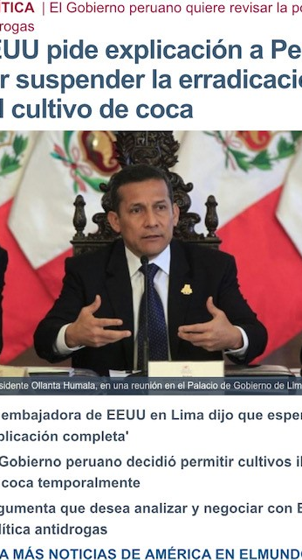
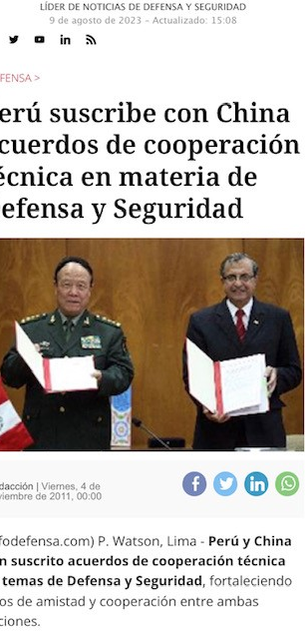
“U.S. Embassy asks for explanation from Government of Peru regarding suspension of coca eradication programs”
“Peru and China sign security and defense cooperation agreement”

Slide 3
Content
Economics
Politics
Security/Migration
Interaction and overlap with US

Slide 4
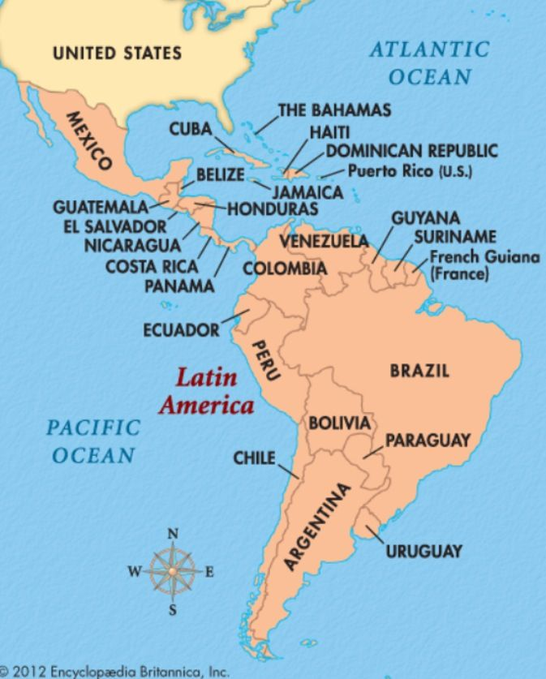

Slide 5

Economics

Slide 6
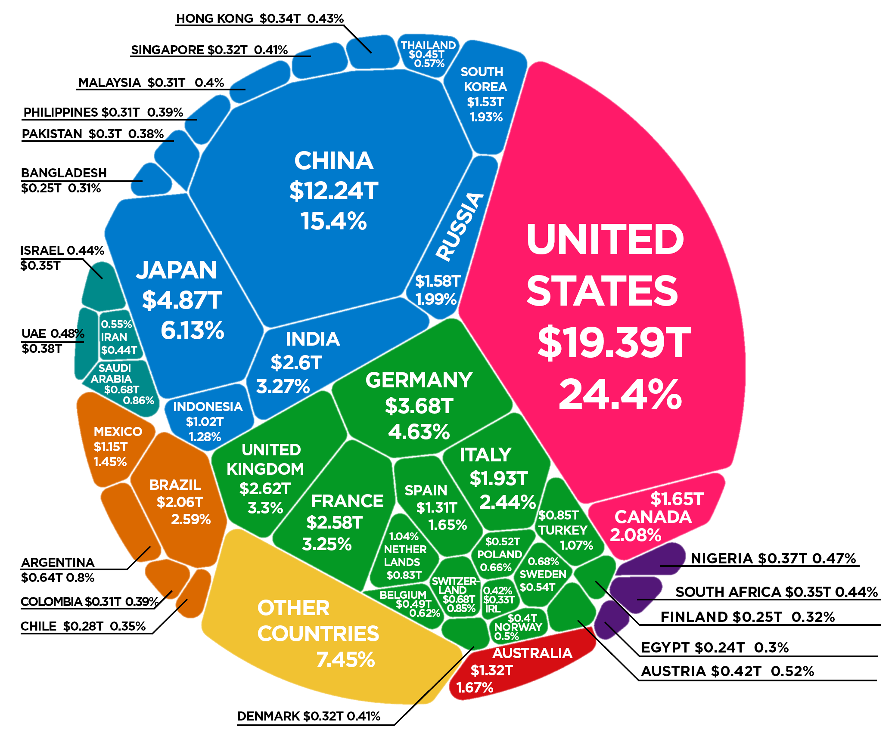

Slide 7
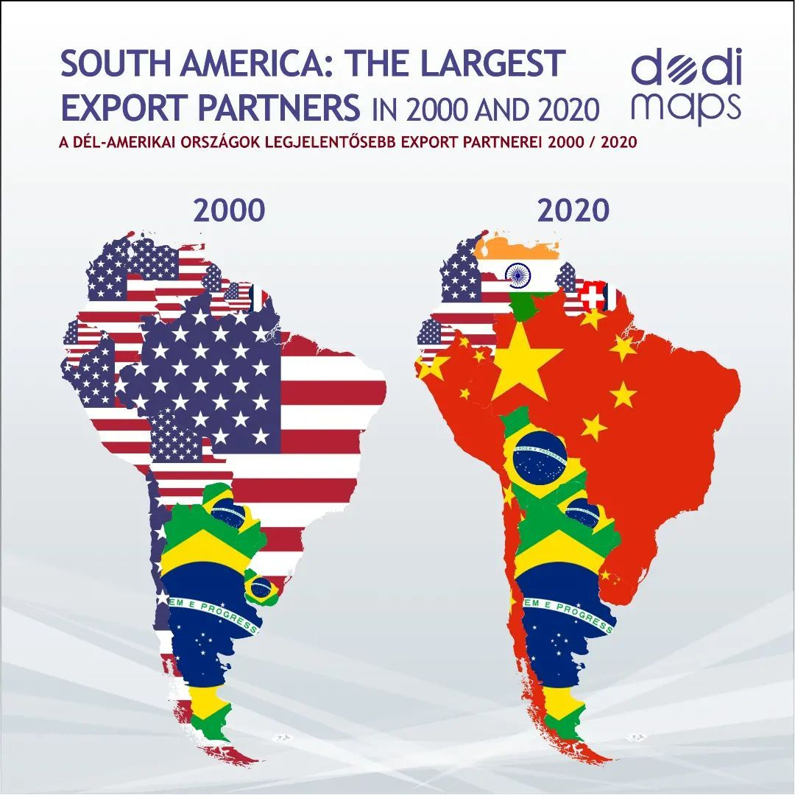

Slide 8
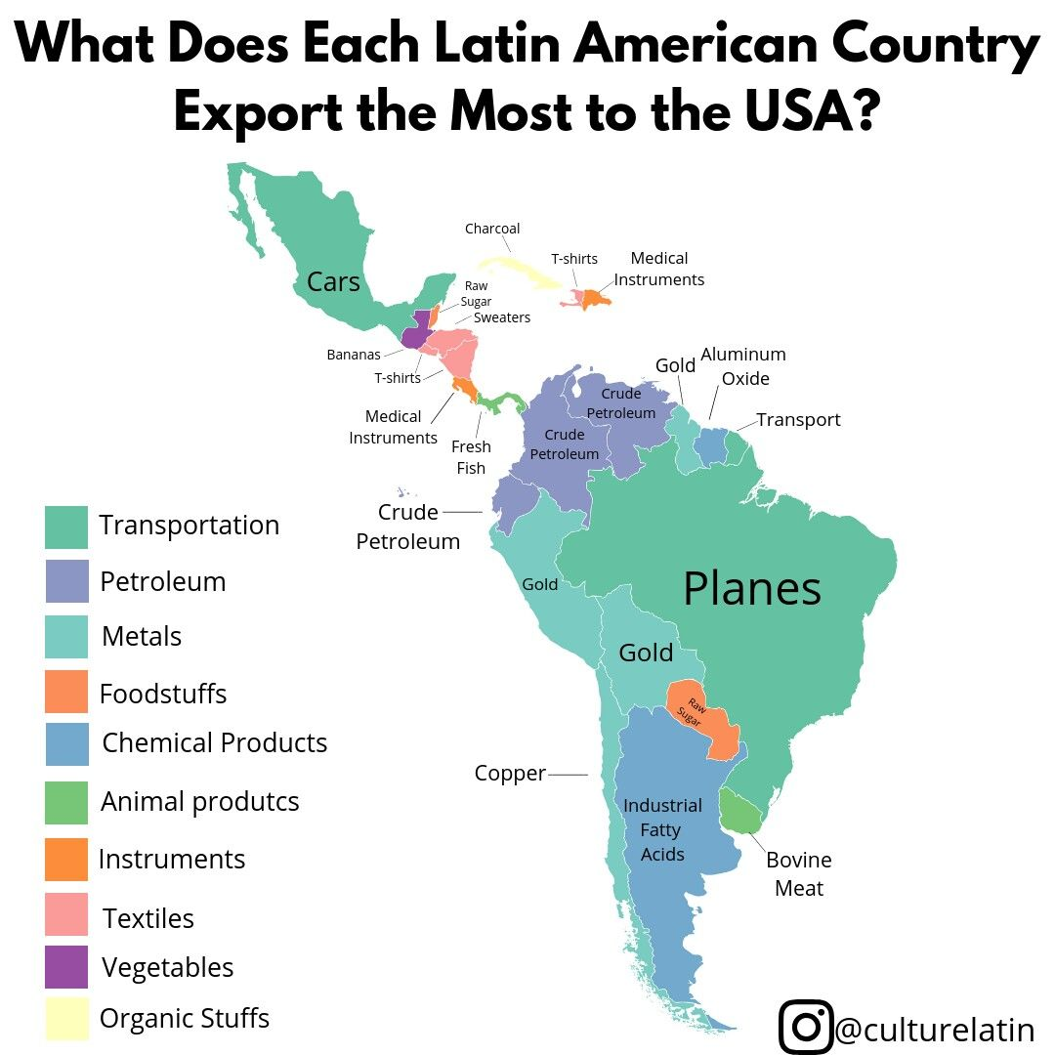

Slide 9
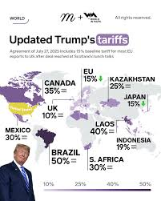
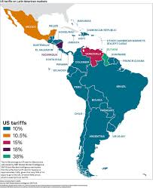
US tariffs

Slide 10

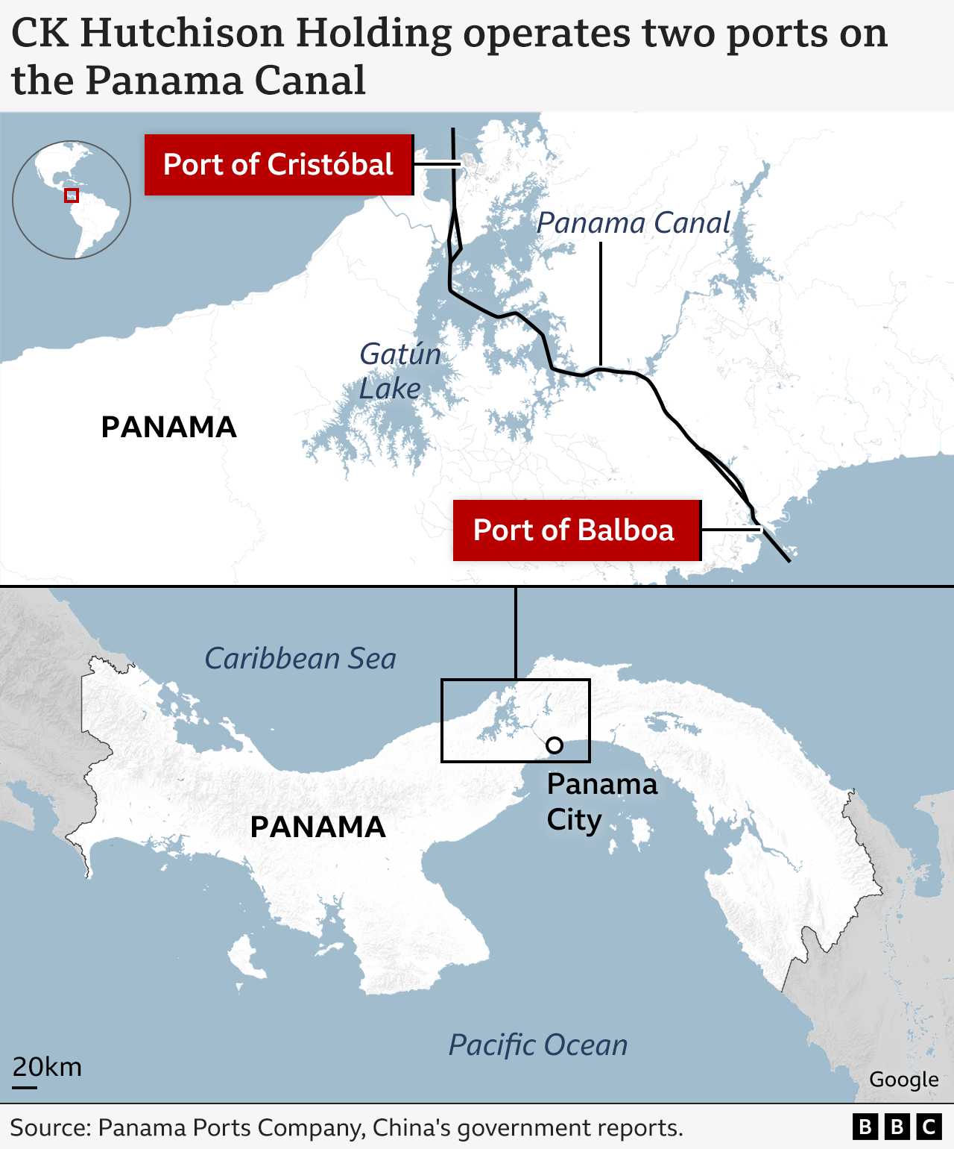

Slide 11

Politics

Slide 12
Last election……..
Successful transition from one political party to another
Governing party remains in power
Ecuador
Jamaica
Mexico
Paraguay
Bolivia*
El Salvador*
Cuba**
Nicaragua**
Venezuela**
Argentina
Bahamas
Barbados
Belize
Brazil
Chile
Colombia
Costa Rica
Dominican Republic
Guatemala
Guyana
Honduras
Panama
Trinidad and Tobago
Suriname
Uruguay

Slide 13
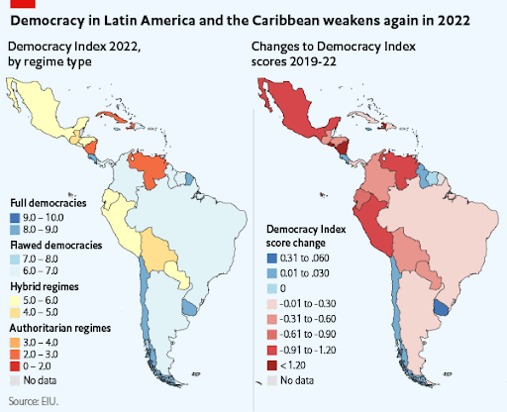

Slide 14
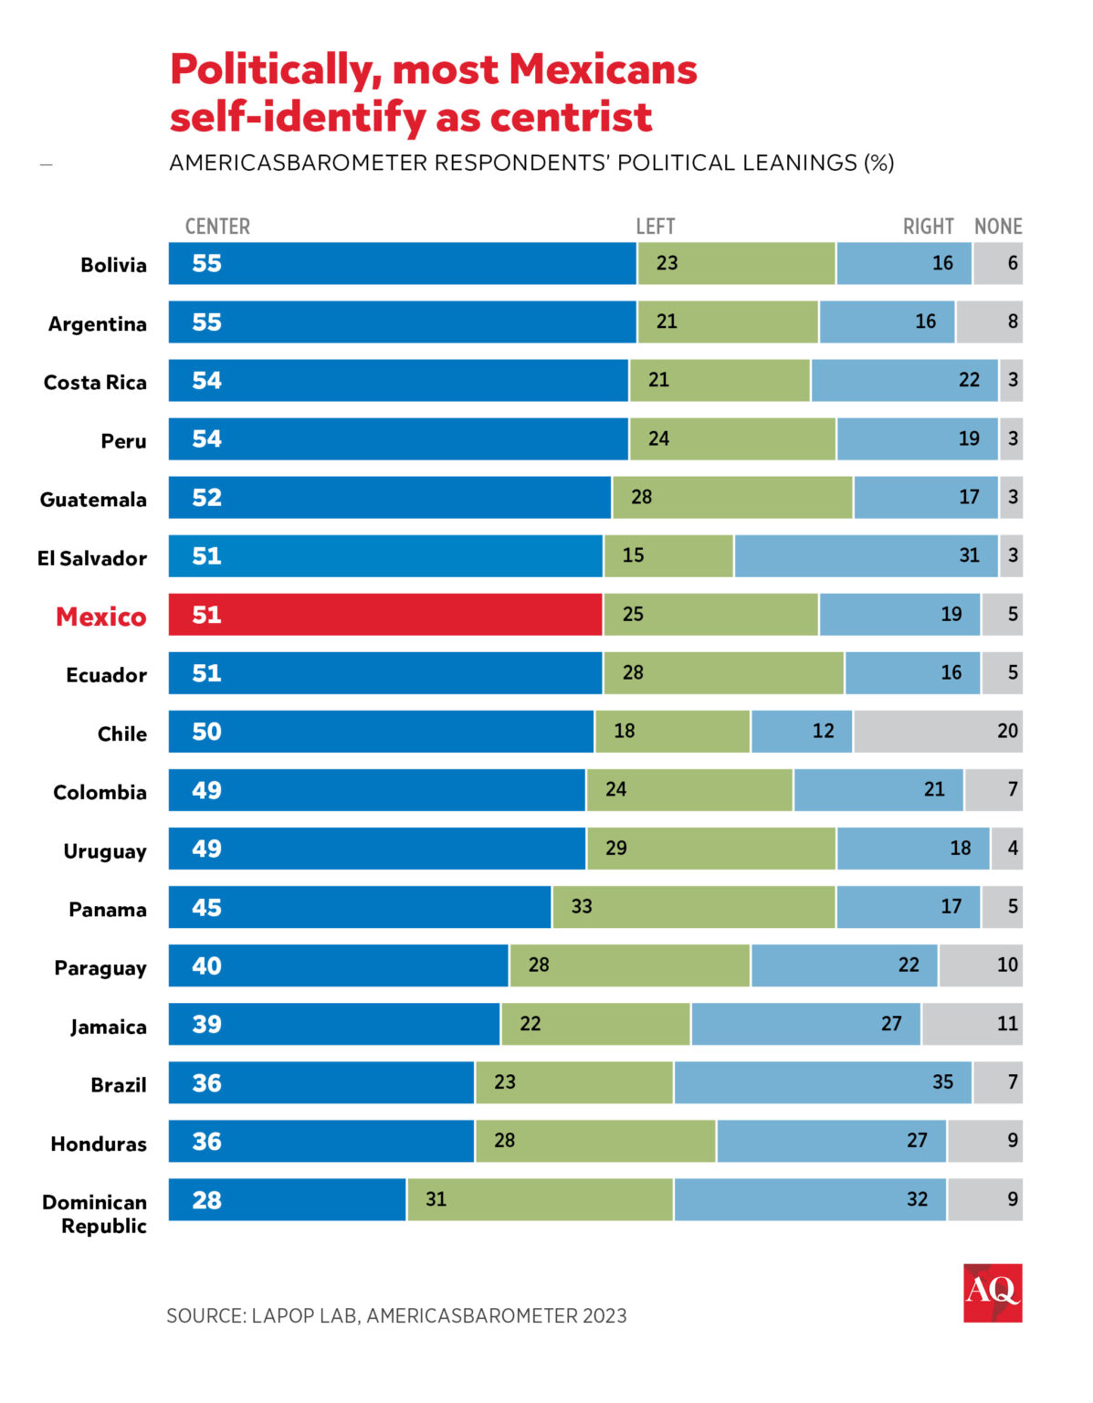

Slide 15
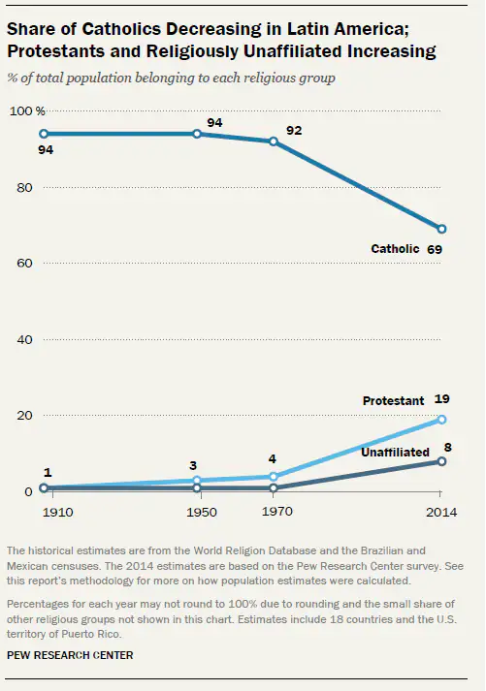

Slide 16
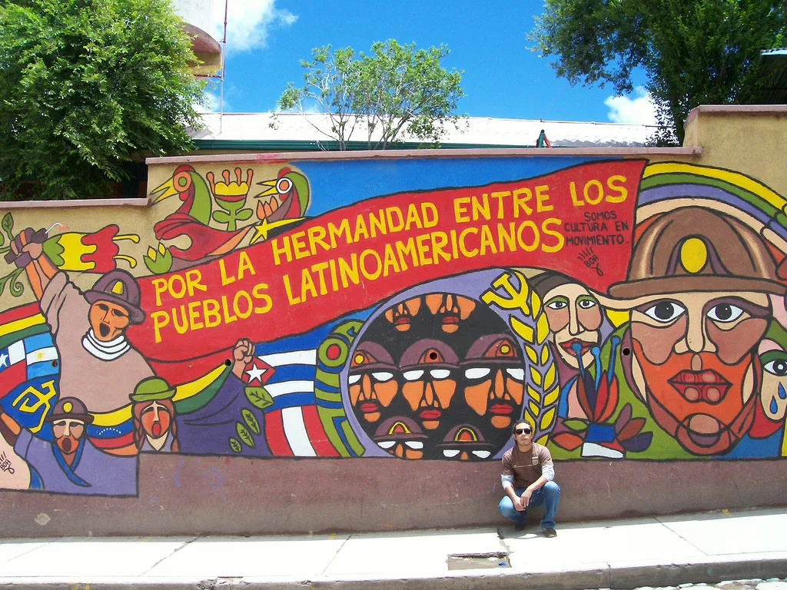
Security and Migration

Slide 17
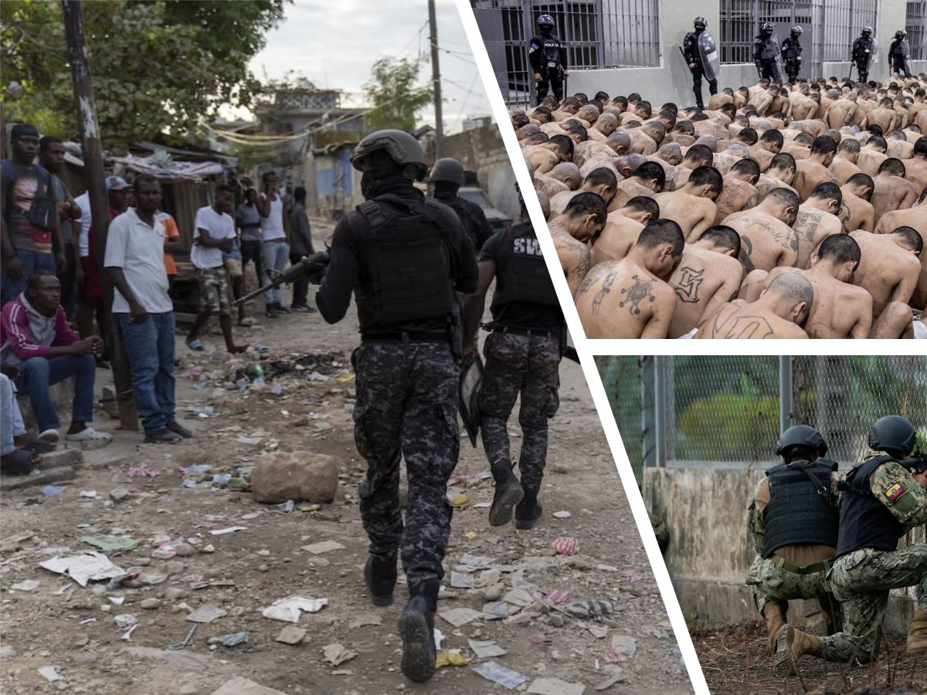

Slide 18
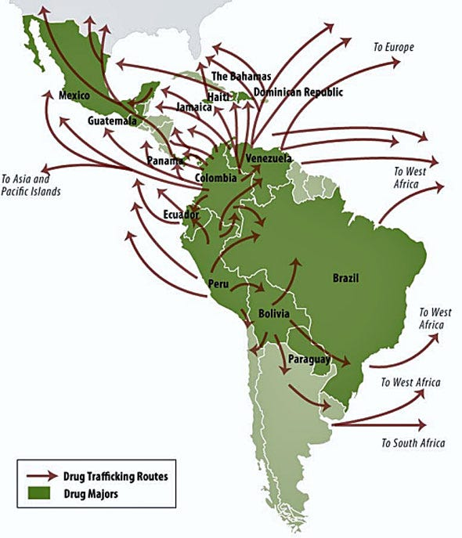

Slide 19
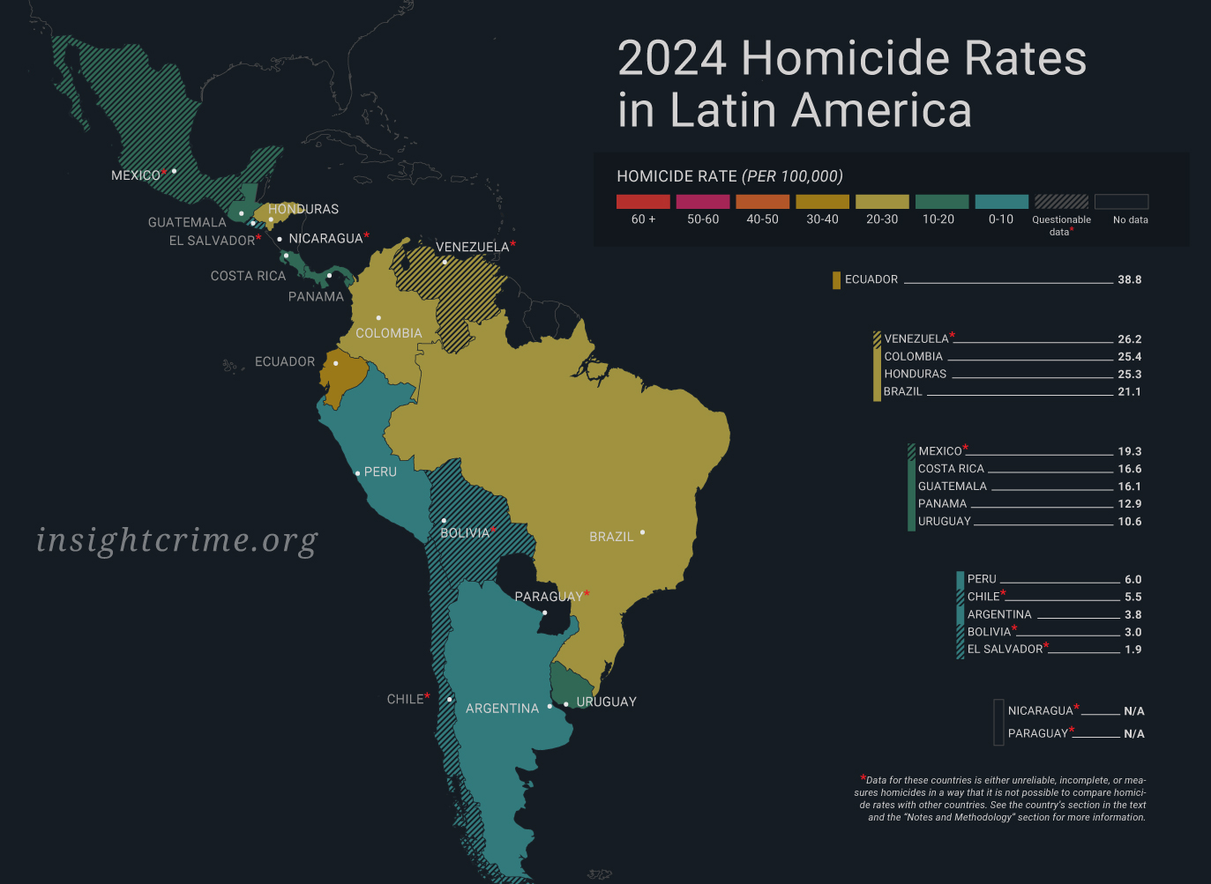

Slide 20
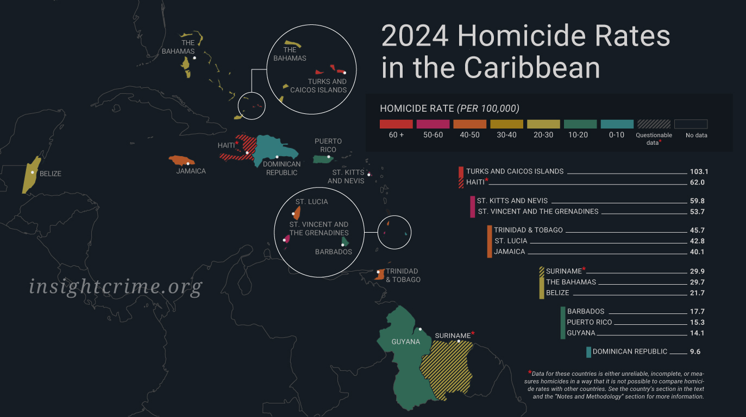

Slide 21
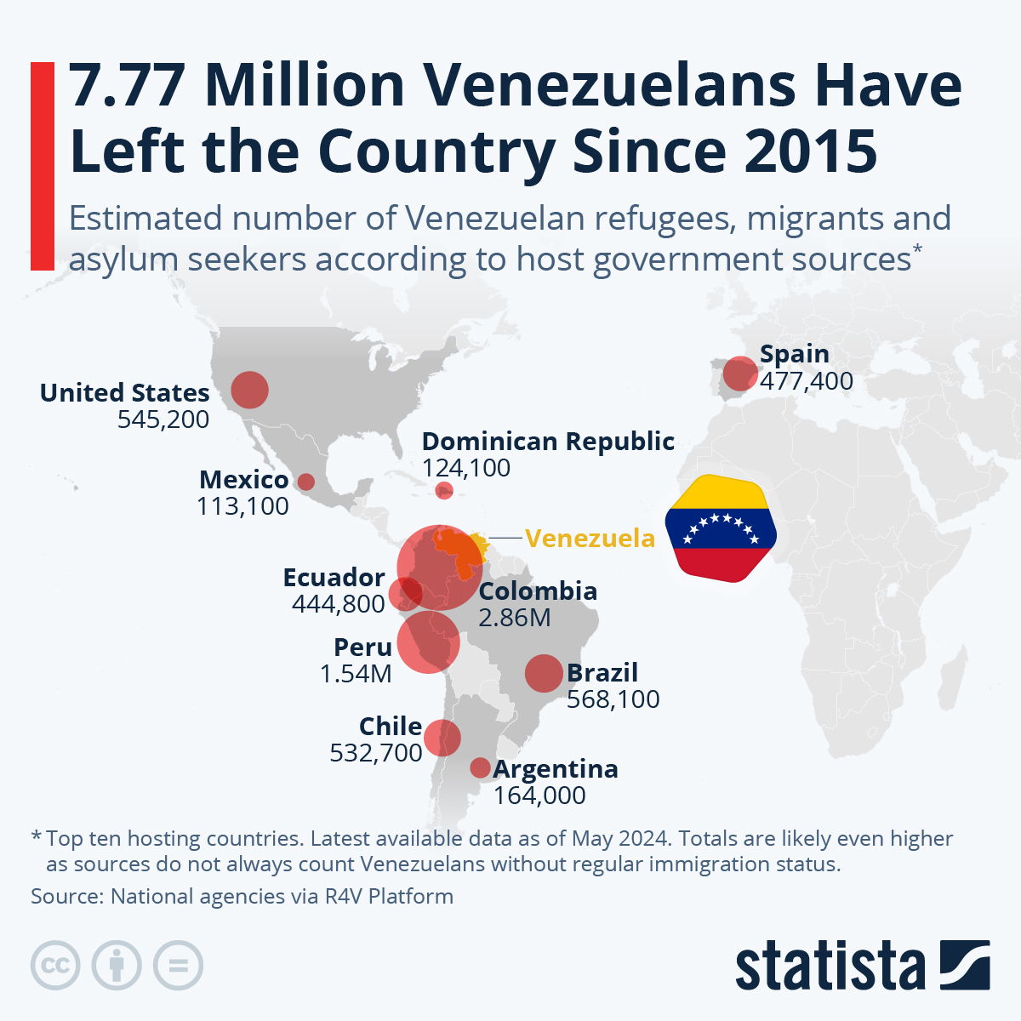

Slide 22
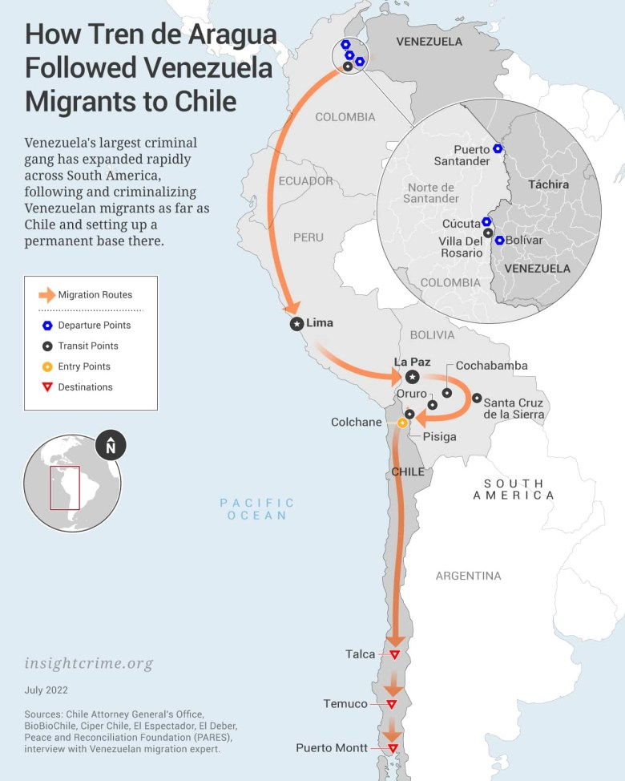

Slide 23
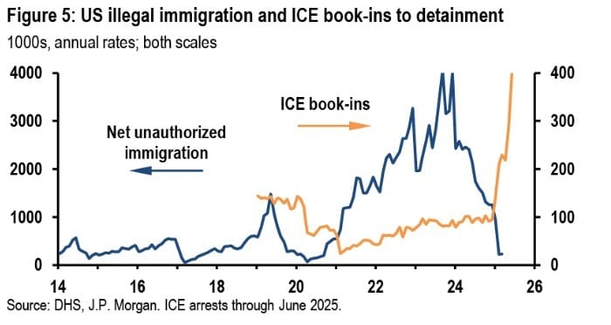

Slide 24
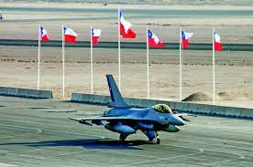
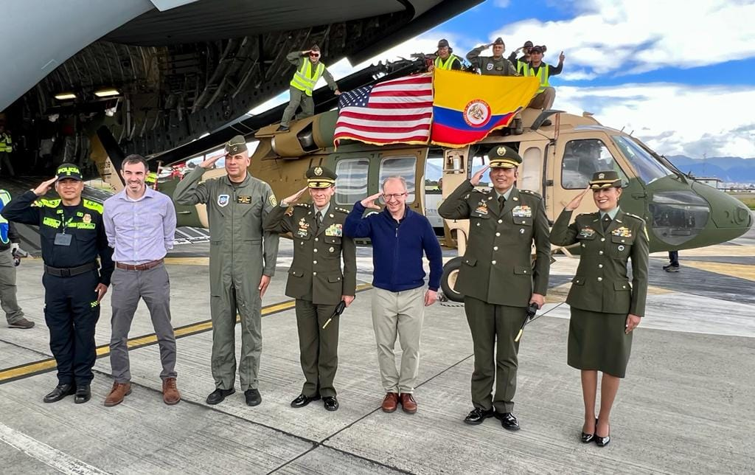
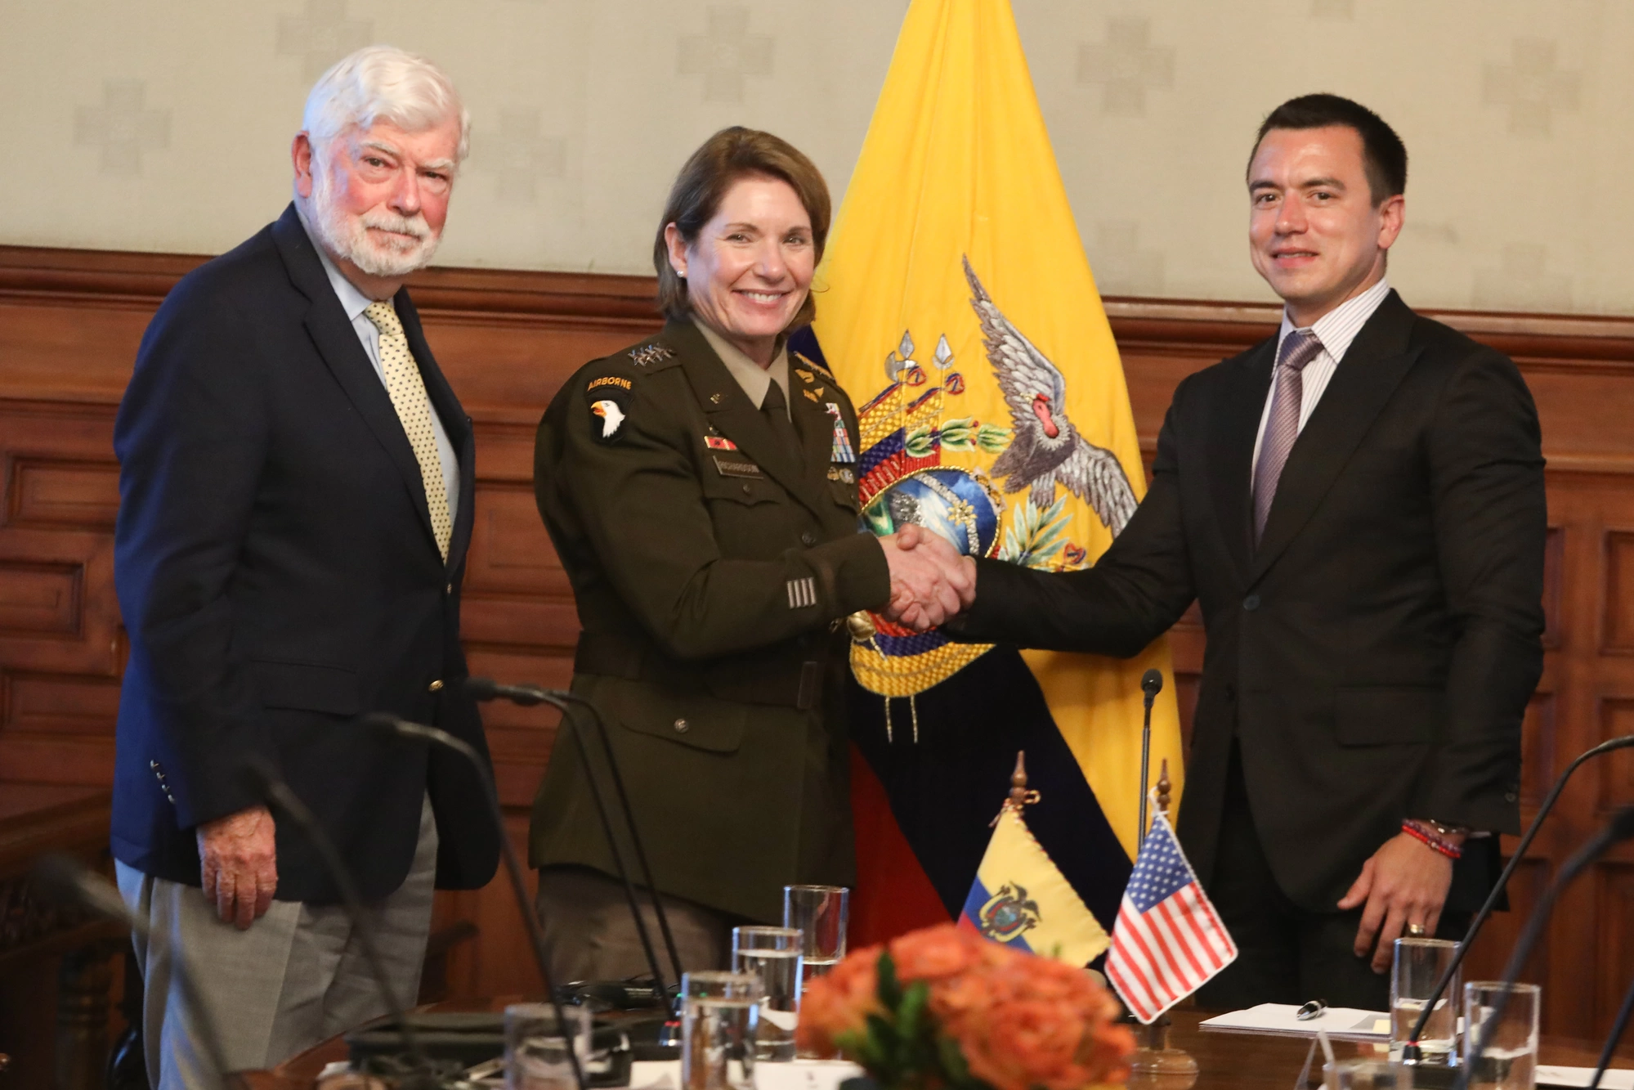
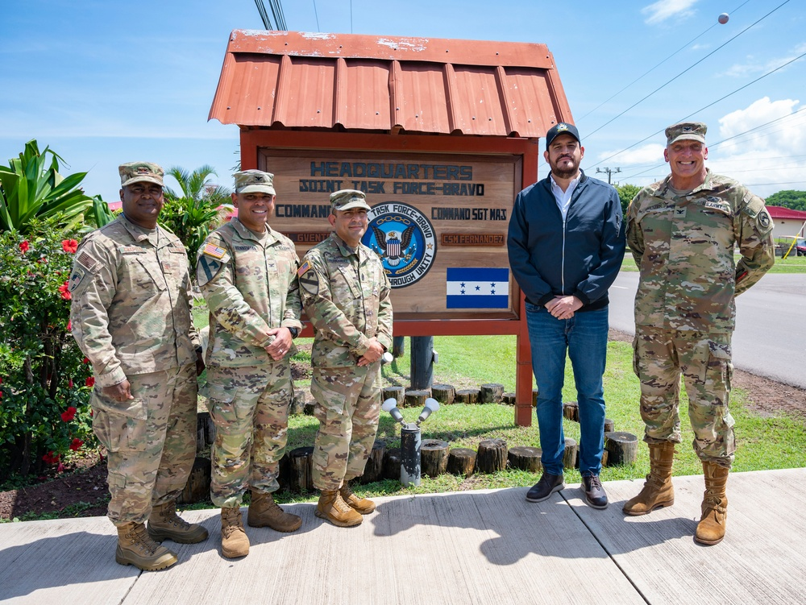

Slide 25
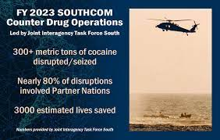

Slide 27

Interaction/Overlap with US

Slide 28
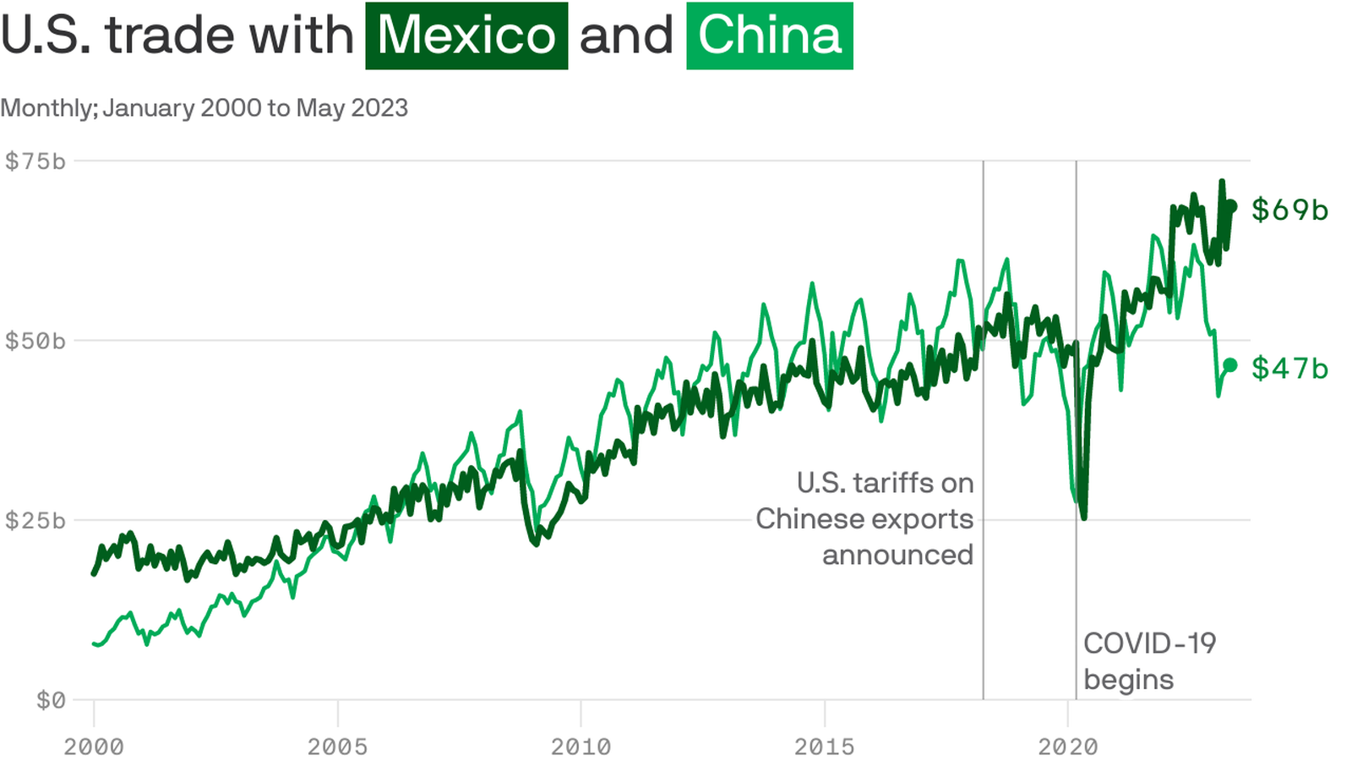

Slide 29
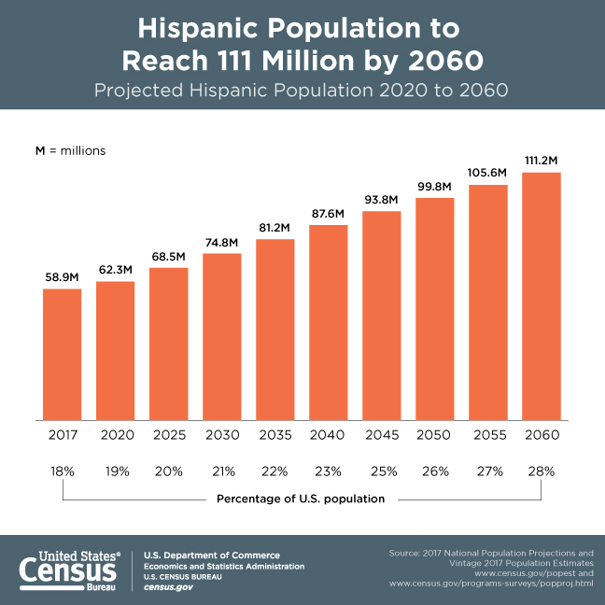

Slide 30
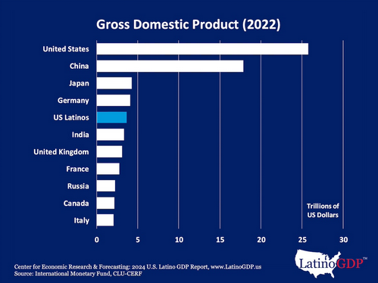

Slide 31



Slide 32
Connect with us
wjpcenter.org
PerryCenterOfficial
WJPerryCenter
William J. Perry Center for Hemispheric Defense Studies

