Slide 1
National Defense University
CAPSTONE 26-2
25 February 2026
The overall classification of this brief is:
CUI//REL TO USA, FVEY
LTG Todd Isaacson
Director, J-6
Joint Staff
Joint Staff J-6
CAO: 19 February 2026
POC: JS J-6 Strategic Initiatives Group
Phone: 703-695-4890

Slide 2
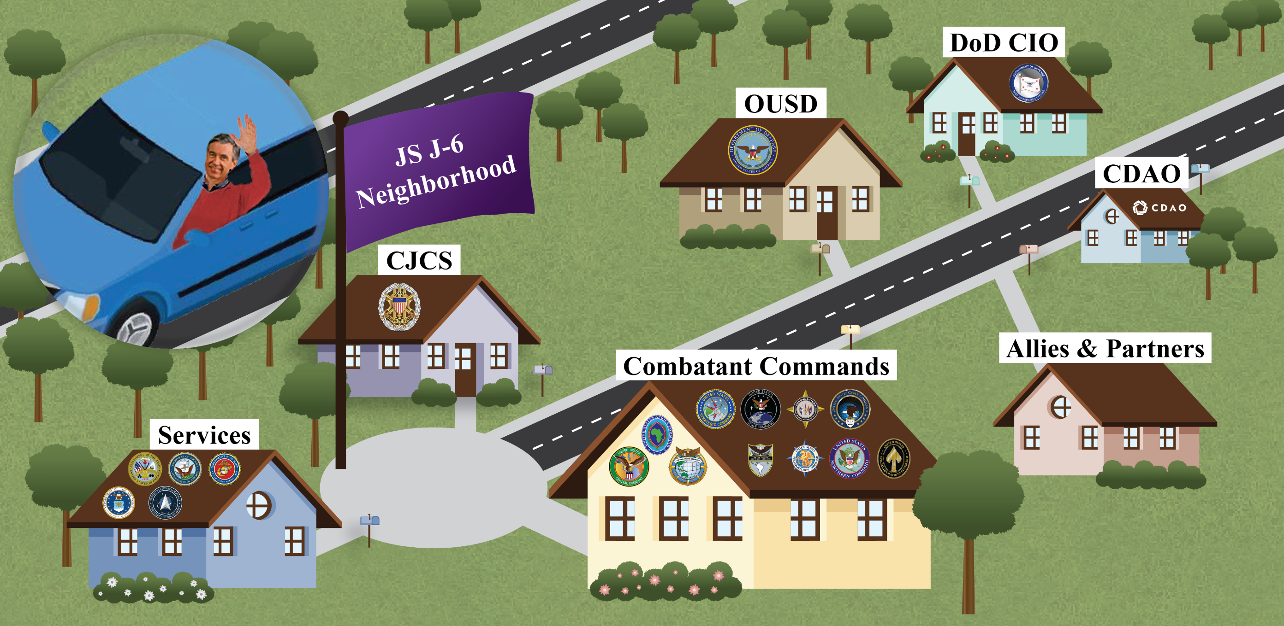
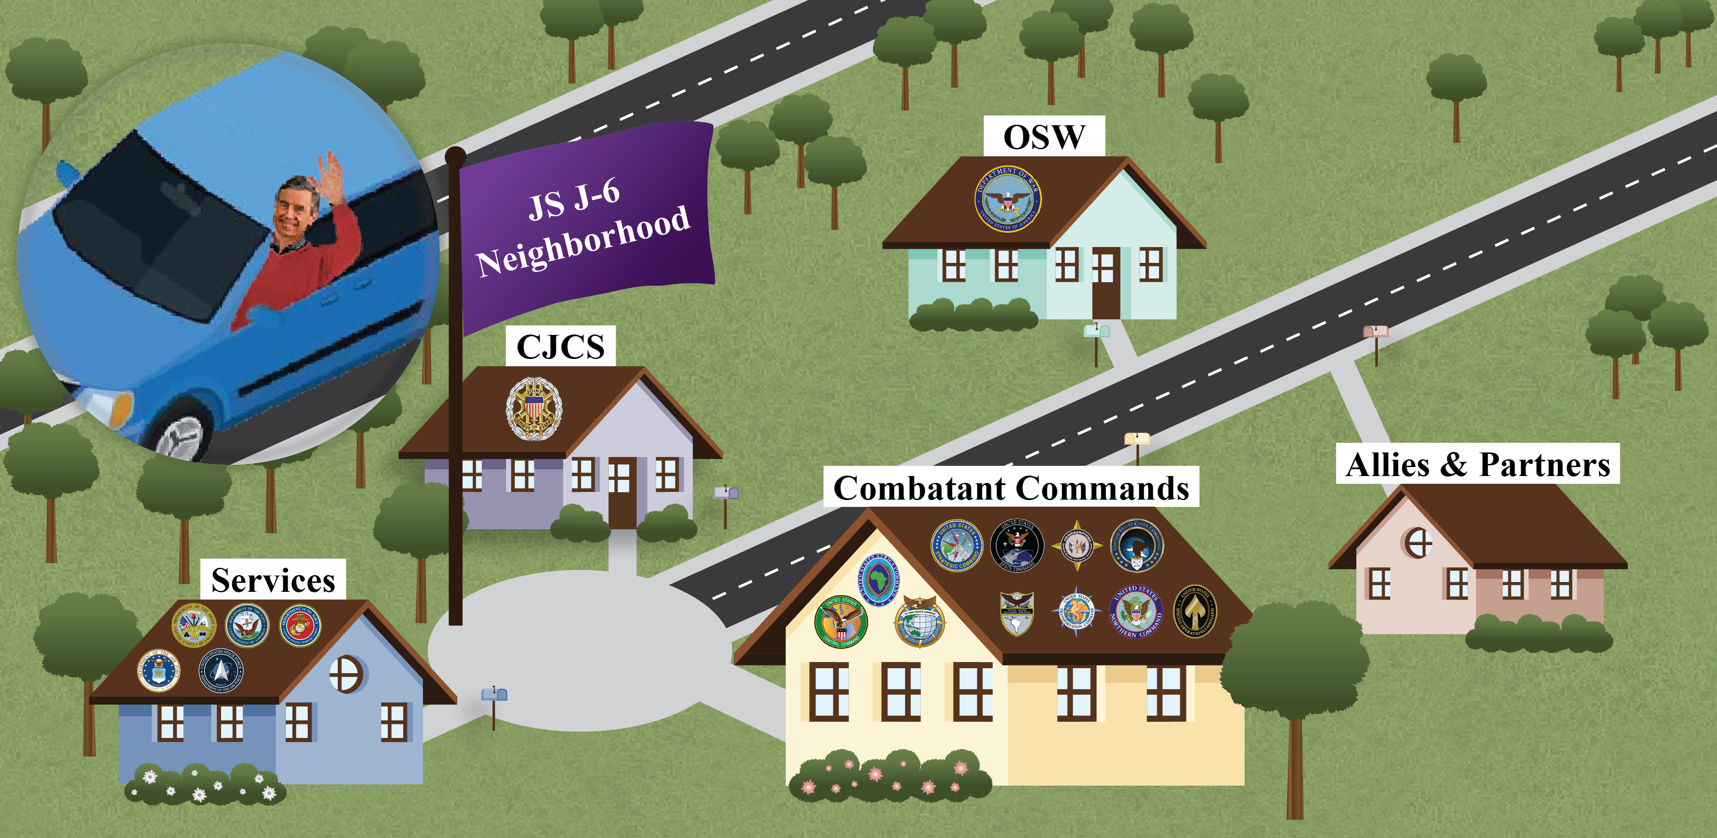

UNCLASSIFIED
(U) Whom We Work With
UNCLASSIFIED

Slide 3
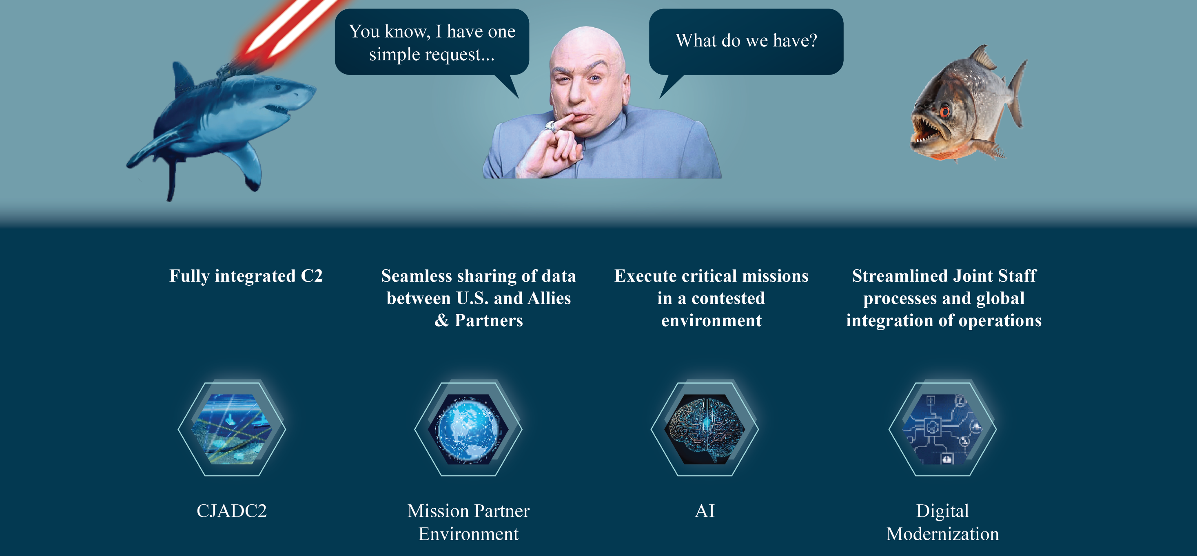
UNCLASSIFIED
(U) Developing Capabilities
UNCLASSIFIED

Slide 4
Discussion / Q&A

