Slide 1

Focusing on Wellness
“Keep your vitality. A life without health is like a river without water.”

Slide 2

What is Wellness?
Health is a state of complete physical, mental, spiritual and social well-being, and not merely the absence of disease or infirmity.

Slide 3


Demographics
Growing Old is Not for Sissies!

Slide 4


Keep Your Heart Strong
“Heart disease kills more people than all cancers combined.”

Slide 5


Cardiac Risk Reduction

Slide 6
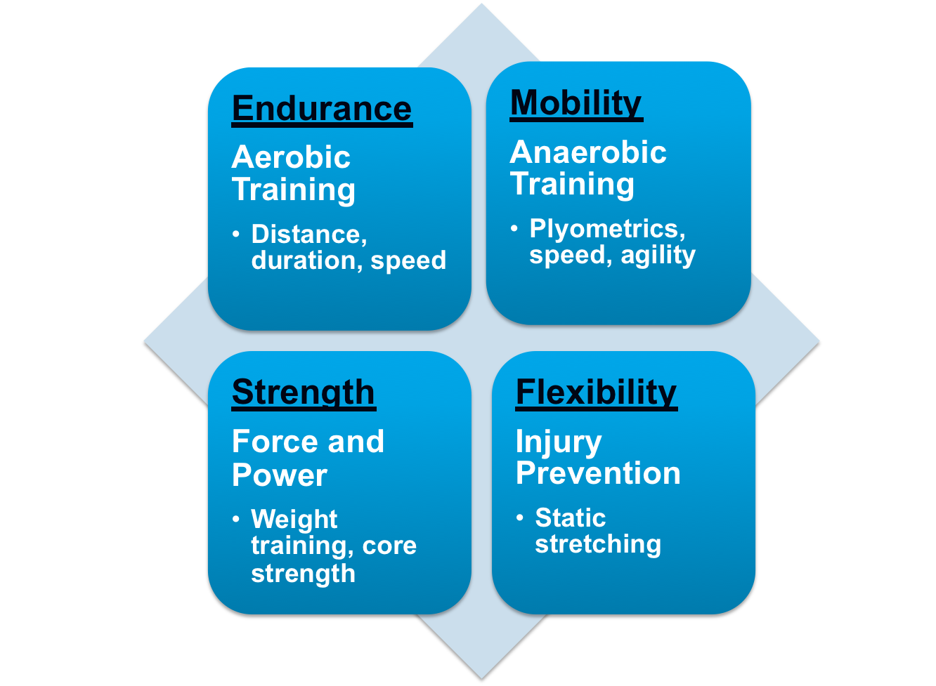

Sitting is the new smoking!
Physical Fitness

Slide 7

What is a Healthy Diet?
The banquet is in the first bite

Slide 8
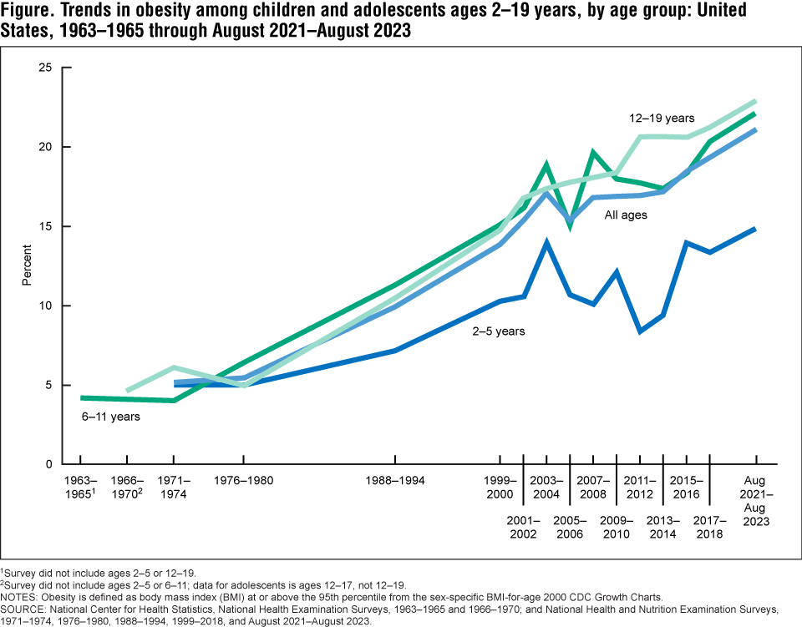

Slide 9
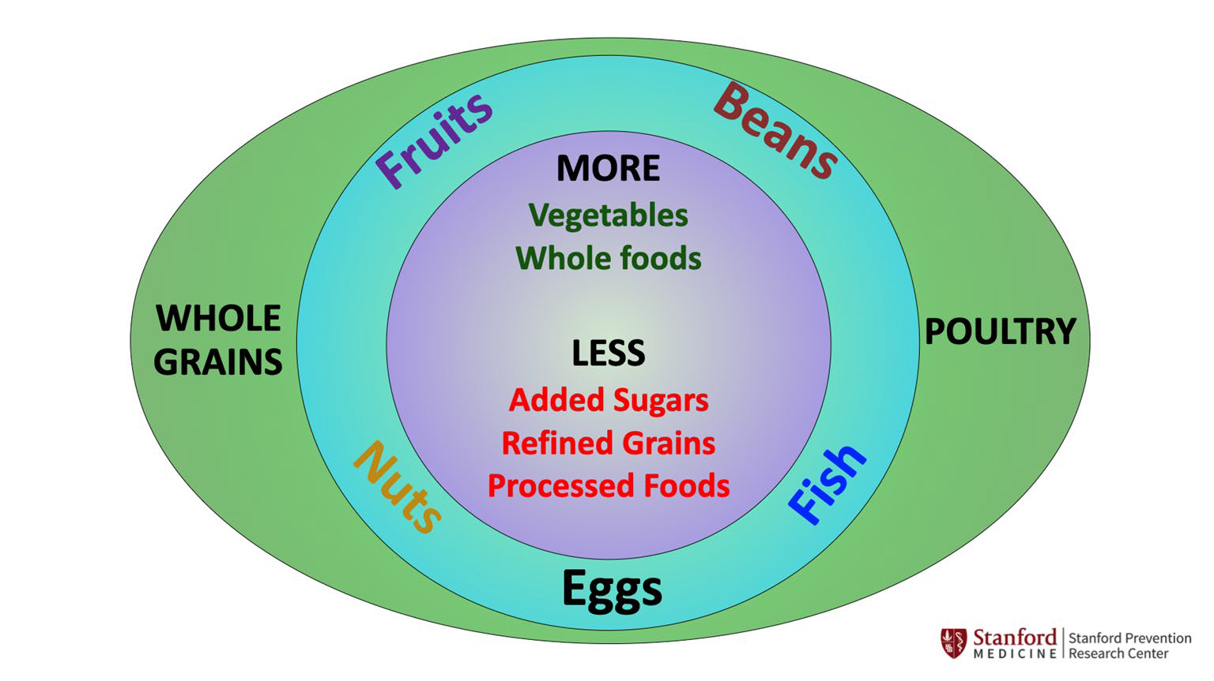
Nutritional Fitness

Slide 10

Sleep…

Slide 11

Sleep Hygiene
Make your bedroom a cave
Use your bed for sleep or sex ONLY
Keep regular sleep hours
Avoid tobacco, alcohol and caffeine
Turn off electronic devices
Relax before bed
Get daily exercise and AM sunlight
Don’t “horribilize”

Slide 12


Preventive Healthcare
Ask about immunizations and screenings

Slide 13
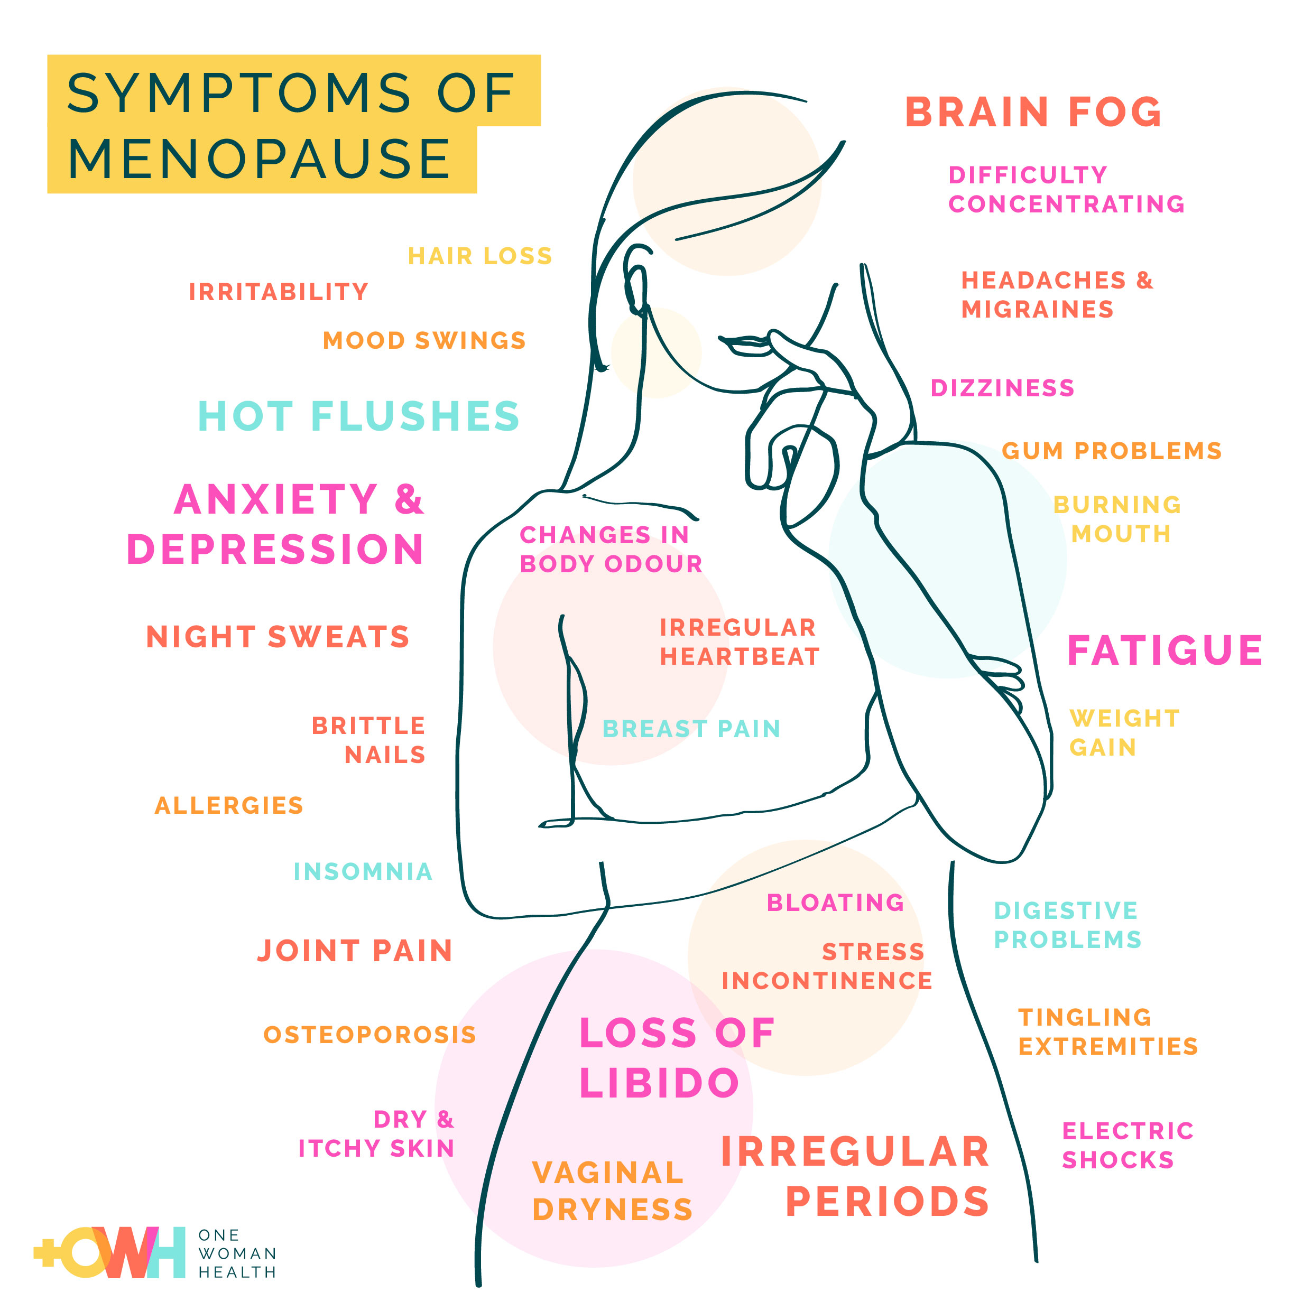

Menopause

Slide 14
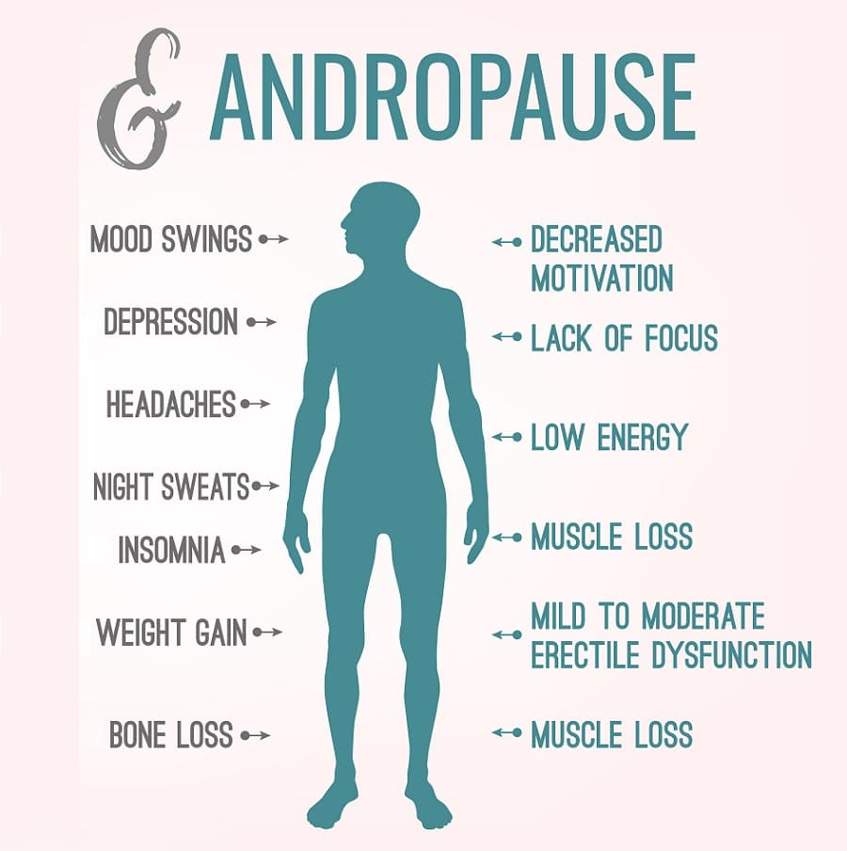

“Manopause”

Slide 15
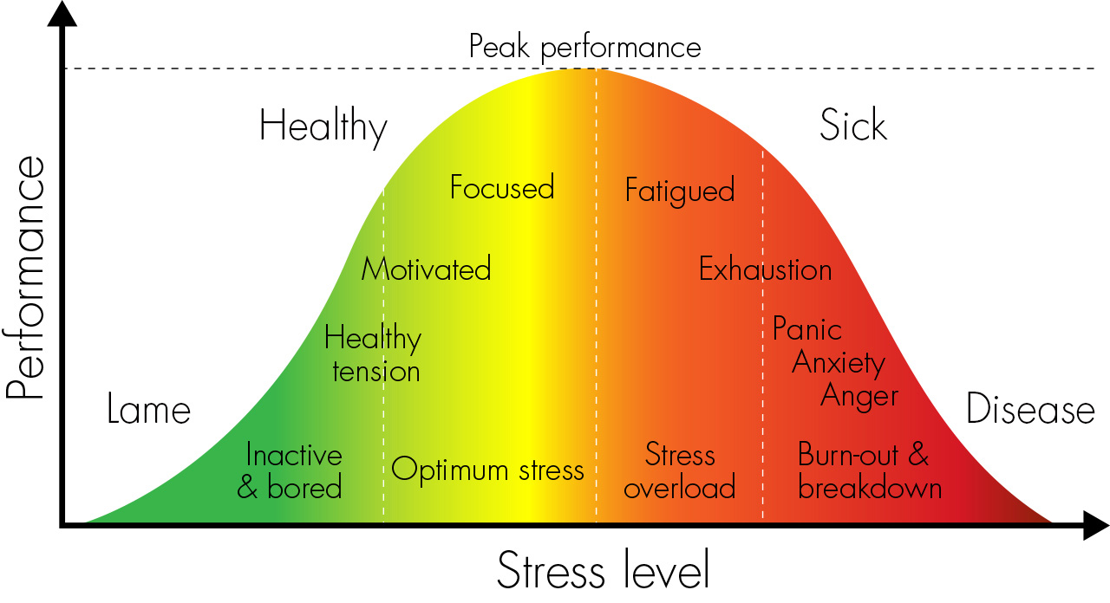
Resilience
Know your limits

Slide 16

Relationships

Slide 17

Your Spouse…
Work as a Team

Slide 18

Family

Slide 19

Hang Out with Friends

Slide 20

Community Connections
Stay Connect4d

Slide 21

Relaxation and Reflection

Slide 22
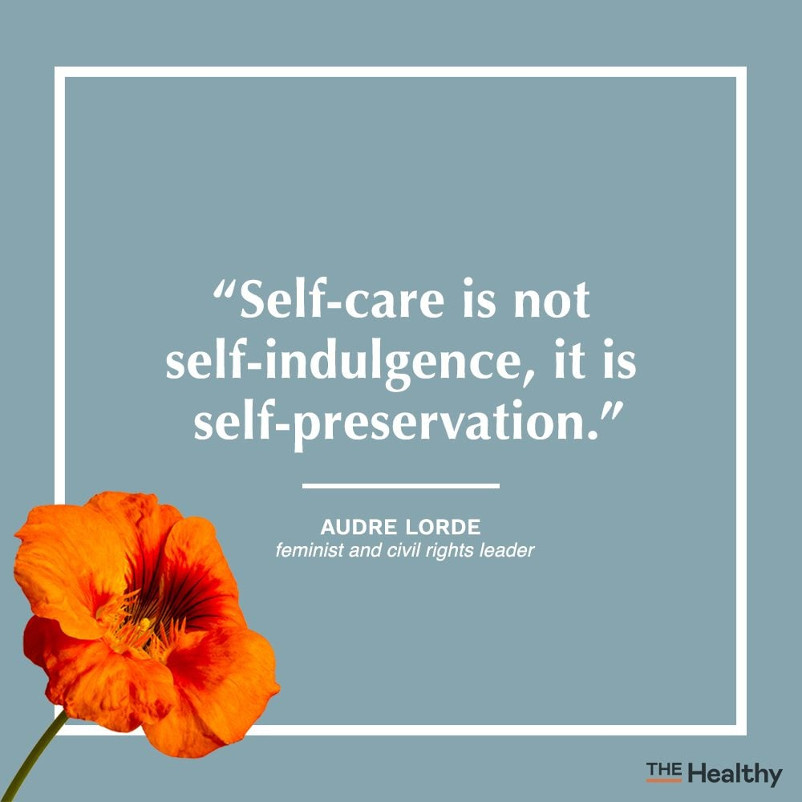

Slide 23


Slide 24
