Slide 1

Focusing on Wellness
“Keep your vitality. A life without health is like a river without water.”
Notes:
Objectives:
1. Define Wellness
2. Discuss strategies to improve/maintain wellness
3. Talk about the importance of self-care
I will discuss the most common risks to healthy aging, and lifestyle strategies to maintain an optimal functional status.
Christine Turpin, a performance dietitian at NDU, will speak later this week and address understanding what your body is going through (physiology and menopause), nutritional needs and how they change across the women’s lifespan, and specific exercises to support health and body composition. She will also touch on supplements that may assist with mental health, bone health and general wellbeing.

Slide 2
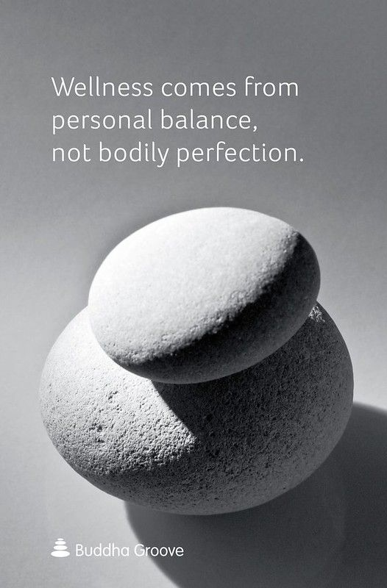
What is Wellness?
Health is a state of complete physical, mental, spiritual and social well-being, and not merely the absence of disease or infirmity.
Notes:
Longevity = “the ability to last a long time.” A better definition of longevity is living a longer and healthier life.
Life span = how long we live and Health span = how long we live without profound limitations or disease (how long we live well)
We must continuously improve our function, not simply delay “inevitable” losses.
Growing old is not for sissies!
Age also brings with it a degradation of strength, stamina, balance, flexibility and mobility, and the loss of reserve function in CVR, pulmonary, renal and liver function. Vision, hearing and cognition can be compromised with slower processing speeds and memory/word retrieval.
Think specifically about what you want to be able to do as you age (>80) and focus on the specifics of maintaining that “health span”

Slide 3

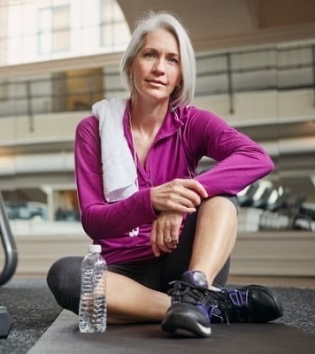
Demographics
Growing Old is Not for Sissies!
Notes:
Think specifically about what you want to be able to do as you age (>80) and focus on the specifics of maintaining that “health span”
By 2030, one in eight people will be middle-aged or older. For the first time in history, people over the age of 65 will outnumber those under the age of five.
Cohort >100 yrs old has expanded 44% since 2000, and 80% are women. In 40 years it will 6x larger.
Age brings with it a degradation of strength, stamina, balance, flexibility and mobility, and the loss of reserve function in CVR, pulmonary, renal and liver function. Vision, hearing and cognition can be compromised with slower processing speeds and memory/word retrieval.
US healthcare systems emphasize rescue care, acute care at the expense of investing in, supporting, and enabling health promotion and disease prevention.
Medicare does not cover home health care and has limited rehab reimbursement (100days).

Slide 4


Keep Your Heart Strong
“Heart disease kills more people than all cancers combined.”
Notes:
Primary “horsemen” of aging and death include:
CVR disease
Cancer
Neurodegenerative diseases
Infections/Falls
CVD encompasses four major areas: 1.CHD manifested by MI, angina, heart failure and coronary death 2.Cerebrovascular disease manifested by stroke and TIA 3. Peripheral vascular disease manifested by intermittent claudication 4. Aortic aneurysm (Richard Holbrooke)
Leading cause of death in women and men, and has increased in the last two years.
1 in 25 women die of breast cancer; 1 in 4 women die of heart disease. Incidence of MI increases after menopause
Coronary heart disease mortality higher in women than men, possibly due to co-morbidities, age or lower index of suspicion or gender bias. Higher mortality within one year of MI, especially in younger women. Higher risk of stroke than men. Within 5 yrs of MI, nearly 50% of women will die, develop HF or have a stroke compared to 36% men. Risk for CVD higher in nonwhite women
Approximately 2/3 women who die of MI have no previous symptoms or atypical sx that are unrecognized as cardiac
Higher risk of CHF due to more exuberant response to high BP (more LV hypertrophy)

Slide 5
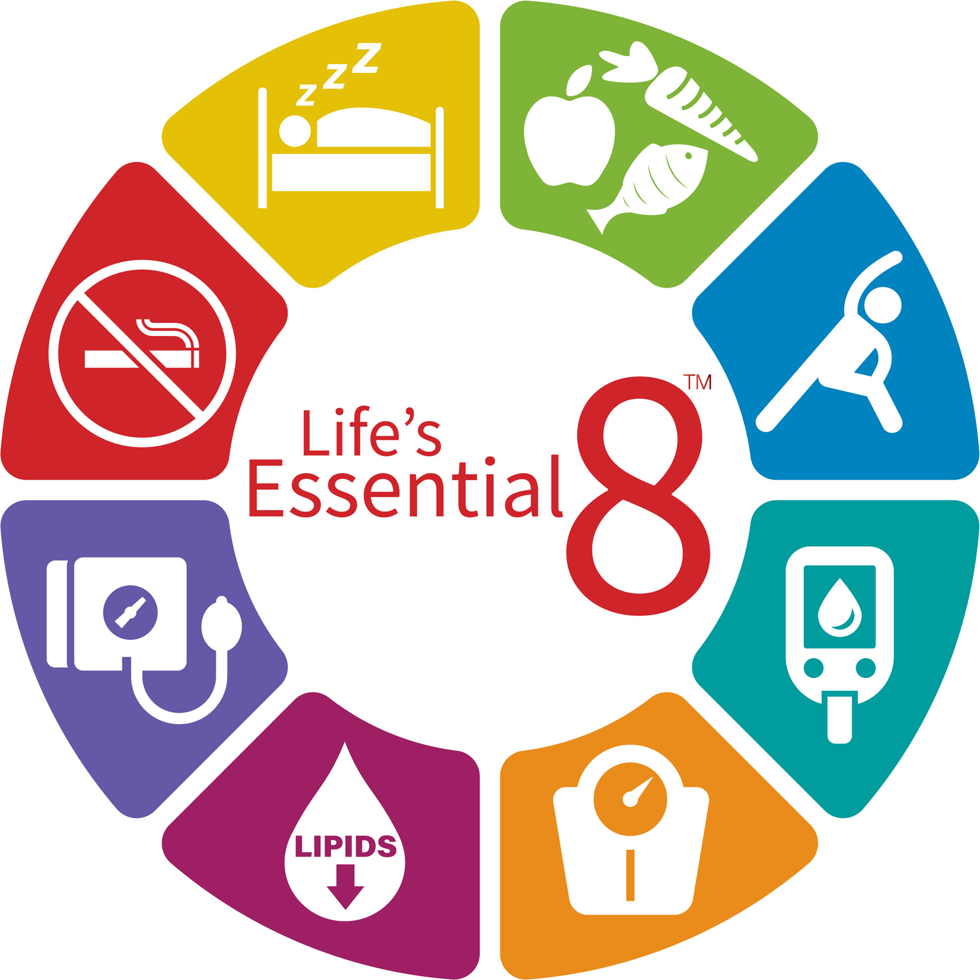

Cardiac Risk Reduction
Notes:
Lifestyle Modifications (include stress management and social interactions)
A variety of factors, often acting in concert, are associated with an increased risk for CVD.. These RF actually predictive of CHD-related events (can predict 90% CVR events).
Risk factor assessment and modification can reduce the incidence of CV events and improve survival.
Eight metrics of CV health – optimal lipids, blood pressure, and glucose levels, healthy diet, appropriate energy intake (weight maintenance), physical activity, restorative sleep and avoidance of tobacco.
FH of premature CAD (<55 in men, <65 in women) doubles risk for MI in men, 70% increased risk in women.
Prevalence of hypertension >age 65 higher in women than men.
https://mlc.heart.org/registration for AHA My Life Check
https://www.heart.org/en/healthy-living/healthy-lifestyle/lifes-essential-8

Slide 6
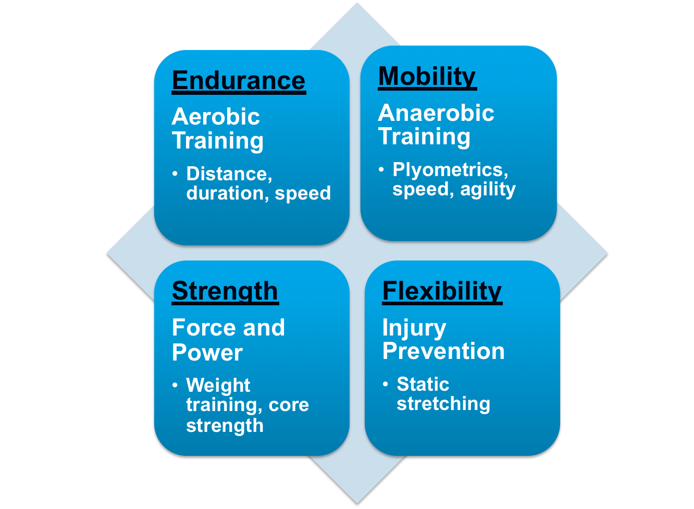

Sitting is the new smoking!
Physical Fitness
Notes:
Cross training and diversity
Studies looking at both men and women found that those in the fittest groups had the lowest all-cause death rates, and that the level of physical activity was inversely related to the occurrence of both CAD and stroke.
60% of US adults do not achieve the recommended amount of physical activity, citing lack of time. Sitting is the new smoking!! Only 30% of people 45-64 engage in regular physical activity and drops to 25% for those over 65.
Cardiovascular fitness focuses on aerobic exercise, which has a protective effect and has a positive impact on all other risk factors. But for optimal health need a diverse fitness program with mobility (plyometrics, speed, agility), strength/resistance training (weights and core strength), and flexibility (injury protection, reduced fall risk).
Exercise improves cognitive function, sleep, mood, helps with weight maintenance, sexual and GU function, vision and hearing, resilience, and reduces risk of CAD and cancer. Women who walk briskly as little as a half hour a day reduce their risk of breast cancer, diabetes, and CAD. Walking helps you maintain your independence and ability to do daily tasks as you age. Walking protects against memory loss and dementia, helps cut the risk of heart disease, and reduces the change of developing type II DM in high risk adults by 60%.
Think specifically about what you want to be able to do as you age (>80) and start specific fitness strategies now to ensure that you remain active.

Slide 7
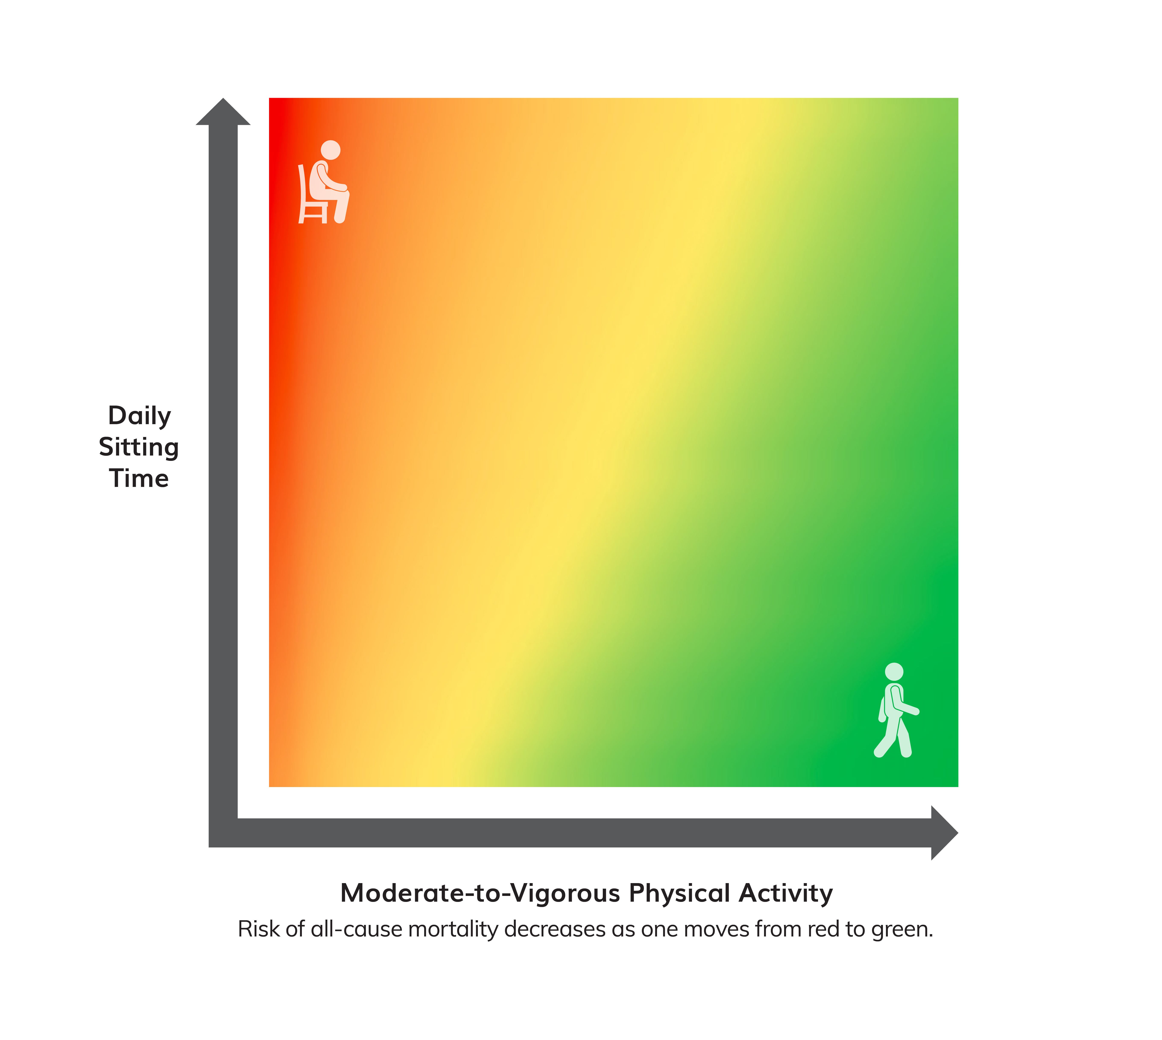
Move More and Sit Less
Relationship Among Moderate-to-Vigorous Physical Activity, Sitting Time, and Risk of All-Cause Mortality in Adults
Sedentary behavior increases risk of:
  All-cause mortality
  Cardiovascular disease mortality
  Cardiovascular disease
  Type 2 diabetes
  Colon, endometrial, and lung cancers
Notes:
The first key guideline for adults is to move more and sit less.
This recommendation is based on new evidence that shows a strong positive relationship between increased sedentary behavior and increased risk of all-cause mortality, heart disease, and high blood pressure.
All physical activity, especially moderate-to-vigorous activity, can help offset these risks.
For inactive adults, replacing sedentary behavior with light-intensity physical activity is likely to produce some health benefits.
Among all adults, replacing sedentary behavior with moderate- or vigorous-intensity physical activity may produce even greater benefits.
This figure, adapted from a meta-analysis of over 1 million people by Ekelund and colleagues, demonstrates the relationship between moderate-to-vigorous physical activity and the risk of all-cause mortality.
At the greatest time spent sitting (the top), the risk of all-cause mortality begins to decrease (color becomes orange) even with small additions of moderate-to-vigorous physical activity.
At the greatest volume of moderate-to-vigorous physical activity, the risk is low even for those who sit the most (upper right corner).
At the lowest volume of moderate-to-vigorous physical activity (the left of the figure), the risk of all-cause mortality increases as time spent sitting increases.
This suggests that for inactive adults, replacing sitting time with light-intensity physical activities reduces the risk of all-cause mortality.
Although the risk of all-cause mortality is reduced as the time spent in sedentary behavior is reduced, even adults who sit the least have an elevated risk if they perform no moderate-to-vigorous physical activity (lower left corner).

Slide 8
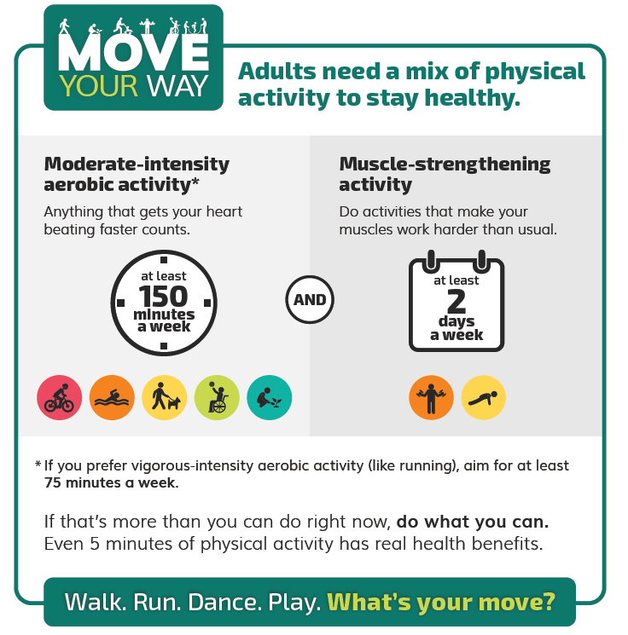
ACSM and CDC Physical Activity Recommendations

Slide 9
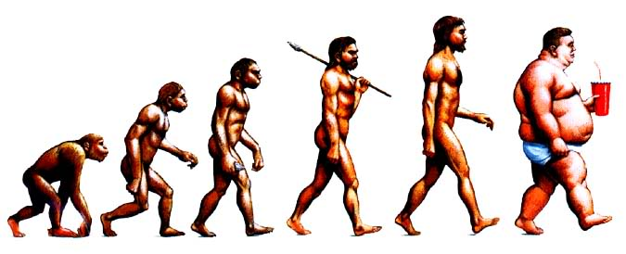
What is a Healthy Diet?
The banquet is in the first bite
Notes:
Average man weighed 173lbs in the 1970’s….now he weighs 200lbs. National data from the 2017-2020 National Health and Nutrition Examination Survey showed 41.9% adults have obesity (2 in 5 adults) with 9.2% severely obese. Nearly 1 in 3 adults (30.7%) are overweight. About 1 in 6 children and adolescents ages 2 to 19 (16.1%) are overweight with 19% obesity and 6% severely obese.
Rural parts of the country had higher rates of obesity than did urban and suburban areas.
Obesity predisposes you to numerous diseases and risks (DM, CAD, stroke, breast cancer, arthritis). Aggravates insulin resistance, BP, causes LVH, low HDL, OSA, metabolic syndrome. With age shift from muscle to fat unless you continue active exercise and weight resistance. Abdominal or central obesity more predictive of risk. Metabolism slows as you age so you will gain weight if you do not reduce calories and increase exercise. Typically gain a pound/year during peri-menopause, and often lands either in the hips or the abdomen. After menopause women accumulate fate where men do – in the neck, chin and abdomen. Hormones and genes play a role.
Weight regain is common because weight loss triggers the body to increase appetite (hunger), and slow the metabolic rate to get back to the previous “set point”. Thus, prevention of obesity is key! To maintain weight, reduce calories and increase exercise. May need to consider increasing to 200-300 minutes a week (an hour a day). Lifting weights may be one of the best ways to beat belly fat

Slide 10
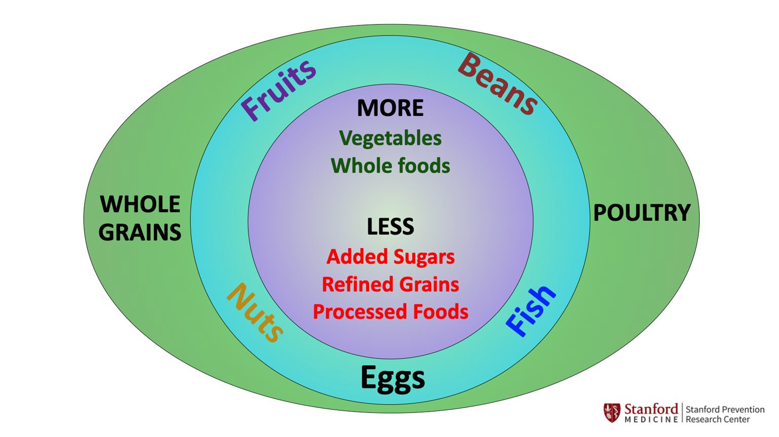
Nutritional Fitness
Notes:
Mediterranean diet reduces risk of CVR and chronic disease. High in antioxidants, vitamins, minerals and fiber.
Mediterranean diet rated as 2019’s best overall diet in US News and World Report. Reduces risk for diabetes, lipids, dementia, memory loss, depression, obesity and breast cancer. Best for healthy eating, plant-based diet, best for diabetes and heart disease, and easiest diet to follow. Fruits, vegetables, whole grains, beans, nuts and seeds with EVOO, fish, eggs, dairy, poultry and small amounts of red meat. Primarily eating plant-based foods, such as fruits and vegetables, while incorporating whole grains, beans, nuts, seafood, lean poultry and unsaturated fat
--Studies show that this diet may lower the risk of recurrent heart disease^{[1]} and lead to reduced rates of coronary heart disease, ischemic stroke and total cardiovascular disease^{[2}
The DASH diet emphasizes fruits, vegetables, whole grains, lean protein and low-fat dairy, which are high in blood pressure-lowering nutrients, like potassium, calcium, magnesium and fiber.

Slide 11
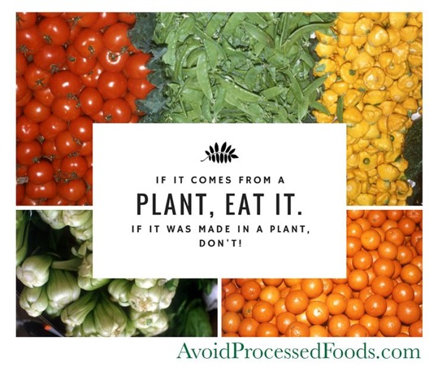
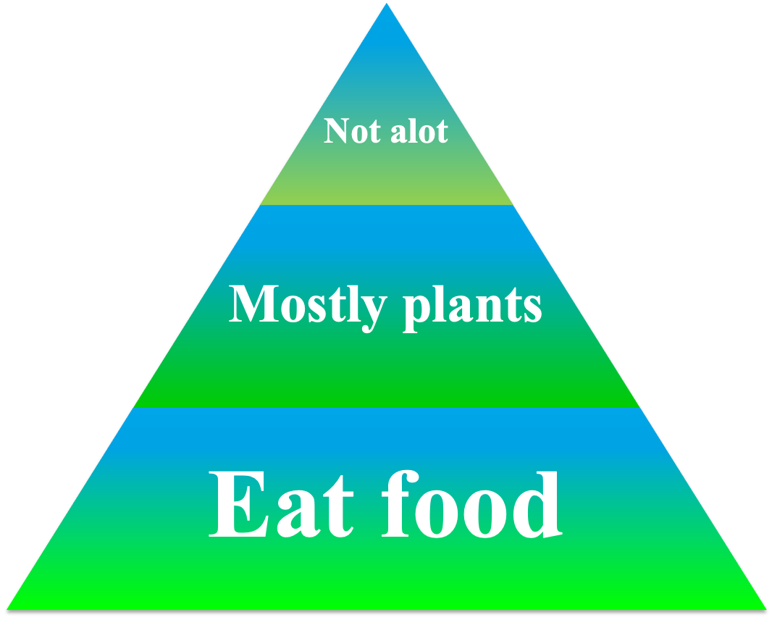
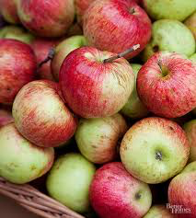
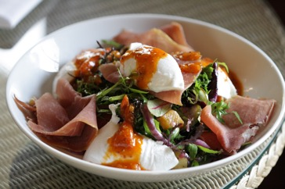
Nutritional Fitness
Notes:
Michael Pollan – Food Rules
80/20 rule = adhering to a health diet 80% of the time and allowing some indiscretion 20% of the time.
"Late-eaters (individuals who ate their largest meal after 12:38) exhibited several obesogenic and unhealthy behaviors (such as lower diet quality, shorter sleep duration, sedentary lifestyle, and prolonged screen time) that could potentially contribute to long-term weight gain and obesity,"

Slide 12

Sleep…
Notes:
Sleep deprivation and “sleep debt”, prompting use of both OTC and prescription sedatives. Increased risk of accidents
Cognitive deficits, hampering memory and reasoning
Quality of life (aggravates depression and mood)
Impaired organ systems with increased risk of hypertension and PAF
Changes in appetite (blunts release of leptin hormone that controls appetite)
In 1960’s median amount of sleep was 8 hours – today typically 6-7 hours. Insufficient sleep is the most common cause of excessive sleepiness (affects 1/3 of normal adults). Develop sleep debt and affects judgment, reaction time and cognitive skills. DO NOT ADAPT to getting less sleep. UPENN study restricted participants to 4-6 hrs sleep – they felt only “slightly” sleepy but their performance on cognitive tests mirrored that of those who hadn’t slept in 2-3 days….AND THEY DIDN’T REALIZE they were performing poorly!
VA Tech study focused specifically on executive functioning and sleep deprivation – tests that required reasoning and situational awareness (putting things in context). Sleep deprivation caused poor decision making and an increase in planning errors. With driving, sleep deprivation is the equivalent of alcohol intoxication and only magnifies drinking behaviors.

Slide 13

Sleep Hygiene
Make your bedroom a cave
Use your bed for sleep or sex ONLY
Keep regular sleep hours
Avoid tobacco, alcohol and caffeine
Turn off electronic devices
Relax before bed
Get daily exercise and AM sunlight
Don’t “horribilize”
Notes:
Enhances performance, learning and memory. Allows NS to repair itself, replenishing NTs and clean up byproducts (?free radicals). It is also the time when other neuronal connections, often not used, are exercised so that they do not deteriorate. Encode memory and improve learning. “Let me sleep on it” allows for an incubation period so that connections between ideas can be restructured – often weaken initial links so that the brain can look at something differently (“pruning”). Sleep brings a change of approach and is crucial for creativity.
Concept of beauty sleep with cell growth, rest in areas that control emotion, decision making and social interactions to allow optimal functioning when awake.
Even low levels of light can disrupt sleep architecture.
Appropriate exposure to light is also key, with early AM sunlight and evening dimming of lights to trigger melatonin.
Treat all medical conditions that may be disrupting sleep. Evaluate medications and supplements.

Slide 14


Preventive Healthcare
Ask about immunizations and screenings
Notes:
At every age below 80, Americans are dying more often than people in their peer nations. U.S. life expectancy has declined to 76.4 years, the shortest in nearly two decades. Infant mortality is 3X as high as other countries, and 1 in 25 kindergartners will not reach 40, a rate 4X as high as that of other countries. Americans are twice as likely to die between 15-24 than those in other wealthy nations. Death rates among working-age adults higher than they were 40 years ago. Ironically we are good at keeping old people alive, so 75 yr olds have a good chance of making it to 90-100.
US healthcare systems emphasize rescue care, acute care at the expense of investing in, supporting, and enabling health promotion and disease prevention. Healthcare often translates into “disease” care. Only 4-5% of our entire healthcare costs are spent on public health and preventive health measures.
Getting preventive care reduces the risk for diseases, disabilities, and death. Immunizations, screening for breast, cervical, colon and prostate cancer. Screening for cardiovascular risk, hypertension and diabetes. Screening for osteoporosis, domestic violence (do you feel safe), depression/anxiety, and fall risk. Screening for sleep disorders and cognitive dysfunction.

Slide 15
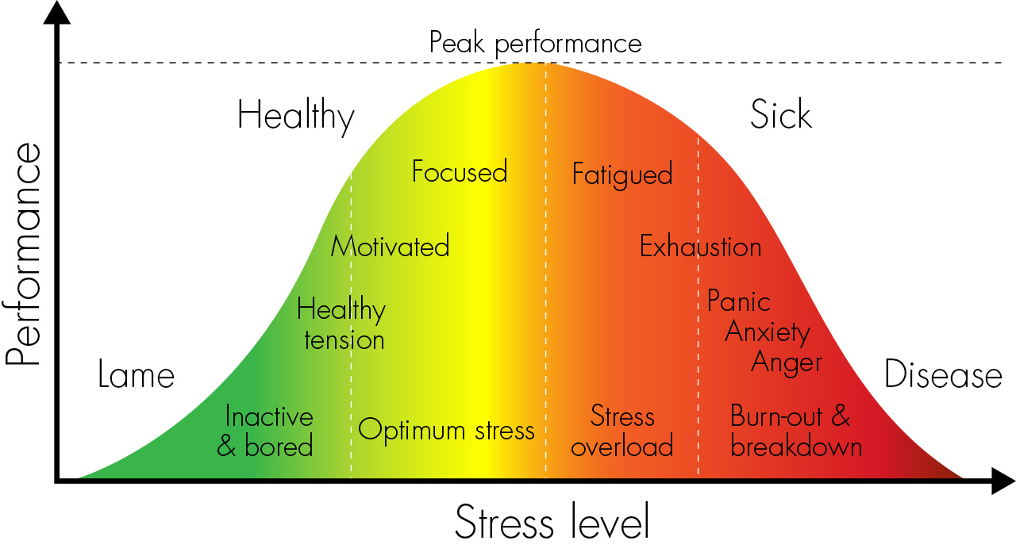
Resilience
Know your limits
Notes:
Stress is indicated with physical, intellectual, emotional, behavioral, and spiritual symptoms, and is contagious. Optimal stress promotes growth, learning and increased resilience. Source can be environment, physical, emotional, psychological. Response to sustained stress prompts wear and tear on mind, body, spirit
Begins in your brain w/ activation of SNS – increased HR, changes vasculature (flushing), slows intestines, releases cortisol with disrupted circadian rhythms, memory disruption and brain fog
You must believe in yourself, you must be compassionate of yourself, and you must feel worthy. Separate what you want from what others want for you. (Alice in Wonderland conversation with the Cheshire cat at the fork in the road….”Where are you going?” “I don’t know.” “Then it doesn’t matter what path you take.”) You need a sense of direction, vision mission.
This is more than simply what you do day to day – this is an ability to conceptualize and move beyond daily realities to a direction or perspective that looks ahead. You do this more than you know, with your children, with your spouse about your future in the military, with your financial savings….do it for yourself. This is a process as well as a goal, and provides a sense of purpose, accountability and sense of control.
Self-awareness means knowing your own personal priorities, where your stress comes from (ie personal conflicts, sources beyond your control) and recognizing the need (or urgency) to create balance. Recognize the problem, decide on an adaptive behavior, develop an action plan to achieve the objective and reduce the stress, and monitor your responses to stress
Remember you need to have room to surge

Slide 16

Relationships
Notes:
The Good Life: Lessons from the World’s Longest Scientific Study on Happiness by Robert Waldinger and Marc Schulz. Began in 1938 with 724 men from all over Boston whose families they have followed (three generations) for over 80 years.
What makes a life fulfilling and meaningful?
The stronger our relationships, the more likely we are to live happy, satisfying, and overall healthier lives. Strong relationships stand out for their impact on physical health, mental health, and longevity.
The Harvard Study of Adult Development reveals that the strength of our connections with others can predict the health of both our bodies and our brains as we go through life. The key findings are bolstered by research findings from many other studies and from ancient wisdom.
Relationships in all their forms—friendships, romantic partnerships, families, coworkers, tennis partners, book club members, Bible study groups—all contribute to a happier, healthier life.
And as The Good Life shows us, it’s never too late to strengthen the relationships you have, and never too late to build new ones.
Take stock by looking inward
Consider how your needs may differ at different stages of life
Prioritize your relationships and be present
When difficulties arise, be reflective, not reflexive
Let people know how much they matter to you

Slide 17

Your Spouse…
Work as a Team
Notes:
You are only as good as your resources!!
Show up! Treat your spouse like your dog.
Know how to get their attention. Talk openly and regularly (and not just about the kids). Listen actively with enthusiasm and interest. Ask questions, be engaged, and show positive emotion.
You can be their eyes/ears as you are often the liaison between the command structure and the families and communities
You are also the “pin to their balloon”
Know your limitations with each other. You are not their doctor or priest, and you shouldn’t feel as if you have to be.
Discuss and recognize warning signs. Make sure they know your “tipping point.”
Make time for each other. Create space for spontaneity to happen. Plan date nights, or random picnics, or take a class together. (PB with Jim)
“How are we going to do this” when confronted with a new challenge/billet/demand. Example of ADM Mullen being deliberate about taking time off/planning brief periods of respite for both them and their staff

Slide 18

Family
Notes:
Appreciation expressed. Acknowledge effort even if it is expected
Good communication patterns. Congruent respectful considerate communication – feelings can be expressed/accepted even if you do not necessarily agree with them
Time spent together
Commitment to family implies a sense of identity and loyality. It is defined through family rituals, perhaps designing a family flag or crest, Mother’s Day photo books, Christmas “mix”, care packages, Camp Zlatoper, mid-deployment trips.
High degree of spirituality. Spirituality is love, acceptance and forgiveness. “you don’t have to be perfect to be loved.” Accepting what is, not ignoring or misrepresenting something but acknowledging that it no longer remains a barrier to the relationship.
Ability to handle crisis in a positive manner. Linda Kauskay with her mom and Alzheimers.
The three “R’s” of memory making. “R”s are routines, rituals and the ridiculous. They give kids structure and security….and memories. It is as simple as reading to them at night or stroking their hair or being at a sports event in the rain.

Slide 19
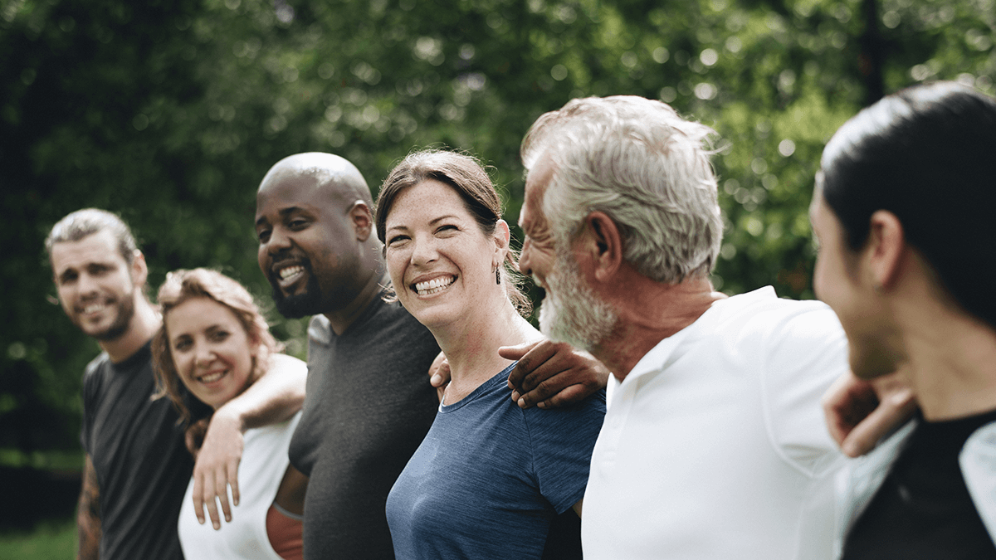
Hang Out with Friends
Notes:
Develop a circle of “Confidantes”
Re-establish contact with a mentor
Having someone hold my hand during the loss of a pregnancy.

Slide 20

Community Connections
Stay Connect4d
Notes:
Concept of self-reliance as an interdependence on others, turning to them for support and accepting responsibility for their development. Idea of “adaptive energy” or synergy.
Involvement of all individuals – you can provide the vision but allow others to help shape and refine the direction (works well with kids…concept of controlled chaos in PEP)
Also promotes a sense of allegiance because people feel like they make a difference (critical in spouses’ clubs)
Command Resources
Know What’s Available
Make an Introductory Call
Know how to Muster Support
Community Resources
Your USMC/USN/JCS community
Keep other interests, personal and professional
Volunteer
Faith community

Slide 21

Relaxation and Reflection
Notes:
Quieting of mental activity gives you time to think and feel again. Relaxation is anything that promotes a feeling of contentment and should focus totally on you.
An opportunity to live in the present (avoid vacation deficit disorder) Decompressing on the commute home, mentally organizing your day on the way in.
Strengthens family cohesion
Choose, don’t drift!
Internal jogging (concept of mindfulness and solitude)
Concept of mindfulness (meditation/contemplative prayer, working on a car, yardwork, walking the dog…..)
Practicing gratitude
Quiet reflection is restorative, illuminating and, I believe, essential for mental stability. If we don't have time to think, we can't grow and we certainly can't learn.
When stressed, “pull the rug out” by turning to a quieting activity to counteracts the negative effects of the stress hormones. The brain releases endorphins, quiets down (“calm commotion”) with a focused increase in activity in areas of the brain assoc with higher neurologic performance. So 1)lean into a problem initially…do the hard work and stop when you’re more stressed than productive 2)walk away and do something totally different that produces a relaxation response. Breath, exercise, pet an animal, look at a painting, go outside, take a shower, take a nap, knit…..totally detach from the activity. 3)gain a sudden insight which often leads to a higher level of performance.

Slide 22

Spiritual Vitality
Notes:
Centers on a sense of our own meaning
Provides an opportunity to make a difference
Put principles into practice
Re-enforce spiritual ”cues”
Be open to the “awe” in your life
Have a spiritual friend, someone who sees the joy in life. They are not naïve, simply joyful or exuberant.
Spirituality allows you to find peace and happiness in an imperfect world, and to feel that one’s own personality is imperfect but acceptable. “I am enough.” (The Missing Piece)
“Paying attention to the presence of God in your life”
Fosters a sense of service which complements the ability to be productive. It provides an opportunity to make a difference, to develop a sense of empathy (M Dinneen and Harvard reunion). It involves a sense of purpose, hope, connection with others. It allows you to practice gratitude and joy.
The courage to be imperfect, the compassion for self and others, and connection to others. It embraces vulnerability because what makes you vulnerable makes you beautiful. Spirituality allows us to let ourselves be seen, allows us to love with our whole heart even when there are no guarantees. It is the birthplace of joy, creativity and understanding.
Benefits of spirituality felt to include hope and optimism, less depression(or increased recovery from depression) and fewer suicides, less anxiety, less alcohol and drug abuse, greater marital stability, less risky behavior, and lower mortality.
Greater acceptance of difficult situations and opportunities for post-traumatic growth leading to spiritual resilience.
Charitable , feeling connected, with less sense of loneliness or isolation
Fosters a sense of humility and community
Instead of “life, liberty and the pursuit of happiness”, it should be life, liberty and the pursuit of meaningfulness. Personal success devoid of meaningfulness, free of a steady commitment to social justice, that’s more than a barren life; it is a trivial one. It’s looking good instead of doing good. (Toni Morrison)

Slide 23
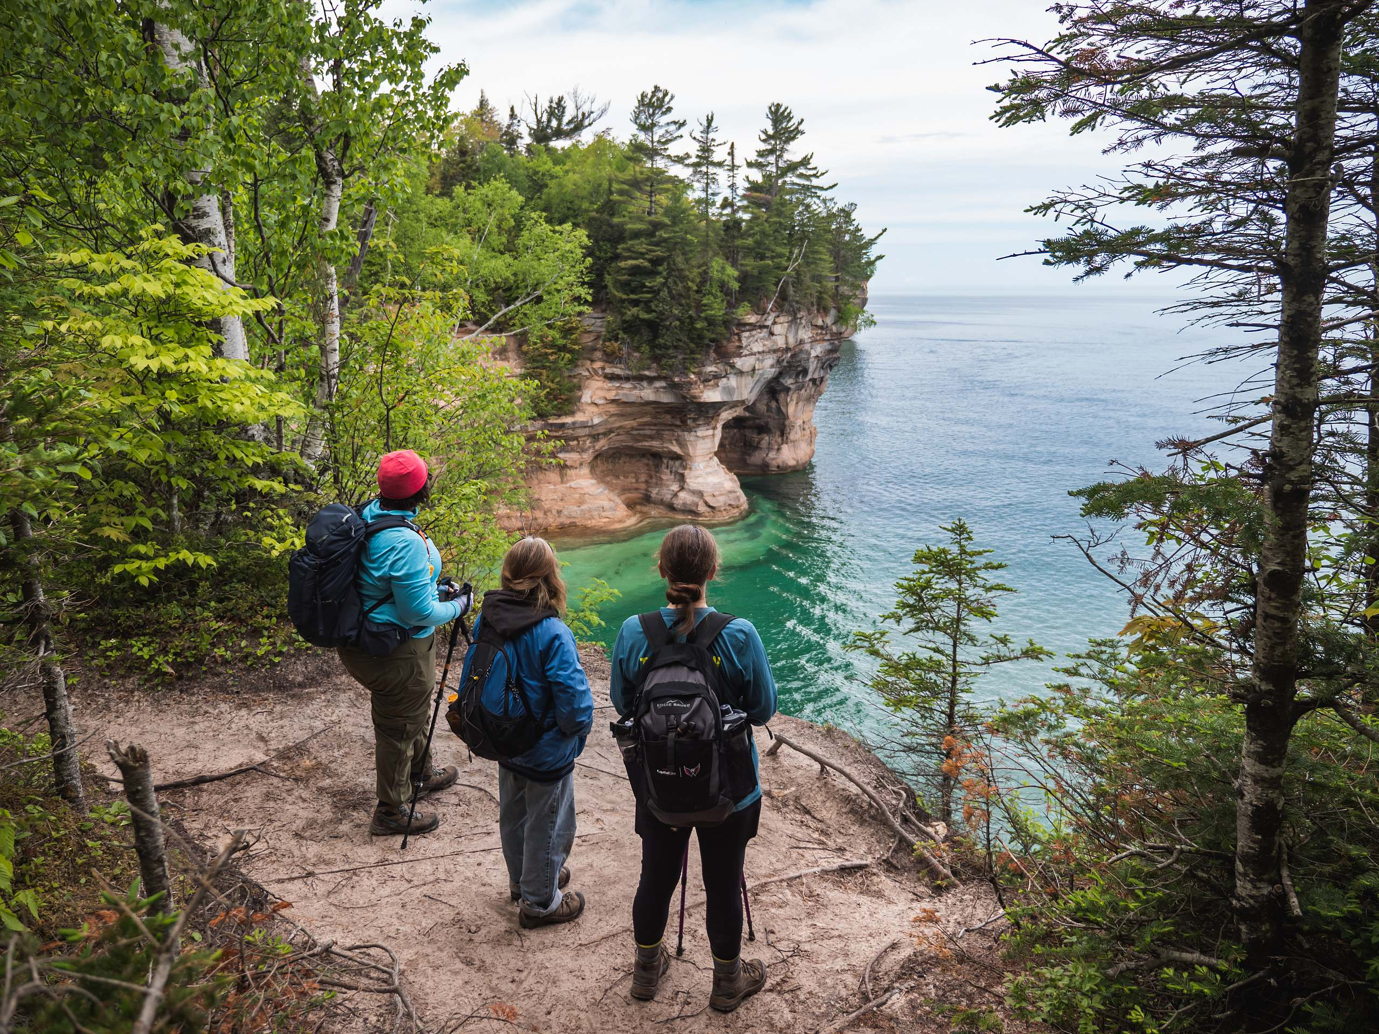
Self care isn’t vanity, it’s sanity
Notes:
Being selfish means there's a desire to take from others, often to their detriment. However, self-care is about replenishing your resources without depleting someone else's. Self-care is a means of restoring your own energy, which promotes healthy physical and emotional well-being.
Start with self-compassion….strongly linked to overall well-being. Studies show that it can reduce depression, stress, performance anxiety. It is not self-indulgent / self-pity.
Mindfully acknowledge our pain in a nonjudgmental way, remind ourselves that we are not alone, imperfection is part of human experience, and then offer ourselves kindness and support. (similar to how we would treat a close friend). Take a self-compassion break. You deserve your care and attention

Slide 24
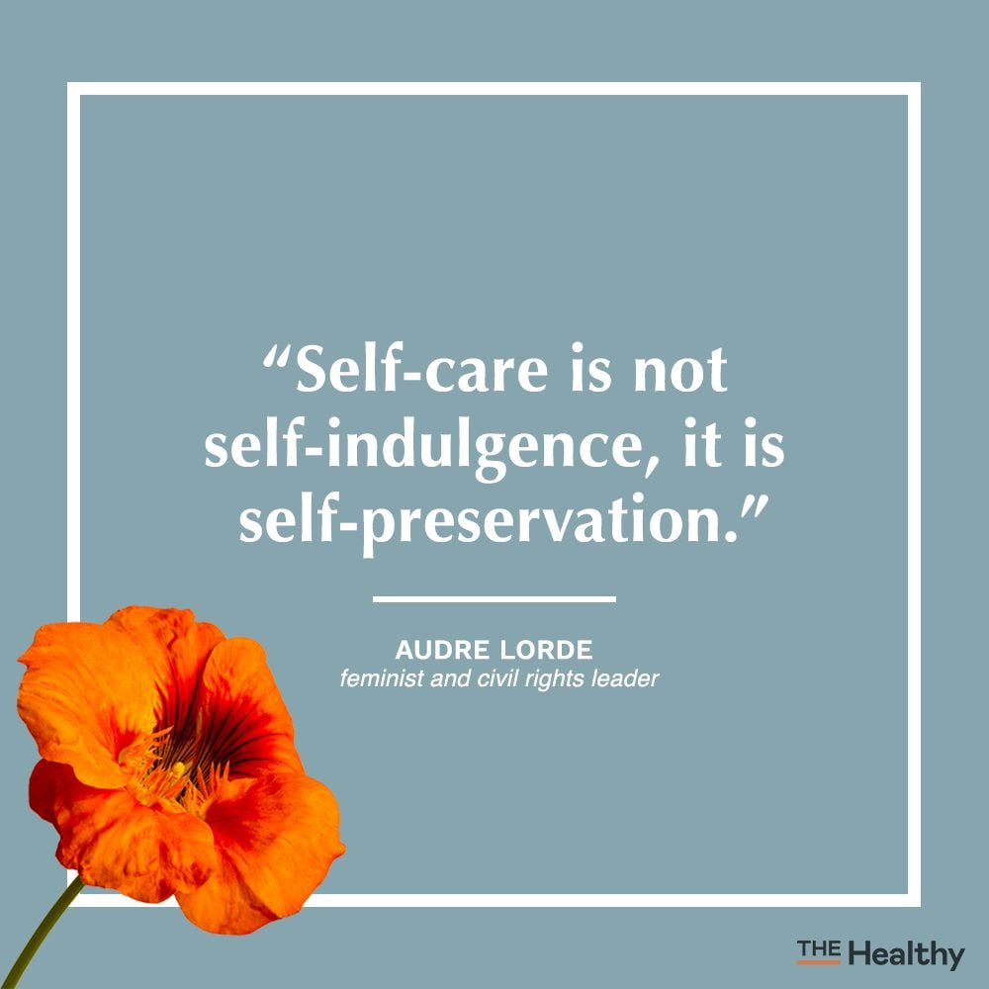
Notes:
Take stock by looking inward
Consider how your needs may differ at different stages of life
Prioritize your relationships and be present
When difficulties arise, be reflective, not reflexive
Let people know how much they matter to you
Being selfish means there's a desire to take from others, often to their detriment. However, self-care is about replenishing your resources without depleting someone else's. Self-care is a means of restoring your own energy, which promotes healthy physical and emotional well-being.
Start with self-compassion….strongly linked to overall well-being. Studies show that it can reduce depression, stress, performance anxiety. It is not self-indulgent / self-pity.
Mindfully acknowledge our pain in a nonjudgmental way, remind ourselves that we are not alone, imperfection is part of human experience, and then offer ourselves kindness and support. (similar to how we would treat a close friend). Take a self-compassion break. You deserve your care and attention…how often do you actually sit down and reflect on the quality of your personal life? What are you doing to impact others within your sphere of influence, starting with yourself? Example of pie chart.
You need to really think about what will make you proud when you are old and look back on your life. That is the right direction to take.” Doing what you love is a major contributor to your happiness/worthiness as a human. And happiness equates to more optimism, healthier and productive lives, and enthusiasm about growing (remaining intellectually and creatively curious).

Slide 25
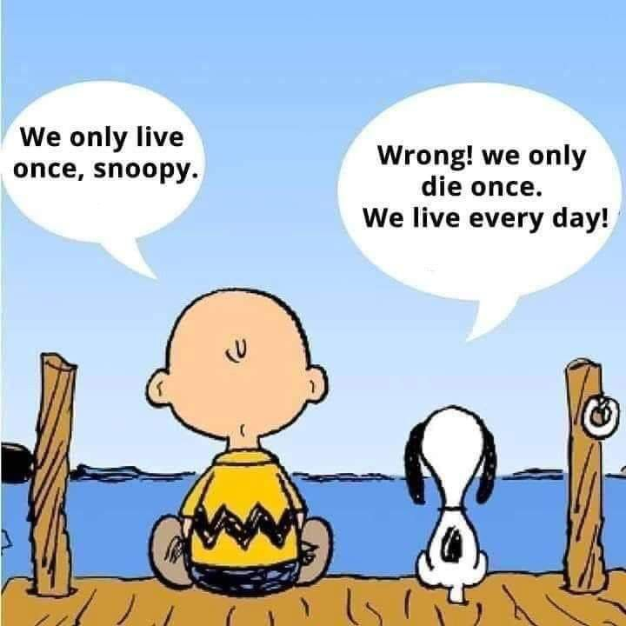
Notes:
What enhances longevity is enlightened self-care, better medical attention, genetics and deliberate mental, social and physical activity in later life. This means continuing to learn new things, staying involved in the community and maintaining a sense of purpose and meaningfulness. New “retirementality”.

Slide 26
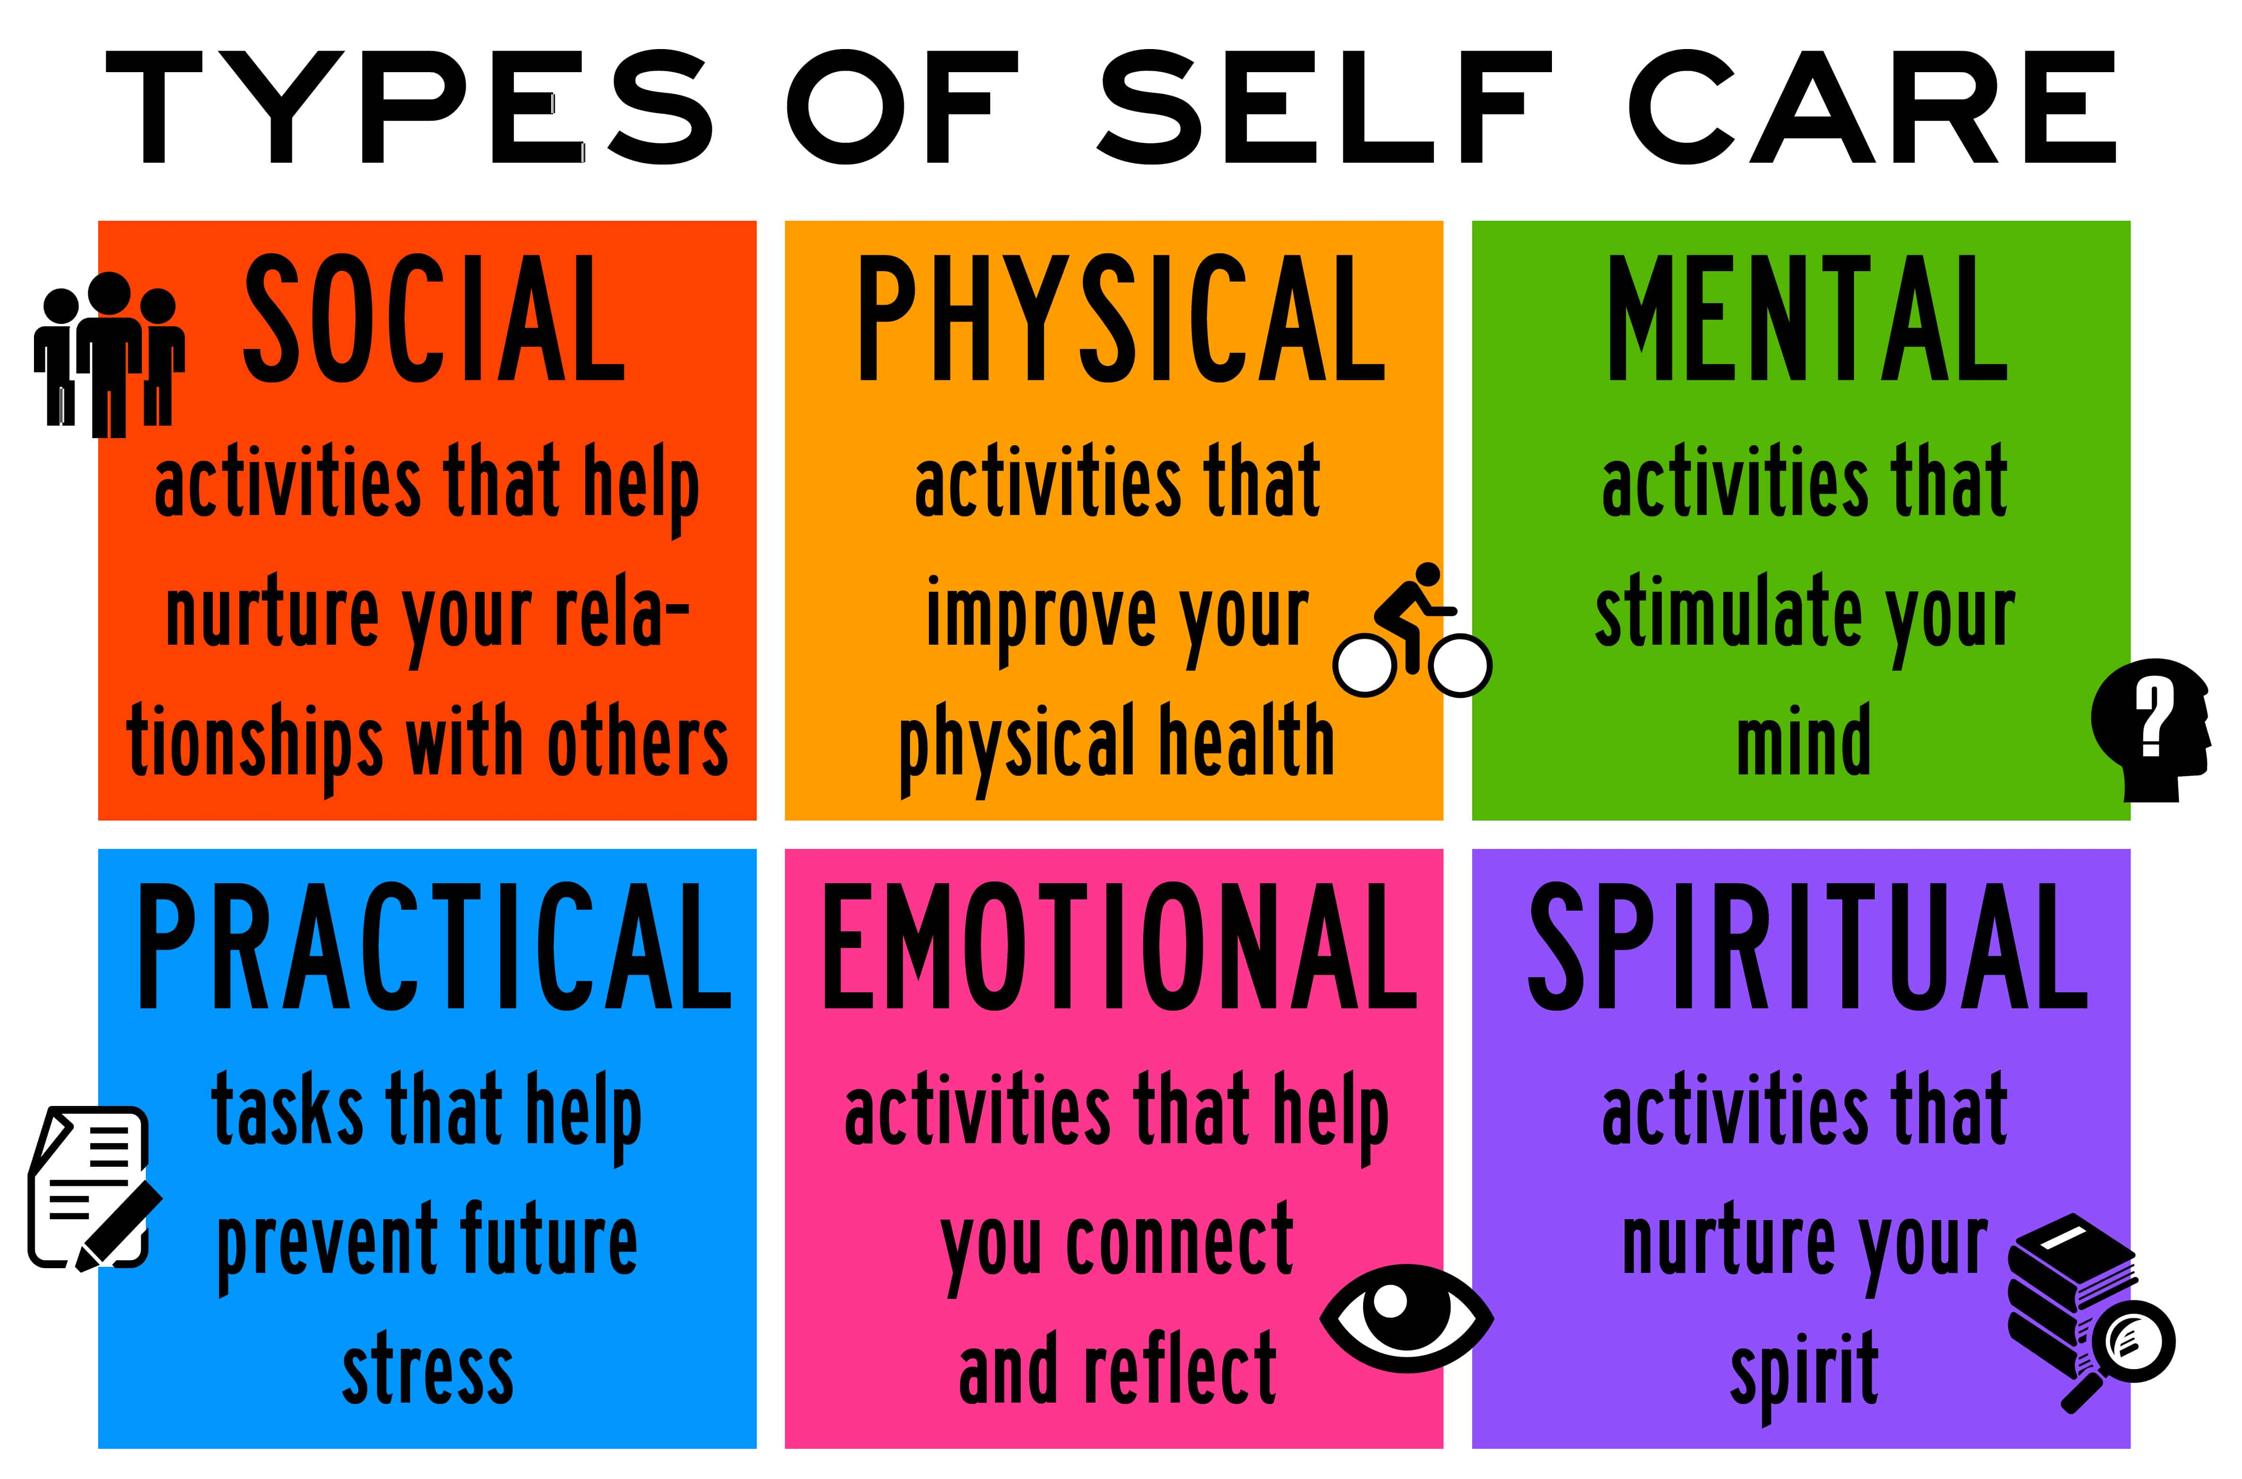
Notes:
What enhances longevity is enlightened self-care, better medical attention, genetics and deliberate mental, social and physical activity in later life. This means continuing to learn new things, staying involved in the community and maintaining a sense of purpose and meaningfulness. New “retirementality”.

Slide 27
