Slide 1
Focusing on Wellness
“Keep your vitality. A life without health is like a river without water.”

Slide 2
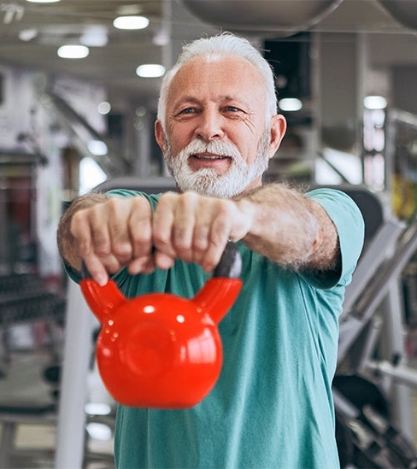
Demographics
Growing Old is Not for Sissies!

Slide 3
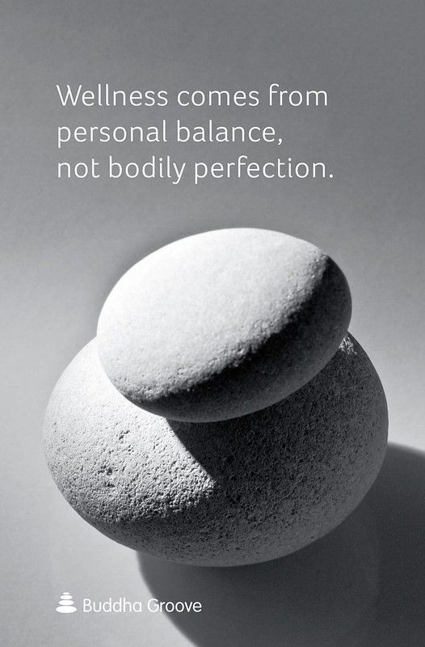
What is Wellness?
Health is a state of complete physical, mental, spiritual and social well-being, and not merely the absence of disease or infirmity.

Slide 4
Keep Your Heart Strong
“Heart disease kills more women than all cancers combined.”

Slide 5
Cardiac Risk Reduction
Lifestyle Modifications
Exercise daily (150 min/week)
Don’t smoke
Mediterranean diet
Restorative sleep
Treat hypertension, diabetes and high cholesterol
Stress management and social engagement

Slide 6
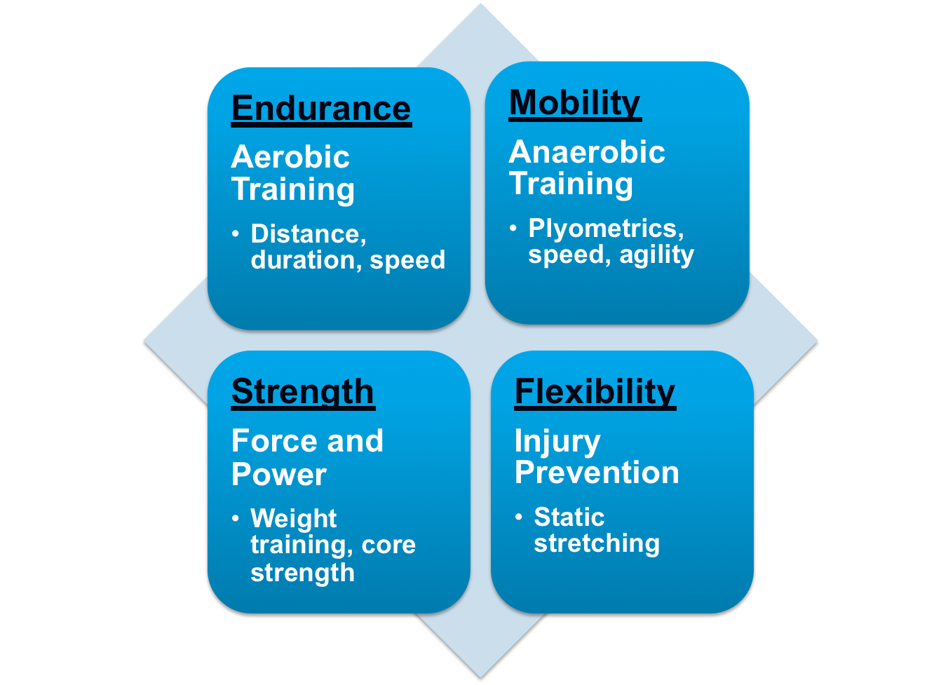
Sitting is the new smoking!
Physical Fitness

Slide 7
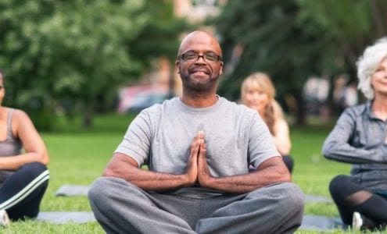
Cross Training & Diversity

Slide 8
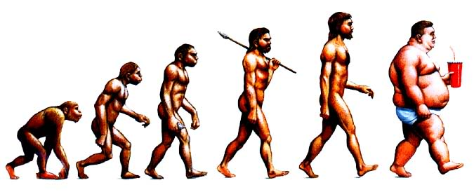
What is a Healthy Diet?
The banquet is in the first bite

Slide 9
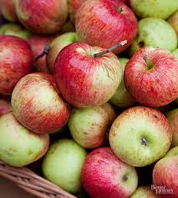
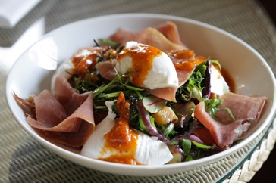
Nutritional Fitness
Notes:
Michael Pollan – Food Rules

Slide 10
Sleep…

Slide 11
Sleep Hygiene
Make your bedroom a cave
Use your bed for sleep or sex…ONLY
Keep regular sleep hours
Avoid tobacco, alcohol and caffeine
Turn off electronic devices
Relax before bed
Get daily exercise and AM sunlight
Don’t “horribilize”

Slide 12
Preventive Healthcare

Slide 13
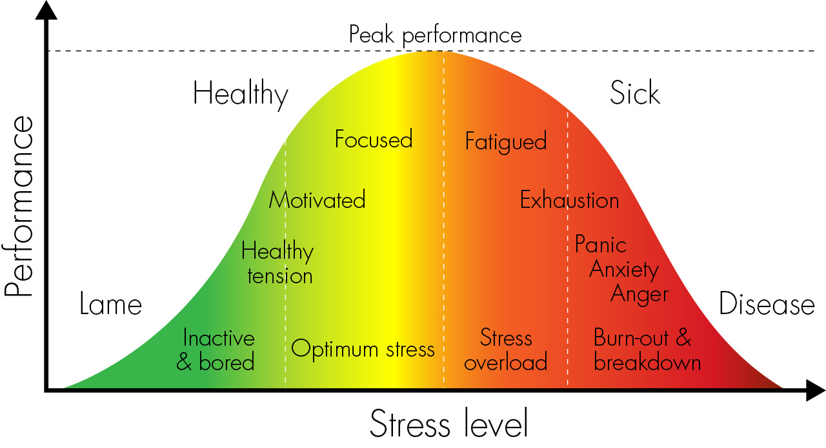
Resilience
Know your limits
Notes:
Stress is indicated with physical, intellectual, emotional, behavioral, and spiritual symptoms.”
Source can be environment, physical, emotional, psychological. Stress is contagious
Begins above your shoulders in your brain – amygdala processes data and communicates with the hypothalamus to turn on the SNS – increased HR, changes vasculature (flushing), slows intestines, releases cortisol with disrupted circadian rhythms, memory disruption and brain fog
Adrenaline, NE, catechols, cortisol
Sustained stress response prompts wear and tear on mind, body, spirit

Slide 14
Your Spouse…
Work as a Team

Slide 15
Family

Slide 16
Hang Out with Friends

Slide 17
Community Connections
Stay Connect4d

Slide 18
Relaxation and Reflection

Slide 19
Spiritual Vitality

Slide 20
Self care isn’t vanity, it’s sanity

Slide 21
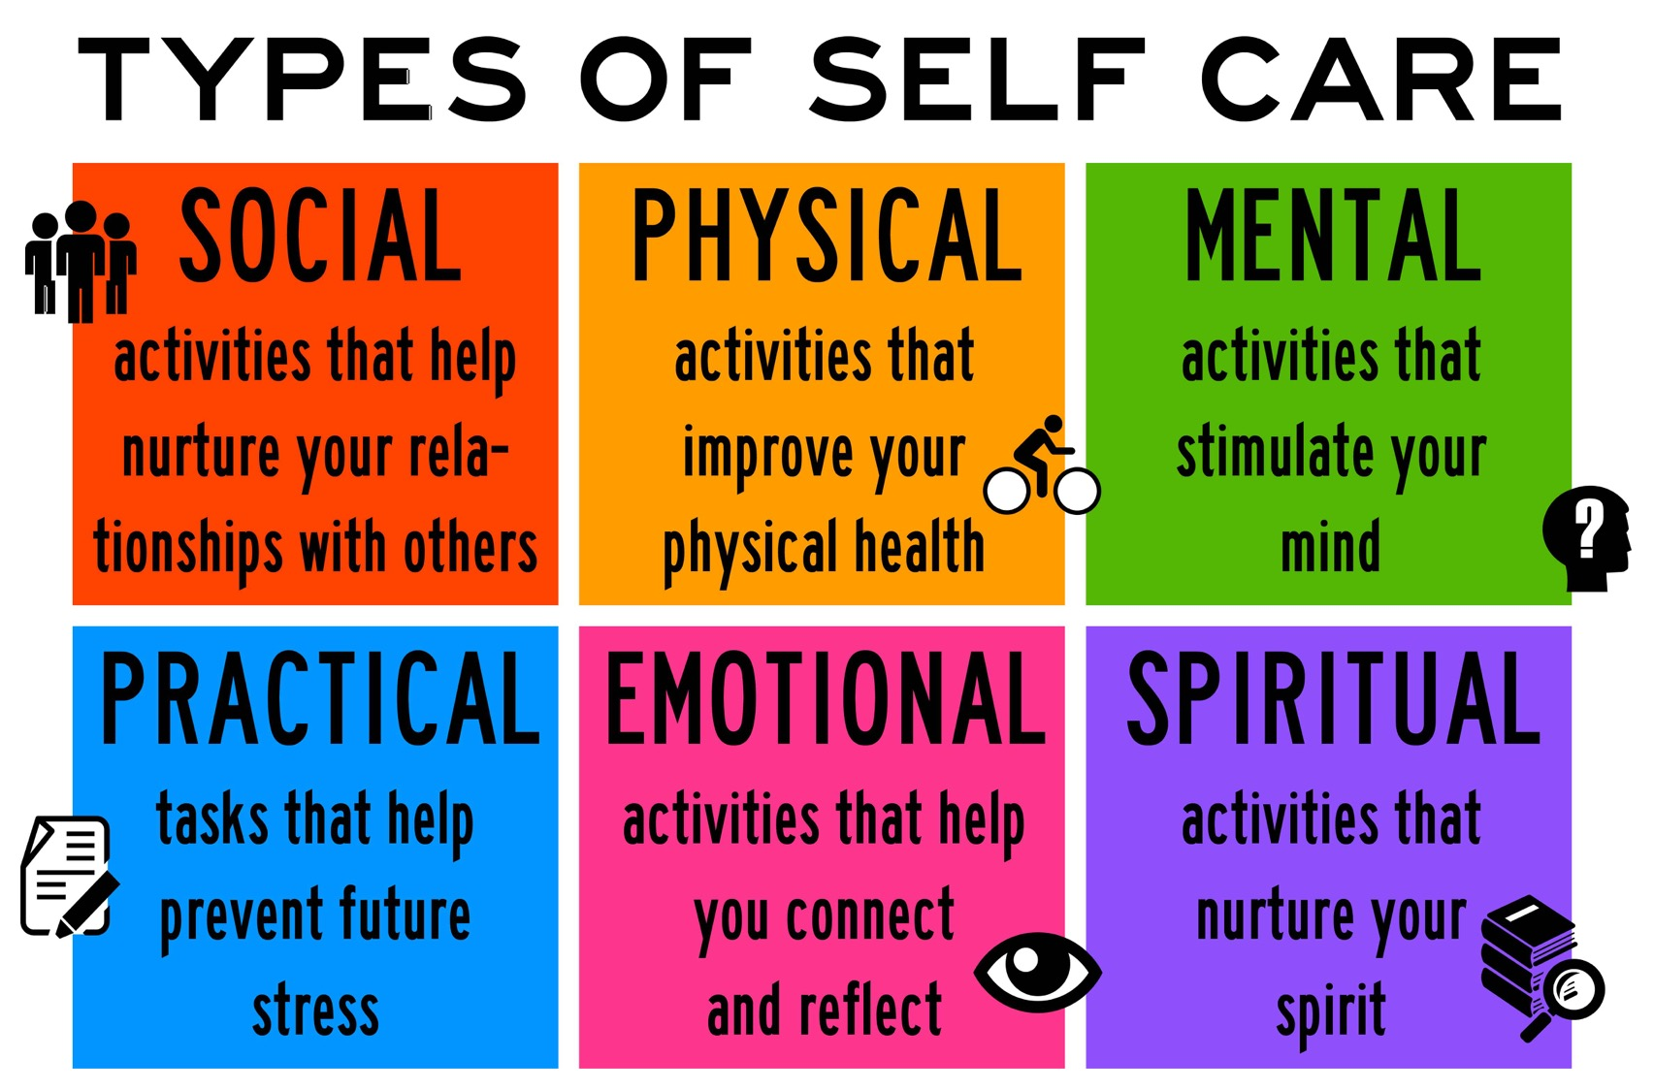

Slide 22
