Slide 1
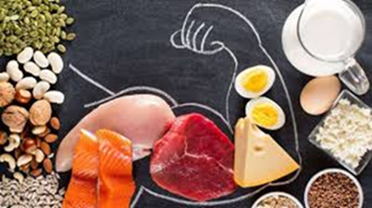
Executive Physiology & Strength Training
Frank Wintrich, Director Health and Fitness
Christine Turpin, Performance Dietitian
National Defense University Health and Fitness Directorate

Slide 2
Executive Physiology: Learning Objectives
  Design and implement strategies to enhance food intake for sustainable energy
  Understand nutrition needs change across lifespan and activity levels
  Learn about supplements that may assist with mental health, bone health and physical health
  Apply suggested exercises to your workout routine while on travel or away from your home gym.

Slide 3

Executive Physiology: Strategic Fueling
Assessment Activity
Fuel Assessment
  24-hour recall
Typical Client
Skips breakfast
Restricts energy
Skimps on protein
Overeats in evening
Exercises under fueled or fasted
Performs workouts without a purpose or potential
Neglects sleep

Slide 4

Executive Physiology: Science
Low Energy Availability (LEA)

Slide 5
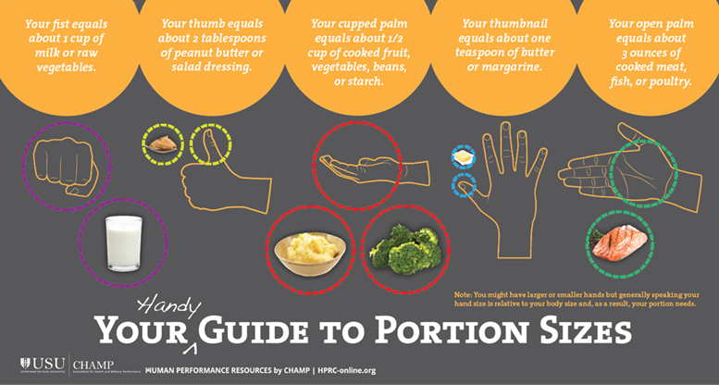
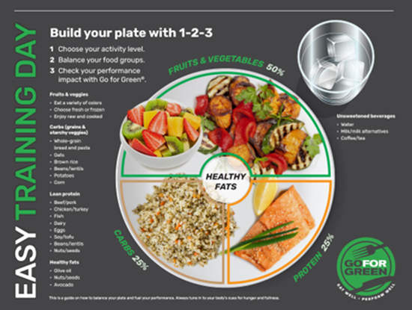
Executive Physiology: Strategic Fueling
Power up your Plate: Fuel with a Purpose
Fruits and Vegetables Half
Carbohydrate Quarter
Protein Quarter
Healthy fats Need to have some!

Slide 6
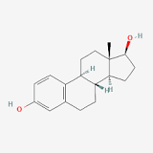
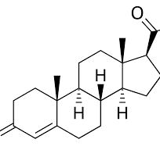
Executive Physiology: Science
Hormones
Hormones are your body’s messengers
  Circulate through your blood taking and delivering messages to your organs from your brain vise versa
    Tell your body what to do to stay healthy and strong
    Signal muscles to grow, bones to form, control temperature, appetite, and fat storage and control much of our mental, physical and emotional well-being.

Slide 7
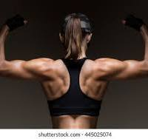
Executive Physiology: Review
  Hormones: Effect of Less Estrogen/Testosterone Production
  Less muscle mass
  Increased Inflammation
  Insulin resistant
  Altered appetite
  Elevation of stress hormone (cortisol)
  Blood vessels are less compliant
  Hormones: Effect of Less Progesterone Production
  Decreases ability to lie bone
  Breaks down muscle tissue

Slide 8
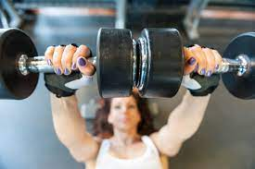

Executive Physiology: Science
  Hormones: Effect of Less Testosterone Production
  Decreases bone strength
  Decreases muscle strength
  Decreases sex drive

Slide 9
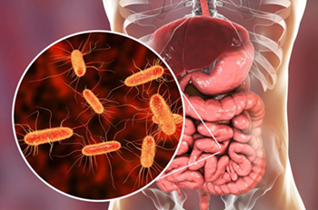
Executive Physiology: Gut Microbiome
How to Build a Robust Belly
Food
Exercise
Sleep
Behaviors Destroy and Cause Havoc in Your Belly
Antibiotics
Artificial sweeteners
Processed foods
High sugar and saturated fats

Slide 10
Executive Physiology: Gut Microbiome
How to Better Your Belly
Unprocessed foods
  Foods in their whole form, most natural state, at time of purchase
    Fruits, vegetables, seeds, fresh lean meats, fish, legumes and nuts
Processed foods
  Foods that have undergone changes that alter the natural state of the food – heating, freezing, dicing and juicing
    Frozen fruits/vegetables, pre sliced fruits and vegetables, fresh juices, instant brown rice, nut butter, tofu, whole wheat break, extra virgin olive oil, plain yogurt and dried fruits
Ultra processed foods
  Foods to created mostly or entirely from substances extracted from foods or derived from food constituents with little intact
    Snacks, drinks and ready-made meals

Slide 11
Executive Physiology: Gut Microbiome
“Plant Eating Challenge”
Eating a wide variety of plants improves our gut microbiome, provides many essential ingredients, improves your mood, reduces the risk of chronic disease/inflammation and keeps you fuller for longer (think fiber). Additionally plant-based foods use less water and land and greenhouse gas emissions than animal –based foods, which means it’s better for the environment.
How it Works
Commit to tracking your intake of plant-based food for one week. The goal is to eat 30 DIFFERENT plant sources in one week. Portions do not count in this challenge; a large and small banana counts both count as one point. You don’t need a specific amount or serving size to count – if you have a couple of grapes or a bite of an apple, you can count it as part of your total.
What foods count as points (one point)
Whole grains: Oats, whole wheat pasta/crackers/cereal/quinoa, red rice, farro, buckwheat, brown rice, spelt
Nuts & seeds: Walnuts, cashews, peanuts, almonds, chia/flax, pumpkin, sunflower and hemp
Legumes: Lentils, chickpeas, kidney beans, black-eyed beans, butter beans, cannellini beans, garbanzo beans
Fruits and vegetables: Fresh, dried or canned (natural juices, no sugar)
Non-dairy yogurt: Plant-based yogurt (soy, almond, oat milk)
What foods count as points (¼ point)
Turmeric, cayenne pepper, paprika, cumin, thyme, rosemary, black pepper, cinnamon, ginger, coffee, tea, dark chocolate, olive oil

Slide 12



Executive Physiology: Supplements
  Supplements
        Not regulated for legality, efficacy and safety
        What to look for in a supplement
          Third-party organizations to review products quality
          If certified, will have label and listed on company’s website
          Supplement label and no 3rd party certification = move on
        Use caution
          Propriety blends
          Herbal ingredients
Notes:
Propriety blends – amounts of ingredients are not disclosed, you can be getting some of the ingredient marketed and rest of ingredients are fillers
Herbal ingredients – higher risk for contamination, depending on country of orgin; little research to support their use; interact with other herbs, foods and medications
supplements can be a helpful tool to address potential deficiencies and support overall health and well-being.

Slide 13
Executive Physiology: Supplements
  Supplements
        The Department of Defense Dietary Supplement Resource
        Operation Supplement Safety
          DOD Prohibited Dietary Supplement Ingredients
            https://www.opss.org/dod-prohibited-dietary-supplement-ingredients
Notes:
Macha – don’t use if on thyroid medication

Slide 14

Executive Physiology: Supplements
Supplementation
Creatine
Omega-3
Vitamin D
Magnesium
Protein

Slide 15
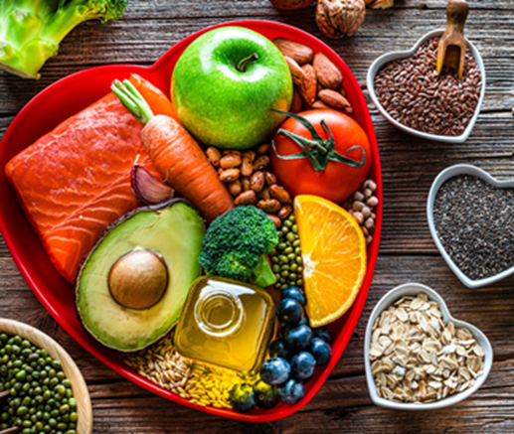
Executive Physiology: Supplements
  Supplements
        Manage Mental Health
        Creatine
          Body makes; obtain from protein-rich foods
          Supplies energy to muscles
          Improves mood and severity of depressive episodes
          Reduces mental fatigue and improves cognition
          Helps slow the decline in skeletal muscle and bone mineraly density
        Sources
          Beef, pork, chicken, turkey, fish, daily
        Supplementation
          Creatine monohydrate
          3-5 grams / day

Slide 16

Executive Physiology: Supplements
  Supplements
        Bone Health
        Vitamin D
          Obtained from food and body makes it
          Absorbs and retains calcium and phosphorous
          Essential for immune function, heart health and muscle function
          Consume with the presence of fat in a meal to enhance absorption
        Sources
          Fatty fish (tuna, salmon, mackerel), egg yolks, fortified milk & cheese, ready-to-eat cereal, fruit juices and SUNSHINE
        Supplementation – Vitamin D3
          2,000 – 4,000 IU

Slide 17
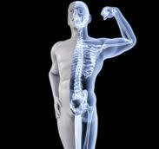
Executive Physiology: Supplements
  Supplements
        Bone Health
        Calcium
          Decrease in bone mass (estrogen protects) at 30 years
          Small decline until menopause; decline is more dramatic
        Institute of Medicine
          1,200 mg calcium / day over 50 - through food
          1,000 mg calcium / day under 50 – through food
        Sources of Calcium
          Leafy greens, salmon, canned sardines with bones, yogurt, string cheese, milk, fortified cereals/grains, tofu, bok choy, fortified cereals/orange juice
        Supplementation
          500 – 600 mg/day; Calcium Citrate or Malate

Slide 18
Executive Physiology: Supplements
  Supplements
        Bone Health
        Magnesium
          Maintains blood pressure, muscle/nerve function
          Regulates blood sugar
          Protects of bone health
        Sources
          Leafy greens, black beans, bananas, brown rice, legumes, nuts, seeds, spinach whole grains, fish, poultry and beef
        Supplementation
          310-320 mg /day Magnesium glycinate (sleep)

Slide 19
Executive Physiology: Supplements
  Supplements
        Protein
          Provides amino acids your body needs to build / repair muscles and cells
          Supports immune functions; facilitate chemical reactions
        Sources
          Whey protein (more bioavailable)
          Plant-based (pea, soy)
          Recommendations increase for plant-based diets
        Supplement Dose
          10-60 grams (newest research) Whey protein

Slide 20
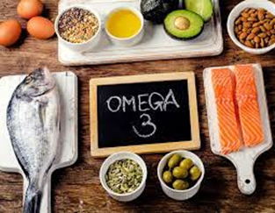
Executive Physiology: Strategic Fueling
Supplements
Omega 3-Fatty Acid
  Decreases inflammation / assist with good cholesterol reduces risk of cardiovascular disease, reduces depression and anxiety
Supplement Dose
  1-2 g/day but not more
  than 3 grams a day
  TG based fish oil = increased bioavailability

Slide 21
References
Simms , Stacy, and Selene Yeager . Next Level . 1st ed., vol. 1 1, Penguin Random House, LLC, 2022.
Simms, Stacy. Roar. 1st ed., vol. 1 2, Rodale Inc, 2016.
Brooks, S. J., Candow, D. G., Roe, A. J., Fehrenkamp, B. D., Wilk, V. C., Bailey, J. P., … Brown, A. F. (2023). Creatine monohydrate supplementation changes total body water and DXA lean mass estimates in female collegiate dancers. Journal of the International Society of Sports Nutrition, 20(1). https://doi.org/10.1080/15502783.2023.2193556
Sims ST, Kerksick CM, Smith-Ryan AE, Janse de Jonge XAK, Hirsch KR, Arent SM, Hewlings SJ, Kleiner SM, Bustillo E, Tartar JL, Starratt VG, Kreider RB, Greenwalt C, Rentería LI, Ormsbee MJ, VanDusseldorp TA, Campbell BI, Kalman DS, Antonio J. International society of sports nutrition position stand: nutritional concerns of the female athlete. J Int Soc Sports Nutr. 2023 Dec;20(1):2204066. doi: 10.1080/15502783.2023.2204066. PMID: 37221858; PMCID: PMC10210857.
Candow DG, Forbes SC, Ostojic SM, Prokopidis K, Stock MS, Harmon KK, Faulkner P. "Heads Up" for Creatine Supplementation and its Potential Applications for Brain Health and Function. Sports Med. 2023 Dec;53(Suppl 1):49-65. doi: 10.1007/s40279-023-01870-9. Epub 2023 Jun 27. Erratum in: Sports Med. 2023 Jul 10;: PMID: 37368234; PMCID: PMC10721691.
Konstantinos Prokopidis, Panagiotis Giannos, Konstantinos K Triantafyllidis, Konstantinos S Kechagias, Scott C Forbes, Darren G Candow, Effects of creatine supplementation on memory in healthy individuals: a systematic review and meta-analysis of randomized controlled trials, Nutrition Reviews, Volume 81, Issue 4, April 2023, Pages 416–427, https://doi.org/10.1093/nutrit/nuac064
Konstantinos Prokopidis, Panagiotis Giannos, Konstantinos K Triantafyllidis, Konstantinos S Kechagias, Scott C Forbes, Darren G Candow, Effects of creatine supplementation on memory in healthy individuals: a systematic review and meta-analysis of randomized controlled trials, Nutrition Reviews, Volume 81, Issue 4, April 2023, Pages 416–427, https://doi.org/10.1093/nutrit/nuac064
Brooks, S. J., Candow, D. G., Roe, A. J., Fehrenkamp, B. D., Wilk, V. C., Bailey, J. P., … Brown, A. F. (2023). Creatine monohydrate supplementation changes total body water and DXA lean mass estimates in female collegiate dancers. Journal of the International Society of Sports Nutrition, 20(1). https://doi.org/10.1080/15502783.2023.2193556

Slide 22
References
Sejbuk, Monika, et al. “The Role of Gut Microbiome in Sleep Quality and Health: Dietary Strategies for Microbiota Support.” Nutrients, vol. 16, no. 2259, 13 July 2024, pp. 2–15, https://doi.org/https://doi.org/10.3390/nu16142259.

Slide 23
Frank Wintrich, CSCS
Health Fitness Director
Phone: 202-685-3946
Email: francis.p.Wintrich.civ@ndu.edu
Christine Turpin, RD, CSSD, LDN, CSCS
Performance Dietitian
Phone: 202:685-0448
Email: christine.m.turpin.civ@ndu.edu

