Slide 1
Economic Competition with China
2026 capstone february brent

Slide 2
Outline
China’s rise
  How did China do it?
  U.S. manufacturing & finance
Is it changing?

Slide 3
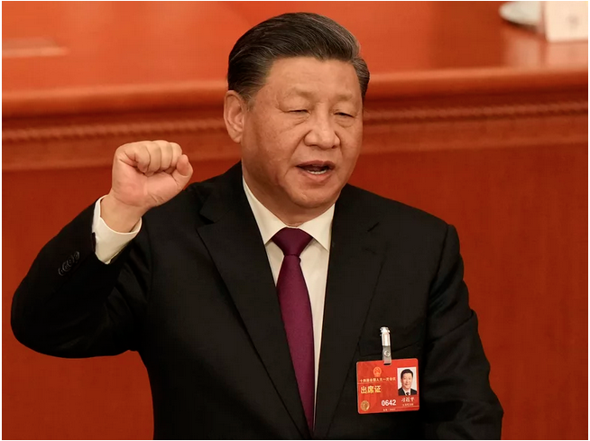
Innovation is the battleground
Technological innovation has become the main battleground of the global playing field.
Innovation is the soul of national progress.

Slide 4
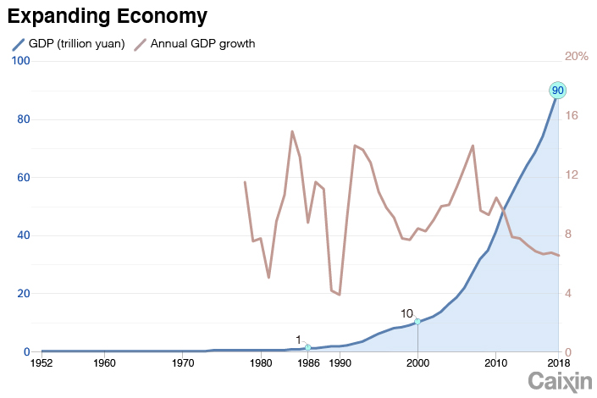


Long slow takeoff
Deng Era
(Reform and Opening)
WTO Entry
(Takeoff)
Mao Era
(No Growth))

Slide 5
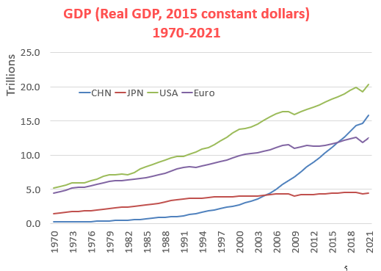
Most gains since 2001
GDP in constant dollars at exchange rates

Slide 6
China = U.S. + EU
Shares of global manufacturing value added
Source: “What It Would Take for Apple to Disentangle Itself from China,” Patrick McGee, Financial Times, January 18, 2023

Slide 7
Outline
China’s rise
  How did it happen?

Slide 8
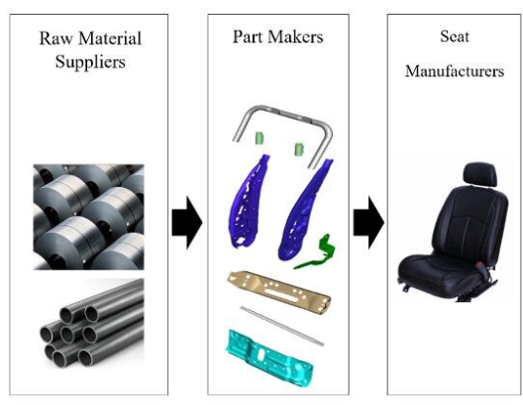
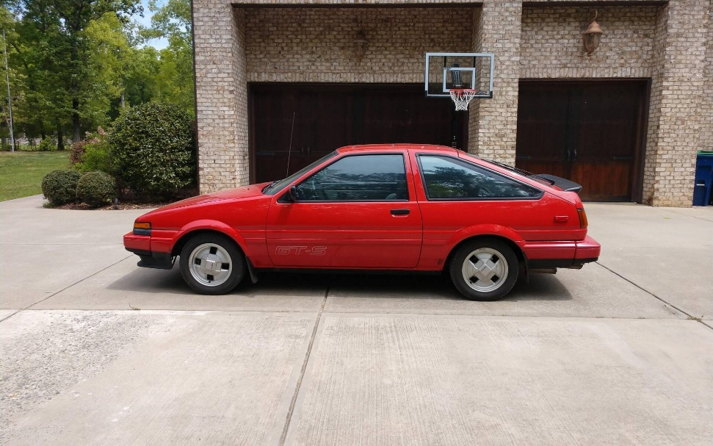
Fragmentation of production
Richard Baldwin
1985 Toyota Corolla
Car Seat Today

Slide 9
Put China’s growth on steroids
Japan & Korea produced whole products and kept foreign investment out
China took low-wage phases of many industries & got major help from Western companies

Slide 10
How did China dominate?
Whole-of-nation cost minimization and investment maximization
Takes global market shares at increasing technology levels from low-cost end
Redistributes manufacturing from others to itself

Slide 11
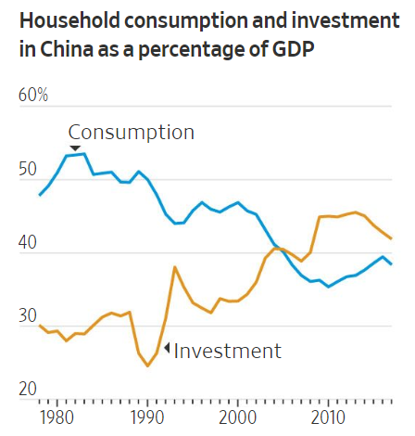
Consumption Down, Investment Up
Notes:
Source: Wall Street Journal, June 3, 2019

Slide 12
Technology strategy
At each stage take markets from others based on lower costs
Excels at process innovation linked to manufacturing
  With electro-industrial stack, has moved to cutting edge

Slide 13
Outline
China’s rise
  How did China do it?
  U.S. manufacturing & finance

Slide 14
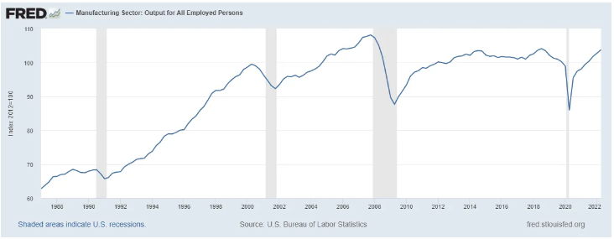
U.S. manufacturing output flat

Slide 15
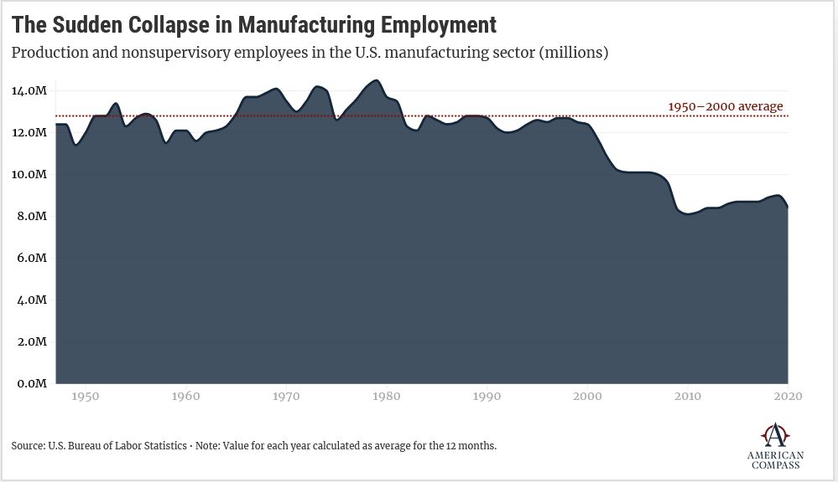
U.S. manufacturing jobs down

Slide 16
Financial short-termism hurts manufacturing
Shareholders more like renters than owners
Required rates of return of 15% mean investments have to pay back in 5 years or less
  Factories can’t do that
Companies can boost Return on Invested Capital by reducing investment or offshoring production

Slide 17
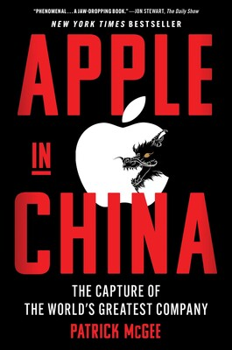
Even Mag 7 offshore production
Apple investment in China = twice the Marshall Plan
Built Chinese process knowledge & skills
  Leaked to BYD

Slide 18
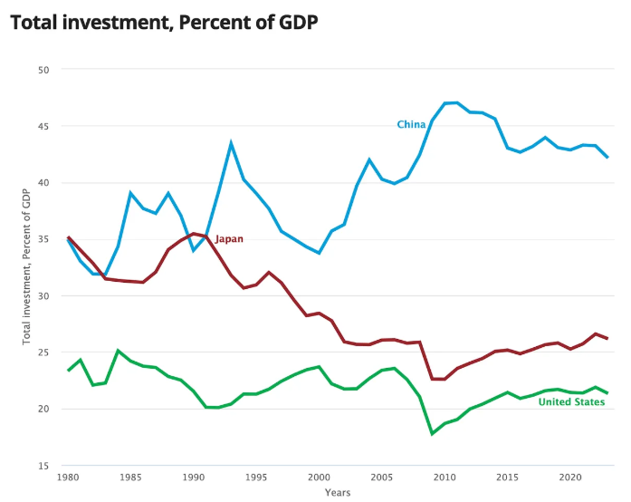
How different can you be?
Investment as percent of GDP

Slide 19
Asymmetric Racers on Different Tracks
China
U.S.
Low rates of return & high investment
One step behind technology linked to manufacturing
Manufacturing juggernaut helps defense
High rates of return & low investment
Cutting-edge innovation led by knowledge sectors
Weak manufacturing hurts defense

Slide 20
Outline
China’s rise
  How did China do it?
  U.S. manufacturing & finance
Is it changing?

Slide 21
China’s slowdown
Serious macroeconomic problems but continued technology advance
  EV’s & electro-industrial stack
Xi is committed to high investment & industries of the future

Slide 22

Second China shock is coming
David Autor
High tech + manufacturing
The next one will be worse

Slide 23
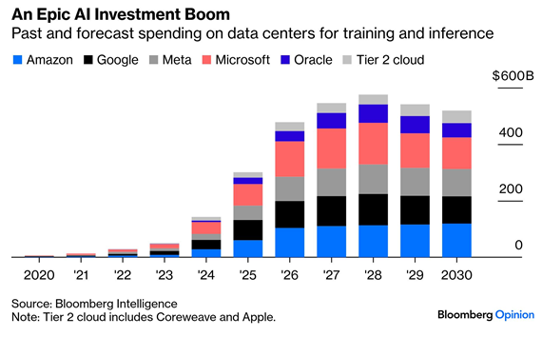
Will the Mag 7 save us?
Mag 7 investments in AI

Slide 24
What do you think?

Slide 25
Each may lead AI in different areas
U.S. leads in data centers & models
  70% of global AI compute; vs. China’s 10%
China may lead in applications of AI to industry
  Good enough AI & open models

Slide 26
Bonus Slides

Slide 27
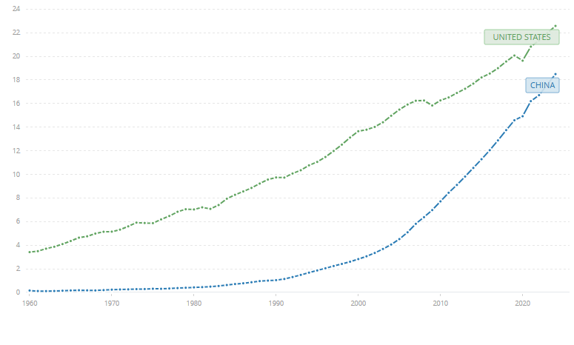
Most gains since 2001
GDP in constant dollars at exchange rate

Slide 28
Waves of global disruption
Clayton Christensen
United States
High End Demand
Japan
Quality
China
Korea, Taiwan, Singapore, Hong Kong
India
Low End Demand
Time

Slide 29
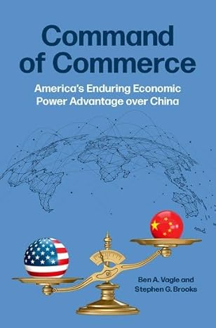
Economic impacts of an extended cut off
Taiwan war games show high risk of escalation
If allies join a trade embargo, China’s losses would be 5-11 times as high as America’s
  If only U.S., closer to equal
China would suffer lasting damage

Slide 30
Does not mean no conflict
Nations often go to war knowing high economic costs
  Japan in WWII, Putin in Ukraine

Slide 31
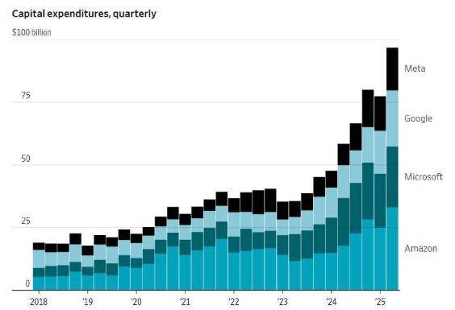
Is it the Mag 7 vs. China Inc.?
Mag 7 investments in AI

Slide 32
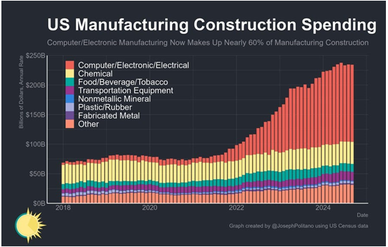
Is it Changing?
U.S. manufacturing construction up

Slide 33
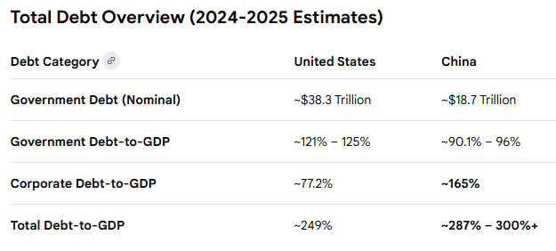
U.S. vs China total debt

Slide 34
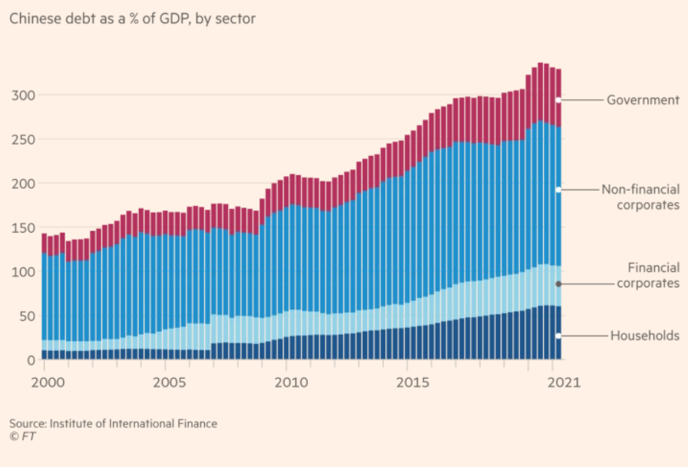
Rising debt
Source: Financial Times, January 6, 2022
Notes:
Source: Financial Times, January 6, 2022

Slide 35
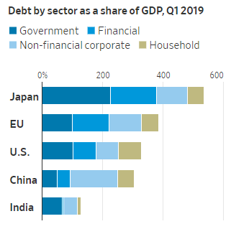
Comparative debt

Slide 36
Plays into China’s hands
When U.S. hurtle rates are high & China’s are low, manufacturing flows to China
We think the problem is China, but the problem is China + U.S. financial short-termism

Slide 37

Asymmetric Racers
We think it’s this
But is it this?
Asymmetric racers on different tracks

Slide 38
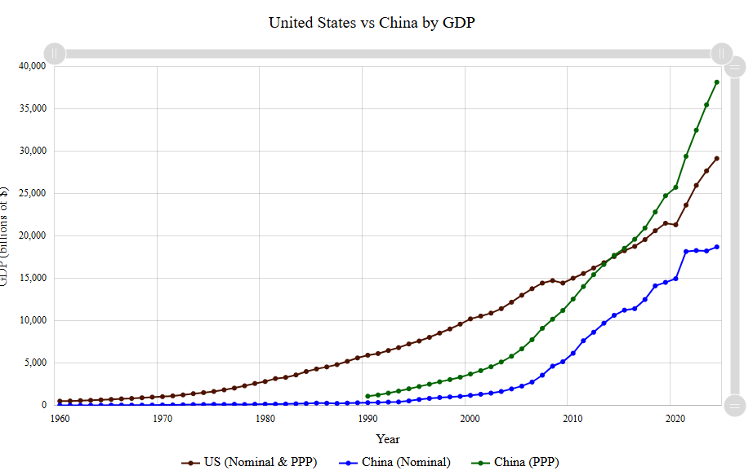
U.S.-China GDP at PPP
Purchasing power parity

Slide 39
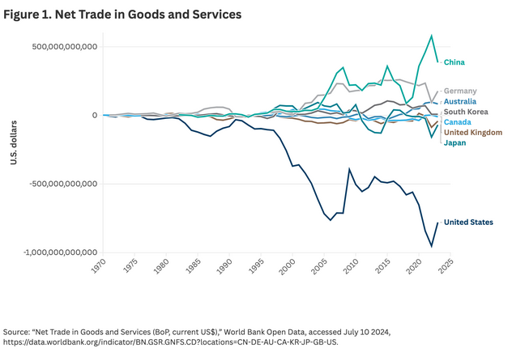
Global trade surpluses & deficits

Slide 40
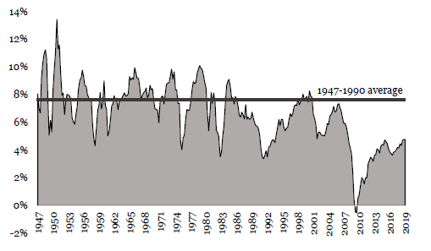
U.S. private investment down
Rubio
U.S. Net Private Domestic Investment as % of GDP (1947-2019)
Source: American Investment in the 21st Century, Senator Marco Rubio (2019)

Slide 41

USTR Jamieson Greer
Why We Remade the Global order
The U.S. has paid for the system with the loss of industrial jobs and economic security… the biggest winner has been China.

Slide 42
Future Strategy
Oren Cass: a hard break
Graham Allison: a productive partnership

Slide 43
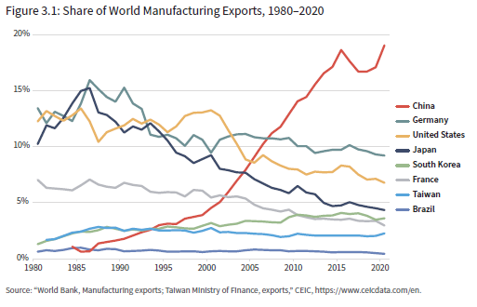
China dominates world manufacturing exports

Slide 44
Defense Prime Supply Chain

Slide 45
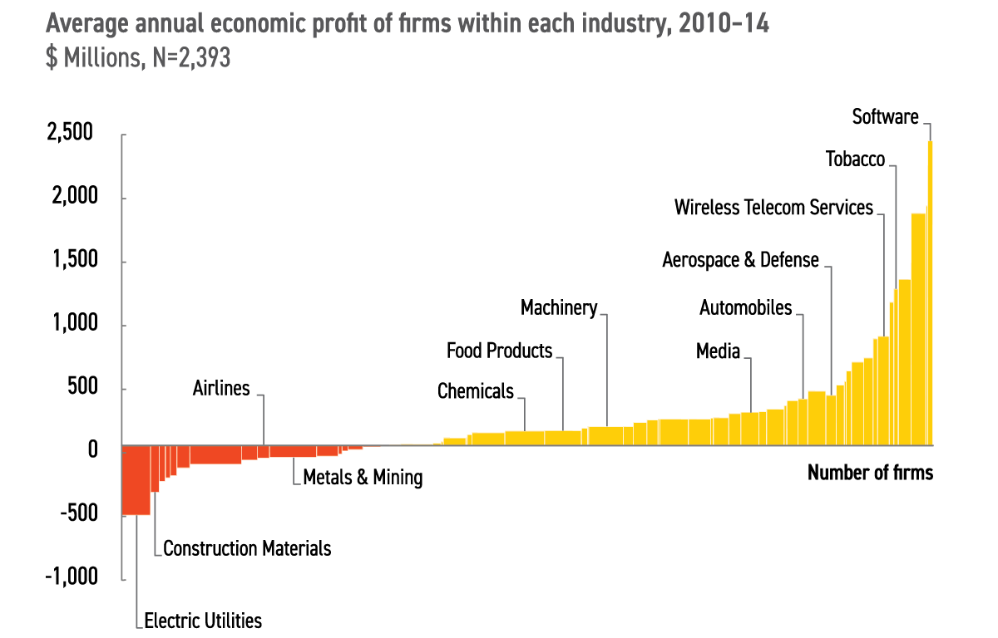
U.S. Power Curve Economy
Average profit by industry
Source: “Is Your Strategy Good Enough to Move You Up on the Power Curve?” Martin Hirt, McKinsey & Company (2018)

Slide 46

Treasury Secretary Scott Bessent
At the end of the day, the Administration can probably reach an agreement with Japan, Korea, Vietnam, & India. Then we can approach China as a group.

Slide 47

Oren Cass: one view
American Compass
Tariffs are necessary to restore U.S. manufacturing
U.S. has to force China to come to the negotiating table
U.S. goal should be a collective perimeter that excludes China.

Slide 48

Graham Allison: another view
Foreign Policy July 29, 2025
A great rebalancing that allows a productive partnership
“That dot is Taiwan; the desk is China.”

Slide 49
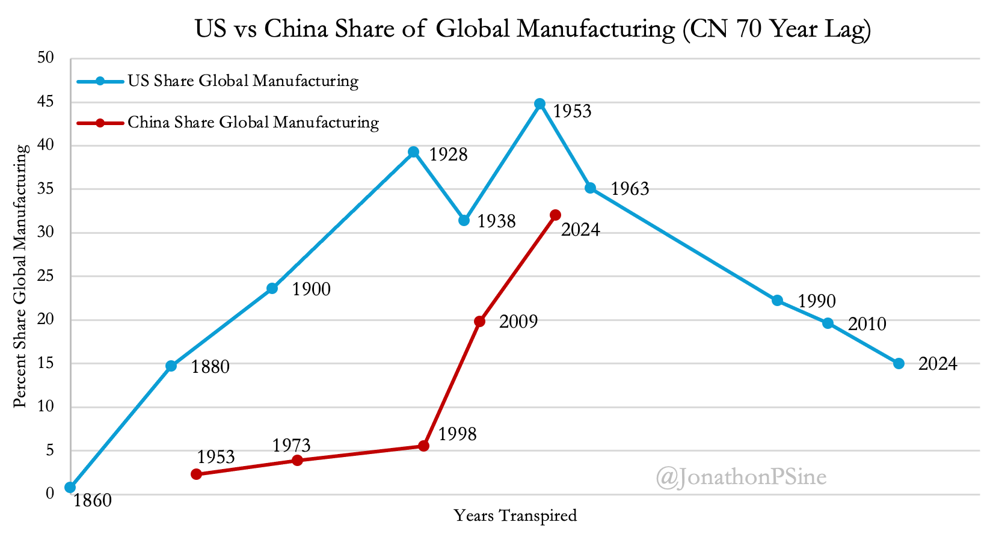
U.S. China Shares of Global Manufacturing

Slide 50
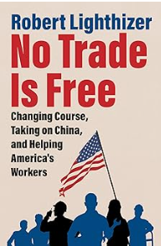
USTR Robert Lighthizer
First Trump Administration
Documented China’s abuses
Tried to get China to change

Slide 51
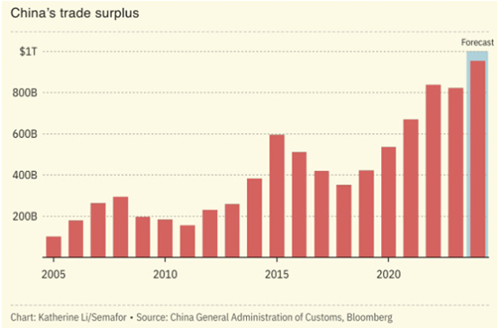
China’s trade surplus in goods

Slide 52
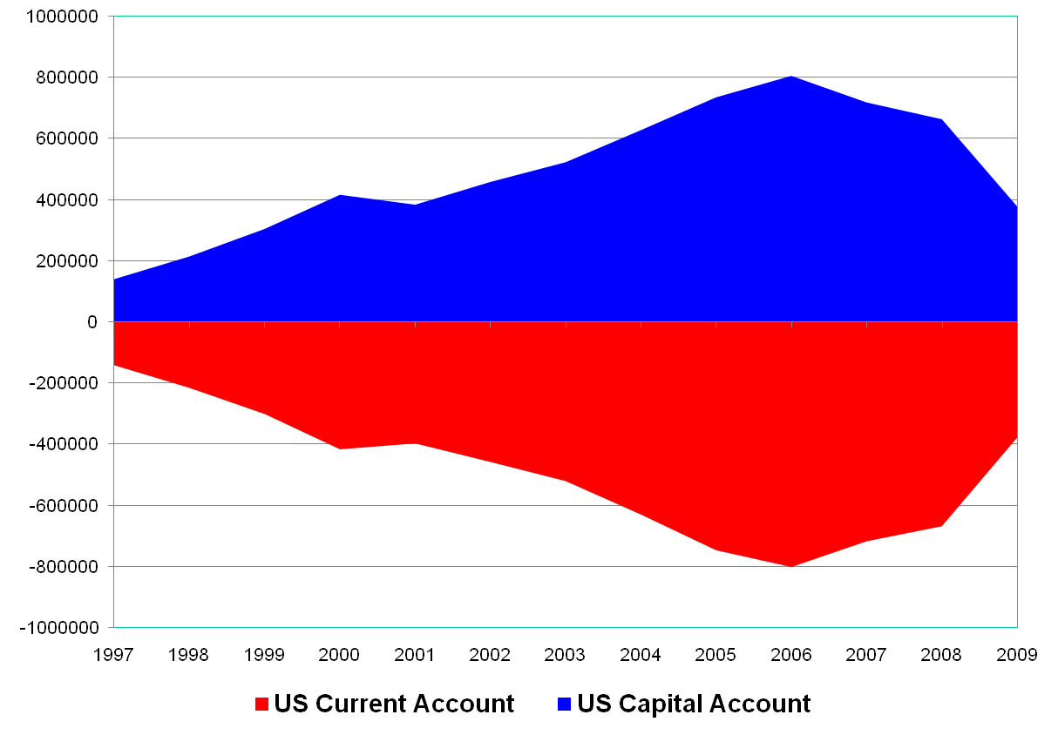
U.S. trade and capital flows
Capital inflows = trade outflows
FINANCIAL ACCOUNT
Foreign Capital Inflows
Capital flows
CURRENT ACCOUNT
Trade balance
=
US Financial Account
Notes:
51
Alejandro Justiniano, Georgio E. Primiceri, and Andrea Tambalotti, “The Effects of the Saving and Banking Glut on the U.S. Economy,” September 4, 2013
“…international imbalances are best understood through the lens of the balance between desired saving and investment … rather than through that of the balance between exports and imports … the main source of these imbalances since the late nineties were developments in the RoW [rest of the world], rather than in the U.S., and in particular the surge in desired saving in emerging Asia and the Middle East, looking for safe harbor in the United States.”

Slide 53
U.S. low percent of GDP in manufacturing
Share of GDP in manufacturing | Percent
China today | 28
U.S. today | 11
U.S. in 1970 | 23

Slide 54
Morris Chang
Founder of Taiwan Semiconductor Manufacturing Company
“The Americans like ratios, like RONA,.. Driving assets off the balance sheets drives the ratios up. I keep looking but, so far, I have not found a single bank that accepts deposits denominated in ratios. Banks only take currency. There is capital everywhere and it is cheap. So why are the Americans so afraid of using capital?

Slide 55
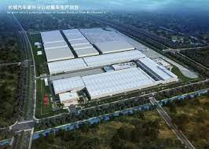
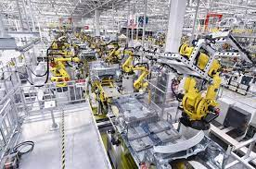
China’s EV juggernaut
Taizhou smart factory

Slide 56
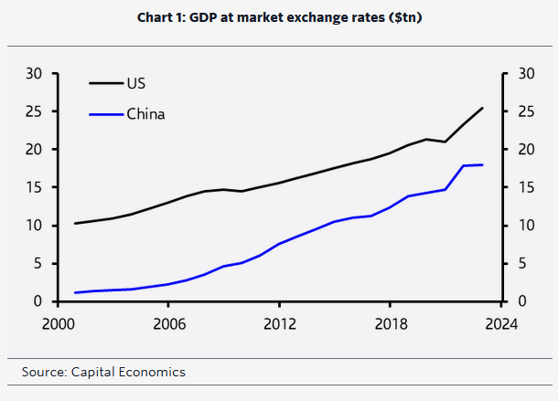
China’s rapid rise in GDP
Market exchange rates

Slide 57
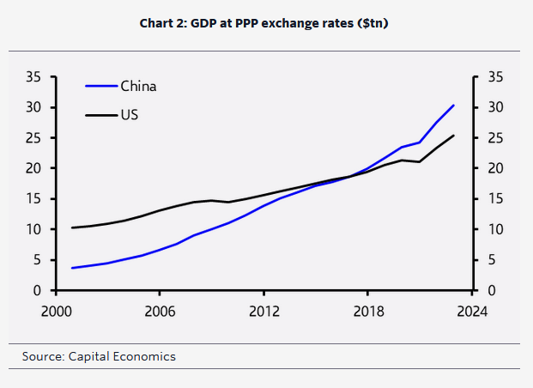
Largest GDP in PPP
Purchasing power parity

Slide 58
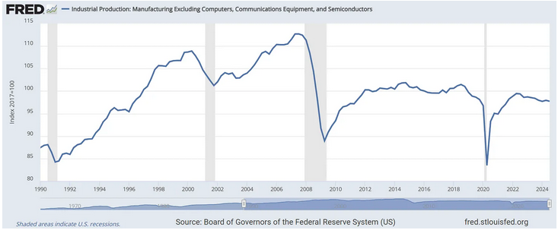
U.S. manufacturing output excluding computers & semiconductors

Slide 59
What does this mean for U.S. policy?
Policy Perspective
Three Perspectives
Three Priorities
Priority
National Security
NSRS
Economic
Perspective
Priority
Market
Efficiency
Priority
Shareholder
Value
Business
Perspective
Notes:
Market focus inefficiency
Economy efficiency
National security/conflict
Microprocessor/Chips discussion as an example…

Slide 60
China’s low consumption, high manufacturing
 | U.S. | China
Share of global GDP | 23% | 17%
Share of global consumption | 29% | 13%
Share of global manufacturing | 17% | 31%

Slide 61


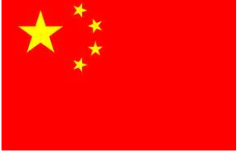
Super high investment
GDP = C + I + (X-M) + G
68%
16%
-3%
19%
38%
43%
+2%
17%
Notes:
Consumption 2013: 36.8%
(Wayne M. Morrison, “China-U.S. Trade Issues,” CRS RL33536, December 5, 2014)

Slide 62
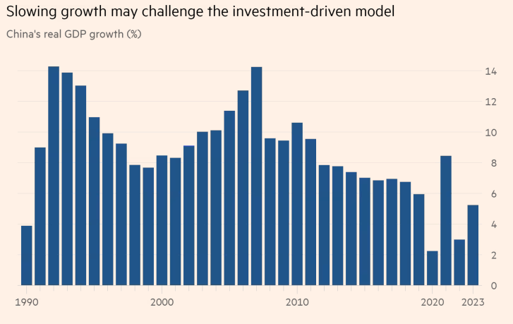
China’s slowing growth rates

Slide 63
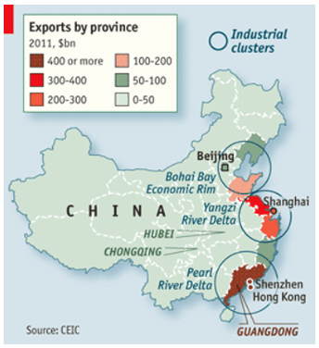
Coastal zones

Slide 64
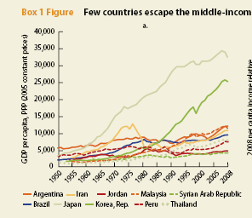
Japan & Korea broke out of middle-income trap
Notes:
Source: World Bank and Development Research Center of the State Council, People’s Republic of China, “China 2030,” February 27, 2012. http://www.worldbank.org/content/dam/Worldbank/document/China-2030-complete.pdf

Slide 65
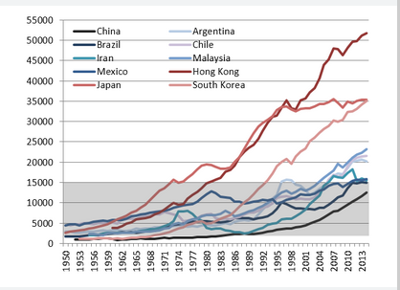
What if China does half of a Korea?

Slide 66
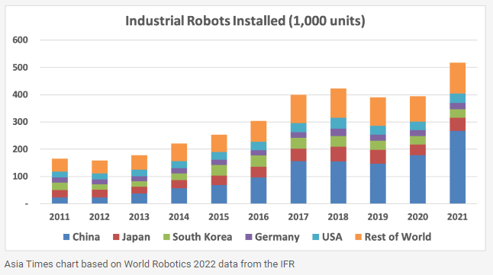
Robots: from minnow to whale in 10 years

Slide 67
No heed to ROE
Kentara Aikawa, Chairman of Mitsubishi Heavy Industry, 1998:
  “For some time, I have been asserting that the business practices of MHI puts more stress on employment than profits. We pay absolutely no heed to such concepts as ROE...
  That is why I publicly comment that MHI will not give its shareholders preference. If the stock has no appeal, the investors can sell it off straight away, but our employees do not have such freedom of choice.”

Slide 68
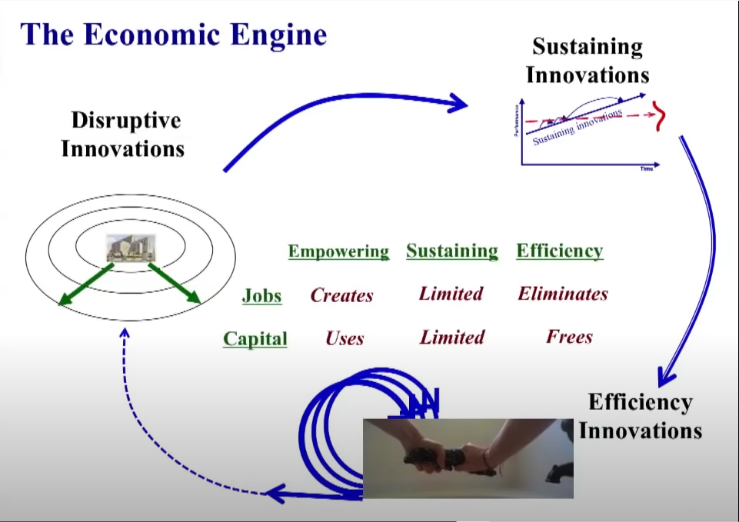
How short-termism fails to invest in market creating & factories
Performance-Improving
Market-Creating
Market
Creating
Performance
Improving
Efficiency

Slide 69
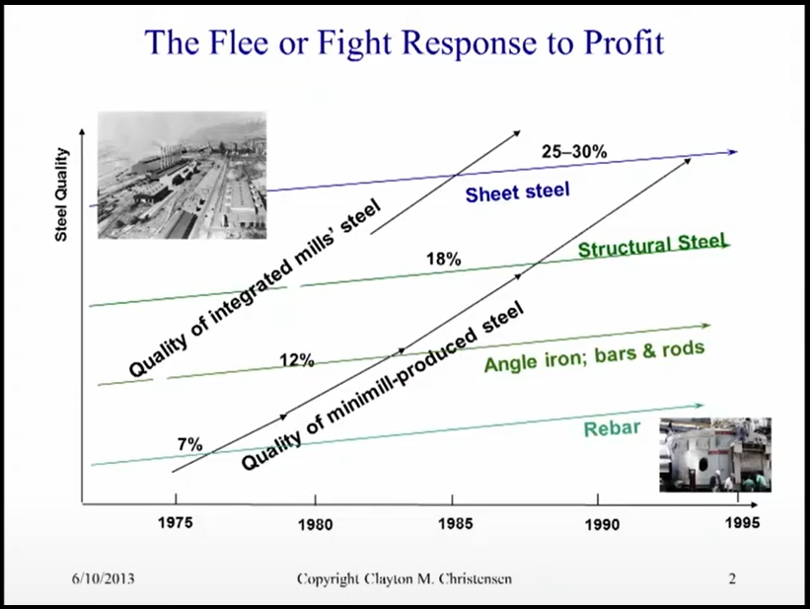
Eating markets from below
Nucor Steel (Clay Christensen)

