Slide 1
Contemporary Strategic
Deterrence Challenges
-- Some Thoughts for Leaders and Practitioners --
Paul Bernstein
Expert Consultant
Center for the Study of
Deterrence and WMD
National Defense University
CAPSTONE 26-2
FEBRUARY 2026

Slide 2
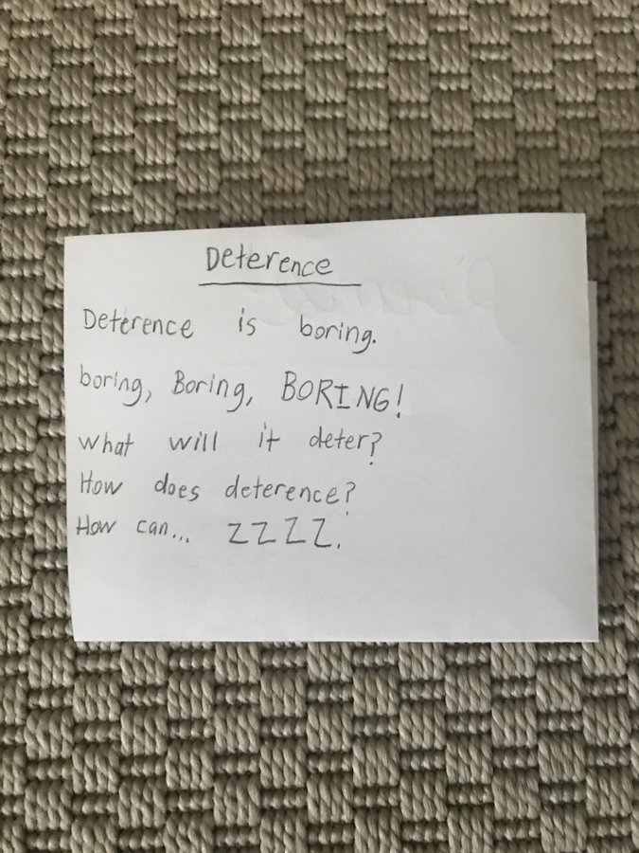
A Foundational Thought

Slide 3
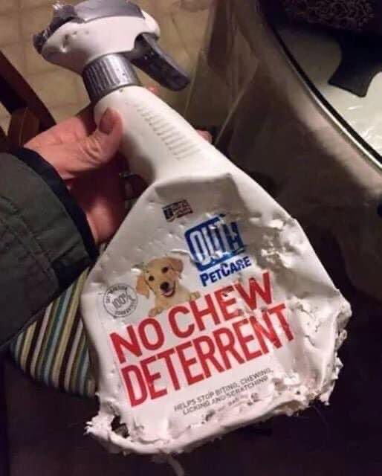
Another Foundational Thought

Slide 4
What We Talk About When We Talk About Deterrence
Temporal
General – Immediate – Intra-war
Object
Tailored – Extended – Trilateral
Capabilities
Conv – Nuc – Cyber – Space – Integrated

Slide 5
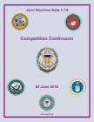
What We Talk About When We Talk About Deterrence
Temporal
General – Immediate – Intra-war
Tailored – Extended
Capabilities
Conv – Nuc – Cyber – Space – Integrated
“…deterrence must be thought of over extended periods of time. The joint force seeks to deter a conventional attack against a partner or ally, but even if that occurs, it is still possible to deter the attacker from expanding the war geographically or from using certain forms of weapons (such as WMD). Moreover, if deterrence fails because an adversary miscalculates US will or capability, but is then decisively defeated, the one ‘failure’ of deterrence might deter future adversaries from taking similar risks.” Competition Continuum (2019)

Slide 6
Central Idea
Deterrence operates in the cognitive domain and is essentially an influence operation directed at an adversary’s decision making
Adversary decision calculus shaped by perception of three key factors
  The benefits of a COA
  The costs of a COA
  The consequences of restraint
We seek to shape these perceptions by demonstrating resolve and capability through words and actions

Slide 7
Adversary Calculus
Costs of Action | Benefits of Action
Benefits of Restraint | Costs of Restraint
Blue seeks to increase
Blue seeks to reduce

Slide 8
Adversary Calculus
deterrence by cost imposition
deterrence by denial
Costs of Action | Benefits of Action
Benefits of Restraint | Costs of Restraint ?
inducements
Blue seeks to increase
Blue seeks to reduce
Capabilities -- Credibility -- Communication

Slide 9
Adversary Calculus
deterrence by cost imposition
deterrence by denial
Costs of Action | Benefits of Action
Benefits of Restraint | Costs of Restraint ?
inducements
Blue seeks to increase
Blue seeks to reduce
Capabilities -- Credibility -- Communication
Comprehension (“Strategic Diagnosis”)

Slide 10
Deterrence in Specific Context
Deter Actor X
From Taking Action Y
In Circumstance Z

Slide 11


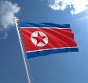



What’s Hard About This Today?
    Multiple adversaries – tailored strategies required
    Incomplete knowledge – intel challenge and irreducible uncertainties
    Asymmetry of stakes – can challenge credibility
    More complex operating environment – shaping firebreaks / thresholds
    Deterrence messaging – in today’s infosphere?
    Deciding what is intolerable – not always easy
    Difficult to practice and rehearse – and therefore to prepare leaders
    There is deterrence impact in virtually everything we do – or don’t do

Slide 12
Integrated Deterrence (my take)
More / better
  Whole of government / nation
  DoD integrated planning + multi-domain approaches
  Collaboration with allies and partners
Underlying drivers also reflect hard power limits
  Gray Zone
  China
  Budget
Mix of denial (defense + resilience) and cost imposition (direct + indirect)

Slide 13
Hard and Soft Power
To what degree can the threat of
non-military costs shape an
adversary’s perception of risk
and his decision calculus?
      > in crisis?
      > once conflict is underway?

Slide 14
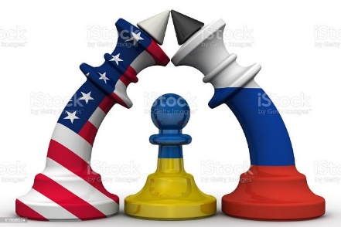
“Integrated Deterrence” and Russia’s Special Military Operation
Multiple instruments of national power
Mobilization of allies/partners
Inducements
Denial
Cost imposition
“I don’t think there is any doubt that the model of integrated deterrence comes out smelling pretty good here.” Un-named senior defense official
???

Slide 15


“Integrated Deterrence” and Russia’s Special Military Operation
Multiple instruments of national power
Mobilization of allies/partners
Inducements
Denial
Cost imposition
“I don’t think there is any doubt that the model of integrated deterrence comes out smelling pretty good here.” Un-named senior defense official
???
Deter Aggression
Restore Deterrence
Deter Wider Conflict

Slide 16
Deterring Russian Tactical Nuclear Use?
US SECDEF AUSTIN TO RUSSIAN DEFMIN SHOIGU (TELCON)
THERE IS NO NUCLEAR PATHWAY TO ADVANTAGE OR VICTORY
RUSSIA WILL NOT BE ABLE TO CONTROL THE ESCALATION OF NUCLEAR CONFLICT
RUSSIA CANNOT PREDICT THE INTERNATIONAL RESPONSE TO ITS USE OF NUCLEAR WEAPONS
THE UNITED STATES WILL CEASE ACTING WITH RESTRAINT IF RUSSIA EMPLOYS NUCLEAR WEAPONS OF ANY KIND ON ANY SCALE
THE US STAKE WILL CHANGE IF RUSSIAN EMPLOYS NUCLEAR WEAPONS….THE US STAKE IN NUCLEAR SECURITY IS HIGHER THAN ITS STAKE IN THE OUTCOME OF THE CONFLICT….DO NOT ASSUME THE US IS UNWILLING TO TAKE RISKS
THE US WILL WORK TO ISOLATE RUSSIA AND MAKE IT A GLOBAL PARIAH….THE COSTS TO RUSSIA WILL BE HIGH
IF RUSSIA DOES NOT ESCALATE, NEITHER WILL THE UNITED STATES

Slide 17
Why Nuclear Deterrence is Getting More Complicated
Adversary regional nuclear doctrines
China’s nuclear breakout and the ”three body problem”
The end of the current regulatory regime
US modernization challenges
Uncertain implications of new technology
Strains in allied relationships
What adjustments to US policy, forces, posture and plans are needed?

Slide 18
Nuclear Deterrence Challenges
The “central deterrence” problem
  China’s nuclear expansion – what intent? what capabilities? what strategy and doctrine?
  Sufficiency of current US strategy and planned forces – beyond current modernization programs?
The regional deterrence problem
  Coercive nuclear threats to shield local aggression – like Russia in Ukraine
  Deterring limited nuclear use in regional wars – with what postures and capabilities?
The technology – stability problem
  Deterring non-nuclear strategic attacks – which ones?
  Understanding new escalation pathways – how to maintain crisis stability?
The ally assurance problem
  New threat dynamics – are existing extended deterrence arrangements fit for purpose?
  New political dynamics – such as “burden-shifting” and trade tensions

Slide 19
“Restore Deterrence” – One Interpretation
US has been slow to adapt to great power competition and technology advances, degrading our position
  unfavorable balances of military power in key regions
  political inroads by competitors
  weakened defense industrial base
  cooperation among rivals
Perception that US coercive power has weakened
  reluctance to confront hostile behavior, impose serious costs, use force
Others have not reciprocated US restraint, efforts to sustain strategic stability – “new nuclear era” carries significant risk
The homeland is vulnerable in new ways
Other?

Slide 20
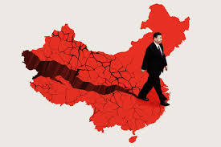
Deterring China
SecDef Dec 2025: “…be postured strongly enough to balance China’s growing power...ensuring none of our allies are vulnerable to sustained, successful military aggression…ensuring they do not have the ability to dominate us or our allies…It is our job to make sure that Beijing sees unquestionable US military strength…We insist that China respect our long-standing interests in the Indo-Pacific.”
USDP Jan 2026: “Our defense strategy in the Indo-Pacific centers on deterrence by denial along the First Island Chain…We are focused on building a military posture that ensures that aggression along the FIC is infeasible, that escalation is unattractive, and that war is indeed irrational. This includes a resilient, distributed and modernized force across Japan, the Philippines, the Korean peninsula, and elsewhere in the region, a posture optimized for a denial of quick decisive gains through military force, that is resilient rather than fragile..."

Slide 21
China’s Strategic Deterrence Option?
Threaten high risks to the homeland to delay or deter US action
Test the limits of US resolve to defend Taiwan through a mix of nuclear, non-nuclear space, cyber and info tools, e.g.,
  nuclear signaling
  conventional long-range missiles (e.g., CICBM, FOBS)
  major cyber attacks vs critical infrastructure
  operations vs US space architecture
China may believe it is well-positioned to deter the US this way
  nuclear expansion + lessons from UKR
  perception of US decline
  asymmetry of stakes

Slide 22
Deterring China – Present and Future
2025
How to convince China that it cannot win a warfight at acceptable cost with the US even over something it feels is a core interest?
General Deterrence……Immediate Deterrence
DETER A LOCAL
FAIT ACCOMPLI
BY A
REGIONAL
POWER
All sides may refer to “limited objectives” – but capabilities, doctrine, and political stakes carry significant escalation potential Intra-War Deterrence
2030
2040

Slide 23
Deterring China – Present and Future
2025
How to convince China that it cannot win a warfight at acceptable cost with the US even over something it feels is a core interest?
General Deterrence……Immediate Deterrence
DETER A LOCAL
FAIT ACCOMPLI
BY A
REGIONAL
POWER
All sides may refer to “limited objectives” – but capabilities, doctrine, and political stakes carry significant escalation potential Intra-War Deterrence
2030
What’s most important about deterring China?
- its perception of US resolve?
- its perception of US capabilities?
2040

Slide 24
Deterring China – Present and Future
2025
How to convince China that it cannot win a warfight at acceptable cost with the US even over something it feels is a core interest
General Deterrence……Immediate Deterrence
DETER A LOCAL
FAIT ACCOMPLI BY A
REGIONAL POWER
All sides may refer to “limited objectives” – but capabilities, doctrine, and political stakes carry significant escalation potential. Intra-War Deterrence
2030
Mature space / nuclear / cyber power
Extra-regional power projector
DETER A GLOBAL
MULTI-DOMAIN
PEER
“China has a broad concept of strategic deterrence, one in which a multidimensional set of military and non-military capabilities combine to constitute the “integrated strategic deterrence” posture required to protect Chinese interests….Powerful military capabilities of several types – nuclear, conventional, space and cyber – are all essential components….non-military aspects of national power also contribute…”
2040

Slide 25
“The Other War in Europe” --
Can You Deter Grey Zone Conflict?
Infowar, sabotage, arson, drone incursions, cyberattacks, election interference, assassination….
A coercive strategy targeting morale, political will, social cohesion, trust in government….
  Non-kinetic
  Many discrete actions over time
  Hard to identify redlines and convey risk/cost to adversary
Conventional wisdom emphasizes other approaches – hardening, active defense, resistance, competition

Slide 26
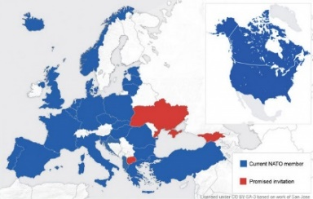
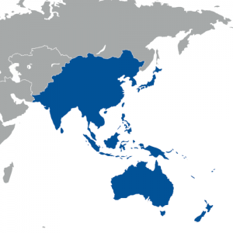
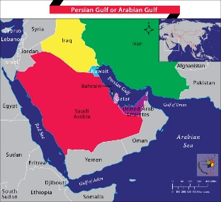
Extended Deterrence
Common purpose – but no single model
  NATO: deep institutional structure, forward-based nukes
    How well-suited to new challenges, extended period of tension?
  East Asia: bilateral treaties, simpler consultation, OTH nuclear capabilities
    How to adapt in response to NK advances – and the China challenge?
  Middle East: mature security relationships, but looser guarantees – and changing dynamics
    What might extended deterrence look like – and are we moving toward it?
Should the U.S. run these risks and bear these costs?

Slide 27
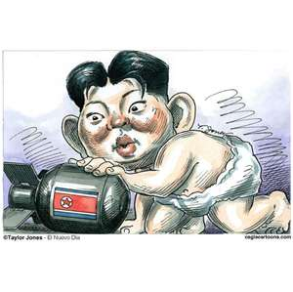
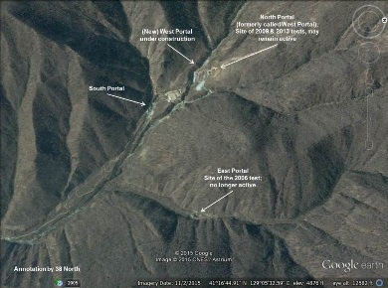
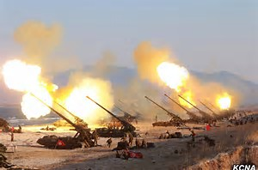
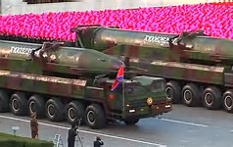
Deterring North Korea
How is deterrence affected as NK nuclear capabilities expand?
- credibly hold the US homeland at risk
- attempt to decouple alliances
- tactical nuclear weapons?
How do we wage a decisive conventional campaign that does not trigger nK nuclear use?
- their incentives could be high
How do we respond to nK limited nuclear use?
    - no ”cookbook” answer

Slide 28
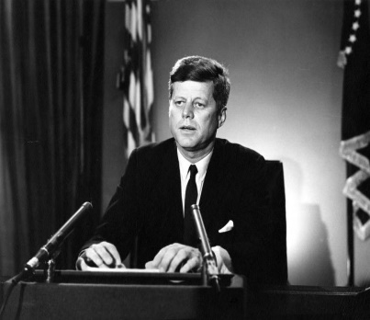
And above all, while defending our own vital interests, nuclear powers must avert those confrontations which bring an adversary to a choice of either a humiliating retreat or a nuclear war. To adopt that kind of course in the nuclear age would be evidence only of the bankruptcy of our policy – or of a collective death-wish for the world.
John. F. Kennedy

Slide 29
Can Terrorists or VEOs Be Deterred from Using WMD?
Sure – every actor weighs costs, risks and benefits, and these can be influenced
No way – our VEO adversaries are undeterrable, so “possession = use”
Maybe – it depends on the circumstances

Slide 30
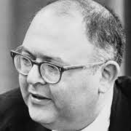
Last thought….
Deterrence is not a pre-eminent value; the primary values are safety and morality
Herman Kahn

Slide 31

Closing Haiku
Next year this
class will be taught
by a chatbot

Slide 32
A Resource for You
Paul Bernstein
pbernstein83@gmail.com

Slide 33


Slide 34
BACKUPS

Slide 35



The Old Problem and the New
Conv War w/Rapid Nuclear Escalation
InadvertentNuclear War
THEN
Surprise Attack
NOW
Multi-Domain Calibrated Escalation
Gray Zone/ Hybrid
InadvertentNuclear War
Non-Nuc
Strategic
Limited
Nuclear
Notes:
Old problem was largely a conv-nuc , US-Soviet dynamic. Early cold war fear – bolt out of blue nuc or big conv attack in Europe leading to rapid nuc escalation. Inadvertent war via rogue actors or false warning
New: multi-phase, multi-domain, multi-actor dynamic. No longer worry much surprise nuclear attack but do worry about the opposite end of the spectrum – gray zone and how deterrence applies there, if at all. Still worry about unintended nuclear use but concerns now focused on degraded C2 due to cyber attacks, or inadvertent escalation because conv and nuc forces and C2 are commingled, or the advent of AI that could reduce human agency in strategic decision making
The middle problem….the same but different. Still an escalation problem but more complex today for the reasons we were just talking about. Below the nuclear threshold through non-nuclear strategic capabilities that can be very coercive and damaging, and just above the nuclear threshold through capabilities and doctrines for the limited use of nuclear weapons. Russia the most clear embodiment of this type of approach but we think China is moving in this direction as well.
The final wrinkle here…

Slide 36
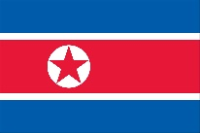
The Old Problem and the New
Conv War w/Rapid Nuclear Escalation
THEN
InadvertentNuclear War
Surprise Attack
NOW
Multi-Domain Calibrated Escalation
Gray Zone/ Hybrid
InadvertentNuclear War
Non-Nuc
Strategic
Limited
Nuclear
Notes:
The new wrinkle is that there is now a rogue state that is part of this new problem set. China is the much bigger and more consequential new player, but North Korea presents its own deterrence dilemmas. Talk about that a little later, time permitting.
We have folks from the region.

Slide 37
Biden finds limits to America’s deterrent powers WashPo 8 July 2021
“Not quite 170 days into his term, President Biden has come up against limits to his powers to deter foreign actors — specifically Iran-backed militias and Russia-based hackers — from targeting American interests.”
“What he does about both problems in the coming days, weeks and months — whether he escalates the U.S. response or opts to stay the course — could reshape relations with a regional power eager to expand its influence and a “great power” rival often looking to undermine Washington.
“Biden’s approach could also affect relations with other players on the world stage, like China and North Korea, which whom the United States has tense relations.
“The president’s public responses — military retaliation in Iraq and Syria; warnings to Moscow that it must act to rein in hackers on its territory — have not seemed to deter attacks on either front.”
Notes:
Let me just widen the aperture a little beyond influence ops and pol warfare narrowly defined to pick up some specific problems we’re wrestling with in real time. We’re talking here about real attacks by known bad actors, but we’re still in a bit of a gray area because they are proxy actors and some of these attacks are not kinetic but cyber.
WashPo commentary last summer-- looking at ransomware attacks coming out of RF and attacks on US personnel by militias supporting Iran, we appear to be failing in our goal of deterring such attacks.
Do you agree? And if so, how to restore or strengthen deterrence – on both the cyber piece and the Iran piece?

Slide 38
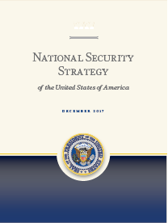
2017 National Security Strategy
“….Deterrence today is significantly more complex to achieve than during the Cold War. Adversaries studied the American way of war and began investing in capabilities that targeted our strengths and sought to exploit perceived weaknesses. The spread of accurate and inexpensive weapons and the use of cyber tools have allowed state and non-state competitors to harm the United States across various domains. Such capabilities contest what was recently U.S. dominance across the land, air, maritime, space, and cyberspace domains. They also enable adversaries to attempt strategic attacks against the United States – without resorting to nuclear weapons – in ways that could cripple our economy and our ability to deploy military forces. Deterrence must be extended across all these domains and must address all possible strategic attacks.”
Notes:
The 2017 NSS recognized this…most direct statement about deterrence in last admin’s strat docs. Articulates the point about the complexity of the environment for operations and strategic decisionmaking and the need to deter in and across many domains of competition, capabilities, or conflict. It was good to see this in a high level strategy document but of course it’s a statement of a complicated problem and the directive in that last sentence is a tall order and a big agenda that demands some hard effort.
2018 NDS – does not make statements like this or address deterrence in this way. It talks about the need to compete harder to deter better but does not put forth any particular vision or concept for deterrence.

Slide 39
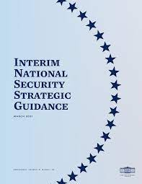
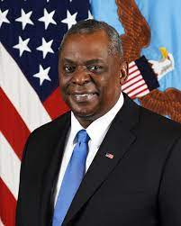
The Next NSS and NDS?
        Opinion: The Pentagon must prepare for a much bigger theater of war – WashPo 5 May 2021
        “integrated deterrence” – existing and new capabilities used in new and networked ways
        tailored cross domain concepts to deter and gain advantage across the spectrum of conflict
Recognizes complexity and challenges
of the security environment, but no
critical assessment or vision of
deterrence analogous to 2017 NSS
Notes:
The Interim National Security Strategy Guidance came out in March I believe and really does not offer anything like what we saw a couple of minutes ago from the 2017 NSS. New NSS has been drafted for a while and was supposed to be out a while ago but is held up, is suspect by what is happening in Ukraine. And until it’s issued we’re not going to see the NDS or the NPR or the MDR.
When the NDS does come out, I’m guessing in March, you’ll see that this idea of integrated deterrence you’ve been hearing about will be one of the central pillars of the strategy. You can see what the Secretary was starting to articulate last year. Pretty general…now fleshed out

Slide 40
The Big Deterrence Matrix (work in progress)
 | Political Warfare/ Gray Zone/ Hybrid | Local Fait Accompli | Escalating Conflict (Non-Nuc Strategic + Limited Nuc) | Chem or Bio | Strategic-Scale Cyber Attacks | Strategic Nuclear War (Bilateral / Trilateral) | Extended Deterrence
Great Powers
Rogue States
VEOs
Allies
Notes:
Work in progress, not complete or right yet but my effort to plot the problem space and ask if and how deterrence works in these cells. And asking those questions reminds us that in the end, we are trying to deter specific actors from doing specific things in particular circumstances, across a pretty broad set of possible circumstances – and of course allies are key in many cases. Indeed if we find ourselves in a regional war, it’s almost certain we’re there because we are somehow defending an ally.
Also a pretty broad set of functional challenges embedded here -- from influence ops to cyber to chem-bio, to advance precision strike to nuclear at a couple of different levels.
This would be a roadmap for a 3 hour briefing but I’ll only touch on a few of these with the time we have, moving across the top axis.

Slide 41
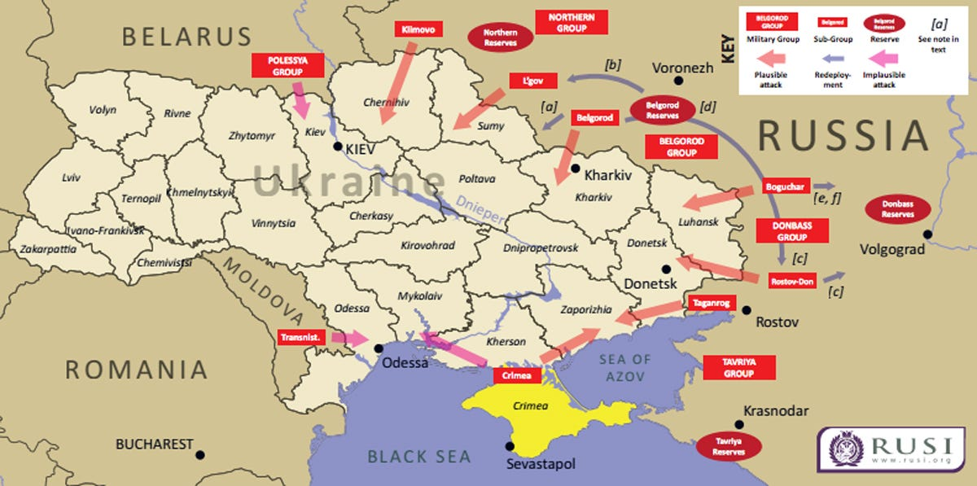
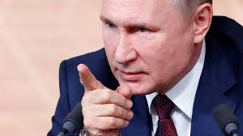
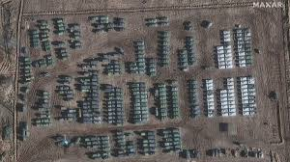
7 Months Later….
What’s our deterrence strategy?
Is it “integrated?”
Will it work?
Notes:
No longer talking about deterring hostile actions below the threshold of armed conflict.
Now talking about deterring a major military action against another sovereign nation whose security is an interest of ours – though not an interest we would go to war over.
Go back to our conceptual model of deterrence
what’s the deterrence by denial piece? How robust/dissuasive?
what’s the deterrence by cost imposition piece? More substantial.
what’s the benefit of restraint/inducement piece? Other items we’re willing to talk about + reputational risk. (INF, BMD, missiles) + off ramp
how does asymmetry of stakes play? LIM FAC. If any ally, much more denial
What’s the integrated deterrence mix on the table (based on what we’re hearing)
Tools: economic, military, pol-dip (interagency)
Mechanisms: denial (mil equip to UKR) + cost imp (sanctions + NATO mil presence expands + reputational/pol/dip) + inducement
W/allies: good so far re NATO unity/cohesion
Colleagues working in NATO: GEN Annibale, GEN Wasmund

Slide 42
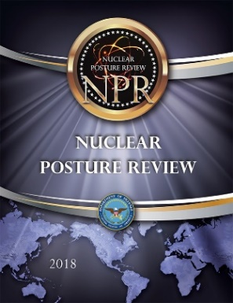
Nuclear Deterrence Challenges
Meta-issue: How do we balance goals of “reduced reliance” and “safe, secure, effective nuclear deterrent” in the emerging security environment?
  Declaratory Policy – circumstances of nuclear use
  Force modernization – scope and pace
  Deter limited nuclear use – required capabilities
  “Substitution” – non-nuclear for nuclear
“Pivot” issues
  China’s nuclear expansion – two nuclear peers and trilateral deterrence in the next decade
  Nuclear / non-nuclear interactions -- new risks and escalation pathways
2018
NPR
2022
Notes:
The meta issue for nuclear deterrence today is defined by POTUS guidance to look for ways to reduce reliance on NW rubbing up against what we’re seeing in the world -- what you might characterize as a nuclear security environment that continues to deteriorate. I would say this is the CENTRAL TENSION that NPR has been dealing with. And it’s playing out across the 4 issues I’ve listed here. 1. Do we move toward NFU/SP or do we retain some calculated ambiguity in our posture? 2. Do we move forward with full scope nuclear force mod or can we forego a next generation ICBM? 3. What kinds of regional and low yield nuc forces do we need to deter limited nuclear escalation by an adversary in a conv war? 4. Can we use offensive cyber/space or hypersonics to substitute for NW as a deterrent? TENTATIVE ANSWERS PIB 1. Retain ambiguity but raise the bar a little on circumstances of use. 2. Press on w/MOD; no serious argument not to field new ICBM 3. Need some capability but no as much as the 2018 NPR said we needed. 4. Can’t really substitute today, maybe future.
GEN RAFFERTY – how good will we get with long range conv precision strike?
Those are the hot button issues and lots of discussion and debate. The pivot issues are the ones that frame future deterrence challenges but which today are still forming. Just talked China -- CENTRAL NEW FACT facing the strategic deterrence community since 2018. But questions about end state capability/strategy and strategic intentions -- maybe they don’t fully know yet. So hard to figure out what impact all that has today on nuclear strategy and forces? When no longer a lesser included case? A/C w/RF? Hedging strategy for breakout? Work on this going forward.
Second pivot issue is one we’ve already talked about a little. How are so-called new domain capabilities likely to interact with NW/nuc deterrence in a crisis or conflict and are there new escalation pathways and risks for miscalculation in those interactions? Don’t know enuf today

Slide 43
Nuclear Deterrence Challenges
How does China’s nuclear expansion influence strategy, forces, and policy?
How do we deter escalation in a regional conflict over limited objectives with a nuclear-armed adversary?
Can we safely reduce reliance on nuclear weapons in our deterrence strategy given the security environment? Can non-nuclear means substitute?
How much ambiguity in our declaratory policy should we retain regarding the potential circumstances of nuclear use?
What does all this mean for nuclear modernization?
Notes:
A couple of different columns of the matrix. NPR.
China – CENTRAL NEW FACT. Looking at what appears to be a trajectory of significant expansion over time – say 15 yrs or so, but uncertainty about endstates and strategic intent. A CENTRAL UNCERTAINTY, which forces us to ask: what does that mean for the nuclear policy we’re writing today? Do we need to being hedging now if China in the future is no longer a lesser included case? Are we constrained in what we might do with RF in arms control? Monitor….but be prepared to act in time.
The problem of limited nuc war – a big issue in rhe 2018 NPR which directed the development and fielding of new low yield nuclear weapons to strengthen deterrence of limited war scenarios. This idea/logic not as accepted among pol appointees in DoD and WH. So those capabilities are on the table.
POTUS has said he wants to reduce reliance on nuc weapons – the INSSG says that. But how do you that safely given what we’re seeing in the threat environment. CENTRAL TENSION. And, how do we assess the ability of non-nuclear systems -- kinetic and non-kinetic, to do the things we have traditionally relied on NW to do? ANOTHER CENTRAL UNCERTAINTY
POTUS has also spoken favorably about removing or reducing the ambiguity in US declaratory policy regarding the circumstances under which we might consider the use of nuclear weapons. Is that wise policy – and how would allies and adversaries react? And what does all that mean for the full scope nuclear force modernization underway? Do we need it all? Is the cost justified? CENTRAL PTS OF CONTENTION

Slide 44
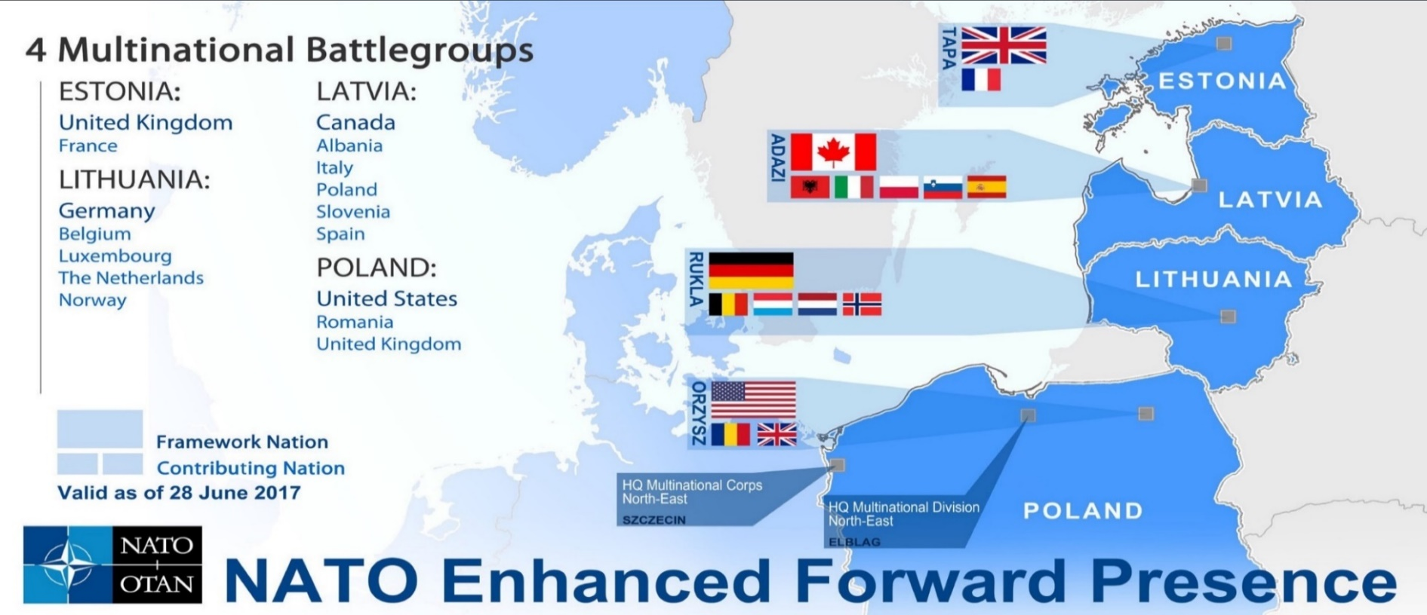
Shoring Up Deterrence Post-Ukraine 2014
    Expanded NATO Response Force
    Expanded Baltic Air Policing
    New Very High Readiness Joint Task Force
    NATO Readiness Initiative
    Enhanced Forward Presence in the East and the Black Sea region
    US armored brigade to PO
    Multinational land brigade in RO
    Adapted Command Structure
    Rapid Air Mobility initiative
    Joint Air Power Strategy
    NATO Space Policy
    New Commands
Notes:
2nd column matrix. Spend a moment on the fait accompli because it seems to be a dominant focus our deterrence thinking today wrt GPC – so RF/CH.
Big muscle movements by NATO since UKR/CRI 2014 -- by NATO standards, sprint to achieve a lot on the ground to strengthen deterrence in the northeast and specifically to deter some kind of land grab by RF.
I don’t know if anyone has worked on this but I want to pose a couple of Qs
How much about deterring RF and how much about reassuring allies? How important is the reassuring part?
Do we think it’s working? Is RF more deterred today than say in 2015 when all this was put in motion? Is it working the most important RF problem?
[Are there risks? Eg in moving more capability closer to RF? Issue: at what point does a deliberate set of actions designed to deter risk serve instead to provoke?
ADM CARULLO –you’re in the fight in Europe….

Slide 45
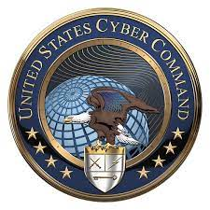
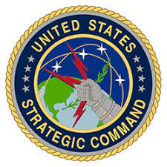
Nuclear-Cyber Nexus
Can nuclear weapons deter “big cyber” attacks on the homeland?
Can nuclear weapons deter attacks on US military cyber capabilities?
Can cyber-offense substitute for nuclear weapons to deter and achieve objectives if deterrence fails?
Notes:
The cyber-nuclear connection is something you’re hearing about all the time and there are at least three dimensions to consider.
1.. Can NW deter big strategic cyber attacks – the cyber Pearl Harbor that we worry about? The 2018 Nuclear Posture Review addressed this question of catastrophic strategic attacks under the nuc threshold and decided that our policy is to reserve the right to use NW in response to such threats. Sharpen adversary sense of risk. Good idea? Credible deterrence threat? GEN CONNOR
2. VARIANT. Can nw deter crippling attacks on our military cyber assets that are key enablers of operations and whose loss could put the Joint Force at a significant disadvantage? And the fact is that an adversary will have strong incentives to mount such attacks if our cyber architectures and networks are not particularly resilient yet. So what can we do to deter such attacks – and can the threat of a nuclear response credibly achieve that deterrence? Deterrence by resilience NDS.
3. A different kind of question that goes back to the previous slide. A lot of chatter posing this question – why can’t we just use cyber capabilities to provide strategic deterrence and begin to move away from nuclear deterrence? It’s a fair question, but a lot more complex than is widely appreciated. Some of the complexity goes to the nature of our cyber-offense tools and the ways we can and cannot talk about them. Fundamentally, we need to ask whether the cyber toolkit can do well the things we ask NW to do: convey a deep sense of risk to adversaries and cast a shadow over their decision making during crisis and conflict; impose unbearable costs when you need them to; and reassure allies. If you go thru that assessment, it is not a simple thing to answer the question. COMMENTS?

Slide 46
Nuclear Deterrence Challenges
Force / doctrine asymmetries
Intra-war deterrence and escalation Preparing for the possibility of adversary limited nuclear use
Regional
2018 NPR
Strategic
Maintaining parity / Triad modernization Challenges to strategic stability
Whither arms control?
“Reduced reliance”
Ambiguity vs. “No First Use”
Non-nuclear strategic threats
Policy Orientation
Notes:
Columns 3&4 – local wars escalate. In fact, concern about how conventional wars could escalate to nucl level one of the main threads in our nuc policy discussions today and was a key theme in 2018 NPR. Focus there not China so much as RF, and the NPR goes so far to say that there is a deterrence gap in Europe driven by imbalance in NSNW, and we worry that this could lead RF to believe it could use such weapons on a limited scale w/ low risk in the belief that US/NATO do not have the will or capability to respond in a proportionate way. Directs new limited use/low yield options plus direction to the joint force to be able to survive/ operate thru ADV lim nuc use. Strat msg to RF: we won’t be paralyzed WEIDNER: Strat but Army/CNI: How important and making progress? Are regional CCs taking this on board? GEN SHOEMAKER? ADM Behning: from your vantage as mission planner – utility of added low yield options?
Strategic issues really driven by work RF has done to modernize and expand strat nuc forces and uncertainty RE: scope/strategic intent behind CH nuc buildup, and sense of urgency this has created about our own nuclear mod. A lot of pushback against the mod program – do we need it all? Is the cost defensible given other needs? GEN WILSON: from a DET standpoint, what do you think is at stake here and what does your experience tell you will happen?
3rd set of issues here goes to specific policy choices RE: role of NW. INSSG: reduced reliance (Obama). OK but how do you operationalize that idea? Also big debate about DECPOL or what we say publicly about circumstances under which we would use NW -- an important part of our deterrence posture. Do we maintain a degree of ambiguity about those circumstances or do we declare that we will never be the first to use NW under any circumstance ore that sole purpose of NW is to deter/respond – POTUS on record supporting. A big part of this debate: do you believe there non-nuclear threats we could face that potentially could be deterred by the threat of a nuclear retaliatory response. SLIDE

Slide 47
Deterring the Local Fait Accompli
What strategy, capability, and messaging do we need to convince China that it cannot win a warfight with the US even over something it feels is a core interest?
General Deterrence……Immediate Deterrence
The context for a future US- China conflict may be “limited objectives” – but capabilities, doctrine, and underlying political stakes carry significant escalation potential.
Intra-War Deterrence
Notes:
Still working our way through this wrt to CH and I think there are two major deterrence questions. First: what’s the best military strategy to deter Chinese aggression and this is the main thing we’re talking about as a community and as you would expect the NDS provides our answer to this. All in on deterrence by denial and accepting higher risk for other threats.
The second question in my opinion is not getting as much attention, because it’s really about what we discussed earlier– what happens if initial deterrence fails? What risks do we then face? We tend to talk about conflict with China using the language of limited objectives – meaning even a hot war over Taiwan is not likely to be seen by either side as truly existential – in the sense of national survival being at stake for China or the United States. But I’d argue that the underlying political stakes are likely to be very high for both sides, and when you marry that to the high end capabilities each side will possess and to doctrines that emphasize surprise, shock, taking the initiative, and “early decisive action” – I think the risks of deterrence failure and escalation are not trivial, so no guarantee of staying limited.
MG Vowell, ADM Brown, ADM Gaucher -- what do you guys think?

Slide 48
Integrated Deterrence
Across domains, spectrum of conflict, time horizons
With allies & partners
Joined to other USG efforts
Deterrence by: denial, resilience, cost imposition, entanglement
Reduce reliance on nuclear weapons (?)
Notes:
let me just try to unpack this a little based on the work now being done on the NDS. Those first three bullets – this is what we hear most commonly from the DoD leadership when it talks publicly about ID. 5 vectors; without question the most challenging in my opinion are the first and last. Integrating across domains and across the USG. Real challenges are there.
In the middle there is an emerging idea of 4 types of deterrence logics – most of this is familiar/JOC. Deterrence by denial and resilience – being able to defeat and absorb and recover from attacks. Deterrence by cost imposition – through a punitive attack or through this somewhat new idea of entanglement – which as I understand it is the idea that if we can marshall a large enough network of allies and coalition partners, an adversary like China will be deterred thru the realization that it is likely to suffer significant political, diplomatic, economic and reputational costs even it prevails militarily.
And shadowing all this is the President’s interest in reducing the role of nuclear weapons in US strategy. And of course this goes to the question of whether we use some of the new capabilities like cyber to do the strategic deterrence mission traditionally associated w/ NW. The more complicated corollary question is whether we can figure out how to combine nuclear, cyber, space and other tools in an orchestrated way to deliver tailored deterrence effects. Challenging task but high payoff if we can figure it out. But all these ideas are being discussed in NDS and NPR.

Slide 49
Can Nukes Deter Cyber? Should They?
“The U.S. would only consider the employment of nuclear weapons in extreme circumstances to defend the vital interests of the US, its allies, and partners. Extreme circumstances could include significant non-nuclear strategic attacks. Significant non-nuclear strategic attacks include, but are not limited to, attacks on the U.S., allies or partner population or infrastructure, and attacks U.S. or allied nuclear forces, their C2, or warning and attack assessment capabilities.”
2018 NPR
Notes:
2018 NPR addressed this question of strategic attacks under the nuclear threshold – attacks with non-nuclear wpns that could have strategic impact and inflict devastating damage to our nuclear forces or our economy or infra or the nation more broadly. And it answered that question by stating that, as part of our declaratory policy, we reserve the right to use NW in response to such non-nuclear attacks. The idea is to make deterrence stronger by sharpening an adversary’s sense of risk. What kind of attacks are we talking about? Likely crippling cyber tho not explicit.
2 Qs: are these kind of extreme cyber threats plausible and something we worry about? GEN CRAFT
Is the threat of nuclear response credible? GEN WEIDNER

Slide 50
Debating Cyber-Deterrence – One Take
Thesis
Antithesis
Synthesis
Deterrence remains relevant, to a point
  Nuclear experience can be adapted, but total prevention of cyberwar is not possible
  Requires improved attribution and greater emphasis on norm-building
Deterrence is not a useful construct
  The hypercompetitive nature of cyberspace – “persistent offense” – is not compatible with traditional deterrence concepts
  Rather, we need to reduce operating constraints to better engage adversaries earlier, with the goal of establishing dominance
In practice, we are trying to synthesize these perspectives
  Going on the offensive and more risk-acceptant
  But also looking to change adversary risk calculus and behavior through fear of high costs….and mindful of escalation risks
Deterrence Adaptors
Paradigm Smashers
Cyber-Synthesizers
Notes:
Larger debate about cyber-deterrence for several years now and that really has influenced DoD policy. This is just my take, and I’ll ask our cyber experts what they think.
One side: those have believe our experience with nuc det can be applied and tailored to cyber. These folks acknowledge there are some limits to how traditional deterrence can be adapted but don’t believe there’s anything uniquely different about cyber that would make deterrence irrelevant. Deterrence Adaptors.
Other side: those who believe that deterrence w/its emphasis on restraint and well defined thresholds just not well suited to address the world of cyber, which defined by persistent engagement, persistent offense, and where attacks of many different kinds will be ubiquitous in conflict. So rather than seeking to establish rules of the road for mutual deterrence, we need to adopt an offensive/competitive mindset and seek a position of superiority – not to deter adversary cyber attacks but to defeat adversary capabilities. Paradigm Smashers.
Natl Cyberstrategy tries to balance these approaches, picking up arguments from both sides of the debate. DOD strategy clearly downplays deterrence and adopts a highly competitive approach emphasizing going on the offense..
My take is that we’re really trying to reconcile and synthesize these two big ideas about cyberdeterrence. It’s not just about degrading and disrupting capabilities. Yes, we’ve gone on the offense and we’re going to be more risk-acceptant but we’re also clearly looking to change adversary behavior thru the fear of high costs and doing so in way that takes account of the escalation risks of our actions. If you look at what’s been said and written about US operations during the 2018 mid-term election season directed at Russian cyberoperations, this is exactly how it has been described. (Enabled by new POTUS guidance on offensive use of cyber (old PPD 20)). So the debate about cyber deterrence may seem black and white with a stark choice to be made, but the real world is very much gray – the world of the Cyber-Synthesizers.

Slide 51
Can Cyber Deter Kinetic Attacks?
The Urgent Search for a Cyber Silver Bullet Against Iran
New York Times, 23 Sept 2019 (Sanger and Barnes)
“….a broader debate is taking place…over whether a cyberattack alone will be enough to alter Iran’s calculations, and what kind of retaliation a particularly damaging cyberstrike might provoke.”
“The question circulating now through the White House, the Pentagon and Cyber Command’s operation room is whether it is possible to send a strong message of deterrence with a cyberattack without doing so much damage that it would prompt an even larger Iranian counterstrike.”
“The Pentagon and other military officials have told the White House that neither a cyberattack nor the new deployment announced Friday will likely prove robust enough to re-establish deterrence and prevent another attack by Iran on United States allies.”
Notes:
I then ask a different question about cyber and deterrence. Can cyber threats or attacks deter kinetic strikes by a lesser power that has demonstrated a willingness to use force? Here, too, not a theoretical problem, because it’s the question that that was being debated 15 months ago when we were looking for a response to the Iranian attack on Saudi oil infra – an attack on our interests and the territory of our ally – but not our territory or our forces. ARTICLE. D Sanger and J Barnes
You see the questions being framed here. They’re about trying to restore deterrence and alter behavior with actions short of kinetic force and calibrating that use of non-kinetic force because we’re concerned about retaliation and escalation. And in that third quote, you see at least an initial answer to the Q I ask in the title of the slide – and the answer is “probably not”. Roll tape forward and we saw essentially kinetic action – assassination of Sulemaini and Iranian response against the US base. You should be thinking about your own answer to this question about cyber threats as a deterrent.
Lots going on here. The basic question: do think cyber can deter – and if so what? A subset of a broader question about what’s the right coercive toolkit and the right deterrence strategy for dealing with problem actors like Iran, which has a very aggressive regional posture and a toolkit of its own. We can assume Iran sees some strategic value in cyber, given what we know about its activities directed at the US financial system, a Las Vegas casino, the dam in NY state, the water supply in Israel.
would love to talk to the folks offering this judgment to see what’s driving it, because there are assumptions here about the Iranians think and behave, how cyber attacks are perceived…and as the authors of the article I think rightly suggest, this could be a really important test case of what we can and can’t do with cyber – not to do damage, but as an instrument of strategic influence and coercion. THOUGHTS?
. .

Slide 52
The Old Problem and the New Problem
The Old Problem
The New Problem
Gray Zone Hybrid Conv Local Conv Strategic Nuclear
Conventional
Nuclear
Notes:
Why is this harder to think about today than in the past? One reason is that security landscape for deterrence has changed pretty dramatically. The old problem was not simple but it was pretty straightforward. We worried about conventional war and the problem of escalation to the nuclear level – how to build a firebreak against that and what it could look like against the one major power we were concerned with.
Today’s we need to think about conflict at multiple levels and with more than one great power. We still pay a lot of attention to major conflict operations and how these could be shaped by new concepts and technologies, but there is also growing attention to new problems at the lower and higher ends. At the lower end, gray zone operations are intended to achieve strategic goals short of open armed conflict and with manageable escalation risks. At the higher end, in that space marked conventional strategic, we see the emergence of what I like to call “modern strategic warfare” – shaped by the uncertain impact on deterrence and escalation of non-nuclear capabilities that can deliver strategic effects.
So that’s a lot more complexity -- a continuum of competition and conflict to which deterrence might apply that’s just more diverse and dynamic. One result: esc firebreaks and thresholds may be harder to define or discern. OLD: C-N firebreak…not living in that world anymore…more complex ladder of esc to use a very traditional metaphor.

Slide 53
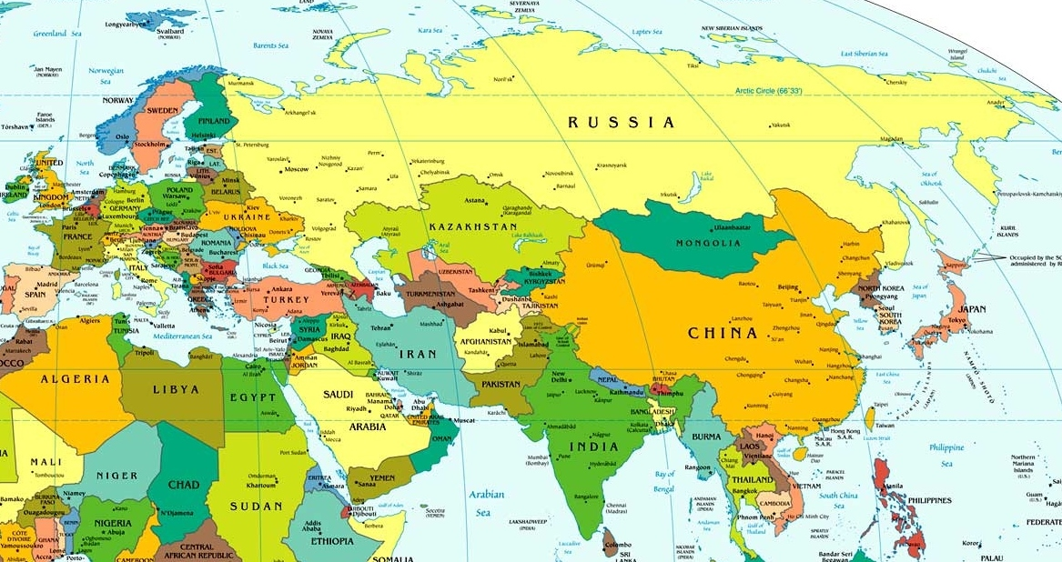
Key Deterrence Challenges
Deter in cyber and space domains
Deter local aggression and subsequent escalation
Deter political warfare
Deter a small
nuclear power
Deter CB use – state & VEO
Manage deterrence & escalation with an advanced adversary
Reassure allies through Extended Deterrence
Notes:
THIS PROBLEM SET REALLY COMBINES REGION- OR ACTOR-SPECIFIC CONCERNS AND A SET OF FUNCTIONAL CHALLENGES. IN THE END, WE ARE TRYING TO DETER SPECIFIC ACTORS FROM DOING SPECIFIC THINGS IN PARTICULAR CIRCUMSTANCES.
AT THE SAME TIME WE’RE ALSO STRUGGLING TO UNDERSTAND HOW TRADITIONAL APPROACHES TO DETERRENCE APPLY TO NEW TYPES OF CAPABILITY AND NEW TYPES OF COMPETITION AND CONFLICT.
WALK THROUGH SOME OF THESE….START WITH RUSSIA NOT BECAUSE RUSSIA IS NECESSARILY THE HARDEST PROBLEM OR THE LONG TERM PROBLEM - BUT BECAUSE IN SOME RESPECTS IT IS THE MOST CONCRETE PROBLEM IN THE NEAR TERM SO A GOOD LENS FOR LOOKING AT HOW WE ARE TRYING TO OPERATIONALIZE DETERRENCE TODAY. RELEVANT TO CHINA – MORE SALIENT OVER TIME

Slide 54
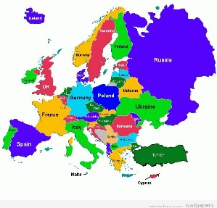
Russia – Deterrence Challenges
Political
Warfare
Hybrid
Warfare
Local
Aggression
Theater
Conv
Limited
Nuclear
Major
Nuclear
Regional
Escalation
Coercive short of armed conflict
Regular + irregular
Kinetic +
non-kinetic
Fait accompli
enforced by A2/AD
Steady
State
Ukraine
Crimea
Baltics
Belarus?
2018 NPR
Notes:
And when we look at RF, we see what I think is a pretty broad spectrum of conflict and deterrence challenges. This ranges from the arena that I like to call Pol Warfare – tho others have different names for it – where the action is not kinetic but where the intent is coercive, to the hybrid warfare challenges represented by UKR/CR, to the main defense planning problem NATO has been focusing on for 6 yrs now – local aggression to achieve some kind of fait accompli, and also our concerns about how such a local action could escalate to something like limited nuc war and all the risks associated w/that.
Quickly walk through 3 of these.

Slide 55
Russia – Deterrence Challenges
Political
Warfare
Hybrid
Warfare
Local
Aggression
Theater
Conv
Limited
Nuclear
Major
Nuclear
Regional
Escalation
Coercive short of armed conflict
Regular + irregular
Kinetic +
non-kinetic
Fait accompli
enforced by A2/AD
Steady
State
Ukraine
Crimea
Baltics
Belarus?
2018 NPR
Notes:
Start over here at the beginning of the spectrum.
Doctrinally we call this competition below the level of armed conflict. That’s a lot of words, so I just call it political warfare. Others use contested peace or competitive shaping, or just gray zone. Lot of debate on terminology. It’s about Russian influence operations and supporting actions designed to shape the political env and set conditions for a possible future contest with NATO. Environment of constant competition, what GERASIMOV calls a “permanently operating front.” Where adversary is trying to win or make strategic gains w/out fighting. I see it as an area where the cumulative stakes are very high for our allies and friends and therefore for our interests, but where discrete or individual acts by the adversary may not on their own convey a high degree of strategic danger and where it may be difficult to identify clear redlines and convey risk to the adversary. Which makes deterrence a challenge.
The question for us is – and this is broader than RF (CH too): can you deter this type of malign activity? Is there a role for deterrence or do need to be relying on other approaches – that emphasize resilience, hardening, resistance and things like that. GEN PEPIN? Elections red line?

Slide 56
Toolkit for Countering Political Warfare
Mitigate conditions that create vulnerability
Shape narratives
Aggressively counter disinformation and expose adversary activities
Strengthen rule of law and good governance
Reduce ethnic tension
Harden against cyber and economic attacks
Protect economic sovereignty
Establish some red lines – e.g., electoral interference
Denial…Resistance…Resilience…Competition…Deterrence?
Notes:
In trying to elicit answers to this question, I show this slide which reflects the conventional wisdom on the POL WARFARE toolkit. Most of these are about resisting and being more resilient and more competitive. My own feeling is that there may some kinds of strategically significant activities where issuing deterrence threats make sense; we saw GE and FR in do this in 2018 wrt to their national elections -- but on balance I think this is an area where deterrence and cost-imposition are going to be a secondary line of effort and where the key to countering the threat will be to significantly up our competitive game. That’s my opinion; some GO/FOs agree but not all. Some of them believe this is an area where deterrence by denial can work. But again hard to impose costs if few things cross obvious redlines.

Slide 57
Russia – Deterrence Challenges
Political
Warfare
Hybrid
Warfare
Local
Aggression
Theater
Conv
Limited
Nuclear
Major
Nuclear
Regional
Escalation
Coercive short of armed conflict
Regular + irregular
Kinetic +
non-kinetic
Fait accompli
enforced by A2/AD
Steady
State
Ukraine
Crimea
Baltics
Belarus?
2018 NPR

Slide 58
Russia – Deterrence Challenges
Political
Warfare
Hybrid
Warfare
Local
Aggression
Theater
Conv
Limited
Nuclear
Major
Nuclear
Regional
Escalation
Coercive short of armed conflict
Regular + irregular
Kinetic +
non-kinetic
Fait accompli
enforced by A2/AD
Steady
State
Ukraine
Crimea
Baltics
Belarus?
2018 NPR
Notes:
A third deterrence challenge w/RF is the problem of escalation. A concern in the Cold War – large scale use of regional nuc wpns – today morphed into something different based on developments in Russian strike capabilities.

Slide 59
Intra-War Deterrence to Manage an Escalating Conflict
How might Russia use credible threats to escalate a conflict to hold its advantage and deter a NATO effort to mobilize and counter-attack?
“Pre-nuclear” – precision strike, cyber, counter-space/C4ISR
Limited nuclear use – to coerce and alter political dynamics
Notes:
We’re concerned how RF might initiate aggression then threaten escalation to deter a NATO response. Not just a nuc problem. Big investment over last 20yrs in non-nuc options that can deliver strategic level effects deep into NATO territory vs. mil/econ/infra tgts. Saw some of the new missile capabilities showcased in Syria, incl theater range CM/BM (test bed/lab). So escalation options short of nuc use an important part of Russia’s coercive toolkit designed to deter us.
But also significant investment in NSNF or tac nukes resulting in a large, modern force that well outstrips NATO, and we worry that this asymmetry could lead RF to believe it could use such weapons on a limited scale with low risk in the belief that US/NATO do not have capability or will to respond proportionately.
Main deterrence challenge framed by the 2018 NPR. That this theater nuc asymmetry in particular encourages a coercive strategy and could weaken deterrence in a crisis.
.
STRAT CC: “There is a very real possibility that a regional crisis with Rf or CH could escalate quickly to a conflict involving nuclear weapons if they perceived a conventional loss would threaten the regime or state.”

Slide 60
Intra-War Deterrence to Manage an Escalating Conflict
How might Russia use credible threats to escalate a conflict to hold its advantage and deter a NATO effort to mobilize and counter-attack?
“Pre-nuclear” – precision strike, cyber, counter-space/C4ISR
Limited nuclear use – to coerce and alter political dynamics
    2018 Nuclear Posture Review
    - RF has “exploitable advantage” that weakens deterrence
    - Close the gap with additional nonstrategic nuclear weapons….
    - ….and improved “conventional-nuclear integration”
Notes:
Main deterrence challenge framed by the 2018 NPR. That this theater nuc asymmetry in particular encourages a coercive strategy and could weaken deterrence in a crisis.
The NPR offers what I’ll call a hardware and a software solution. 2 new low yield weapons for the regional context – Low yield option for SLBMs (fielded), and new generation nuclear SLCM to replace the now retired TLAM-N (2030). Not about being able to use NW vs more or different targets, but about sending a strategic level msg to RF: if you believe we will be deterred from responding to your limited use of NW out of fear of escalation, you’re mistaken. We will have credible options that are proportional. Software: CNI. making sure joint force can survive/operate thru limited nuclear attacks and credibly sustain a conventional campaign. Strat msg: we won’t be paralyzed by such attacks. CAN JOINT FORCE SURVIVE AND OPERATE THRU?

Slide 61
Deterrence and Escalation in a “Cross-Domain” Environment
“China has a broad concept of strategic deterrence, one in which a multidimensional set of military and non-military capabilities combine to constitute the “integrated strategic deterrence” posture required to protect Chinese interests….Powerful military capabilities of several types – nuclear, conventional, space and cyber – are all essential components….non-military aspects of national power also contribute…” RAND study (2016)
Challenge: The context for a future US- China conflict may be “limited objectives” – but capabilities, doctrine, and underlying political stakes carry significant escalation potential. “Multidimensional capabilities” on both sides create uncertainties with respect to understanding redlines, thresholds, and managing escalation risks.
  How well do we understand these dynamics?
  Do we have a comparable concept for integrated strategic deterrence?
Notes:
Cyber is one of the things we worry about WRT China. We’ve recently seen China apparently wielding the cyber sword vs India. I think compared with RF, whose cyber capabilities we’ve become all to familiar with, my sense is we know less about CH . Though we do know that China has developed cyber options as part of its strategy to threaten escalation short of the nuclear threshold in a regional conflict with the US. So it sees cyber as part of an integrated mix of coercive capabilities that can support deterrence and escalation
And more than we do, I think, CH refers to integrated strategic deterrence, the idea that you can achieve advantage if you effectively knit together all these various strategic level capabilities: N, Advanced Precision Strike, Cyber, Space/Counterspace, advanced ISR, maybe Missile defense. A lot of this is certainly still aspirational, but we should assume they are working on it and will make progress. Interesting work on this from Michael Chase/RAND – now DASD China.
Challenge or proposition in the middle is what I’d suggest is something we need to be thinking about – the esc potential of these and other high end operational capabilities when married to the underlying political stakes in any conflict and to doctrines that emphasize surprise, shock, taking the initiative and “early decisive action.” CH term.
Do you think we understand these dynamics well?
Do we have a comparable concept for integrated strategic deterrence?
GEN SONKISS? STRAT CC: “We must ensure that all of our capabilities map to an overarching strategy.”

Slide 62
Deterrence Challenges -- China
Do we understand China well enough to develop effective deterrence strategies?
Can the US deter Chinese coercive strategies to impose new security arrangements in the region (“win without fighting”)?
Can the US deter China from aggression even over core interests in its own region?
Will China move beyond “secure second strike” toward nuclear parity? Will it move toward limited nuclear options to strengthen regional deterrence of US?
Notes:
Back to the 4th C – comprehension. Do we know enough – are we learning enough -- to have an effective tailored deterrence strategy? Certainly lots of “emulation”….
We know China wants to win without fighting. Can we deter their coercive strategies in the region that aim to change the balance of political and military power and even push us out? Back to the grey zone question and what role deterrence plays.
What kind of capability and what kind of messaging do we need to convince China that it cannot win a warfight with the US even over something China feels is vitally important? Taiwan.
How do nuclear weapons fit in CH strategy?. At the strat level, do we think China wants to move away from a MIN DET posture toward something more robust? And, if we can dominate or stalemate China at the conventional level, will they move toward a more operational theater nuclear posture based on some concept of limited nuclear war? In other words, more like RF…and should that concern us? JWC struggling w/this.

Slide 63
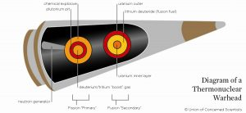
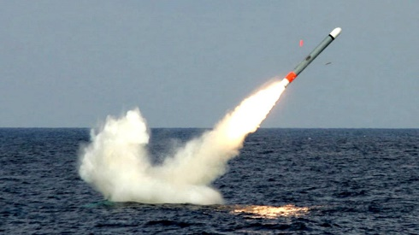
2018 Nuclear Posture Review
Mismatch in US-RF nonstrategic nuclear capabilities and doctrine encourages coercive strategy and could lead to deterrence instability
  “exploitable advantage”
  limited initial use of nuclear weapons
Steps to strengthen deterrence
  additional nonstrategic nuclear capabilities
    Low yield SLBM option (fielded)
    Nuclear SLCM (~2030)
  improved conventional-nuclear integration (CNI)
Notes:
NPR says yes there is a deterrence gap due to these asymmetries; creates an exploitable advantage for RF.
Close the gap 2 ways – hardware and software. 1. through new capabilities for limited use of nuclear weapons in a regional context. Not really about being able to use NW vs. more or different tgts, but to send a strategic level message to RF: if you believe we will be deterred from responding to your limited use of NW out of fear of escalation, you’re mistaken. We will have credible options that are proportional. 2. through making sure joint force can survive and operate thru limited nuclear attacks and do its best to sustain a conventional campaign. That’s the heart of what the DoD is calling CNI and here too it’s about strategic messaging – we won’t be paralyzed by such attacks.

Slide 64
Debating Cyber-Deterrence
Deterrence remains relevant, to a point
  Nuclear experience can be adapted, but total prevention of cyberwar is not possible
  Requires improved attribution and greater emphasis on norm-building
Deterrence is not a useful construct
  The hypercompetitive nature of cyberspace – “persistent offense” – is not compatible with traditional deterrence concepts
  Rather, we need to reduce operating constraints to better engage adversaries earlier and with the goal of establishing dominance
Deterrence Adaptors
Paradigm Smashers
Notes:
This is a sort of a springboard to a larger discussion about cyber deterrence, As some of you probably know, there is a very open, intensive debate among theorists/academics and some practitioners on this topic. an excellent literature that has developed around this.
One side: those have believe our experience with nuc det can be applied and tailored to cyber. These folks acknowledge there are some limits to how traditional deterrence can be adapted but don’t believe there’s anything uniquely different about cyber that would make deterrence irrelevant. Deterrence Adaptors.
Other side: those who believe that deterrence w/its emphasis on restraint and well defined thresholds just not well suited to address the world of cyber, which defined by persistent engagement, persistent offense, and where attacks of many different kinds will be ubiquitous in conflict. So rather than seeking to establish rules of the road for mutual deterrence, we need to adopt an offensive/competitive mindset and seek a position of superiority – not to deter adversary cyber attacks but to defeat adversary capabilities. Paradigm Smashers.

Slide 65
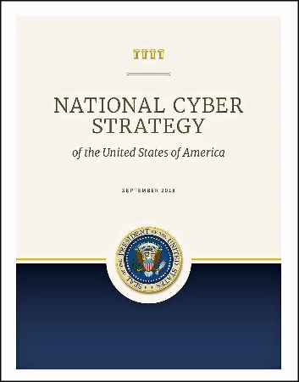
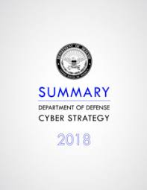
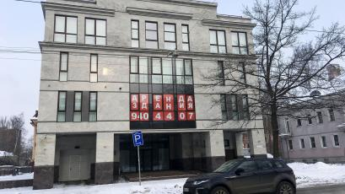
What are we saying and doing?
In practice, we are synthesizing the two perspectives
  Going on the offensive and more risk-acceptant
  But also looking to change adversary risk calculus and behavior through fear of high costs….and mindful of escalation risks
  And hoping “persistent engagement” brings deterrence benefits
CYBER-SYNTHESIZERS
Notes:
Natl Cyberstrategy tries to balance these approaches, picking up arguments from both sides of the debate. DOD strategy clearly downplays deterrence and adopts a highly competitive approach emphasizing going on the offense. Very assertive and there’s no question that in terms of publicly defining our policy, the Paradigm Smashers have won the day.
But if you listen to policymakers and military officials, and you look at our actions it’s pretty clear we are trying to reconcile and synthesize these two big ideas about cyberdeterrence. It’s not just about degrading and disrupting capabilities. Yes, we’ve gone on the offense and we’re going to be more risk-acceptant but we’re also clearly looking to change adversary behavior thru the fear of high costs and doing so in way that takes account of the escalation risks of our actions. If you look at what’s been said and written about US operations during the 2018 mid-term election season directed at Russian cyberoperations, this is exactly how it has been described. (Enabled by new POTUS guidance on offensive use of cyber (old PPD 20)). So the debate about cyber deterrence may seem black and white with a stark choice to be made, but the real world is very much gray – the world of the Cyber-Synthesizers.
Believe important role for deterrence in trying to prevent the most egregious attacks that we fear. If we’re vulnerable to catastrophic types of attacks, so likely are our adversaries and perhaps in that mutual vulnerability there is prospect for some of kind stability to avoid maybe not all bad outcomes, but at least the worst outcomes. But that means being prepared to say what is tolerable and what is not. And not clear we are prepared to do that. Recent revelations about extensive RF hacking of federal agencies and major tech companies underscores this. Also underscores something we should keep in mind: that while we have some experience trying to deal w/threats to critical infra, not much experience with or empirical info about cyber as a feature of great power warfare.

Slide 66

Deterring Multiple Levels of Conflict w/Russia
1
Ongoing political/information warfare
Manufactured or opportunistic political crisis
“Gray Zone” conflict via irregulars and proxies
Local, rapid military fait accompli
A2/AD bubble to deter initial response
2
N u c l e a r
S h a d o w
Conventional escalation to deter/disrupt counter-attack
Limited nuclear use to “de-escalate”
3
Notes:
Here’s a way to think about the full spectrum deterrence problem posed by one of our great power competitors.
3 ZONES OR LEVELS --- plus I’d argue Nuc Shadow (cloud). Not just the bottom – because RF uses nuc power as a tool of coercion/intimidation in peacetime – nuc saber rattling. SO, nuc dimension not some distant point on ladder of escalation, but a feature of RF strategy throughout
POL WARFARE/CONTESTED PEACE – Can we deter here? Right concept? DISCUSS -- NEXT SLIDE
PRINCIPAL NATO FOCUS POST-UKRAINE – STRENGTHEN DETERRENCE IN THE EAST AGAINST RUSSIAN AGGRESSION >>>>> show no lo cost option
COME BACK TO THIS
SKIP AHEAD ONE SLIDE

Slide 67
Deterring Multiple Levels of Conflict w/Russia
1
Ongoing political/information warfare
Manufactured or opportunistic political crisis
“Gray Zone” conflict via irregulars and proxies
Local, rapid military fait accompli
A2/AD bubble to deter initial response
2
N u c l e a r
S h a d o w
Conventional escalation to deter/disrupt counter-attack
Limited nuclear use to “de-escalate”
3
Notes:
Here’s a way to think about the full spectrum deterrence problem posed by one of our great power competitors.
3 ZONES OR LEVELS --- plus I’d argue Nuc Shadow (cloud). Not just the bottom – because RF uses nuc power as a tool of coercion/intimidation in peacetime – nuc saber rattling. SO, nuc dimension not some distant point on ladder of escalation, but very much present throughout
POL WARFARE/CONTESTED PEACE – Can we deter here? Right concept? DISCUSS -- NEXT SLIDE
PRINCIPAL NATO FOCUS POST-UKRAINE – STRENGTHEN DETERRENCE IN THE EAST AGAINST RUSSIAN AGGRESSION >>>>> show no lo cost option
COME BACK TO THIS
SKIP AHEAD ONE SLIDE

Slide 68
Deterring Multiple Levels of Conflict w/Russia
1
Ongoing political/information warfare
Manufactured or opportunistic political crisis
“Gray Zone” conflict via irregulars and proxies
Local, rapid military fait accompli
A2/AD bubble to deter initial response
2
N u c l e a r
S h a d o w
Conventional escalation to deter/disrupt counter-attack
Limited nuclear use to “de-escalate”
3
Notes:
Here’s a way to think about the full spectrum deterrence problem posed by one of our great power competitors.
3 ZONES OR LEVELS --- plus I’d argue Nuc Shadow (cloud). Not just the bottom – because RF uses nuc power as a tool of coercion/intimidation in peacetime – nuc saber rattling. SO, nuc dimension not some distant point on ladder of escalation, but very much present throughout
POL WARFARE/CONTESTED PEACE – Can we deter here? Right concept? DISCUSS -- NEXT SLIDE
PRINCIPAL NATO FOCUS POST-UKRAINE – STRENGTHEN DETERRENCE IN THE EAST AGAINST RUSSIAN AGGRESSION >>>>> show no lo cost option
WHAT IF DETERRENCE FAILS AND WE FIND OURSELVES IN AN ESCALATING CONFLICT WITH RF…NOT NATO FOCUS SO FAR

Slide 69
“Integrated Strategic Deterrence”
Widespread assumption: military capabilities can be better integrated for enhanced deterrence, escalation risk management, and Presidential decision space
Increasingly apparent reality: We don’t yet know how to buy better deterrence or risk management this way
How important is this?
conventional
cyber
space
nuclear
BMD/CMD
ISR
Notes:
And it’s really cyber that has driven the discussion of X-domain or integrated deterrence. And this about what the NSS said about extending deterrence to all domains.
We’ve been talking about this for many yrs now –our aspiration to buy better deterrence, risk mgmt and presidential decision space with enhanced integration across domains, but we still don’t know how to make that real. and my guess is not likely to figure it out until faced with the need to do it in a real world cont..
i think our cultural tendency is to stovepipe the means of deterrence each in their own domains. So default view tends to be that we deter cyber with cyber and respond to cyber with cyber. We’re trying to move beyond that but struggling to understand how actions in one domain – whether a deterrent action or an actual operation – will or should affect actions in other domains.
Policy wonks and theorists? PB: lots of ssttings ….operators/planners/commanders?

Slide 70
And…
“U.S. forces will ensure their ability to integrate nuclear and non-nuclear military planning and operations. Combatant Commands and Service components will be organized and resourced for this mission, and will plan, train, and exercise to integrate U.S. nuclear and non-nuclear forces and operate in the face of adversary nuclear threats and attacks.”
Notes:
Additionally, there is a shortfall in more operational and doctrinal sense that could undermine deterrence. Meaning?
Not about creating an integrated conv-nuc battlefield or moving toward nuc warfighting. More about making sure the CCs and Services understand the possible nuclear dimension of conflict. How adversaries may think about using nuclear weapons to defeat or disrupt our conventional campaigns; how our campaign plans need to incorporate that possibility; what effects adversary use could have on US/coalition ops; preparing the joint force to operate in a nuclear environment; and thinking about how we might use nuclear weapons, in the context of the overall campaign, if that’s what the President decides to do.
We used to call this theater nuc planning…now regional integration

Slide 71
Can Terrorists or VEOs Be Deterred from Using WMD?
Sure – every actor weighs costs, risks and benefits, and these can be influenced
Can / should we deter Iran from transferring WMD to proxy forces?
Maybe – it depends on the circumstances

Slide 72
If Deterrence is an Influence Operation….
….How can we get better at “strategic messaging?”
  Shape adversary perceptions to reduce confidence, induce restraint
  Reassure allies/onlookers
  Reinforce legitimacy
  Look for resolution
    Strategic intent – policies, objectives, resolve, redlines….
    Unity of effort – national, alliances, coalitions, international….
    Adversary vulnerabilities – we understand and can exploit
    Adaptability and resilience – our vulnerabilities are manageable
    Capabilities – via testing, demonstrations, evaluations, adaptations….
    Exercises – big, small, integrated, multinational….
    “Off ramps” – to leave the adversary something to lose
  A couple of worries
    Too much noise
    An “information-denied” operational environment
    Is IC postured to support?
Notes:
COME BACK TO WHAT WE SAID AT THE VERY OUTSET ABOUT DETERRENCE BEING AN INFLUENCE OPERATION. HOW DO WE GET BETTER AT MESSAGING?
SOME MESSAGES WE NEED TO BE THINKING ABOUT AND THESE GO TO HOW WE CONVEY OUR INTENT, OUR RESOLVE, OUR CAPABILITY.
HOW WE CONVEY TO THE ADVERSARY THAT WE SEE AND UNDERSTAND HIS VULNERABILITIES
HOW WE CONVEY OFF RAMPS IN A WAY THAT CAN BE HEARD ABOVE EVERYTHING ELSE THAT HAPPENS. SO I SORT OF BRING YOU BACK TO THE THOUGHT EXPERIMENT ON THE CUBAN MISSILE CRISIS AND ASK SOME QUESTIONS ABOUT MESSAGING IN WHAT IS LIKELY TO BE A VERY TOUGH INFORMATION AND DECISION MAKING ENVIRONMENT.
HOW DO YOU GET THROUGH OR ABOVE THE NOISE?
HOW DO YOU ENSURE CONNECTIVITY TO ADVERSARY LEADERSHIP IF EACH SIDE IS DOING THINGS TO MAKE THE OTHER BLIND AND DEAF?
AND WILL WE BE ABLE TO COUNT ON OUR IS TO ANSWER THE QUESTIONS LEADERS ARE CERTAIN TO ASK, WHICH ARE LESS ABOUT OOB AND MORE ABOUT “WHAT’S THE OTHER GUY THINKING?” I HAVE MY CONCERNS HERE.

Slide 73
JPME Special Area of Emphasis
Strategic Deterrence in the 21st Century
Deterrence today is more complex and in some ways more difficult than during the Cold War. We now must deter multiple nuclear armed-states simultaneously through multiple domains, across regions, and with multiple methods, including forward presence and the use of conventional forces. The risk that a regional adversary will try to escalate its way out of a conventional conflict is growing….Yet JPME generally treats nuclear deterrence as a Cold War relic and cross-domain deterrence as an interesting experiment; there is a critical need to raise the bar both in content and in levels of learning across the Joint Force.
Notes:
BUILT FOR CAPSTONE AFTER CJCS SAE
RECOGNITION THAT AFTER 15 YRS CT/COIN…
WITH NPR, MOMENTUM GIVEN TASKING
NDS: “PME HAS STAGNATED” IN PROVIDING FUTURE LEADERS WITH THE SKILLS AND KNOWLEDGE NEEDED…DETERRENCE ON EXAMPLE

Slide 74
Key NATO Actions Since 2014
    Expanded NATO Response Force
    Expanded Baltic Air Policing
    New Very High Readiness Joint Task Force
    NATO Readiness Initiative
    Enhanced Forward Presence in the East and the Black Sea region
    US armored brigade to PO
    Multinational land brigade in RO
    Adapted Command Structure
    Rapid Air Mobility initiative
    Joint Air Power Strategy
    NATO Space Policy (forthcoming)
Notes:
DECISIONS TAKEN AT WALES AND WARSAW AND WHOSE IMPLEMENTATION WILL BE REVIEWED IN BRUSSELS.
WHAT ARE OUR GOALS HERE? WHAT ARE WE TRYING TO DO?
DETER? REASSURE? TRIPWIRE? MORE? NECESSARY? EFFECTIVE?
SHOW RF NO LOST COST OPTION TO ATTACK A NATO MEMBER IN THE EAST
MIXED CRITERIA….SET OF MEASURES THAT BEST BALANCES POL ACCEPTABILITY, AFFORDABILITY, MIL EFFECTIVENESS, REASSURANCE PAYOFF, AND ESCALATION RISK…WHAT THE TRAFFIC HAS BEEN ABLE TO BEAR
GO BACK ONE SLIDE – ZONE 3. WHAT HAPPENS IF DETERRENCE FAILS AND WE FIND OURSELVES IN AN ESCALATING CONFLICT….THIS HAS NOT BEEN NATO’S FOCUS.

Slide 75
Today’s Topics
North Korea
Cyber (and Space)
China
Russia
Nuclear Weapons
VEOs

Slide 76
What’s different from the Cold War era?
  Regional challengers / rogue states
  Regional conflict with “near-peer” challengers
  Limited war / Asymmetric conflict
  New capabilities/domains (cyber, space, BMD)
  VEOs with potential access to WMD

Slide 77
Deterrence and the 4 +1 Challenges
Key to our approach is being able to deter the most advanced adversaries while continuing to fight terrorist groups. The means we must have – and be seen to have -- the ability to impose unacceptable costs on an advanced aggressor that will either dissuade them from taking provocative action, or make them deeply regret it if they do…We will be prepared for a high-end enemy – what we call full spectrum. In our budget, our plans, our capabilities, and our actions, we must demonstrate to potential foes that if they start a war, we are able to win, on our terms. Because a force meant to deter conflict can only succeed if it can show that it will dominate a conflict.
We have this ability with respect to North Korean and Iranian military forces, as well as in executing the military aspects of countering terrorists… Russia and China are our most stressing competitors…DoD has elevated their importance in our defense planning and budgeting to ensure we maintain our advantages in the future.
FY17 Defense Posture Statement, SecDef Ash Carter

Slide 78
“Full Spectrum Deterrence” – Three Lenses
  Across the spectrum of conflict
  Peace – Gray Zone – Crisis – Limited conv – Major conv – WMD – Limited nuc – Major nuc
  Across the DoD toolkit
  Forward presence – TSC/BPC – Power Projection – Unconventional – Conventional – Cyber – Nuclear
  Across all elements of national power
  Diplomatic/Political – Informational – Military – Economic
Not linear – traditional escalation ladders may be much more dynamic
Gray Zone – is deterrence relevant?
DIME – how are we doing?
Notes:
HEAR THIS TERMS USED A LOT THO NOT EVERYONE MEANS SAME THING. 3 LENSES….3 POINTS
DON’T EXPECT SPECTRUM OF CONFLICT TO BE PERFECTLY LINEAR EVEN THO PORTRAYED HERE THAT WAY. OUR CONCEPTION USED TO BE MORE LINEAR – LADDER OF ESCALATION THAT WAS RELATIVELY SIMPLY – CONV TO NUC, MAYBE WITH THEATER NUC THROWN IN. NOW WE HAVE TO THINK NOT JUST ABOUT A BROADER SPECTRUM THAT INCLUDES THE GRAY ZONE, BUT ONE WHERE THE LINES AND BOUNDARIES BETWEEN STAGES ARE NOT NECESSARILY CLEAR OR CLEAN. WHERE ADV LIKE RF ARE TRYING TO LEVERAGE THEIR NUC CAPS ACROSS THE SPECTRUM AS A TOOL OF COERCION AND INTIMIDATION. NUCLEAR NO LONGER SOME DISTANT POINT ON A LADDER OF ESCALATION. BOTTOM LINE: WEIGHING AND MANAGING ESC RISKS NOT STRAIGTHFORWARD.
CAN WE DETER IN THE GRAY ZONE? IS THAT EVEN THE RIGHT STRATEGY? COMPETE/RESIST/BE RESILIENT
DIME – WOG. HOW ARE WE/YOU DOING? NDS AND PME CONNECTION

Slide 79
Deter Conventional Aggression by a
Locally Superior Force
Challenge: Convince Russia it does not have a low-cost option to achieve a fait accompli against a NATO member in the east
What deterrence strategy best balances political acceptability, affordability, military effectiveness, reassurance payoff, and escalation risk?
“Big & Heavy”
Costs
“Tire
Shredder”
“Tripwire”
Benefits

Slide 80

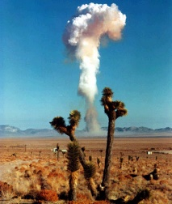
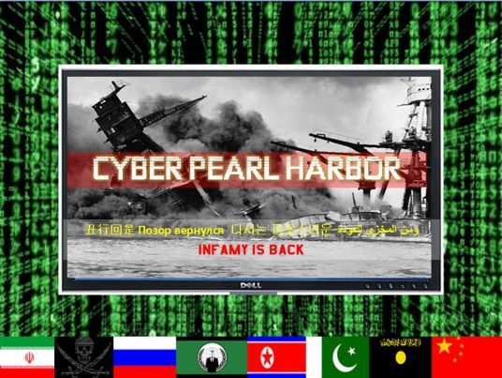
2018 U.S. Nuclear Posture Review
Renewed great power competition
More dangerous nuclear threat environment – coercive strategies
Imbalances in US-RF capabilities and doctrine at the nonstrategic nuclear level (“deterrence gap”)
Growing set of non-nuclear threats with potential to inflict extreme damage
More/better low yield nuclear options
Potential for nuclear response to major non-nuclear strategic attacks
Notes:
AND THESE TWO PROBLEMS ARE PRECISELY WHAT US POLICYMAKERS ARE WORRIED ABOUT AND WHICH DRIVE BIG TAKEAWAYS FROM THE NPR.
THE FIRST PROBLEM WE IDENTFITED – LAST BULLET ABOVE – GROWING NON-NUC CAPS THAT ARE OR COULD BE AVAILABLE WITH POTENTIAL TO INFLICT DEVASTATING EFFECTS – CREATING WHAT NPR REFERS TO AS “EXTREME CIRCUMSTANCES.” SO WHAT WE SEE IN NPR IS A SUBTLE SHIFT IN DECL POL TO RESERVE THE OPTION TO USE NW IN SUCH CIRCUMSTANCES. WHAT KIND OF NON-NUC ATTACK? LIKLELY BUT NOT EXPLICITLY CYBER
THE SECOND PROBLEM – THE PERCEIVED DETERRENCE GAP AT THE LEVEL OF LIMITED USE OF NSNW – THE NPR SOLUTION IS TO EXPAND AVAILABLE LOW YIELD OPTIONS AS A MEANS TO SIGNAL TO RF: IF YOU BELIEVE WE WILL BE SELF-DETERRED FROM RESPONDING FOR FEAR OF ESCALATION RISKS, YOU ARE WRONG.
LOW YIELD SLBM OPTION + SLCM. THOUGHTS ON BOTH? FIRST USE?

Slide 81

Does it have Russian doctrine right?
If so, does it have the solution right?
Does it create risks of “lowering the nuclear threshold?”
  New capabilities
  Declaratory policy
Does it say the right things about arms control and disarmament?
Notes:
MOST OF THESE QUESTIONS – WHICH HAVE FRAMED THE DEBATE IN THE US – GO TO THAT FRAMING OF PROBLEM AND SOLUTION, THREAT AND RESPONSE.
NOT EVERYONE AGREES THE NPR HAS RF DOCTRINE RIGHT
SOME SAY EVEN IF YOU DO, DON’T NEED NEW CAPS AND THESE CAPS CARRY NON-TRIVIAL RISKS
APART FROM ALL THAT, MANY BELIEVE THE NPR WALKS TOO FAR AWAY FROM LONGSTANDING US VIEWS ON AC, DISARMAMENT, AND NP, BASICALLY TREATING AS AFTERTHOUGHT RATHER THAN CENTRAL.

Slide 82
Deterrence and the 4 +1 Challenges
Key to our approach is being able to deter the most advanced adversaries while continuing to fight terrorist groups. The means we must have – and be seen to have -- the ability to impose unacceptable costs on an advanced aggressor that will either dissuade them from taking provocative action, or make them deeply regret it if they do…We will be prepared for a high-end enemy – what we call full spectrum. In our budget, our plans, our capabilities, and our actions, we must demonstrate to potential foes that if they start a war, we are able to win, on our terms. Because a force meant to deter conflict can only succeed if it can show that it will dominate a conflict.
We have this ability with respect to North Korean and Iranian military forces, as well as in executing the military aspects of countering terrorists… Russia and China are our most stressing competitors…DoD has elevated their importance in our defense planning and budgeting to ensure we maintain our advantages in the future.
FY17 Defense Posture Statement, SecDef Ash Carter
Notes:
SHIFT GEARS TO LOOK AT EAST ASIA..
THIS SAYS WE HAVE THE ABILITY TO DOMINATE A CONFLICT W/NK…
TO WHICH I WOULD SAY: SURE, BY CONVENTIONAL MEASURES AND IF THEY FIGHT OUR WAR. BUT THE REASON COUNTRIES LIKE THIS ACQUIRE WMD – ESP NW – AND MODERN MISSILES TO TRY TO CHANGE THE TERMS OF CONFLICT – TO GAIN THE MEANS OF ESCALATION IN ORDER TO LEVEL THE PLAYING FIELD

Slide 83
Challenge 2: Deterrence in Cyber and Space
“The DOD must be able to declare or display effective response capabilities to deter an adversary from initiating an attack; develop effective defensive capabilities to deny a potential attack from succeeding, and strengthen the overall resilience of US systems to withstand a potential attack if it penetrates the United States’ defenses. In addition, the US requires strong intelligence, forensics, and indications and warning capabilities to reduce anonymity in cyberspace and increase confidence in attribution.” The DoD Cyber Strategy (April 2015)
“We will: support diplomatic efforts to promote norms of responsible behavior in space; pursue international partnerships that encourage potential adversary restraint; improve our ability to attribute attacks; strengthen the resilience of our architectures to deny the benefits of an attack; and retain the right to respond, should deterrence fail.” National Security Space Strategy (January 2011)

Slide 84
Challenge 5: US Nuclear Weapons and Deterrence
U.S. nuclear forces help convince potential adversaries that they cannot escalate their way out of failed conventional aggression against the United States or our allies and partners. QDR 2014
Possible nuclear employment tied to regional campaigns, underscoring the need for integrated planning
Can we use nuclear weapons in a way that conveys restraint, restores deterrence, and enables war termination on our terms?
What nuclear capabilities do we need to do this, and will the modernized arsenal provide them at an acceptable cost?
Are senior leaders being prepared for complex escalation scenarios?

Slide 85
US Nuclear Weapons and Deterrence (2)
There is a lot of senior level attention to the policy/political aspects, but less to the challenges of nuclear crisis management, potential nuclear use, and escalation dynamics
  Senior leaders do not appear to exercise or rehearse complex escalation scenarios
  J/PME devotes relatively little attention to deterrence, escalation, x-domain warfare, or operating under the nuclear shadow
Planners are struggling to anticipate and account for escalation
  Some tough problems maybe “assumed away” and GCC capacity to “think nuclear” is limited
  Some new concepts may not address this challenge

Slide 86
Deterring WMD Use – The Syria CW Case
“We have been very clear with the Assad regime, but also to other players on the ground, that a red line for us is we start seeing a whole bunch of chemical weapons moving around or being utilized. That would change my calculus. That would change my equation…We’re monitoring that situation very carefully. We have put together a range of contingency plans.”
POTUS 8/12/12
“Once the commander in chief draws that red line, then I think the credibility of the commander in chief and this nation is at stake if he doesn’t enforce it.” Former SecDef Leon Panetta
“Assad is effectively being rewarded for the use of chemical weapons, rather than punished, as originally planned.” Brookings scholar
“The threat of force was credible enough for them to give up their chemical weapons. We threatened military action and they responded. That’s deterrent credibility.”
US Senator Tim Kaine
“No one sees Obama as a weak president, and no one saw that moment as a moment of weakness…Risking war with a nuclear power over Ukraine was just not going to happen. It would have been clear even if Obama had hit Syria. It wouldn’t have changed anything…these things are not connected to each other in any way.”
Russian commentators close to the Kremlin

Slide 87
“We need high-velocity learners…”
“deterrence isn’t easy…we need high-velocity learners who are willing to develop and stretch their intellect well beyond one-dimensional problem solving as we work on these things...We need leaders who do not become static, and who search for and recognize signals of change − and then find connections and solutions that are seemingly impossible. We need “chess players” who can operate in a multi-dimensional environment, with multiple activities taking place simultaneously, on a board where they may not fully understand the rules by which multiple adversaries are playing. We need to inspire and develop the next Tom Schelling or Henry Kissinger to address 21st century deterrence, assurance and escalation control issues.”
former Commander, STRATCOM

Slide 88
Deterrence Operations Joint Operating Concept (2006)
Provide a conceptual foundation and a working model: How do we wage deterrence against adversaries, and how do we deliberately plan for such campaigns?
  Deterrence operations convince adversaries not to take actions that threaten vital US interests by means of decisive influence over their decision making.
  Decisive influence is achieved by credibly threatening to deny benefits or impose costs, while encouraging restraint by convincing the actor that restraint will result in an acceptable outcome
Key challenges
        Multiple adversaries – tailored strategies required
        Incomplete knowledge – intel challenge and unavoidable uncertainties
        Asymmetry of stakes – can weaken credibility
        New domains of warfare – can complicate the management of escalation risks
Operationalize through an analytic process that feeds adversary-specific plans
www.dtic.mil/futurejointwarfare/concepts/do_joc_v20.doc

Slide 89
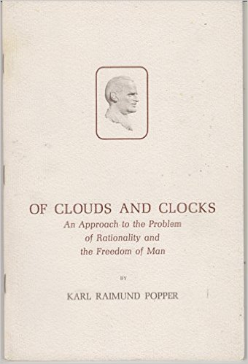
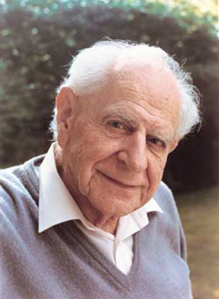


Is Deterrence….
A Clock?
Or a Cloud?

Slide 90
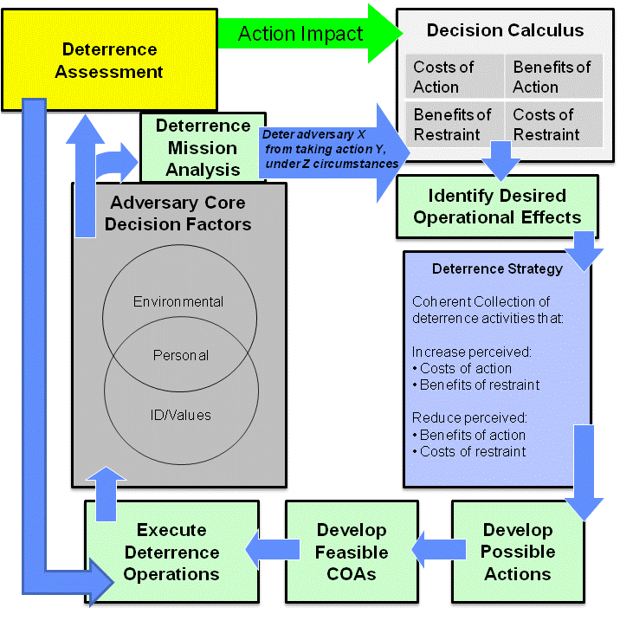
Deterrence Analysis, Planning, & Operational Flow

Slide 91


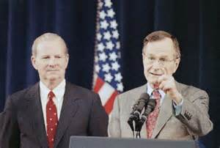
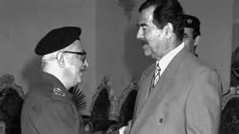
One Quick History Lesson
Did deterrence work in the first Gulf War?
“…purposefully left the impression” that CB use would invite “tactical nuclear retaliation.”
To deter Iraq’s invasion of Kuwait?
To deter Iraq’s use of chemical or biological weapons?
What’s the lesson?

