Slide 1
DEPARTMENT OF DEFENSE
SCHOOL LIAISON PROGRAM
PreK-12 Education
Supporting Readiness, Retention and Recruiting

Slide 2
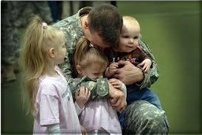
Charge to Community Leaders
Military families report that the decision to continue military service is influenced by public education opportunities for their children. To address this issue, the Secretaries of the Army, Navy and Air Force informed the National Governor’s Association that...
"Eliminating or mitigating these barriers will improve quality of life for our military families and ease the stress of transferring duty stations with consideration for long-term career implications. We realize improving schools... will take time. Over the long term, however, leaders who want to make a difference for the military and our missions will make the most impact if we focus on what matters.”
— February 23, 2018

Slide 3
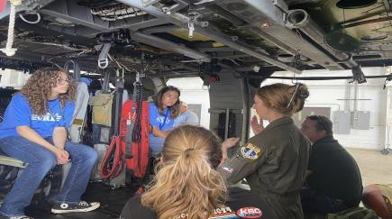
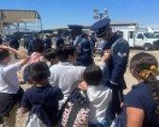
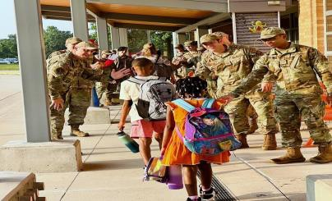
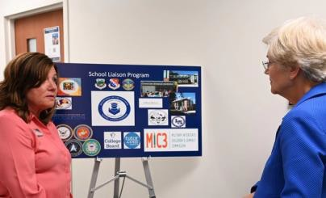
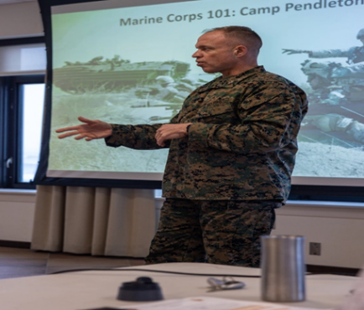
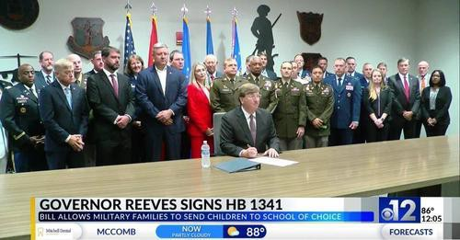
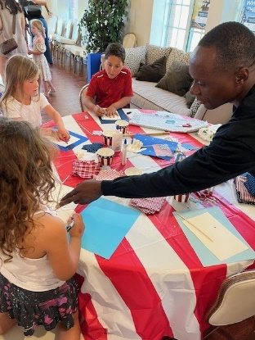
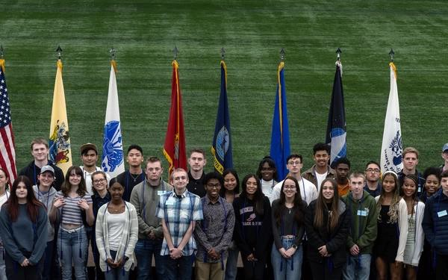
OUR WHY?
Readiness, Retention, and Recruitment of the Future Force

Slide 4
DEPARTMENT OF DEFENSE HQ SCHOOL LIAISON PROGRAM POINT OF CONTACTS
Defense Department School Liaison Program
The School Liaison Program offers an array of services and resources to support students, parents, installation leadership, schools and the surrounding community. School liaisons are located at each installa- tion and serve as the primary point of contact for grades pre-K through 12 for education-related matters. They inform parents about local schools, graduation require- ments, afterschool programs, homeschooling and much more. By working together with these stakeholders, the School Liaison Program builds a support network to provide the best possible education experience for military-connected children and youth worldwide.
School liaisons at each installation provide information and build partnerships with the civilian and military community to address common education challenges of military families. School liaisons are also an initial contact for participation in the Youth Sponsorship Program which helps build resilience in youth and ease transitions.
The school liaison:
Defense Department School Liaison Program
education-related matters
• Serves as the primary point of contact for
The School Liaison Program goals are to:
• Represents, informs and assists command
• Assists military families with educational issues
• Coordinates with local school systems
• Forges partnerships between the military,
• Identify barriers to academic success and
Army
hqschoolliaison@army.mil
develop solutions
• Promote parental involvement and educate local
the community and schools
communities and schools about the needs of
military children
Marine Corps
hqmc.slp@usmc.mil
• Develop and coordinate partnerships in education
• Provide students, parents and school personnel with
School Liaison Program support is free of charge and open to all DOD ID cardholders, educators who serve military-connected students, and community partners involved with pre-K through 12 education.
the tools they need to overcome obstacles to
education that stem from the military lifestyle.
Navy
NavyHQSchoolLiaison@us.navy.mil
Air Force
afsvc.daf.slo@us.af.mil
Visit Us Online
Space Force
afsvc.daf.slo@us.af.mil
https://installations.militaryonesource.mil/ search?program-service=12/view-by=ALL
Lori A. Phipps
Stephanie Borrowman
Kristen Acquah
Jackie Cajina
Horace Franklin
AIR FORCE AND
SPACE FORCE
ARMY
MARINES
MARINES
NAVY

Slide 5
Total Force Program
Service DoD Total Force service members to include
Active Duty – Guard – Reserve
DoD Civilians
Retirees
National Oceanic and Atmospheric Administration (NOAA)
United States Public Health Service (USPHS)
Foreign national employees assigned and working directly for the DoD
DoD Contractors working full-time on the installation
Educators that service military-connected students
WORLDWIDE LIS TING O F
S CHOO L LI AISO NS
Building a Purple Capacity Community

Slide 6
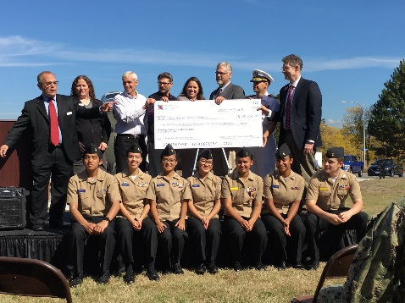
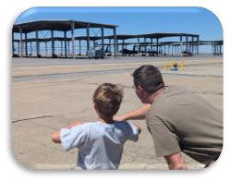
School Liaison Program
PREK-12 EDUCATION
SLPM Authorizations | 285
Military-Connected Students Served | 770K
Schools Served | 24K
Public Schools on Military Installations (PSMI) | 108
Military & Family Life Counselors (School Embedded) | 1300
# of Command Team Contacts | 143K
Student Transition Programs | 200+
# of Professional Develop or Workshops Conducted | 7K
# of Family Contacts | 537K
QUALITY OF LIFE IMPACTS
Readiness, Retention, Recruitment of the Future Force
Total Force Multiplier - Command, Families, & Communities
Installation Command Team SME
Legislation Advocacy - Testimony
Strategic Basing, Mission Impact
Educational Community Partnerships
Crisis and Contingency Planning-Execution
Special Education
Deployment & Transition
MIC3 Compliance
Compassionate Reassignments/Humanitarian Transfers
Department of Justice Engagement
Family Readiness = Mission Readiness

Slide 7
Customer Focus
PreK-12 Education SME
Installation Commander Driven Program
Command Team
Lynchpin, Influencer and
Ambassador
Educators
Mutually Beneficial

Slide 8
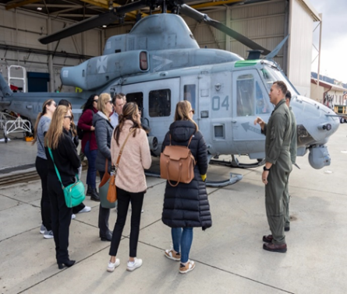
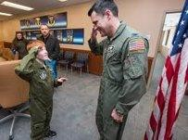
HIGH VISIBILITY – HIGH RESPONSIBILITY – HIGH CAPABILITY
SME
Face of the Installation
DoD State Representative
Advocate
Individualized Solutions
System of Support
Committed
Legislative
Changes/DSLO
Professional
Development
Strategic Basing
Building
Partnerships
Systemic
Change
Real-time
Solutions
To Get to a YES
Workshops
PreK-12
Quality Education/Local Policy
Resources
Pulse of
Education
Joint Service
Effort
Customized
Results
PSMI
Working Groups
Referral
Partnerships Drive Results

Slide 9
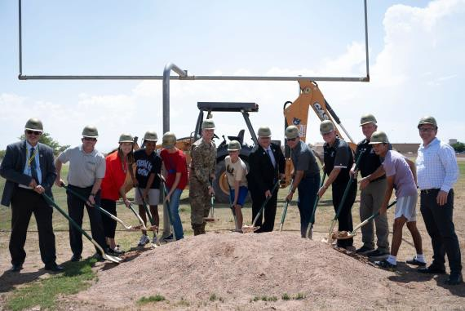
School Liaison Program Portfolio
Military & Family Life Counseling Program (MFLC)
Confidential non-medical counseling
School embedded MFLC Installation Point of Contact
Utilize Data Warehouse reports; realignment; trends
1322 CYB-MFLCs Authorized in Schools; 1124 Currently Onsite
Public Schools on Military Installations (PSMI)
Office of Local Defense Community Cooperation
Grants provided to improve school facility condition and capacity deficiencies (i.e., construct/renovate schools) on military installations
Land + Policy + Building (Three Different Owners)
108 On Installations (not DoDEA)
Crisis Action Requirements

Slide 10
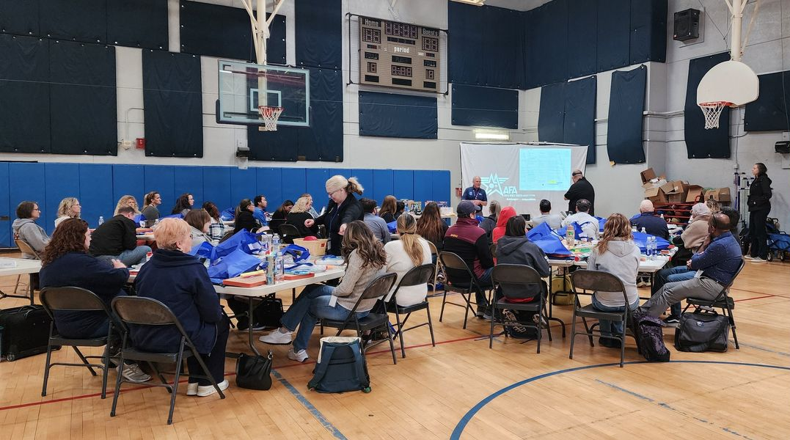
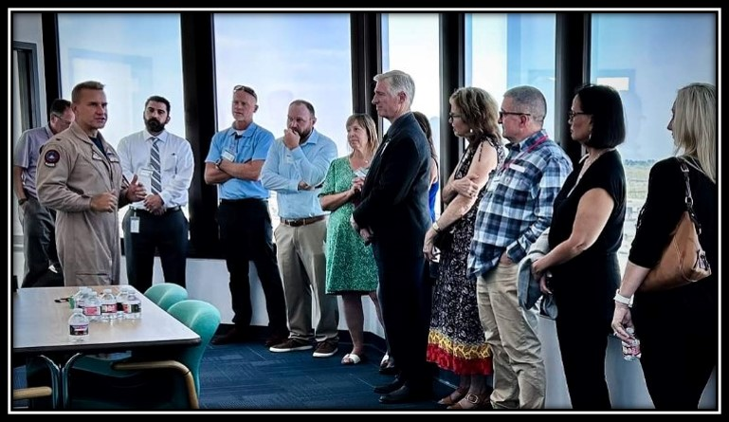
School Liaison Program Portfolio
ECP/PIE
School Navigation & Options
Homeschool Support
Special Education Navigation Transition Support
Deployment & Parental Absence College, Career & Military Readiness Grants & Scholarships
Professional Development & Workshops MIC3 Compliance & Training
Continuity, Stability and Comprehensive Support
Notes:
ECP- Education Community Partnerships
PIE- Partnerships in Education

Slide 11
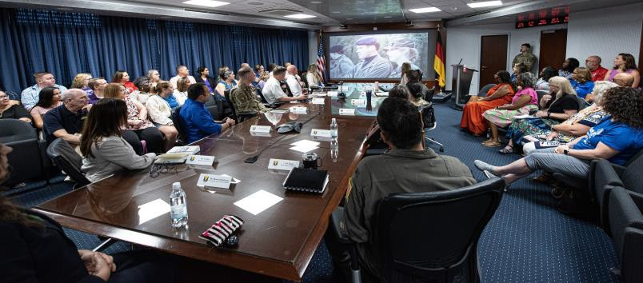
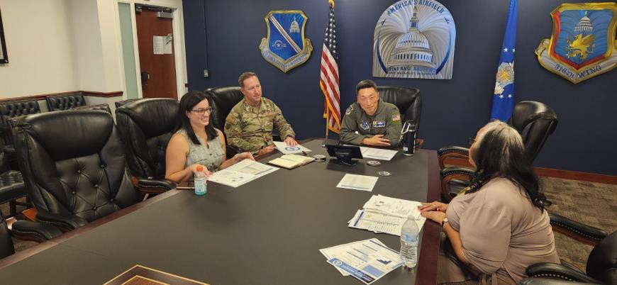
Co mmand Team Engagement
PreK-12 SME
Local and state
Support
Priorities
Readiness, Retention, Recruiting
Connections
Educational Community Partnerships
Information
Solutions
Customized
Advocate
Legislation
Trend Analysis
Mission Impact
Transitions
Address Gaps and Barriers
Awareness of Trends, Challenges and Successes

Slide 12
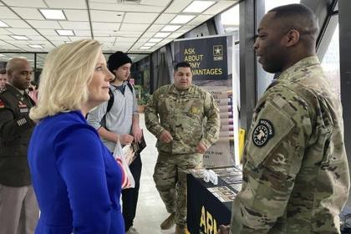
Commun ity Stakeholder Engagement
Command SME
Face of the Installation
Support
Professional Development
Programming and Resources
Solutions
Trend Analysis
Relationships
Legislation
Information
Programming
Resources
Connections
Community Partnerships
Invest in the Community
Transitions
With military-connected students constituting less than 1% of the total student population in many of our military impacted schools, cultivating and sustaining Education Community Partnerships are vital.
Address Gaps and Barriers
School-Based Programming

Slide 13
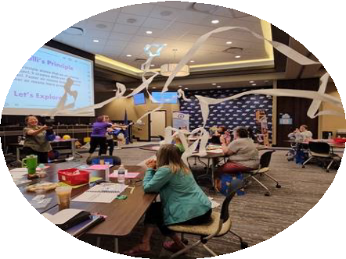
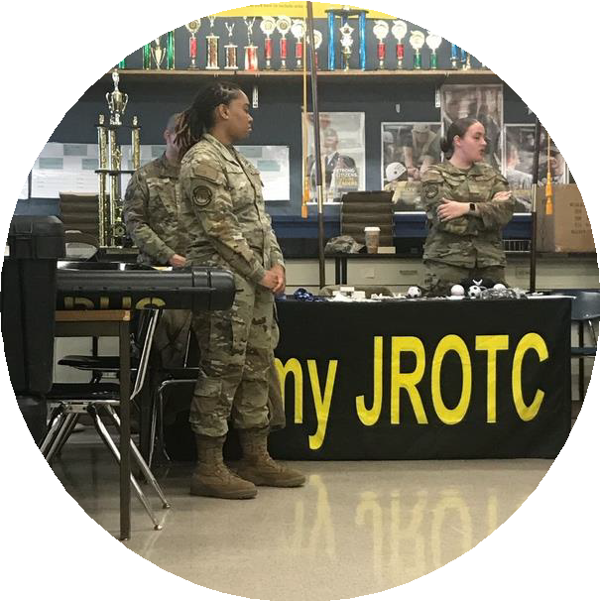
DoD Requirements
Direct access to Installation Commander
SME on PreK-12 Education
Engagement with Schools
Annual OSD Certification Inspection
Local and State Level Responsibilities
Identify Educational Gaps, Coordinate, and Advocate
Joint Service Reciprocity
Status of Education Immersion
Commander Flexibility on School Liaison priorities, office location,
communication protocol and supervision
Primary OPR for all PreK-12 engagements, challenges, concerns, education programming components to include Special Education, state-level or host-nation representation, and education community partnerships

Slide 14
Inside a Successful Program…
Strong Education Community
Partnerships
Pulse on Education in the Community
Initiatives to Improve PreK-12
Education
School Based Programming
Crisis Action Planning Team Member
Joint Service Collaboration
PreK-12 Working Groups or Education Councils
Providing Professional Development in Schools
Partnership with Defense State Liaison Office
Collaborate with Host Nation

Slide 15
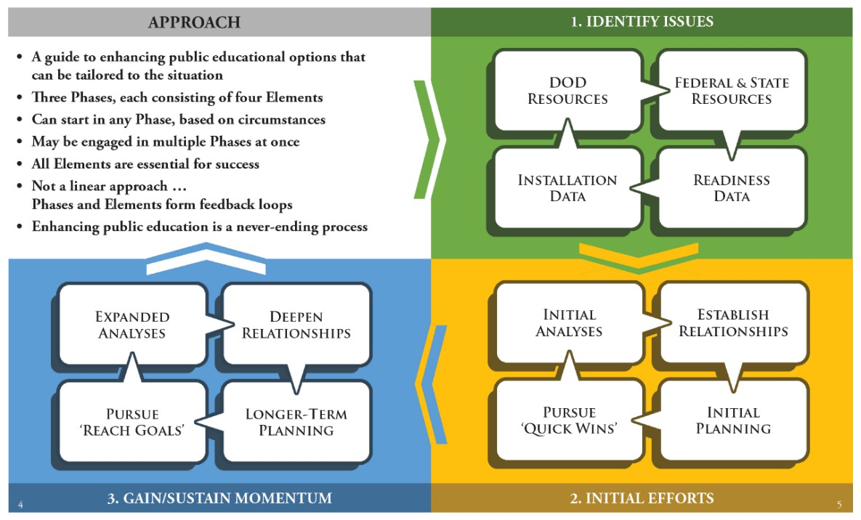
A+ Toolkit
Resources
Examples
Case Studies
Approach
A flexible model
Can start anywhere
Not linear
Resources & Actions
Embedded in the model
Also listed in the appendix
Hyperlinked (online)
Examples
Short; Illustrates Actions
Longer; Case Studies
Footnoted & Hyperlinked (online)

Slide 16
Interstate Compact for the Education of Military Children
DoDI 1342.29
Joint Service Effort for Education
Equality
Educational Records & Enrollment
Placement and Attendance
Eligibility
Graduation
Opens Communication Barriers for
Systemic Change
District of Columbia
Service Designated State Lead
USA
Puerto Rico
USN
Marianas/Guam
Virgin Island
American Somoa
USMC
USAF

Slide 17
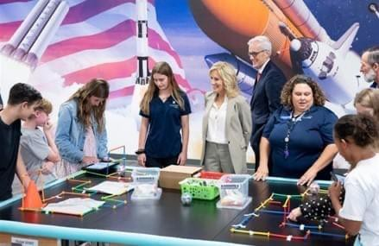
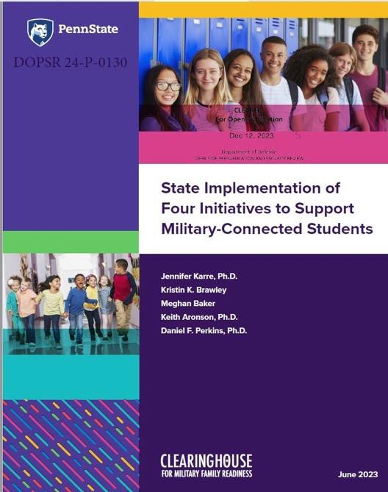
Tracking Trends
Program
Duplication of Effort from Private Organization
Lack of Awareness of SL Program
Communication with Command Teams
Reciprocal Partnerships with Schools
Families/Students
Housing
Pre-Kindergarten availability
School Choice or Attendance Zones
Early College High School Continuation
Magnet School Lottery
State Immunization Requirements
Advance Placement/Dual Credit Issues/MS Credit

Slide 18
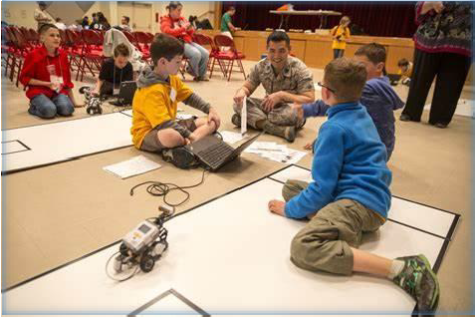
CONUS vs OCONUS
Same Programming Requirements
DoDEA Schools
– School System
Dual responsibility for the equivalent of State Dept. of Education and
Public School District
Not in school building business
Arranges and Financially supports education requirements
Non-DoDEA School Program (OCONUS)
Special Arrangements
Grants
Host Nation Schools
Advisory Councils

Slide 19
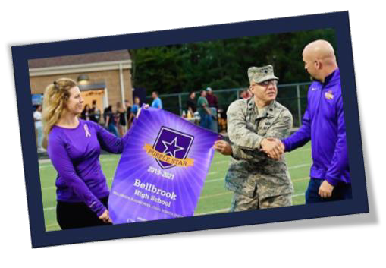
What? So What? Now What?
Get to know your SL
Meet Regularly
Have Conversations
Help Connect/Correct
Eyes-Ears-Voice
Reinforce Position/Responsibility
Invite to Meetings
Social Media
Welcome Letters/Newsletters
Advocate for Education/SLP Needs
Education Forums
Share Stories
Manage Expectations

Slide 20
Connect with Us
Provide support - Tools - Programs – Advocacy
PARTNERSHIPS Drive RESULTS
Call Anytime!
Notes:
Add contact info slide

