Slide 1
Your TRICARE Program CAPSTONE Spouse Course
Curt B. Prichard, MHA, FACHE
Deputy Director, TRICARE Health Plan
November 19, 2024

Slide 2
Agenda
Purpose and Highlights
TRICARE and the Military Health System (MHS)
Benefits and Coverage
Eligibility, Coverage, and Exclusions
Who and What TRICARE Pays
How does a benefit become a benefit?
TRICARE Plans
TRICARE Open Season
T-5 Contracts
TRICARE Overseas Program

Slide 3
Purpose and Highlights
Purpose – To foster better understanding of your TRICARE program and its health plans, and updates
Highlights
The Military Health System (MHS) provides a healthcare benefit to our 9.5 million beneficiaries both through the Direct Care System (DCS) at the military medical treatment facilities (MTFs) when capability/capacity exists, and in private sector care (PSC) under the TRICARE program
TRICARE wraps-around local MTFs to increase capacity and capability through TRICARE-authorized providers, suppliers, and pharmacies, network and non-network, in PSC including international host nation providers
In addition to Active-Duty Service Members (ADSMs), TRICARE covers Active-Duty Family Members (ADFMs), retirees and their families, and qualified survivors
The family of TRICARE health plans is administered by large federal service contracts
The unique MHS promotes recruitment, retention, and readiness in the eight covered Uniformed Services
Grounded in statutory law, the TRICARE is a federal health benefit program. It is not health insurance.
TRICARE is implemented in federal regulation (32 CFR 199)
TRICARE contractors administer the program according to requirements specified in the four TRICARE Manuals (Policy (TPM), Operations (TOM), Reimbursement (TRS), and Systems (TSM))
www.tricare.mil contains the most up-to-date information for MHS beneficiaries; includes one website for each MTF
www.health.mil also contains information of interest

Slide 4
TRICARE – A Wrap-Around Local MTFs
TRICARE Private Sector Care
MTF
Uniformed Services (8)
}
United States Army | United States Navy | United States Space Force
United States Marine Corps | United States Air Force | United States Coast Guard
United States Public Health Service (PHS) Commissioned Corps
National Oceanic and Atmospheric Administration Commissioned Officer Corps (NOAA)
Armed Forces (6)
4

Slide 5
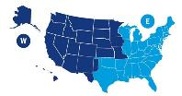
The Military Health System
Direct Care System (DCS) of military hospitals and clinics
“Training Platform for Ready Medical Force”
Patients by TRICARE Plan
Private Sector Care (PSC)
“TRICARE authorized civilian providers, network and non-network”
4.38 M
TRICARE Prime
2.09 M TRICARE Select
 | FY2024
Inpatient Hospitals | US 33 | Intl 14
Inpatient Admissions FY 2023 | 850K
Outpatient Clinics | US 481 | Intl 91
Outpatient Encounters FY 2023 | 87.9 M
Prescriptions Filled FY 2023 | 101.7 M
Dental Clinics | 115
Administered by:
9.5M
Two USA regions/contractors
HealthNet
Humana
One International contractor
International SOS
433K
Direct Care Only
Eligible
Beneficiaries
T2017
 | FY2024
Network Providers | 931,689
Network Hospitals | 4,158
Behavioral Health facilities | 2,148
Network Pharmacies | 41,500
Network Dentists | 105,000
2.54 M
Medicare-Eligible
TRICARE Health Plans
TRICARE Prime
TRICARE Select
TRICARE for Life
TRICARE Reserve Select
US Family Health Plan (USFHP)
TRICARE Young Adult
TRICARE Dental Program
Federal Employee Dental & Vision Insurance Plan (FEDVIP)
Combat Support
Joint Medical Logistics | Research & Development | Global Public Health | Education & Training | Joint Trauma System
Identify and deliver medical materiel solutions to meet operational requirements | Provide novel medical tools, techniques, and clinical practice guidelines to modernize MHS capabilities for near-peer conflict | Provide combatant commands with near real-time disease and bio-surveillance threat information | Help build a ready medical force to execute operational medicine and readiness-related requirements | Maximize battlefield injury survival functional recovery rates
Source: FY 2024 Evaluation of the TRICARE Program, pgs. 11-12

Slide 6
TRICARE Benefits and Coverage

Slide 7
TRICARE Eligibility
Relationship | Benefits
Sponsors and Spouses | Eligible For TRICARE Benefits
Unmarried Dependent Children | Eligible Until Age 21, Up to Age 23 If A Full-time Student May Qualify For TRICARE Young Adult Up To Age 26 Extended Eligibility For Children Incapable Of Self-support Retain Eligibility After Parents Divorce Or Remarry
Dependent Parents | Eligible For Care At MTFs on a space-available basis Not Eligible for Civilian TRICARE Benefits
Former Spouses | Eligible Based on Years of Marriage Contact ID Card Office or DEERS for More Information
Surviving Spouse | Eligible for TRICARE Benefits at Retiree Rate Until Remarriage
Surviving Children | Eligible for TRICARE Benefits Until They Reach the Eligibility Age Limit, Marry, or Otherwise Lose TRICARE Eligibility

Slide 8
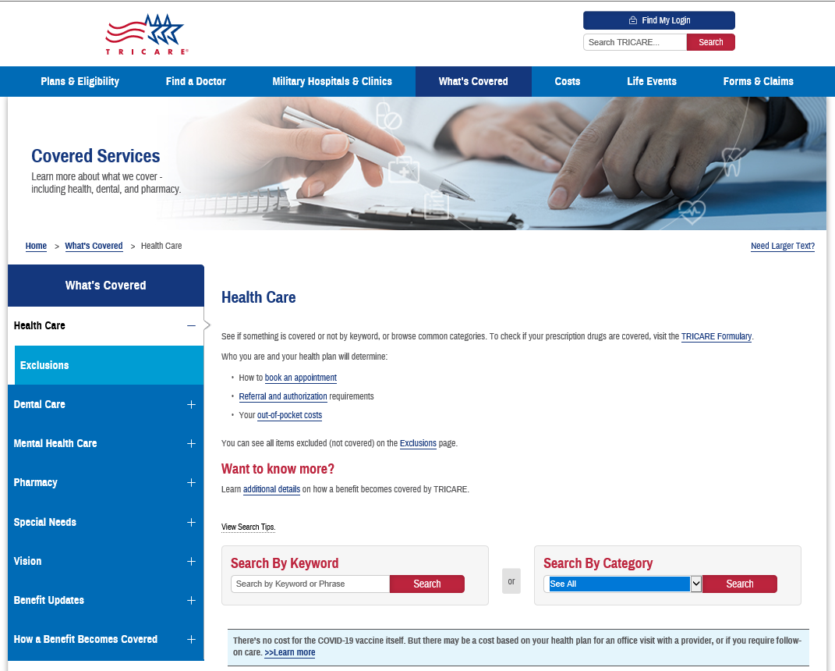
What TRICARE Covers
TRICARE covers treatments, procedures, drugs, or devices (benefits) that are:
medically or psychologically necessary;
considered appropriate medical care; and
are proven safe and effective
Services that are not medically or psychologically necessary must be specifically authorized by statute and regulation
Ex. smoking cessation, preventive services, & clinical trials
Demonstration authority – may test improvements in quality, efficiency, convenience, and cost-effectiveness
Ex. Autism Care Demonstration (ACD)
For more information, visit www.tricare.mil/CoveredServices
Notes:
medically or psychologically necessary?
The frequency, extent, and types of medical services or supplies which represent appropriate medical care and that are generally accepted by qualified professionals to be reasonable and adequate for the diagnosis and treatment of illness, injury, pregnancy, and mental disorders or that are reasonable and adequate for well-baby care.
Appropriate medical care. (i) Services performed in connection with the diagnosis or treatment of disease or injury, pregnancy, mental disorder, or well-baby care which are in keeping with the generally accepted norms for medical practice in the United States;
(ii) The authorized individual professional provider rendering the medical care is qualified to perform such medical services by reason of his or her training and education and is licensed or certified by the state where the service is rendered or appropriate national organization or otherwise meets CHAMPUS standards; and
(iii) The services are furnished economically. For purposes of this part, “economically” means that the services are furnished in the least expensive level of care or medical environment adequate to provide the required medical care regardless of whether or not that level of care is covered by CHAMPUS.
Proven Safe and Effective: Reliable evidence shows that any medical treatment or procedure has been the subject of well-controlled studies of clinically meaningful endpoints, which have determined its maximum tolerated dose, its toxicity, its safety, and its efficacy as compared with standard means of treatment or diagnosis. (See the definition of reliable evidence in 32 CFR 199.2 of this part for the procedures used in determining if a medical treatment or procedure is unproven.)
If reliable evidence shows that the consensus among experts regarding the medical treatment or procedure is that further studies or clinical trials are necessary to determine its maximum tolerated doses, its toxicity, its safety, or its effectiveness as compared with the standard means of treatment or diagnosis (see the definition of reliable evidence in 32 CFR 199.2 for the procedures used in determining if a medical treatment or procedure is unproven).
“Demonstration and studies:” may include: “(A) Alternative methods of payment for health and medical care services; (B) Cost-sharing by eligible beneficiaries; (C) Methods of encouraging efficient and economical delivery of health and medical care services; (D) Innovative approaches to delivery and financing of health and medical care services; (E) Alternative approaches to reimbursement for the administrative charges of health care plans; (F) Prepayment for medical care services provided to maintain the health of a defined population” (10 USC 1092).

Slide 9
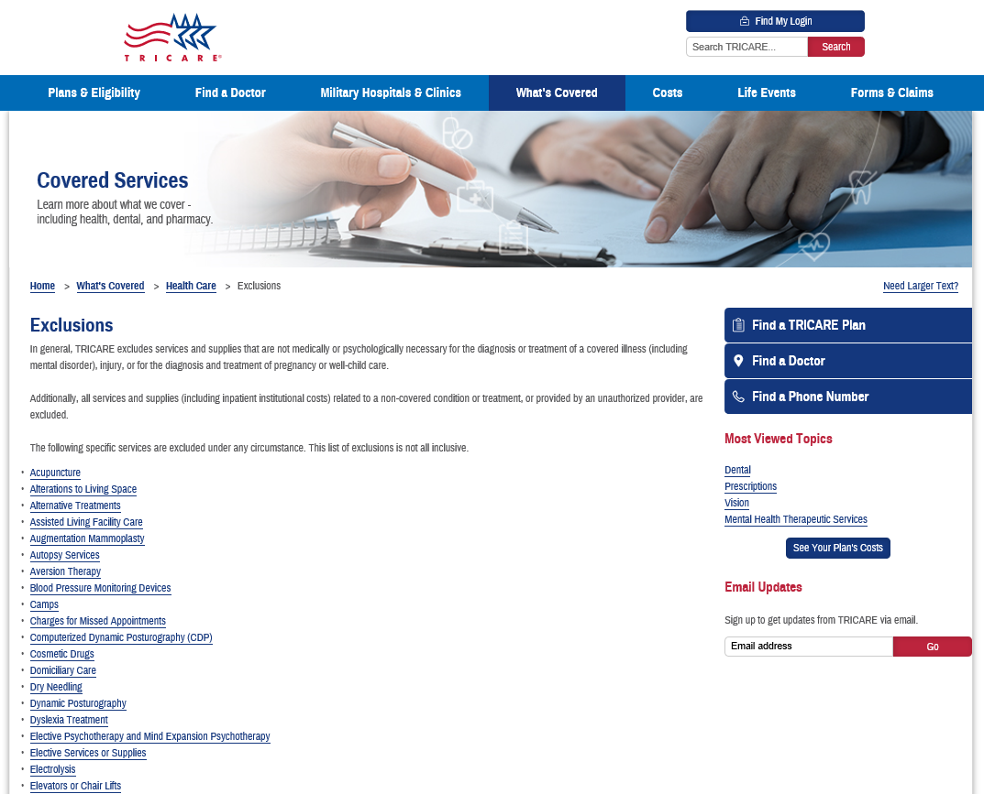
What TRICARE Excludes
In general, TRICARE excludes services and supplies that are not medically or psychologically necessary, or which are inappropriate or unproven
Additionally, TRICARE excludes all services and supplies (including inpatient institutional costs)
related to a non-covered condition or treatment,
or provided by an unauthorized provider.
Congress has also added specific exclusions under the medical benefit, such as routine dental care
For the exclusion list, and more information, visit www.tricare.mil/CoveredServices/IsItCovered/Exclusions

Slide 10
Who and What TRICARE Covers
Active-duty service members 10 U.S.C. 1074 | Private sector care is covered under rules of the Supplemental Health Care Program (SHCP) In addition to covered services, non-covered services can be provided with an approved SHCP waiver from DHA Director (or designee)
Active-duty family members 10 U.S.C. 1079 | Only covered services that are medically necessary or psychologically necessary can be provided New or emerging services or technology must be confirmed “proven” using a hierarchy of reliable evidence (32 CFR 199.2)
Retirees and family members 10 U.S.C. 1086

Slide 11
What TRICARE Pays
TRICARE must reimburse like Medicare by law, where practicable (10 USC 1079). Not practicable includes:
Most areas overseas
Areas where reimbursement does not align with needs of younger/healthier population (e.g., maternity)
Network discounts are permitted by law
Locality-based waivers (LBW) – rates may be increased in certain localities or for specific providers to prevent severely limited access to care
Cost-shares are required by law and cannot be waived

Slide 12
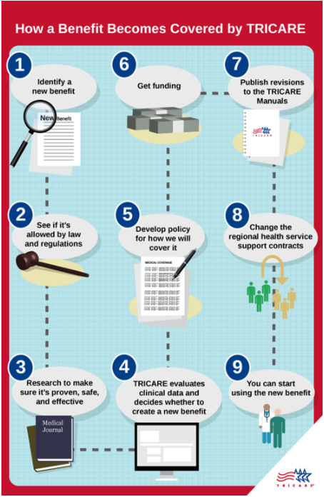
How does a benefit become a benefit?
A TRICARE covered benefit must be:
Allowed by law and the Code of Federal Regulations (and not specifically excluded)
Proven safe and effective
Officially added to the TRICARE program with a policy change and/or regulatory change (if applicable)
This process may take years, depending on the authority needed to change or add a benefit

Slide 13
Beneficiary Experience

Slide 14
Add Video

Slide 15
TRICARE Plans

Slide 16
TRICARE Plans
TRICARE Select (PPO model) – a non-“gatekeeper” plan for enrollment worldwide
No referrals required for coverage
TRICARE authorized providers, network and non-network
TRICARE Prime (HMO model) – a “gatekeeper” plan in Prime Service Areas (PSAs).
Requires referrals. Enrollees are assigned to a primary care manager (PCM).
Mandatory enrollment for active-duty service members (ADSMs).
Variations:
TRICARE Prime Remote (TPR) – available for certain ADSMs in areas geographically remote from MTFs, i.e. outside PSAs
TRICARE Prime Remote for Active-Duty Family Members (TPRADFM) – offered to certain ADFMs of a TPR-enrolled Service member, i.e. outside PSAs
TRICARE Overseas Program (TOP) Prime and TOP Prime Remote
US Family Health Plan (USFHP) – closed network TRICARE Prime plan offered in six designated service areas in the U.S.

Slide 17
TRICARE Plans (Continued)
TRICARE For Life (TFL) - wraparound coverage for TRICARE beneficiaries who have both Medicare Part A and Medicare Part B, regardless of age or place of residence
TFL pays Medicare deductibles and copayments, for TRICARE covered services
TFL coverage will begin automatically the first day an individual has both Medicare Parts A and B.
Medicare is awarded in the 25th month of receiving SSDI (for those under 65).
or
*** Sign up for Medicare Parts A and B two months before your 65th birthday !! ***
Medicare card and Uniformed Services ID card are proof of TFL coverage and must be presented at time of service
TFL beneficiaries may get care from:
Medicare participating and Medicare nonparticipating providers
Military hospitals and clinics if space is available
Avoid getting TFL-covered services from either (a) the VA for non-service connected conditions, or (b) a Medicare opt-out provider.
Medicare cannot pay anything for services from either of these providers
Patient will be responsible for billed charges minus 20% of TRICARE allowable charge paid by TRICARE

Slide 18
TRICARE Plans (Continued)
TRICARE Overseas Program (TOP) – coverage for all eligible overseas beneficiaries, including eligible Reserve Component (RC) Service members
Also includes dental coverage for TOP Prime Remote ADSMs
Other eligible beneficiaries may purchase TRICARE Dental Program (TDP) coverage
Premium-based TRICARE health plans
TRICARE Reserve Select (TRS) – member/family TRICARE Select coverage available for purchase by qualified Selected Reserve members and qualified survivors
TRICARE Retired Reserve (TRR) – member/family TRICARE Select coverage available for purchase by qualified Retired Reserve members and qualified survivors
TRICARE Young Adult (TYA) – individual Prime or Select coverage available for purchase by sponsor to cover qualified family members under the age of 26 who have lost or will lose TRICARE eligibility due to age (compare to Affordable Care Act)
Notes:
TRS – ADFM level of cost sharing payable by both RC sponsor and covered family members/qualified survivors
TRR – retiree level of cost sharing payable by both RC sponsor and covered family members/qualified survivors
TYA – level of cost sharing depends status of sponsor, ADSM or retired

Slide 19
TRICARE Plans (Continued)
Temporary Continuation of Coverage
Transitional Assistance Management Program (TAMP) – offers 180 days of premium-free TRICARE Select or TRICARE Prime (in PSA) coverage upon separation from active duty for certain sponsors
ADFM cost-sharing applies to both sponsor and family members
Continued Health Care Benefit Program (CHCBP) – offers full-cost premium-based medical coverage to certain beneficiaries for 18–36 months after TRICARE eligibility or premium-based plan coverage ends
No MTF access
Dental Plans (by DoD)
Active-Duty Dental Program (ADDP)
ADSMs – remote from Dental Treatment facilities (DTFs) or care referred by DTFs
Reserve Service members – while activated 30 or more days/covered by TAMP (family members not included)
TRICARE Dental Program (TDP) – premium-based coverage
ADFMs
Members of the Ready Reserve and their eligible family members
Selected Reserve (drilling Guard/Reserve)
Individual Ready Reserve (IRR), Inactive National Guard (ING)

Slide 20
TRICARE Pharmacy Program
All TRICARE health plans, except USFHP, include pharmacy coverage through the TRICARE Pharmacy Program.
You may fill prescriptions through:
Military pharmacies
TRICARE Pharmacy Home Delivery (some limitations overseas)
TRICARE retail network pharmacies
Non-network pharmacies or overseas pharmacies
Most retirees and their family members are required to fill certain maintenance medications through home delivery.
Learn more about your pharmacy options and copayments at https://www.tricare.mil/pharmacy.

Slide 21
Other Benefit Programs
TRICARE Plus – a primary care program offered at some military hospitals and clinics.
Each military hospital or clinic commander decides if TRICARE Plus is available.
Extended Care Health Option (ECHO) – a supplemental program to the TRICARE Basic Program. Provides eligible Active Duty Family Members (ADFMs) with an additional financial resource to assist in the reduction of the disabling effects of the beneficiary’s qualifying condition.
Women, Infants, and Children (WIC) Overseas Program – supplemental food and nutrition program for qualified families as certified by a WIC Overseas counselor.
Federal Employee Dental and Vision Insurance Program (FEDVIP) – administered by U.S. Office of Personnel Management (OPM), not by DoD.
FEDVIP exclusions:
ADSMs. Enrollees in TYA, CHCBP, and TAMP.
DoD eligible persons not enrolled in a TRICARE health plan (i.e. direct care only)
Foreign Force members and their families
Dental plan – retirees, including members of the Retired Reserve, their families, and survivors.
Additional exclusion – anyone eligible for the TRICARE Dental Program (TDP)
Vision plan – TFL & TRICARE health plan enrollees, including TRS & TRR enrollees (i.e. must be enrolled)

Slide 22
Open Season

Slide 23
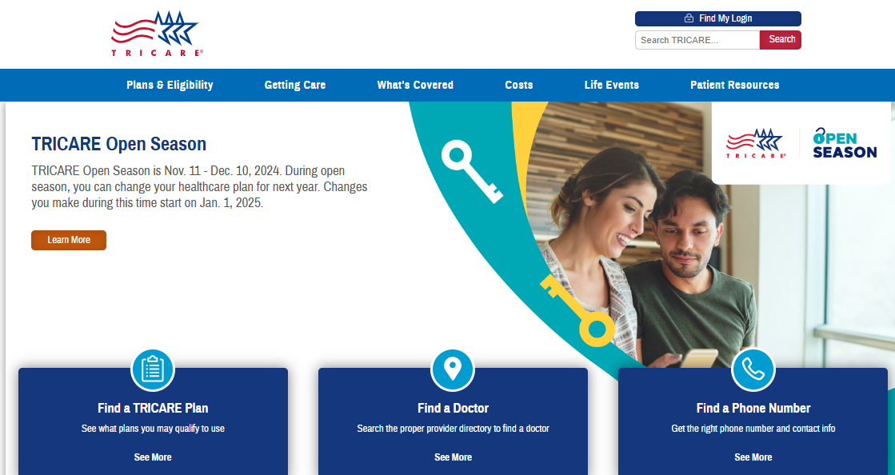
www.tricare.mil
As of Nov 2024

Slide 24
What Is TRICARE Open Season?
TRICARE Open Season is the annual period when you can enroll in or change your health care coverage for the next calendar year.
This year’s open season is Nov. 11–Dec. 10, 2024.
Enrollment changes you make during open season take effect on Jan. 1, 2025.
Learn more at www.tricare.mil/OpenSeason.
Note: Outside of TRICARE Open Season, you can only enroll in or make changes to TRICARE Prime and TRICARE Select plans following a TRICARE Qualifying Life Event.
A QLE opens a 90-day period for you to make eligible enrollment changes.
Learn more about QLEs at www.tricare.mil/LifeEvents.
Notes:
Open season occurs annually, beginning on a Monday the second full week of November and lasting at least 30 days. Open season this year is November 11—December 10, 2024. Enrollment changes take effect on January 1, 2025.
If you do not enroll or make changes during open season, your only option to do so is concurrent with a QLE, or Qualifying Life Event. QLEs are 90 day windows to make enrollment changes. Generally, the window begins on the date of the qualifying event. One important exception to the 90 day window is retirement. The timeframe for making changes following retirement can extend up to 12 months, but we won’t get into the specifics of that here. Be sure to check out our “Using TRICARE after Retirement” webinar or “Qualifying Life Events” webinars for more details about that.
Tricare.mil/lifeevents gives more information about each QLE.

Slide 25
TRICARE Open Season Eligibility
Applies to anyone (except active duty service members) enrolled in or eligible for:
TRICARE Prime
TRICARE Prime Remote
TRICARE Prime Overseas
TRICARE Prime Remote Overseas
US Family Health Plan
TRICARE Select
TRICARE Select Overseas
Doesn’t apply to:
Active duty service members
TRICARE For Life—Coverage is automatic when you have Medicare Part A and Medicare Part B.
Premium-based plans—If eligible, you may purchase these plans at any time:
TRICARE Reserve Select
TRICARE Retired Reserve
TRICARE Young Adult
Learn more about these plans at www.tricare.mil/plans.
Notes:
Now that we have discussed your open enrollment options with Prime and Select, let’s talk about how to make enrollment changes. For this year, We have some important announcements about using our Beneficiary Web Enrollment tool, or BWE.
Slide

Slide 26
Options During TRICARE Open Season
If TRICARE Open Season applies to you, you have three options:
Stay in your same plan: If you want to stay in your current TRICARE health plan, you don’t need to reenroll. You’ll continue in your current health plan through 2025 or as long as you remain eligible.
Enroll in a plan: If you’re eligible for a TRICARE Prime option or TRICARE Select but not enrolled, you can enroll in a plan.
Change plans: If you’re already enrolled in a TRICARE Prime option or TRICARE Select, you can switch health plans, if eligible. You may also switch between individual and family enrollment.
Note: If you aren’t enrolled in a health plan, you’ll only be able to get care at military hospitals and clinics—if space is available.
Notes:
So, you have 3 options if open season applies to you.
#1- if you listen to this webinar, look at all your resources and conclude that you’re in the right health plan option, you don’t need to re-enroll. You’ll continue in the same health plan for Calendar year 2025 as long as you maintain eligibility.
#2- if you are not currently in a health plan and you’re eligible for Prime or Select, you can use Open Season to enroll
#3- you can use open season to change health plans.
If you find that you need to change health plans and Open Season has closed, you will need to wait until you have a Qualifying Life Event, or until the next Open Season.
Your eligibility is managed in DEERS, the Defense Enrollment Eligibility Reporting System.
Beyond sponsor status, DEERS also records your address, which may factor into which plans are available to you. It is important that you keep information for you and family members current in DEERS. Learn more about DEERS and how to make updates at https://www.tricare.mil/deers.
Next slide, please!

Slide 27
Beneficiary Web Enrollment
Your options for how you can make open season enrollment changes may be different this year.
Effective through Dec. 31, 2024, you cannot make enrollment changes online through milConnect if:
You live in the U.S.
You move to the U.S. from overseas.
You move overseas from the U.S.
You can make enrollment changes during this time if:
You live overseas (and haven’t recently moved from the U.S.)
You have other options for making enrollment changes during this time.
!
Note: You can still update your contact information in DEERS with milConnect.
Notes:
Now that we have discussed your open enrollment options with Prime and Select, let’s talk about how to make enrollment changes. For this year, We have some important announcements about using our Beneficiary Web Enrollment tool, or BWE.
Slide

Slide 28
How To Make Enrollment Changes (Stateside)
If you choose to make open season enrollment changes, call or mail an enrollment form to the regional contractor for your 2025 region.
East Region: Humana Military
West Region: TriWest Healthcare Alliance
For enrollment changes effective before Jan. 1, 2025 (such as changes related to qualifying life events), contact the current contractor for your current region.
East Region: Humana Military
West Region: Health Net Federal Services
Find contact info at www.tricare.mil/regions. Find enrollment forms at www.tricare.mil/forms.
Want to enroll in USFHP?
Learn more at www.tricare.mil/enroll.

Slide 29
Stateside Regional Contractors
Who to contact to make enrollment changes:
East Region | West Region Enrollment Changes Before Jan. 1 | West Region Open Season Enrollment Changes (Jan. 1 or Later)
Humana Military 800-444-5445 | Health Net Federal Services, LLC 844-866-9378 | TriWest Healthcare Alliance 888-TRIWEST (888-874-9378)
Notes:
Here are the contacts for making enrollment changes if you are stateside. You’ll notice that >>>before Jan 1…
(To reiterate, these are your contacts for enrollment changes. )

Slide 30
TRICARE (T-5) Contracts

Slide 31
T-5 Contract Objectives
Readiness - Support the MHS readiness mission by partnering with the Military Medical Treatment Facilities (MTFs) to optimize the delivery of health care services to enhance the clinical expertise of providers in the direct care system (see definition of MTF optimization in the TRICARE Manual, Definitions ) for all TRICARE-eligible beneficiaries (see definition at Title 32 Code of Federal Regulations (CFR) Part 199.17(a)(6)(i))
Experience of Care - Provide a care experience that is patient and family centered, compassionate, convenient, equitable, safe, and always of the highest quality
Manage Per Capita Cost - Create value by focusing on quality, eliminating waste, and reducing unwarranted variation; considering the total cost of care over time, not just the cost of an individual health care activity
Population Health - Within the constraints, boundaries, and benefits of the current program, encourage beneficiaries and providers to seek ways to improve health

Slide 32
T5 Transition
T-5 Contracts provide significant improvements in customer service, access to care, referral management and medical management of complex cases
The 8-year contracts also provide greater stability to TRICARE networks
DHA will assess network adequacy across all specialties, including OB/Gyn and Pediatrics in all Prime Service Areas
DHA will ensure network directories remain accurate over life of contract
Transition activities are proceeding on schedule – with Start of Health Care Delivery beginning January 1, 2025
DHA is implementing a comprehensive communications and outreach program to ensure beneficiaries are aware of their health plan choices

Slide 33
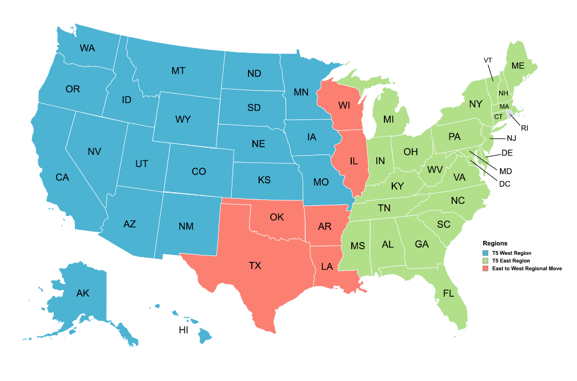
T-5 Major Contractual Changes
One year transition-out/transition-in
Transition began 1 Jan 24
Health Care Delivery begins 1 Jan 25
8-year Health Care Delivery contract
2025 – 2032
6 states move from East to West Region
~1.1M beneficiaries
T-5 West Region | T-5 West (Moved from East) | T-5 East Region

Slide 34
T-5 Major Contract Overview
This transition does not affect:
Dual-eligible Medicare/TRICARE beneficiaries (2.2 M)
TRICARE Overseas beneficiaries (400 K)
Uniformed Services Family Health Plan enrollees (100 K)
TRICARE Dental Program
Prescription Drug Networks

Slide 35
Communications Overview
T-5 transition tasks embedded into TRICARE Open Season 11 Nov – 10 Dec; maximize beneficiary attention
For active-duty families (ADFMs), many will not be affected by transition
East Region = No changes to PCMs or Specialty Network
West Region = Many Service members and ADFMs enrolled to MTF, and no transition-induced PCM changes (some specialty care network providers may change)
No enrollment fees = No action for recurring payments to TriWest
For retirees (Prime & Select), TRR, TRS, TYA enrolled
East Region = No changes; standard TRICARE and FEDVIP Open Season activities apply
West Region Approximately 270K beneficiaries using credit card or bank EFT paying recurring enrollment/premium fees must authorize TW to collect those fees
Cohort paying by military pay allotment = No action required
Comprehensive outreach -- Articles, webinar, social media, email, postal letter directed at this cohort; Automatic Payment Authorization Form - tricare.mil/west
ADFMs and Retirees enrolled to civilian PCMs in West = ~ 250,000; TRIWEST is matching their network providers (incoming) against HealthNet network providers (outgoing) in November; will target communications to individuals who may need to change PCM

Slide 36
How To Prepare for T-5
Ensure your address, email, and phone number are up-to-date in DEERS
Keep an eye out for key communications from TRICARE
If not on allotment, update your payment information with the new contractor when directed
Help us spread the word amongst your communities

Slide 37
TRICARE Overseas Program

Slide 38
TRICARE Overseas Program Complexities
TRICARE Overseas Program | Managed Care Support Program
Potential for varying number of eligible beneficiaries (9.6M) | 7.1 M eligible beneficiaries
3 Geographical areas | 2 Geographical areas
251 Countries/Territories (as recognized by the UN) | 1 Country
99 Languages | 1 Language
134 Currencies | 1 Currency
Health care delivery accommodates a wide range of cultural differences | Health care delivery is largely standardized

Slide 39
TRICARE Overseas Program Contract (TOP21)
Third Generation Overseas Contract
Contractor: International SOS (TOP contractor since 2010)
Start of Health Care Delivery under the TOP 21 contract: 1 September 2021: Contract ends 31 August 2028
Health care support services include the development of private sector provider networks, referral management activities, medical evacuation, medical documentation collection, translation services, medical management, customer service/call center activities, beneficiary/provider education, marketing, and claims processing
Requirements place emphasis on Clinical Quality, Beneficiary Experience, and Combatant Command Support
Primary Objectives of the TOP21 Contract:
Optimal Beneficiary Experience of Care
Flexible, Versatile, and Adaptable Overseas Health Care Delivery System
Highest Level of Clinical Quality
Efficient and Integrated Overseas Health Care Delivery
Notes:
Explain remote dental no longer part of TOP contract.
Most significant changes: under TOP 21 are improved clinical quality, beneficiary experience of care, and medical document collection
59 TOP Prime Locations; 275 TOP Prime Remote Locations (3 new sites in progress)

Slide 40
TRICARE in Support
TRICARE is honored to help our uniform members and their families get the healthcare that they need.
Notes:
Different health and dental plans are available under the TRICARE Program to meet the needs of each uniform member and their dependent(s).
The TRICARE team is ready to assist the family on finding the appropriate plan and getting the needed care.
When a question or issue arises, please reach out to us by way of the information in the subsequent/back-up slides.
TRICARE is here to support you and your family.

Slide 41
Questions?
Curt Prichard
Call or text: 571-217-8476
curt.b.prichard.civ@health.mil

Slide 42
Back-up Slides

Slide 43
Statutory / Regulatory / Policy Basis for the TRICARE Program
Statutory entitlement - Chapter 55 of Title 10, US Code
TRICARE Regulations - 32 Code of Federal Regulations, Part 199
Amended to implement new statutes or to change program rules/policy
DoD Issuances
Health Affairs Policy memorandums may be used temporarily
TRICARE Manuals – compilation of TRICARE contract requirements
Directs Contractor actions
Changed often as new statute, regulations policies, procedures, dictate
Followed by contract modifications to implement

Slide 44
TRICARE BENEFIT CHANGES DoD Health Benefits Have Been Expanding Steadily Since 1995
Enhanced Benefit –“Watershed” Legislative Year
TRICARE for Life (TFL)
TRICARE Senior Pharmacy
Zero copays for AD Families in TRICARE Prime
Retiree catastrophic cap reduced from $7,500 to $3,000
…and much more
CHAMPUS Legislated Benefit
Civilian Health Care where MTFs do not exist
Families and Retirees <65
TRICARE Managed Care Legislation
3 health plan options (Prime, Standard, Extra)
Automatic enrollment for Active Duty
Space Required for TRICARE Prime enrollees
Space Available for Non-enrollees
TRICARE Reserve Select Plan Added
TRICARE Benefit Expansion
Dependents Medical Care Act
Authorizes SecDef to contract with civilian providers for medical care for Active Duty dependents
TRICARE Young Adult Plan Added
CHAMPUS Reform Initiative (CRI)
Pilots in CA and HI introduce health plan choice (pre-cursor to TRICARE)
TRICARE Select replaces TRICARE Standard & Extra
Added FEDVIP vision & dental
Title 10 Legislated Benefit
Space Required for Active Duty
Space Available for Families and Retirees
Family Member Dental Program Established
1956
1966
1986
1988
1994
2001
2005
2011
2018
1940
1950
1960
1970
1980
1990
2000
2010
2020
1948 - 2011
1998
2013
2017
2019
Defense Health Agency (DHA) established
Expands and supersedes role of TMA
NDAA 2019
New DHA organizations for:
Research & Development
Training & Education
Public Health
MHS Oversight & Management
TRICARE Management Activity (TMA) established
Field activity of OASD/Health Affairs
MHS Governance Studies
18 Commissions and/or studies conducted to evaluate best approach for managing and delivery the military health benefit
NDAA 2017
DHA authority expanded to include management & administration of MTFs

Slide 45
Patient Care Numbers for the MHS Fiscal Year 2024
Type of Care | Annual Workload Summary
Inpatient Admissions | 850,400 Total 145,900 Direct Care 17% 330,500 Private Sector Care 39% 374,000 TRICARE for Life 44%
Outpatient Visits | 87,900,000 Total 21,700,000 Direct Care 25% 36,100,000 Private Sector Care 41% 30,100,000 TRICARE for Life 34%
Births | 89,200 Total 13,800 Direct Care 15% 75,400 Private Sector Care 85%
Prescriptions Filled | 101,700,000 Total 30,700,000 Direct Care 30% 5,800,000 Home Delivery 6% 24,800,000 Retail Pharmacies 24% 40,400,000 TRICARE for Life 40%
Emergency Department Visits | 3,962,600 Total 1,226,300 Direct Care 31% 1,560,400 Private Sector Care 39% 1,176,200 TRICARE for Life 30%
www.health.mil/Military-Health-Topics/MHS-Toolkits/Media-Resources/Media-Center/Patient-Care-Numbers-for-the-MHS
Source: FY 2024 Evaluation of the TRICARE Program (p. 12)

Slide 46
Where to Find Answers/Get Help
Sign up for email updates at www.tricare.mil
Become familiar with and understand your health benefits
Keep your contact information up to date in Defense Enrollment Eligibility Reporting System (DEERS)
In person: Visit a local ID card office. Find an office near you at www.dmdc.osd.mil/rsl.
Phone: Call 1-800-538-9552 (TTY/TDD: 1-866-363-2883) or fax updates to 1-800-336-4416 (Primary) or 1-502-335-9980 (Alternate)
Online: Log into milConnect at https://milconnect.dmdc.osd.mil
Mail: Mail updates to: Defense Manpower Data Center Support Office; Attention: COA, 400 Gigling Road, Seaside, CA 93955-6771
Links to MTF Patient Advocates are on every MTF website
Contact a Beneficiary Counseling and Assistance Coordinator (BCAC) or Debt Collection Assistance Officer (DCAO) for help https://tricare.mil/bcacdcao

Slide 47
Getting Care When Traveling
Your TRICARE health plan covers you worldwide while traveling on business, for vacation, or when moving
Rules for getting care vary by your particular plan and travel destination
US Family Health Plan enrollees should first call Customer Service at (800) 748-7347 and then save all healthcare receipts
Visit www.tricare.mil for more information
Click on “Find a Doctor”
And select “Getting Care When Traveling”
Alternatively, you can go directly to www.tricare.mil/FindDoctor/Traveling
Procurement Sensitive – See FAR 3.1

Slide 48
Maintaining or Changing Your TRICARE Coverage
Once you’re enrolled in a TRICARE Prime or TRICARE Select plan, you may only change plans during TRICARE Open Season or if you or a family member have a QLE.
To stay in the same plan the next year, you don’t need to reenroll.
Continue to pay applicable enrollment fees and monthly premiums to maintain your coverage.
No enrollment needed for TRICARE For Life. Coverage is automatic if you have Medicare Part A and Part B.
Don’t forget to keep DEERS updated!
More Info
TRICARE Open Season: https://www.tricare.mil/openseason
QLEs: https://www.tricare.mil/lifeevents
Compare Plans: https://www.tricare.mil/compareplans
Compare Costs: https://www.tricare.mil/comparecosts

Slide 49
TRICARE Contractors
TRICARE East Region Humana Military 800-444-5445 https://www.humanamilitary.com
TRICARE West Region (for enrollments effective Jan. 1, 2025) TriWest Healthcare Alliance 888-874-9378 https://www.tricare.mil/west
TRICARE West Region (through Dec. 31, 2024) Health Net Federal Services, LLC 844-866-9378 https://www.tricare-west.com
TRICARE Overseas International SOS https://www.tricare-overseas.com/contact-us
US Family Health Plan 800-748-7347 https://www.tricare.mil/usfhp
TRICARE For Life Wisconsin Physicians Service—Military and Veterans Health U.S. and U.S. territories 866-773-0404 https://www.tricare.mil/tfl https://www.tricare4u.com
Active Duty Dental Program United Concordia 866-984-2337 https://tricare.mil/CoveredServices/Dental/ADDental
TRICARE Dental Program United Concordia CONUS 844-653-4061
OCONUS 844-653-4060 https://tricare.mil/CoveredServices/Dental/TDP
TRICARE Pharmacy Program Express Scripts, Inc. 877-363-1303 https://militaryrx.express-scripts.com/

Slide 50
Keep Up With TRICARE News and Updates
TRICARE Region Changes www.tricare.mil/changes
TRICARE Open Season www.tricare.mil/OpenSeason
TRICARE Newsroom https://newsroom.tricare.mil
TRICARE Newsletters www.tricare.mil/newsletters
TRICARE Webinars www.tricare.mil/webinars
Connect With Us!
facebook.com/TRICARE
twitter.com/TRICARE
instagram.com/TRICARE
tricare.mil/subscriptions
Notes:
I want to remind you that there are many ways to stay up to date with TRICARE.
If you’re looking for more information about the 2025 region changes, I encourage you to check out tricare.mil/changes.
And if you’re looking for more information about Open Season, be sure to check out tricare.mil/OpenSeason.
Visit newsroom.tricare.mil to see the latest articles and news about region changes, Open Season, and other information about your TRICARE benefit.
You can go to tricare.mil/subscriptions to subscribe to benefit update emails and newsletters.
As a reminder, you can find this information by going to tricare.mil/webinars and downloading a copy of this presentation
You can also follow TRICARE on social media.
Now, I’ll hand things back over to Calvin to start our Q&A session.

Slide 51
TRICARE Network of Providers
The TRICARE Network is designed to augment the Direct Care System to meet the primary, specialty, inpatient, outpatient, and pharmacy needs of the TRICARE beneficiary population.
TRICARE contractors establish and maintain the TRICARE network of individual and institutional providers sufficient in number, mix, and geographic distribution. to provide the full scope of benefits for TRICARE health plan enrollees.
TRICARE access to care and quality standards are followed and monitored by the DHA’s TRICARE Health Plan division for all Prime Service Areas (PSA), non-PSAs (i.e., remote areas), and worldwide.
In addition to meeting all TRICARE requirements, TRICARE contractors must obtain and maintain accreditation of the TRICARE network by a nationally recognized accrediting body.
Accreditation standards for network providers and facilities cover areas including, but not limited to, licensure, education, training, hospital privileges, and liability insurance.
Network Accreditation standards guide contractors in evaluating network provider performance and program compliance while monitoring that services provided are within the standard of care.
For instance, the current TRICARE contractors for the East and West regions are accredited by URAC.
The U.S. Family Health Plans (6) are accredited by either URAC or the National Committee for Quality Assurance (NCQA).

Slide 52
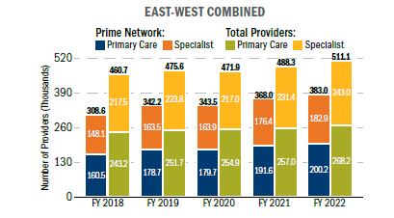
Provider Participation
Total number of participating providers has been rising steadily for more than a decade.
Trend is due primarily to an 18 percent increase in the number of network providers between FY 2019 and FY 2023.
Number of non-network providers increased by 4 percent over the same period.
Between FY 2019 and FY 2023
East Region saw an increase of 17 percent in total TRICARE providers, while West Region saw an increase of 9 percent.
East Region saw an increase of 21 percent in TRICARE network providers, while the West Region saw an increase of 13 percent.
TRENDS IN NETWORK AND TOTAL PARTICIPATING PROVIDER FTEs, FYs 2018–2022ª
232.9
242.8
178.2
252.2
242.9
224.7
Source: MHS administrative data, 1/20/2022
ª Network providers are TRICARE-authorized providers who have a signed agreement with the regional contractors to provide care at a negotiated rate. Participating providers include network providers and those non-network providers who have agreed to file claims for beneficiaries, to accept payment directly from TRICARE, and to accept the TRICARE allowable charge, less any applicable cost shares paid by beneficiaries, as payment in full for their services.
Source: FY 2024 Evaluation of the TRICARE Program, p. 136.

Slide 53
Civilian Provider Acceptance of, and Beneficiary Access to, TRICARE Select
The DoD completed surveys of civilian providers and MHS non-enrolled beneficiaries (i.e., TRICARE Select), designed to determine civilian provider acceptance of, and beneficiary access to, the TRICARE Select benefit option.
Provider survey results and key points
84 percent of physicians and 34 percent of behavioral health providers accept new TRICARE Select patients if they accept new patients of any insurance.
Physicians were more likely to not accept TRICARE Select because they were not accepting new patients.
Behavioral health providers were more likely to not accept TRICARE Select because of “other”—they were not aware of it, the reimbursement was too low, or they only took private insurance.
Beneficiary survey results and key points
Compared with the civilian benchmark, TRICARE Select enrollees rate their care experience and access to care higher than or comparable to the civilian benchmarks.
Access of TRICARE Select users to personal doctors and specialists is lower than civilian benchmarks.
Beneficiaries in non-PSAs were more likely to say personal doctors did not accept TRICARE and the travel distance was too long than those in PSAs.
Other access measures do not differ significantly between PSAs and non-PSAs.
Source: FY 2024 Evaluation of the TRICARE Program, p. 137.

Slide 54
TRICARE Plans (Stateside Options)
Those Eligible for TRICARE Health Plan Enrollment | Stateside Health Plan Choices
Active duty service members (ADSM), including National Guard and Reserve (NGR) members activating for more than 30 days | TRICARE Prime TRICARE Prime Remote (TPR)
Active duty family members (ADSM), including eligible family members of NGR sponsors activating for more than 30 days | TRICARE Select TRICARE Prime US Family Health Plan (USFHP; where available) TRICARE Prime Remote for Active Duty Family Members (TPRADFM) TRICARE Young Adult (TYA)
Members of the Selected Reserve (not activated) and their eligible family members | TRICARE Reserve Select (TRS) & TYA
Members of the Retired Reserve (not activated) and their eligible family members | TRICARE Retired Reserve (TRR) & TYA
Medal of Honor recipients and Retired service members, including retired Reservist (at age 60), along with their family members, survivors. Qualified unremarried former spouses | TRICARE Select TRICARE Prime & USFHP (where available locally) TYA
TRICARE-eligible beneficiaries who have both Medicare Part A and B (Excluding AD/ADFM) | TRICARE for Life (TFL)

Slide 55
Questions To Ask Before You Choose a Plan
Questions | Learn More
Which plans might I be eligible for based on my sponsor’s status and my location? | www.tricare.mil/PlanFinder
What type of health plan is it? Consider which plan type best serves each of your family members. | www.tricare.mil/ComparePlans
How much will you have to pay for care? Consider enrollment fees and cost per service. | www.tricare.mil/CompareCosts
Do I prefer getting care at military hospitals or clinics or from civilian providers? | www.tricare.mil/FindDoctor
How would I get care with my plan? Understand each plan’s rules for getting care, including if you need referrals. | www.tricare.mil/GettingCare
Am I expecting any big life changes next year? Examples include having a baby or becoming eligible for Medicare. | www.tricare.mil/LifeEvents
Notes:
So here is the crux of your research into health plans.
On the left we have some questions that are important to consider before you choose a health plan. On the right is a list of websites that can offer more information as you answer these questions for your family.
*go through the questions and talk through some options*
TRICARE Open Season applies to anyone enrolled in or eligible for:
TRICARE Prime
TRICARE Prime Remote
TRICARE Prime Overseas
TRICARE Prime Remote Overseas
US Family Health Plan
TRICARE Select
TRICARE Select Overseas
Moving onto slide 15, we’ll answer some of these questions. Next slide, please.

Slide 56
Upcoming Communications Tactics
November 2024:
Beneficiary communication about updating payment information (ongoing)
Social Media Posts continue (Facebook, X, Instagram)
Open Season/T-5 webinar (11/14)
T-5 briefing at MSO/VSO Executive Roundtable with DHA Director (11/18)
T-5 update in TRICARE Guide in the Nov. issue of MOAA's Military Officer magazine
Articles to be posted:
Know Your 2025 Costs
Open Season Starts, Payment Methods
Eligibility for Open Season
December 2024: ​
Beneficiary communication about updating payment information (ongoing)
Social Media Posts continue (Facebook, X, Instagram)
Final start of health care delivery content uploaded in Sitecore
Virtual meeting to brief MSO/VSO community
Articles to be posted:
Open Season Ends Soon/T-5
T-5 Reminders
January 2025: ​
Priority 2 products posted to TRICARE.mil
Virtual meeting to brief MSO/VSO community

Slide 57
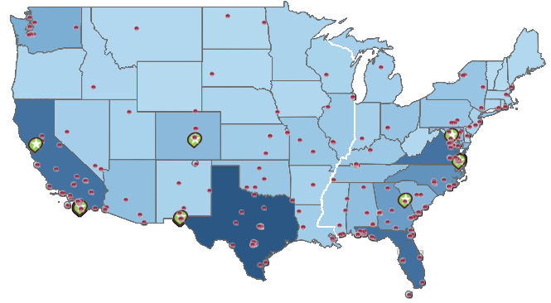
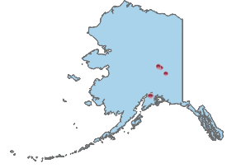
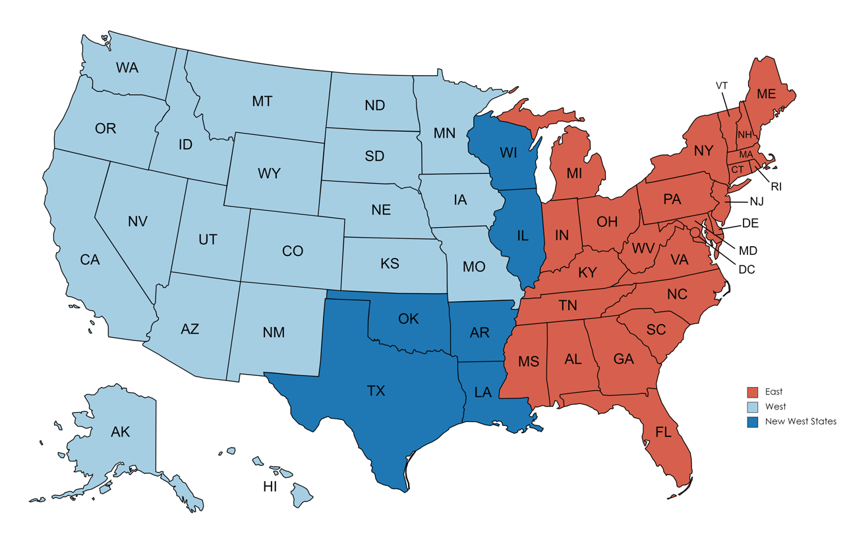
T-5 Contract Regions
West
DHN Main Site
Washington
Montana
North Dakota
East
Defense Health Networks (DHNs)
DHN MTFs
Minnesota
South Dakota
Wisconsin
Vermont
Maine
INDO-PACIFIC
PACIFIC RIM
WEST
CENTRAL
ATLANTIC
EAST
NATIONAL CAPITAL REGION
EUROPE*
CONTINENTAL
Oregon
Idaho
New Hampshire
Wyoming
Michigan
New York
Massachusetts
Iowa
Connecticut
Nebraska
Pennsylvania
Rhode Island
Colorado
Illinois
Ohio
New Jersey
Nevada
Utah
Indiana
Maryland
Kansas
Missouri
West Virginia
Delaware
California
Kentucky
Virginia
Oklahoma
Arkansas
Tennessee
North Carolina
Arizona
New Mexico
South Carolina
*TAO covers Europe DHN
Mississippi
Alabama
Georgia
Texas
Louisiana
Florida
Alaska
Hawaii
Source: M2 Demographics, Tableau (frances.l.bautista.civ@health.mil)

Slide 58
Places To Learn More
https://newsroom.tricare.mil/News/TRICARE- News/Article/3254092/changes-to-tricare-expected-in-2024
https://newsroom.tricare.mil/News/TRICARE- News/Article/3776346/qa-what-to-know-as-new-tricare- contracts-begin-in-2025
https://tricare.mil/About/Regions/East-Region
https://tricare.mil/About/Regions/West-Region
https://public.govdelivery.com/accounts/USMHSTMA/subscriber/new

