Slide 1

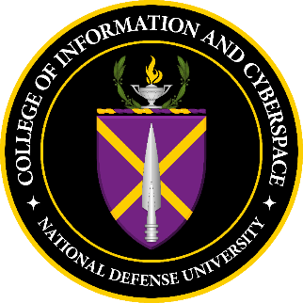
Cyber, Cyber Security and the AI Future
Professor & Associate Dean of Joint Warfighting
Matt Easley, PhD
13 August 2026

Slide 2
We Live in a Digital World
Your personal cybersecurity matters
Everything is becoming even more connected
AI is driver of the economy
Energy, data centers and semiconductor supply chains are strategic assets
Cyber is now an element of national power

Slide 3
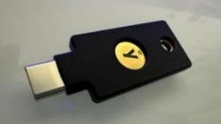
Cybersecurity is Personal Security
You and your family are part of your spouse’s attack surface.
Social Engineering in the #1 threat
Manage your online presence
Data Aggregation can make you vulnerable: geofencing, geotagging, image recognition of faces and places
Your home network is a soft target: WPA3, router firmware, separate networks for IoT devices
Your smart phone is a soft target: be cautious with app permissions, esp. contacts & microphone

Slide 4
AI is Transforming Knowledge Work
“I am no longer needed for the actual technical work of my job. I describe what I want built, in plain English, and it just... appears. Not a rough draft I need to fix. The finished thing. I tell the AI what I want, walk away from my computer for four hours, and come back to find the work done. Done well, done better than I would have done it myself, with no corrections needed.” Matt Shumer
Legal Work (contracts, case law, briefs, research)
Financial Analysis (models, data, memos, reports)
Writing and Content (Marketing, journalism, technical writing)
Software Engineering (coding, complex projects)
Medical Analysis (reading scans, lab results, diagnoses)
Customer Service (complex, multi-step problem-solving)
https://shumer.dev/something-big-is-happening
https://www.bloomberg.com/news/videos/2026-02-20/ai-investor-matt-shumer-on-viral-essay-on-ai-risks-video

Slide 5
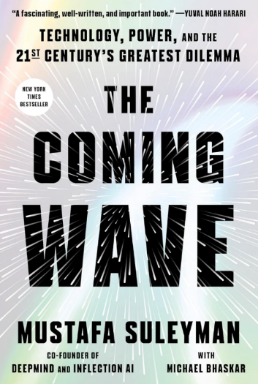
Is AI Replacing Labor or Redefining It?
Three Claims About AI
AI will automate professional work at scale.
AI will increase productivity but not reduce employment.
AI will increase demand for elite human talent while hollowing out the middle.
Dario Amodei, the CEO of Anthropic, says AI is now writing "much of the code" at his company, … predicts that AI will eliminate 50% of entry-level knowledge workers in 1-5 years
Mustafa Suleyman (CEO of Microsoft AI, former head of DeepMind):
https://youtu.be/YTrBz6Z5c0E?t=688 (11:25) https://www.youtube.com/watch?v=YTrBz6Z5c0E

Slide 6
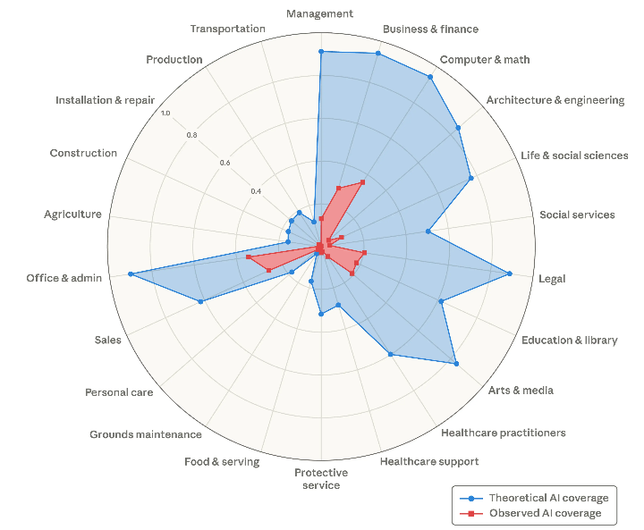
Theoretical capability and observed exposure by occupational category
https://www.anthropic.com/research/labor-market-impacts

Slide 7
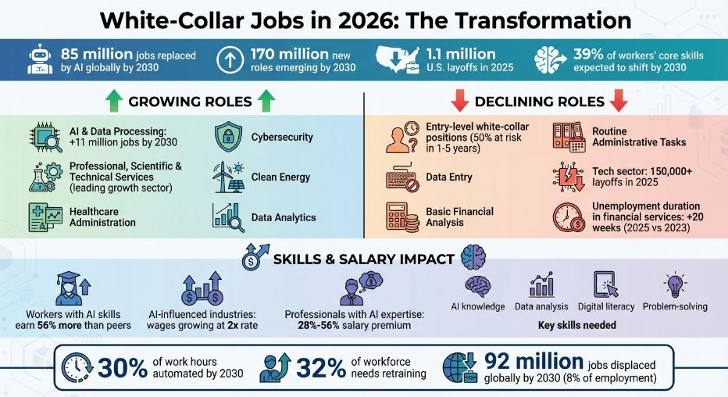
Jobs in 2026
https://www.lockedinai.com/blog/white-collar-jobs-2026-roles-grow-disappear

Slide 8
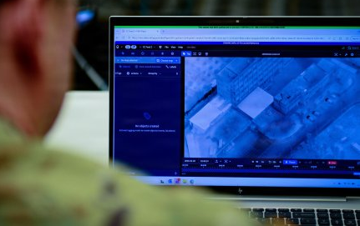
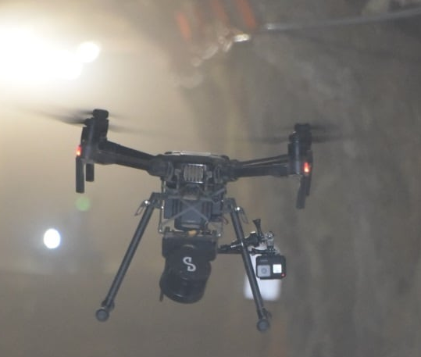

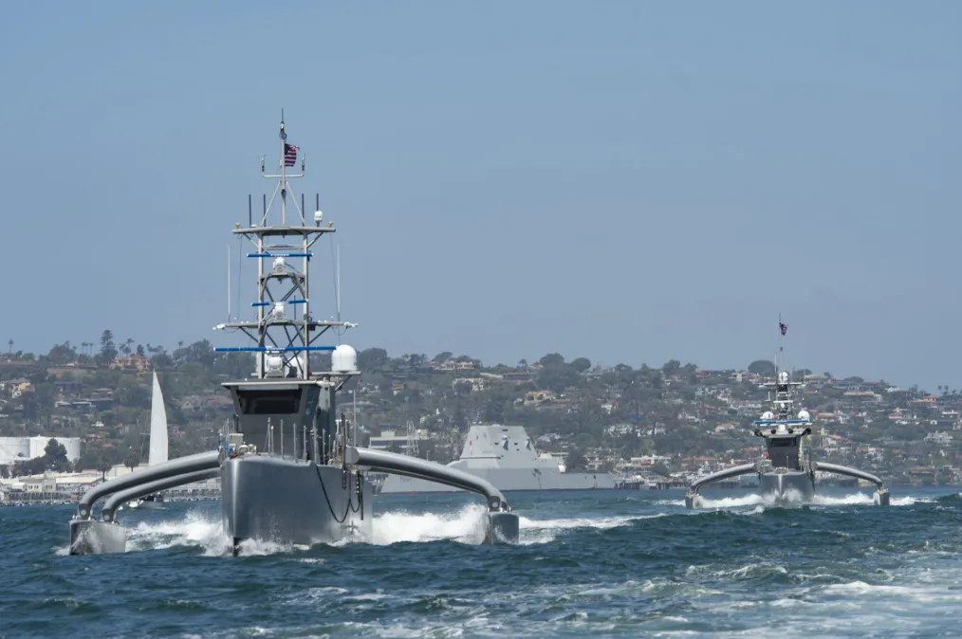
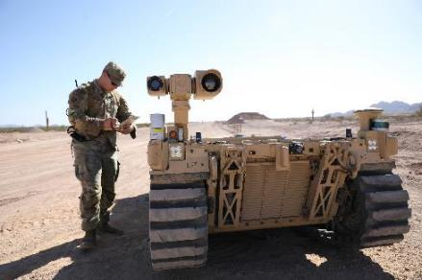

Militaries Rely on Cyber
Notes:
C2
Intelligence
Logistics
Weapons System
All these digital capabilities come with vulnerabilities

Slide 9
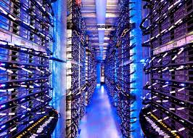
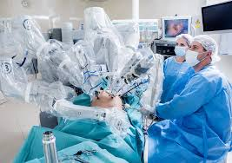
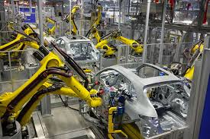
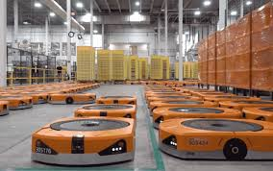
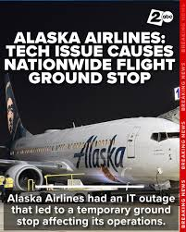
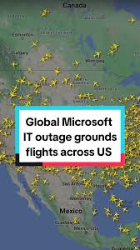
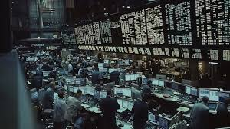
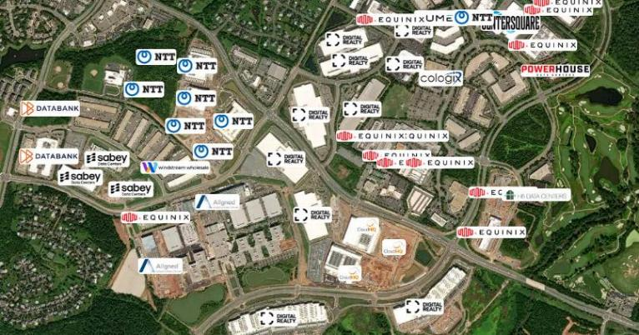
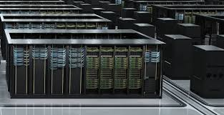
The US Economy Relies on Cyber
Notes:
Every Aspect of Modern Society requires digital infrastructure:
travel, logistics, healthcare, finance, education, retail
Civilian world has the vast majority since this is were the IP and $$$
Economies, Governance

Slide 10
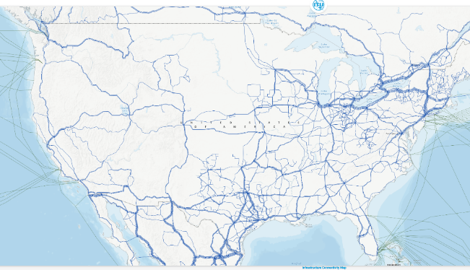
Structural Reality
Cyber Infrastructure
  Privately Owned (mostly)
  Globally Interconnected
  Capital-intensive
  Jurisdictionally Fragmented
  Concentrated critical supply chains
  Energy & Water intensive
The result of decades of efficiency-driven globalization
Notes:
"When you hear people arguing about data centers, they're often talking about electricity, water, and land use. But from a national security perspective, they're also talking about where the computing power for the AI economy will live."
https://foreignpolicy.com/2016/06/29/the-man-who-nailed-jello-to-the-wall-lu-wei-china-internet-czar-learns-how-to-tame-the-web/
We know how much the internet has changed America, and we are already an open society. Think how much it will change China. There’s no question China has been trying to crack down on the internet. Well, good luck. That’s sort of like trying to nail Jello to the wall. Bill Clinton March 8, 2000

Slide 11

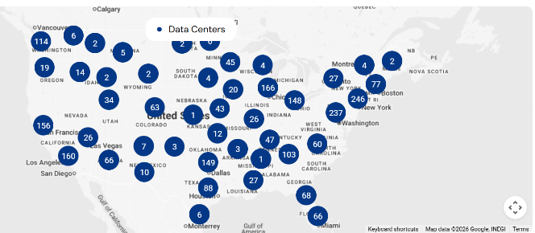
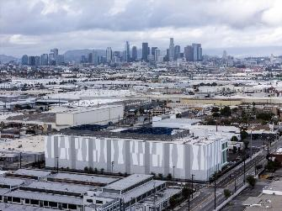
Top American Data Center Operators
Equinix Co-Location Center in a repurposed telephone building
Operator | Data Centers | Connectivity | Cloud On-Ramps
Equinix | 92 | 3514 | 113
Digital Realty | 115 | 2546 | 19
CoreSite | 38 | 2529 | 44
529 Bryant Street in Palo Alto, CA
Location, Location, Location
LAXo1 242k sq feet building in Vernon, CA (population 200)
33 MW
https://cloudscene.com/rankings/leaderboard
Notes:
https://www.latimes.com/business/story/2025-12-30/southern-california-has-unlikely-ai-mecca-very-industrial-vernon

Slide 12
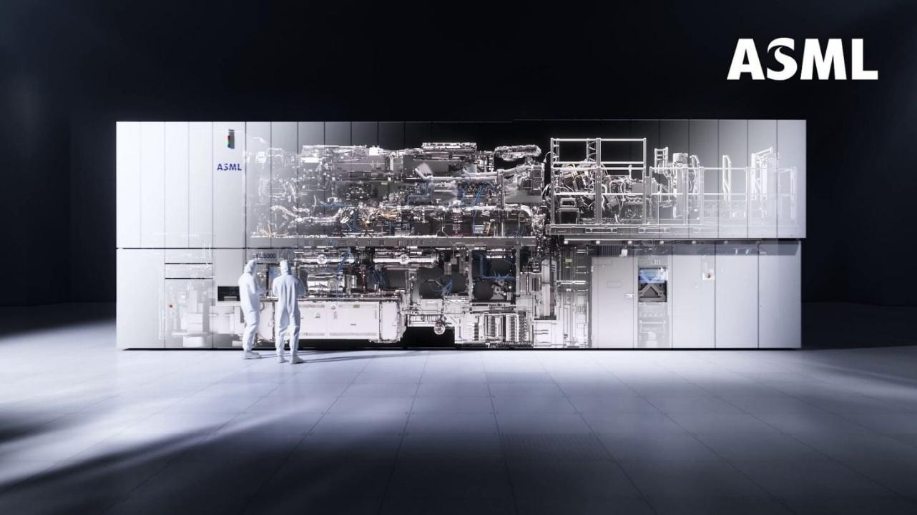
Advanced Semiconductor Materials Lithography
“ASML: The US$378 Million Machines That Make Modern Life Possible”, Yahoo! Finance, 2 OCT 2025
“Every smartphone in your pocket, every car with advanced electronics, and every server that powers the internet relies on one company’s machines.”
Notes:
[NOTES PAGE]"Almost every advanced AI chip in the world ultimately depends on one Dutch company. That's remarkable. We often think globalization makes systems more resilient because there are many suppliers, but in some of the most important technologies the opposite is true: there are only one or two suppliers. That creates both economic opportunity and strategic vulnerability.“
https://sg.finance.yahoo.com/news/asml-us-378-million-machines-093000549.html
https://www.tweaktown.com/news/99105/asml-rumored-to-charge-up-700-million-per-next-gen-hyper-na-euv-machine-by-2030/index.html
https://www.tweaktown.com/news/98185/intel-places-orders-to-secure-all-of-asmls-high-na-euv-machines-built-this-year/index.html

Slide 13
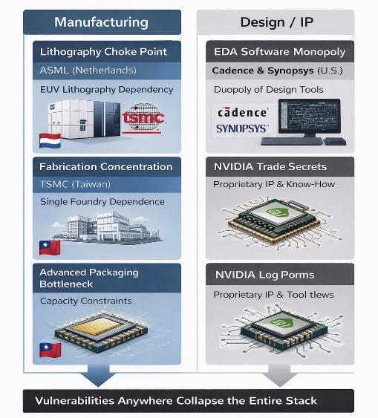
Points of Failure In NVIDIA’s Supply Chain
Lithography choke point (ASML – Netherlands)
Advanced NVIDIA chips cannot exist without EUV lithography
Single firm, single country, export-controlled toolchain
Political or supply disruption halts all leading-edge production
Design software duopoly (Cadence / Synopsys – U.S.)
Chip design depends on a duopoly of EDA software
Loss of access = inability to design, verify, or iterate new chips
Software updates, licenses, and IP controls are strategic leverage
Fabrication concentration (TSMC – Taiwan)
NVIDIA relies on one dominant foundry for advanced nodes
No near-term substitute at equivalent scale or yield
NVIDIA Verification Logic
“AI superiority” rests on a stack of privately owned, globally distributed single points of failure—none of which the state fully controls in crisis.
Notes:
https://sg.finance.yahoo.com/news/asml-us-378-million-machines-093000549.html

Slide 14
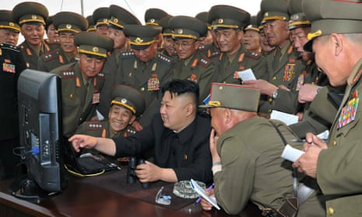
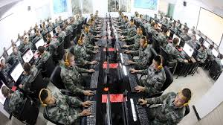
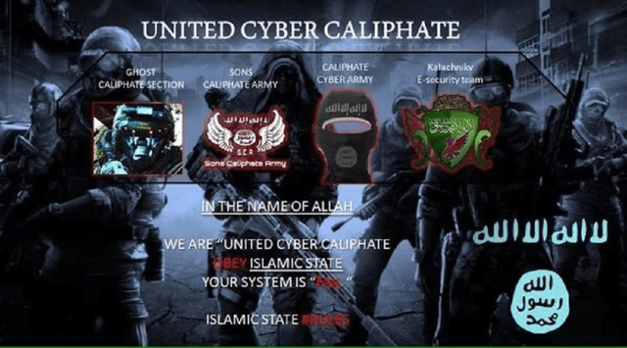
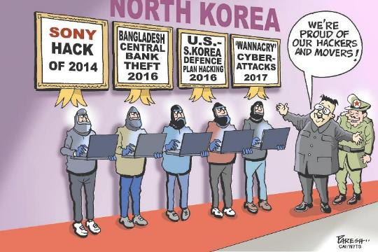
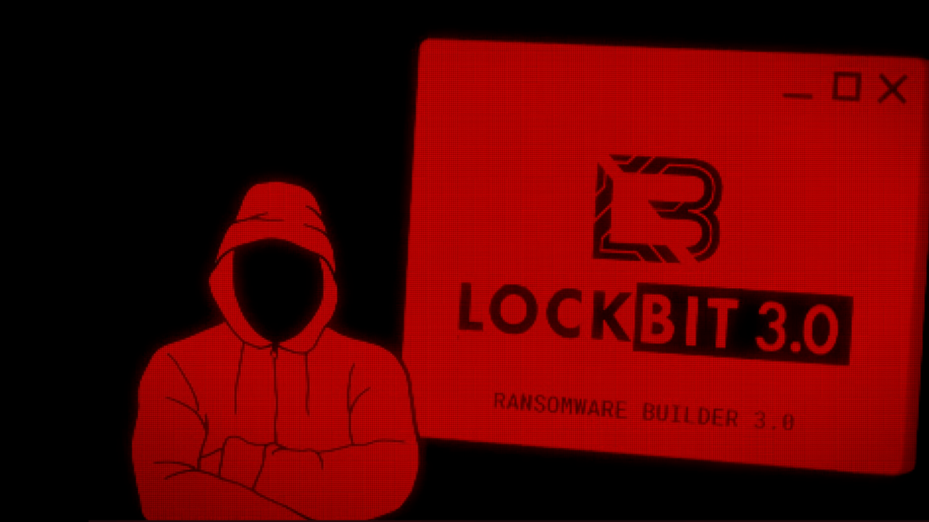
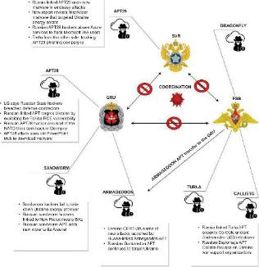
External Threats
Notes:
Cyberspace has erased the distinction between the battlefield and the home front. A foreign intelligence service no longer has to come to Washington to collect information. They can do it from anywhere in the world, against anyone connected to the people they're interested in. That's why your personal cybersecurity isn't just a personal issue—it contributes to your family's operational security.“
Structured/Unstructured Hackers
Hacktivists
Compromised or Disgruntled Insiders
Petty criminals
Non-state actors
Organized crime
Terrorists
Freelance nationalists
Nation-states

Slide 15
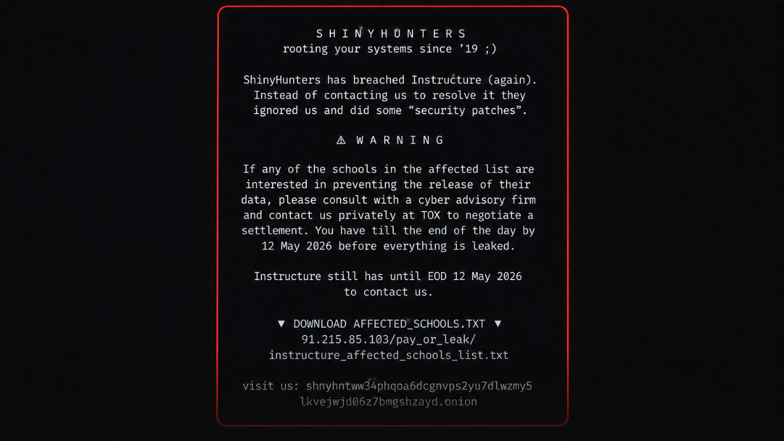
Notes:
Image of the Canvas Breach

Slide 16
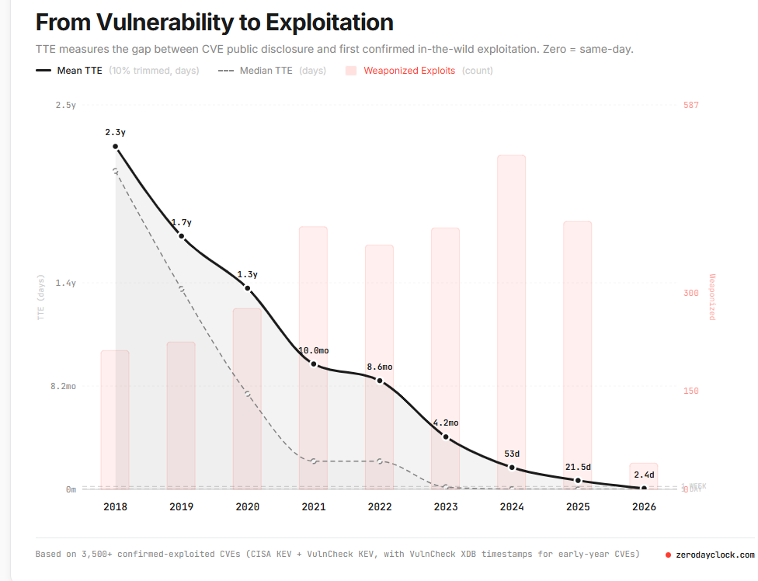
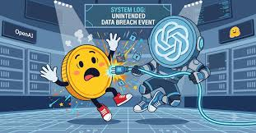
Zero-Day Exploits
In 2027 this should reach 1 hour to 1 minute
Notes:
"AI doesn't just help American companies. It also makes our adversaries more effective. It lowers the cost of writing malware, creating convincing phishing emails, generating deepfakes, translating into perfect English, and conducting influence campaigns. AI is becoming an amplifier of cyber power for everyone."

Slide 17
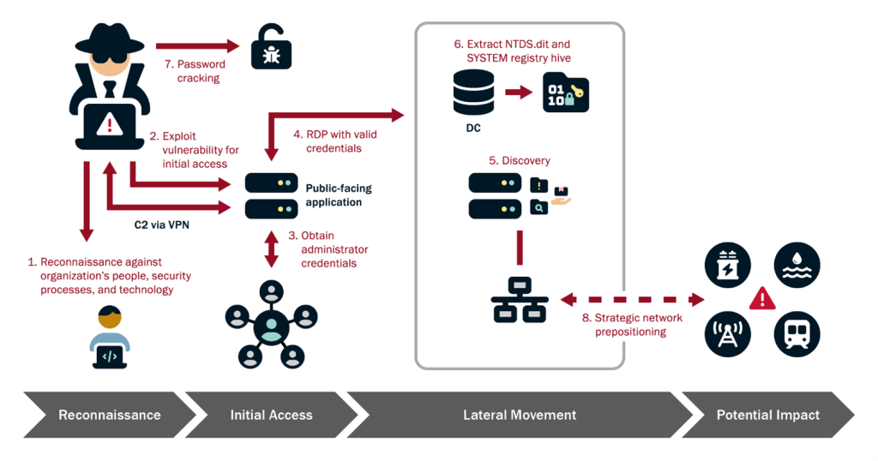
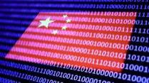
Volt Typhoon
Critical
Infrastructure
https://www.cisa.gov/news-events/cybersecurity-advisories/aa24-038a

Slide 18
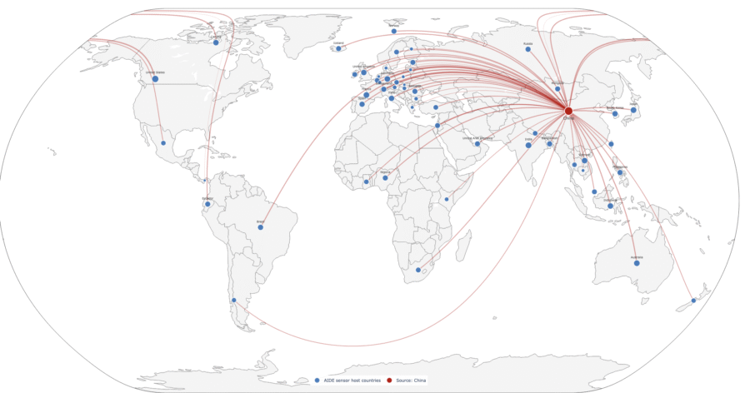
Salt Typhoon Attack Footprint
Compromised Telecommunication Infrastructure
Allowed Breaching for government wiretapping systems
Established persistence in 80 nations & at least 600 organizations
https://globalcyberalliance.org/new-report-salt-typhoon-across-the-internet/

Slide 19
Cyber Aware Case Study: OPM Breach
Every SF-86 asks the most personal questions the government can legally ask you. The breach wasn't about stealing names; it was about giving a foreign intelligence service a dossier on millions of Americans that could be used for recruitment, blackmail, or identifying relationships.
https://www.dni.gov/ncsc/e-Learning_CyberAware/pdf/Cyber_Aware_CaseStudy_OPM.pdf
Notes:
OLD SLIDE CONTENT: In what appeared to be a coordinated campaign to collect information on government employees, attackers stole the personnel files of 4.2 million former and current government employees and security clearance background investigation information on 21.5 million individuals. Additionally, fingerprint data for 5.6 million of these individuals was stolen. Background investigation information includes some of the most intimate and potentially embarrassing aspects of a person’s life, including whether the applicant consulted with a healthcare professional regarding an emotional or mental health condition, used illegal drugs, abused alcohol, or experienced financial problems.

Slide 20
Conclusion
Everything depends on cyber.
Protect yourself and your family.
Your online presence is part of your family's operational security.
AI will change professional work far faster than most people expect.
Technology will continue to change rapidly. Curiosity, skepticism, and good judgment will always be your best defenses.

