Slide 1

CAPSTONE 26-2
  Gen Ken Wilsbach, CSAF 24

Slide 2
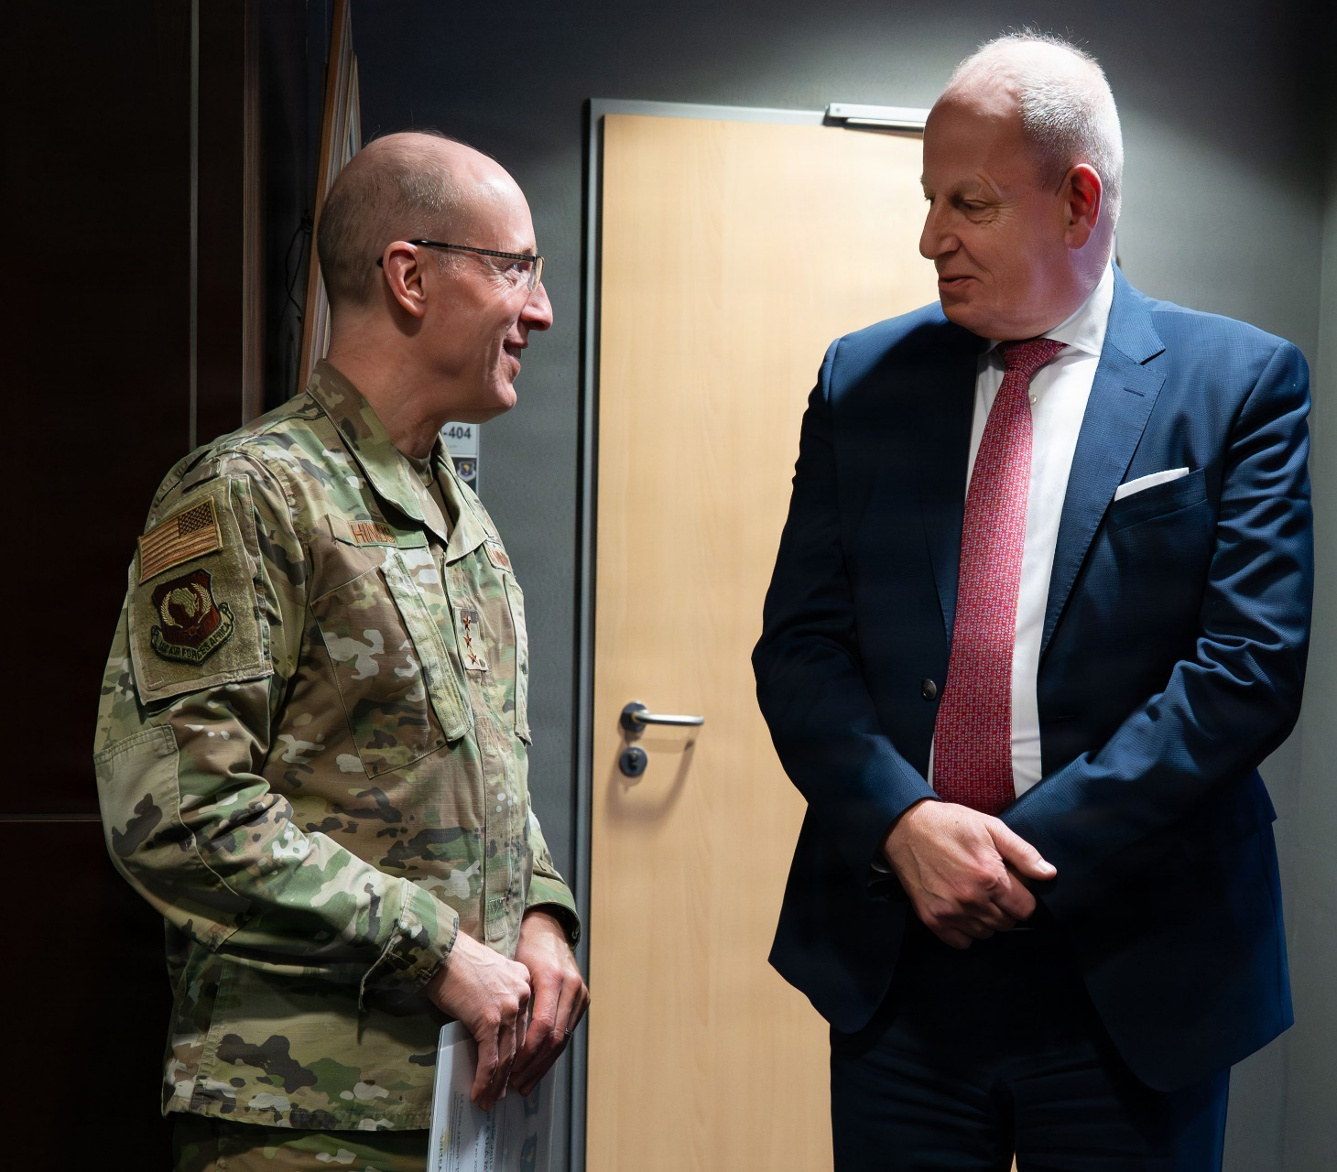
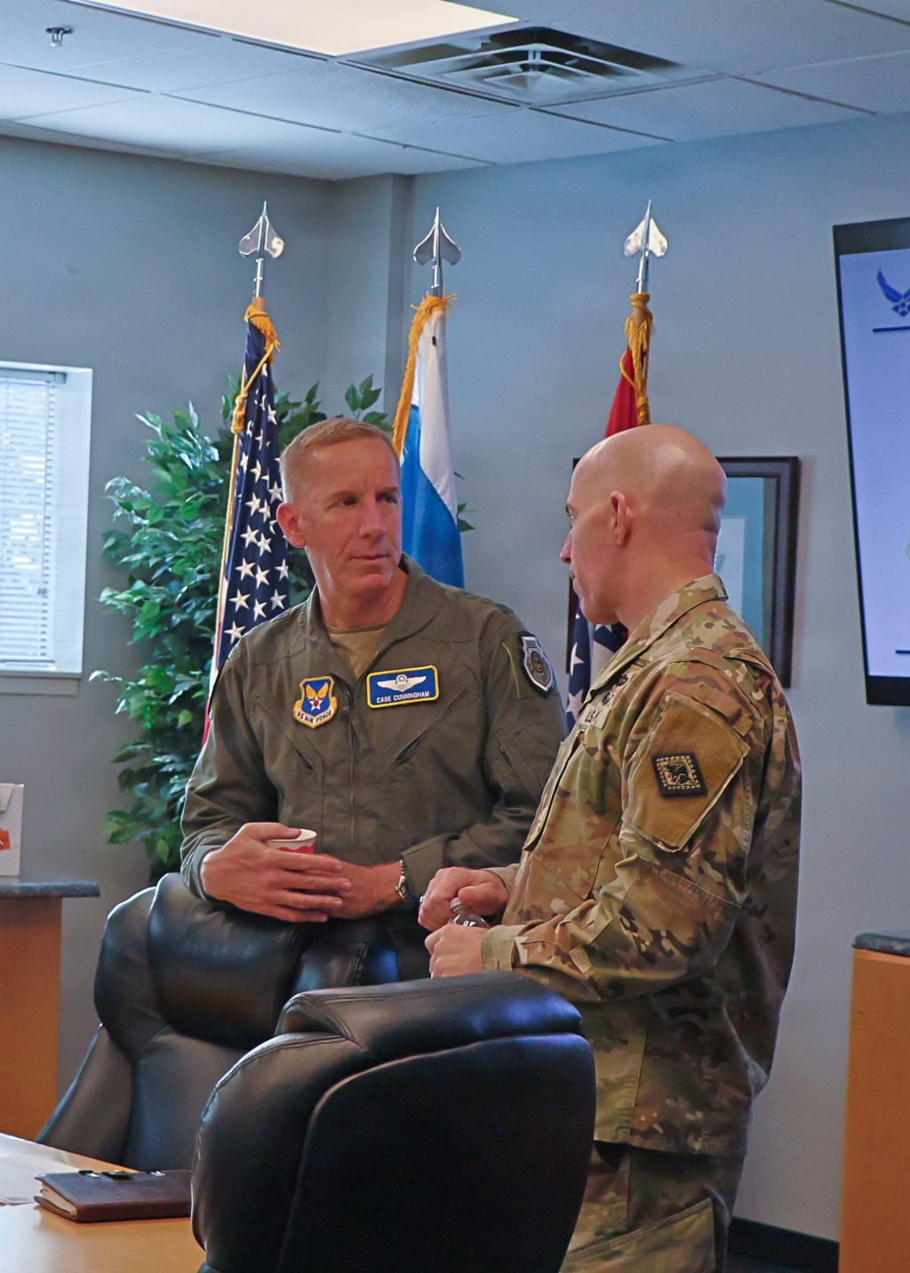
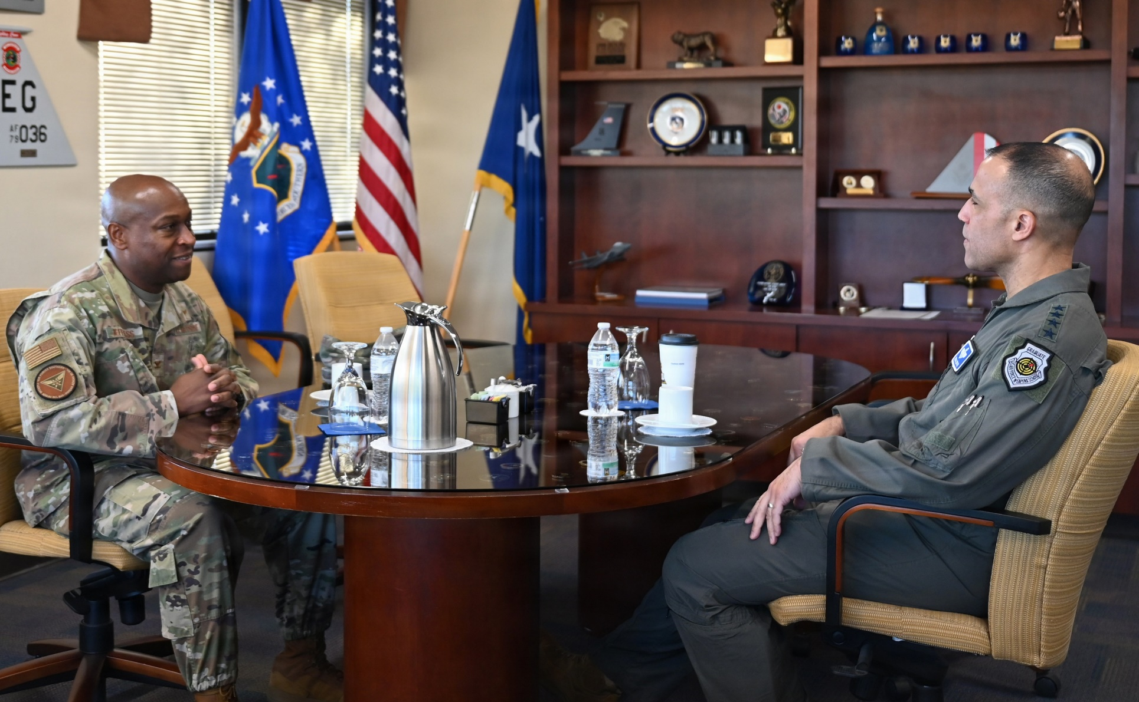
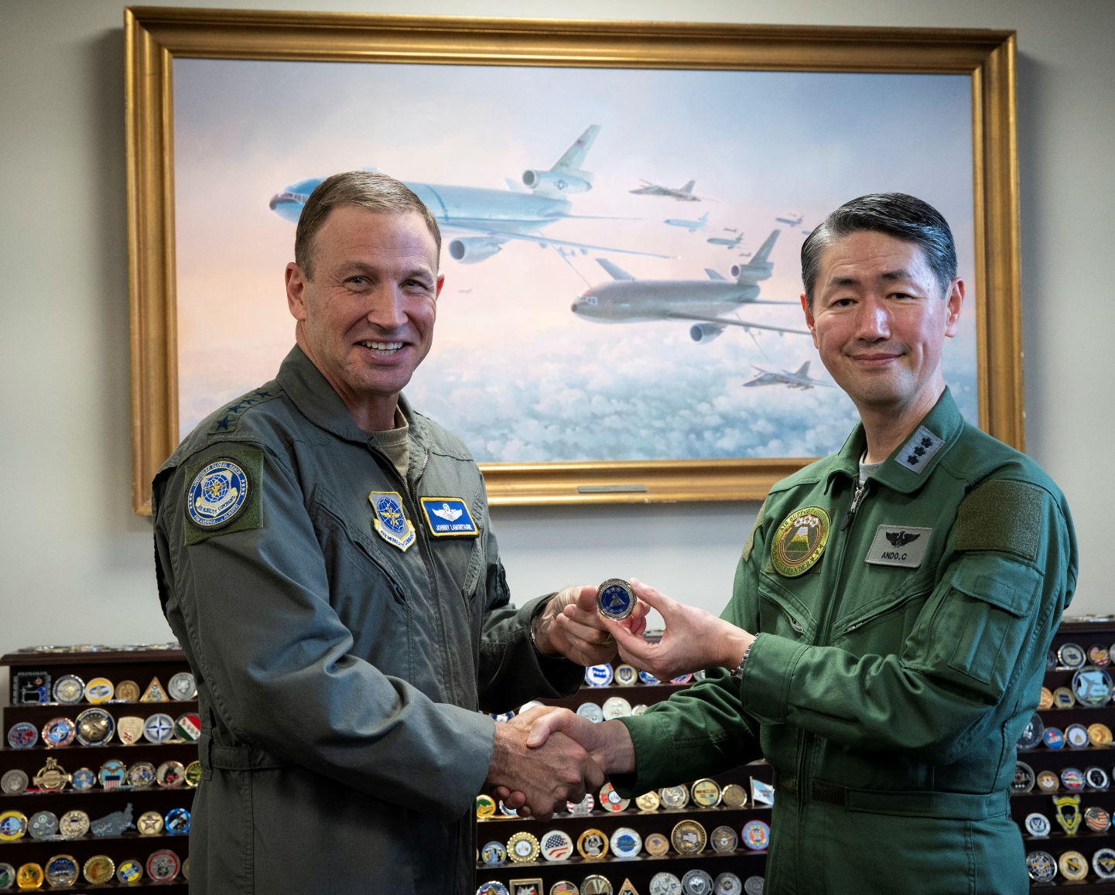
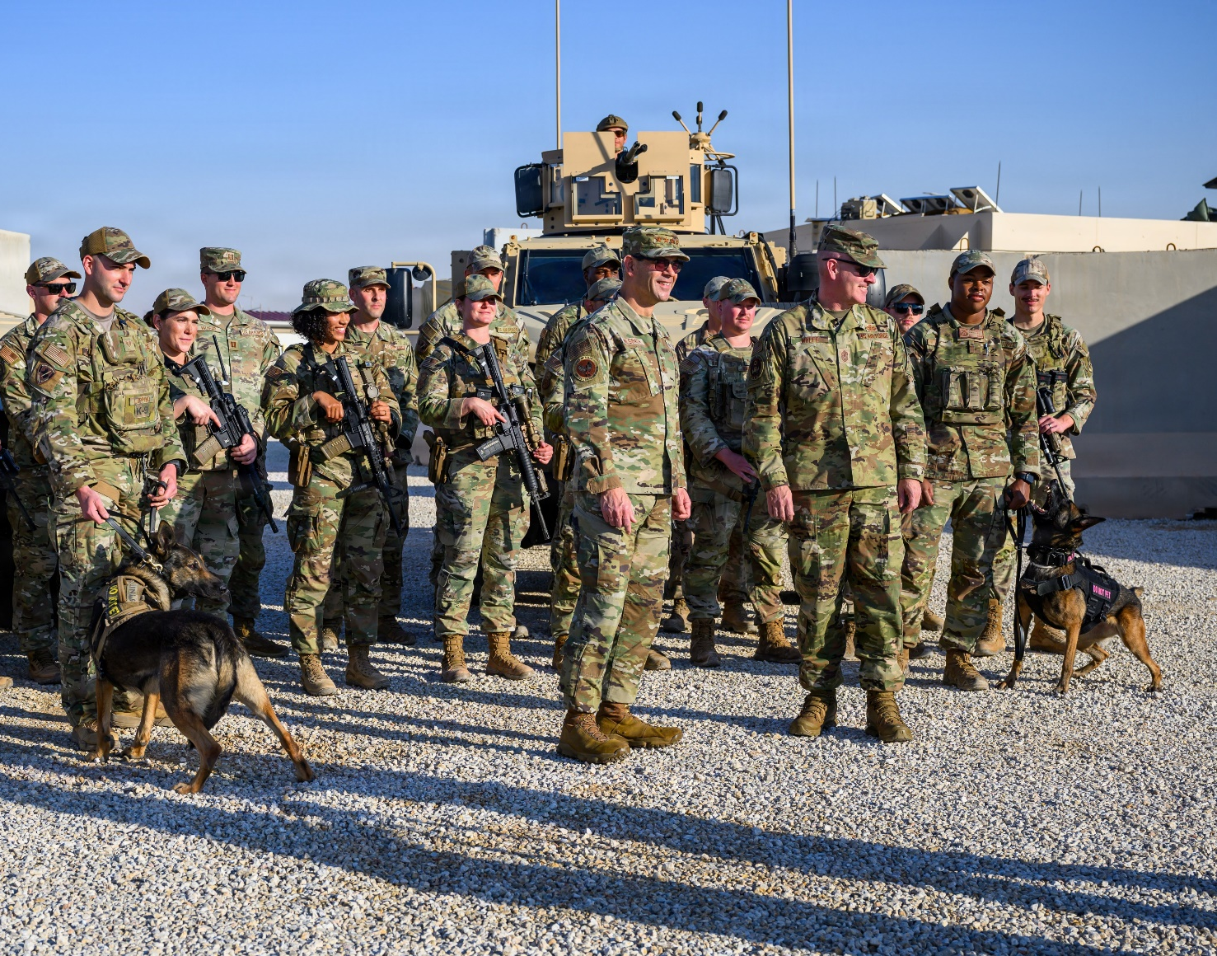
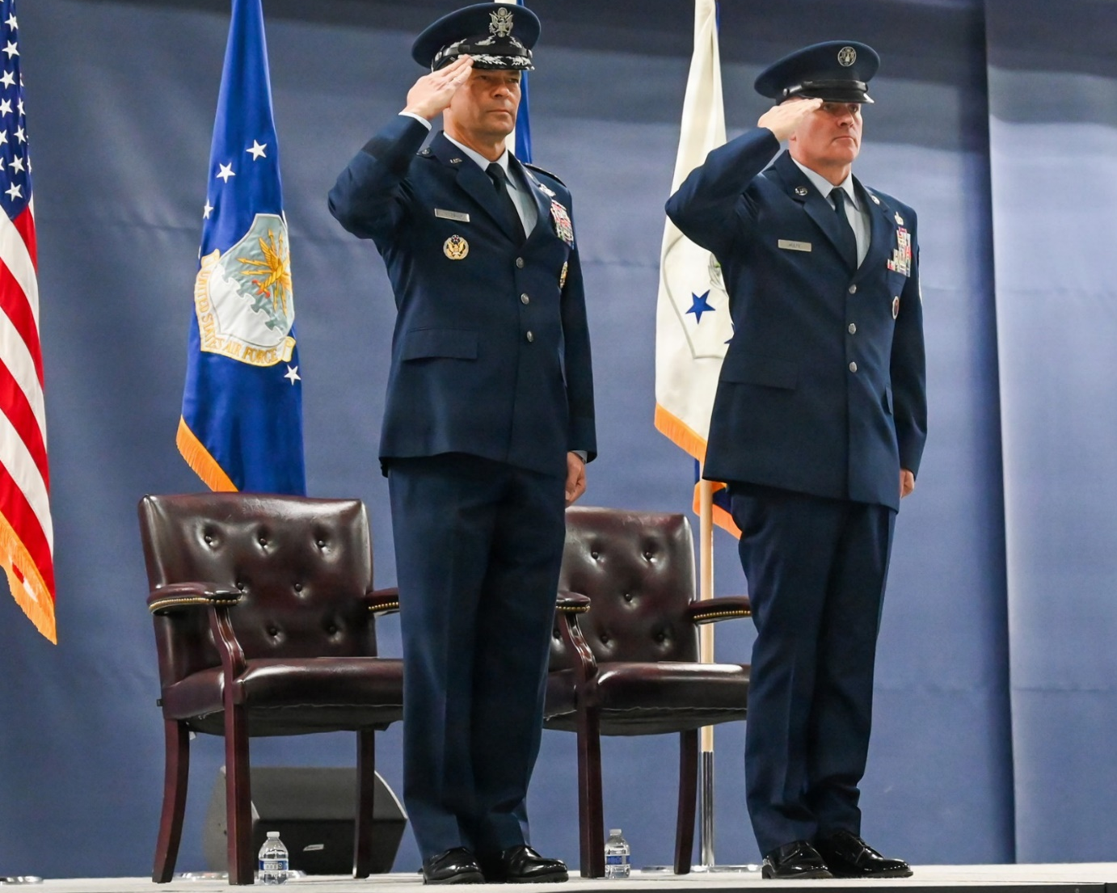
  GENERALSHIP

Slide 3
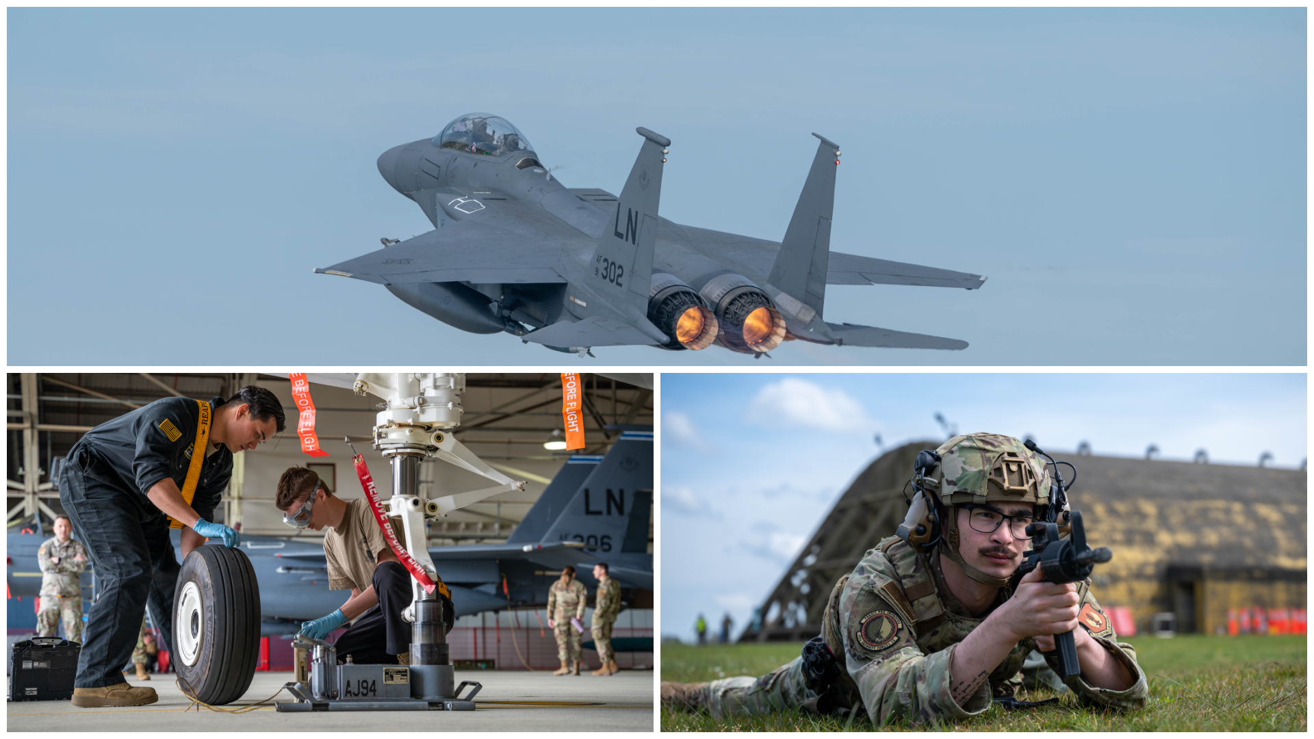
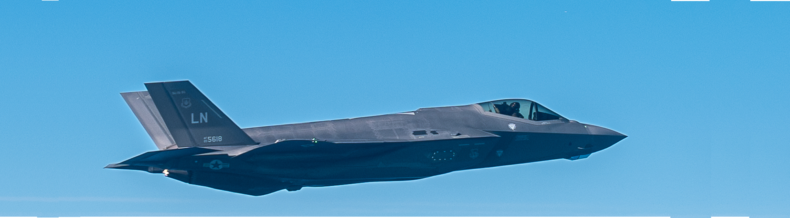
  FLY & FIX

Slide 4
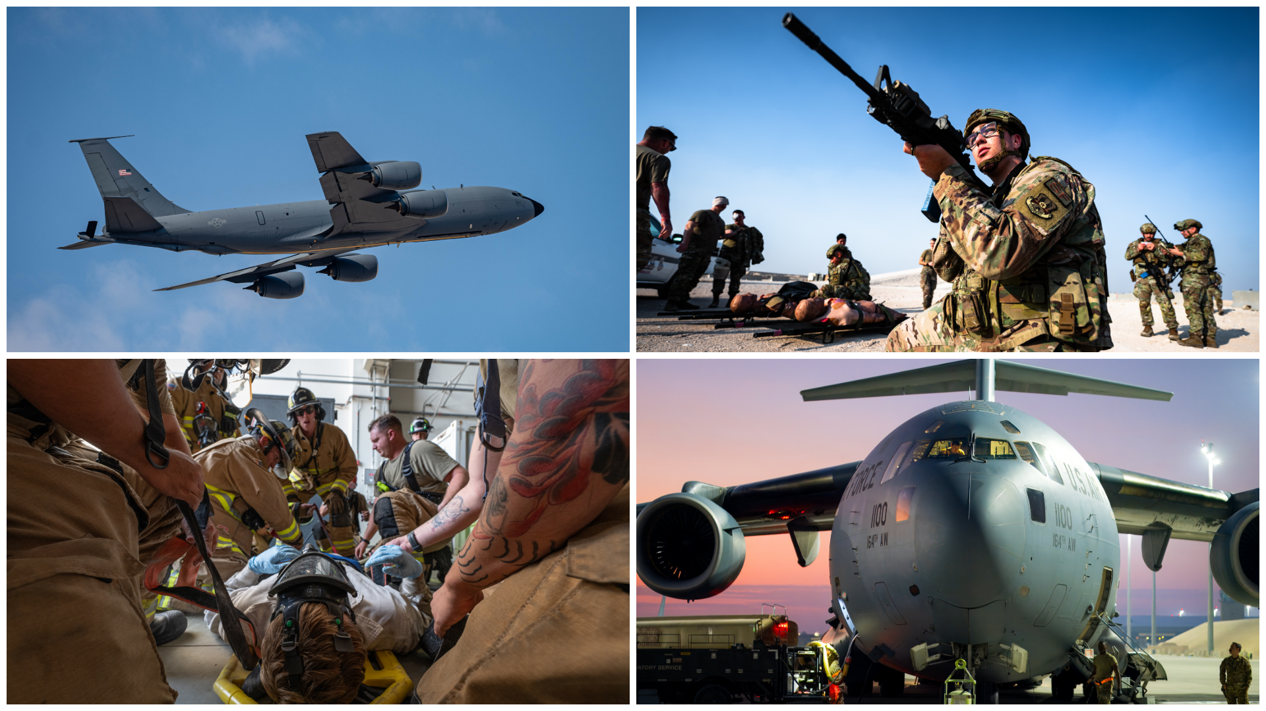
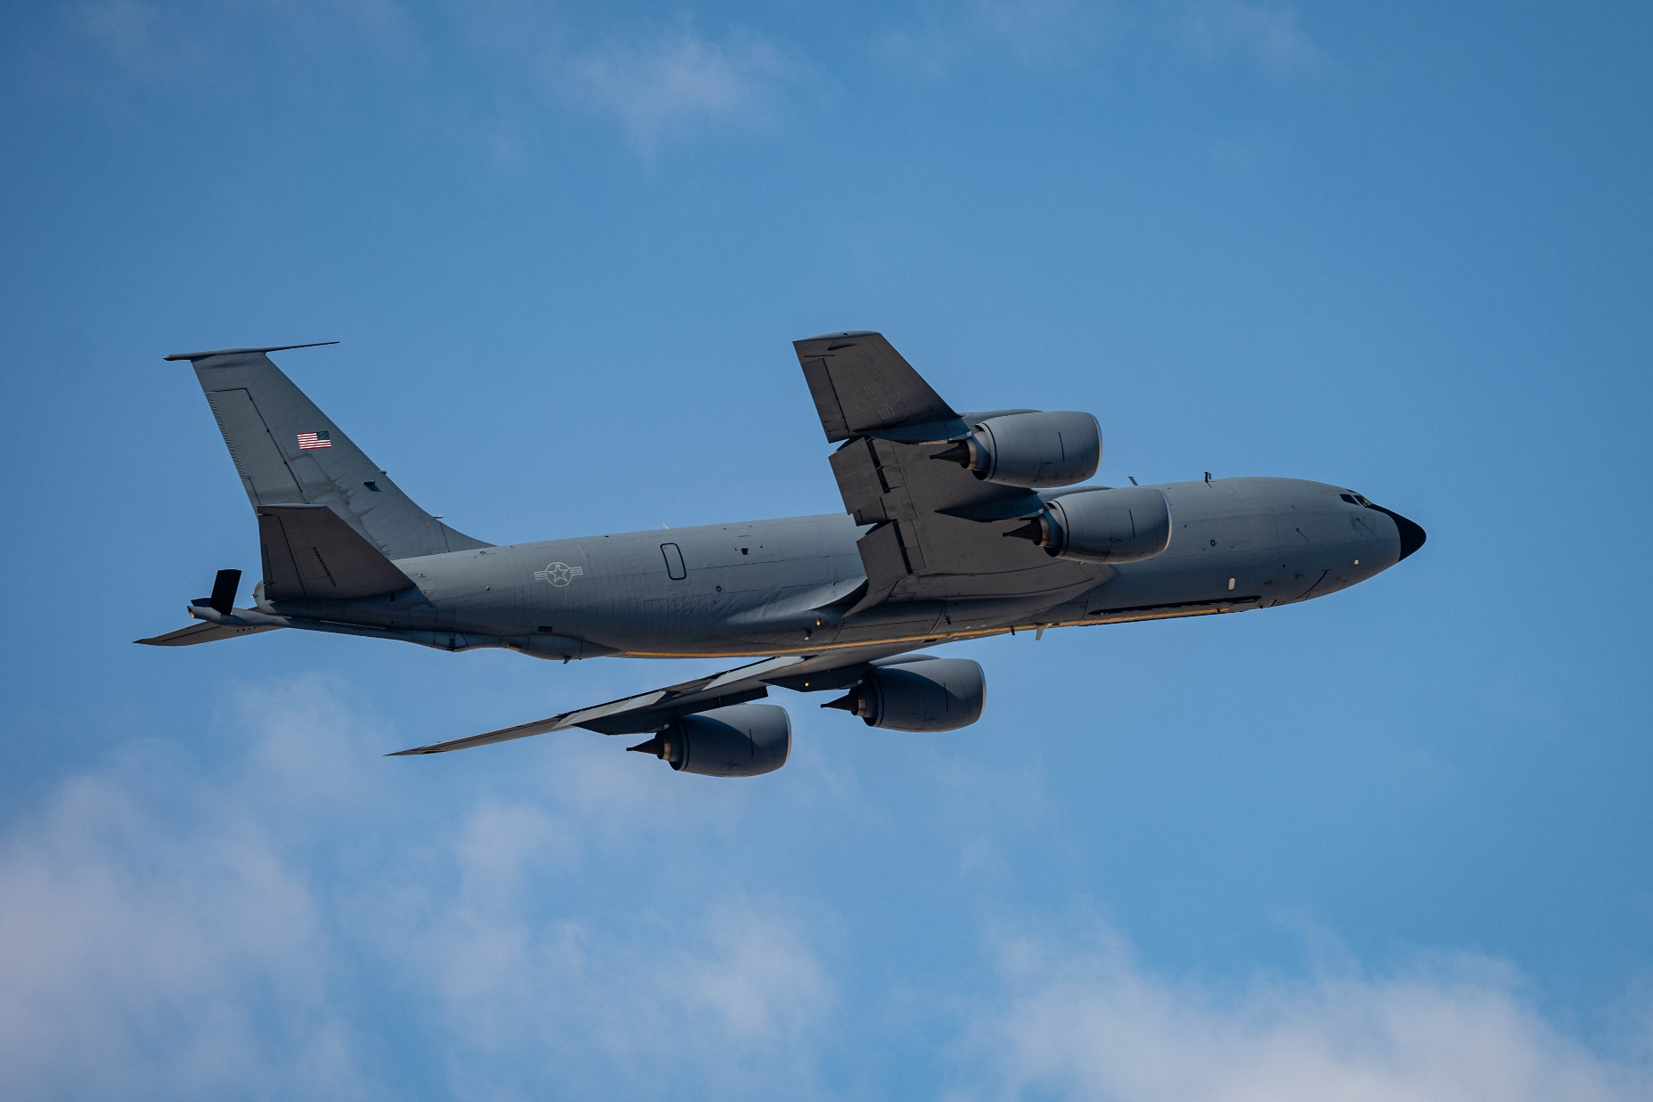
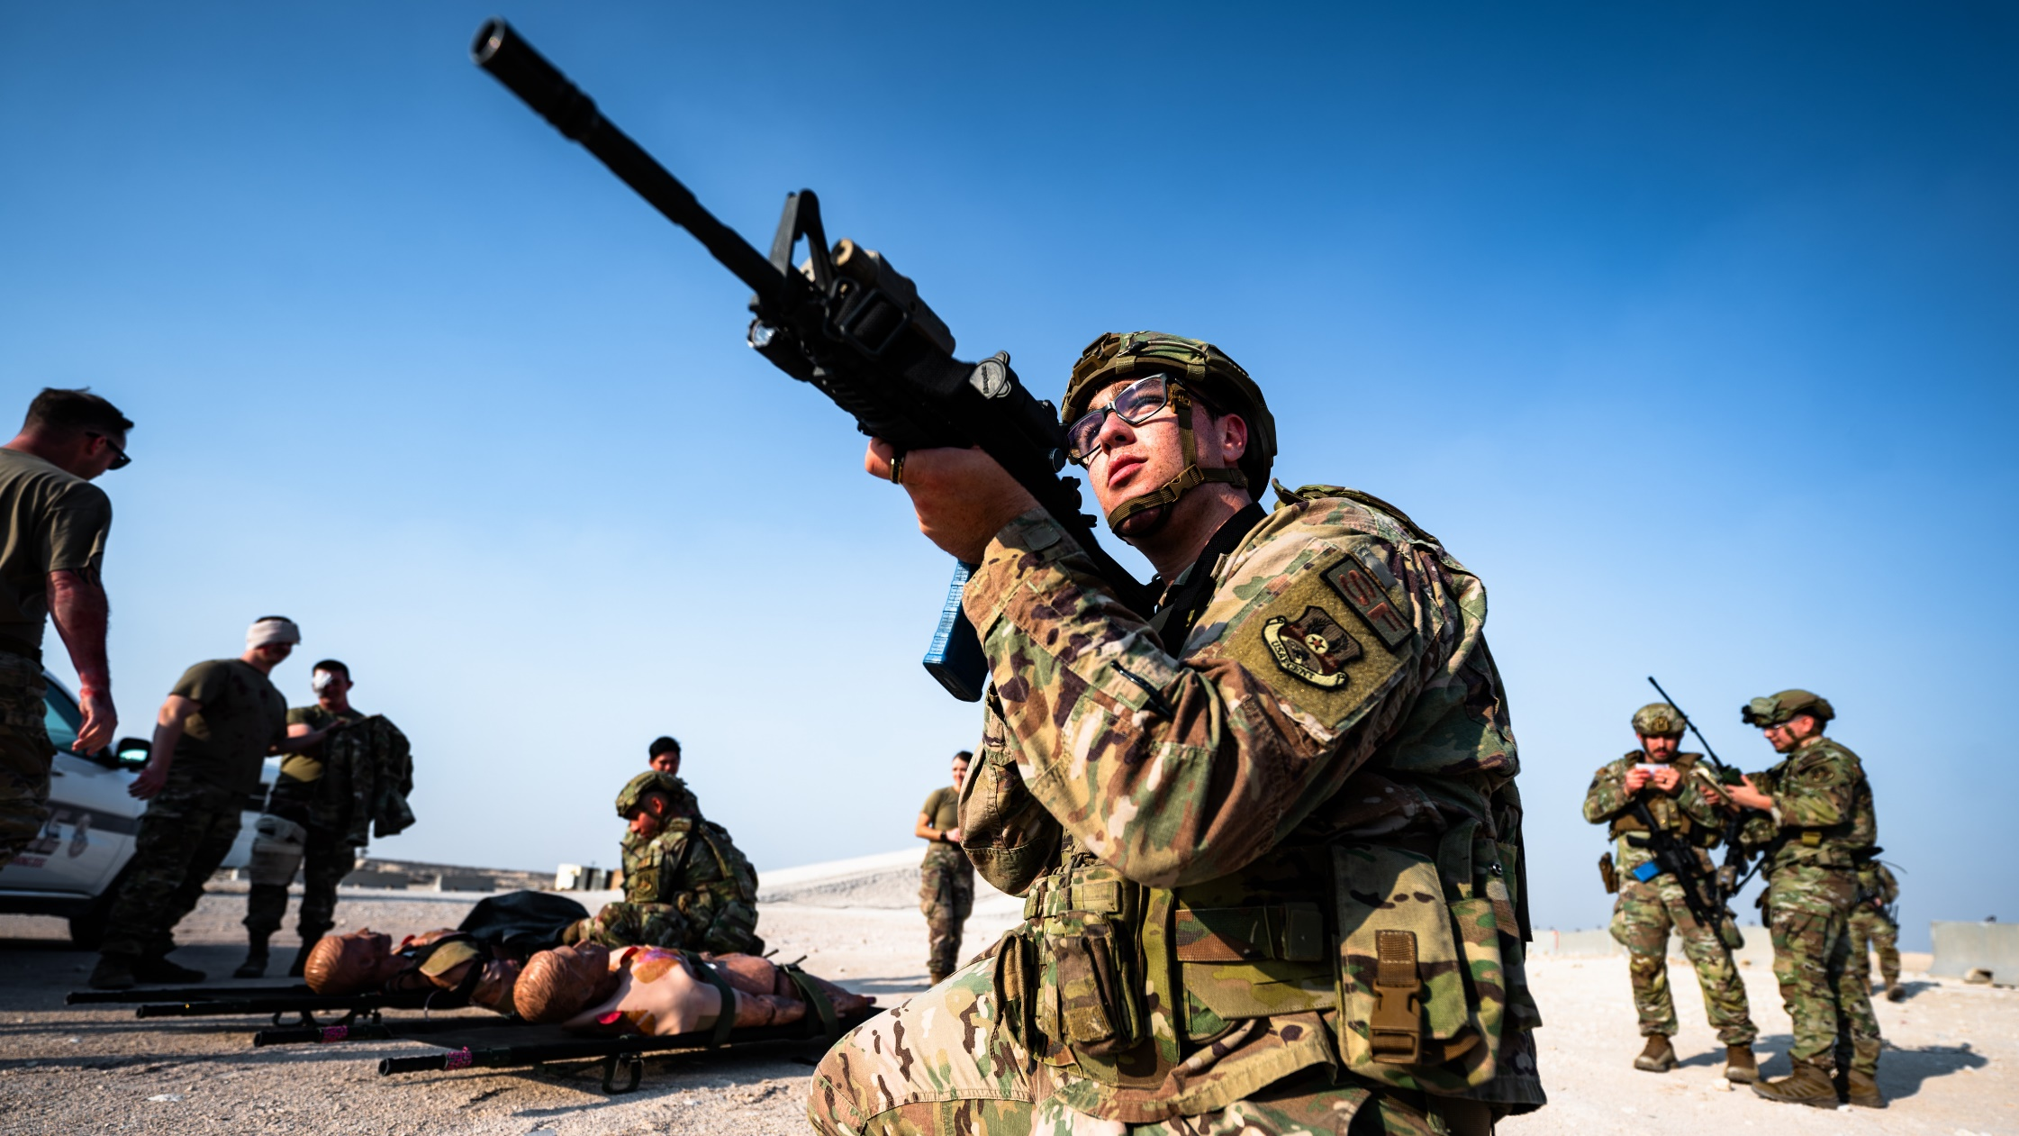
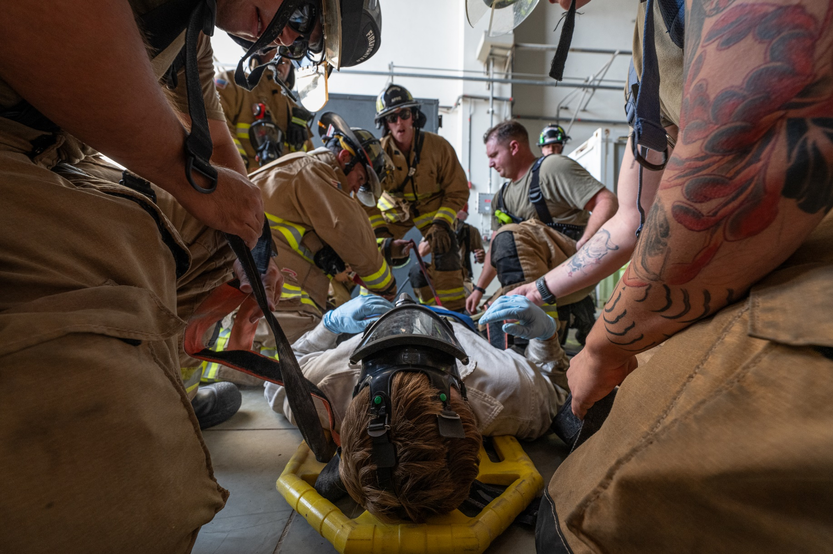
  READINESS…UNRELENTING FOCUS
Notes:
People engaging in an exercise (SF doing anti-drone, people in MOPP gear, People practicing ACE, etc … make it more support/people focused)

Slide 5
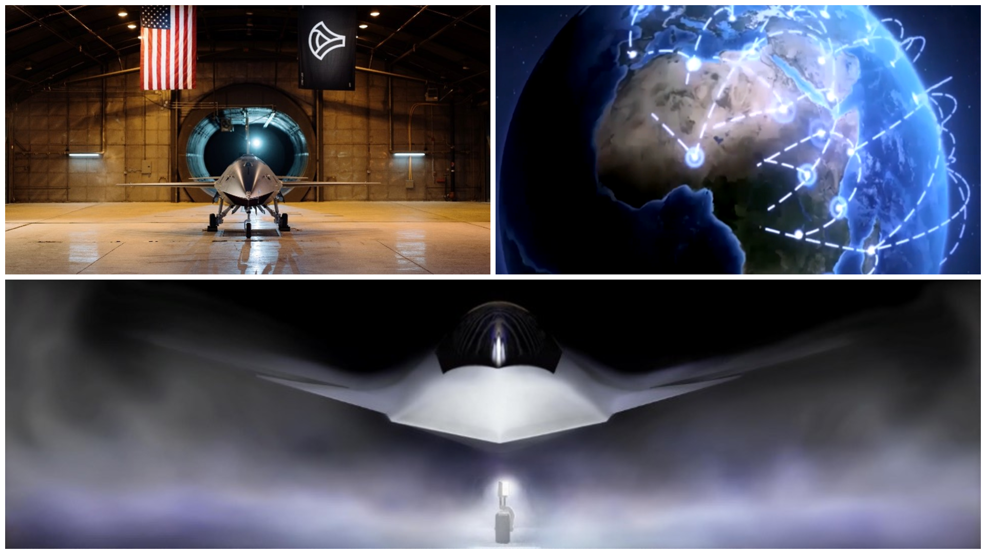
  MODERNIZATION…DOMINANCE INTO THE FUTURE
Notes:
B-52 engine upgrade picture – Lockheed? Whoever got the contract
B-52 historical progression? Could have a picture series showing how the Buff has evolved over time and in different conflicts and is still relevant because of modernization

Slide 6
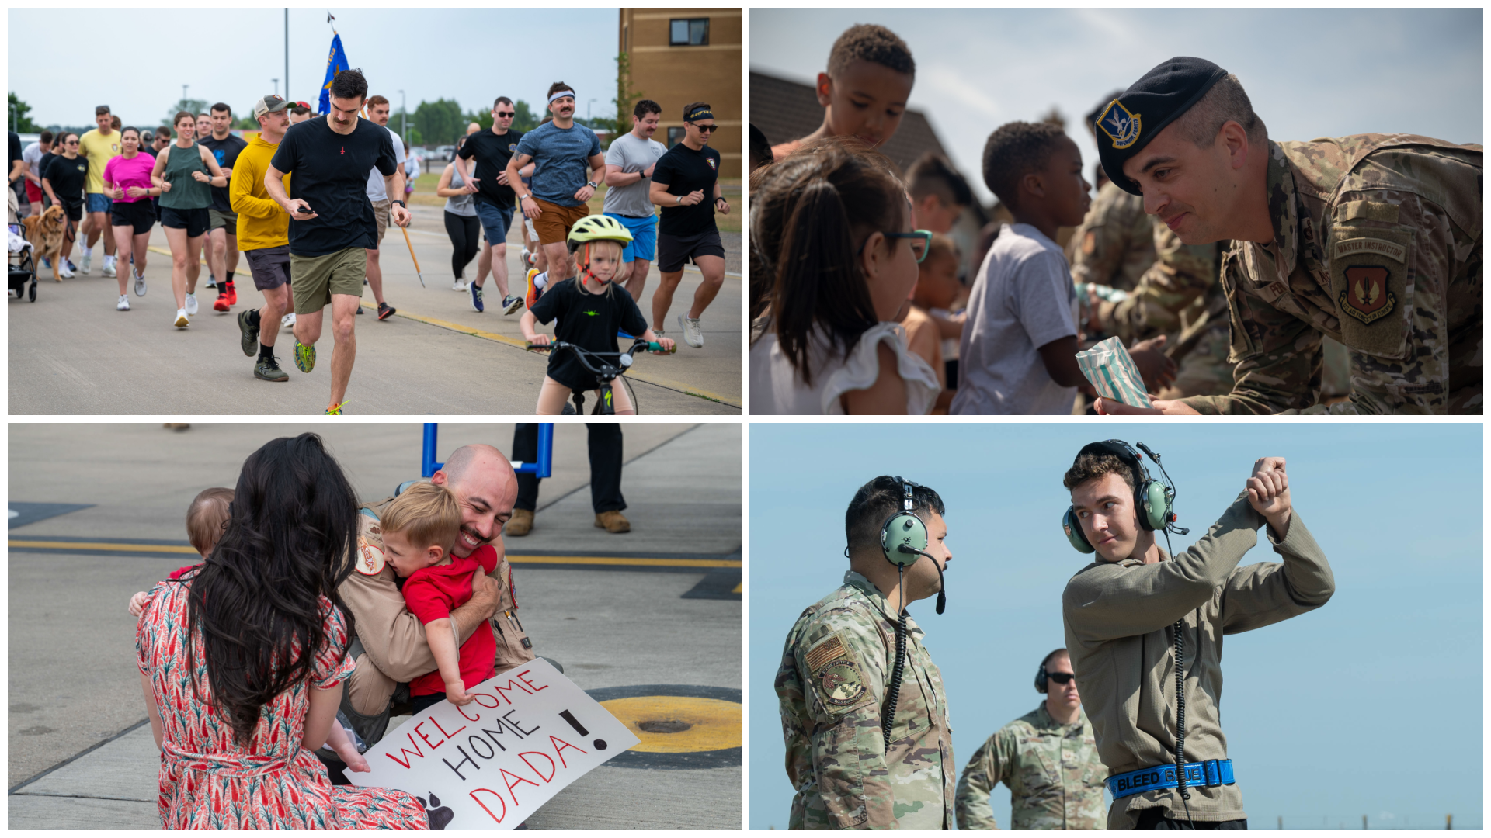
PEOPLE…OUR FOUNDATION
Notes:
Capture the following:
Warrior ethos, sense of community, family, unit pride

Slide 7
Questions

