Slide 1

Gen. Steven Nordhaus
30th Chief of the National Guard Bureau

Slide 2
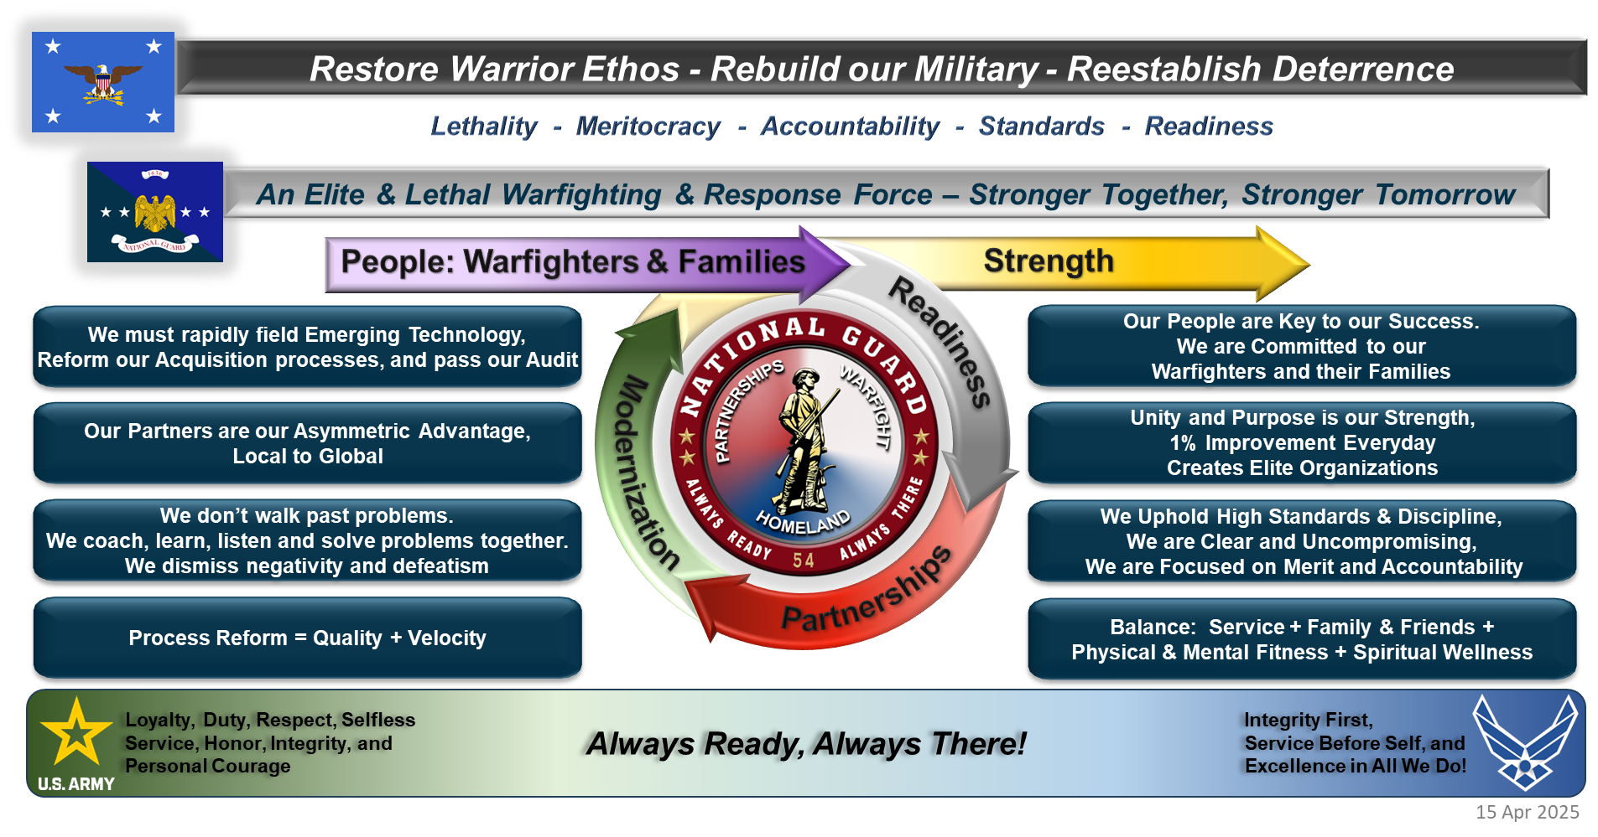
Leadership Vision & Expectations

Slide 3

NATIONAL GUARD Toolset
Multi-Purpose & Flexible
Title 10
Federal C2 / Federal $
POTUS / Congress
SecDef / Service Secretary
Examples: WWII, GWOT, OCONUS
NG ≈ 20% of the Joint Force
War / National Emergency – 12301(a), 12302
ARNG
42% of Total Army Operational Forces
Invasion / Rebellion or Danger Thereof / POTUS is unable w/ the regular forces to execute the laws of the U.S. – 12406
1,424 Aircraft
42% of Army Divisions
47% of Army Brigade Combat Teams
29% of Army Special Forces Groups
30% of Army Space Battalions
14% of Army Expeditionary & Sustainment Commands
Selected Reserve Call-Up assistance in response to a major disaster or emergency (<120 days) – 12304a
Title 32
State C2 / Federal $
SecDef / Service Secretary
Examples: Fed SW Border, COVID Response, ACA
Selected Reserve Call-Up other than during war or national emergency (<365 days) – 12304(a)
ANG
30% of Total Air Operational Forces
Preplanned CCMD Support – 12304b
928 Aircraft
35% of AF Air Refueling
32% of AF Strategic-Tactical Airlift
33% of AF Fighter-Attack
94% of Operation NOBLE EAGLE Aerospace Control Alert fighter mission
22 Cyber Ops SQs = 2x 24/7 AF Cyber Protection Teams
Augment AC for Cyber Event – 12304(c)
Operational Missions – 12301(d)
The Multi-Purpose NG
State Active Duty (SAD)
State C2 / State $
Governor
Examples: Hurricane / Wildfire / Op Lone Star
OCONUS Annual Training – 12301(b)
Homeland Defense & Training – 904, 502(f)
Homeland (Defense & Response)
ACA + Tanker Alert
Civil Support Teams
Cyber Teams
Counter Drug
CBRN
CERF/HRF
Air Defense Sectors
Crisis Response
Immediate Response Authority (IRA) –
Across 2,500 communities, in every zip code
Ground-Based Missile Defense
Always Ready, Always There – In Competition, Crisis & Conflict
Notes:
USNR 59658 USMCR 38368 AFR 70100 USAR 190719 NG 443000 801845

Slide 4
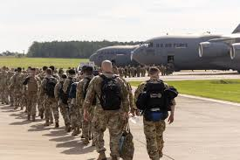
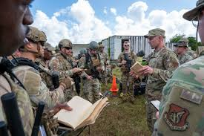
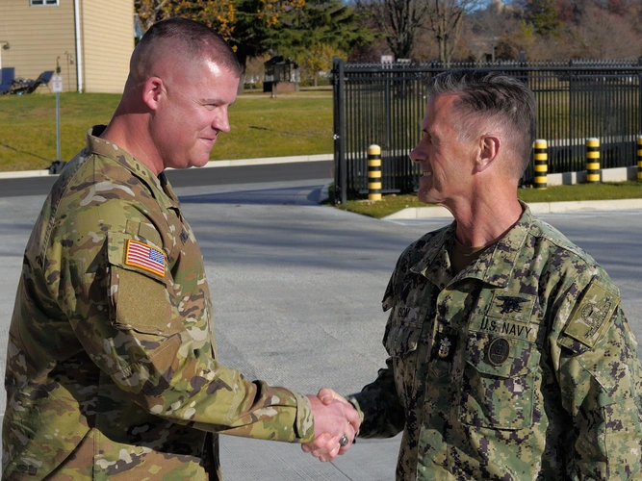


People & Teams – Key to Our Success
We Set the Tone – Everyday!
Humble; Approachable; Credible
Empower Others for Mission Success!
Solve Problems at the Lowest Level
  Don’t walk past problems…they become the standard
1% improvements—lead to big changes!
Enemies to our Profession of Arms
Leadership is solving problems.
The day soldiers stop bringing you their problems is the day you have stopped leading them. They have either lost confidence that you can help or concluded you do not care. Either case is a failure of leadership.
- Colin Powell

Slide 5


Warfighters & Families
Strength
Readiness
Modernization
Partnerships

