Slide 1
CAPSTONE SPOUSE
Security Trends in Africa
11 August 2026
Alix Boucher

Slide 2
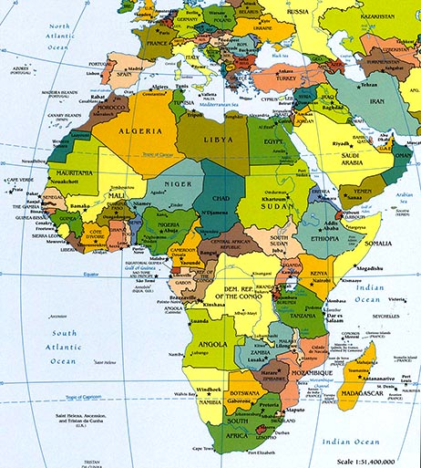
Africa at a Glance
54 countries
Sahara Desert: largest hot desert in the world (size of U.S.)
South Sudan: world’s newest country (2011)
Nile : 4,132 mi. – longest river in the world
Nigeria: most populous country on the continent (206 million)
    1.6 billion people today; 2.5 billion by 2050
    Youthful population: 44% under 15; less than 3% over 65
    Average life expectancy is approximately 59 years (ADB)
    Great wealth & poverty: 75% of the population lives on less than $2 a day but mineral wealth with:
      80% of platinum 52% of cobalt
    37% of chromium 35% of manganese
    55% of diamonds 10% of proven oil reserves
Source: Worldatlas.com
Notes:
I like to begin here by providing an overview of the continent.
Before I do that, a question: has anyone traveled there? Lived there? Care to share some experiences?
This slides provides an overview of the continent. It has 54 countries. The Sahara desert is the largest hot desert in the world. South Sudan is the world’s newest country—it gained independence from Sudan in 2011.

Slide 3
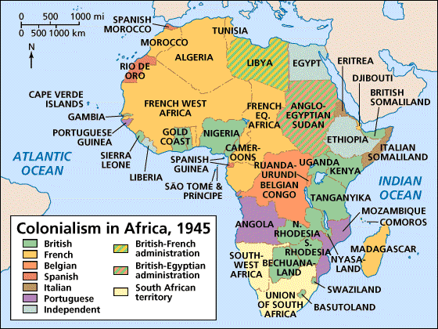
Africa’s Colonial Legacies
Consequences of colonial relationships:
Languages
Legal traditions
Trade relationships
Military interventions
Source: Holt, Rinehart, and Winston
Notes:
This slides provides an overview of Africa’s colonial legacies.
Today, I’m going to provide an overview of the key security challenges the continent faces. These have been shaped by these colonial legacies.
But I also want to discuss how several of these security challenges, including conflict, poor governance, terrorism, and the role of external actors, are intertwined.

Slide 4
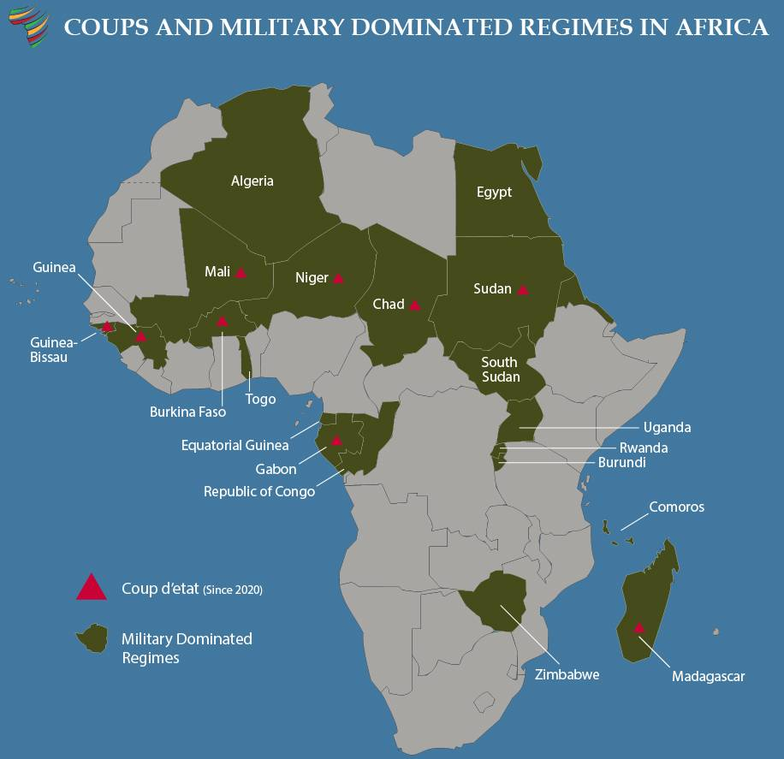
Notes:
Military interference continued to be a dominant theme with military juntas attempting to consolidate earlier seizures of power through electoral exercises in Gabon and Guinea.
A military coup in Guinea-Bissau in November 2025 preempted the long-delayed election there. Another coup, in Madagascar in October, further undermined constitutionalism in that Indian Ocean Island state, where a wave of youth protests had called for the president to step down.
Benin was able to prevent a military coup in December 2025 with the help of ECOWAS forces from Nigeria and Côte d’Ivoire. Suggestions that the Benin coup plotters may have been aided by the Sahelian juntas underscores their active effort to normalize military takeovers of democratic governments.
These coups add to the trend of recent years, resulting in nine African countries having had militaries seize power since 2020. But I think looking at this map, it’s also important to note that these military regimes do not bring security, stability, and prosperity to their own citizens or indeed to the regions as a whole, since if you try to keep in mind the green countries, you will see in the following slides, the multitude of challenges these countries face.

Slide 5
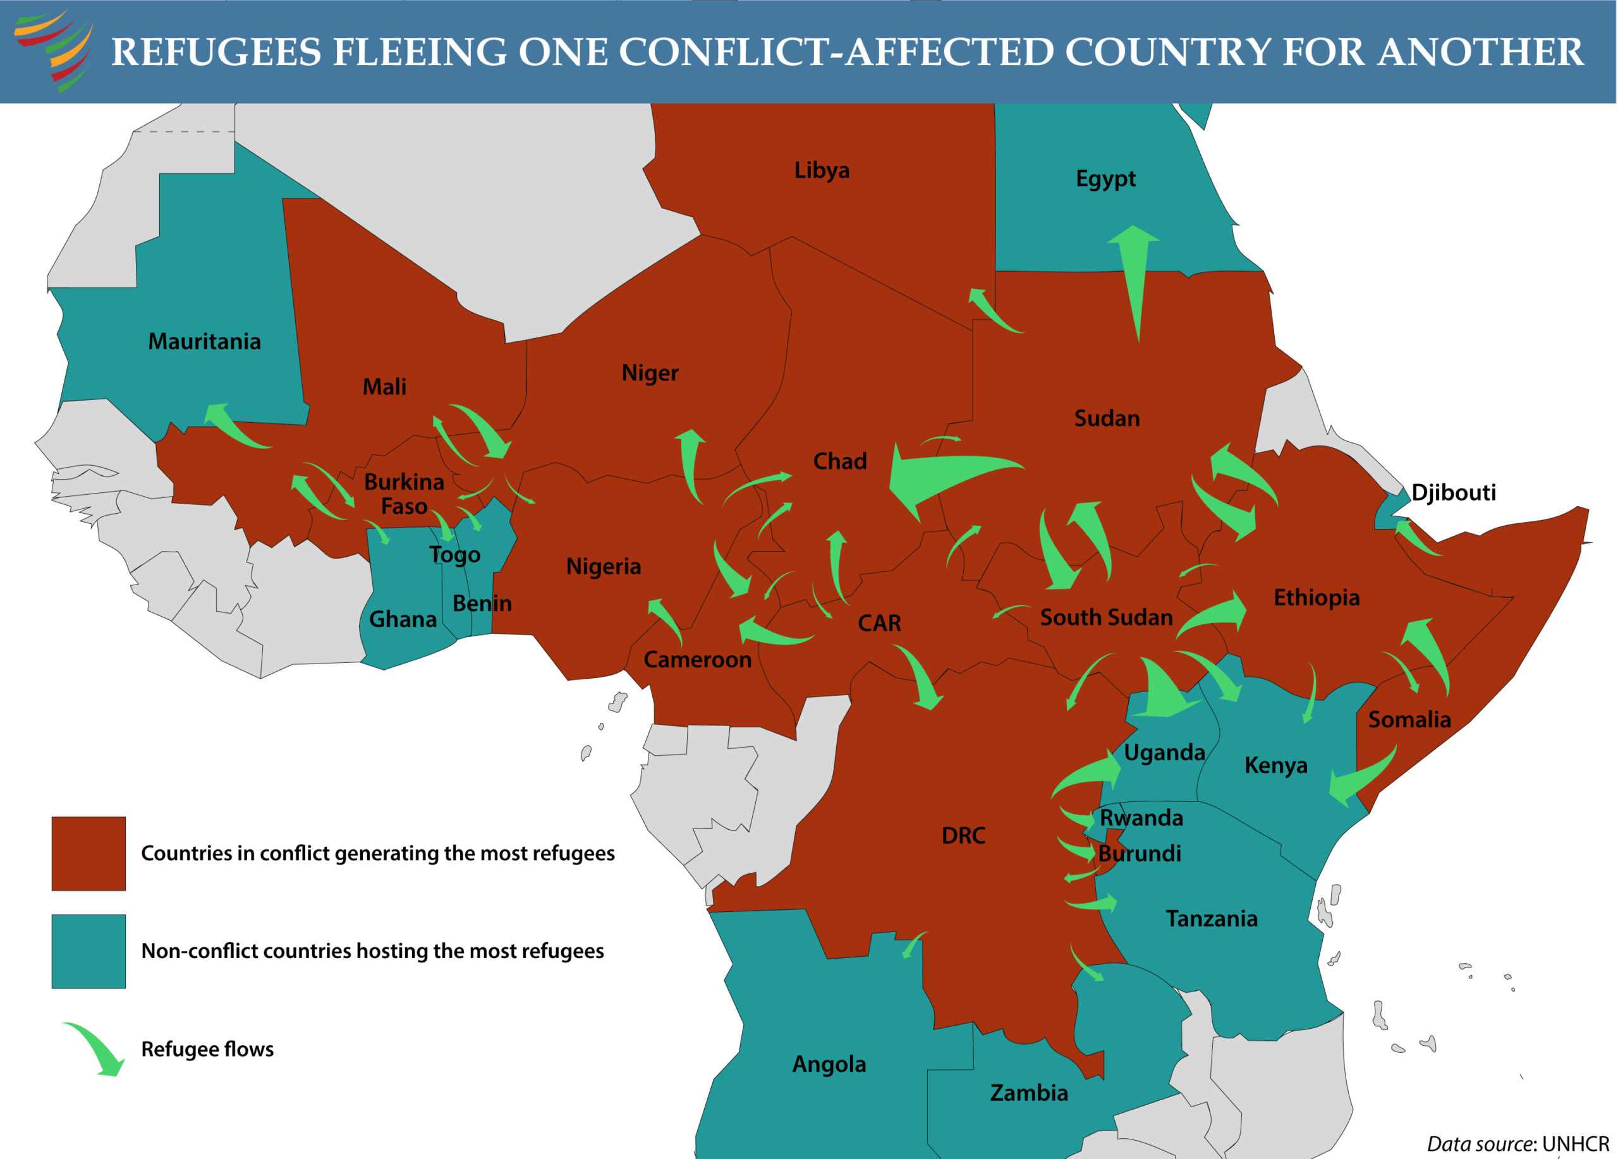
Notes:
An estimated 45.7 million Africans are forcibly displaced—refugees, internally displaced, or asylum seekers—comprising 3 percent of the total African population.
This continues a pattern of 15 years of steadily increasing numbers of forcibly displaced populations. Africa remains the continent with the largest number of people who are forcibly displaced accounting for 43 percent of the global total.
69 percent of the 45.7 million are IDPs. However, the share of externally displaced has expanded significantly in 2025—largely due to increased refugee flows from Sudan, Burkina Faso, DRC and Mali.
97 percent of Africa’s forcibly displaced population seek refuge on the continent.
96 percent of forcibly displaced populations are from countries facing armed conflict, underscoring the centrality of war as a driver to population displacement.
8 of the 11 countries hosting the greatest numbers of those displaced across borders are themselves experiencing conflict. This reflects the growing regionalization—and interregional linkages—of conflicts in the Greater Horn, the Sahel, and the Lake Chad Basin.

Slide 6
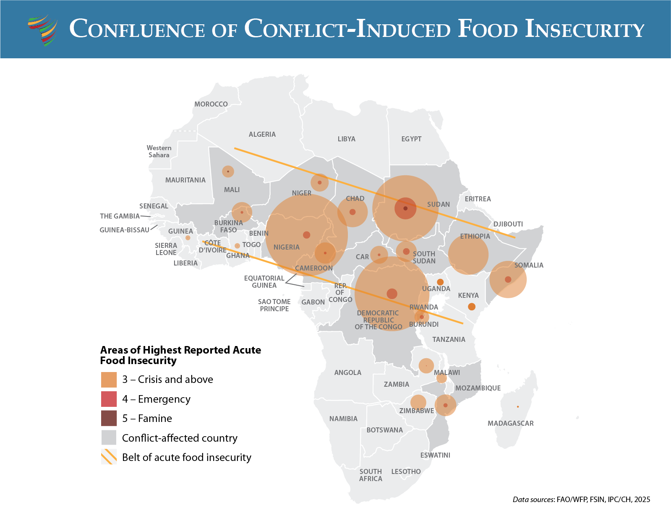
Notes:
An estimated 167 million Africans faced acute food insecurity in 2025—a record high. This represents the sixth consecutive annual increase in the number of Africans experiencing acute food crises.
Conflict continues to be the primary driver of food insecurity in Africa.130 million (roughly 78 percent) of those facing acute food insecurity are in countries experiencing conflict.
In April, the UN reported that 700,000 children in Sudan face the risk of famine.

Slide 7
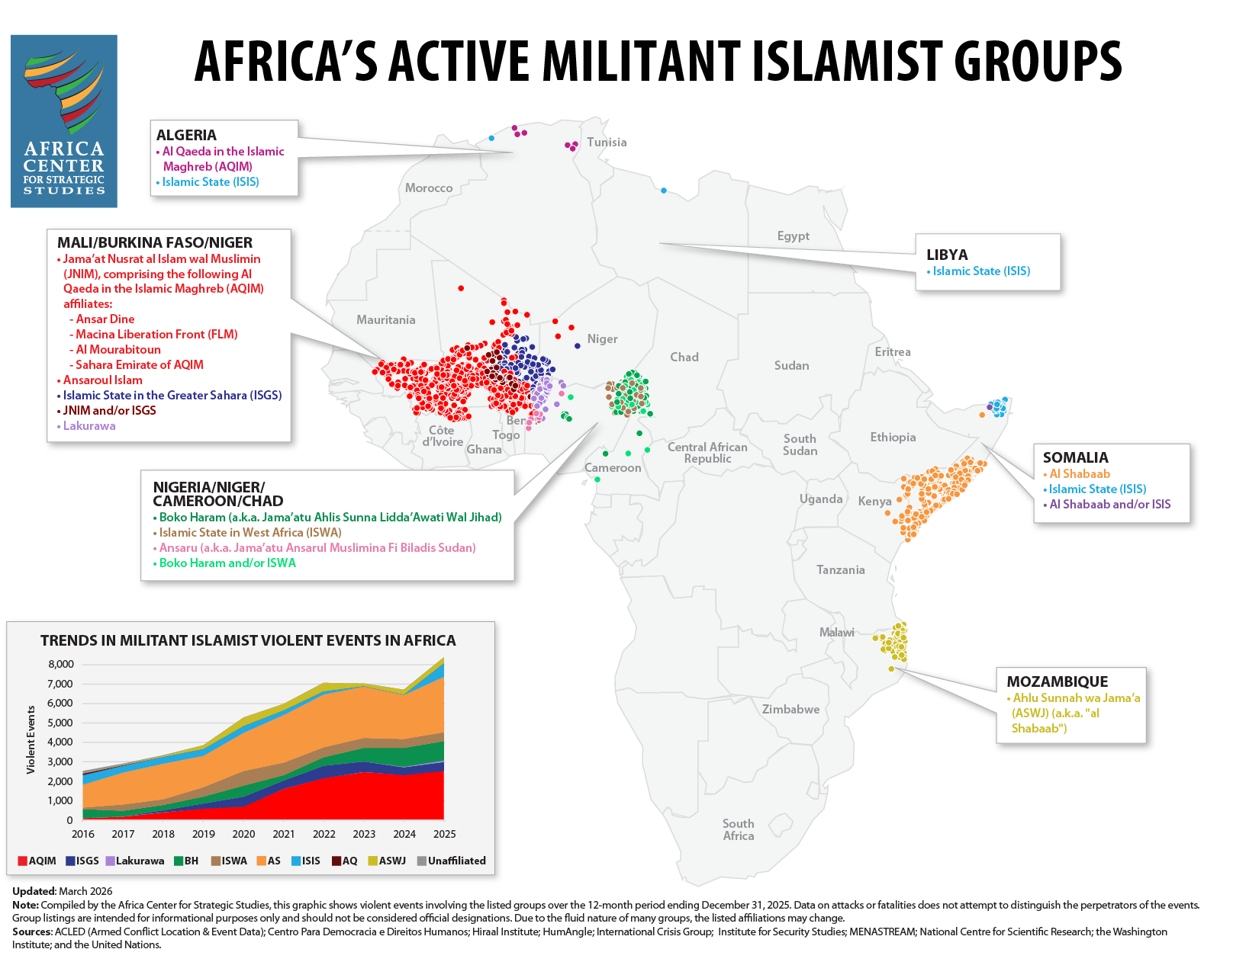
Notes:
Fatalities linked to militant Islamist groups in Africa continue to occur at near record levels.
When we look at militant Islamist groups on the continent, we can really see 5 theaters: the Sahel, Somalia, the Lake Chad Basin, Mozambique, and North Africa.
The 23,968 fatalities in 2025, a 24 percent increase from the previous year, reflect increased violence in nearly every theater. The reported 8,375 violent events linked to these groups were the highest ever reported on the continent.
The Sahel continues to experience the greatest number of militant Islamist group-linked fatalities of any region on the continent—a position the Sahel has maintained for the past 5 years. The elevated number of reported fatalities in the Sahel persists despite growing restrictions on reporting from the region that are likely undercounting the severity of this violence.

Slide 8
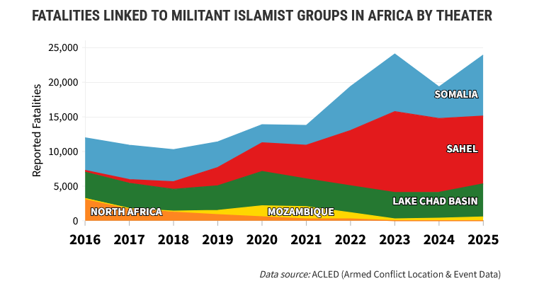
Notes:
Heavy-handed tactics by security forces in the Sahel are continuing to drive jihadist recruitment. Fatalities linked to violence against civilians by the armed forces and allied militias in Mali and Burkina Faso, collectively, have exceeded those attributed to militant Islamist groups since 2023.
Somalia saw the biggest surge in reported fatalities across all regions, 8,813 deaths linked to al Shabaab and the Islamic State (ISIS) over the past year represent a 93-percent increase from the previous year.
The Lake Chad Basin also saw a 28-percent increase in fatalities from the previous year, demonstrating the continued threat from Boko Haram and the Islamic State in West Africa (ISWA), mostly in northeast Nigeria.
Collectively—the Sahel, Somalia, and Lake Chad Basin—account for 98 percent of all militant Islamist group-linked fatalities in Africa.

Slide 9
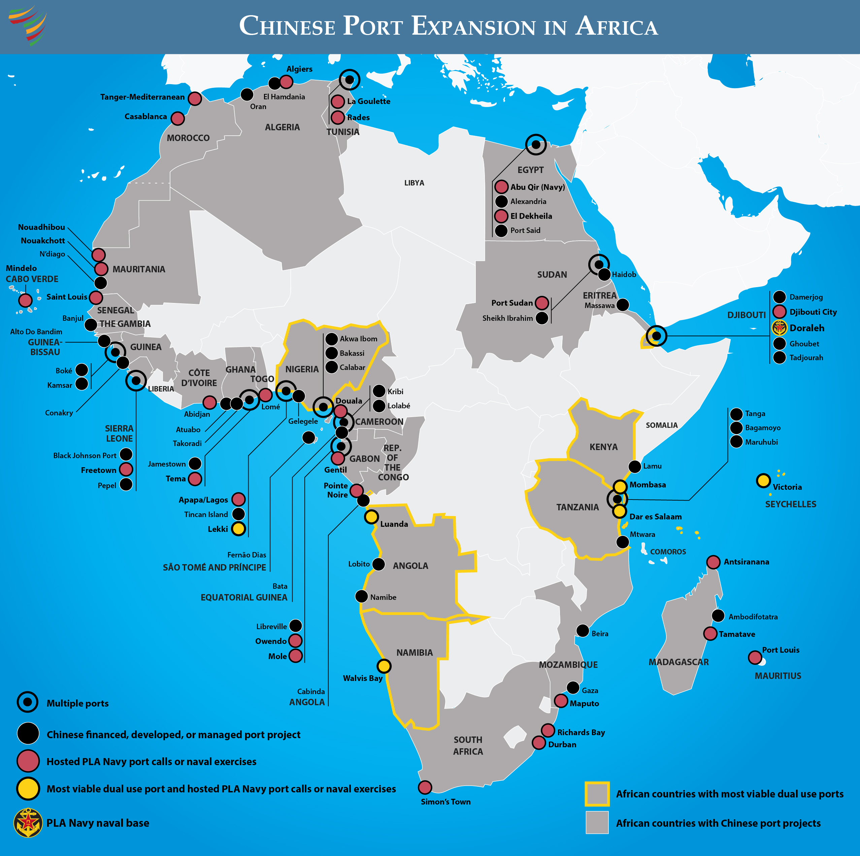
Notes:
And finally, I want to use this map of Chinese Port Expansion in Africa to talk about China’s presence on the continent. This map just shows ports, but China’s presence is multidimensional and I think this is an interesting starting point because while ports provides an interesting example of all the places where Chinese state-owned firms have a stake, the issue of ports isn’t just economic. It also has security dimensions. China’s expansive port development opens the door for China to repurpose commercial ports for military activities.
Africa faces a central tension from China’s deepening engagement in Africa’s port and trade corridors and maritime networks: expanded capacity may result in economic benefits, but it also comes with the risk of reduced autonomy over critical infrastructure as well as altered governance and regulatory norms.
With a total of 231 commercial ports in Africa, Chinese firms are present in 78 ports across 32 African countries as builders, financiers, or operators, that’s over a third of Africa’s maritime trade hubs. Chinese state-owned firms are active stakeholders in an estimated Chinese port developments are concentrated in West Africa, with 35 compared to 17 in East Africa, 15 in Southern Africa, and 11 in North Africa.
African officials are attracted to Chinese engagements in terms of port efficiency, reduced transport costs, trade connectivity, increasing automation, and access to global markets. In landlocked states, Chinese-financed rail corridors are also seen as improving access to global markets and strengthening regional connectivity. Security cooperation through exercises and training, moreover, is credited by many African officials for improving maritime domain awareness and anti-piracy capacity.
Critics, however, argue that China’s growing role in training, governance, and data systems could entrench long-term influence over African institutions, potentially normalizing Chinese standards and creating structural dependencies.
China has also gained a dominant position in Africa’s critical minerals sector. Of 166 Chinese-owned mining projects globally, 66 are in Africa, more than in any other region. This dominance often inhibits resource-rich African countries from advancing up the value chain.
On the security side, The 9-day BRICS Plus naval exercise led by China’s People’s Liberation Army (PLA) in January 2026, coined “Will for Peace,” has underscored China’s growing use of military power in Africa to advance Chinese geostrategic objectives. Involving Russian, Iranian, and South African as well as Chinese naval forces off South Africa’s Western Cape, the exercise reinforces China’s role as the primary convening power of this emerging security bloc.
The PLA Navy conducted at least 15 African port calls between 2024 and 2025, exceeding all previous annual African recorded port-call totals within PLA datasets—underscoring the notable expansion of China’s naval presence, reach, and defense diplomacy in Africa.
The Forum for China-Africa Cooperation (FOCAC) Beijing Action Plan (2025-2027) is notable for containing more security commitments than any previous FOCAC action plans.
The FOCAC Action Plan, for example, set a target to train 6,000 senior and 500 early career African military officers as well as 1,000 police by September 2027 when the next FOCAC Summit takes place.

Slide 10
About the Africa Center for
Strategic Studies
The Africa Center is a U. S. Department of Defense institution established and funded by Congress for the study of security issues relating to Africa and serving as a forum for bilateral and multilateral research, communication, exchange of ideas, and training involving military and civilian participants. (10 U.S.C 342)
Our vision: Security for all Africans championed by effective institutions accountable to their citizens.
Our mission: Security for all Africans championed by effective institutions accountable to their citizens.
Please visit our website : africacenter.org , where our publications (short analytical articles, infographics, and research publications) are available.
Our Youtube channel has videos of our events.

